Slide 1

Follow-up: SNP Discovery with TASSEL
Oregon State University
Center for Genome Research and Biocomputing
May 19, 2015

Slide 2
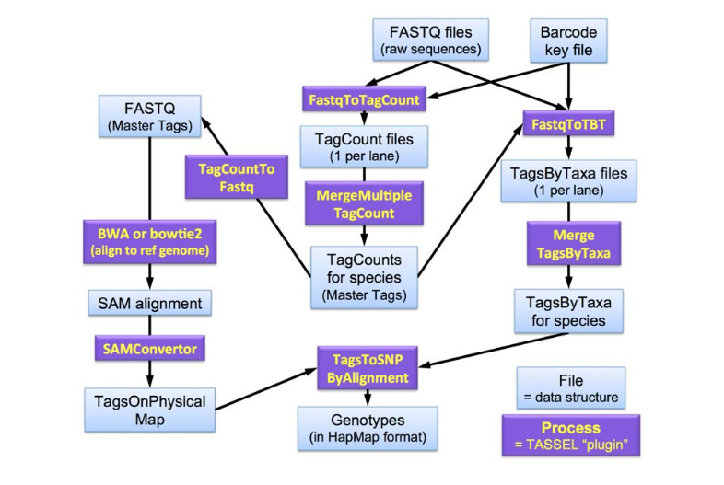
TASSEL Discovery pipeline plugins
https://bytebucket.org/tasseladmin/tassel-5-source/wiki/docs/TasselPipelineGBS.pdf
Reference genome-based

Slide 3
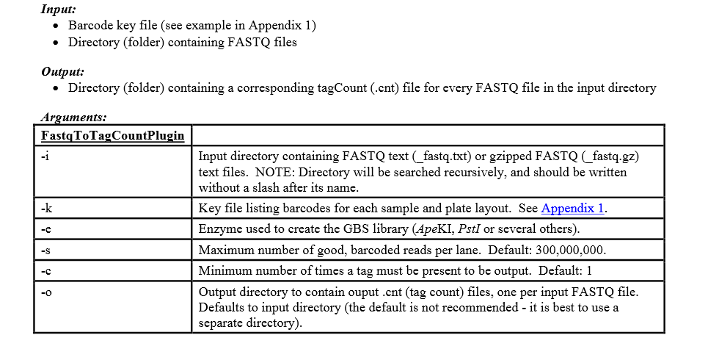
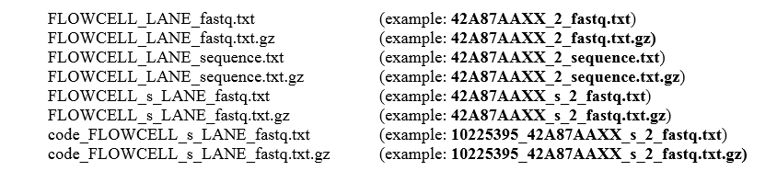
FastqToTagCountPlugin
ApeKI cut site
GCAGC or GCTGC
Acceptable fastq file naming conventions
/local/cluster/hts/gbs/tassel3.0_standalone/run_pipeline.pl -Xmx512g -fork1 -FastqToTagCountPlugin -i Illumina -k key/key.tsv -e ApeKI -o tagCounts -endPlugin -runfork1

Slide 4
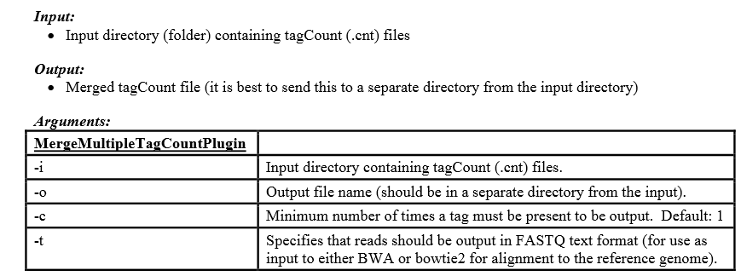
MergeMultipleTagCountPlugin
/local/cluster/hts/gbs/tassel3.0_standalone/run_pipeline.pl -Xmx512g -fork1
-MergeMultipleTagCountPlugin -i tagCounts -o mergedTagCounts/FRA_MasterTags.cnt -c 5 -t
-endPlugin -runfork1

Slide 5
Reference genome alignment with Bowtie2
Reference genome
bowtie2 -x /nfs1/Teaching/data/viningk/GBS/PhytozomeV10/Fvb -U mergedTagCounts/FRA_MasterTags.cnt.fq -S mergedTagCounts/FRA_AlignedMasterTags.sam
Unpaired sequence reads
Output in .sam format
Default:
No mismatches allowed
Maximum one alignment to reference reported for each read

Slide 6
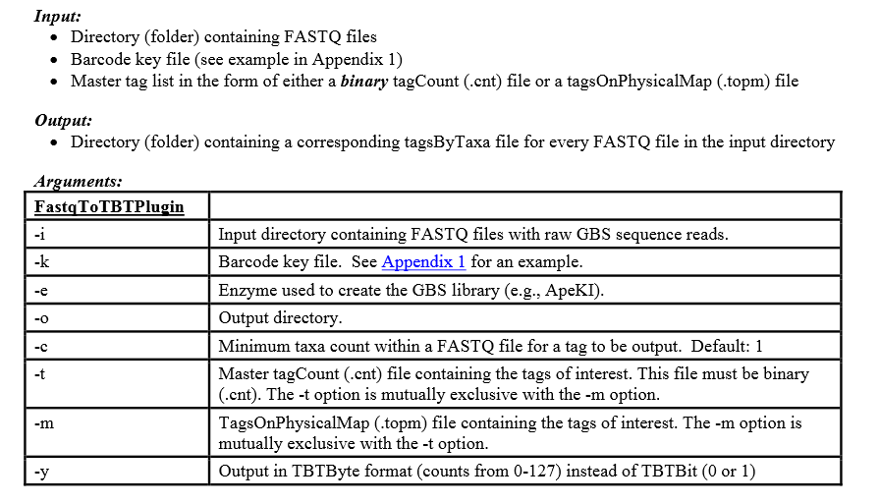
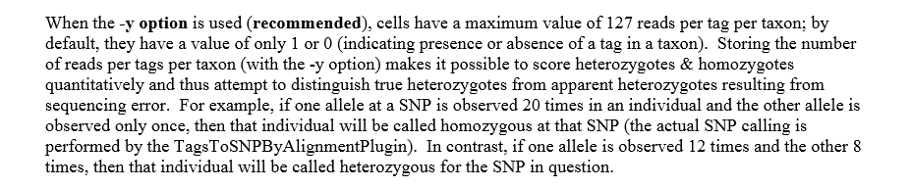
FastqToTBTPlugin
/local/cluster/hts/gbs/tassel3.0_standalone/run_pipeline.pl -fork1 -FastqToTBTPlugin -i Illumina -k key/key.tsv -e ApeKI -o tbt -t mergedTagCounts/FRA_MasterTags.cnt -y -endPlugin -runfork1

Slide 7
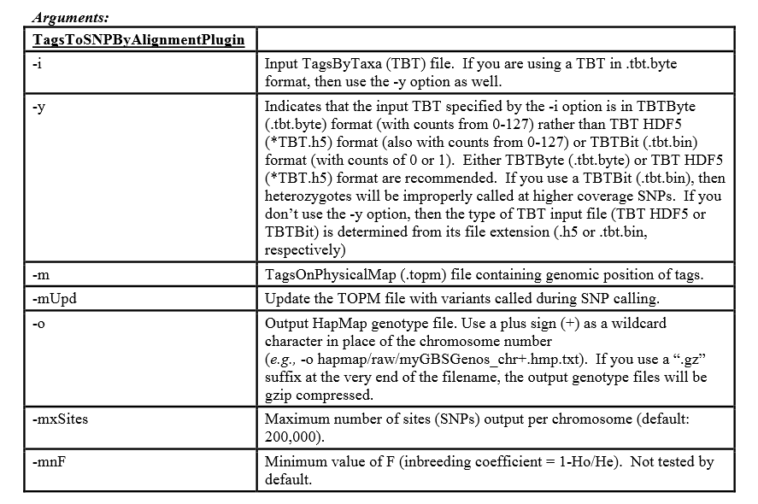
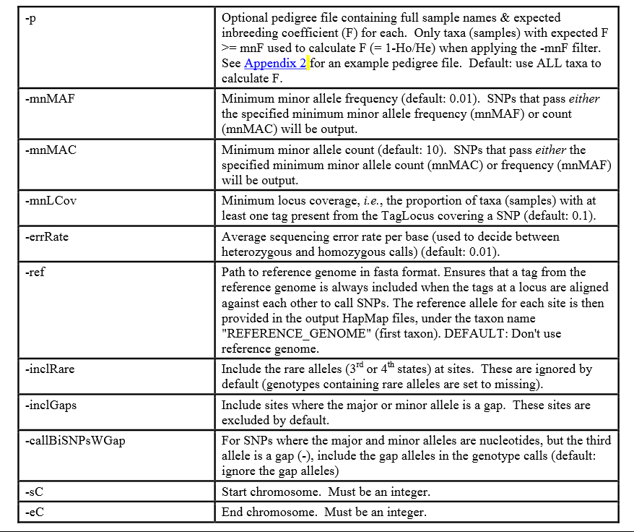
TagsToSNPByAlignmentPlugin
/local/cluster/hts/gbs/tassel3.0_standalone/run_pipeline.pl -Xmx512g -fork1 -TagsToSNPByAlignmentPlugin -i mergedTBT/SUB_C1JDAACXX_s_2.tbt.byte -m topm/FRA_MasterTags.topm.bin -o hapMap/chr+_hmp.txt -mnLCov 0.001 -mnMAC 0 -mnMAF 0.0001 -sC 0 -eC 7 -endPlugin -runfork1

Slide 8
More TASSEL plugins
MergeDuplicateSNPs* Merges SNPs from overlapping tags (on opposite DNA strands)
MergeIdenticalTaxa* Merges SNPs from genotypes with identical names (up to first colon)
GBSHapMapFilters Filters SNPs with low coverage (missing data for most genotypes), high heterozygosity, low/high minor allele frequency, or SNPs that are not in linkage disequilibrium with at least one other SNP.
BinaryToText Reads a binary file (.topm, .tbt, etc) and outputs text format
LOCAL WRAPPER SCRIPT TO RUN TASSEL PIPELINE WITH DEFAULT SETTINGS*: /local/cluster/gbs/buildtassel3.bash

