Slide 1

SNP Discovery with TASSEL
Oregon State University
Center for Genome Research and Biocomputing
May 14, 2015

Slide 2
TASSEL overview
Trait Analysis by aSSociation Evolution and Linkage
Java-based bioinformatics pipeline for SNP discovery, population analysis, genome-wide association analysis (GWAS)
Developed by Buckler lab, Cornell -> maize genetics
Current version: 5.0
TASSEL -> reference genome-based UNEAK -> Non-reference-genome pipeline
Command-line interface
Graphical user interface

Slide 3
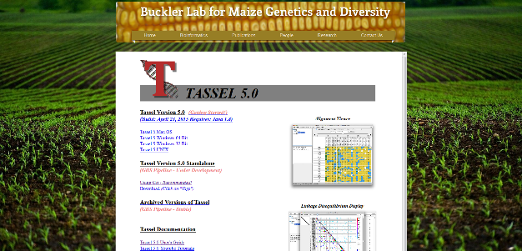
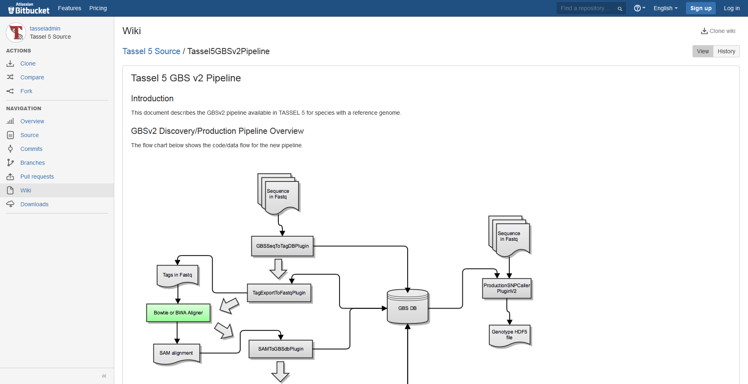
TASSEL resources
TASSEL 5.0 home page http://www.maizegenetics.net/#!tassel/c17q9
Wiki https://bitbucket.org/tasseladmin/tassel-5-source/wiki/Home
Pipeline documentation https://bytebucket.org/tasseladmin/tassel-5-source/wiki/docs/TasselPipelineGBS.pdf?rev=35424013c39d1cc26ea88b9679679ceeb99365cb
Google group https://groups.google.com/forum/#!forum/tassel

Slide 4
TASSEL SNP Discovery pipeline
Glaubitz JC, Casstevens TM, Lu F, Harriman J, Elshire RJ, Sun Q, Buckler ES. 2014. TASSEL-GBS: A High Capacity Genotyping by Sequencing Analysis Pipeline. PLoS ONE 9: e90346.

Slide 5
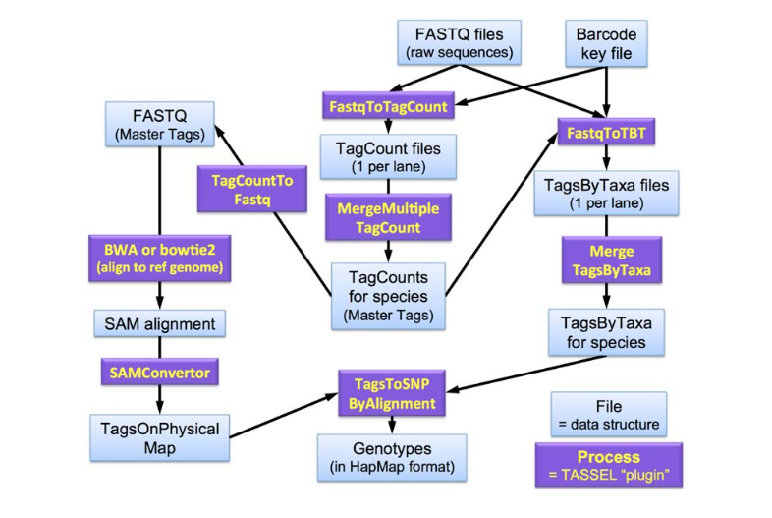
Discovery pipeline plugins
https://bytebucket.org/tasseladmin/tassel-5-source/wiki/docs/TasselPipelineGBS.pdf
Intermediate files in binary format
Reference genome-based

Slide 6
TASSEL project directory structure
./Illumina -> original raw data files, one file per flowcell lane
./tagCounts -> output from FastqToTagCountPlugin
./mergedTagCounts -> output from MergeMultipleTagCountPlugin
./topm -> output from SAMConverterPlugin
./tbt -> output from FastqToTBTPlugin
./mergedTBT -> output from MergeTagsByTaxaFilesPlugin
./hapmap
./hapmap/raw output from TagsToSNPByAlignmentPlugin
./hapmap/mergedSNPs -> output from MergeDuplicateSNPsPlugin
./hapmap/filt -> output from GBSHapMapFiltersPlugin
./hapmap/bpec -> output from BiParentalErrorCorrectionPlugin

Slide 7
Supported file formats
hapMap
Fasta
Vcf
Phylip
Plink
Hdf5 (more memory-efficient)

Slide 8
Discovery pipeline
https://bytebucket.org/tasseladmin/tassel-5-source/wiki/docs/TasselPipelineGBS.pdf
Two inputs:
Sequence files
Barcode key file

Slide 9
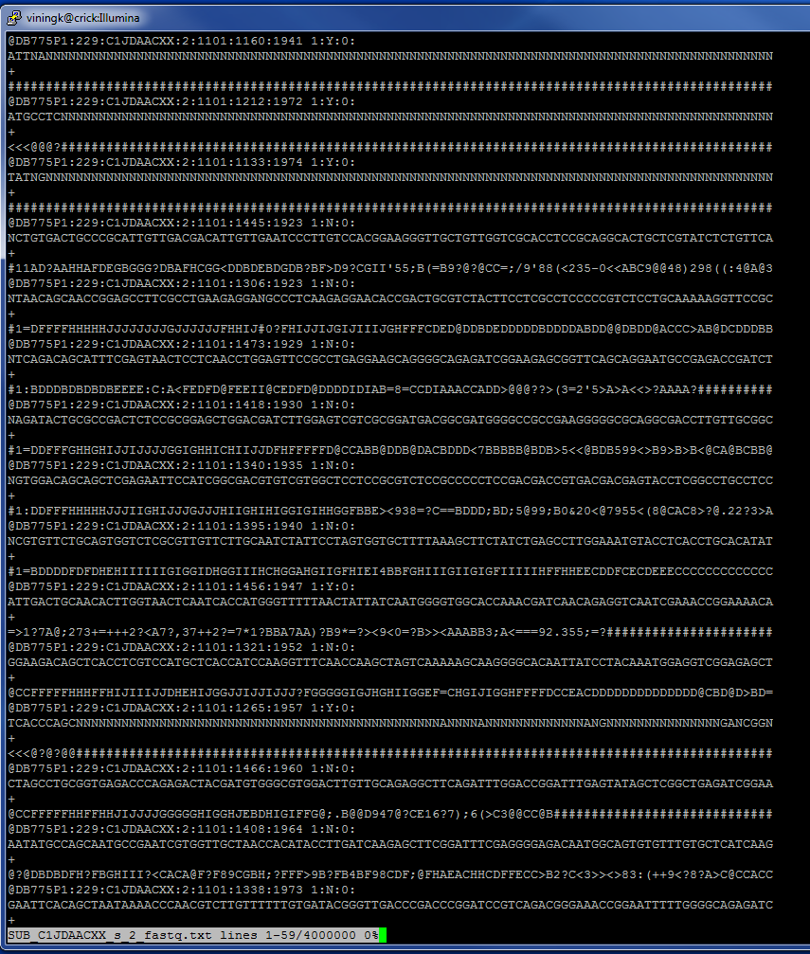
Fastq file
Barcode key file
Flowcell | Lane | Barcode | Sample | PlateName | Row | Column | LibraryPrepID | Comments
C4Y4VACXX | 1 | AGTGGC | Esp-1392 | 9-24-12ORFieldFrag-Spanishcoll-10BRubusGBS-G1 | G | 1 | 1 | 1
C4Y4VACXX | 1 | ACCGCT | Esp-1392 | 9-24-12ORFieldFrag-Spanishcoll-10BRubusGBS-G1 | E | 2 | 1 | 1
C4Y4VACXX | 1 | TCATGAC | Esp-1392 | 9-24-12ORFieldFrag-Spanishcoll-10BRubusGBS-G1 | B | 9 | 1 | 1
C4Y4VACXX | 1 | ATGCGT | Esp-232 | 1322-07-25-13FragAxiom3A-B3 | E | 1 | 1 | 1
C4Y4VACXX | 1 | CACGTT | Esp-232 | 1322-07-25-13FragAxiom3A-B3 | F | 1 | 1 | 1
C4Y4VACXX | 1 | GGTACAC | Esp-232 | 9-24-12ORFieldFrag-Spanishcoll-10BRubusGBS-F1 | A | 9 | 1 | 1
C4Y4VACXX | 1 | CGCAT | Esp-93-11 | 9-24-12ORFieldFrag-Spanishcoll-10BRubusGBS-C1 | C | 1 | 1 | 1
C4Y4VACXX | 1 | AGCTA | Esp-93-12 | 9-24-12ORFieldFrag-Spanishcoll-10BRubusGBS-D1 | D | 1 | 1 | 1
C4Y4VACXX | 1 | CAGCCT | Esp-93-15 | 9-24-12ORFieldFrag-Spanishcoll-10BRubusGBS-F2 | F | 2 | 1 | 1
C4Y4VACXX | 1 | CCAGTC | Esp-93-16 | 9-24-12ORFieldFrag-Spanishcoll-10BRubusGBS-G2 | G | 2 | 1 | 1
C4Y4VACXX | 1 | ATTCAGT | Esp-93-21 | 9-24-12ORFieldFrag-Spanishcoll-10BRubusGBS-H2 | H | 2 | 1 | 1
C4Y4VACXX | 1 | TAGTGC | Esp-93-24 | 9-24-12ORFieldFrag-Spanishcoll-10BRubusGBS-A2 | A | 2 | 1 | 1
C4Y4VACXX | 1 | CATCGC | Esp-93-26 | 9-24-12ORFieldFrag-Spanishcoll-10BRubusGBS-B2 | B | 2 | 1 | 1
C4Y4VACXX | 1 | AGGTCT | Esp-93-32 | 9-24-12ORFieldFrag-Spanishcoll-10BRubusGBS-C2 | C | 2 | 1 | 1
C4Y4VACXX | 1 | CTTGAC | Esp-93-33 | 9-24-12ORFieldFrag-Spanishcoll-10BRubusGBS-D2 | D | 2 | 1 | 1
C4Y4VACXX | 1 | TTGCAGA | Esp-93-36 | 9-24-12ORFieldFrag-Spanishcoll-10BRubusGBS-F3 | F | 3 | 1 | 1
C4Y4VACXX | 1 | AACTTGT | Esp-93-37 | 9-24-12ORFieldFrag-Spanishcoll-10BRubusGBS-G3 | G | 3 | 1 | 1
C4Y4VACXX | 1 | CTAGCT | Esp-93-4 | 9-24-12ORFieldFrag-Spanishcoll-10BRubusGBS-H1 | H | 1 | 1 | 1
C4Y4VACXX | 1 | TACTGAT | Esp-93-42 | 1321-07-25-13FragAxiom2A-F11 | H | 3 | 1 | 1
C4Y4VACXX | 1 | TCTAGGA | Esp-93-46 | 9-24-12ORFieldFrag-Spanishcoll-10BRubusGBS-A3 | A | 3 | 1 | 1
C4Y4VACXX | 1 | ACACGGT | Esp-93-47 | 1321-07-25-13FragAxiom2A-G11 | B | 3 | 1 | 1
C4Y4VACXX | 1 | GGCTAGA | Esp-93-50 | 9-24-12ORFieldFrag-Spanishcoll-10BRubusGBS-C3 | C | 3 | 1 | 1
C4Y4VACXX | 1 | TACGGTA | Esp-93-54 | 9-24-12ORFieldFrag-Spanishcoll-10BRubusGBS-D3 | D | 3 | 1 | 1
C4Y4VACXX | 1 | CGTGAAT | Esp-93-56 | 9-24-12ORFieldFrag-Spanishcoll-10BRubusGBS-E3 | E | 3 | 1 | 1
C4Y4VACXX | 1 | TGCAATA | Esp-93-57 | 9-24-12ORFieldFrag-Spanishcoll-10BRubusGBS-B4 | B | 4 | 1 | 1
C4Y4VACXX | 1 | GCATTGA | Esp-93-58 | 9-24-12ORFieldFrag-Spanishcoll-10BRubusGBS-A4 | A | 4 | 1 | 1
C4Y4VACXX | 1 | ATATCGT | Esp-93-59 | 9-24-12ORFieldFrag-Spanishcoll-10BRubusGBS-C4 | C | 4 | 1 | 1
C4Y4VACXX | 1 | GATT | Esp-93-6 | 9-24-12ORFieldFrag-Spanishcoll-10BRubusGBS-A1 | A | 1 | 1 | 1
C4Y4VACXX | 1 | AGTCTAT | Esp-93-60 | 9-24-12ORFieldFrag-Spanishcoll-10BRubusGBS-D4 | D | 4 | 1 | 1
C4Y4VACXX | 1 | GTCTGAA | Esp-93-61 | 9-24-12ORFieldFrag-Spanishcoll-10BRubusGBS-E4 | E | 4 | 1 | 1
C4Y4VACXX | 1 | CAGTTGA | Esp-93-62 | 9-24-12ORFieldFrag-Spanishcoll-10BRubusGBS-F4 | F | 4 | 1 | 1
C4Y4VACXX | 1 | CTAATGT | Esp-93-64 | 9-24-12ORFieldFrag-Spanishcoll-10BRubusGBS-G4 | G | 4 | 1 | 1
C4Y4VACXX | 1 | GCGTAAT | Esp-93-65 | 9-24-12ORFieldFrag-Spanishcoll-10BRubusGBS-H4 | H | 4 | 1 | 1
C4Y4VACXX | 1 | GTTACGA | Esp-93-66 | 9-24-12ORFieldFrag-Spanishcoll-10BRubusGBS-A5 | A | 5 | 1 | 1
C4Y4VACXX | 1 | CAGCGTA | Esp-93-69 | 9-24-12ORFieldFrag-Spanishcoll-10BRubusGBS-B5 | B | 5 | 1 | 1
C4Y4VACXX | 1 | AGTTCGA | Esp-93-70 | 9-24-12ORFieldFrag-Spanishcoll-10BRubusGBS-C5 | C | 5 | 1 | 1
C4Y4VACXX | 1 | CTTAGAT | Esp-93-72 | 9-24-12ORFieldFrag-Spanishcoll-10BRubusGBS-D5 | D | 5 | 1 | 1
C4Y4VACXX | 1 | ATGTCAA | Esp-93-73 | 9-24-12ORFieldFrag-Spanishcoll-10BRubusGBS-E5 | E | 5 | 1 | 1

Slide 10
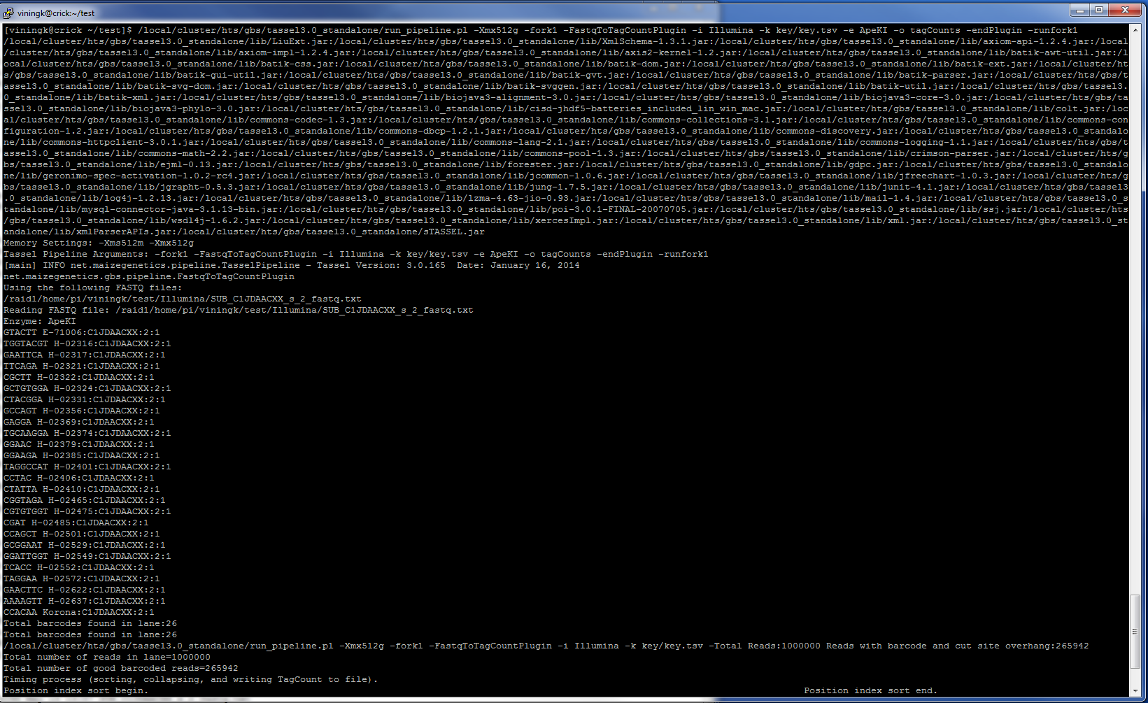

Slide 11
FastqToTagCount plugin
https://bytebucket.org/tasseladmin/tassel-5-source/wiki/docs/TasselPipelineGBS.pdf
Matches flowcell/lane combinations in key file with fastq files in Illumina directory
In fastq file(s), finds reads with expected barcodes, cut site remnants (e.g. CAGC or CTGC for ApeKI)
Trims reads to 64-bp “tags”
Output:
one .cnt file for each Illumina lane

Slide 12
MergeMultipleTagCount plugin
https://bytebucket.org/tasseladmin/tassel-5-source/wiki/docs/TasselPipelineGBS.pdf
Merges each tag count file into a single “master”
tag list
Output:
.cnt file for population
.fq file for alignment to reference genome

Slide 13
TagCountToFastq plugin
https://bytebucket.org/tasseladmin/tassel-5-source/wiki/docs/TasselPipelineGBS.pdf
Generates fastq file from master tags (.cnt) file
Output:
Fastq file for alignment to reference genome

Slide 14
Alignment to reference genome
https://bytebucket.org/tasseladmin/tassel-5-source/wiki/docs/TasselPipelineGBS.pdf
Supported aligners:
BWA, Bowtie2
Output:
Sequence Alignment Map (.sam) file

Slide 15
SAM Converter plugin
https://bytebucket.org/tasseladmin/tassel-5-source/wiki/docs/TasselPipelineGBS.pdf
Converts .sam file to binary format that can be used by SNP calling plugin
Output:
Tags on physical map (.topm) file

Slide 16
FastqToTBT plugin
https://bytebucket.org/tasseladmin/tassel-5-source/wiki/docs/TasselPipelineGBS.pdf
Inputs
raw fastq files
barcode key file
master tags file
Tracks individuals by barcoded adapters
Output:
TagsByTaxa (.tbt) file for each fastq file

Slide 17
MergeTagsByTaxaFiles plugin
https://bytebucket.org/tasseladmin/tassel-5-source/wiki/docs/TasselPipelineGBS.pdf
Merges Tags-By-Taxa files into a single file
Output:
Single .tbt file for population

Slide 18
TagsToSNPByAlignment plugin: Discovery SNP caller
https://bytebucket.org/tasseladmin/tassel-5-source/wiki/docs/TasselPipelineGBS.pdf
Aligns tags mapped to same locus
Calls SNPs from each alignment
Output:
One hapMap file per chromosome

Slide 19
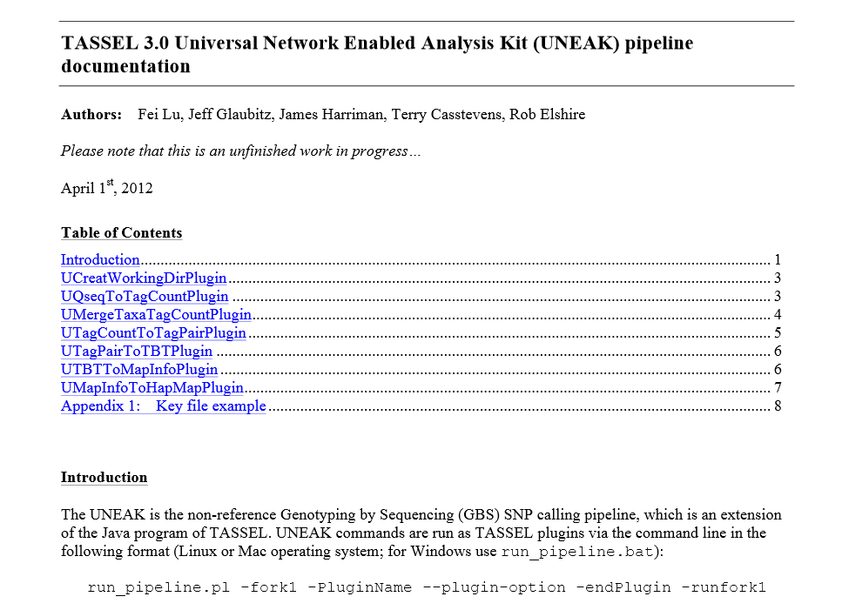

Slide 20
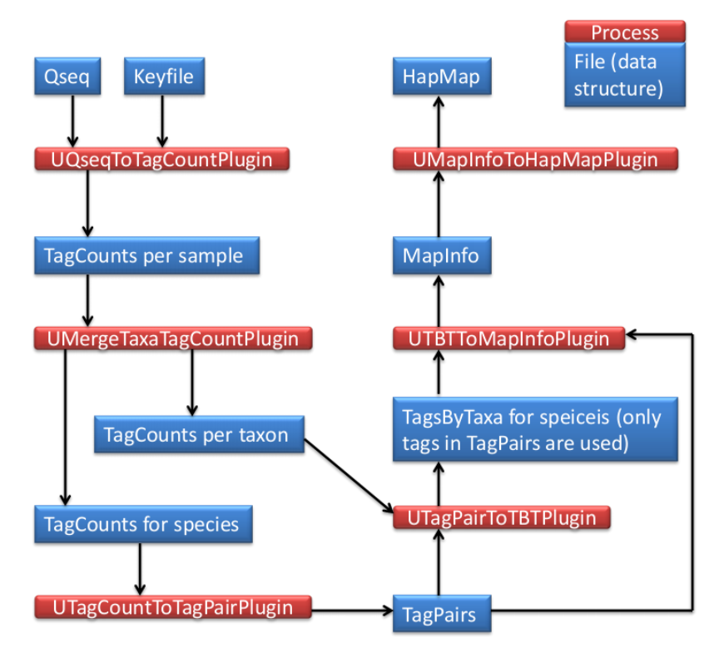
Tags aligned to each other instead of reference genome

Slide 21
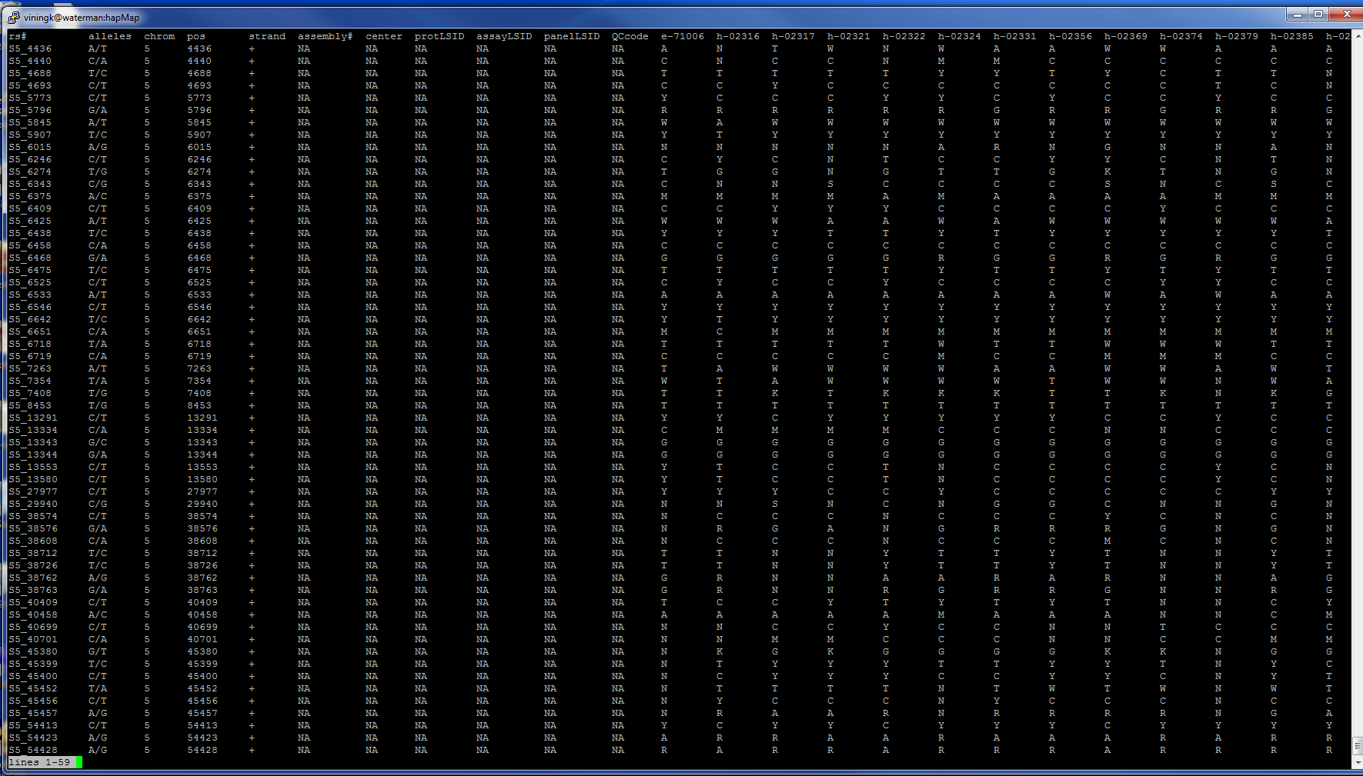

Slide 22
More TASSEL plugins
MergeDuplicateSNPs Merges SNPs from overlapping tags (on opposite DNA strands)
MergeIdenticalTaxa Merges SNPs from genotypes with identical names
GBSHapMapFilters Filters SNPs with low coverage (missing data for most genotypes), high heterozygosity, low/high minor allele frequency, or SNPs that are not in linkage disequilibrium with at least one other SNP.
BinaryToText Reads a binary file (.topm, .tbt, etc) and outputs text format

