Slide 1
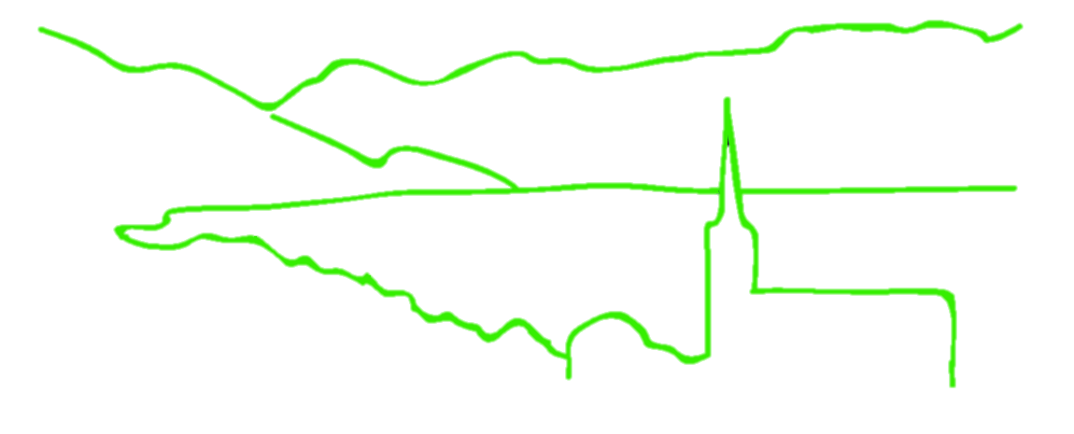
RADseq Pipelines: an overview
B @ G²
i
o
i
n
for
o
r
m
a
t
i
c
s
d
a
p
t
a
t
i
o
n
e
n
o
m
i
c
s
Jonathan B. Puritz
Marine Science Center
Northeastern University

Slide 2

Class Survey
Pipeline | dDocent | Stacks | pyRAD | aftrRAD | Other
Participants Familiar with pipleine | 5 | 22 | 11 | 1 | 7
B@G 2016

Slide 3
RADseq Pipelines: class familiarity in 2015
B@G 2016

Slide 4
The pipelines
Stacks (Catchen et al. 2013)
The first mainstream RADseq software
Designed specifically for mbRAd but can handle ddRAD
dDocent (Puritz et al. 2014)
Simple customizable backbone for bioinformatics
Designed specifically for ddRAD and ezRAD
pyRAD (Eaton 2014)
Analysis pipeline written in python
Can handle many RADseq types, focused on phylogentics
aftrRAD (Sovic et al. 2015)
Newest kid on the blog
Offers a blend between Stacks and pyRAD
B@G 2016

Slide 5
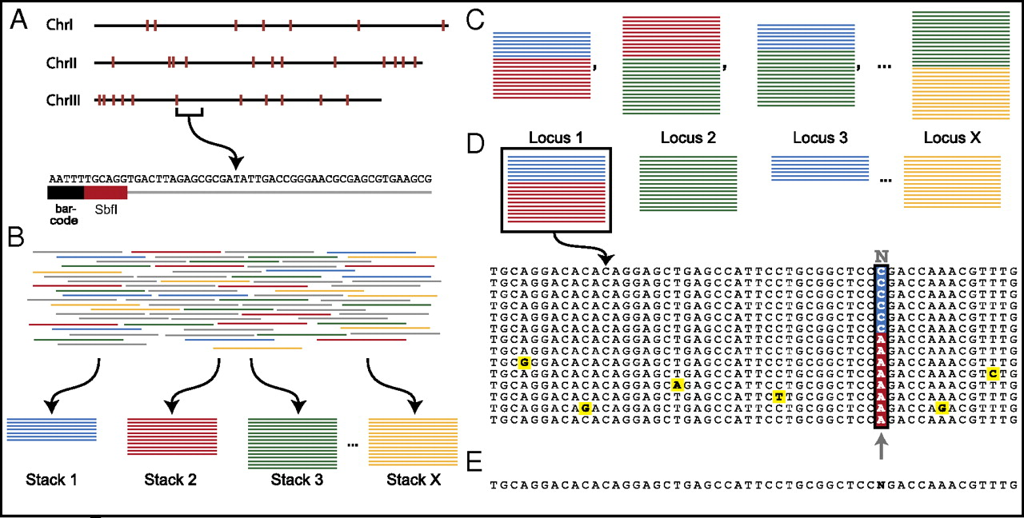
The Stacks Model
Adopted from Emerson et al. 2010
B@G 2016

Slide 6
The Stacks Model
Adopted from Emerson et al. 2010
pyRAD and aftrRAD have a similar methodology except that they perform alignments along with clustering.
B@G 2016

Slide 7
dDocent: ddRAD Analysis Pipeline
Quality Filtering
De Novo Assembly
dDocent is a customizable BASH pipeline that follows the traditional NGS bioinformatic workflow
Specifically designed to handle high levels of polymorphism
Can handle INDEL polymorphisms
It uses a novel data reduction method to help with reference assembly
It uses BWA for mapping and FreeBayes for Variant calling
Read Mapping
SNP Calling
SNP Filtering

Slide 8
Why INDELS matter...
AATGCTAGGA
AATGCTAGGA

Slide 9
Why INDELS matter...
AATGCTAGGA
AATGCTACGA

Slide 10
Why INDELS matter...
AATGCTAGGA
AATGCTACGA

Slide 11
Why INDELS matter...
AATGCTAGGA
AATGCACGAA

Slide 12
STACKS
AATGCTAGGA
AATGCACGAA
Reads from one homologous locus will not cluster together
Three possible outcomes:
Locus is thrown out all together
Locus is split into two loci
Rare alleles linked to INDELS are removed

Slide 13
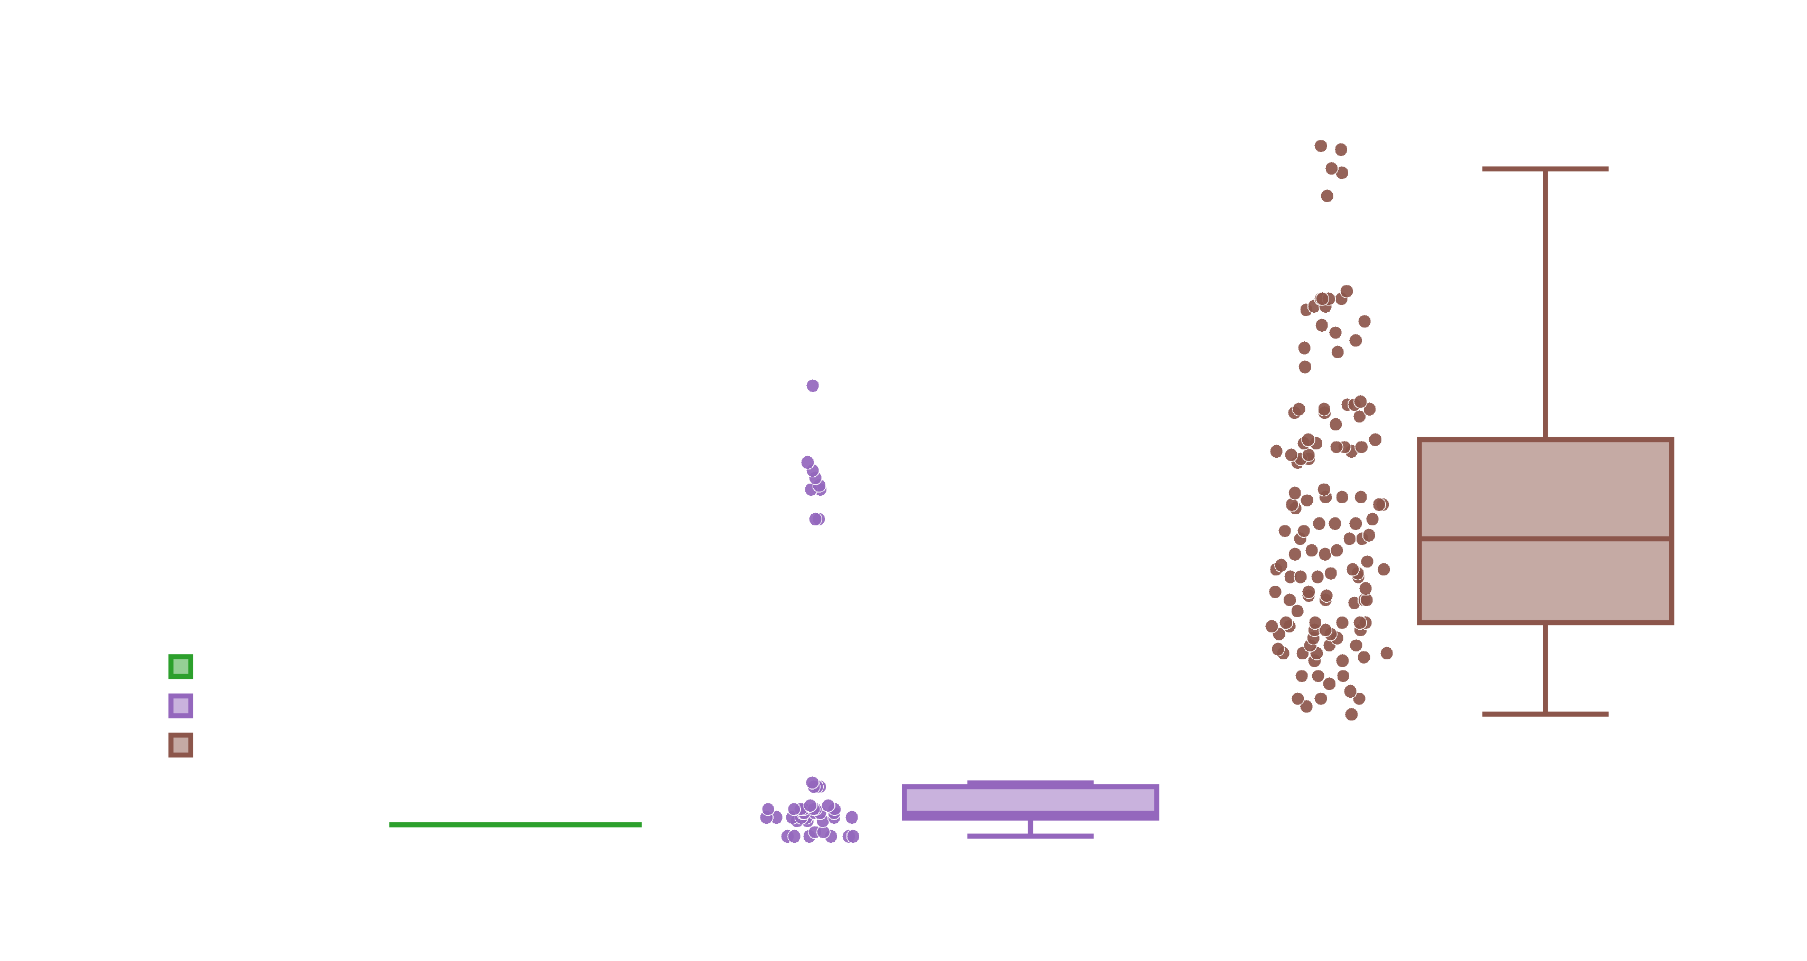
dDocent vs. Stacks vs. aftrRAD

Slide 14
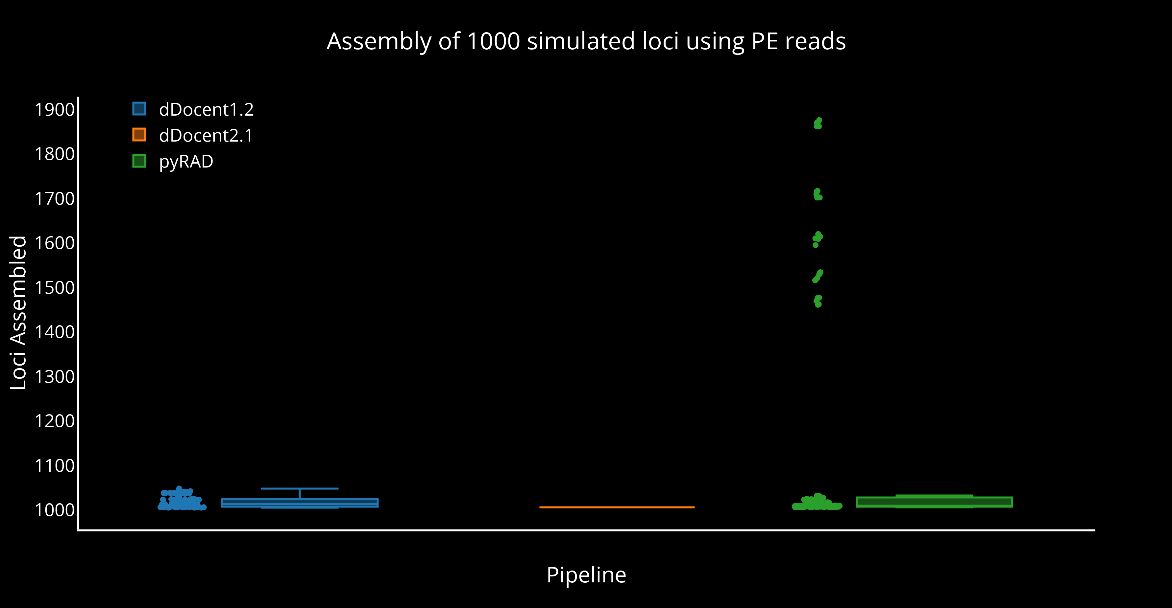
dDocent vs. pyRAD

Slide 15
Stacks
Advantages
Disadvantages
By far the most developed software option.
Syncs with a MySQL database
Can handle reference based analysis or de novo assembly
Can output multiple formats
The de novo assembly method cannot handle INDEL variation at all.
Reads with INDELs will not cluster together
Reads must remain a fixed length, so low quality reads are removed instead of trimmed
Does not call SNPs in PE reads
Has a single sample, single base pair model for SNP calling
rxstacks does improved SNP calls
B@G 2016

Slide 16
dDocent
Advantages
Disadvantages
Performs read trimming and is INDEL aware for assembly and read mapping
Follows a stepwise, traditional NGS workflow
Has a novel data reduction method for de novo assembly
Open source BASH code that is easy to customize
Currently the final output is limited to VCF files.
Requires several different software dependencies and can be difficult to install.
Limited by the development of dependent packages
B@G 2016

Slide 17
pyRAD
Advantages
Disadvantages
Flexible package designed to handle multiple different RADseq methods
Open source, easy to read python code
Performs clustering and alignment, so INDELS are properly handled
Can output several different output types directly
Cannot handle a reference genome. Only does de novo assembly
Has a single sample, single base pair model for SNP calling
Is designed mostly for phylogenetics
B@G 2016

Slide 18
aftrRAD
Advantages
Disadvantages
Performs clustering and alignment, so INDELS are properly handled
Is tuned to be more sensitive than pyRAD for polymorphic loci
Output can be converted to a variety of formats
Cannot handle a reference genome. Only does de novo assembly
Has a single sample, single base pair model for SNP calling
B@G 2016

Slide 19
Discussion? Questions?

Slide 20
Exercises
bash /gdc_home5/groups/bag2016/monday/Install.sh
RefEx, MapEx, FilterEx
Markdown Format exercises can be found at https://github.com/jpuritz/WinterSchool.2016

Slide 21
Exercises
bash /gdc_home5/groups/bag2016/monday/Install.sh
RefEx, MapEx, FilterEx
Markdown Format exercises can be found at https://github.com/jpuritz/WinterSchool.2016
Thank you to ETH and B@G for inviting me back!
Thanks to all of you for your attention!
Find me online!
jpuritz@gmail.com
https://www.researchgate.net/profile/Jonathan_Puritz
Twitter: @jonpuritz
Instagram: @jonpuritz
Website: http://staff.tamucc.edu/jpuritz/

