Slide 1

Sampling and Simulation
Steve Elston
Copyright 2018, 2019, 2020, 2021, 2022, 2023 2024, Stephen F Elston. All rights reserved.

Slide 2
Review
Performing visualization is an essential part of the entire data science pipeline
Initial exploration (EDA)
Understanding model fit and errors
Presenting results and discoveries to colleagues.

Slide 3
Review
Performing visualization is an essential part of the entire data science pipeline
Goal is to understand key, possibly multidimensional, relationships in large complex data sets
Keep in mind the limits of human perception
Use aesthetics to project additional dimensions of complex data onto the 2-dimensional plot surface

Slide 4
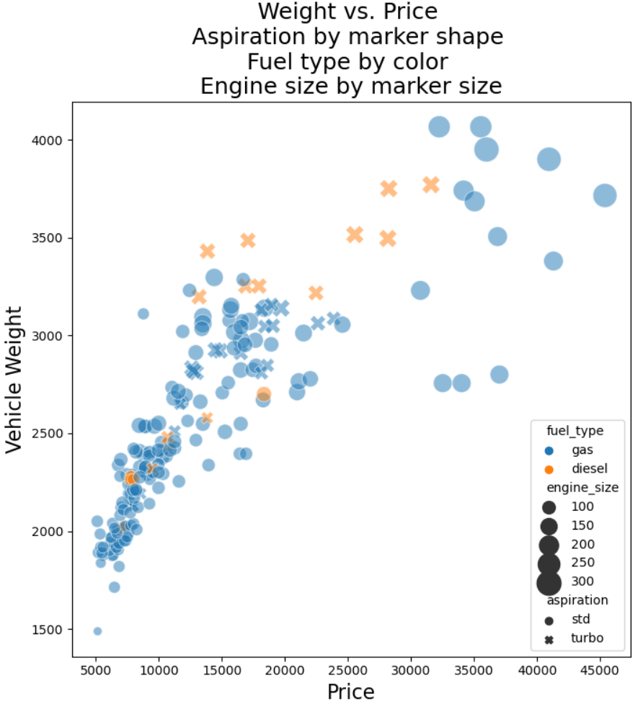
Review
Example, one can learn a lot from a good multi-dimensional plot not evident in simple statistical tables
Vehicle weight has a nonlinear relationship with price
Heavier more expensive cars have larger engines
The diesel cars with turbochargers are expensive and heavy compared to conventional diesel cars
Turbo diesel cars are heavier for the price than typical gas cars
There are some expensive larger-engine mid-weight cars that appear to be outliers

Slide 5
Review
Generally combine multiple methods to effectively display large complex data
Use plots that inherently scale
Avoid over-plotting to ensure plot is understandable
Often a creative case specific plot type is best
Use multi-axis plots
Scatter plot matrices
Facet plots
Filter cases using cognositics

Slide 6
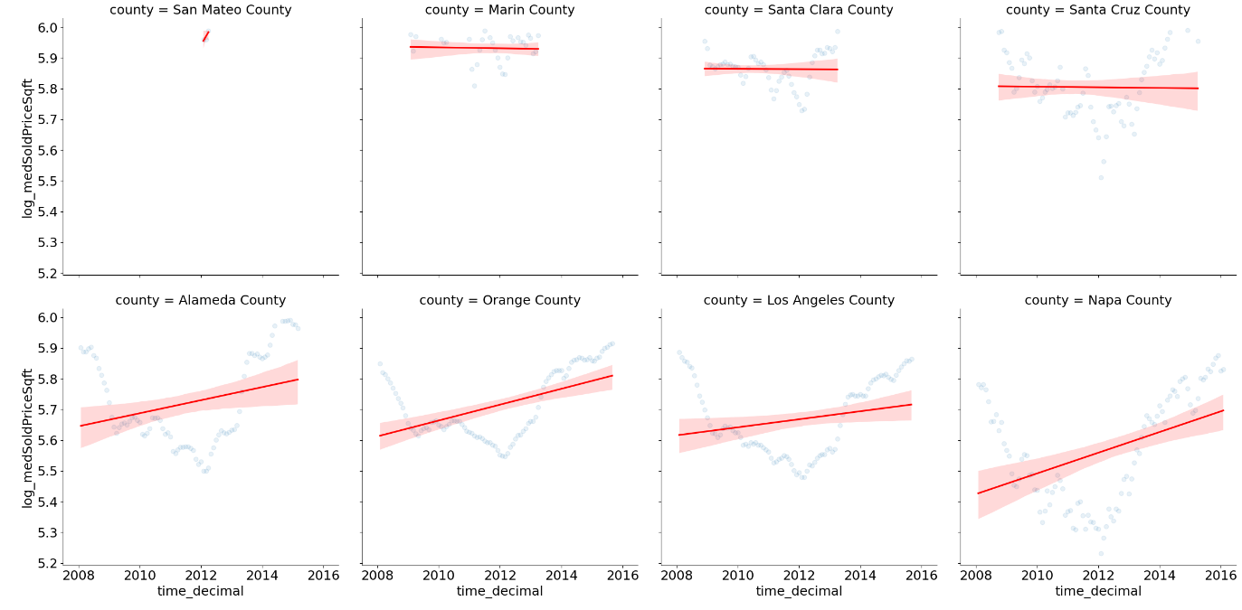
Review
Example, use cognositc to display facet plot for counties with highest median prices per square foot
The 1st order regression line does not look like a good fit!
No simple statistical table will show this complexity

Slide 7
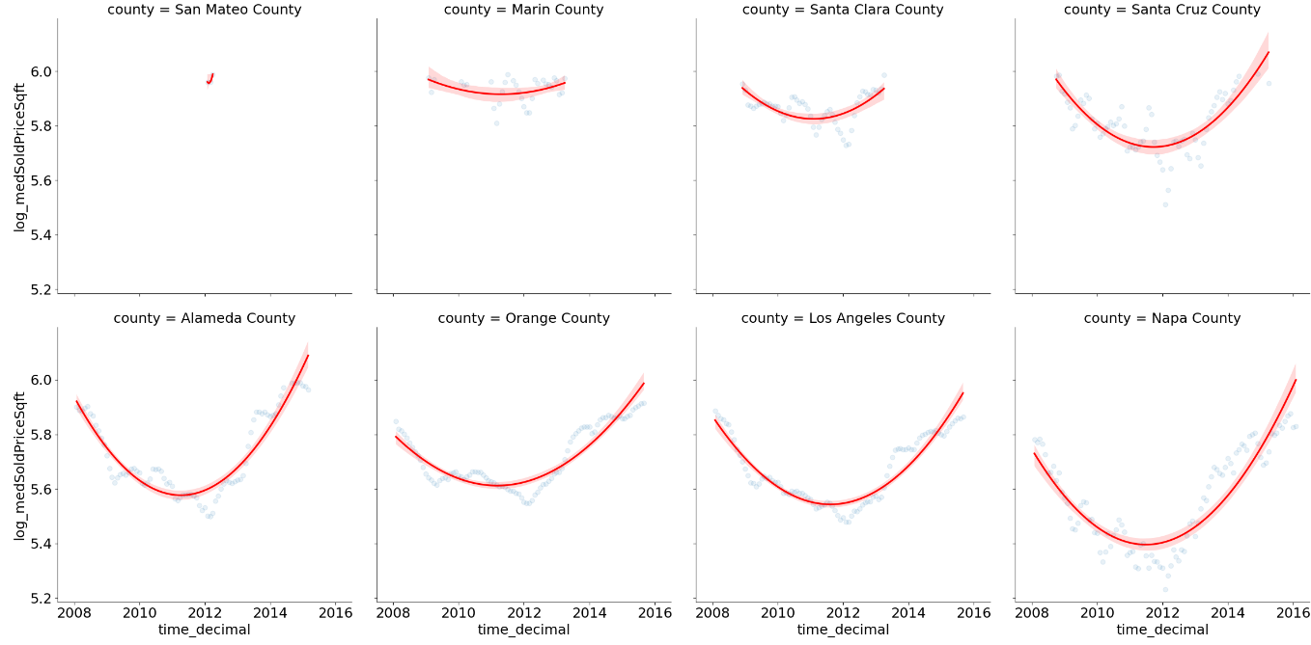
Review
Example, use cognositc to display facet plot for counties with highest median prices per square foot, with second order regression line
One can objectively say the relationship is not linear!
Next step could be to order by significant second order regression coefficients

Slide 8
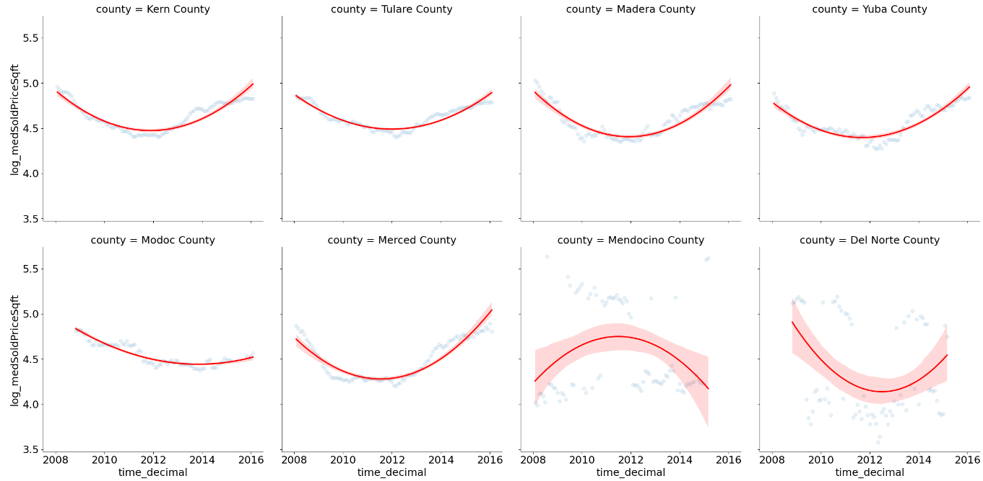
Review
Next, use cognositc to display facet plot for counties with lowest median prices per square foot, with second order regression line
Interesting!
The curvature is generally less in lower cost counties
One county actually has an inverted relationship
Perhaps a congnostic using population density will be enlightening?

Slide 9
Introduction to Sampling
Sampling is a fundamental process in the collection and analysis of data
Sampling is important because we almost never have data on an entire population
Sampling must be randomized to preclude biases
As sample size increases, the standard error decreases by the law of large numbers
In many cases it is not only impractical, but impossible to collect data from the entire population
We nearly always work with samples, rather than the entire population.

Slide 10
Introduction
Sampling is a fundamental process in the collection and analysis of data
Key points to keep in mind:
Understanding sampling is essential to ensure data is unbiased and representative of the entire population
Inferences on the sample say something about the population
The sample must be randomly drawn from the population
Sampling from distributions is the building block of Monte Carlo simulation
We will take up the topic of resampling next week

Slide 11
Examples of Sampling from a Population
Use Case | Sample | Population
A/B Testing | The users we show either web sites A or B | All possible users, past present and future
World Cup Soccer | Teams which qualify from past seasons | All national teams in past, present and future
Average height of data science students | Students in a data science class | All students taking data science classes world wide
Tolerances of a manufactured part | Samples taken from production lines | All parts manufactured in the past, present and future
Numbers of a species in a habitat | Population counts from sampled habitats | All possible habitats in the past, present and future

Slide 12
Importance of Random Sampling
All statistical methods rely on the use of randomized unbiased samples
Failure to randomized samples violates many key assumptions of statistical models and machine learning models
An understanding of proper use of sampling methods is essential to statistical inference
Most commonly used machine learning algorithms assume that training data are unbiased and independent and identically distributed (iid)
These conditions are only met if training data sample is randomized
Otherwise, the training data will be biased and not represent the underlying population distribution

Slide 13
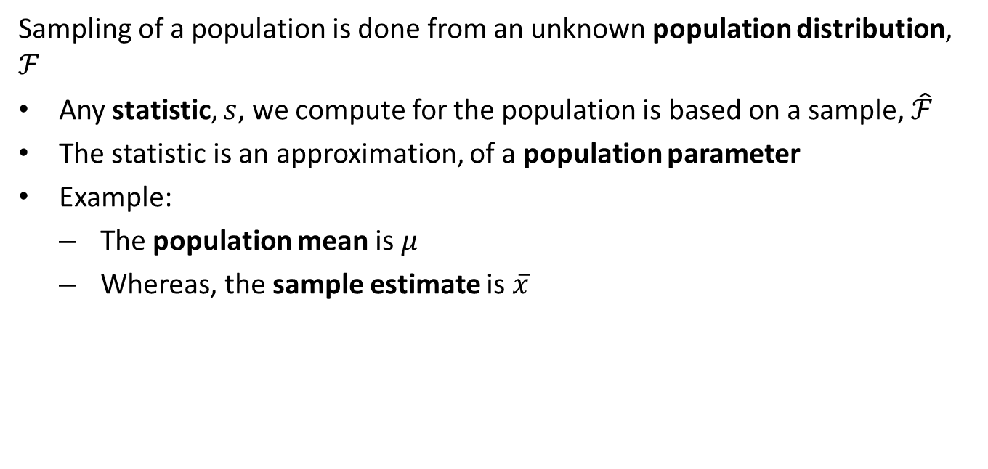
Sampling Distributions
Sampling of a population is done from an unknown population distribution, $ℱ$
Any statistic, $s$, we compute for the population is based on a sample, $\hat{ℱ}$
The statistic is an approximation, of a population parameter
Example:
The population mean is $μ$
Whereas, the sample estimate is $\overset{‾}{x}$

Slide 14
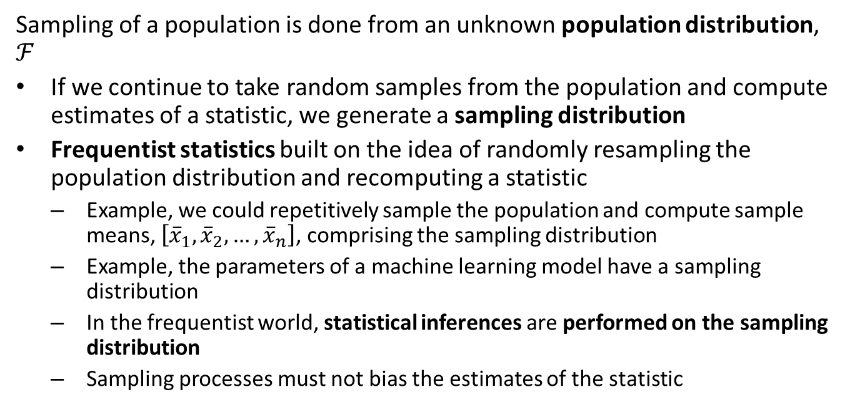
Sampling Distributions
Sampling of a population is done from an unknown population distribution, $ℱ$
If we continue to take random samples from the population and compute estimates of a statistic, we generate a sampling distribution
Frequentist statistics built on the idea of randomly resampling the population distribution and recomputing a statistic
Example, we could repetitively sample the population and compute sample means, $\left[{\overset{‾}{x}}_{1},{\overset{‾}{x}}_{2},…,{\overset{‾}{x}}_{n}\right]$, comprising the sampling distribution
Example, the parameters of a machine learning model have a sampling distribution
In the frequentist world, statistical inferences are performed on the sampling distribution
Sampling processes must not bias the estimates of the statistic

Slide 15
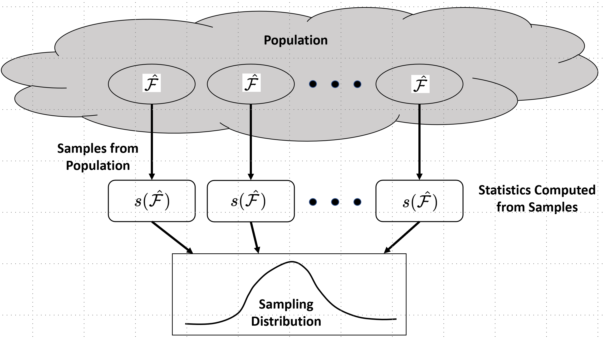
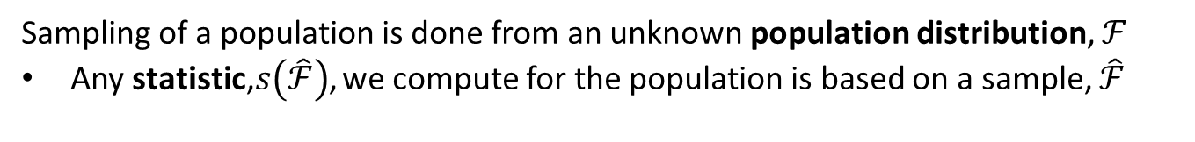
Sampling Distributions
Sampling of a population is done from an unknown population distribution, $ℱ$
Any statistic,$s\left(\hat{ℱ}\right)$, we compute for the population is based on a sample, $\hat{ℱ}$
Sampling distribution of unknown population parameter

Slide 16
Sampling and the Law of Large Numbers
The weak law of large numbers has a long history
Jacob Bernoulli posthumously published the first proof for the Binomial distribution in 1713
Law of large numbers is sometimes referred to as Bernoulli’s theorem
A more general proof was published by Poisson in 1837.

Slide 17
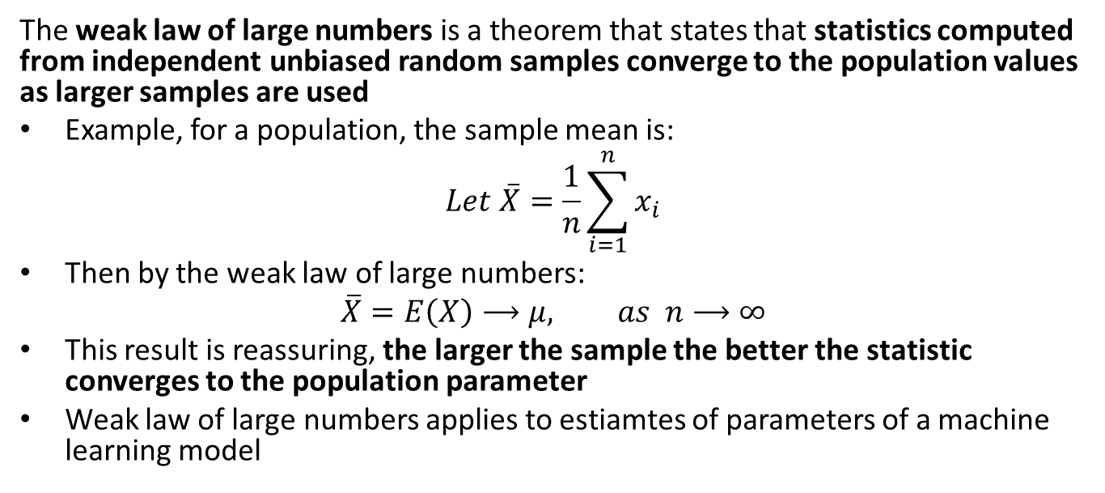
Sampling and the Law of Large Numbers
The weak law of large numbers is a theorem that states that statistics computed from independent unbiased random samples converge to the population values as larger samples are used
Example, for a population, the sample mean is:
$$Let \overset{‾}{X}=\frac{1}{n}\sum_{i=1}^{n}{x_{i}}$$
Then by the weak law of large numbers:
$$\overline{X}=E\left(X\right)⟶μ, as n⟶∞$$
This result is reassuring, the larger the sample the better the statistic converges to the population parameter
Weak law of large numbers applies to estiamtes of parameters of a machine learning model

Slide 18
Sampling and the Law of Large Numbers
The weak law of large numbers is foundational to statistics
We rely on the law of large numbers whenever we work with samples
Can assume that larger samples are more representatives of the population
Is foundation of statistical theory and modern computational methods
Monte Carlo simulation
Bootstrap resampling
Markov Chain Monte Carlo methods
Etc.
If the real world did not follow this theorem, then much of statistics (along with much of science and technology) would fail!

Slide 19
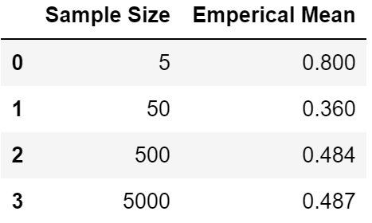
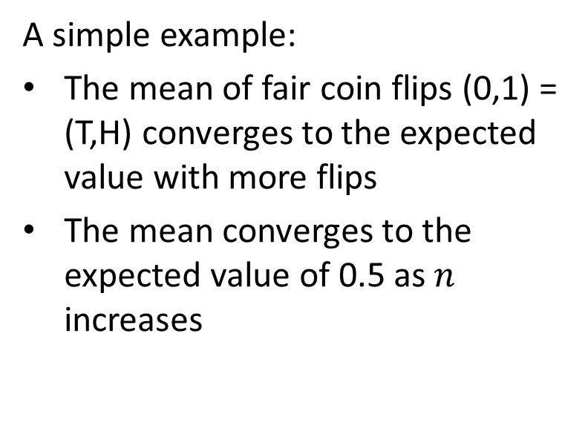
Sampling and the Law of Large Numbers
A simple example:
The mean of fair coin flips (0,1) = (T,H) converges to the expected value with more flips
The mean converges to the expected value of 0.5 as $n$ increases

Slide 20
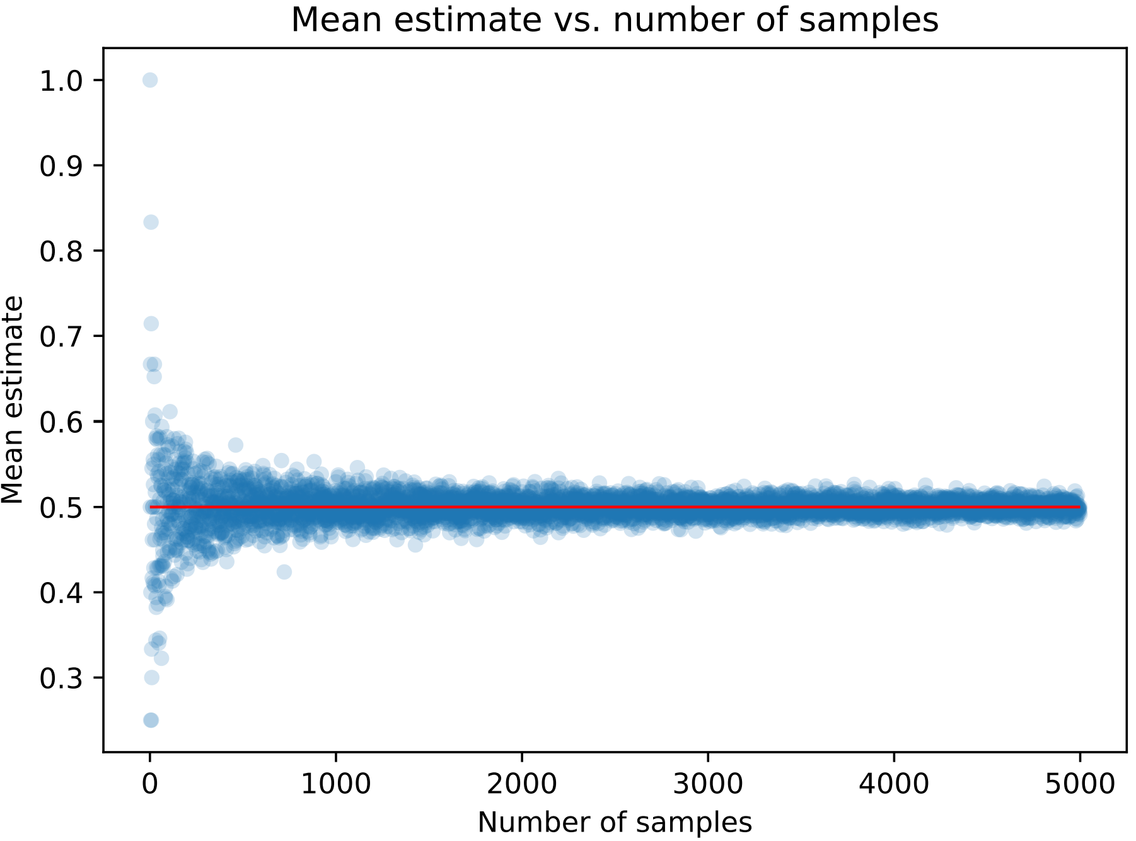
Sampling and the Law of Large Numbers
A simple example: Mean of fair coin flips (0,1) = (T,H) converges to the expected value with more flips
Convergence of mean estimates for fair coin

Slide 21
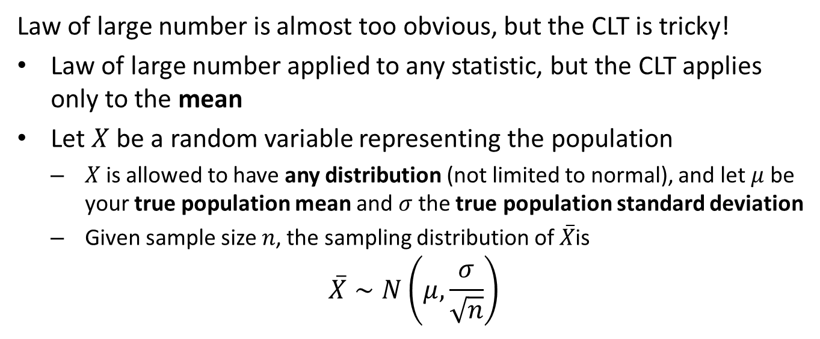
The Central Limit Theorem (CLT)
Law of large number is almost too obvious, but the CLT is tricky!
Law of large number applied to any statistic, but the CLT applies only to the mean
Let $X$ be a random variable representing the population
$X$ is allowed to have any distribution (not limited to normal), and let $μ$ be your true population mean and $σ$ the true population standard deviation
Given sample size $n$, the sampling distribution of $\overset{‾}{X}$is
$$\overset{‾}{X}∼N\left(μ,\frac{σ}{\sqrt[ ]{n}}\right)$$

Slide 22
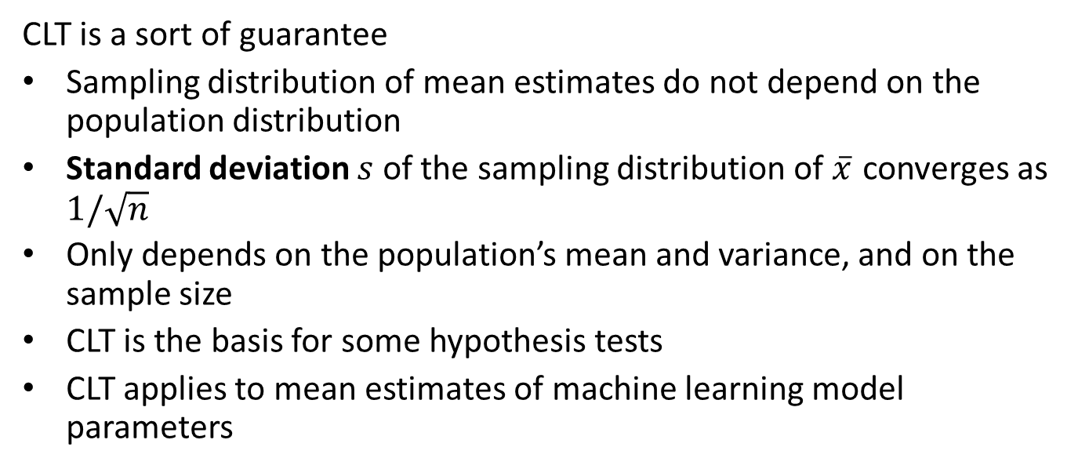
Importance of the CLT
CLT is a sort of guarantee
Sampling distribution of mean estimates do not depend on the population distribution
Standard deviation $s$ of the sampling distribution of $\overset{‾}{x}$ converges as $1/\sqrt[ ]{n}$
Only depends on the population’s mean and variance, and on the sample size
CLT is the basis for some hypothesis tests
CLT applies to mean estimates of machine learning model parameters

Slide 23
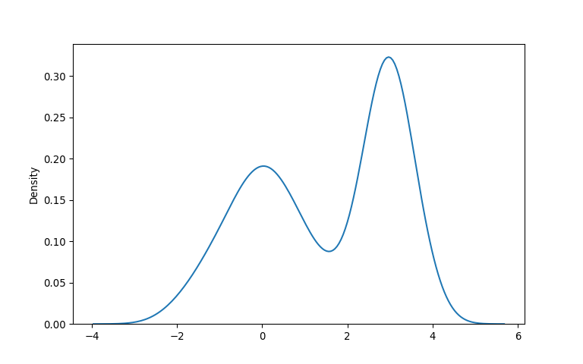
Example of CLT
Start with a mixture of Normal distributions

Slide 24
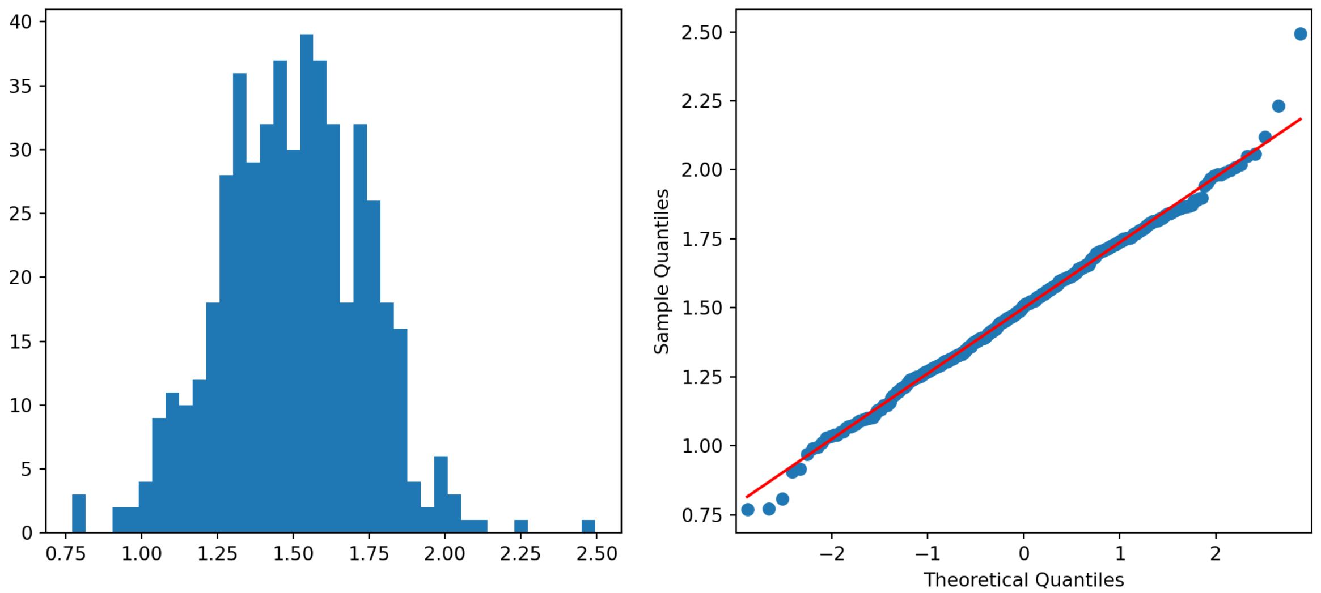
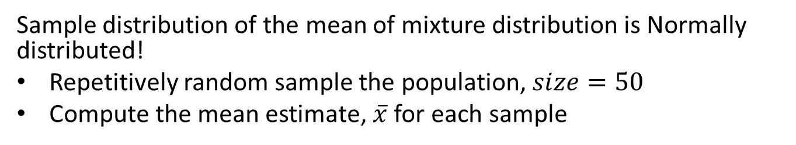
Example CLT
Sample distribution of the mean of mixture distribution is Normally distributed!
Repetitively random sample the population, $size=50$
Compute the mean estimate, $\overset{‾}{x}$ for each sample
Sample distribution of the mean of mixture of distributions is Normally distributed!

Slide 25
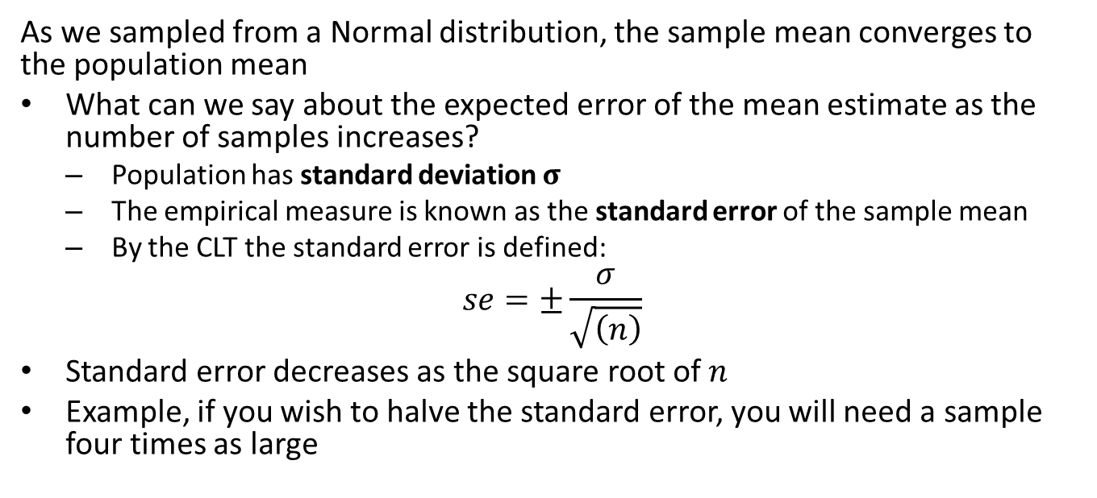
Standard Error and Convergence for a Sample Distribution
As we sampled from a Normal distribution, the sample mean converges to the population mean
What can we say about the expected error of the mean estimate as the number of samples increases?
Population has standard deviation $σ$
The empirical measure is known as the standard error of the sample mean
By the CLT the standard error is defined:
$$se=±\frac{σ}{\sqrt[ ]{\left(n\right)}}$$
Standard error decreases as the square root of $n$
Example, if you wish to halve the standard error, you will need a sample four times as large

Slide 26
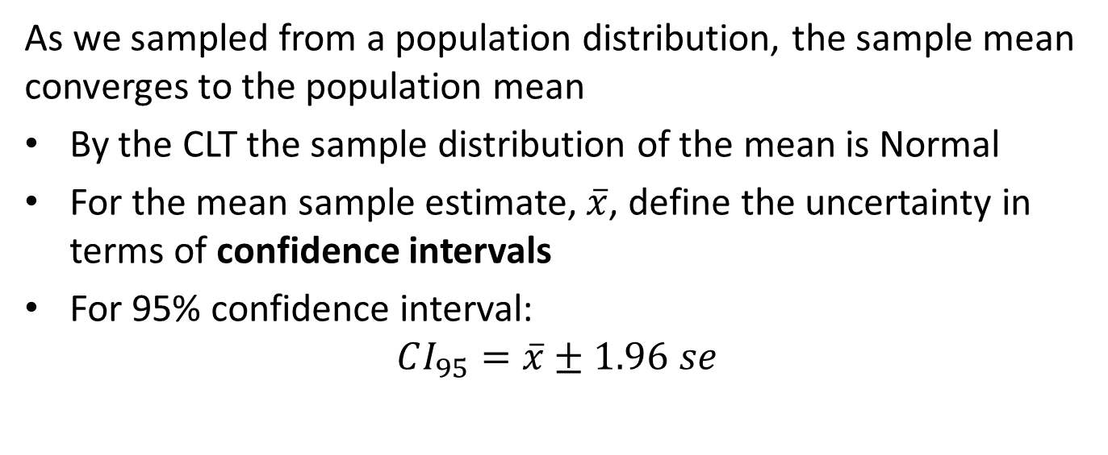
Standard Error and Convergence
As we sampled from a population distribution, the sample mean converges to the population mean
By the CLT the sample distribution of the mean is Normal
For the mean sample estimate, $\overset{‾}{x}$, define the uncertainty in terms of confidence intervals
For 95% confidence interval:
$$CI_{95}=\overset{‾}{x}±1.96 se$$

Slide 27
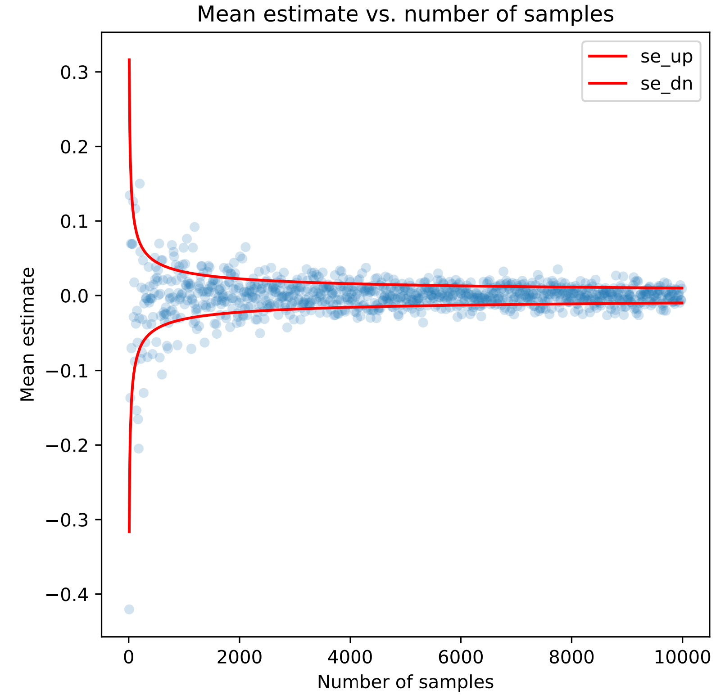
Convergence and Standard Errors for a Normal Distribution
Example: Mean estimates for realizations of standard Normal distribution with 95% confidence intervals
Convergance of mean estimates with standard errors

Slide 28
Sampling Strategies
There are a great number of possible sampling methods, including
Bernoulli sampling, a foundation of random sampling
Stratified sampling, for sampling groups with different characteristics
Cluster sampling, reduces cost of sampling
Systematic sampling and convenience sampling, a slippery slope

Slide 29
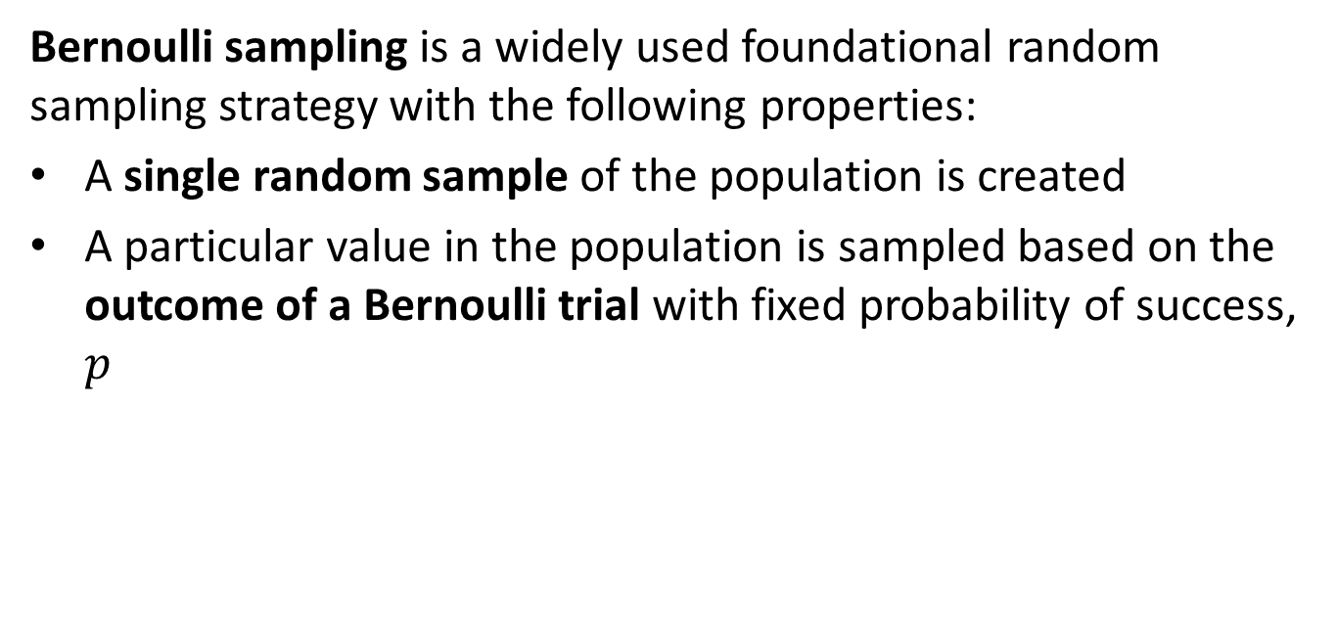
Bernoulli Sampling
Bernoulli sampling is a widely used foundational random sampling strategy with the following properties:
A single random sample of the population is created
A particular value in the population is sampled based on the outcome of a Bernoulli trial with fixed probability of success, $p$

Slide 30
Bernoulli Sampling
Bernoulli sampling example, a company sells a product by weight
Must ensure the quality of a packaging process so few packages are underweight
Population is all packages from the past, presence and future
Impractical to empty and weight the contents of every package
Random Bernoulli sample packages from the production line and weigh contents with say p=0.0001, or 1 out of 10,000
Statistical inferences are made from sample

Slide 31
Bernoulli Sampling
Bernoulli sampling example, a company sells a product by weight
Why not systematically take every 10,000 box from the production line and weigh the contents?
Perhaps, there is a systematic problem with the processing machinery?
Only random sample can be unbiased

Slide 32
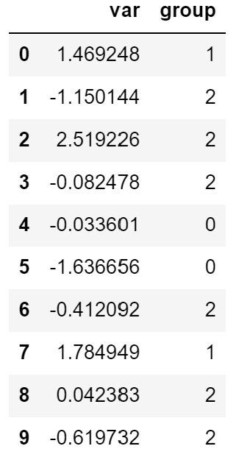
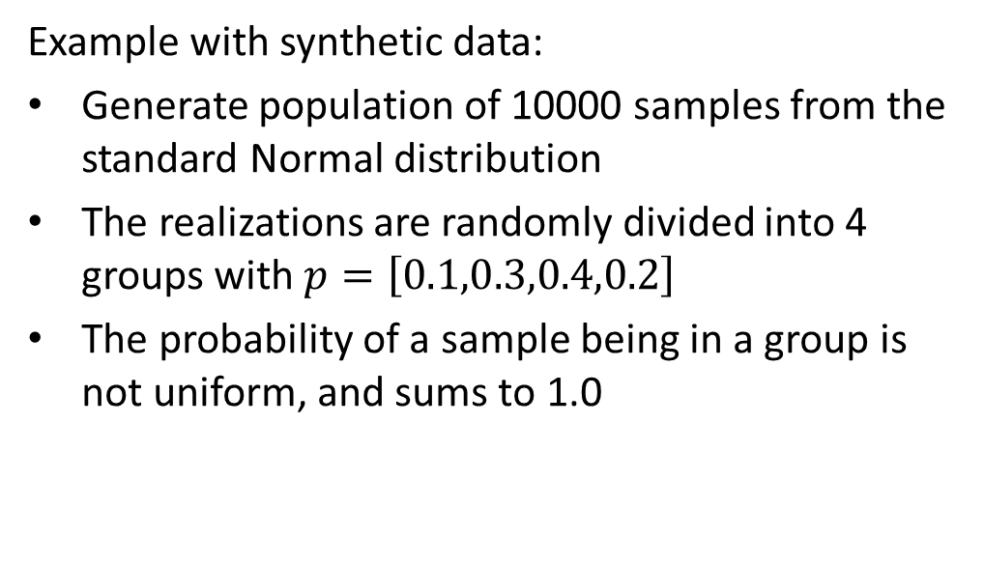
Bernoulli Sampling
Example with synthetic data:
Generate population of 10000 samples from the standard Normal distribution
The realizations are randomly divided into 4 groups with $p=\left[0.1,0.3,0.4,0.2\right]$
The probability of a sample being in a group is not uniform, and sums to 1.0

Slide 33
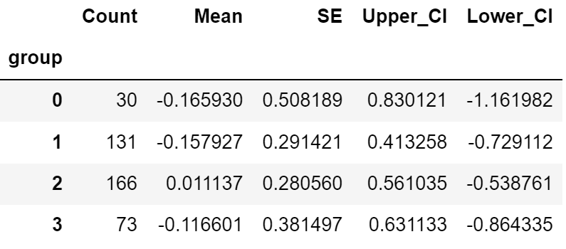
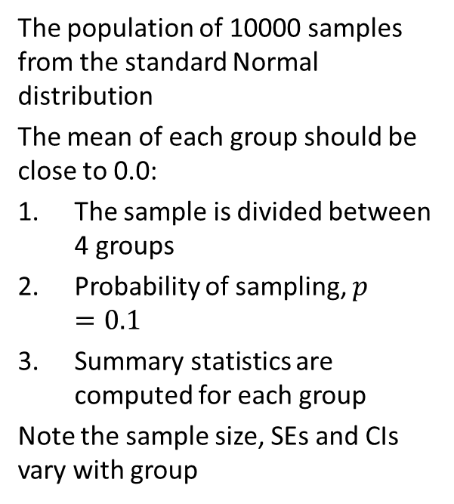
Bernoulli Sampling
The population of 10000 samples from the standard Normal distribution
The mean of each group should be close to 0.0:
The sample is divided between 4 groups
Probability of sampling, $p=0.1$
Summary statistics are computed for each group
Note the sample size, SEs and CIs vary with group

Slide 34
Sampling Grouped Data
Grouped data is quite common in application, for example:
Pooling opinion by county and income group, where income groups and counties have significant differences in population
Testing a drug which may have different effectiveness by sex and age group
Spectral characteristics of stars by type
Etc.

Slide 35
Stratified Sampling
What is a sampling strategy for grouped or stratified data?
Stratified sampling strategies are used when data are organized in strata
Simple Idea: independently sample an equal numbers of cases from each strata
The simplest version of stratified sampling creates an equal-size Bernoulli sample from each strata

Slide 36
Stratified Sampling
What is a sampling strategy for grouped or stratified data?
In many cases, nested samples are required
Example, a top level sample can be grouped by zip code, a geographic strata
Within each zip code, people are then sampled by income bracket strata
Equal sized Bernoulli samples are collected at the lowest level

Slide 37
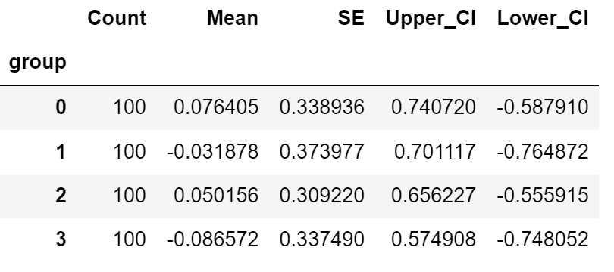
Example
Example:
Data in 4 groups
Bernoulli sample 100 from each group
Compute summary statistics for each group
Notice the similar Ses and CIs

Slide 38
Cluster Sampling
When sampling is expensive, a strategy is required to reduce the cost
Examples of expensive to collect data:
Surveys of customers at a chain of stores
Door to door survey of homeowners
Sampling wildlife populations in a dispersed habitat
Population can be divided into randomly selected clusters:
Define the clusters for the population
Randomly select the required number of clusters
Sample from selected clusters
Optionally, stratify the sample within each cluster

Slide 39
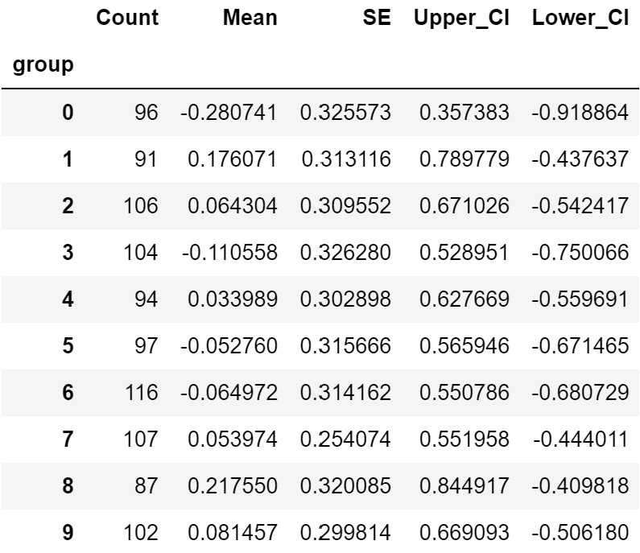
Cluster Sampling
Example:
10 store locations
Random sample store locations
Bernoulli sample store locations.

Slide 40
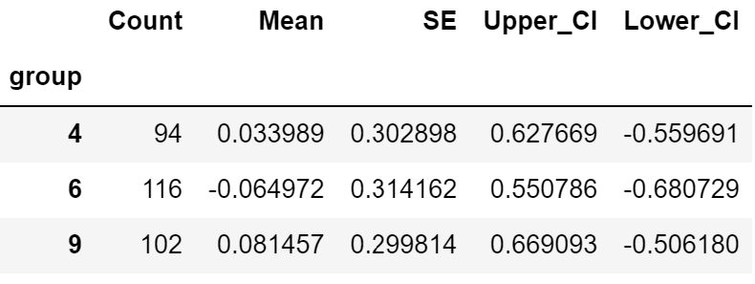
Cluster Sampling
Example:
10 store locations
Bernoulli sample 3 store locations
Bernoulli sample customers at store.

Slide 41
Systematic Sampling
Convenience and systematic sampling are a slippery slope toward biased inferences
Systematic sampling lacks randomization
Convenience sampling selects the cases that are easiest to obtain
Commonly cited example known as database sampling
Example, the first N rows resulting from a database query
Example, every k-th case of the population

Slide 42
A Few More Thoughts on Sampling
There are many practical aspects of sampling.
Random sampling is essential to the underlying assumptions of statistical inference and machine learning
Whenever you are planning to sample data, make sure you have a clear sampling plan
Know the number of clusters, strata, and samples in advance
Don’t just stop sampling when your desired result is achieved!

Slide 43
Introduction to Simulation
Monte Carlo simulations enable data scientists to study the behavior of stochastic processes with complex probability distributions
Many real-world processes have complex distributions of observed values
Two main purposes of Monte Carlo simulation can be summarized as:
Testing models: If data simulated from the model do not resemble the original data, something is likely wrong
Understand processes with complex probability distributions: In these cases, simulation provides a powerful and flexible computational technique to understand behavior
Complex Monte Carlo simulations are a key component of Digital twin models

Slide 44
Introduction to Simulation
As cheap computational power has become ubiquitous, Monte Carlo simulation has become a widely used technique
Simulations compute a large number of samples, or realizations
The computing cost of each realization must be low in any practical simulation
Realizations are drawn by Monte Carlo sampling probability distributions of the process model
In many cases, realizations are computed by sampling conditional probability distributions
The final or posterior distribution of the process is comprised of these realizations
You can find a short tutorial on Monte Carlo simulation here

Slide 45
Representation as a Directed Acyclic Graphical Model
When creating a simulation with multiple conditionally dependent variables it is useful to draw a directed acyclic graphical model or DAG
The graph representation shows independent and conditionally dependent variables
Shapes represent different types of nodes
Directed edges show the dependency structure of the distributions
Arrows point from parent nodes to dependent child nodes
Child node is conditional on parent nodes

Slide 46
Representation as a Directed Acyclic Graphical Model
A directed acyclic graphical model or DAG is an intuitive representation of a Monte Carlo simulation model
Probability distributions are shown as ellipses
Distributions have parameters which must be known or estimated
Decision variables are deterministic and shown as rectangles
Setting decision variables can be performed either manually or automatically
Utility nodes, e.g. profit in this case, are shown as diamonds
Nodes represent a deterministic utility functions

Slide 47
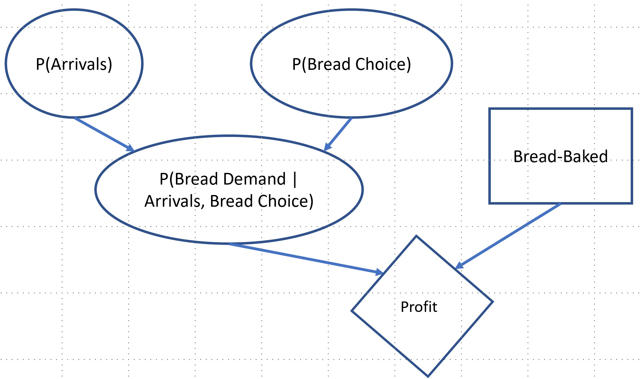
Sandwich Shop Simulation
The sandwich shop simulation can be represented by a DAG
Directed acyclic graph of the posterior distribution of profit

Slide 48
Sandwich Shop Simulation
Interpreting the DAG
The DAG is a shorthand description of the simulation model
Nodes with no dependency are independent distributions
Parameters must be known or estimated
Can be useful to vary the parameters
Child distributions are conditional on their parents
Parameters must be known or estimated
Resulting distribution can be quite complex
Decision variables deterministically change the model parameters
Utility nodes use a fixed deterministic formula to compute the value for each realization of the simulation

Slide 49
Tips on Building Simulations
Creating, testing and debugging simulation software can be tricky given the stochastic nature of simulation
Build your simulation as a series of small, easily tested, chunks
Test each small functional unit individually, including at least testing some typical cases, as well as boundary or extreme cases
Test your end-to-end simulation each time you add a new functional component - avoid big bang integration!
Monte Carlo simulations are inherently stochastic, set a seed so tests are repeatable

Slide 50
Summary
Sampling is a fundamental process in the collection and analysis of data
Sampling is required since we almost never have data on an entire population
Sampling must be randomized to preclude biases
Inferences are made on the sample distribution, not the population distribution
Statistics, including machine learning parameters, must be estimated from random iid samples
As sample size increases the standard error of a statistic computed from the sample decreases by the law of large numbers
The Central Limit Theorem assures us that errors of mean estimates are Normally distributed
Monte Carlo sampling from distributions is the building block simulation

