Slide 1

Forecasting and Time Series Models
Steve Elston
Copyright 2018, 2019, 2020, 2021, 2022, 2023 2024, Stephen F Elston. All rights reserved.

Slide 2
Why Are Time Series Useful?
Data are often time-ordered
Estimates show that 30% of data science problems include time series data
Must use specific time series models

Slide 3
Why Are Time Series Useful?
“It’s tough to make predictions, especially about the future!”
Karl Kristian Steincke, Danish politician, ca 1937
Demand forecasting: Electricity production, Internet bandwidth, Traffic management, Inventory management, sales forecasting
Medicine: Time dependent treatment effects, EKG, EEG
Engineering and Science: Signal analysis, Analysis of physical processes
Capital markets and economics: Seasonal unemployment, Price/return series, Risk analysis

Slide 4
Why Are Time Series Data Different?
Models must account for time series behavior
Most statistical and machine learning assume data samples are independent identically distributed (iid)
But, this is not the case for time series data
Time series values are correlated in time
Time series data exhibit Serial correlation
Serial correlation of values
Serial correlation of model errors
Violate iid assumptions of many statistical and ML Models `

Slide 5
Properties of Time Series
Fundamental elements of time series
Fundamental components which cannot be predicted
White noise
Random walks
Nonstationary components
Trend
Seasonal components
Autocorrelation and partial autocorrelation
Fundamental properties of stationary time series
Differencing to transform to stationarity
Seasonal differencing
Non-seasonal differencing
Stationarity tests
augmented Dicky-Fuller test
KPSS test

Slide 6
Time Series Forecasting Models
Forecasting is the goal of much of time series analysis
ARIMA and SARIMAX models; time series linear models
For comprehensive introduction see Forecasting: Principles and Practice, Hyndman and Athanaosopoulos, 3rd edition, 2018, available as book or free online
Rob Hyndman’s blog is a source of many interesting ideas and example in time series analysis
Another applied source, The Analysis of Time Series, Chatfield and Xing, 2019

Slide 7
Time Series Models
The ARIMA model for stationary time series comprises three components:
Autoregressive component (AR) accounts for partial autocorrelation
Serial correlation of observatons
Integrative component (I) accounts random walks and trend
Moving Average (MA) accounts for autocorrelation
Serial correlation of model error

Slide 8
Time Series Models
Many types of time series models
SARIMA: seasonal autoregressive integrative moving average, adds seasonal components
seasonal AR accounts for serial correlation of seasonal values
seasonal component accounts for random walk and trend of seasonal components
seasonal MA accounts for seasonal serial correlation of errors
SARIMAX: seasonal autoregressive integrative moving average with exogenous variables
Add effect of external factors
Example; effect of specific holiday
Example; effect arising from factors not incorporated in endogenous variable

Slide 9
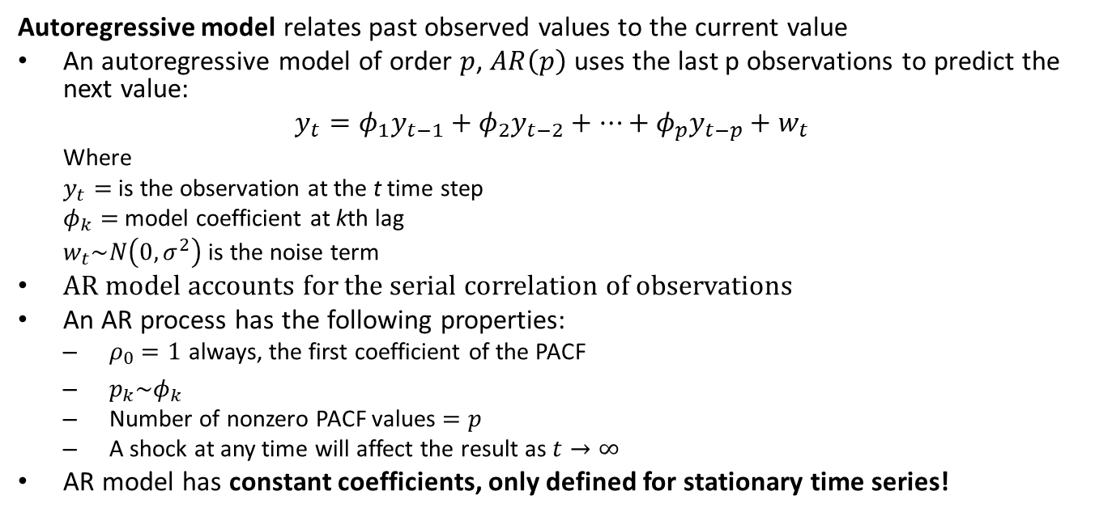
The Autoregressive Model
Autoregressive model relates past observed values to the current value
An autoregressive model of order $p$, $AR\left(p\right)$ uses the last p observations to predict the next value:
$$y_{t}=φ_{1}y_{t−1}+φ_{2}y_{t−2}+…+φ_{p}y_{t−p}+w_{t}$$
Where
$y_{t}=$ is the observation at the t time step
$φ_{k}=$ model coefficient at kth lag
$w_{t}\sim N\left(0,σ^{2}\right)$ is the noise term
AR model accounts for the serial correlation of observations
An AR process has the following properties:
$ρ_{0}=1$ always, the first coefficient of the PACF
$p_{k}\sim φ_{k}$
Number of nonzero PACF values $=p$
A shock at any time will affect the result as $t→∞$
AR model has constant coefficients, only defined for stationary time series!

Slide 10






The Autoregressive Model
$$φ_{2}y_{t−2}$$
$$φ_{1}y_{t−1}$$
$$y_{t−2}$$
$$y_{t−1}$$
$$y_{t}$$
$$y_{t}=φ_{1}y_{t−1}+φ_{2}y_{t−2}+w_{t}$$
Illustration of the AR(2) model

Slide 11
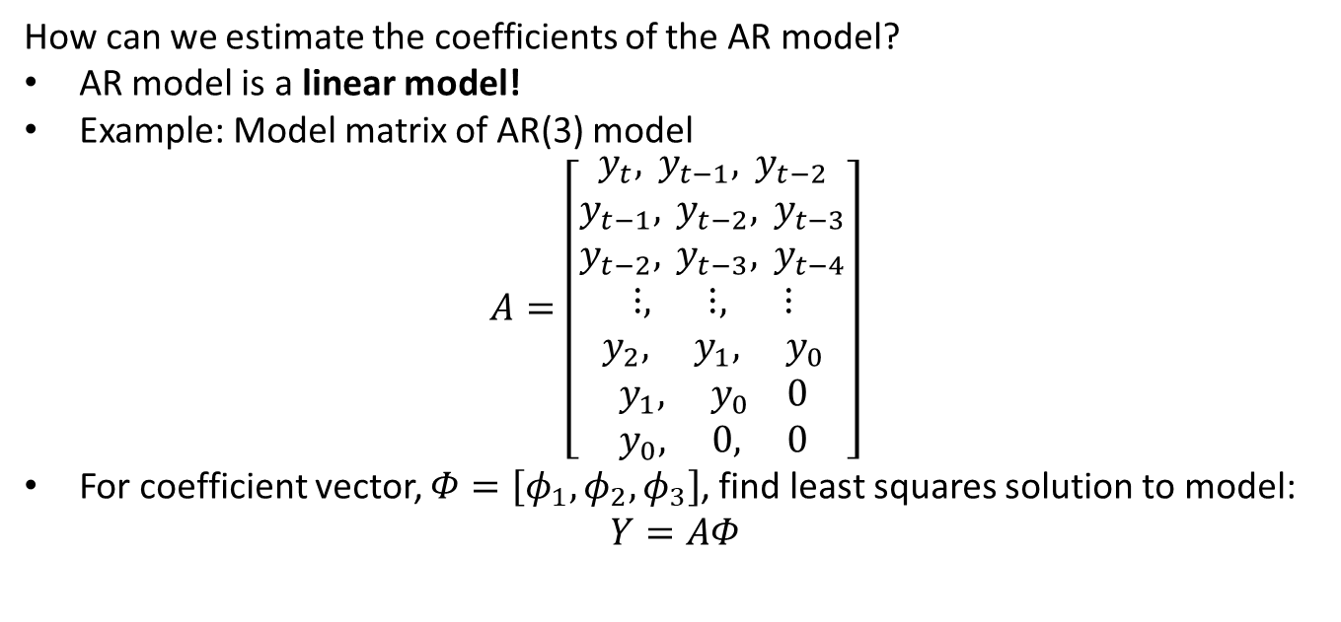
The Autoregressive Model
How can we estimate the coefficients of the AR model?
AR model is a linear model!
Example: Model matrix of AR(3) model
$$A=\left[\begin{matrix}y_{t}, y_{t−1}, y_{t−2} \\ y_{t−1}, y_{t−2}, y_{t−3} \\ y_{t−2}, y_{t−3}, y_{t−4} \\ ⋮, ⋮, ⋮ \\ y_{2}, y_{1}, y_{0} \\ y_{1}, y_{0} 0 \\ y_{0}, 0, 0\end{matrix}\right]$$
For coefficient vector, $Φ=\left[φ_{1},φ_{2},φ_{3}\right]$, find least squares solution to model:
$$Y=AΦ$$

Slide 12
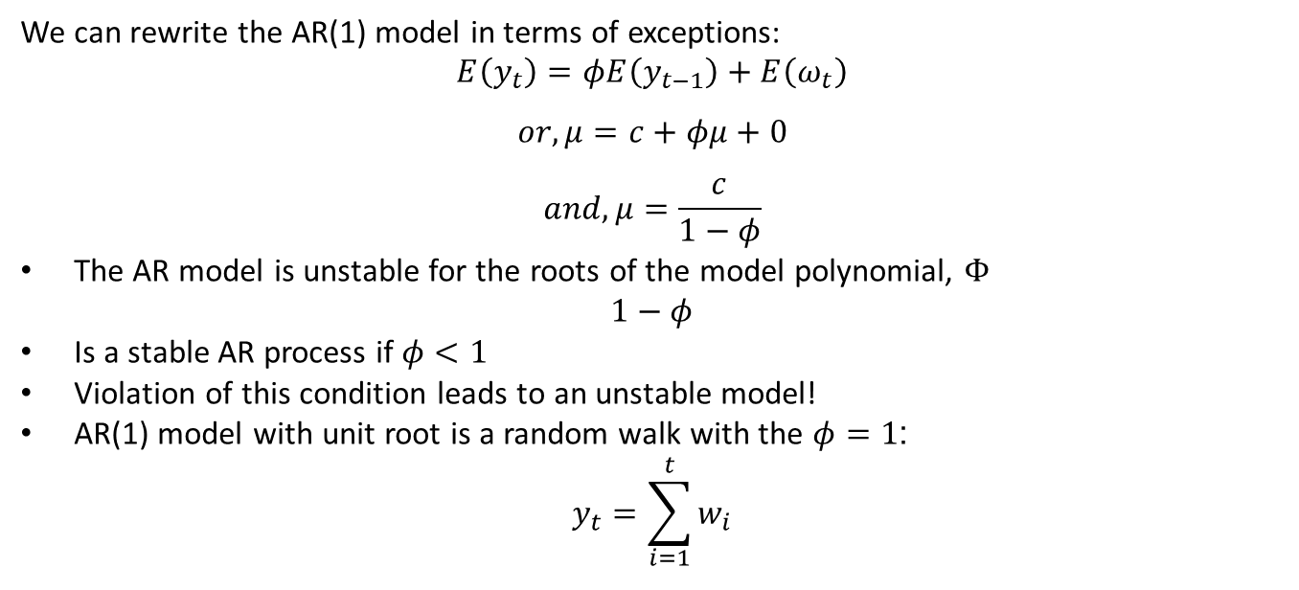
The Autoregressive Model
We can rewrite the AR(1) model in terms of exceptions:
$$E\left(y_{t}\right)=φE\left(y_{t−1}\right)+E\left(ω_{t}\right)$$
$$or, μ=c+φμ+0$$
$$and, μ=\frac{c}{1−φ}$$
The AR model is unstable for the roots of the model polynomial, $Φ$
$$1−φ$$
Is a stable AR process if $φ<1$
Violation of this condition leads to an unstable model!
AR(1) model with unit root is a random walk with the $φ=1$:
$$y_{t}=\sum_{i=1}^{t}{w_{i}}$$

Slide 13
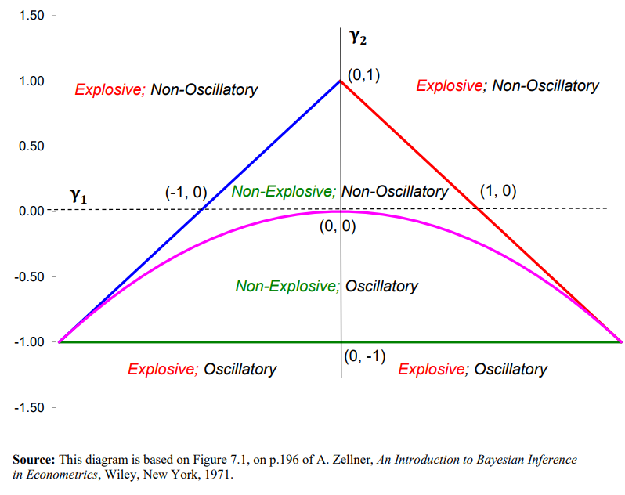
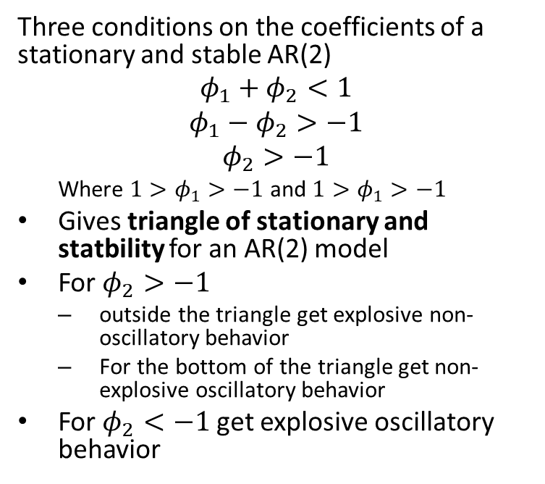
The Autoregressive Model
Three conditions on the coefficients of a stationary and stable AR(2)
$$φ_{1}+φ_{2}<1$$
$$φ_{1}−φ_{2}>−1$$
$$φ_{2}>−1$$
Where $1>φ_{1}>−1$ and $1>φ_{1}>−1$
Gives triangle of stationary and statbility for an AR(2) model
For $φ_{2}>−1$
outside the triangle get explosive non-oscillatory behavior
For the bottom of the triangle get non-explosive oscillatory behavior
For $φ_{2}<−1$ get explosive oscillatory behavior
Stationarity of AR(2) model
From lecture notes by David E. Giles, Simon Fraser University

Slide 14
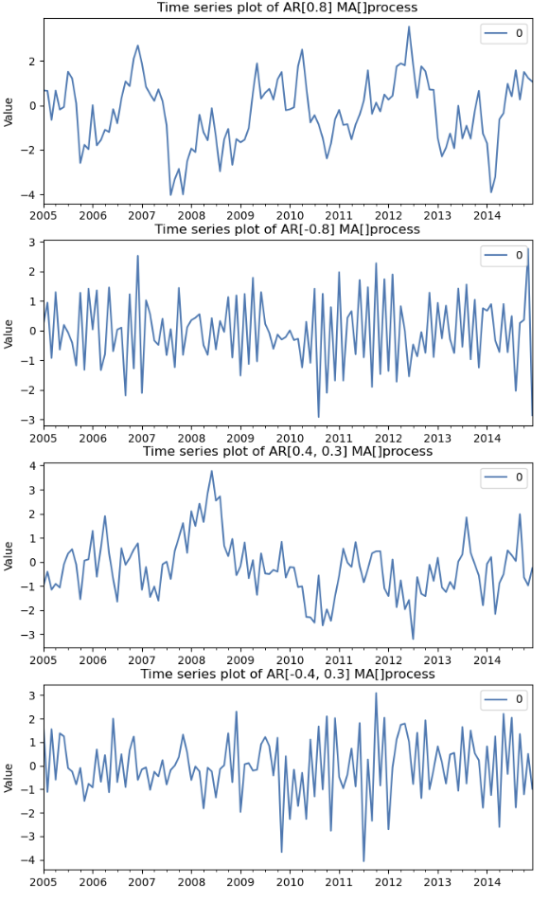
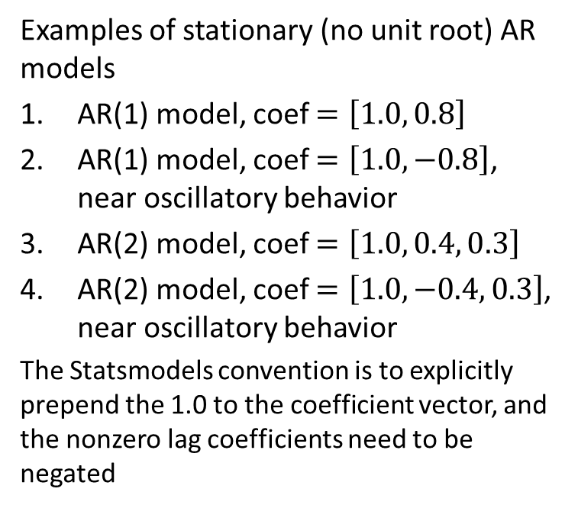
Example: Autoregressive Model
Examples of stationary (no unit root) AR models
AR(1) model, coef $=\left[1.0, 0.8\right]$
AR(1) model, coef $=\left[1.0, −0.8\right]$, near oscillatory behavior
AR(2) model, coef $=\left[1.0, 0.4, 0.3\right]$
AR(2) model, coef $=\left[1.0, −0.4, 0.3\right]$, near oscillatory behavior
The Statsmodels convention is to explicitly prepend the 1.0 to the coefficient vector, and the nonzero lag coefficients need to be negated

Slide 15
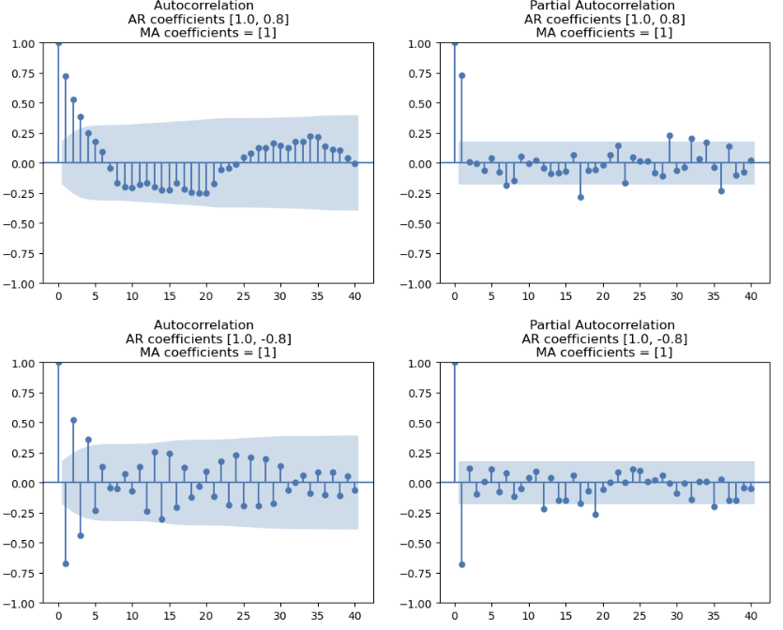
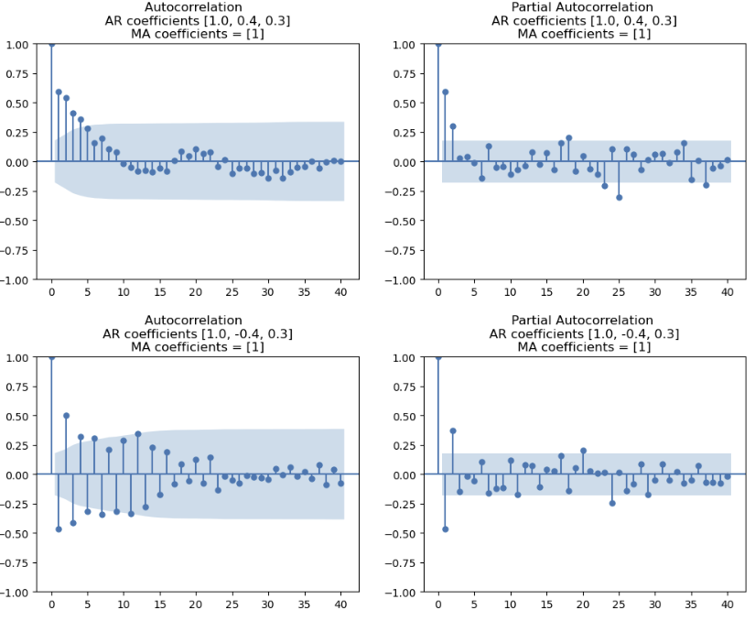
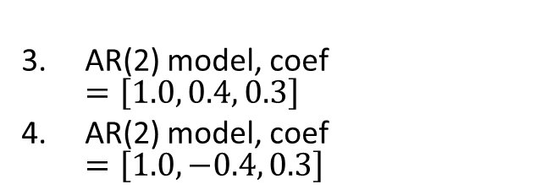
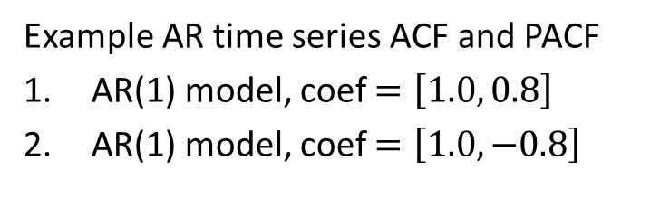
Example: Autoregressive Model
AR(2) model, coef $=\left[1.0, 0.4, 0.3\right]$
AR(2) model, coef $=\left[1.0, −0.4, 0.3\right]$
Example AR time series ACF and PACF
AR(1) model, coef $=\left[1.0, 0.8\right]$
AR(1) model, coef $=\left[1.0, −0.8\right]$

Slide 16
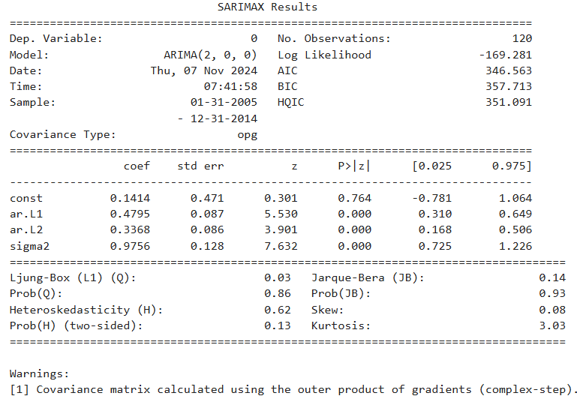
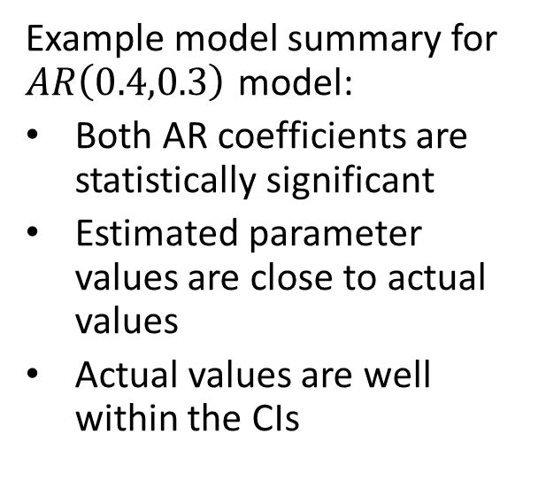
The Autoregressive Model
Example model summary for $AR\left(0.4,0.3\right)$ model:
Both AR coefficients are statistically significant
Estimated parameter values are close to actual values
Actual values are well within the CIs

Slide 17
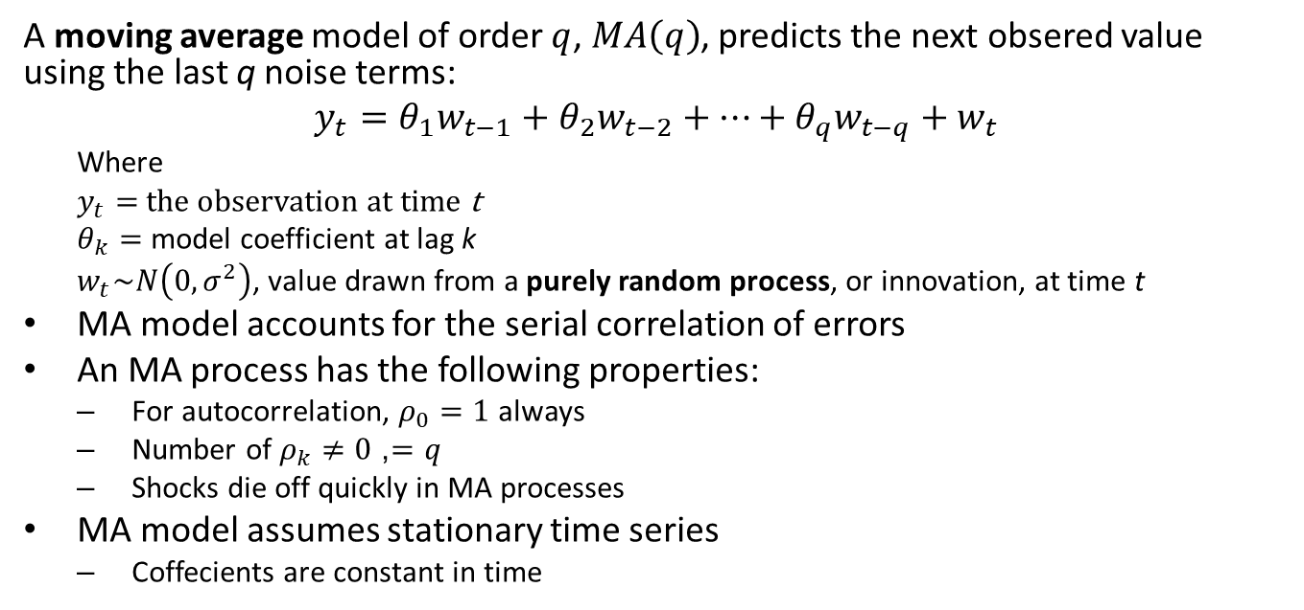
The Moving Average Model
A moving average model of order $q$, $MA\left(q\right)$, predicts the next obsered value using the last q noise terms:
$$y_{t}=θ_{1}w_{t−1}+θ_{2}w_{t−2}+…+θ_{q}w_{t−q}+w_{t}$$
Where
$y_{t}=$ the observation at time t
$θ_{k}=$ model coefficient at lag k
$w_{t}\sim N\left(0,σ^{2}\right)$, value drawn from a purely random process, or innovation, at time t
MA model accounts for the serial correlation of errors
An MA process has the following properties:
For autocorrelation, $ρ_{0}=1$ always
Number of $ρ_{k}≠0$, $=q$
Shocks die off quickly in MA processes
MA model assumes stationary time series
Coffecients are constant in time

Slide 18
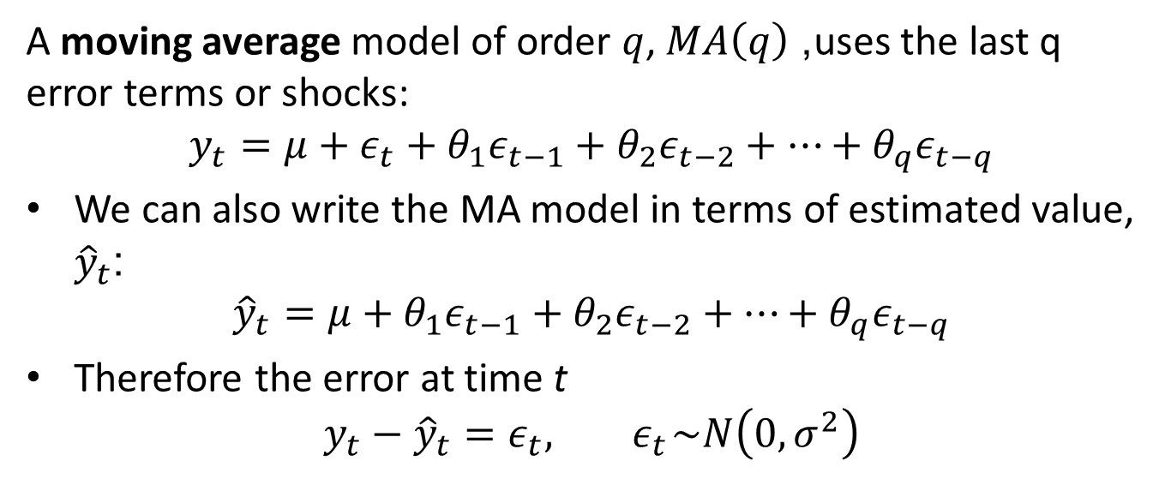
The Moving Average Model
A moving average model of order $q$, $MA\left(q\right)$, uses the last q error terms or shocks:
$$y_{t}=μ+ε_{t}+θ_{1}ε_{t−1}+θ_{2}ε_{t−2}+⋯+θ_{q}ε_{t−q}$$
We can also write the MA model in terms of estimated value, ${\hat{y}}_{t}$:
$${\hat{y}}_{t}=μ+θ_{1}ε_{t−1}+θ_{2}ε_{t−2}+⋯+θ_{q}ε_{t−q}$$
Therefore the error at time t
$$y_{t}−{\hat{y}}_{t}=ε_{t},{ ε}_{t}\sim N\left(0,σ^{2}\right)$$

Slide 19
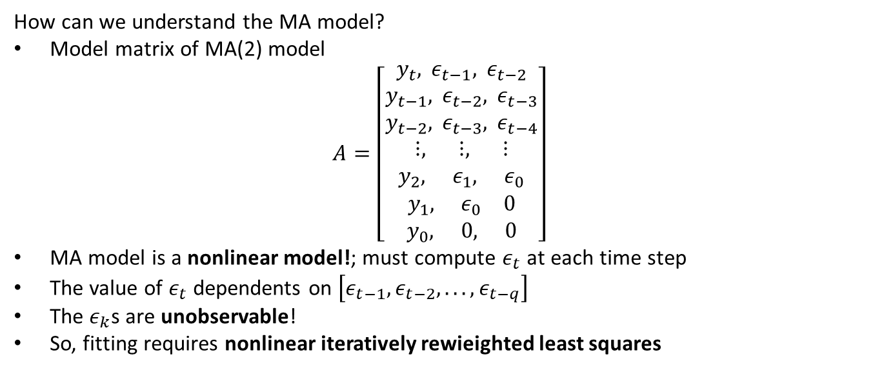
The Moving Average Model
How can we understand the MA model?
Model matrix of MA(2) model
$$A=\left[\begin{matrix}y_{t}, ε_{t−1}, ε_{t−2} \\ y_{t−1}, ε_{t−2}, ε_{t−3} \\ y_{t−2}, ε_{t−3}, ε_{t−4} \\ ⋮, ⋮, ⋮ \\ y_{2}, ε_{1}, ε_{0} \\ y_{1}, ε_{0} 0 \\ y_{0}, 0, 0\end{matrix}\right]$$
MA model is a nonlinear model!; must compute $ε_{t}$ at each time step
The value of $ε_{t}$ dependents on $\left[ε_{t−1},ε_{t−2},...,ε_{t−q}\right]$
The $ε_{k}$s are unobservable!
So, fitting requires nonlinear iteratively rewieighted least squares

Slide 20
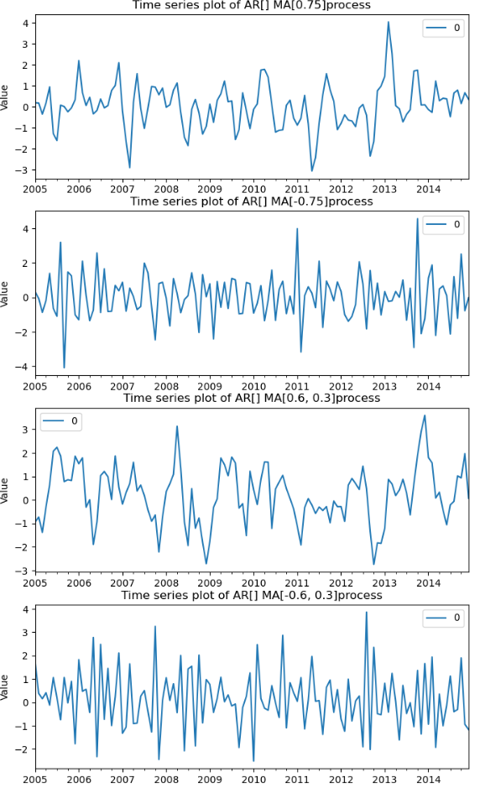
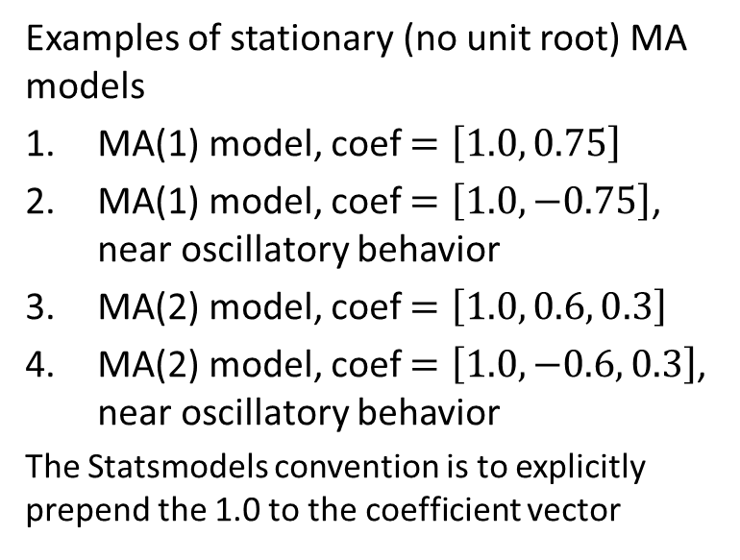
Example: Moving Average Model
Examples of stationary (no unit root) MA models
MA(1) model, coef $=\left[1.0, 0.75\right]$
MA(1) model, coef $=\left[1.0, −0.75\right]$, near oscillatory behavior
MA(2) model, coef $=\left[1.0, 0.6, 0.3\right]$
MA(2) model, coef $=\left[1.0, −0.6, 0.3\right]$, near oscillatory behavior
The Statsmodels convention is to explicitly prepend the 1.0 to the coefficient vector

Slide 21
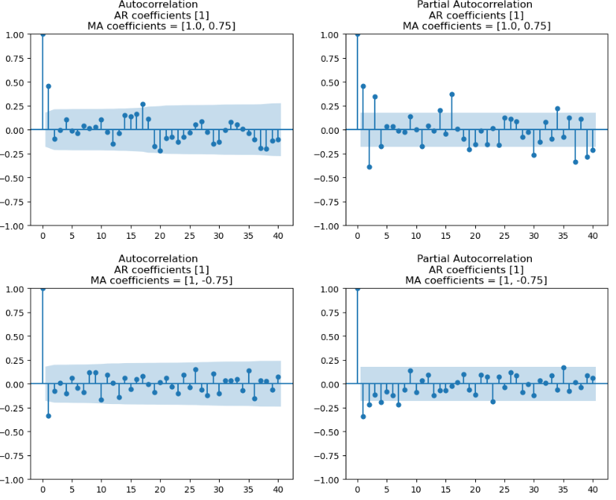
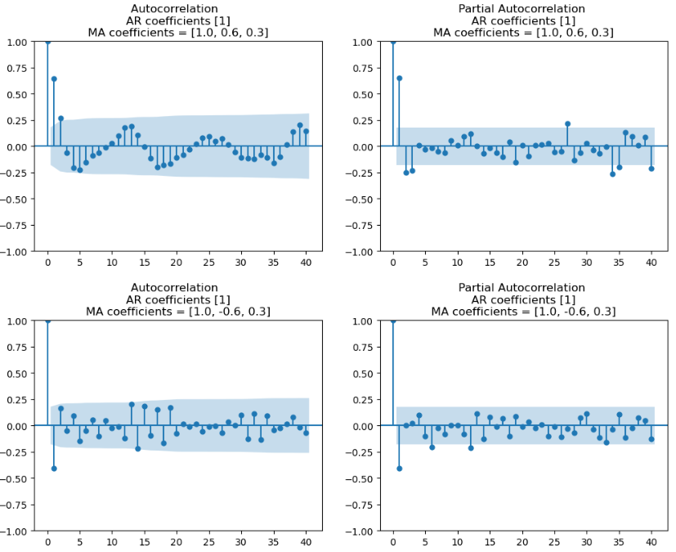
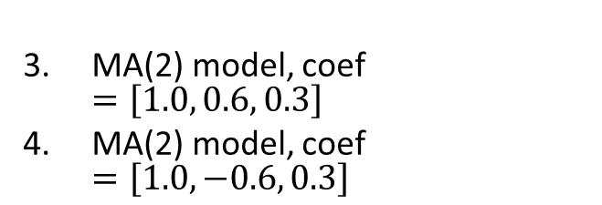
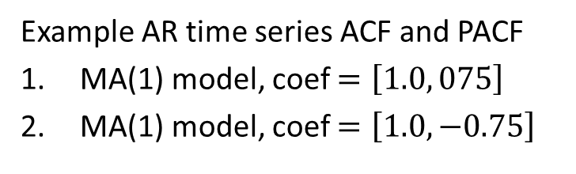
Example: Moving Average Model
MA(2) model, coef $=\left[1.0, 0.6, 0.3\right]$
MA(2) model, coef $=\left[1.0, −0.6, 0.3\right]$
Example AR time series ACF and PACF
MA(1) model, coef $=\left[1.0, 075\right]$
MA(1) model, coef $=\left[1.0, −0.75\right]$

Slide 22
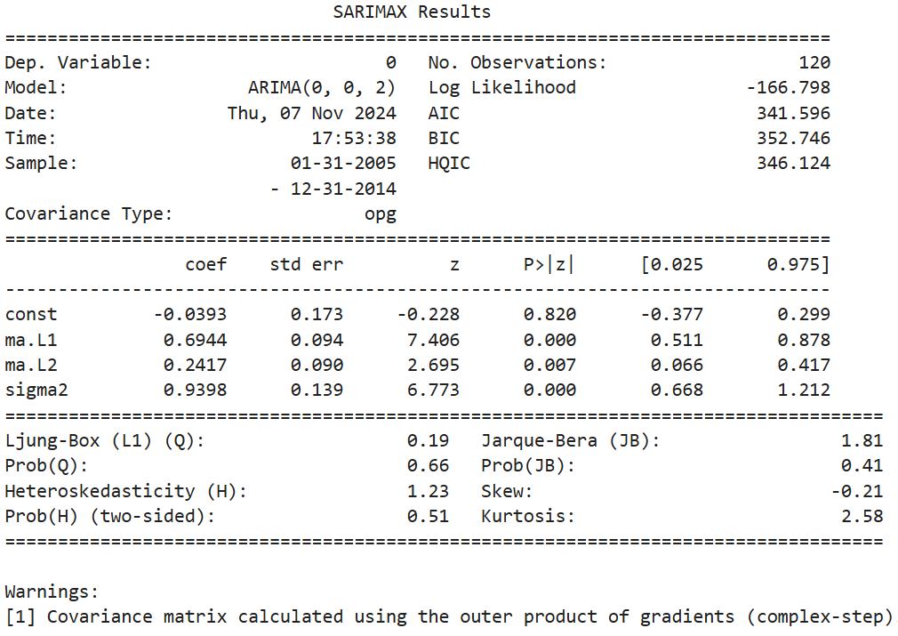
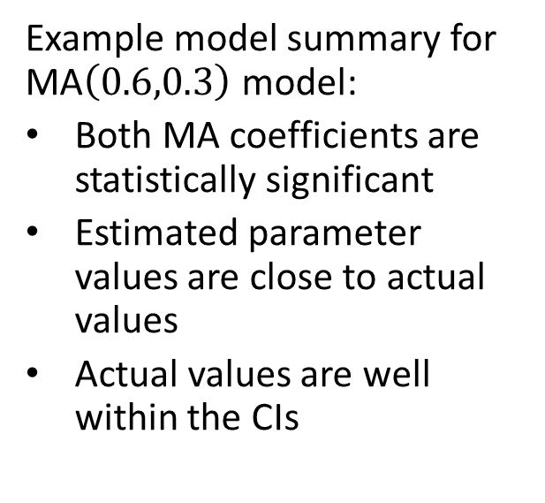
Example: Moving Average Model
Example model summary for MA$\left(0.6,0.3\right)$ model:
Both MA coefficients are statistically significant
Estimated parameter values are close to actual values
Actual values are well within the CIs

Slide 23
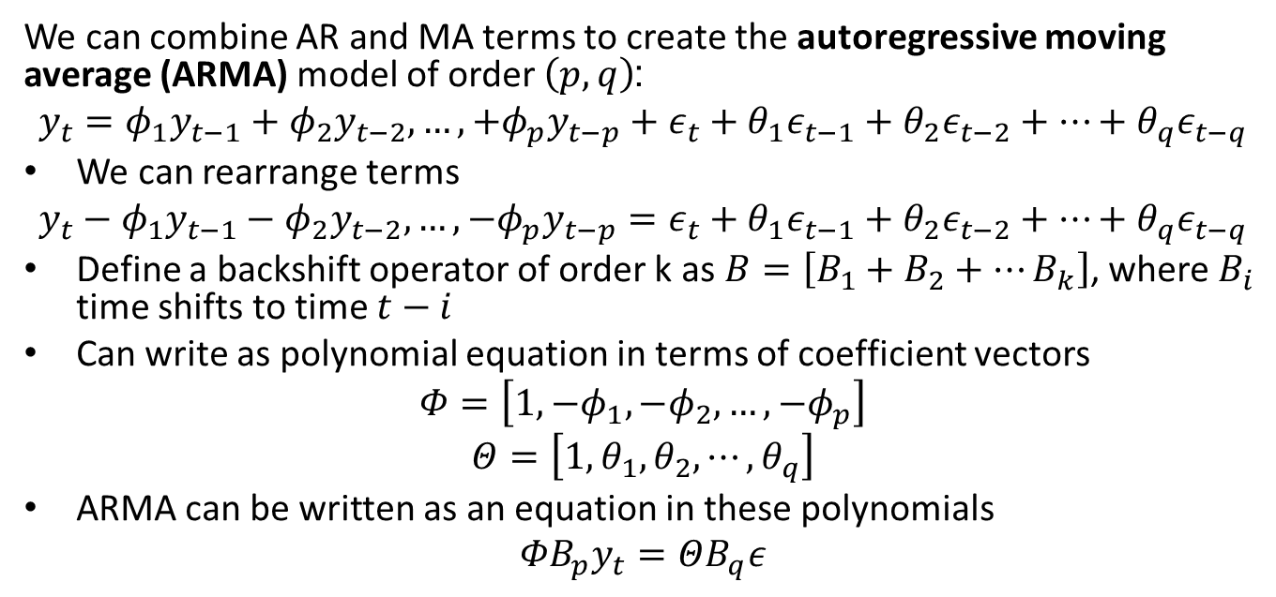
Autoregressive Moving Average Model
We can combine AR and MA terms to create the autoregressive moving average (ARMA) model of order $\left(p,q\right)$:
$$y_{t}=φ_{1}y_{t−1}+φ_{2}y_{t−2},…,+φ_{p}y_{t−p}+ε_{t}+θ_{1}ε_{t−1}+θ_{2}ε_{t−2}+⋯+θ_{q}ε_{t−q}$$
We can rearrange terms
$$y_{t}−φ_{1}y_{t−1}−φ_{2}y_{t−2},…,−φ_{p}y_{t−p}=ε_{t}+θ_{1}ε_{t−1}+θ_{2}ε_{t−2}+⋯+θ_{q}ε_{t−q}$$
Define a backshift operator of order k as $B=\left[B_{1}+B_{2}+…B_{k}\right]$, where $B_{i}$ time shifts to time $t−i$
Can write as polynomial equation in terms of coefficient vectors
$$Φ=\left[1,{−φ}_{1},−φ_{2},…,{−φ}_{p}\right]$$
$$Θ=\left[1,θ_{1},θ_{2},⋯,θ_{q}\right]$$
ARMA can be written as an equation in these polynomials
$${{ΦB}_{p}y}_{t}=ΘB_{q}ε$$

Slide 24
The ARIMA Model
An integrative term addresses some non-stationary components of a time series
Random walks
Trends
Based on difference operator
Typically first order seasonal and non-seasonal differences
Is deterministic, no model coefficient to estimate

Slide 25
The ARIMA Model
The autoregressive integrative moving average (ARIMA) model includes AR, integrative and MA terms
The order of an ARIMA is specified as (p,d,q)
p is the AR order
d is the order of differencing
q is the MA order
The integrative term transforms time series with trend and random walks to stationarity
First order differencing does not account for seasonal effect

Slide 26
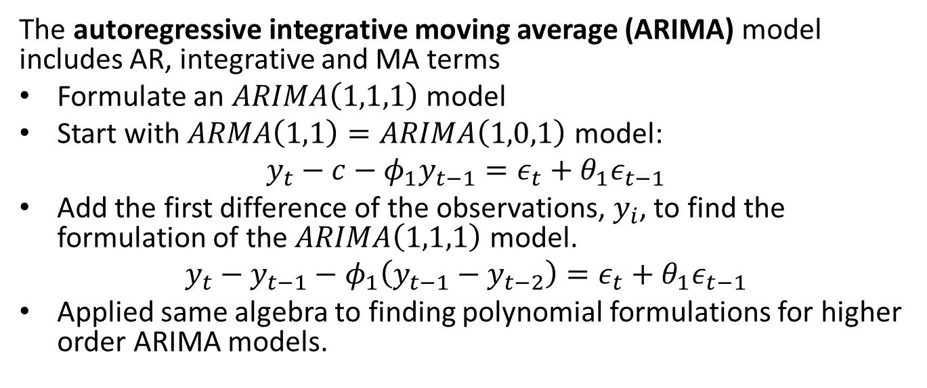
The ARIMA Model
The autoregressive integrative moving average (ARIMA) model includes AR, integrative and MA terms
Formulate an $ARIMA\left(1,1,1\right)$ model
Start with $ARMA\left(1,1\right)=ARIMA\left(1,0,1\right)$ model:
$$y_{t}−c−φ_{1}y_{t−1}=ε_{t}+θ_{1}ε_{t−1}$$
Add the first difference of the observations, $y_{i}$, to find the formulation of the $ARIMA\left(1,1,1\right)$ model.
$$y_{t}−y_{t−1}−φ_{1}\left(y_{t−1}−y_{t−2}\right)=ε_{t}+θ_{1}ε_{t−1}$$
Applied same algebra to finding polynomial formulations for higher order ARIMA models.

Slide 27
Seasonal Models
Several possible seasonal models
Seasonal effects can be periodic or single event (e.g. holiday, game day, etc.)
Linear regression model to find effect for each time step in period
STL decomposition
Fourier decomposition
Accommodates multiple periods of seasonality
Used by PROFIT model, Statsmodels and others
SARIMAX, the S term, requires:
Known period of the cycle or time of seasonal event
Additive or logarithmic transformation (multiplicative)

Slide 28
SARIMAX Model
The SARIMAX model adds seasonal and exogenous terms
Order of SARIMAX model is specified as (p,d,q)(P,D,Q,S)
ARIMA terms are same, (p,d,q)
Seasonal terms:
Seasonal ARIMA model, order (P,D,Q,S)
Must specify period, S, seasonal difference order, D
See Statsmodels State Space User Guide for more details and examples

Slide 29
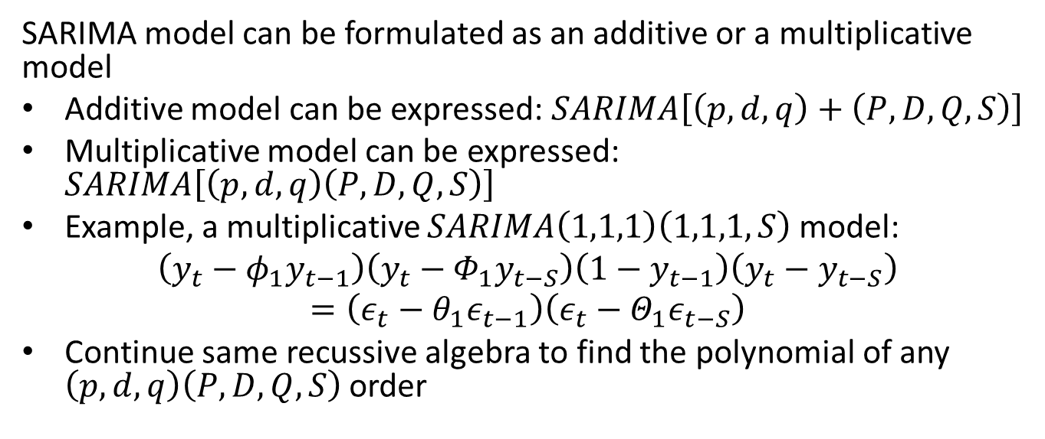
SARIMAX Model
SARIMA model can be formulated as an additive or a multiplicative model
Additive model can be expressed: $SARIMA\left[\left(p,d,q\right)+\left(P,D,Q,S\right)\right]$
Multiplicative model can be expressed: $SARIMA\left[\left(p,d,q\right)\left(P,D,Q,S\right)\right]$
Example, a multiplicative $SARIMA\left(1,1,1\right)\left(1,1,1,S\right)$ model:
$$\left(y_{t}−φ_{1}y_{t−1}\right)\left(y_{t}−Φ_{1}y_{t−S}\right)\left(1−y_{t−1}\right)\left(y_{t}−y_{t−S}\right)=\left(ε_{t}−θ_{1}ε_{t−1}\right)\left(ε_{t}−Θ_{1}ε_{t−S}\right)$$
Continue same recussive algebra to find the polynomial of any $\left(p,d,q\right)\left(P,D,Q,S\right)$ order

Slide 30
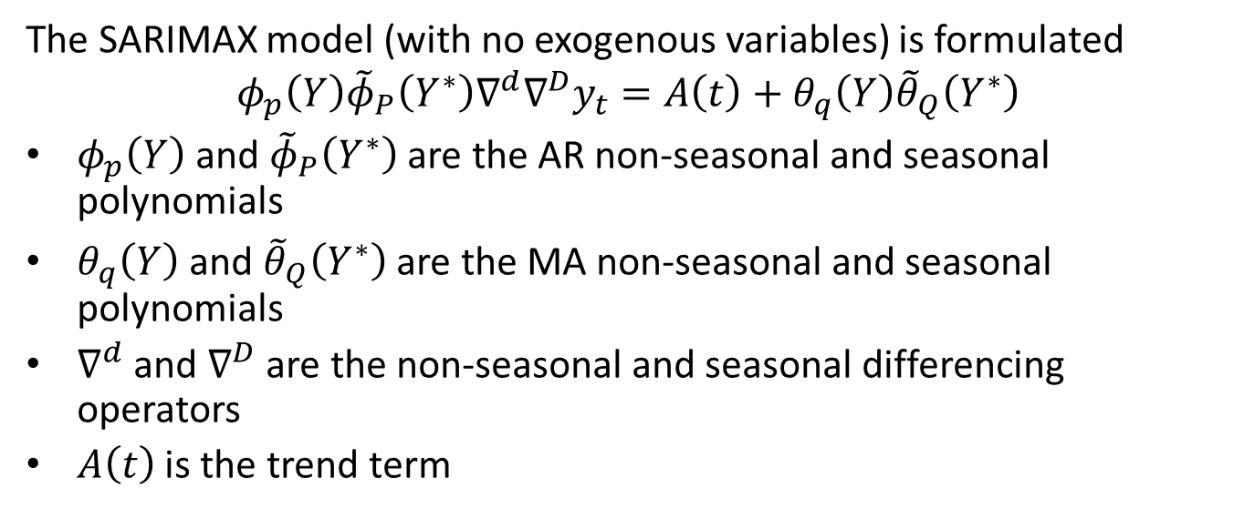
SARIMAX Model
The SARIMAX model (with no exogenous variables) is formulated
$$φ_{p}\left(Y\right){\tilde{φ}}_{P}\left(Y^{∗}\right)∇^{d}∇^{D}y_{t}=A\left(t\right)+θ_{q}\left(Y\right){\tilde{θ}}_{Q}\left(Y^{∗}\right)$$
$φ_{p}\left(Y\right)$ and ${\tilde{φ}}_{P}\left(Y^{∗}\right)$ are the AR non-seasonal and seasonal polynomials
$θ_{q}\left(Y\right)$ and ${\tilde{θ}}_{Q}\left(Y^{∗}\right)$ are the MA non-seasonal and seasonal polynomials
$∇^{d}$ and $∇^{D}$ are the non-seasonal and seasonal differencing operators
$A\left(t\right)$ is the trend term

Slide 31
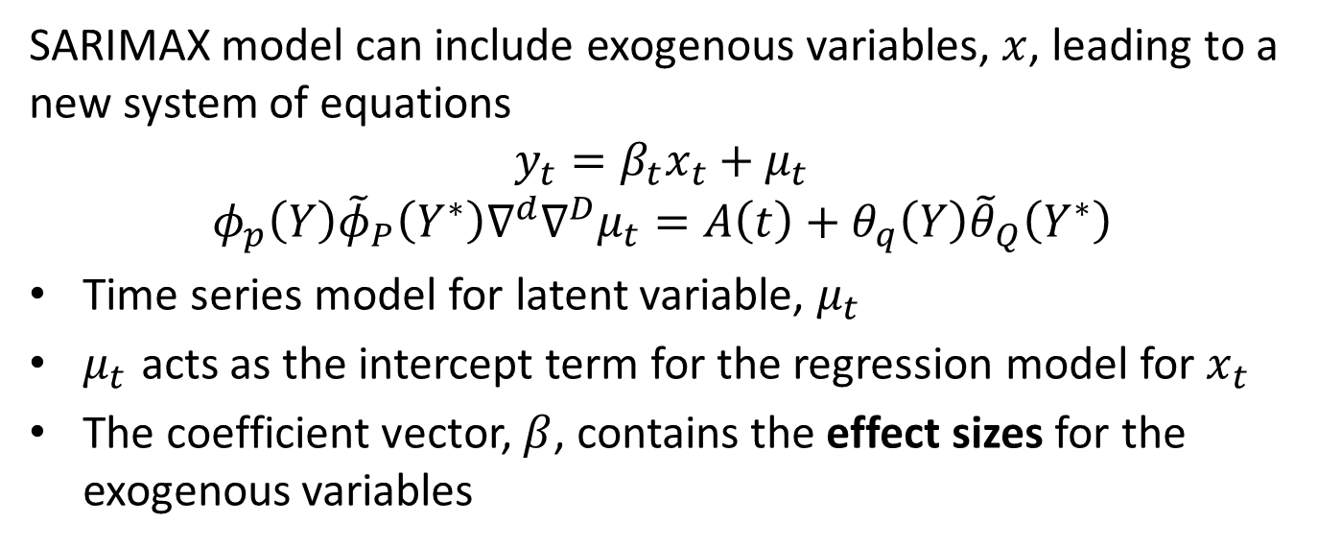
SARIMAX Model
SARIMAX model can include exogenous variables, $x$, leading to a new system of equations
$$y_{t}=β_{t}x_{t}+μ_{t}$$
$$φ_{p}\left(Y\right){\tilde{φ}}_{P}\left(Y^{∗}\right)∇^{d}∇^{D}μ_{t}=A\left(t\right)+θ_{q}\left(Y\right){\tilde{θ}}_{Q}\left(Y^{∗}\right)$$
Time series model for latent variable, $μ_{t}$
$μ_{t}$ acts as the intercept term for the regression model for $x_{t}$
The coefficient vector, $β$, contains the effect sizes for the exogenous variables

Slide 32
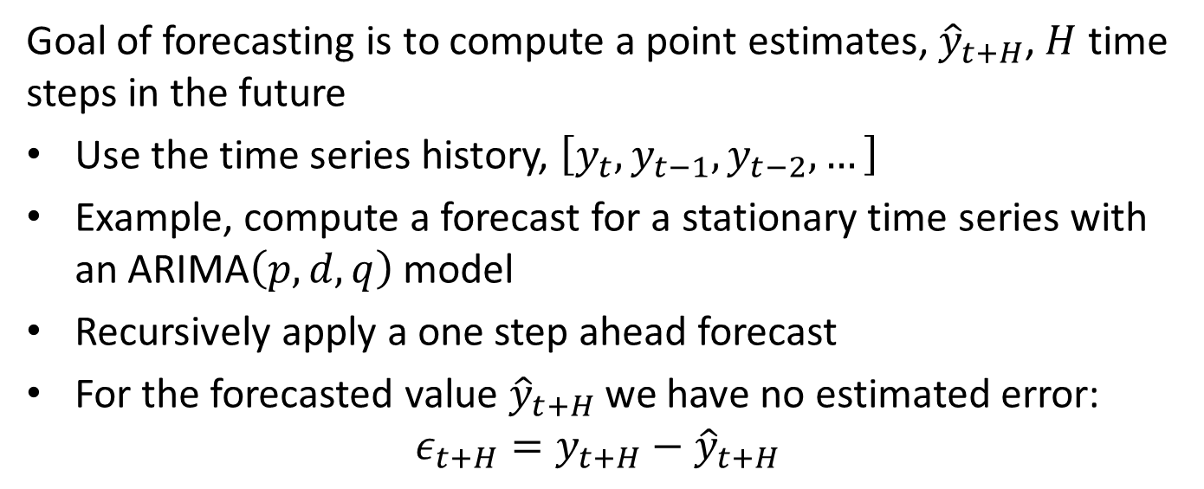
Forecasting with the ARIMA model
Goal of forecasting is to compute a point estimates, ${\hat{y}}_{t+H}$, $H$ time steps in the future
Use the time series history, $\left[y_{t},y_{t−1},y_{t−2},…\right]$
Example, compute a forecast for a stationary time series with an ARIMA$\left(p,d,q\right)$ model
Recursively apply a one step ahead forecast
For the forecasted value ${\hat{y}}_{t+H}$ we have no estimated error:
$$ε_{t+H}=y_{t+H}−{\hat{y}}_{t+H}$$

Slide 33
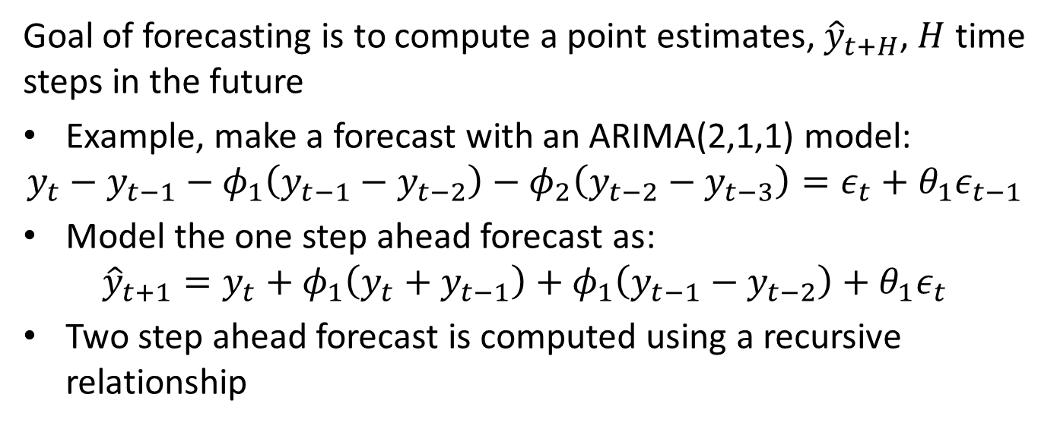
Forecasting with the ARIMA model
Goal of forecasting is to compute a point estimates, ${\hat{y}}_{t+H}$, $H$ time steps in the future
Example, make a forecast with an ARIMA(2,1,1) model:
$$y_{t}−y_{t−1}−φ_{1}\left(y_{t−1}−y_{t−2}\right)−φ_{2}\left(y_{t−2}−y_{t−3}\right)=ε_{t}+θ_{1}ε_{t−1}$$
Model the one step ahead forecast as:
$${\hat{y}}_{t+1}=y_{t}+φ_{1}\left(y_{t}+y_{t−1}\right)+φ_{1}\left(y_{t−1}−y_{t−2}\right)+θ_{1}ε_{t}$$
Two step ahead forecast is computed using a recursive relationship

Slide 34
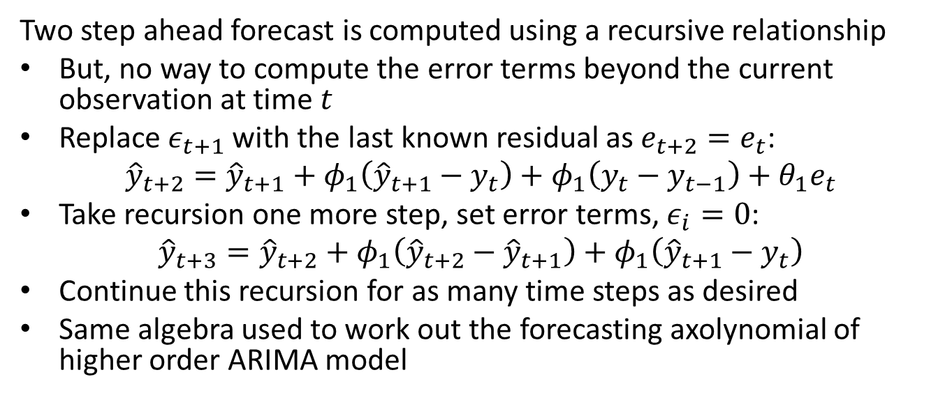
Forecasting with the ARIMA model
Two step ahead forecast is computed using a recursive relationship
But, no way to compute the error terms beyond the current observation at time $t$
Replace $ε_{t+1}$ with the last known residual as $e_{t+2}=e_{t}$:
$${\hat{y}}_{t+2}={\hat{y}}_{t+1}+φ_{1}\left({\hat{y}}_{t+1}−y_{t}\right)+φ_{1}\left(y_{t}−y_{t−1}\right)+θ_{1}e_{t}$$
Take recursion one more step, set error terms, $ε_{i}=0$:
$${\hat{y}}_{t+3}={\hat{y}}_{t+2}+φ_{1}\left({\hat{y}}_{t+2}−{\hat{y}}_{t+1}\right)+φ_{1}\left({\hat{y}}_{t+1}−y_{t}\right)$$
Continue this recursion for as many time steps as desired
Same algebra used to work out the forecasting axolynomial of higher order ARIMA model

Slide 35

Evaluating and Comparing Time Series Models
How can we evaluate time series models?
Confidence intervals
Fit to observations
Forecasts
RMSE; compare forecast to actual values
Fit to observations
Forecasts
Could use log-likelihood; $log\left(p\left(X|θ\right)\right)$
$θ=model parameters$
Use score function $=−2 log\left(likelihood\right)=−2 log\left(p\left(X|θ\right)\right)$
But, score decreases with model complexity
Need to adjust for number of model parameters
We always prefer simpler models; fewer parameters to learn
Akaki Information Criteria (AIC)
Bayes Information Criteria (BIC)

Slide 36
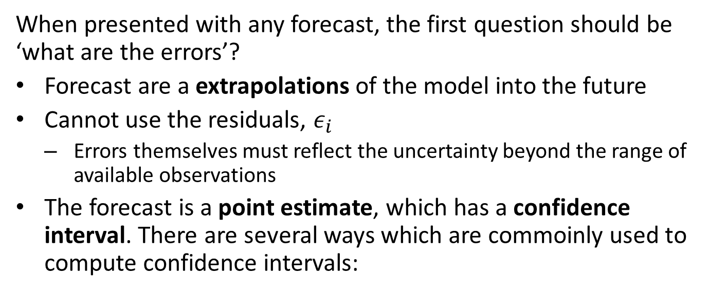
Forecast Confidence Intervals
When presented with any forecast, the first question should be ‘what are the errors’?
Forecast are a extrapolations of the model into the future
Cannot use the residuals, $ε_{i}$
Errors themselves must reflect the uncertainty beyond the range of available observations
The forecast is a point estimate, which has a confidence interval. There are several ways which are commoinly used to compute confidence intervals:

Slide 37
Forecast Confidence Intervals
Several ways which are commonly used to compute confidence intervals:
Theoretical sampling distribution:
Compute confidence intervals from a theoretical sampling distribution
Deriving a suitable distribution can be difficult
Actual sampling distribution is invariably different
Bootstrap resampling:
Use bootstrap resampling to compute a non-parametric sampling distribution
Bootstrap resampling of time series requires specific sampling methods
Confidence intervals are computed from emperical sampling distribution
Back-testing:
Time series model is trained on a training portion of the data
Forecasts are made some time steps ahead, and errors calculated
Move the training and forecast windows
Sampling distribution and the confidence intervals are computed
Compute RMSE, MAE, etc. from the back test

Slide 38
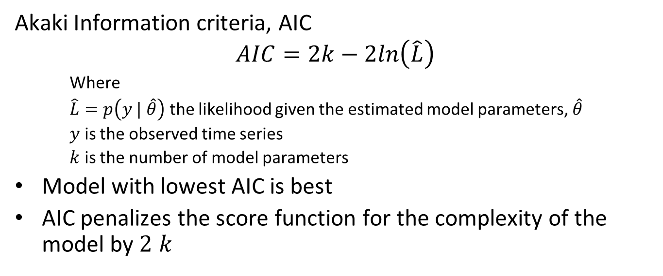
Evaluating and Comparing Time Series Models
Akaki Information criteria, AIC
$$AIC=2k−2ln\left(\hat{L}\right)$$
Where
$\hat{L}=p\left(y | \hat{θ}\right)$ the likelihood given the estimated model parameters, $\hat{θ}$
$y$ is the observed time series
$k$ is the number of model parameters
Model with lowest AIC is best
AIC penalizes the score function for the complexity of the model by $2 k$

Slide 39
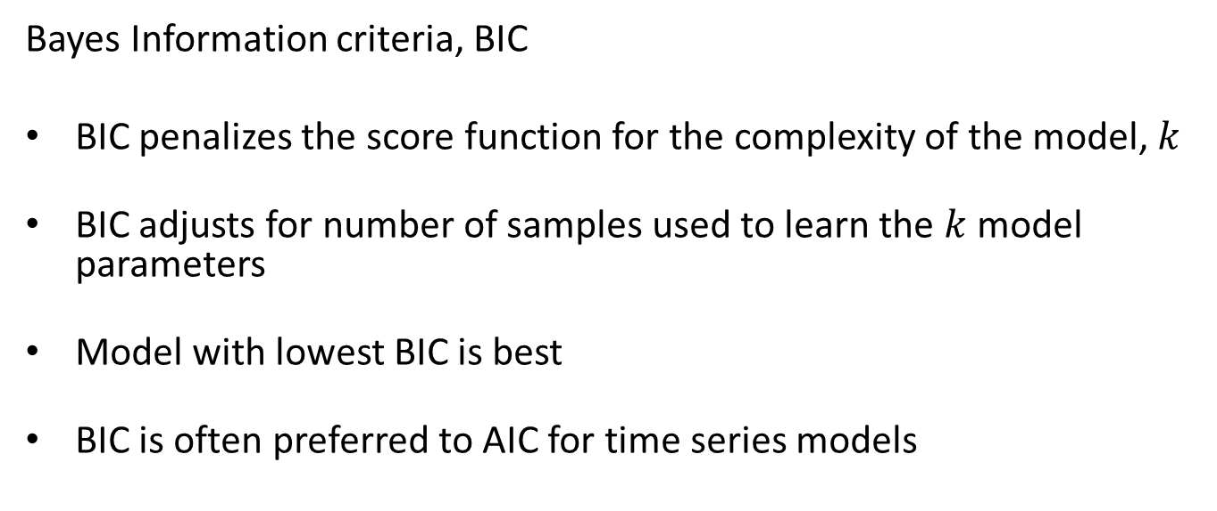
Evaluating and Comparing Time Series Models
Bayes Information criteria, BIC
BIC penalizes the score function for the complexity of the model, $k$
BIC adjusts for number of samples used to learn the $k$ model parameters
Model with lowest BIC is best
BIC is often preferred to AIC for time series models

Slide 40
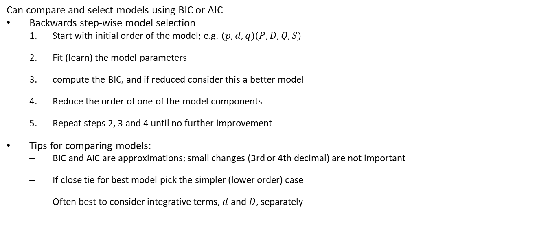
Evaluating and Comparing Time Series Models
Can compare and select models using BIC or AIC
Backwards step-wise model selection
Start with initial order of the model; e.g. $\left(p,d,q\right)\left(P,D,Q,S\right)$
Fit (learn) the model parameters
compute the BIC, and if reduced consider this a better model
Reduce the order of one of the model components
Repeat steps 2, 3 and 4 until no further improvement
Tips for comparing models:
BIC and AIC are approximations; small changes (3rd or 4th decimal) are not important
If close tie for best model pick the simpler (lower order) case
Often best to consider integrative terms, $d$ and $D$, separately

Slide 41
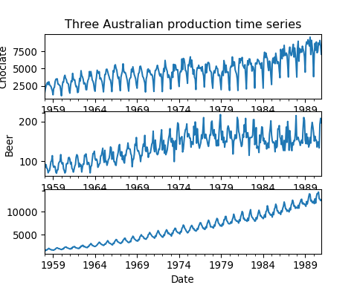
SARIMAX Example
Example: 3 time series of Australian production

Slide 42
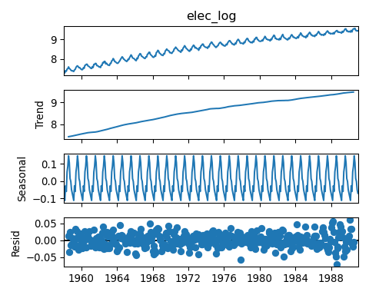

Slide 43
SARIMAX Example
Use the SARIMAX model to find the best ARIMA fit of log(electric production)
Log_electric = CBE.elec_log[:'1989-12-31'] best_model = pm.auto_arima(Log_electric, start_p=1, start_q=1, max_p=3, max_q=3, m=12, start_P=0, seasonal=True, d=1, D=1, trace=True, information_criterion = 'bic', error_action='ignore', # don't want to know if an order does not work suppress_warnings=True, # don't want convergence warnings stepwise=True) # set to stepwise
## Performing stepwise search to minimize bic ## ARIMA(1,1,1)(0,1,1)[12] : BIC=-1794.344, Time=0.78 sec ## ARIMA(0,1,0)(0,1,0)[12] : BIC=-1572.064, Time=0.05 sec ## ARIMA(1,1,0)(1,1,0)[12] : BIC=-1696.320, Time=0.37 sec ## ARIMA(0,1,1)(0,1,1)[12] : BIC=-1800.249, Time=0.88 sec ## ARIMA(0,1,1)(0,1,0)[12] : BIC=-1699.081, Time=0.07 sec ## ARIMA(0,1,1)(1,1,1)[12] : BIC=-1800.515, Time=0.96 sec ## ARIMA(0,1,1)(1,1,0)[12] : BIC=-1742.451, Time=0.22 sec ## ARIMA(0,1,1)(2,1,1)[12] : BIC=-1797.601, Time=2.93 sec ## ARIMA(0,1,1)(1,1,2)[12] : BIC=-1797.846, Time=3.50 sec ## ARIMA(0,1,1)(0,1,2)[12] : BIC=inf, Time=2.00 sec ## ARIMA(0,1,1)(2,1,0)[12] : BIC=-1770.861, Time=0.67 sec ## ARIMA(0,1,1)(2,1,2)[12] : BIC=-1791.556, Time=3.21 sec ## ARIMA(0,1,0)(1,1,1)[12] : BIC=inf, Time=0.53 sec ## ARIMA(1,1,1)(1,1,1)[12] : BIC=-1794.616, Time=1.26 sec ## ARIMA(0,1,2)(1,1,1)[12] : BIC=-1794.617, Time=0.87 sec ## ARIMA(1,1,0)(1,1,1)[12] : BIC=-1767.828, Time=0.91 sec ## ARIMA(1,1,2)(1,1,1)[12] : BIC=-1788.695, Time=1.34 sec ## ARIMA(0,1,1)(1,1,1)[12] intercept : BIC=-1792.517, Time=1.26 sec ## ## Best model: ARIMA(0,1,1)(1,1,1)[12] ## Total fit time: 21.816 seconds

Slide 44
SARIMAX Example
Example of SARIMAX model of order (0.1.1)(0,1,2,12) for monthly electric production series
Model selected by backwards step-wise method
First order model integrative term and MA(1)
First order model integrative term and MA(1) for period 12 seasonality
## <class 'statsmodels.iolib.summary.Summary'> ## """ ## SARIMAX Results ## ========================================================================================== ## Dep. Variable: y No. Observations: 384 ## Model: SARIMAX(0, 1, 1)x(1, 1, 1, 12) Log Likelihood 912.090 ## Date: Sat, 17 Aug 2024 AIC -1816.180 ## Time: 07:38:38 BIC -1800.515 ## Sample: 01-31-1958 HQIC -1809.958 ## - 12-31-1989 ## Covariance Type: opg ## ============================================================================== ## coef std err z P>|z| [0.025 0.975] ## ------------------------------------------------------------------------------ ## ma.L1 -0.6389 0.039 -16.433 0.000 -0.715 -0.563 ## ar.S.L12 0.1787 0.087 2.051 0.040 0.008 0.350 ## ma.S.L12 -0.7912 0.061 -13.075 0.000 -0.910 -0.673 ## sigma2 0.0004 2.66e-05 15.729 0.000 0.000 0.000 ## =================================================================================== ## Ljung-Box (L1) (Q): 0.00 Jarque-Bera (JB): 9.96 ## Prob(Q): 0.97 Prob(JB): 0.01 ## Heteroskedasticity (H): 1.01 Skew: -0.22 ## Prob(H) (two-sided): 0.95 Kurtosis: 3.67 ## =================================================================================== ## ## Warnings: ## [1] Covariance matrix calculated using the outer product of gradients (complex-step). ## """

Slide 45
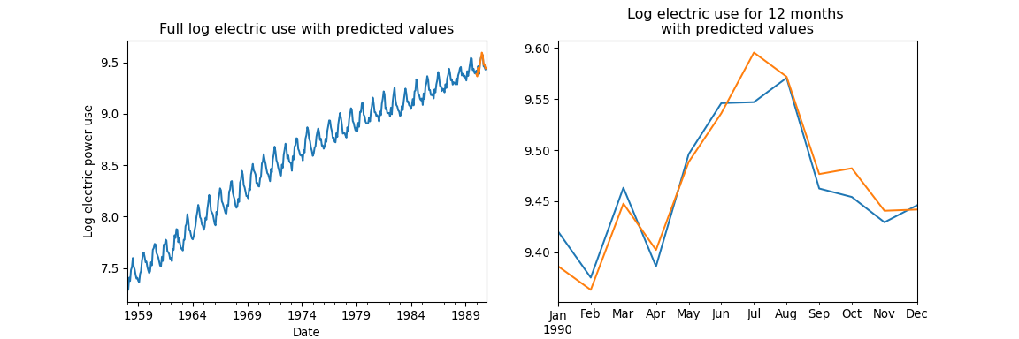
SARIMAX Example
Predictions for the last 12 months of the time series
prediction = pd.Series(best_model.predict(n_periods=12), index = pd.date_range(start = '1990-01-31', end = '1990-12-31', freq = 'M'))

Slide 46
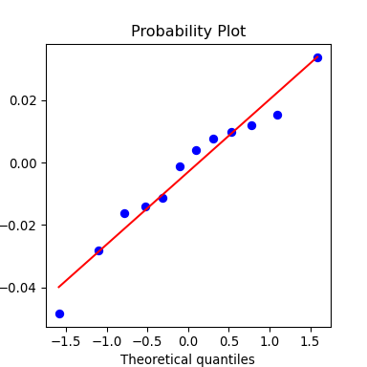
SARIMAX Example
Residuals of the predictions
residuals = CBE.elec_log['1990-01-31':] - prediction fig, ax = plt.subplots(nrows=1, ncols=1, figsize=(4, 4)) _=ss.probplot(residuals, plot = ax); plt.show()

Slide 47
PROFIT Model
The PROFIT model from Meta Research is a deterministic model well suited for some business forecasting
Uses a sophisticated piece-wise linear trend model
Trend computed between breakpoints
Breakpoints found with Bayesian model
Complex trend model confounded by random walks
Multi-seasonal component modeled modeled by Fourier decomposition
Multiple harmonics per seasonal period
Flexible modeling of complex seasonal patterns
Supports exogenous variables
PROFIT model assumes residual is non-informative

Slide 48
PROFIT Model
The PROFIT model from Meta Research is a deterministic model well suited for some business forecasting
PROFIT model assumes residual is non-informative
ACF and PACF must have no significant nonzero lags
If significant ACF and PACF use SARIMAX
Uses information in stationary residual
Gives superior results for time series with stochastic components

Slide 49
Summary
Time series models must account for serial correlation
e.g. ARIMA and SARIMAX
AR components for serial correlation of values
MA components for serial correlation of errors
Integrative components for random walk and trend, I
Seasonal, (P,D,Q,S)
Exogenous variables, X

Slide 50
Summary
Evaluation and model comparison
RMSE
AIC and BIC, penalize score function for model complexity
Use BIC (or AIC) to perform backwards step-wise model selection

Slide 51
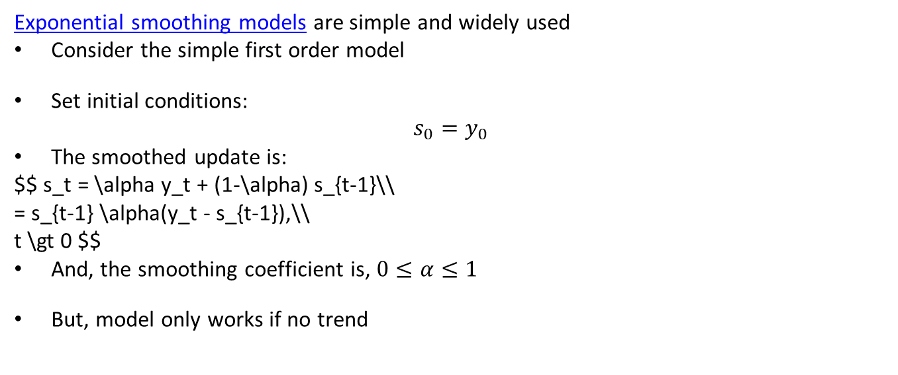
Exponential Smoothing Models
Exponential smoothing models are simple and widely used
Consider the simple first order model
Set initial conditions:
$$s_{0}=y_{0}$$
The smoothed update is:
$$ s_t = \alpha y_t + (1-\alpha) s_{t-1}\\ = s_{t-1} \alpha(y_t - s_{t-1}),\\ t \gt 0 $$
And, the smoothing coefficient is, $0≤α≤1$
But, model only works if no trend

Slide 52
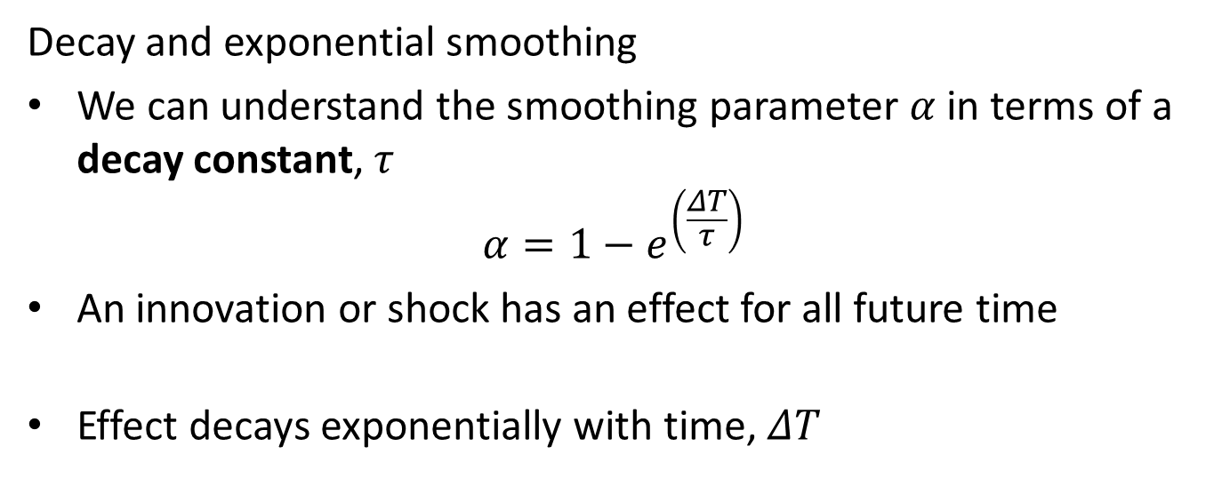
Exponential Smoothing Models
Decay and exponential smoothing
We can understand the smoothing parameter $α$ in terms of a decay constant, $τ$
$$α=1−e^{\left(\frac{ΔT}{τ}\right)}$$
An innovation or shock has an effect for all future time
Effect decays exponentially with time, $ΔT$

Slide 53
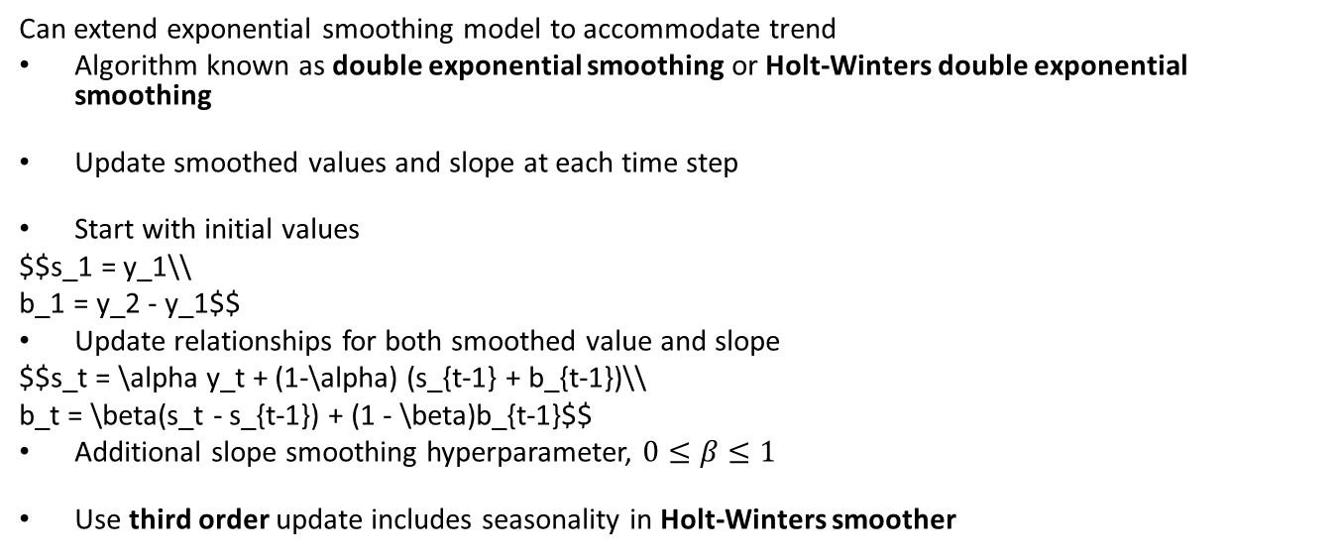
Exponential Smoothing Models
Can extend exponential smoothing model to accommodate trend
Algorithm known as double exponential smoothing or Holt-Winters double exponential smoothing
Update smoothed values and slope at each time step
Start with initial values
$$s_1 = y_1\\ b_1 = y_2 - y_1$$
Update relationships for both smoothed value and slope
$$s_t = \alpha y_t + (1-\alpha) (s_{t-1} + b_{t-1})\\ b_t = \beta(s_t - s_{t-1}) + (1 - \beta)b_{t-1}$$
Additional slope smoothing hyperparameter, $0≤β≤1$
Use third order update includes seasonality in Holt-Winters smoother

Slide 54
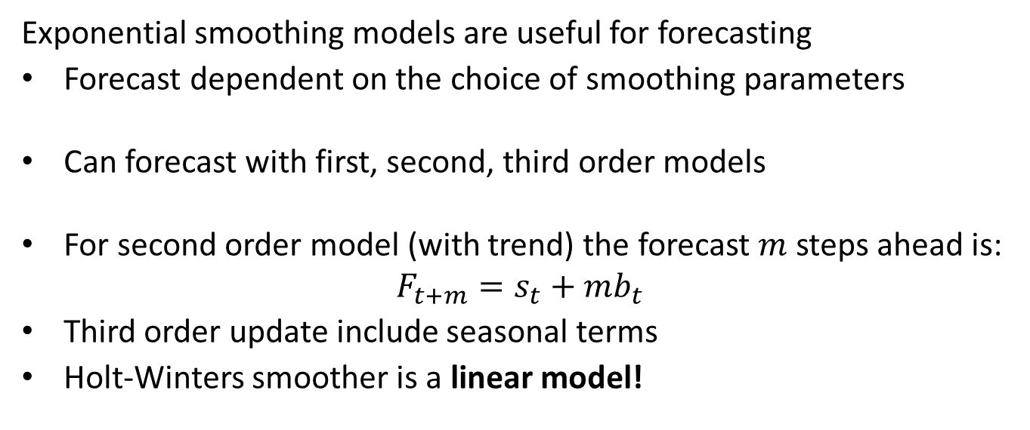
Exponential Smoothing Models
Exponential smoothing models are useful for forecasting
Forecast dependent on the choice of smoothing parameters
Can forecast with first, second, third order models
For second order model (with trend) the forecast $m$ steps ahead is:
$$F_{t+m}=s_{t}+mb_{t}$$
Third order update include seasonal terms
Holt-Winters smoother is a linear model!

Slide 55
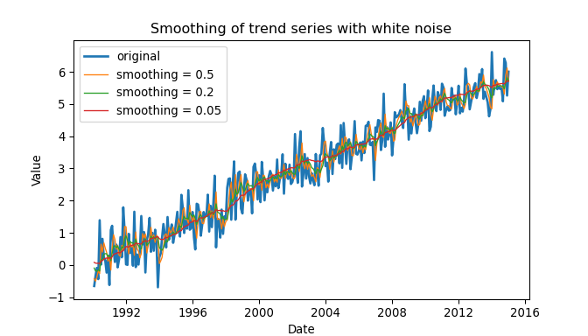

Exponential Smoothing Models
Example of smoothing trend plus white noise series
Decreasing the smoothing parameter, $α$, increases smoothing
Additionally, smooth trend
Additional examples in Statsmodels user documentation

