Slide 1
Review of Probability
Steve Elston

Slide 2
The Gamma and $χ^{2}$ distributions
Gamma family can be parameterized in several ways; we will use: - A shape parameter, $ν$, the degrees of freedom - A scale parameter, $σ$
$$ Gam(\nu,\sigma)=\frac{x^{\nu-1}\ e^{-x/\sigma}}{\sigma^\nu\ \Gamma(\nu)}\\ where\\ x \ge 0,\ \nu > 0,\ \sigma > 0\\ and\\ \Gamma(\nu) = Gamma\ function $$
Alternatively, use an inverse scale parameter, $β=1/σ$.

Slide 3
The Gamma and $χ^{2}$ distributions
Two useful special cases of the Gamma distribution are:
$Gam\left(1,1/λ\right)$ is the exponential distribution with decay constant $λ$, and PDF:
$$exp\left(λ\right)=λe^{−λx}$$
$Gam\left(ν/2,2\right)=χ_{ν}^{2}$ is the Chi-squared distribution with $ν$ degrees of freedom The $χ_{ν}^{2}$ distribution has many uses in statistics.
Used for estimates of the variance of the Normal distribution
PDF of the $χ_{ν}^{2}$ distribution:
$$\chi^2_\nu=\frac{x^{\nu/2-1}\ e^{-x}}{\sigma^{\nu/2}\ \Gamma(\nu/2)}\\ for\ \nu\ degrees\ of\ freedom$$

Slide 4
The $χ^{2}$ Distribution
The $χ^{2}$ distribution is used to construct parametric hypothesis tests of differences in counts between groups and also:
Constructing tests for the significance of fits of observed values to probability distributions.
The likelihood ratio test for the significance of differences between nested models.
Computing confidence intervals for empirical (as opposed to theoretical) variance estimates of observed values.

Slide 5
The $χ^{2}$ Distribution
The $χ^{2}$ distribution is a parametric distribution with a single parameter, the degrees of freedom, k = number of possible outcomes - 1.
For $n$ iid Normal random variables, $Z_{1},Z_{2},...,Z_{n}$, define a statistic, $Q$, as the sum of squares:
$$Q=\sum_{i=1}^{n}{Z_{i}^{2}}$$
$Q$ is said to be $χ_{k}^{2}$ distributed with $k=n−1$ degrees of freedom
$$Q=χ_{k}^{2}=χ^{2}\left(k\right)$$

Slide 6
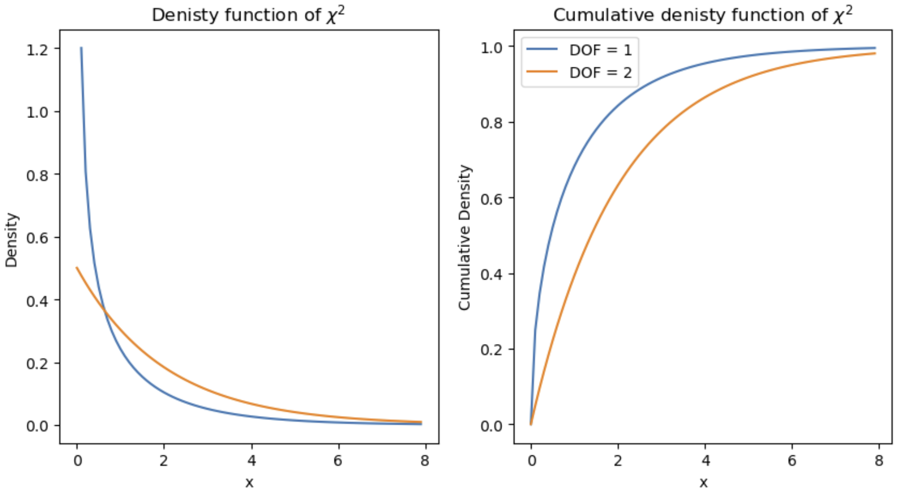
The $χ^{2}$ Distribution
The shape of the $χ^{2}$ distribution changes character with the DoF: For $k=1 or 2$ the $χ^{2}$ distribution has an exponential decay with the maximum value at $x=0$
Heat map of

Slide 7
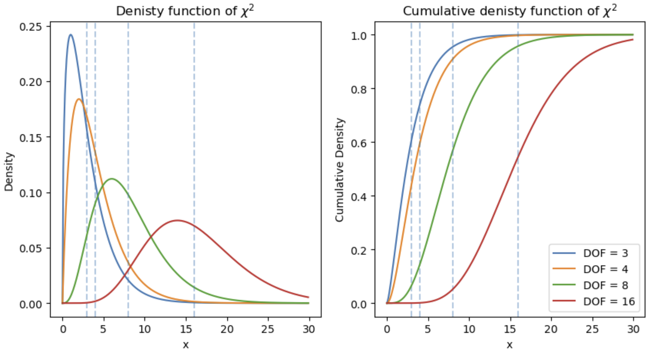
The $χ^{2}$ Distribution
The shape of the $χ^{2}$ distribution changes character with the DoF: For a middle range of DoF values the density starts at 0 and rises to a maximum or mode and then decay back toward 0
Heat map of

Slide 8
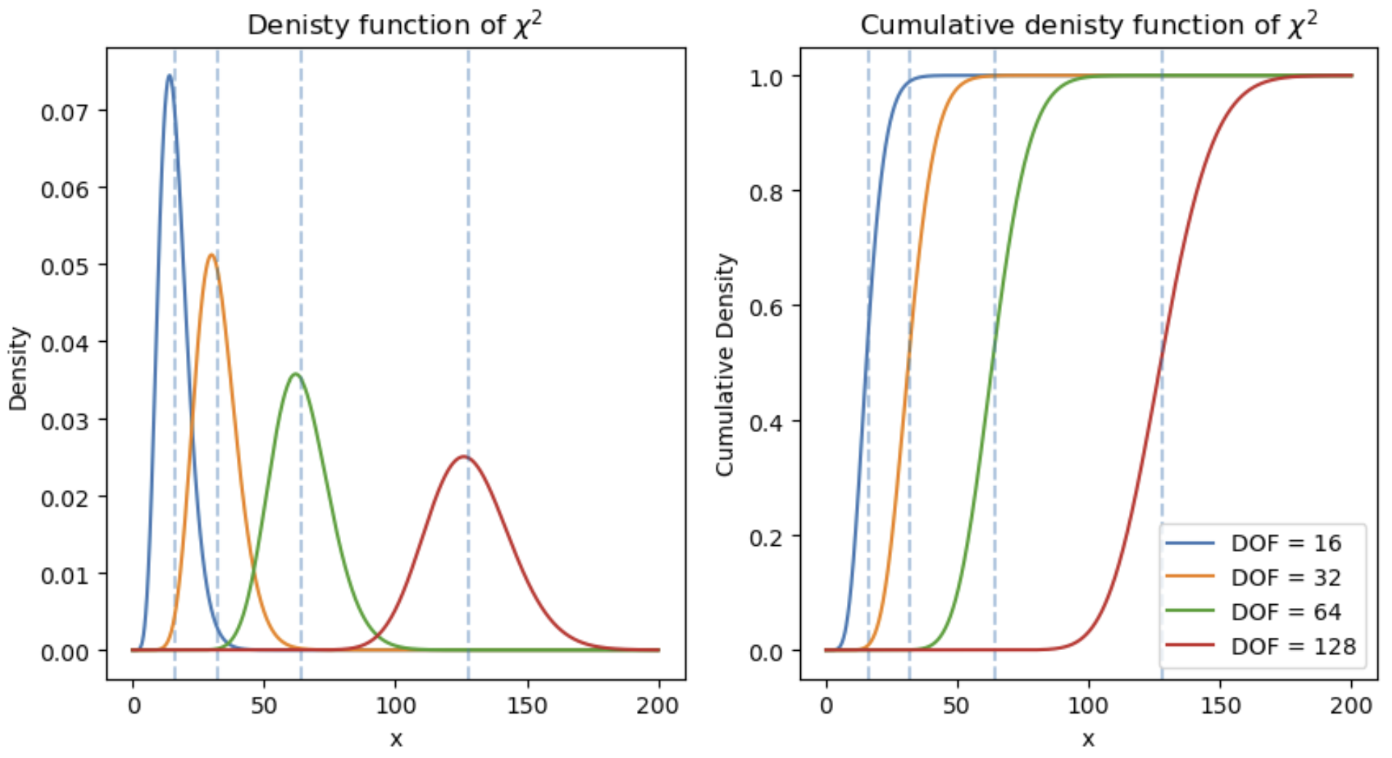
The $χ^{2}$ Distribution
The shape of the $χ^{2}$ distribution changes character with the DoF: For large values of DoF the $χ^{2}$ distribution converges toward a normal distribution with location parameter DoF
Heat map of

Slide 9
Odds
Odds are the ratio of the number of ways an event occurs to the number of ways it does not occur
Can say that odds are the count of events in favor of an event vs. the count against the event
Example: Flip a fair coin, odds of getting heads are $1:1$ (1 in 1)
Example: Roll a single fair die your odds of rolling a 6 are $1:5$ (1 in 5), or 0.2

Slide 10
Odds
What is the relationship between odds and probability of an event?
For some event with count $A$ in a set of all outcomes with count $S$, and count of negative outcomes $B=S−A$:
$$P(A) = \frac{A}{S} = \frac{A}{A + (S - A)} = \frac{A}{A + B} = \frac{count\ in\ favor}{count\ in\ favor\ + count\ not\ in\ favor}\ \\ which\ implies\\ odds = A:(S-A)$$
Example: For the fair coin flip, the odds are $1:1$. So we can compute the probability of heads as:
$$P\left(H\right)=\frac{1}{1+1}=\frac{1}{2}$$
Example In statistics the odds ratio, $\frac{p}{1−p}$, used to predict the response variable in logistic regression

Slide 11
Summary
Axioms of probability; for discrete distribution
$$0<P\left(A\right)≤1$$
PS=ai∈A​Pai=1
$$P(A\ \cup B) = P(A) + P(B)\\ if\ A \perp B$$
Expectation
$$E\left[X\right]=\sum_{i=1}^{n}{x_{i}} p\left(x_{i}\right)$$

Slide 12
Summary
The Categorical distribution
For outcome $i$ we one hot encode the results as:
$$e_{i}=\left(0,0,…,1,…,0\right)$$
For a single trial the probabilities of the $k$ possible outcomes are expressed:
$$Π=\left(π_{1},π_{2},…,π_{k}\right)$$
probability mass function as:
$$f\left(x_{i}|Π\right)=π_{i}$$
Multivariate Normal distribution, parameterized by n-dimensional vector of locations, $\vec{μ}$ and $n$ x $n$ dimensional covariance matrix
$$f\left(\vec{x}\right)=\frac{1}{\sqrt{{\left(2π\right)}^{k}\left|Σ\right|}}exp\left(\frac{1}{2}{\left(\vec{x}−\vec{μ}\right)}^{T}Σ\left(\vec{x}−\vec{μ}\right)\right)$$

