Slide 1

Introduction to Bayesian Models
Steve Elston
Copyright 2018, 2019, 2020, 2021, 2022, 2023 2024, Stephen F Elston. All rights reserved.

Slide 2
Review
Statistical inference seeks to characterize the uncertainty in statistical point estimates
Statistics are estimates of population parameters
Inferences using statistics must consider the uncertainty in the estimates
Confidence intervals quantify uncertainty in statistical estimates
Two-sided confidence intervals: express confidence that a value is within some range around the point estimate
One-sided confidence intervals: express confidence that the point estimate is greater or less than some range of values

Slide 3
Review
Nonparametric bootstrap estimation is widely useful and requires minimal assumption
Bootstrap distribution is comprised of values of the statistic computed from bootstrap resamples of the original observations (data sample)
Computing nonparametric bootstrap distributions requires no assumptions about population distribution!
Bootstrap resampling substitutes computer power for paper and pencil statistician power
Bootstrap resampling estimates the bootstrap distribution of a statistic
Compute mostly likely point estimate of the statistic, or bootstrap estimate
Compute bootstrap confidence intervals

Slide 4
Review
There are several variations of the basic nonparametric bootstrap algorithm
One sample bootstrap
Inference on single statistic,
e.g. inference on mean or variance
Two sample bootstrap
Inference two sample statistic
e.g. difference of means
Special cases
Correlation coefficients - part of your assignment

Slide 5
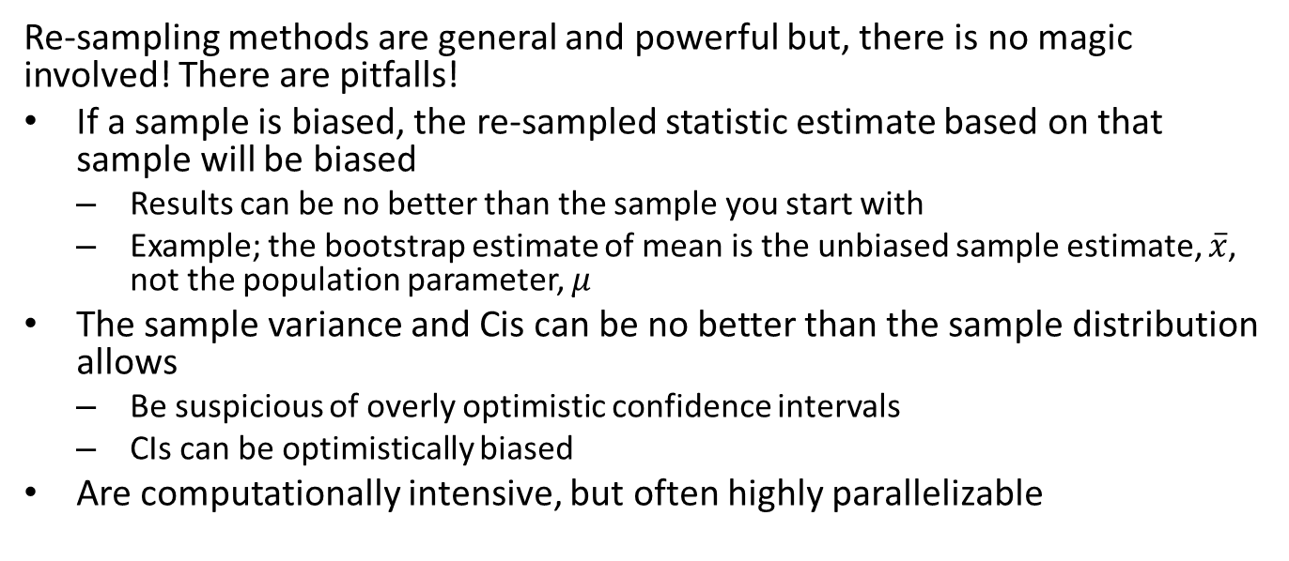
Review
Re-sampling methods are general and powerful but, there is no magic involved! There are pitfalls!
If a sample is biased, the re-sampled statistic estimate based on that sample will be biased
Results can be no better than the sample you start with
Example; the bootstrap estimate of mean is the unbiased sample estimate, $\overset{‾}{x}$, not the population parameter, $μ$
The sample variance and Cis can be no better than the sample distribution allows
Be suspicious of overly optimistic confidence intervals
CIs can be optimistically biased
Are computationally intensive, but often highly parallelizable

Slide 6
Introduction Bayesian Models
Despite the long history, Bayesian models have not been used extensively until recently
Two traditions in statistics
Frequentist classical statistics we have been working with previously
Bayesian statistics
Limited use is a result of several difficulties
Rarely taught for much of the 20th Century
Specifying a prior distribution has proved a formidable intellectual obstacle
Modern Bayesian methods are often computationally intensive and have become practical only with cheap computing
Emergence of improved software and algorithms has resulted in wide and practical use to Bayesian methods

Slide 7
Introduction
Bayesian analysis is a contrast to frequentist methods
The objective of Bayesian analysis is to compute a posterior distribution
Frequentist statistics computes a point estimate and confidence interval from a sample
Bayesian models allow expressing prior information in the form of a prior distribution
Selection of prior distributions can be performed in a number of ways
The posterior distribution is said to quantify our current belief
Update beliefs based on additional data or evidence
Frequentist models which must be computed from a complete sample
Inference can be performed on the posterior distribution by finding the maximum a postiori (MAP) value and a credible interval

Slide 8
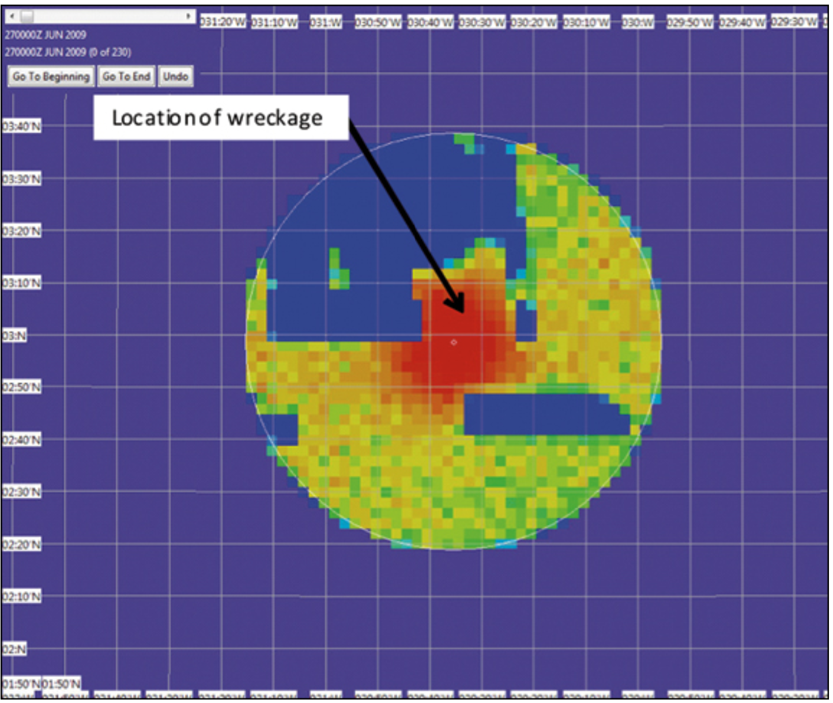
Bayesian Model Use Case
Bayesian methods made global headlines with the successful location of the missing Air France Flight 447
Aircraft had disappeared in little traveled area of the South Atlantic Ocean on June 1, 2009
Conventional location methods had failed to locate the wreckage; potential search area too large
Bayesian methods rapidly narrowed the prospective search area
Used ‘prior information’ on aircraft heading and time of satellite transmission
Posterior distribution of locations of Air France 447

Slide 9
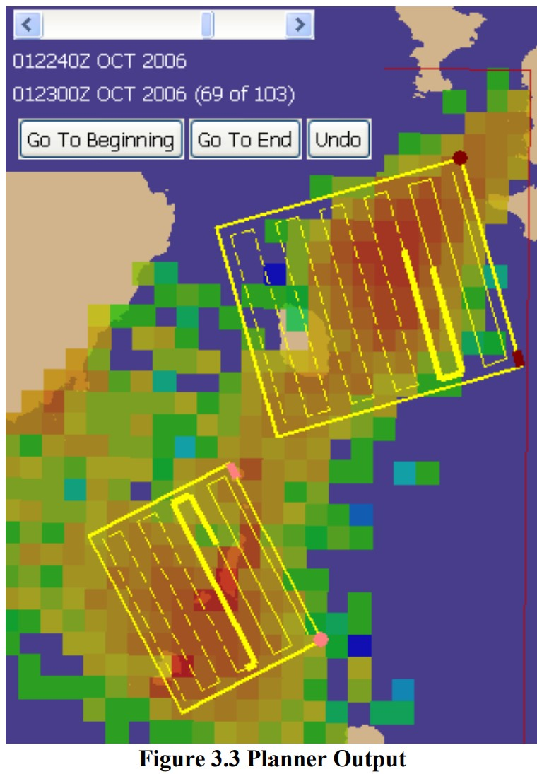
Bayesian Model Use Case
Kratzke, Stone and Frost developed an optimal search planner using Bayesian modeling for the US Coast Guard
Search areas concentrate on high posterior probability regions
Model accounts for current, wind, etc.
Screen shot from USCG search planner

Slide 10
Bayesian vs. Frequentist Views
With greater computational power and general acceptance, Bayes methods are now widely used
Among pragmatists
Some problems are better handled by frequentist methods
Some problems with Bayesian methods
Bayes models allow us to express prior information
Models that fall between these extremes are also in common use
Methods include the so-called empirical Bayes methods
See Empirical Bayes: Concepts and Methods by Bradley Efron for an introduction to the theory

Slide 11
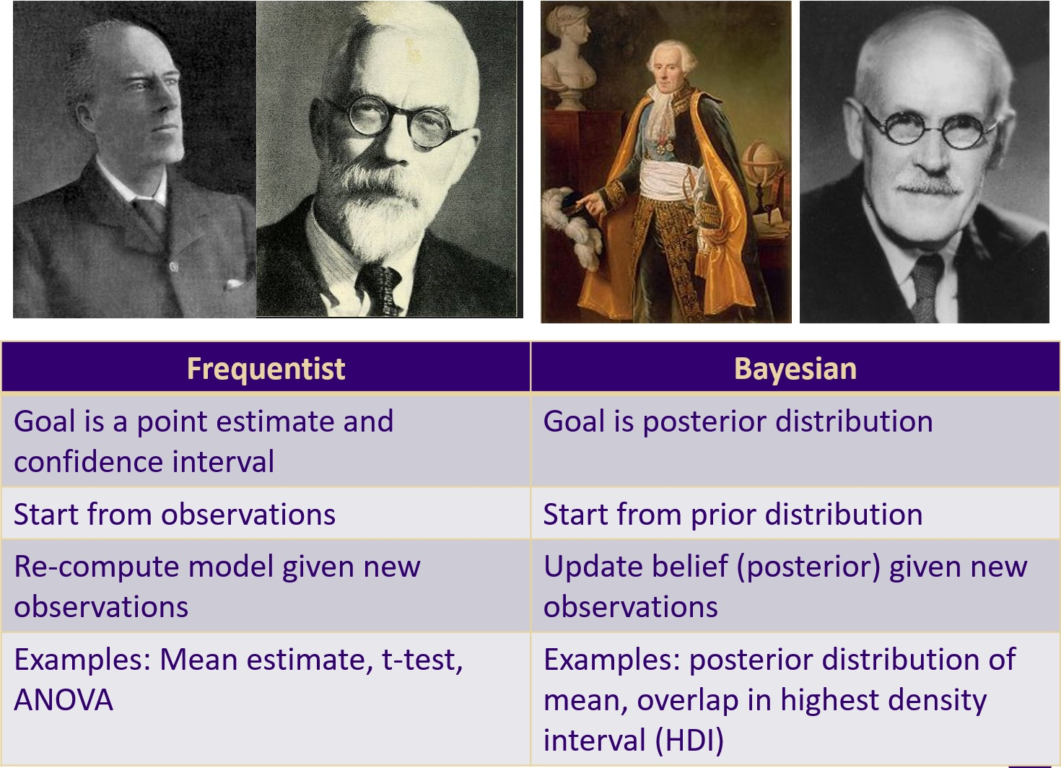
Bayesian vs. Frequentist Views
Can compare the contrasting frequentist and Bayesian approaches

Slide 12
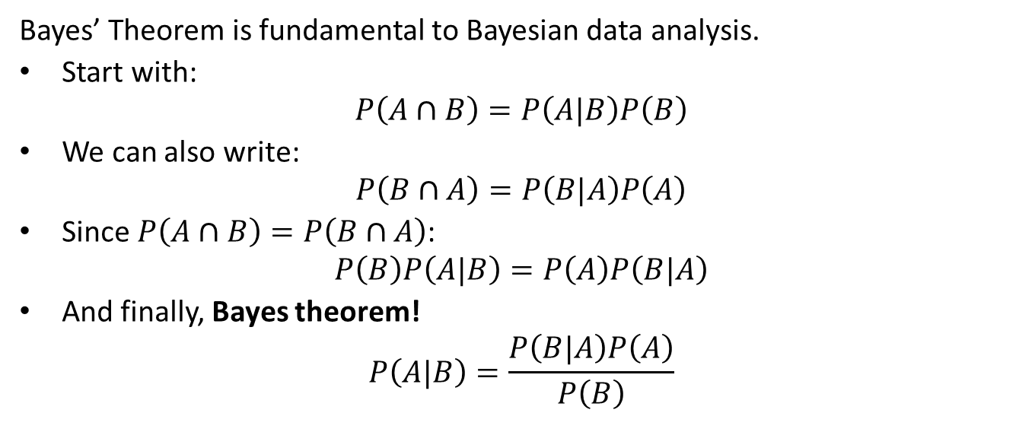
Review of Bayes Theorem
Bayes’ Theorem is fundamental to Bayesian data analysis.
Start with:
$$P\left(A∩B\right)=P\left(A|B\right)P\left(B\right)$$
We can also write:
$$P\left(B∩A\right)=P\left(B|A\right)P\left(A\right)$$
Since $P\left(A∩B\right)=P\left(B∩A\right)$:
$$P\left(B\right)P\left(A|B\right)=P\left(A\right)P\left(B|A\right)$$
And finally, Bayes theorem!
$$P\left(A|B\right)=\frac{P\left(B|A\right)P\left(A\right)}{P\left(B\right)}$$

Slide 13
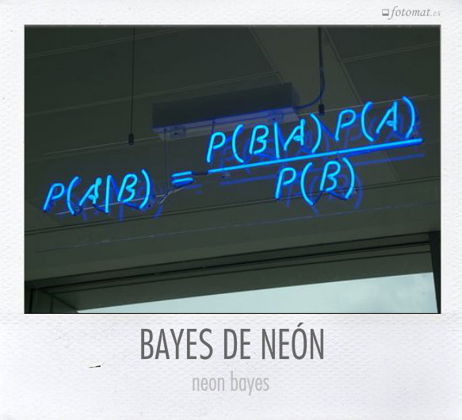
Bayes Theorem
Bayes Theorem!

Slide 14
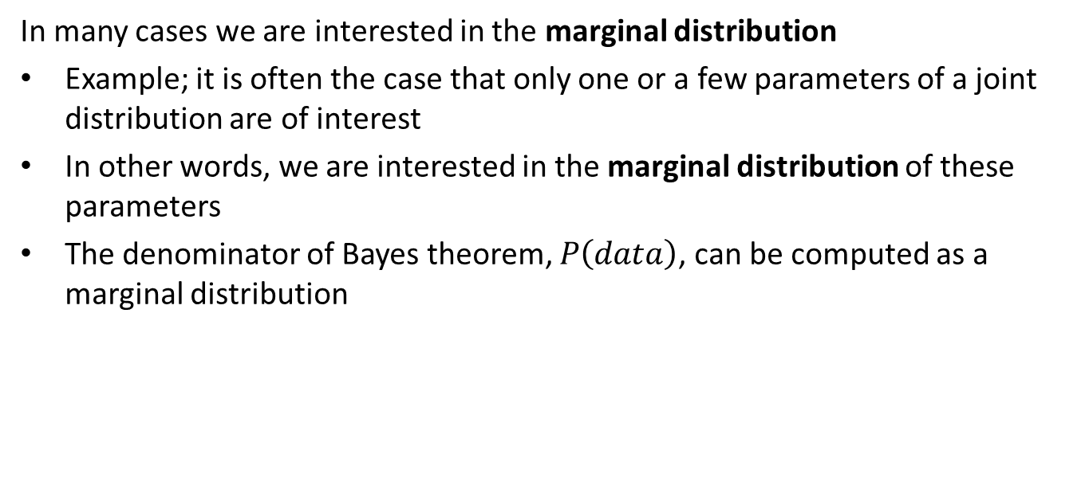
Marginal Distributions
In many cases we are interested in the marginal distribution
Example; it is often the case that only one or a few parameters of a joint distribution are of interest
In other words, we are interested in the marginal distribution of these parameters
The denominator of Bayes theorem, $P\left(data\right)$, can be computed as a marginal distribution

Slide 15
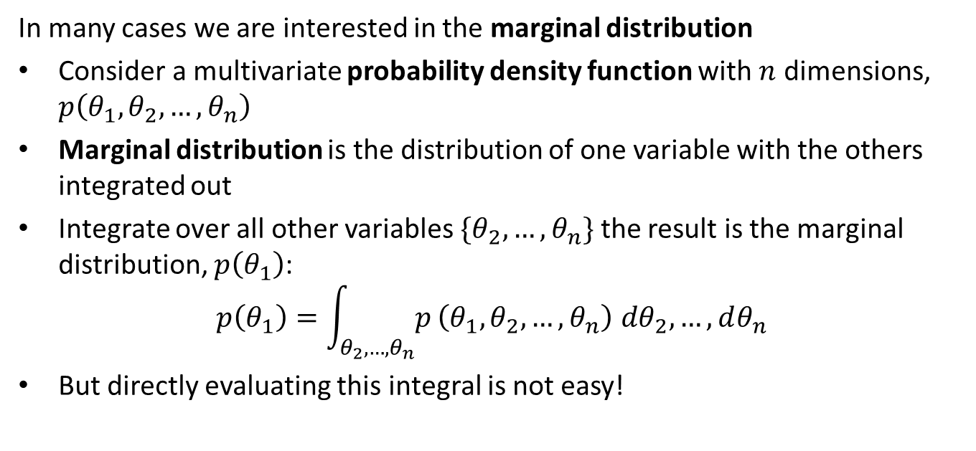
Marginal Distributions
In many cases we are interested in the marginal distribution
Consider a multivariate probability density function with $n$ dimensions, $p\left(θ_{1},θ_{2},…,θ_{n}\right)$
Marginal distribution is the distribution of one variable with the others integrated out
Integrate over all other variables $\{θ_{2},…,θ_{n}\}$ the result is the marginal distribution, $p\left(θ_{1}\right)$:
$$p\left(θ_{1}\right)=\int_{θ_{2},…,θ_{n}}^{​}{p}\left(θ_{1},θ_{2},…,θ_{n}\right) dθ_{2},…,dθ_{n}$$
But directly evaluating this integral is not easy!

Slide 16
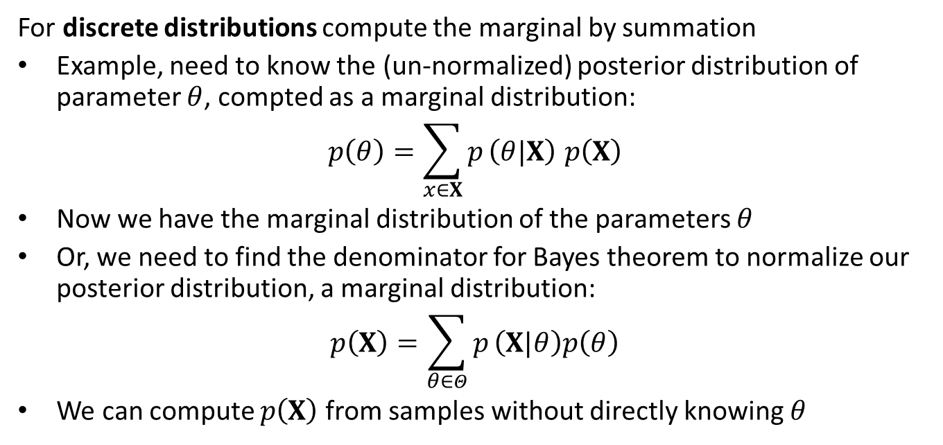
Marginal Distributions
For discrete distributions compute the marginal by summation
Example, need to know the (un-normalized) posterior distribution of parameter $θ$, compted as a marginal distribution:
$$p\left(θ\right)=\sum_{x∈X}^{​}{p}\left(θ|X\right) p\left(X\right)$$
Now we have the marginal distribution of the parameters $θ$
Or, we need to find the denominator for Bayes theorem to normalize our posterior distribution, a marginal distribution:
$$p\left(X\right)=\sum_{θ∈Θ}^{​}{p}\left(X|θ\right)p\left(θ\right)$$
We can compute $p\left(X\right)$ from samples without directly knowing $θ$

Slide 17
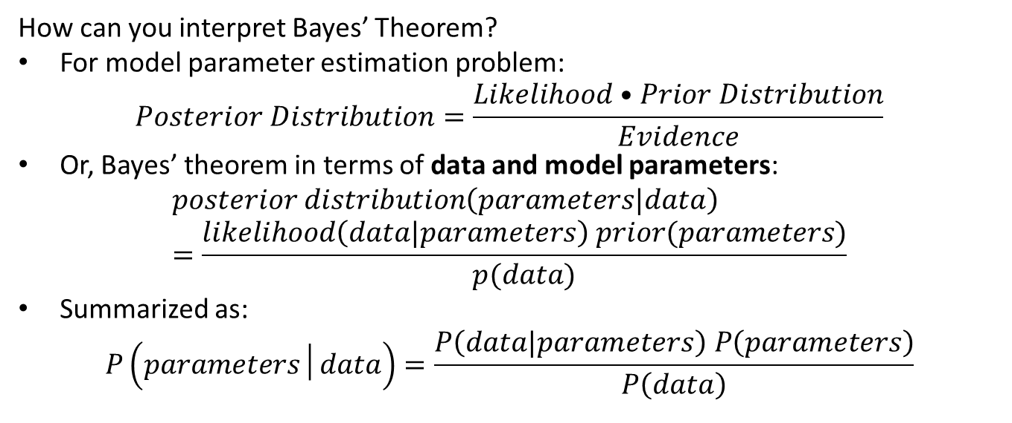
Interpreting Bayes Theorem
How can you interpret Bayes’ Theorem?
For model parameter estimation problem:
$$Posterior Distribution=\frac{Likelihood•Prior Distribution}{Evidence}$$
Or, Bayes’ theorem in terms of data and model parameters:
$$posterior distribution\left(parameters|data\right)=\frac{likelihood\left(data|parameters\right) prior(parameters)}{p(data)}$$
Summarized as:
$$P\left(parameters│data\right)=\frac{P\left(data|parameters\right) P\left(parameters\right)}{P\left(data\right)}$$

Slide 18
Interpreting Bayes Theorem
What do these terms actually mean?
Posterior distribution of the parameters given the evidence or data, the goal of Bayesian analysis
Prior distribution is chosen to express information available about the model parameters apriori
Likelihood is the conditional distribution of the data given the model parameters
Probability of Data or evidence is the distribution of the data and normalizes the posterior
Relationships can apply to the parameters in a model; e.g. partial slopes, intercept, error distributions, lasso constants, etc

Slide 19
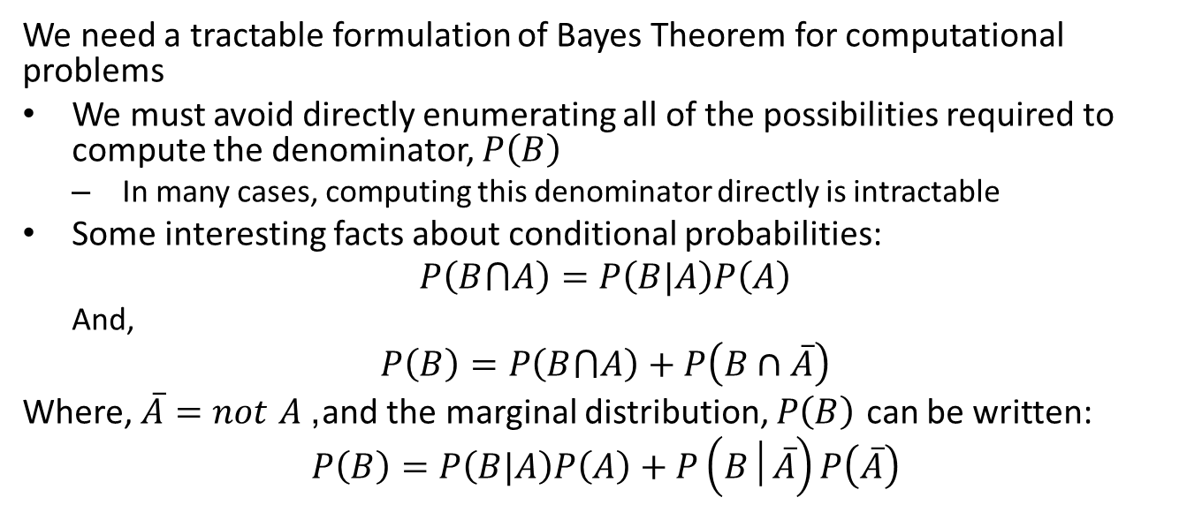
Applying Bayes Theorem
We need a tractable formulation of Bayes Theorem for computational problems
We must avoid directly enumerating all of the possibilities required to compute the denominator, $P\left(B\right)$
In many cases, computing this denominator directly is intractable
Some interesting facts about conditional probabilities:
$$P\left(B⋂A\right)=P\left(B|A\right)P\left(A\right)$$
And,
$$P\left(B\right)=P\left(B⋂A\right)+P\left(B∩\overline{A}\right)$$
Where, $\overset{‾}{A}=not A$, and the marginal distribution, $P\left(B\right)$ can be written:
$$P\left(B\right)=P\left(B|A\right)P\left(A\right)+P\left(B│\overset{‾}{A}\right)P\left(\overset{‾}{A}\right)$$

Slide 20
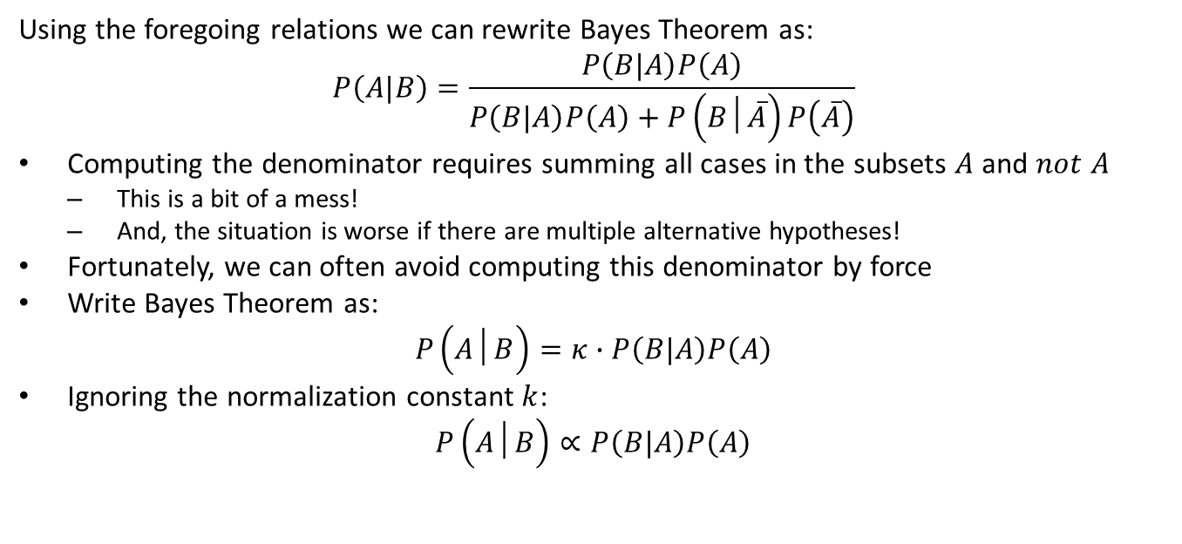
Applying Bayes Theorem
Using the foregoing relations we can rewrite Bayes Theorem as:
$$P\left(A|B\right)=\frac{P\left(B|A\right)P\left(A\right)}{P\left(B|A\right)P\left(A\right)+P\left(B│\overset{‾}{A}\right)P\left(\overset{‾}{A}\right)}$$
Computing the denominator requires summing all cases in the subsets $A$ and $not A$
This is a bit of a mess!
And, the situation is worse if there are multiple alternative hypotheses!
Fortunately, we can often avoid computing this denominator by force
Write Bayes Theorem as:
$$P\left(A│B\right)=κ∙P\left(B|A\right)P\left(A\right)$$
Ignoring the normalization constant $k$:
$$P\left(A│B\right)∝P\left(B|A\right)P\left(A\right)$$

Slide 21
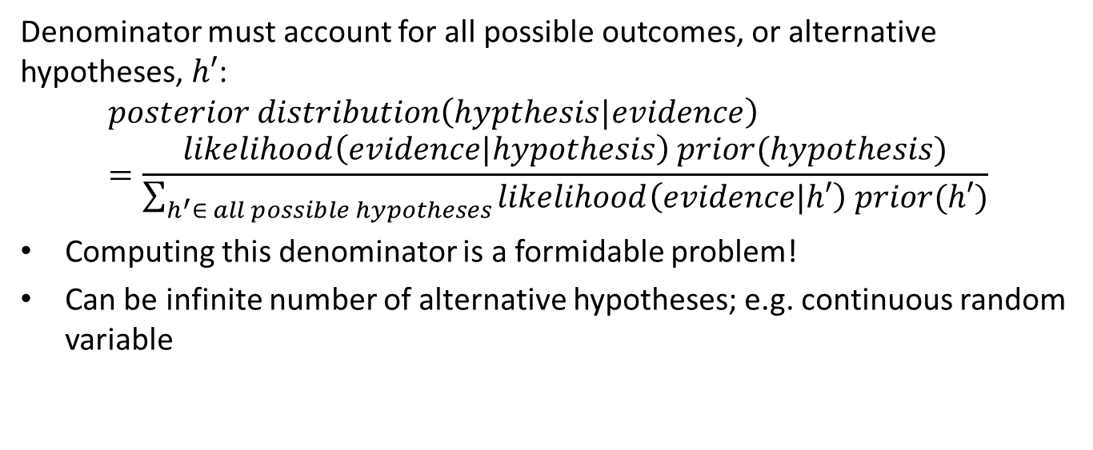
Interpreting Bayes Theorem
Denominator must account for all possible outcomes, or alternative hypotheses, $h′$:
$$posterior distribution\left(hypthesis|evidence\right)=\frac{likelihood\left(evidence|hypothesis\right) prior(hypothesis)}{\sum_{h^{′}∈ all possible hypotheses}{likelihood\left(evidence|h′\right) prior(h′)}}$$
Computing this denominator is a formidable problem!
Can be infinite number of alternative hypotheses; e.g. continuous random variable

Slide 22
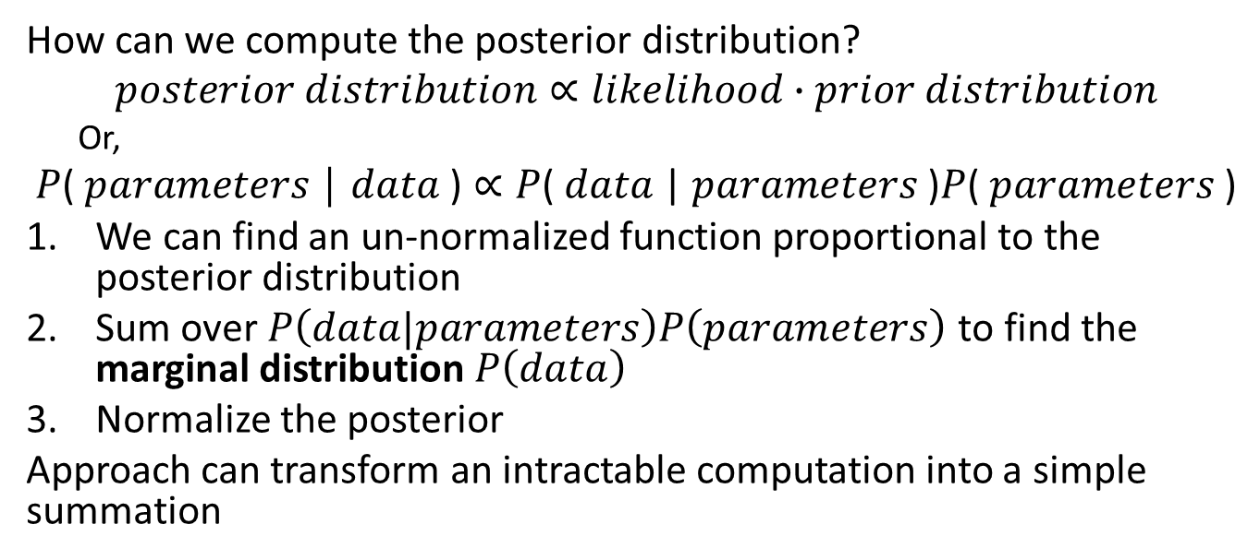
Simplified Relationship for Bayes Theorem
How can we compute the posterior distribution?
$$posterior distribution∝likelihood∙prior distribution$$
Or,
$$\text{P}\text{( }\text{parameters} \text{│ }\text{data} \text{)}∝\text{P}\text{( }\text{data} \text{| }\text{parameters} \text{)}\text{P}\text{( }\text{parameters} \text{)}$$
We can find an un-normalized function proportional to the posterior distribution
Sum over $P\left(data|parameters\right)P\left(parameters\right)$ to find the marginal distribution $P\left(data\right)$
Normalize the posterior
Approach can transform an intractable computation into a simple summation

Slide 23
Bayesian Workflow
The goal of a Bayesian analysis is computing and performing inference on the posterior distribution of the model parameters, generally following these steps:
Identify data relevant to the research question
Define a sampling plan for the data, need not be collected in a single batch
Define the likelihood model; e.g. regression model with Normal likelihood
Specify a prior distribution of the model parameters
Use the Bayesian inference formula to compute posterior distribution of the model parameters
Update the posterior as data is observed
Inference on the posterior can be performed; compute MAP and credible interval
Simulate from the posterior distribution, predictions from the model.

Slide 24
Updating Bayesian Models
Updating belief when new evidence becomes available is a major advantage of Bayesian models
In contrast, frequentist models must be recomputed when new data becomes available
The posterior of a Bayesian model with no evidence is the prior
The previous posterior serves as a prior for model updates

Slide 25
How can you choose a prior?
The choice of the prior is a difficult, and potentially vexing, problem when performing Bayesian analysis
The need to choose a prior has often been cited as a reason why Bayesian models are impractical
General guidance is that a prior must be convincing to a skeptical audience
Tend to use vague or less informative priors in practice
In practice, given a bit of data Bayesian models are robust to choice of prior

Slide 26
How can you choose a prior?
Some possible approaches to prior selection include:
Use empirical information
Empirical Bayes estimates prior from sample of observations
Apply domain knowledge to determine a reasonable distribution
Information from prior work
Example, the viable range of parameter values computed from physical principles
Example, a known price range for some asset
If there is poor prior knowledge for the problem a non-informative prior can be used
One possibility is a Uniform distribution. But be careful, a uniform prior is informative because of limits on the values!
Other options include the Jefferys’ prior, but hard to work with

Slide 27
How can you choose a prior?
How can we use empirical information to estimate the parameters of the prior distribution?
Deriving a prior distribution in this manner is called empirical Bayes
Estimation of useful priors has become practical with large modern data sets
Empirical Bayes approach is often applied in practice
Some Bayesian theoreticians do not consider this a Bayesian approach at all!
Example, need a prior distribution of home prices per square foot by location
Use pooled information to compute distribution of prices for all locations
Use the prior with specific evidence by locations, property characteristics, etc. to compute posteriors by location
Is example of hierarchical model
Typically, a less informative prior distribution is used than the actual empirical distribution so the model is not overlyconstrained

Slide 28
Conjugate Prior Distributions
A conjugate prior is an analytically and computationally simple choice of prior distribution
The posterior distribution computed from the product of a likelihood function and a conjugate prior is in the same family as the prior
Attractive idea for cases where the conjugate distribution exists
Analytic results can be computed
The posterior is a known distribution
But there are many practical cases where a conjugate prior is not used
We will address more general methods later

Slide 29
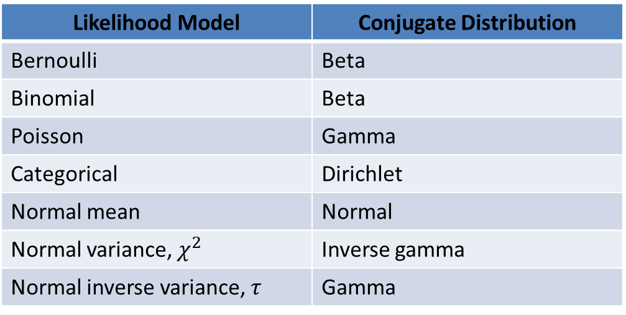
Conjugate Prior Distributions
A conjugate prior is an analytically and computationally simple choice of prior distribution
Likelihood Model | Conjugate Distribution
Bernoulli | Beta
Binomial | Beta
Poisson | Gamma
Categorical | Dirichlet
Normal mean | Normal
Normal variance, $χ^{2}$ | Inverse gamma
Normal inverse variance, $τ$ | Gamma

Slide 30
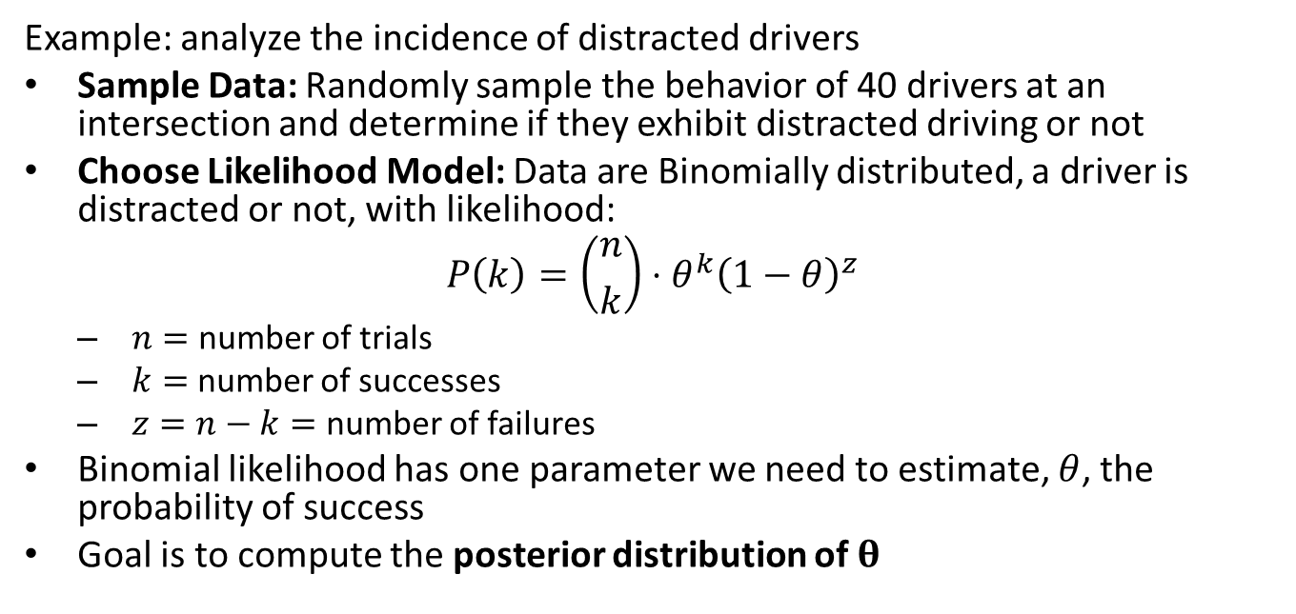
Working with a Conjugate Prior
Example: analyze the incidence of distracted drivers
Sample Data: Randomly sample the behavior of 40 drivers at an intersection and determine if they exhibit distracted driving or not
Choose Likelihood Model: Data are Binomially distributed, a driver is distracted or not, with likelihood:
$$P\left(k\right)=\left({n \atop k}\right)⋅θ^{k}{\left(1−θ\right)}^{z}$$
$n=$ number of trials
$k=$ number of successes
$z=n−k=$ number of failures
Binomial likelihood has one parameter we need to estimate, $θ$, the probability of success
Goal is to compute the posterior distribution of $θ$

Slide 31
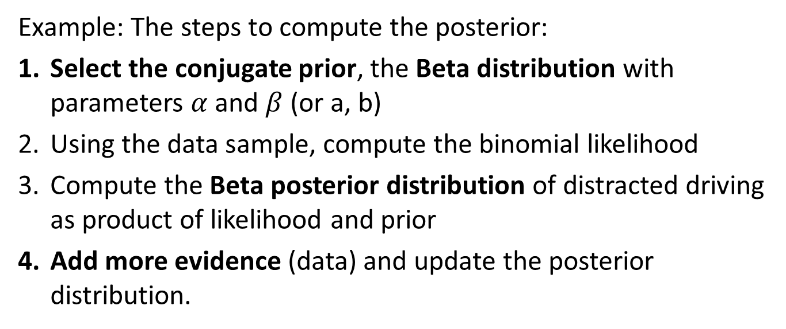
Working with a Conjugate Prior
Example: The steps to compute the posterior:
Select the conjugate prior, the Beta distribution with parameters $α$ and $β$ (or a, b)
Using the data sample, compute the binomial likelihood
Compute the Beta posterior distribution of distracted driving as product of likelihood and prior
Add more evidence (data) and update the posterior distribution.

Slide 32
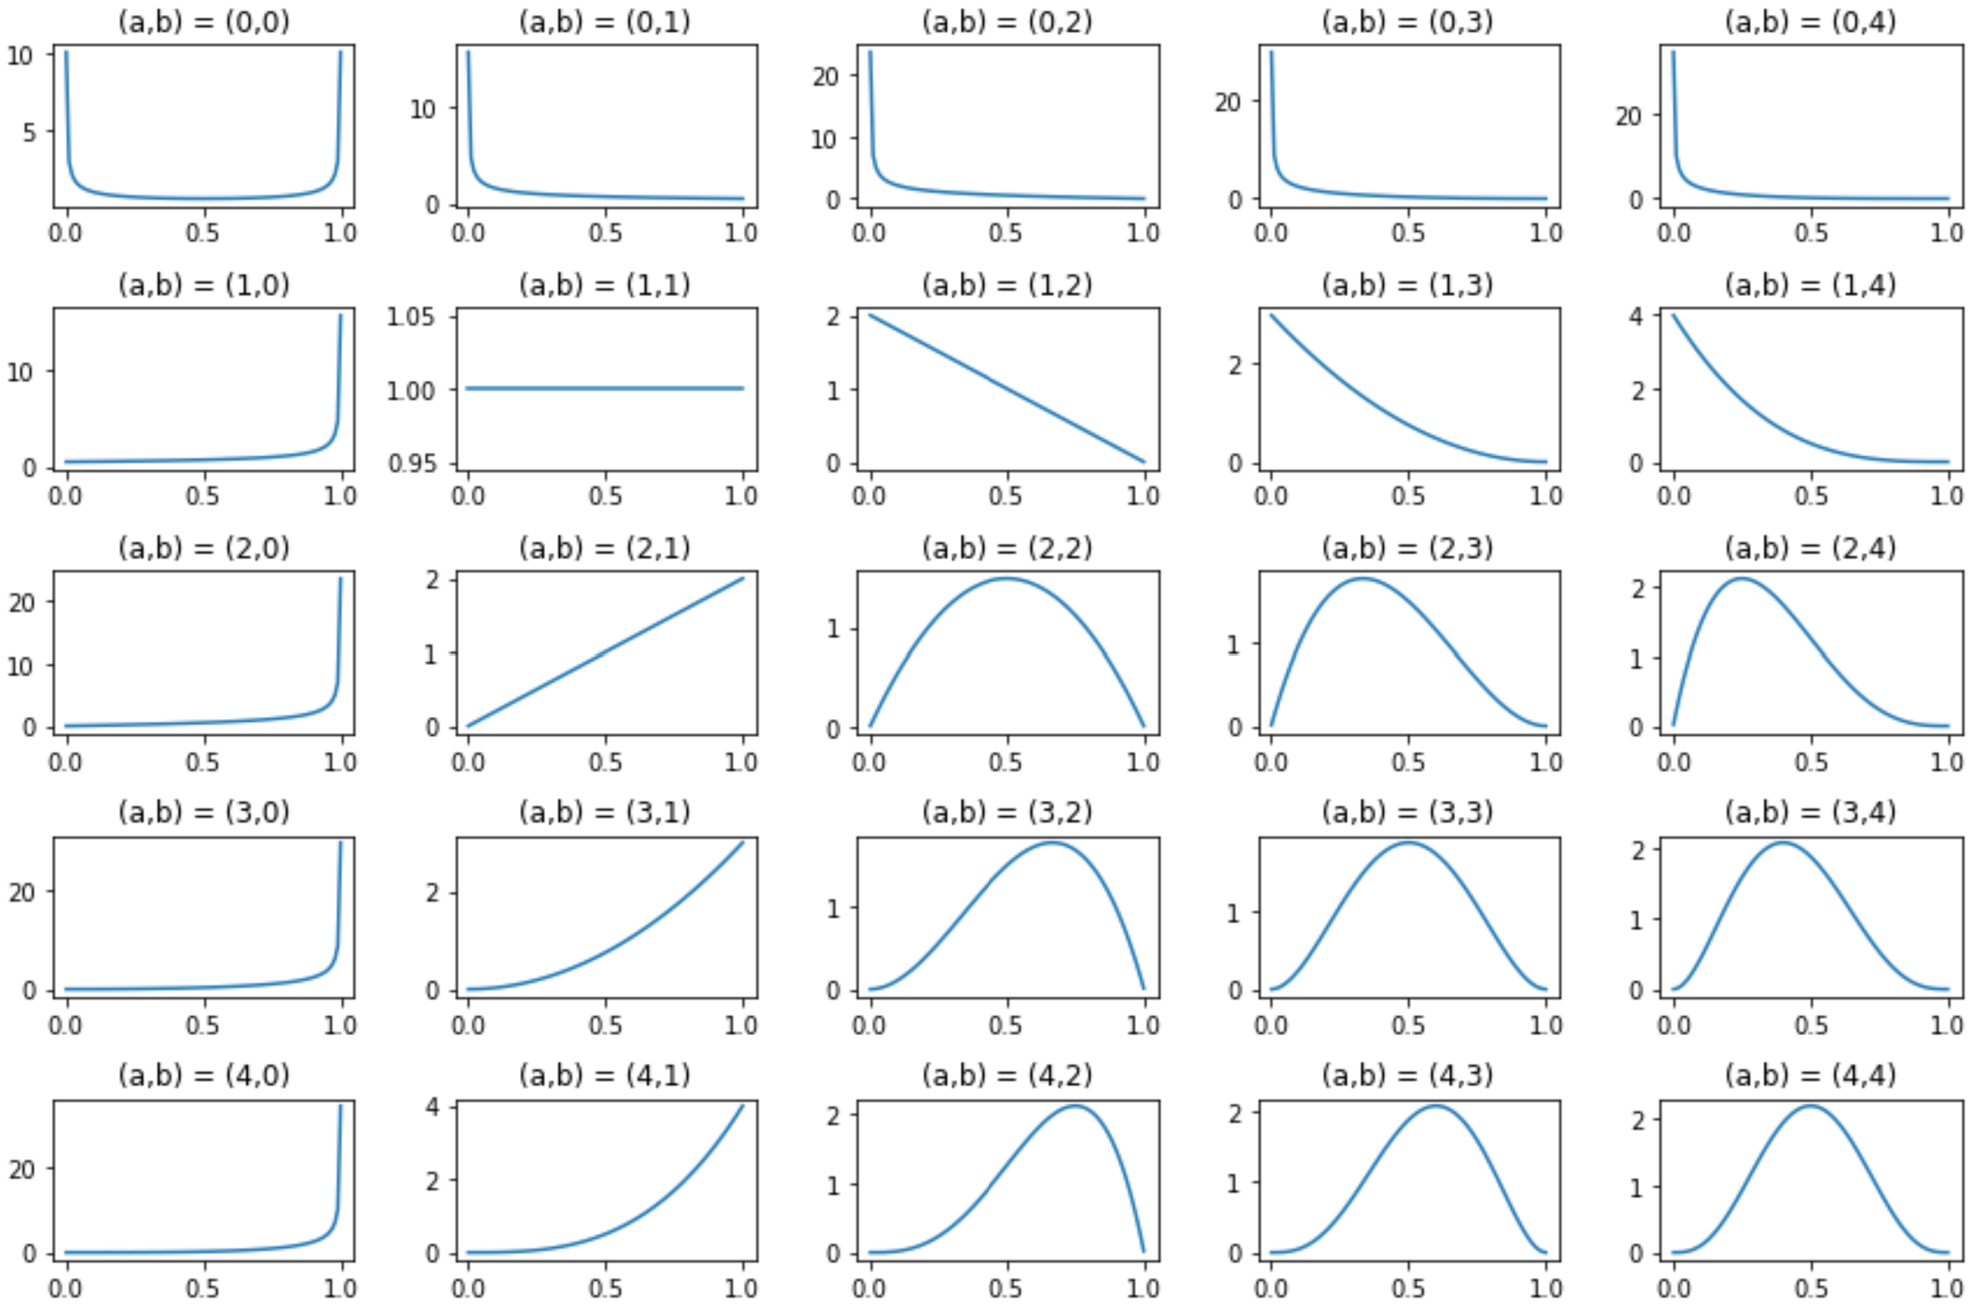
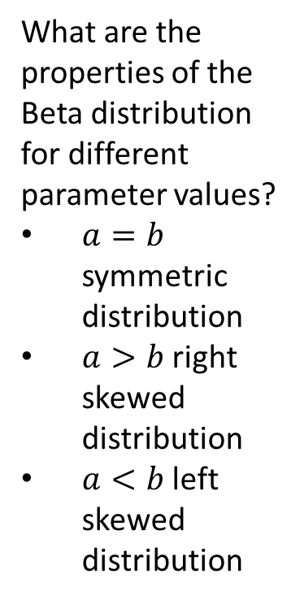
Working with a Conjugate Prior
What are the properties of the Beta distribution for different parameter values?
$a=b$ symmetric distribution
$a>b$ right skewed distribution
$a<b$ left skewed distribution

Slide 33
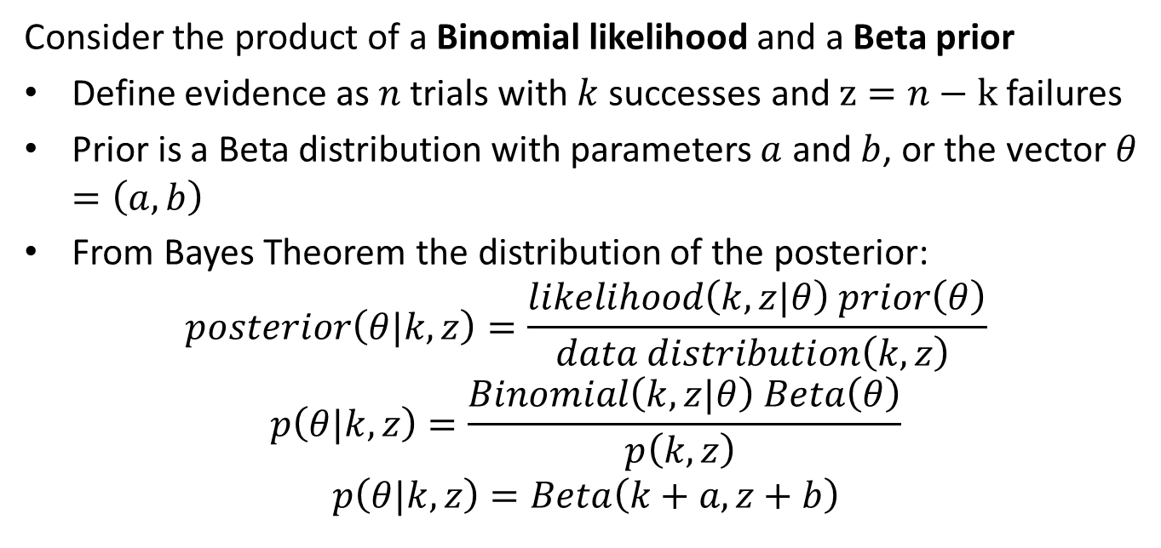
Working with a Conjugate Prior
Consider the product of a Binomial likelihood and a Beta prior
Define evidence as $n$ trials with $k$ successes and $z=n−k$ failures
Prior is a Beta distribution with parameters $a$ and $b$, or the vector $θ=\left(a,b\right)$
From Bayes Theorem the distribution of the posterior:
$$posterior\left(θ|k,z\right)=\frac{likelihood\left(k,z|θ\right) prior\left(θ\right)}{data distribution\left(k,z\right) }$$
$$p\left(θ|k,z\right)=\frac{Binomial\left(k,z|θ\right) Beta\left(θ\right)}{p\left(k,z\right) }$$
$$p\left(θ|k,z\right)=Beta\left(k+a,z+b\right)$$

Slide 34
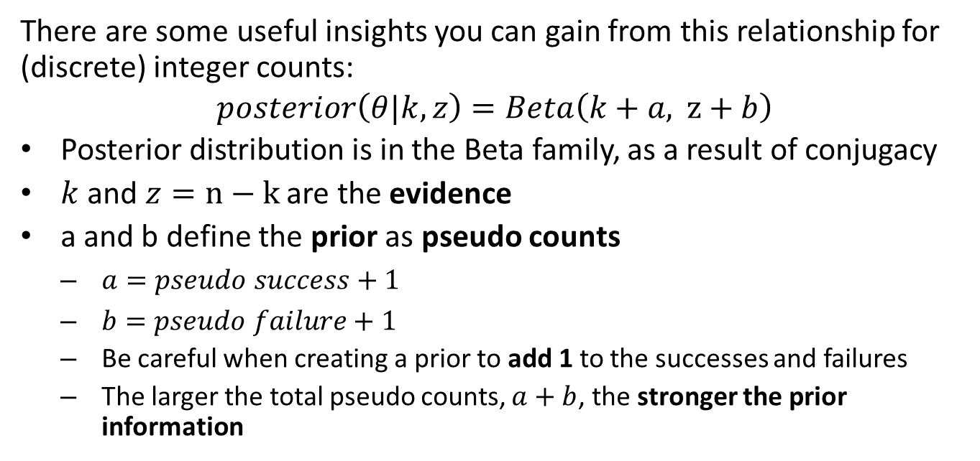
Working with a Conjugate Prior
There are some useful insights you can gain from this relationship for (discrete) integer counts:
$$posterior\left(θ|k,z\right)=Beta\left(k+a, z+b\right)$$
Posterior distribution is in the Beta family, as a result of conjugacy
$k$ and $z=n−k$ are the evidence
a and b define the prior as pseudo counts
$a=pseudo success+1$
$b=pseudo failure+1$
Be careful when creating a prior to add 1 to the successes and failures
The larger the total pseudo counts, $a+b$, the stronger the prior information

Slide 35
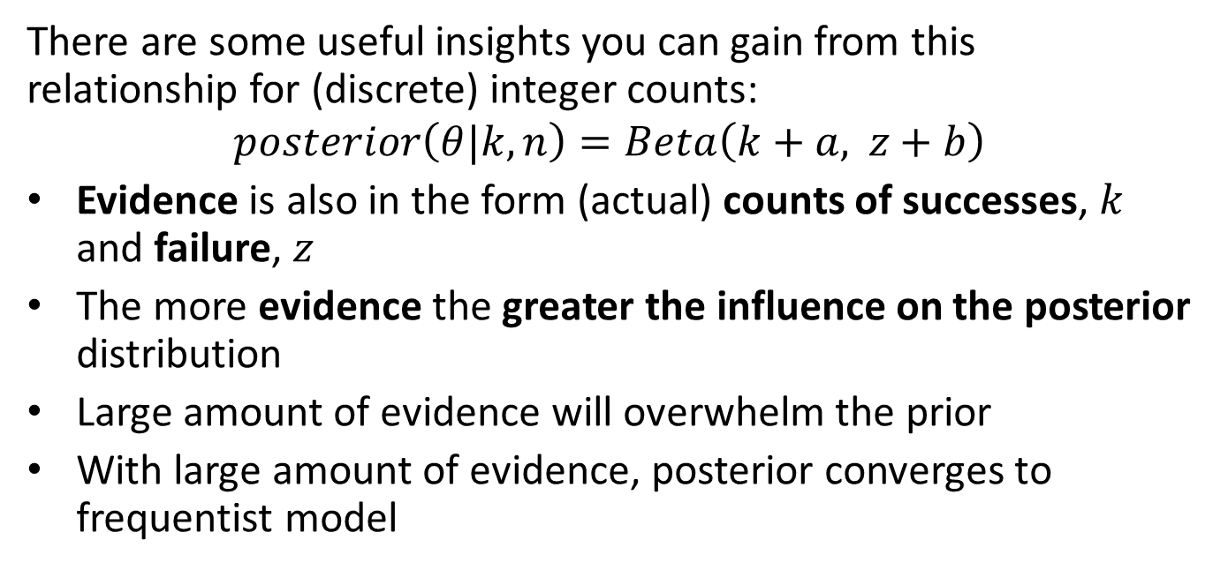
Working with a Conjugate Prior
There are some useful insights you can gain from this relationship for (discrete) integer counts:
$$posterior\left(θ|k,n\right)=Beta\left(k+a, z+b\right)$$
Evidence is also in the form (actual) counts of successes, $k$ and failure, $z$
The more evidence the greater the influence on the posterior distribution
Large amount of evidence will overwhelm the prior
With large amount of evidence, posterior converges to frequentist model

Slide 36
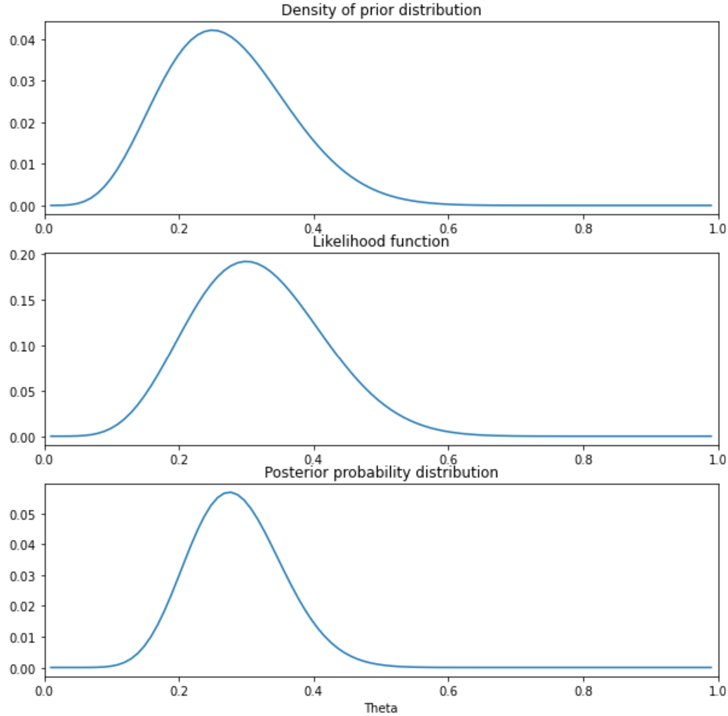
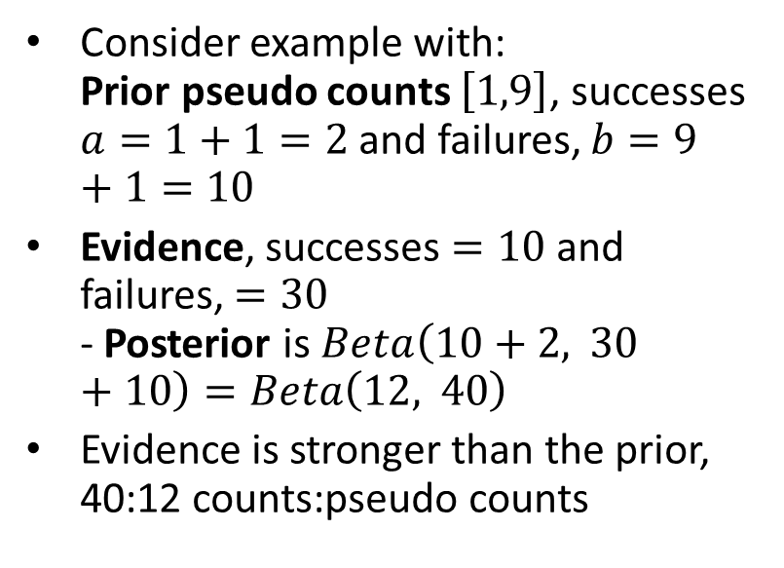
Working with a Conjugate Prior
Consider example with: Prior pseudo counts $\left[1,9\right]$, successes $a=1+1=2$ and failures, $b=9+1=10$
Evidence, successes $=10$ and failures, $=30$ - Posterior is $Beta\left(10+2, 30+10\right)=Beta\left(12, 40\right)$
Evidence is stronger than the prior, 40:12 counts:pseudo counts
Prior, likelihood and posterior for distracted driving

Slide 37
Sampling the Posterior
How can we find an empirical estimate of the posterior distribution?
We can sample from the likelihood function
Sample the analytic conjugate prior if it exists
Grid sample or Markov chain Monte Carlo (MCMC) sample
Take the product of the likelihood and the prior
Normalize to compute proper posterior distribution

Slide 38
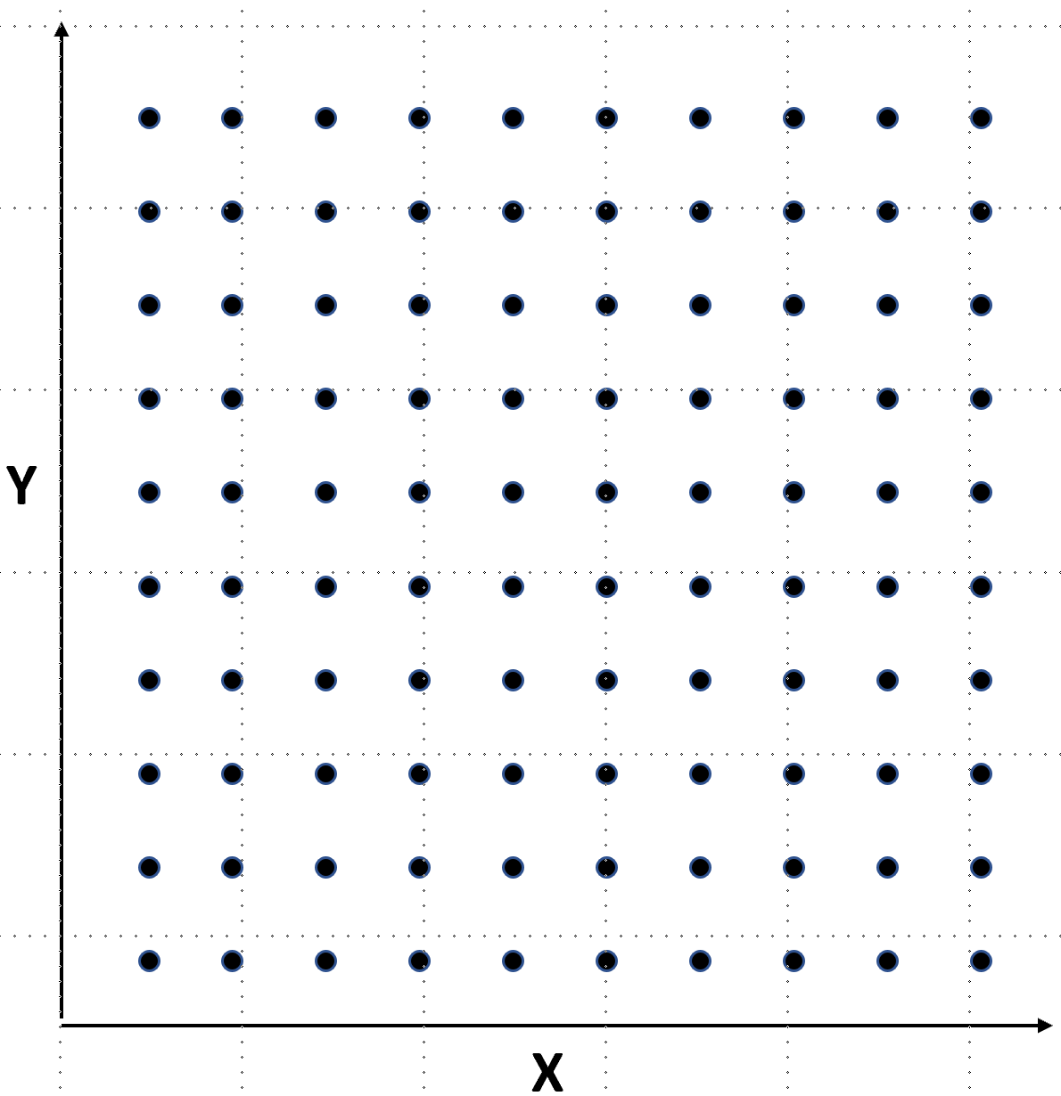
Sampling the Posterior
Grid sampling is a naive approach
Compute the probability at each point on a regular gird
Sample over range of values of interest
Take the product of the prior and likelihood
In principle grid sampliung can work for any number of dimensions
In 1-dimension is just regularly spaced points on a line
Poor scaling to higher dimensions
Sampling grid for bivariate distribution

Slide 39
Sampling the Posterior
Algorithm for grid sampling to compute posterior from likelihood and prior
Procedure CreateGrid(variables, lower_limits, upper_limits): # Build the sampling grid return sampling_grid Procedure SampleLikelihood(sampling_value, observation_values): return likelihood_function(observation_values, sampling_value) Procedure Prior(sampling_values, prior_parameter_value): return prior_density_function(sampling_value, prior_parameter_values) ComputePosterior(variables, lower_limits, upper_limits): # Initialize the sampling grid Grid = CreateGrid(variables, lower_limits, upper_limits) # Initialize array to hold sampled posterior values array posterior[range(Grid)] # Compute posterior at each sampling value in the grid for sampling_value in range(lower_limits, upper_limits): likelihood = SampleLikelihood(sampling_value, observation_values) prior = Prior(sampling_values, prior_parameter_value) posterior[sampling_value] = likelihood * prior # Normalize the posterior probability_data = sum(posterior[range(Grid)]) posterior = posterior[range(Grid)]/probability_data return posterior

Slide 40
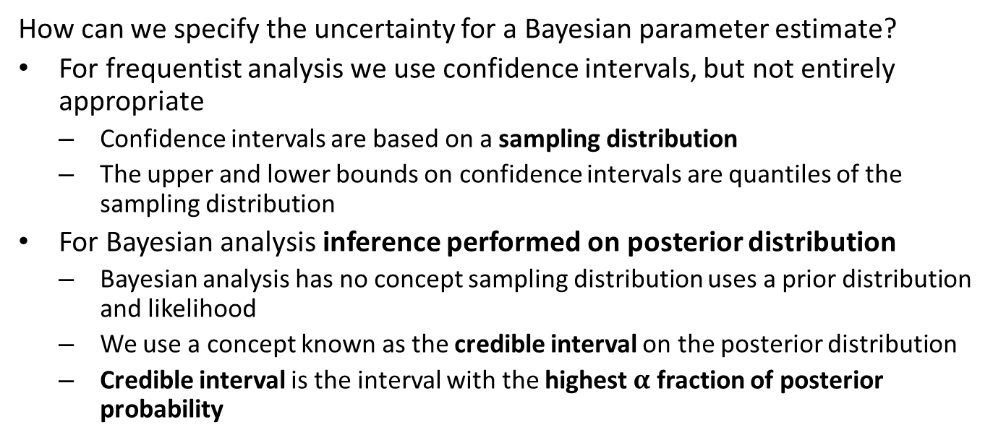
Credible Intervals
How can we specify the uncertainty for a Bayesian parameter estimate?
For frequentist analysis we use confidence intervals, but not entirely appropriate
Confidence intervals are based on a sampling distribution
The upper and lower bounds on confidence intervals are quantiles of the sampling distribution
For Bayesian analysis inference performed on posterior distribution
Bayesian analysis has no concept sampling distribution uses a prior distribution and likelihood
We use a concept known as the credible interval on the posterior distribution
Credible interval is the interval with the highest $α$ fraction of posterior probability

Slide 41
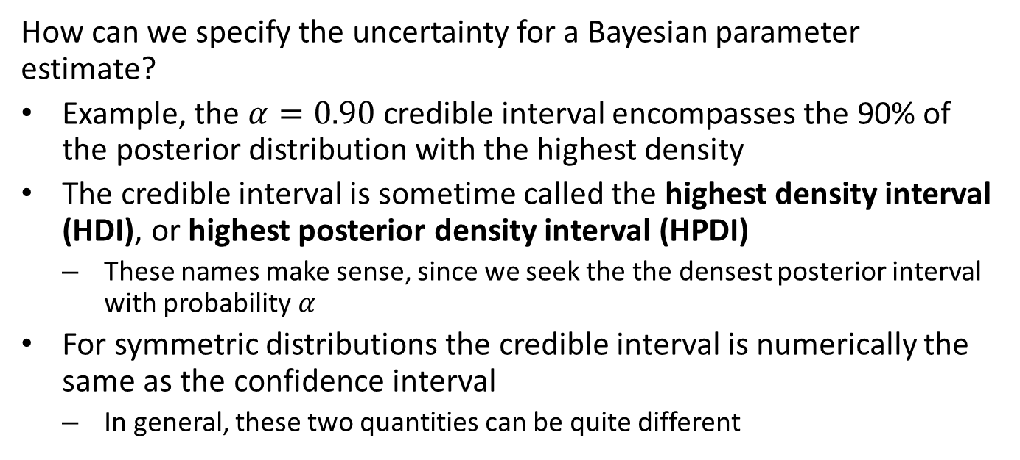
Credible Intervals
How can we specify the uncertainty for a Bayesian parameter estimate?
Example, the $α=0.90$ credible interval encompasses the 90% of the posterior distribution with the highest density
The credible interval is sometime called the highest density interval (HDI), or highest posterior density interval (HPDI)
These names make sense, since we seek the the densest posterior interval with probability $α$
For symmetric distributions the credible interval is numerically the same as the confidence interval
In general, these two quantities can be quite different

Slide 42
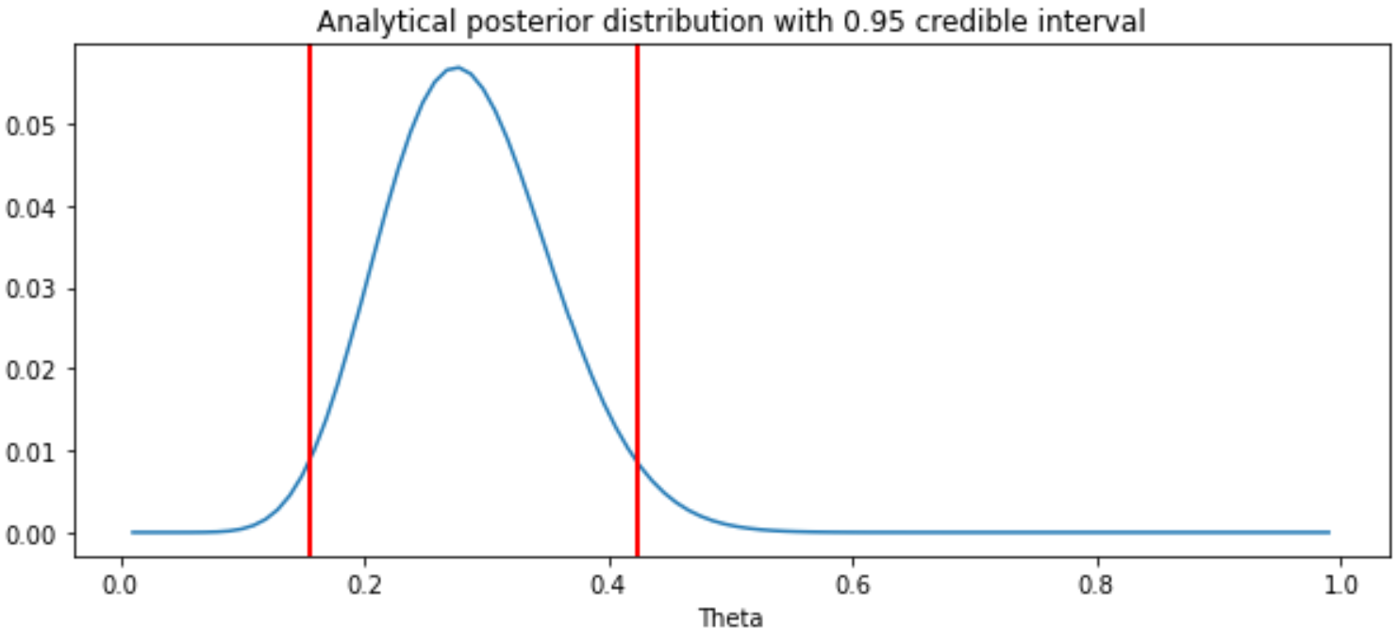

Credible Intervals
What are the 95% credible intervals for $Beta\left(12, 40\right)$?
Probability of distract drivers for next 10 cars

Slide 43
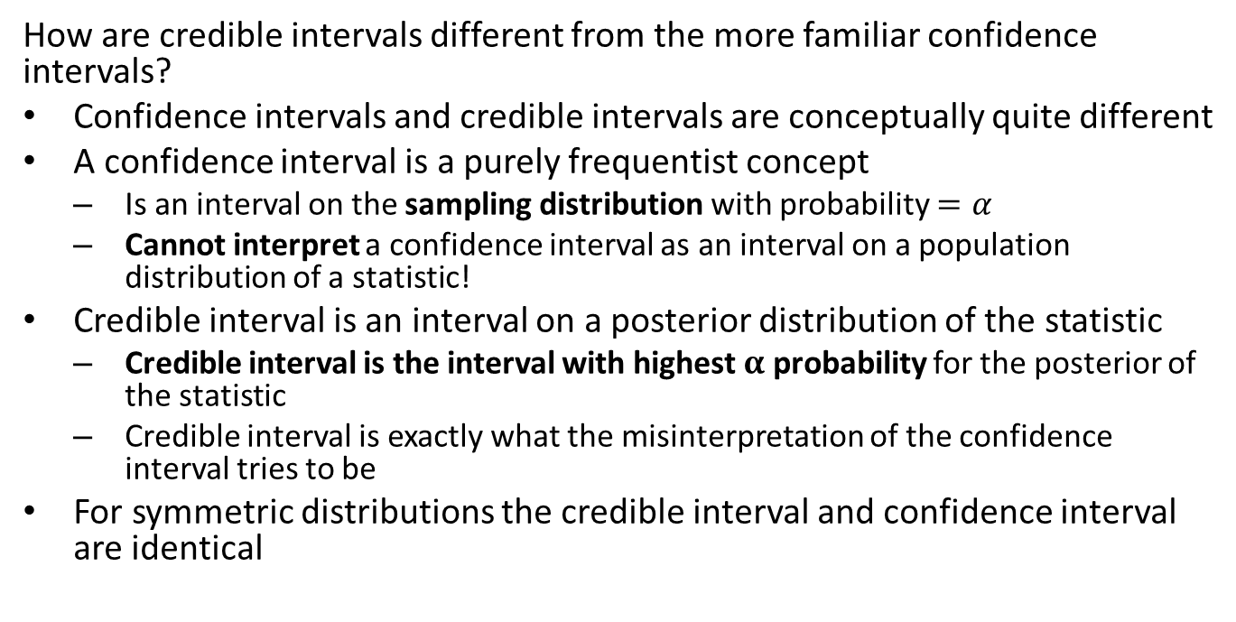
Credible Intervals are not Confidence Intervals
How are credible intervals different from the more familiar confidence intervals?
Confidence intervals and credible intervals are conceptually quite different
A confidence interval is a purely frequentist concept
Is an interval on the sampling distribution with probability $=α$
Cannot interpret a confidence interval as an interval on a population distribution of a statistic!
Credible interval is an interval on a posterior distribution of the statistic
Credible interval is the interval with highest $α$ probability for the posterior of the statistic
Credible interval is exactly what the misinterpretation of the confidence interval tries to be
For symmetric distributions the credible interval and confidence interval are identical

Slide 44
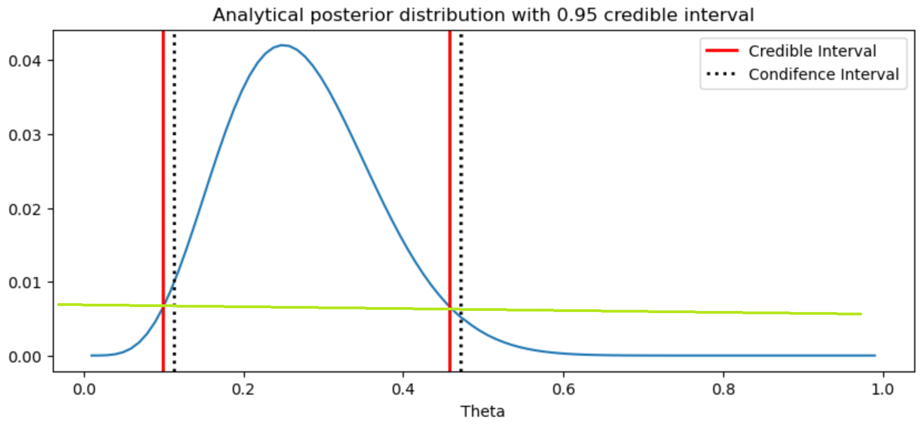
Credible Intervals are not Confidence Intervals
Compare confidence interval and credible interval for the case of 10 observations
Credible intervals cross the density function at exactly the same density
Confidence intervals have the same CDF in the tails beyond the interval
Difference between credible and confidence intervals

Slide 45
Simulating from the posterior distribution: predictions
What else can we do with the Bayesian posterior distribution?
Perform simulations and make predictions
Predictions are computed by simulating from the posterior distribution
Results of these simulations are useful for several purposes, including:
Predicting posterior values
Model checking by comparing simulation results agree (or not) with observations

Slide 46
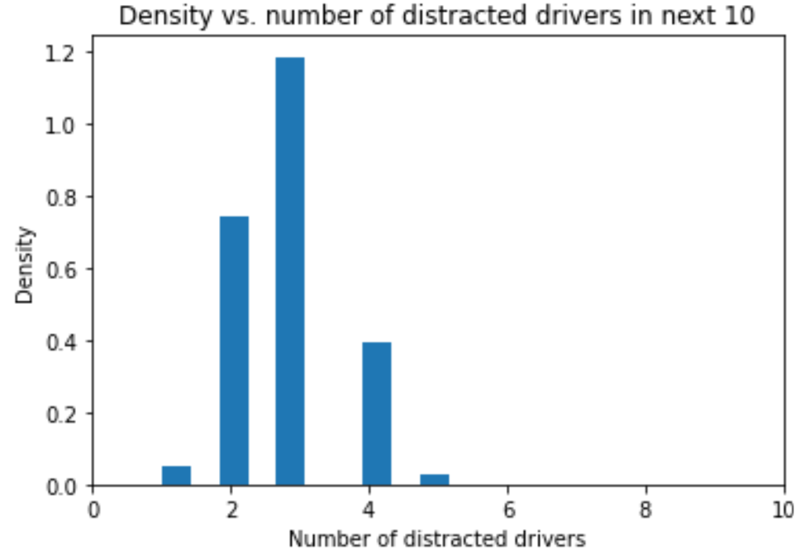
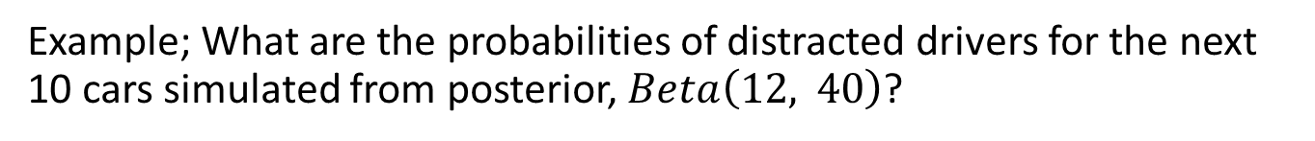
Simulating from the posterior distribution: predictions
Example; What are the probabilities of distracted drivers for the next 10 cars simulated from posterior, $Beta\left(12, 40\right)$?
Probability of distract drivers for next 10 cars

Slide 47
Summary
Bayesian analysis is a contrast to frequentist methods
The objective of Bayesian analysis is to compute a posterior distribution
Contrasts with frequentist statistics which computes a point estimate and confidence interval from a sample
Bayesian models allow expressing prior information in the form of a prior distribution
Selection of prior distributions can be performed in a number of ways
The posterior distribution is said to quantify our current belief
We update beliefs based on additional data or evidence
Inference can be performed on the posterior distribution by finding the maximum a postiori (MAP) value and a credible interval
Predictions are made by simulating from the posterior distribution a

