Slide 1

Properties of Time Series
Steve Elston
Copyright 2018, 2019, 2020, 2021, 2022, 2023 2024, Stephen F Elston. All rights reserved.

Slide 2
Why Are Time Series Important?
Estimates 30% of data science problems include time series data
Time series data are time-ordered
Time ordered data often exhibit serial correlation
Ignoring serial correlation results in incorrect inferences
Analysis requires specific time series models

Slide 3
Why Are Time Series Useful?
“It’s difficult to make predictions, especially about the future!”
Karl Kristian Steincke, Danish politician, ca 1937
Demand forecasting: Electricity production, Internet bandwidth, Traffic management, Inventory management, sales forecasting
Medicine: Time dependent measurements, EKG, EEG
Engineering and Science: Signal analysis, Analysis of physical processes
Capital markets and economics: Seasonal unemployment, Price/return series, Risk analysis

Slide 4
Why Are Time Series Data Different?
Models must account for time series behavior
Most statistical and machine learning models assume that data samples are independent identically distributed (iid)
But, this is not the case for time series data
Time series values exhibit are correlated in time
Time series data exhibit Serial correlation
Serial correlation of values
Serial correlation of errors
Violate iid assumptions of many statistical and ML Models `

Slide 5
Why Are Time Series Data Different
Examples of serial correlation:
Temperature forecasts, where the future values are correlated with the current values
The opening price of a stock is correlated with the price at the previous close
The daily sales volume of a product is correlated with the previous sales volume
A medical patient’s blood pressure reading is correlated with the previous observations

Slide 6
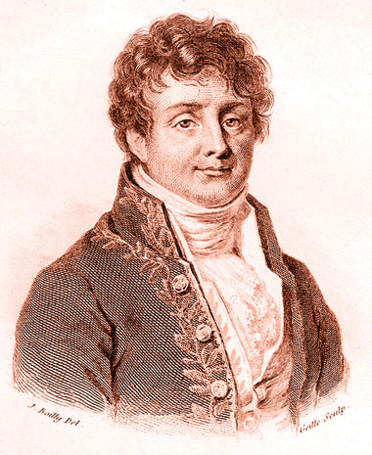
Short History of Time Series Analysis
Time series analysis have a long history
The serial dependency in time series data was recognized long ago
Joseph Fourier and Simeon Poisson worked on time series problems in the early 19th Century
Joseph Fourier

Slide 7
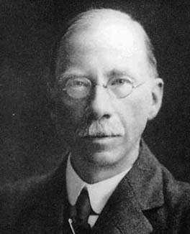
Short History of Time Series Analysis
Modern history of time series analysis started with George Udny Yule (1927) and Gilbert Walker (1931)
Yule worked on sunspot time series
Walker was attempting to forecast the tropical monsoon cycle
Developed the autoregressive (AR) model to account for serial correlation of values
The AR model is foundation of modern time series models
George Yule, time series pioneer

Slide 8
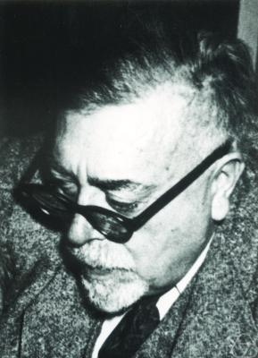
Short History of Time Series Analysis
Mathematical prodigy, Norbert Weiner, invented filters for stochastic time series processes, starting in the 1920s
Weiner’s filter theory is the basis of many time series filter methods
Predictive filters for noisy signals; not discussed here
Weiner process model for random walks is widely used
Norbert Weiner:
Invented time series filters

Slide 9
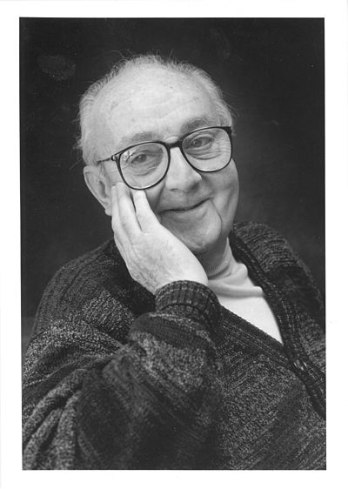
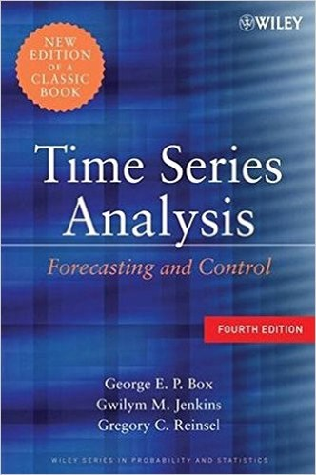
Short History of Time Series Analysis
George Box and Gwilym Jenkins fully developed a statistical theory of time series by extending the work of Yule and Walker in the 1950s and 1960s
Extended the AR model to include moving average (MA) terms
Included the integrative term to create the ARIMA model
The ARIMA model is our focus
George EP Box created general time series model
Seminal time series analysis book

Slide 10
21st Century Time Series Analysis
21st Century time series analysis
Considerable research continues to expand the frontiers
Bayesian time series models
R bsts package and Python PyMC3
Long short term memory (LSTM) models
Rarely give superior results
Many restrictive assumptions
Hidden Markov Models (HMMs) widely used
Python Scikit Learn HMM or R HMM package

Slide 11
Software for Time Series Analysis
Most statistical packages have considerable time series modeling capability
R time series analysis packages are wide and deep
Much leading edge research appears first in R packages
CRAN Time Series Task View, maintained by Rob Hyndman, contains curated index to R time series packages
Primary Python time series analysis package in Statsmodels.tsa
Bayesian time series models supported in PyMC.
Many newer Python time series packages packages, including:
Darts package includes cutting edge methods like hierarchical models
Meta Kats package - strong in forecasting including the PROFIT model
GrayKite Linkedin’s forecasting package

Slide 12
Fundamentals of Time Series
What are the fundamental properties of time series?
Representation and sampling
White noise series
Stationary time series
Autocorrelation and partial autocorrelation
Random walk series
Trend
Seasonal effects

Slide 13
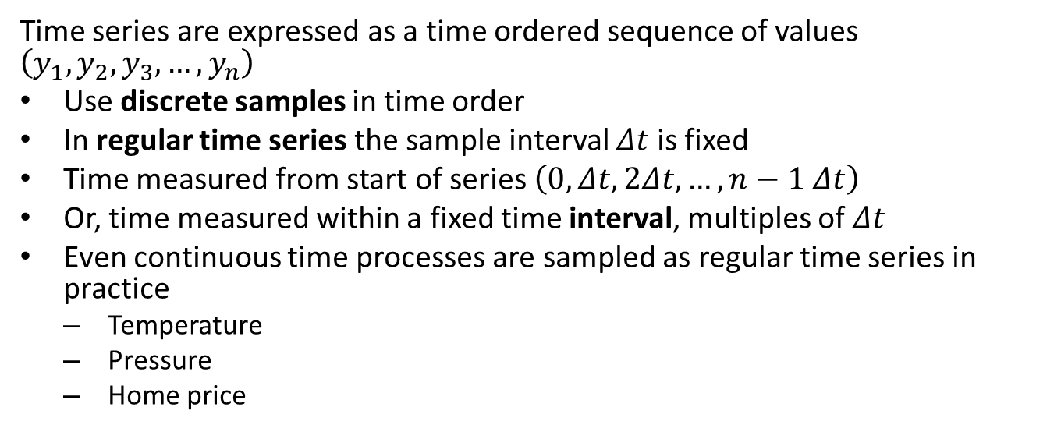
Time Series Representation
Time series are expressed as a time ordered sequence of values $\left(y_{1},y_{2},y_{3},…,y_{n}\right)$
Use discrete samples in time order
In regular time series the sample interval $Δt$ is fixed
Time measured from start of series $\left(0,Δt,2Δt,…,n−1 Δt\right)$
Or, time measured within a fixed time interval, multiples of $Δt$
Even continuous time processes are sampled as regular time series in practice
Temperature
Pressure
Home price

Slide 14
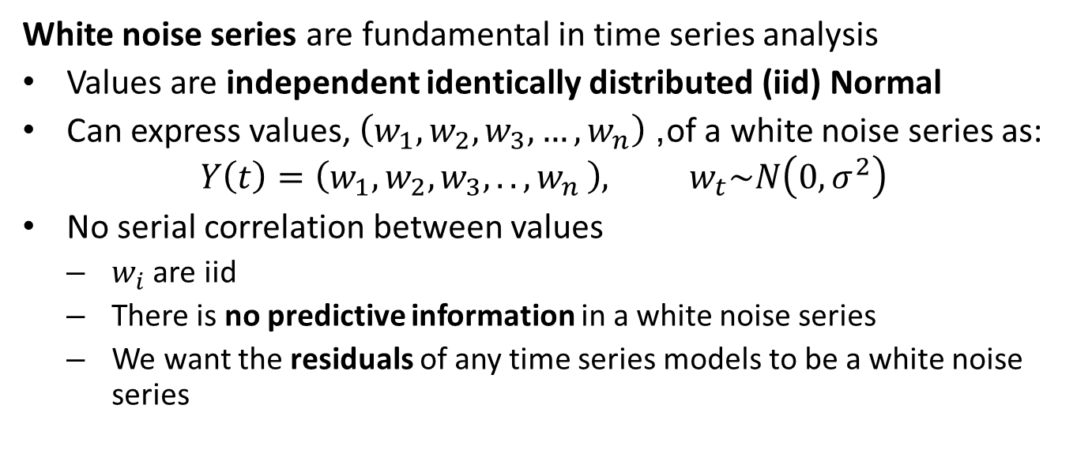
White Noise Series
White noise series are fundamental in time series analysis
Values are independent identically distributed (iid) Normal
Can express values, $\left(w_{1},w_{2},w_{3},…,w_{n}\right)$, of a white noise series as:
$$Y\left(t\right)=\left(w_{1},w_{2},w_{3},{.., w}_{n}\right), w_{t}\sim N\left(0,σ^{2}\right)$$
No serial correlation between values
$w_{i}$ are iid
There is no predictive information in a white noise series
We want the residuals of any time series models to be a white noise series

Slide 15
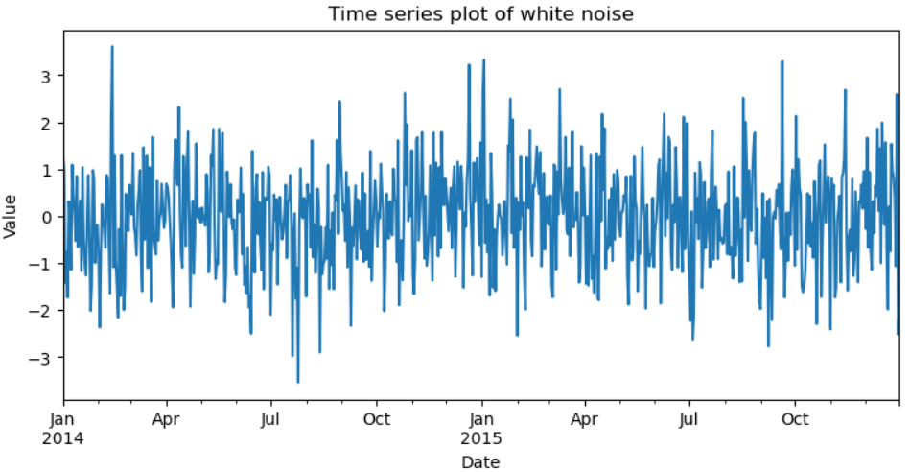
White Noise Series
What does a white noise series look like?
White noise is a series of iid impulses
White noise series has no trend
The white noise series has constant statistical properties for all time

Slide 16
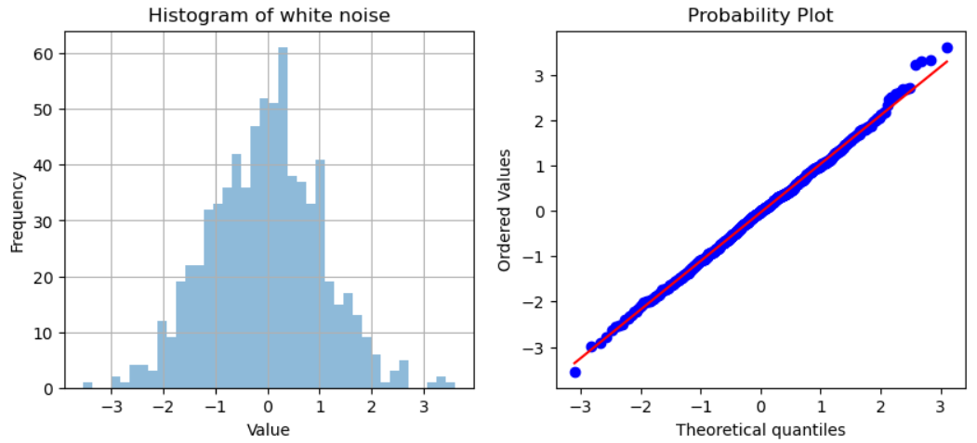
White Noise Series
The distribution of a white noise iid Normal
Each impulse is an independent draw from the Normal distribution

Slide 17
Introduction to Stationary Time Series
A white noise series is stationary
The statistical properties of a stationary time series are constant in time
Example; a stationary time series has constant mean and variance over any sample interval
Many time series models require stationarity
Often transform time series to make them stationary
More on this later

Slide 18
Stationary Time Series
What tests can be used for stationarity?
Plots
Qualitative
Nonstationary from seasonality and trend are usually visible
Hypothesis tests
Augmented Dicky-Fuller test
Kwiatkowski-Phillips-Schmidt-Shin (KPSS) test
More on these tests latter

Slide 19
Autocorrelation Properties of White Noise Series
Can measure the correlation of a time series with itself
The time series is correlated with itself at different time offsets
Each time step of offset is called a lag
The autocorrelation function (ACF) is measured between the series and the series lagged in time

Slide 20
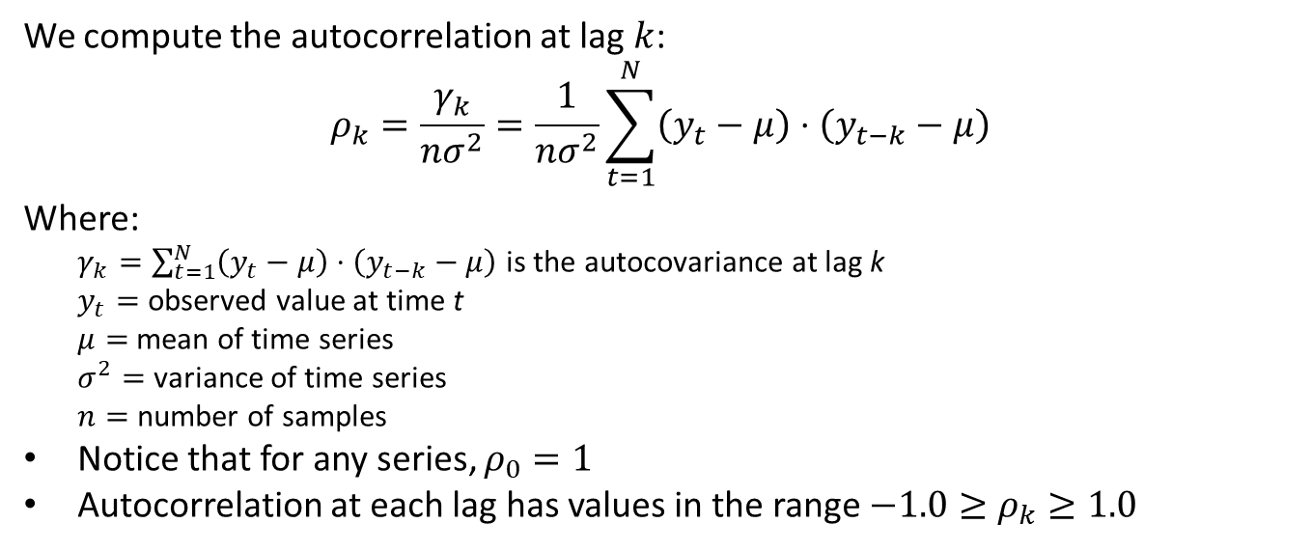
Autocorrelation Properties of White Noise Series
We compute the autocorrelation at lag $k$:
$$ρ_{k}=\frac{γ_{k}}{nσ^{2}}=\frac{1}{nσ^{2}}\sum_{t=1}^{N}{\left(y_{t}−μ\right)}⋅\left(y_{t−k}−μ\right)$$ Where:
$γ_{k}=\sum_{t=1}^{N}{\left(y_{t}−μ\right)}⋅\left(y_{t−k}−μ\right)$ is the autocovariance at lag k
$y_{t}=$ observed value at time t
$μ=$ mean of time series
$σ^{2}=$ variance of time series
$n=$ number of samples
Notice that for any series, $ρ_{0}=1$
Autocorrelation at each lag has values in the range $−1.0≥ρ_{k}≥1.0$

Slide 21
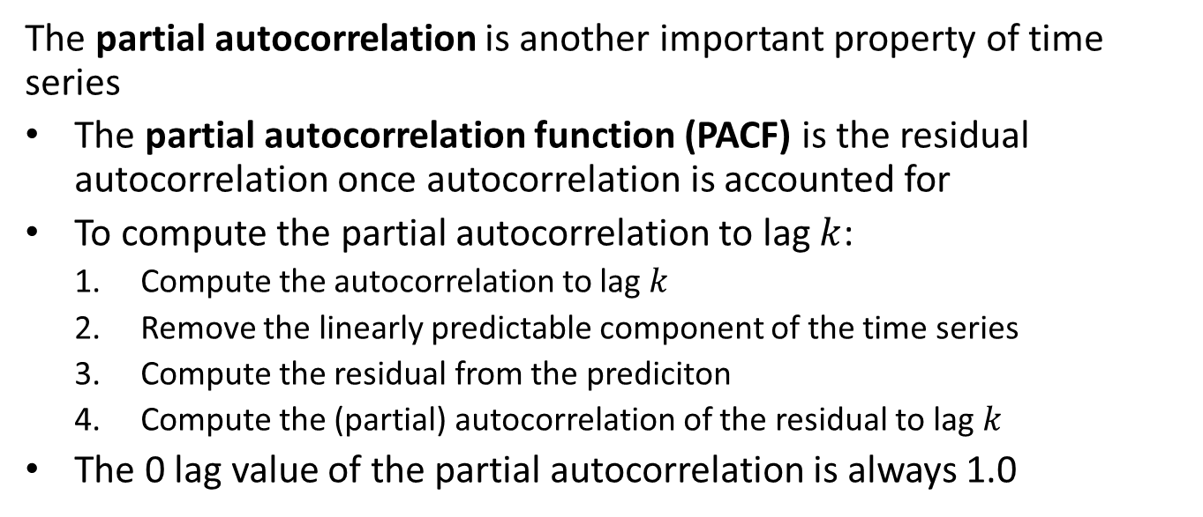
Autocorrelation Properties of White Noise Series
The partial autocorrelation is another important property of time series
The partial autocorrelation function (PACF) is the residual autocorrelation once autocorrelation is accounted for
To compute the partial autocorrelation to lag $k$:
Compute the autocorrelation to lag $k$
Remove the linearly predictable component of the time series
Compute the residual from the prediciton
Compute the (partial) autocorrelation of the residual to lag $k$
The 0 lag value of the partial autocorrelation is always 1.0

Slide 22
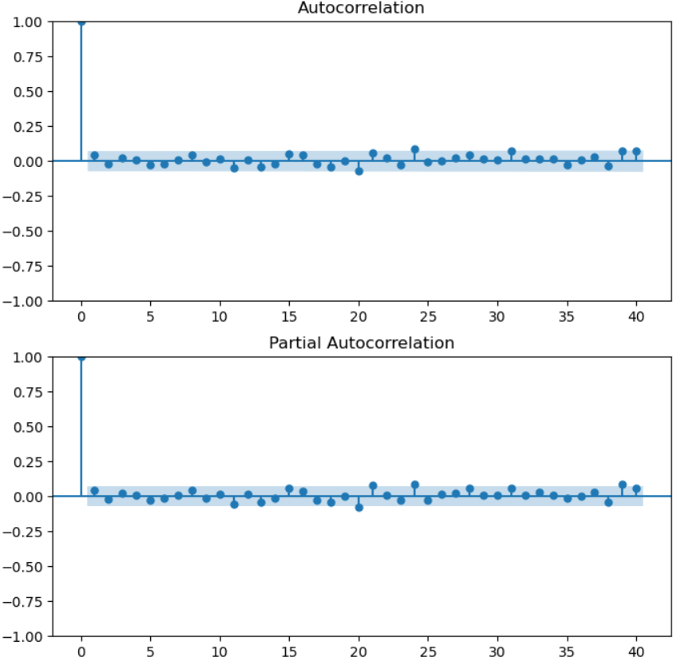
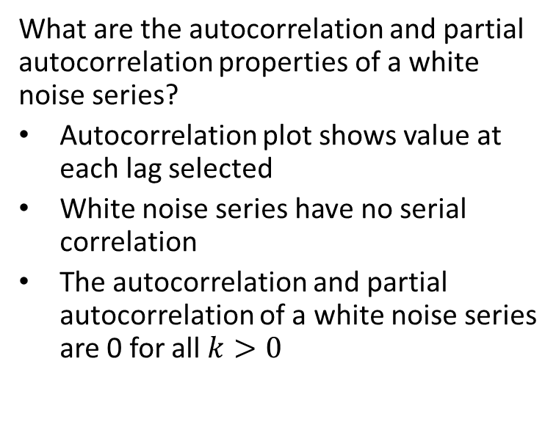
Autocorrelation Properties of White Noise Series
What are the autocorrelation and partial autocorrelation properties of a white noise series?
Autocorrelation plot shows value at each lag selected
White noise series have no serial correlation
The autocorrelation and partial autocorrelation of a white noise series are 0 for all $k>0$

Slide 23
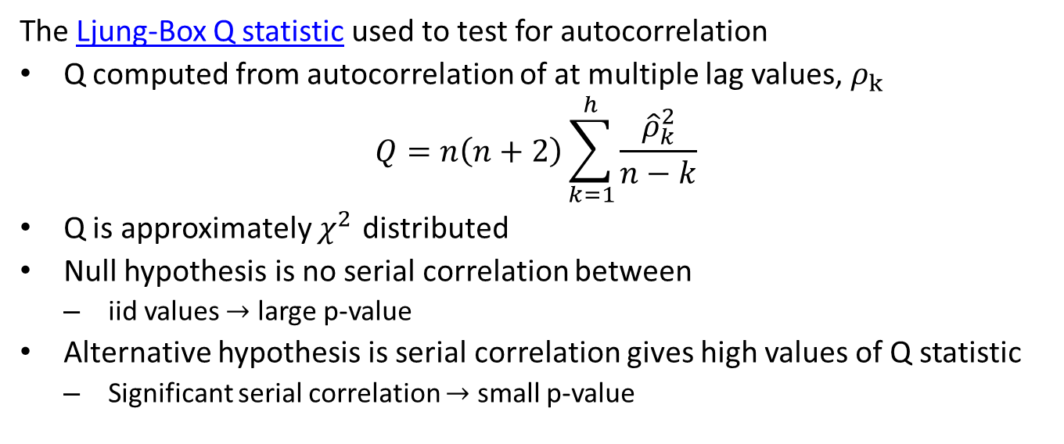
Hypothesis Test of Autocorrelation
The Ljung-Box Q statistic used to test for autocorrelation
Q computed from autocorrelation of at multiple lag values, $ρ_{k}$
$$Q=n\left(n+2\right)\sum_{k=1}^{h}{\frac{{\hat{ρ}}_{k}^{2}}{n−k}}$$
Q is approximately $χ^{2}$ distributed
Null hypothesis is no serial correlation between
iid values $→$ large p-value
Alternative hypothesis is serial correlation gives high values of Q statistic
Significant serial correlation $→$ small p-value

Slide 24
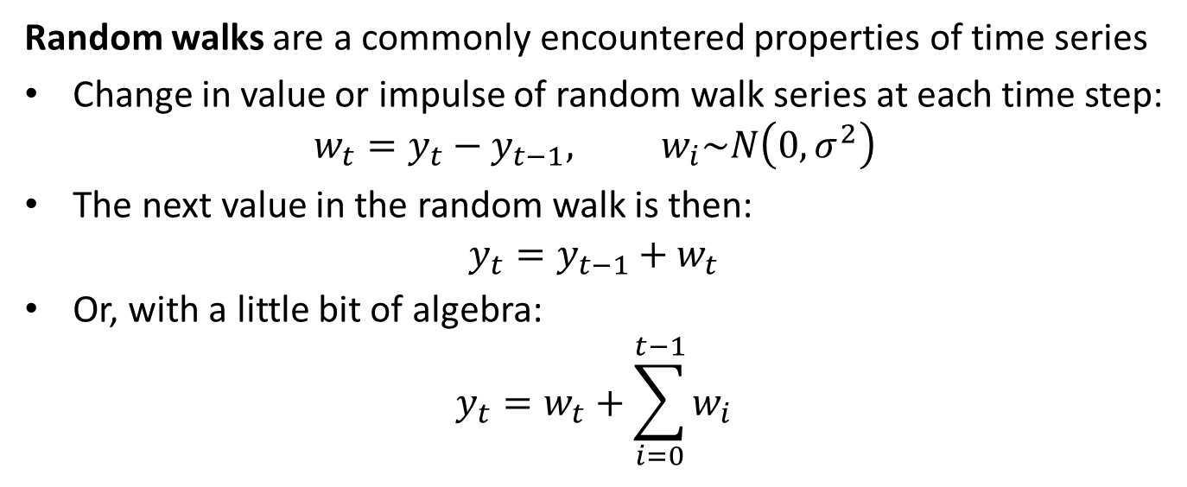
Random Walk Time Series
Random walks are a commonly encountered properties of time series
Change in value or impulse of random walk series at each time step:
$$w_{t}=y_{t}−y_{t−1}, w_{i}\sim N\left(0,σ^{2}\right)$$
The next value in the random walk is then:
$$y_{t}=y_{t−1}+w_{t}$$
Or, with a little bit of algebra:
$$y_{t}=w_{t}+\sum_{i=0}^{t−1}{w_{i}}$$

Slide 25
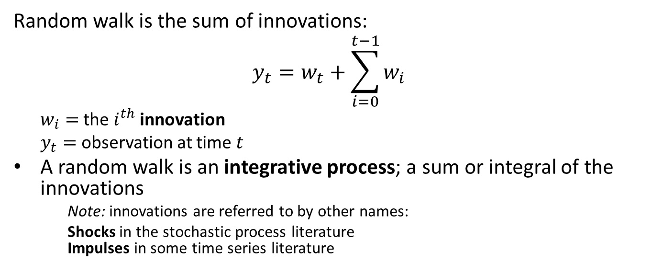
Random Walk Time Series
Random walk is the sum of innovations:
$$y_{t}=w_{t}+\sum_{i=0}^{t−1}{w_{i}}$$
$w_{i}=$ the $i^{th}$ innovation
$y_{t}=$ observation at time $t$
A random walk is an integrative process; a sum or integral of the innovations
Note: innovations are referred to by other names:
Shocks in the stochastic process literature Impulses in some time series literature

Slide 26
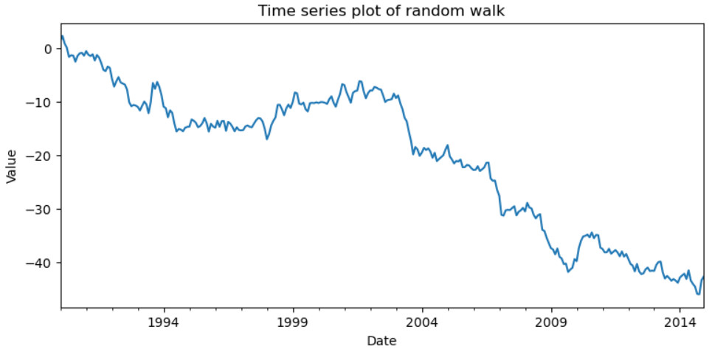
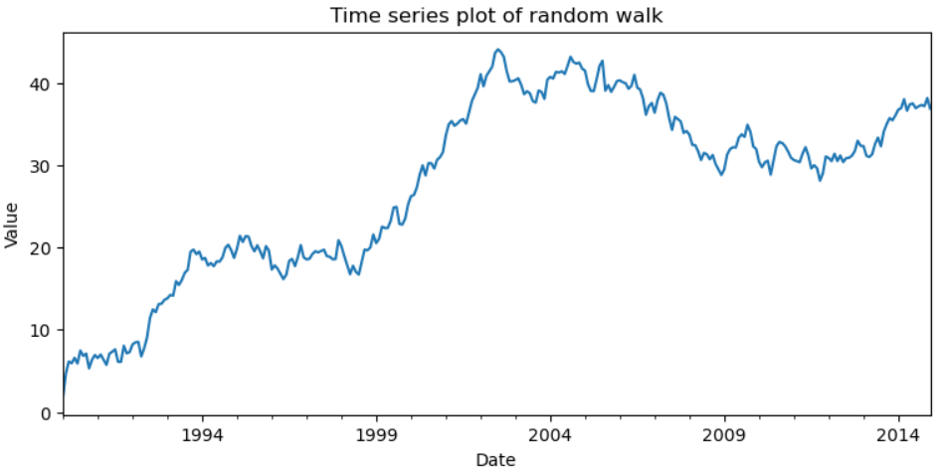
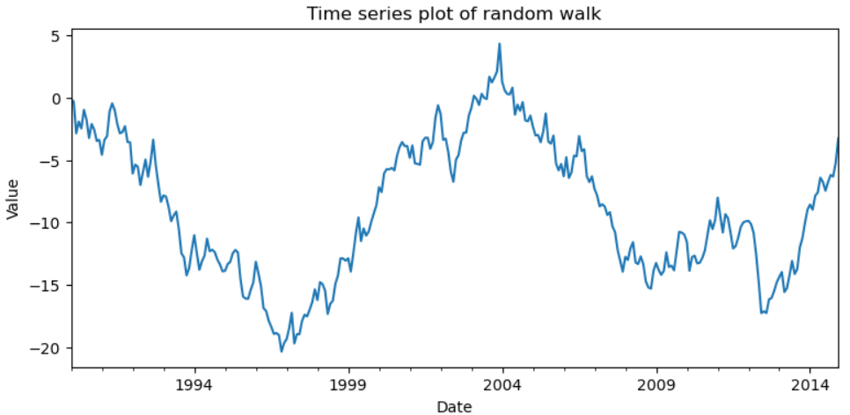
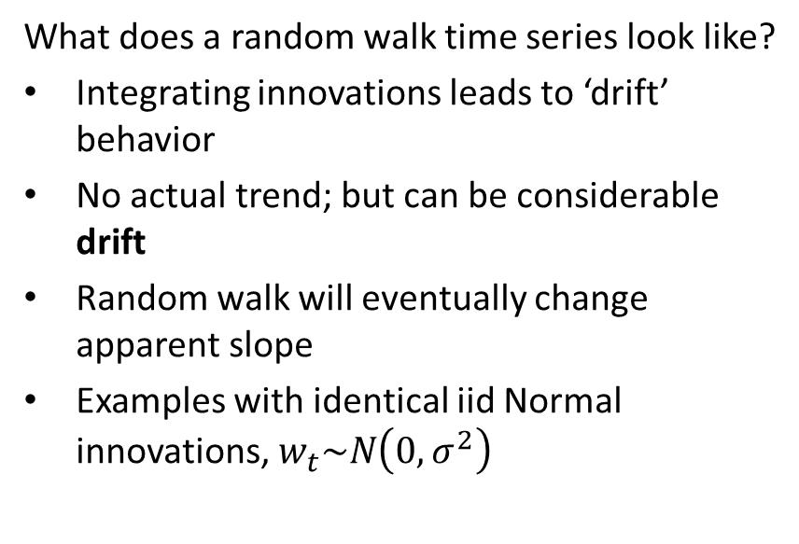
Random Walk Time Series
What does a random walk time series look like?
Integrating innovations leads to ‘drift’ behavior
No actual trend; but can be considerable drift
Random walk will eventually change apparent slope
Examples with identical iid Normal innovations, $w_{t}\sim N\left(0,σ^{2}\right)$

Slide 27
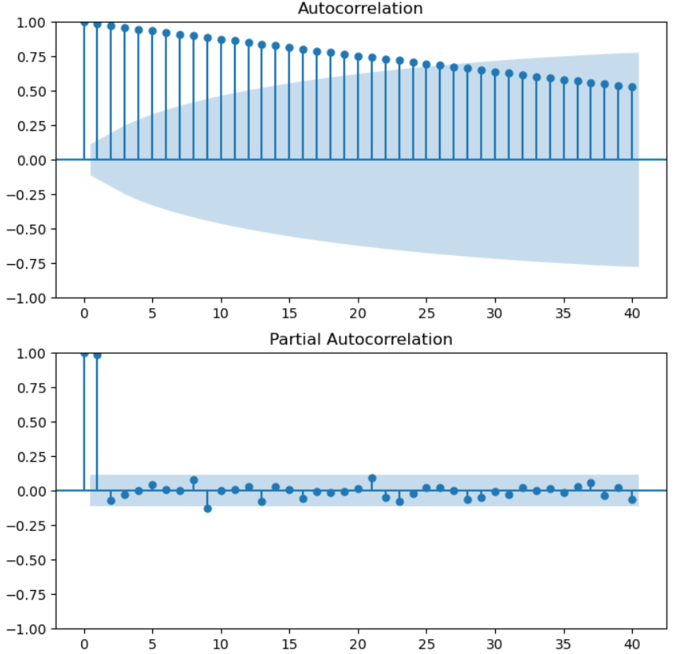
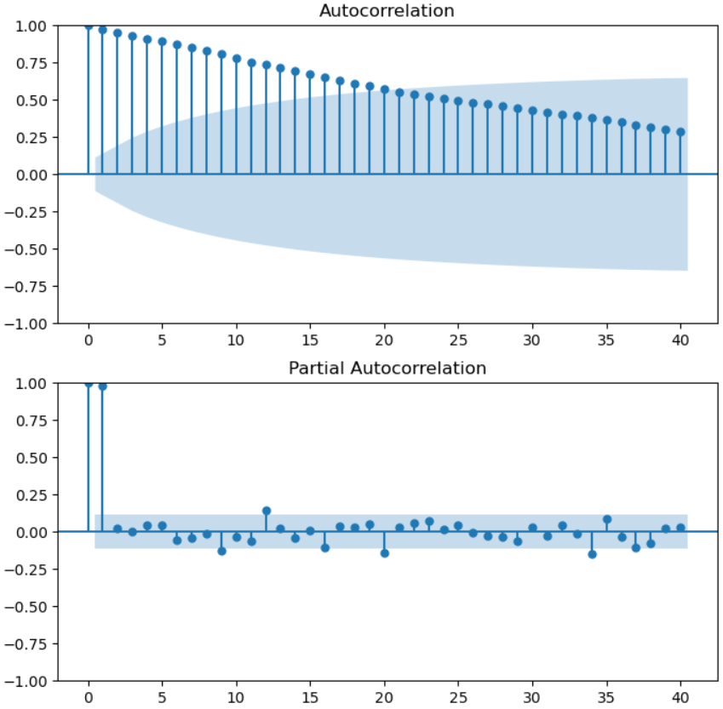
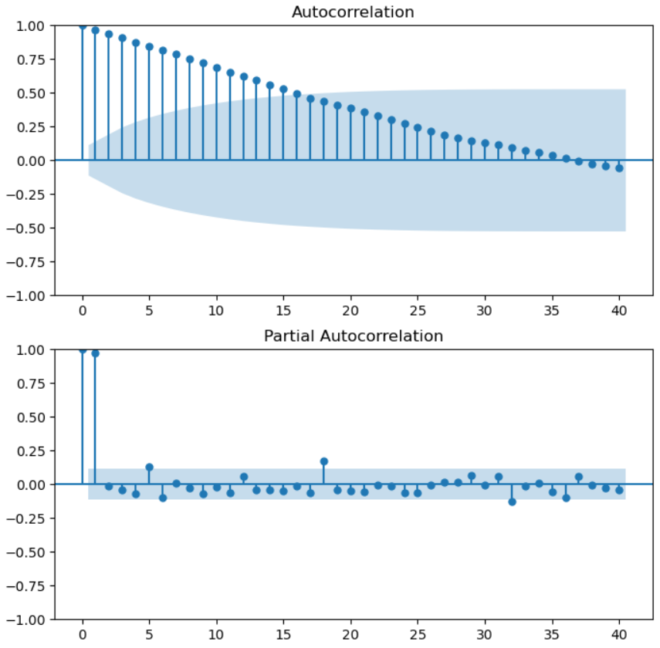
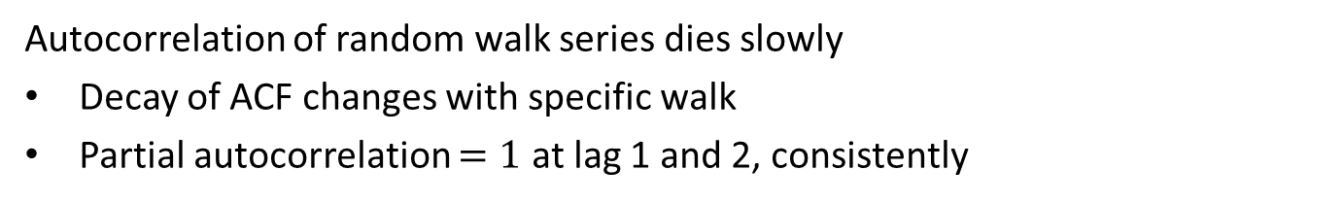
Random Walk Time Series
Autocorrelation of random walk series dies slowly
Decay of ACF changes with specific walk
Partial autocorrelation $=1$ at lag 1 and 2, consistently

Slide 28
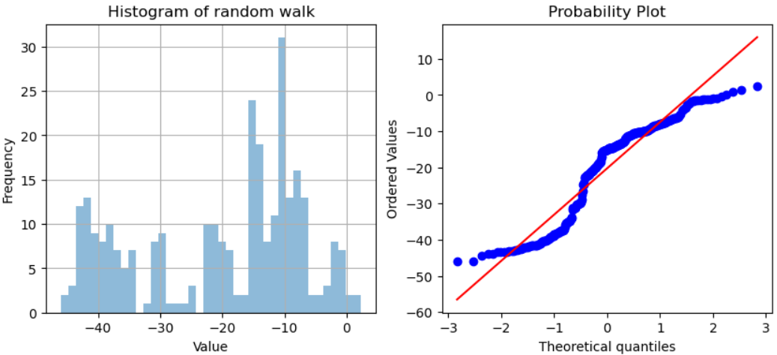
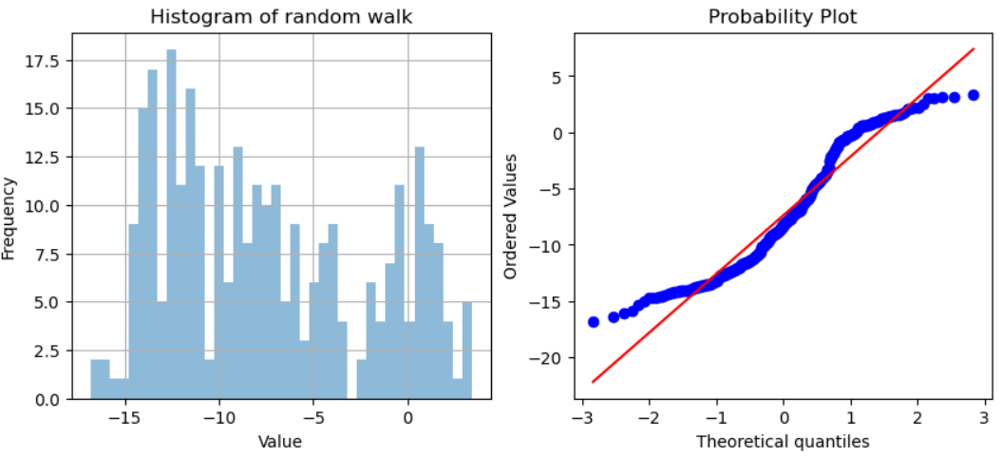
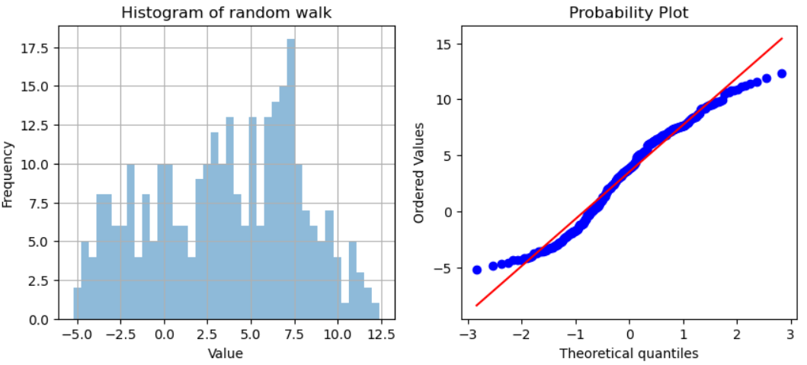
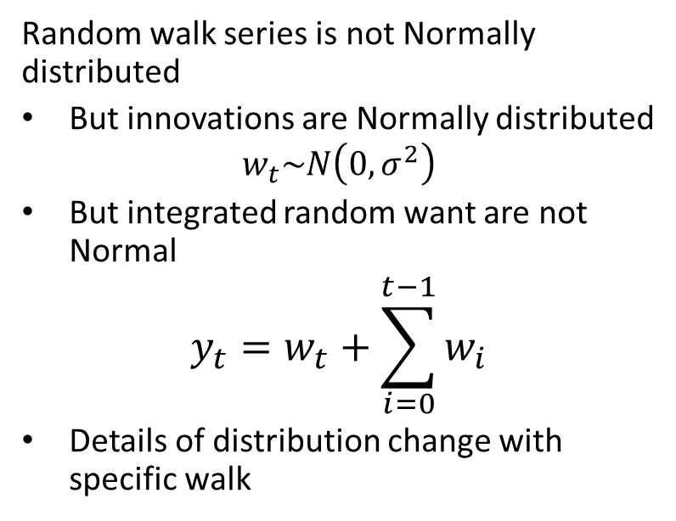
Random Walk Time Series
Random walk series is not Normally distributed
But innovations are Normally distributed
$$w_{t}\sim N\left(0,σ^{2}\right)$$
But integrated random want are not Normal
$$y_{t}=w_{t}+\sum_{i=0}^{t−1}{w_{i}}$$
Details of distribution change with specific walk

Slide 29
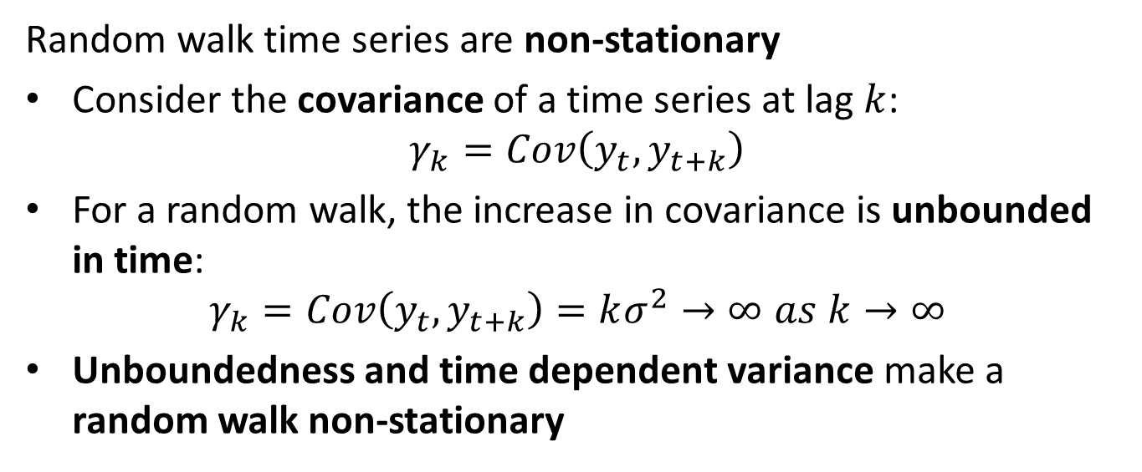
Random Walk Time Series
Random walk time series are non-stationary
Consider the covariance of a time series at lag $k$:
$$γ_{k}=Cov\left(y_{t},y_{t+k}\right)$$
For a random walk, the increase in covariance is unbounded in time:
$$γ_{k}=Cov\left(y_{t},y_{t+k}\right)=kσ^{2}→∞ as k→∞$$
Unboundedness and time dependent variance make a random walk non-stationary

Slide 30
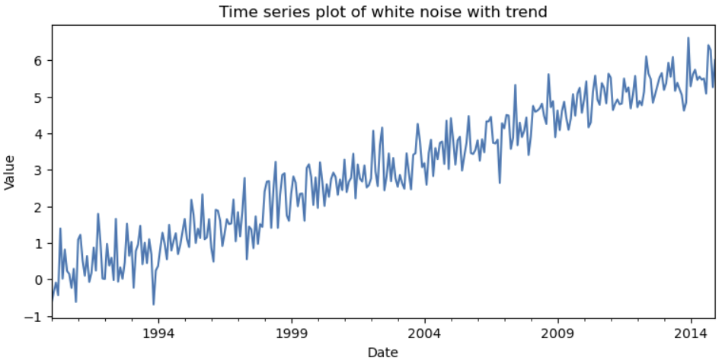
Time Series With Trend
Many real-world time series have a long-term trend
A trend is a long term change in the mean value of the time series
Series with trend are nonstationary since mean changes with time
Typically model trend as linear, polynomial, non-parametric splines, etc.
Example: white noise series with a linear trend

Slide 31
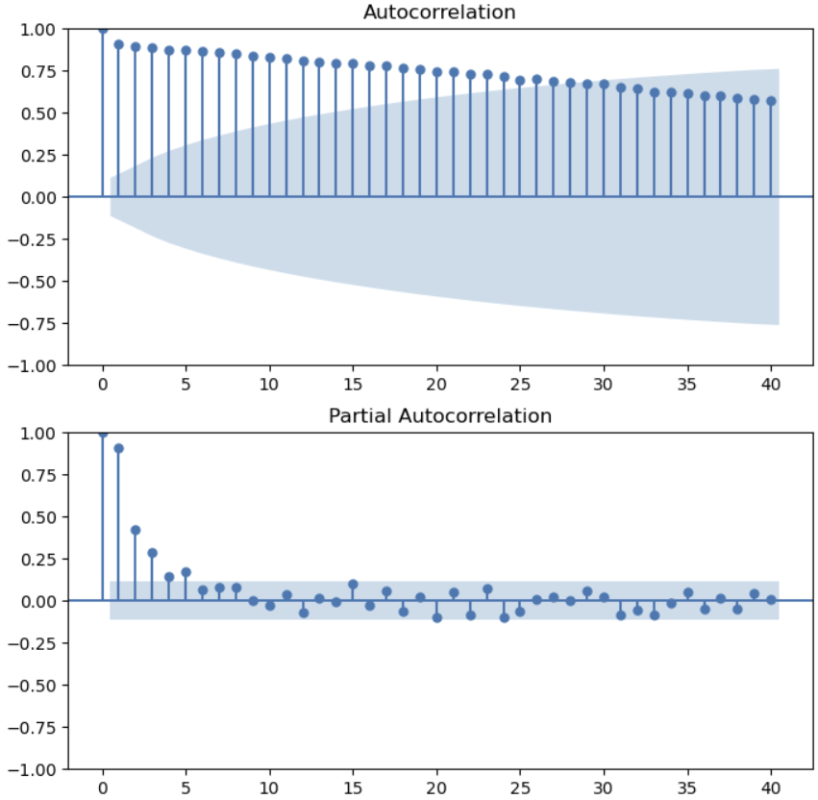
Time Series With Trend
ACF and PACF are only properly defined for stationary series
For non-stationary series, the ACF dies off slowly
Integrating innovations leads to long-term dependency
The PACF dies off quickly with lag, but generally slower than random walk
Example: ACF and PACF of the white noise series with trend

Slide 32
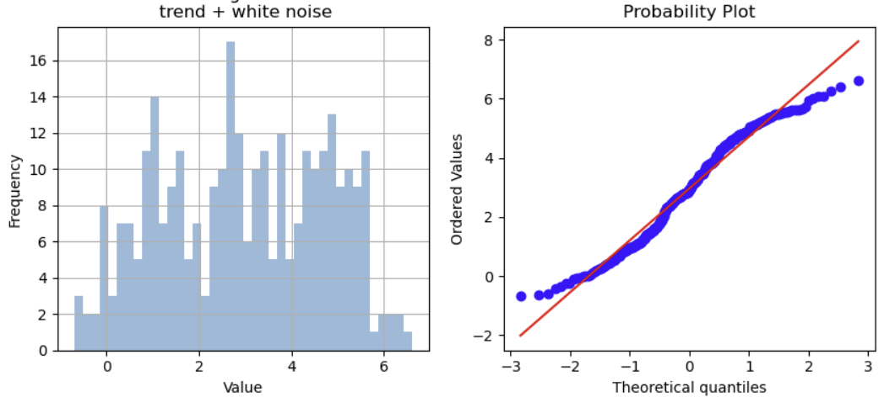
Time Series With Trend
Time series with trend are non-stationary
Any time series with trend is non-stationary
Mean and variance are dependent of window used to compute them
The distribution of even a white noise series with trend is non-Normal

Slide 33
Time Series With Trend
Trend models are not just strait lines
Polynomial regression
Piece-wise polynomial regression - e.g. splines
Used in PROFIT algorithm
A generalized additive model
Local polynomial regression - e.g. LOESS
Used in Statsmodels and R

Slide 34
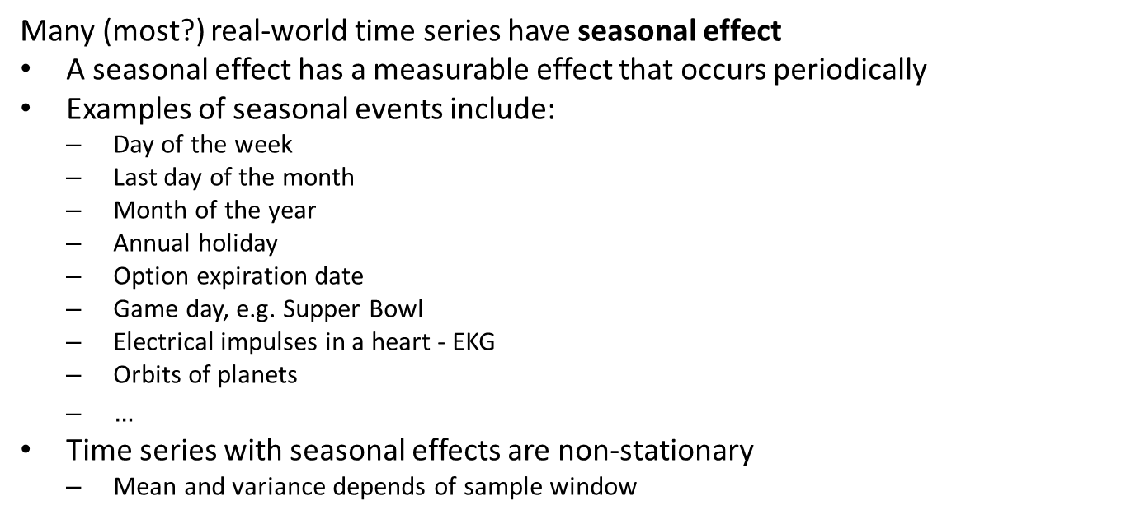
Time Series With Seasonal Effects
Many (most?) real-world time series have seasonal effect
A seasonal effect has a measurable effect that occurs periodically
Examples of seasonal events include:
Day of the week
Last day of the month
Month of the year
Annual holiday
Option expiration date
Game day, e.g. Supper Bowl
Electrical impulses in a heart - EKG
Orbits of planets
$…$
Time series with seasonal effects are non-stationary
Mean and variance depends of sample window

Slide 35
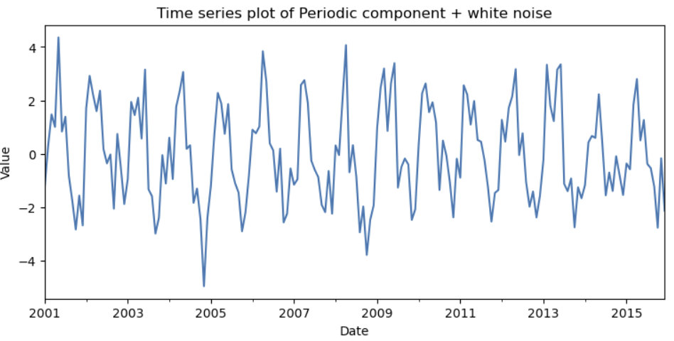
Time Series With Seasonal Effects
Example of a time series with a seasonal effect
White noise series with seasonal behavior
The seasonal behavior is periodic
This series is nonstationary!

Slide 36
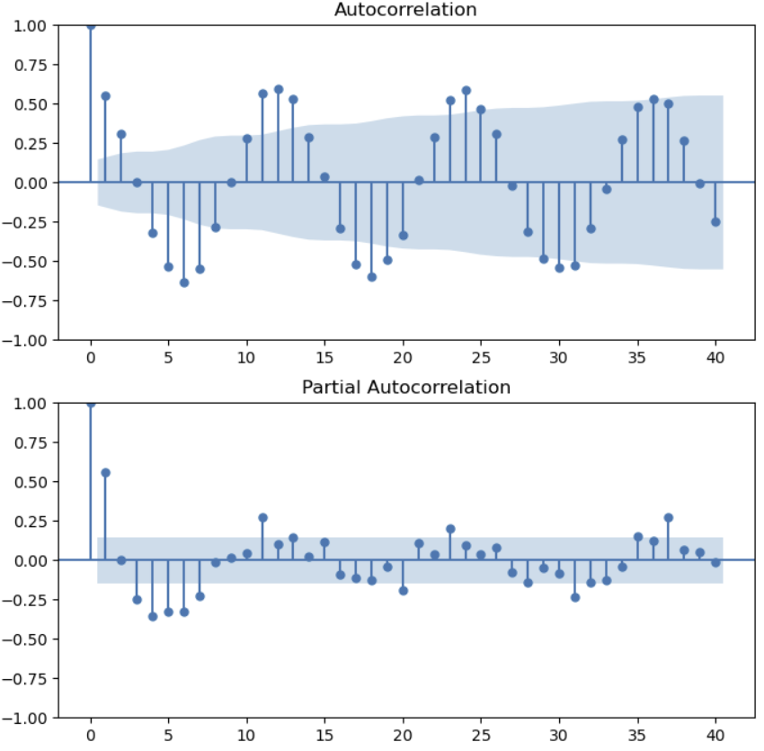
Time Series With Seasonal Effects
ACF and PACF of time series with seasonal behavior shows periodic behavior
Example: ACF and PACF time series with a seasonal effect
Seasonal time series gives periodic behavior of ACF and PACF
Period of ACF and PACF matches seasonal period in time series
Periodic behavior dies off slowly; seasonal time series is nonstationary!

Slide 37
Time Series With Seasonal Effects
How can we find seasonal periods of a time series?
Can use domain knowledge
Past experience can guide analysis
Example, specific holiday or event day effects
Can find periodic behavior with ACF
Periodic behavior can be at multiple periods
Example: solar energy generation series has annual period and daily period
Example: sales of beer has annual period as well as scheduled event day effects

Slide 38
Time Series With Seasonal Effects
Use regression models to find parameters for seasonal effects
Simple regression model:
Coefficient for each interval in period; e.g. 12 coefficients for monthly effects
But simple approach leads to high variance estimates of coefficients for periodic behavior
Coefficient for specific effect - e.g. date of holiday
Good option for specific date behavior
Basis function regression
PROFIT algorithm uses Fourier basis functions
A generalized additive model
Alternative, take seasonal differences

Slide 39
Time Series Decomposition
Simple model for seasonal effects
Goal, decompose the time series into its components
The Seasonal Trend decomposition model using Loess (STL) model
Uses a nonparametric and nonlinear local regression model, LOESS, to decompose trend component
Components are seasonal (S), trend (T), and the residual (R)
Additive decomposition model
Multiplicative decomposition model
MSTL adds modeling of multiple seasonal components
Seasonal differencing model removes seasonal effects

Slide 40
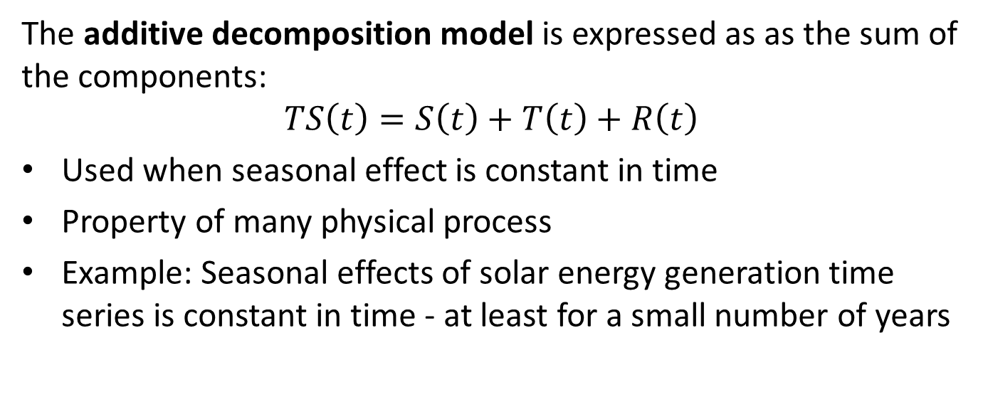
Time Series Decomposition
The additive decomposition model is expressed as as the sum of the components:
$$TS\left(t\right)=S\left(t\right)+T\left(t\right)+R\left(t\right)$$
Used when seasonal effect is constant in time
Property of many physical process
Example: Seasonal effects of solar energy generation time series is constant in time - at least for a small number of years

Slide 41
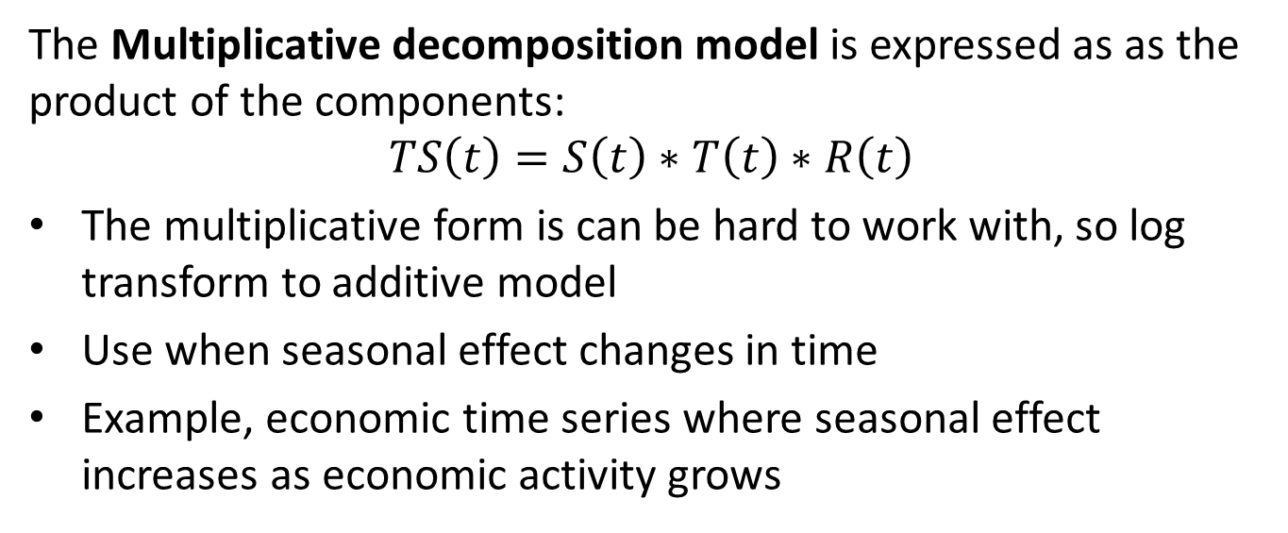
Time Series Decomposition
The Multiplicative decomposition model is expressed as as the product of the components:
$$TS\left(t\right)=S\left(t\right)∗T\left(t\right)∗R\left(t\right)$$
The multiplicative form is can be hard to work with, so log transform to additive model
Use when seasonal effect changes in time
Example, economic time series where seasonal effect increases as economic activity grows

Slide 42
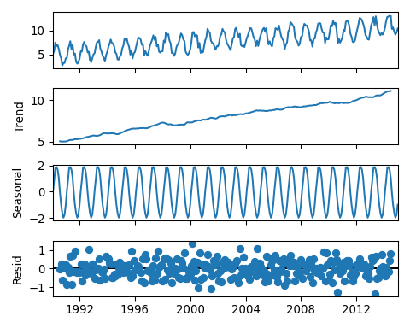
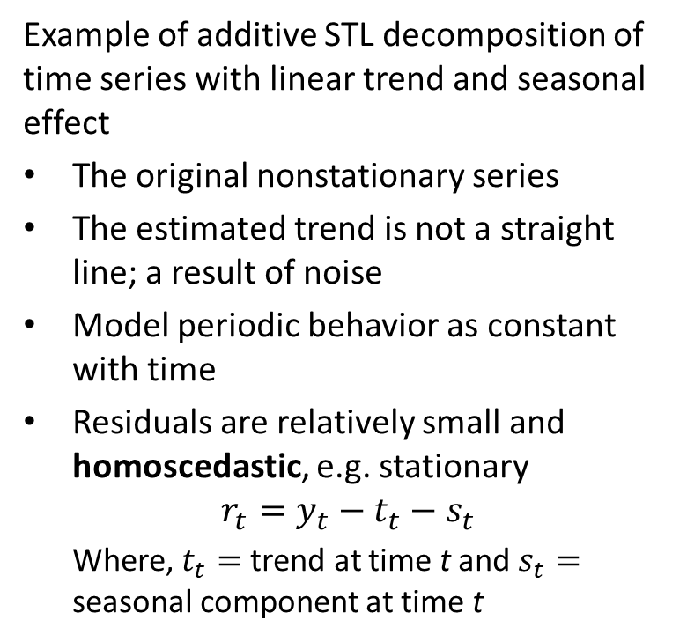
Time Series Decomposition
Example of additive STL decomposition of time series with linear trend and seasonal effect
The original nonstationary series
The estimated trend is not a straight line; a result of noise
Model periodic behavior as constant with time
Residuals are relatively small and homoscedastic, e.g. stationary
$$r_{t}=y_{t}−t_{t}−s_{t}$$
Where, $t_{t}=$ trend at time t and $s_{t}=$ seasonal component at time t

Slide 43
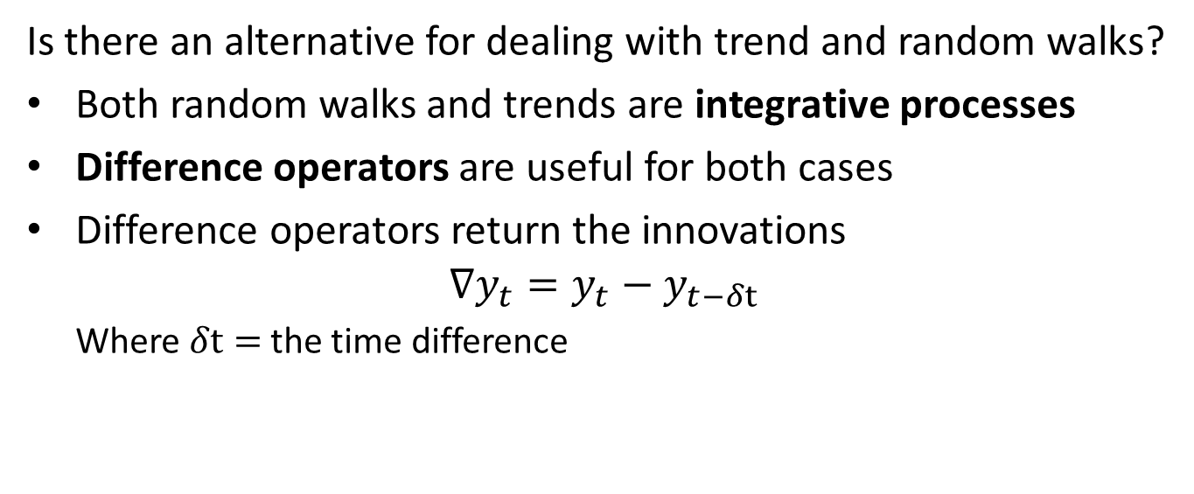
Time Series Difference Operators
Is there an alternative for dealing with trend and random walks?
Both random walks and trends are integrative processes
Difference operators are useful for both cases
Difference operators return the innovations
$$∇y_{t}=y_{t}−y_{t−δt}$$
Where $δt=$ the time difference

Slide 44
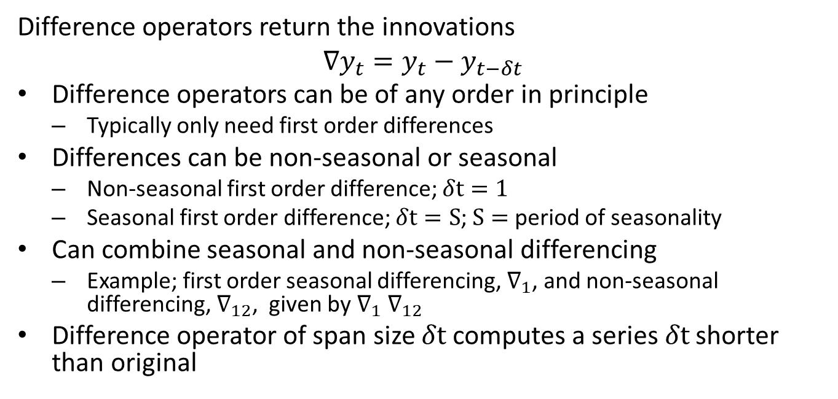
Time Series Difference Operators
Difference operators return the innovations
$$∇y_{t}=y_{t}−y_{t−δt}$$
Difference operators can be of any order in principle
Typically only need first order differences
Differences can be non-seasonal or seasonal
Non-seasonal first order difference; $δt=1$
Seasonal first order difference; $δt=S$; $S=$ period of seasonality
Can combine seasonal and non-seasonal differencing
Example; first order seasonal differencing, $∇_{1}$, and non-seasonal differencing, $∇_{12}$, given by $∇_{1}$ $∇_{12}$
Difference operator of span size $δt$ computes a series $δt$ shorter than original

Slide 45
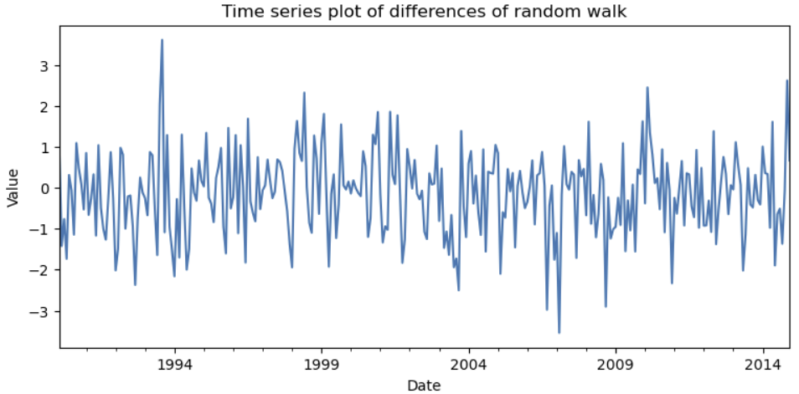
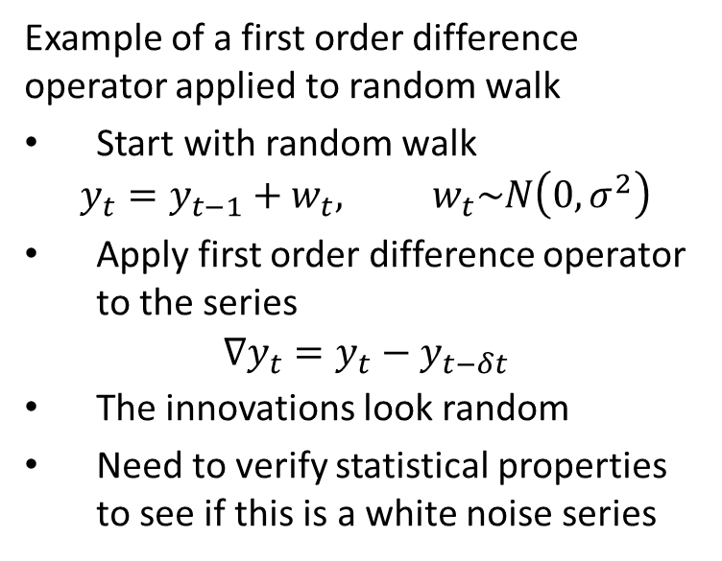
Time Series Difference Operators
Example of a first order difference operator applied to random walk
Start with random walk
$$y_{t}=y_{t−1}+w_{t}, w_{t}\sim N\left(0,σ^{2}\right)$$
Apply first order difference operator to the series
$$∇y_{t}=y_{t}−y_{t−δt}$$
The innovations look random
Need to verify statistical properties to see if this is a white noise series

Slide 46
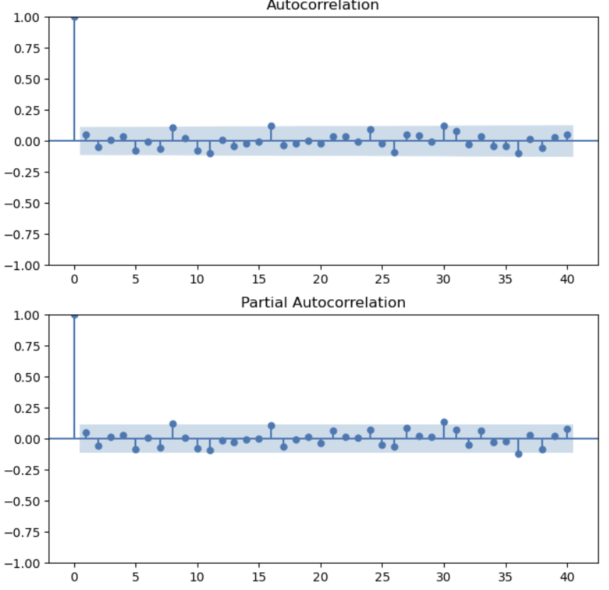
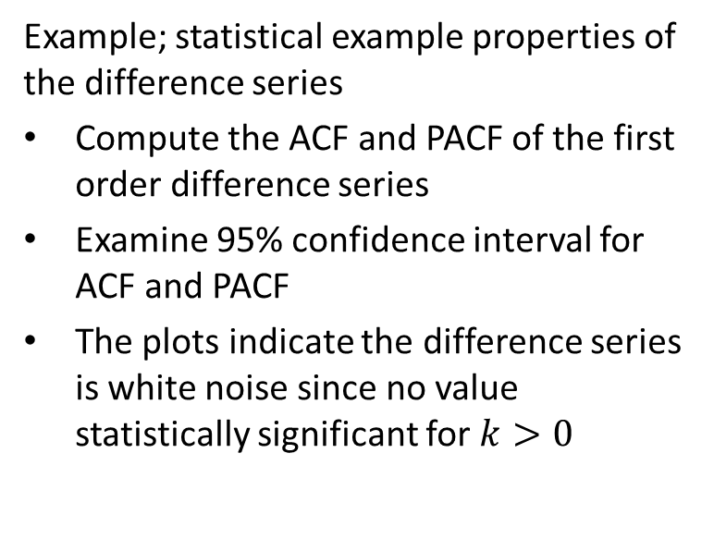
Time Series Difference Operators
Example; statistical example properties of the difference series
Compute the ACF and PACF of the first order difference series
Examine 95% confidence interval for ACF and PACF
The plots indicate the difference series is white noise since no value statistically significant for $k>0$

Slide 47
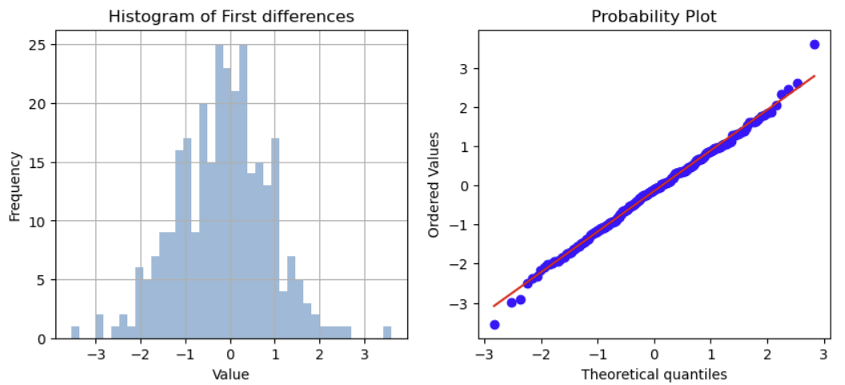
Time Series Difference Operators
Example: statistical properties of the difference series
Examine distribution of first order differences
The distribution is Normal
The plots indicate the difference series is white noise

Slide 48
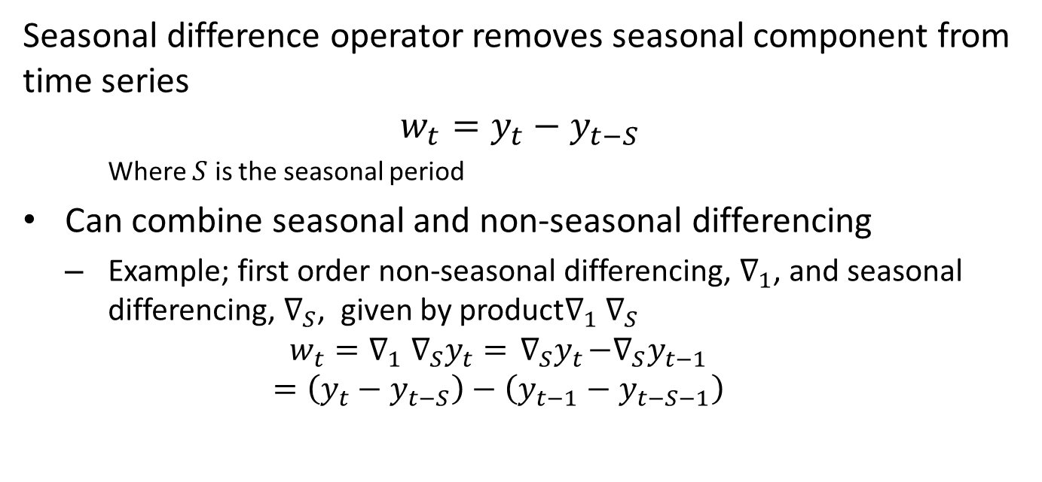
Time Series Difference Operators
Seasonal difference operator removes seasonal component from time series
$$w_{t}=y_{t}−y_{t−S}$$
Where $S$ is the seasonal period
Can combine seasonal and non-seasonal differencing
Example; first order non-seasonal differencing, $∇_{1}$, and seasonal differencing, $∇_{S}$, given by product$∇_{1}$ $∇_{S}$
$$w_{t}={∇_{1} ∇_{S}y}_{t}={ ∇_{S}y}_{t}−{∇_{S}y}_{t−1}$$
$$=\left(y_{t}−y_{t−S}\right)−\left(y_{t−1}−y_{t−S−1}\right)$$

Slide 49
Stationarity
A Stationary time series has statistical properties that are invariant in time
Properties of a second order stationary series
First two moments of series are constant in time
Mean
Variance

Slide 50
Stationarity
A time series is not stationary if it has any of the following properties:
Random walk
Trend
Seasonality
Non-constant variance
Note, a stationary series does not preclude the presence of serial correlations
Do not confuse these points!
Many time series models for serial correlation properties require stationarity

Slide 51
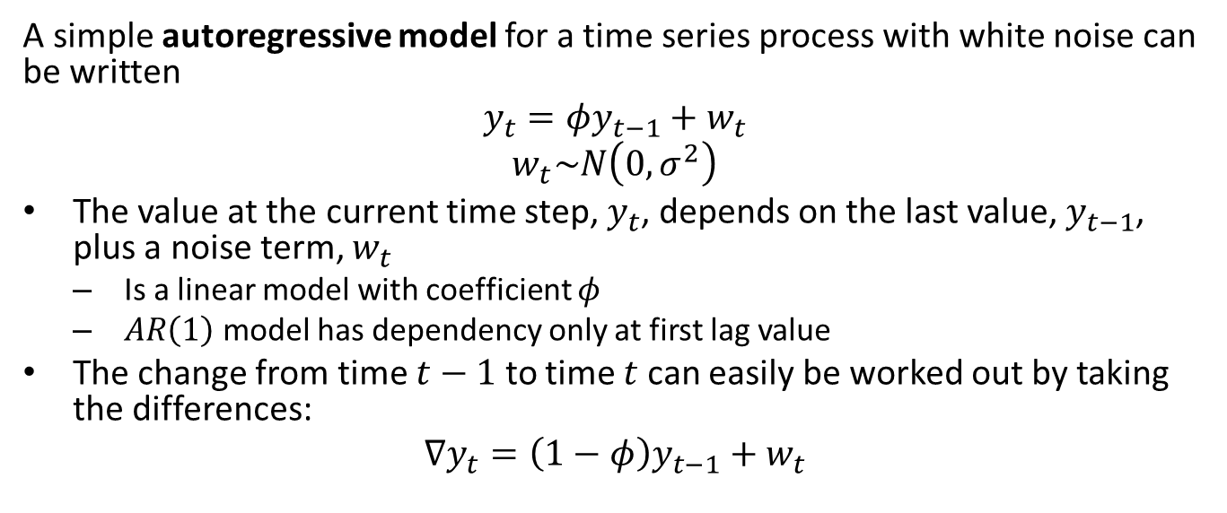
Stationarity
A simple autoregressive model for a time series process with white noise can be written
$$y_{t}=φy_{t−1}+w_{t}$$
$$w_{t}\sim N\left(0,σ^{2}\right)$$
The value at the current time step, $y_{t}$, depends on the last value, $y_{t−1}$, plus a noise term, $w_{t}$
Is a linear model with coefficient $φ$
$AR\left(1\right)$ model has dependency only at first lag value
The change from time $t−1$ to time $t$ can easily be worked out by taking the differences:
$$∇y_{t}=\left(1−φ\right)y_{t−1}+w_{t}$$

Slide 52
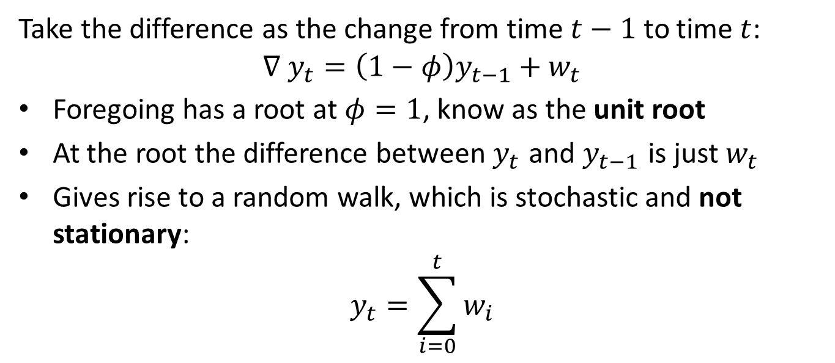
Stationarity
Take the difference as the change from time $t−1$ to time $t$:
$$∇ y_{t}=\left(1−φ\right)y_{t−1}+w_{t}$$
Foregoing has a root at $φ=1$, know as the unit root
At the root the difference between $y_{t}$ and $y_{t−1}$ is just $w_{t}$
Gives rise to a random walk, which is stochastic and not stationary:
$$y_{t}=\sum_{i=0}^{t}{w_{i}}$$

Slide 53
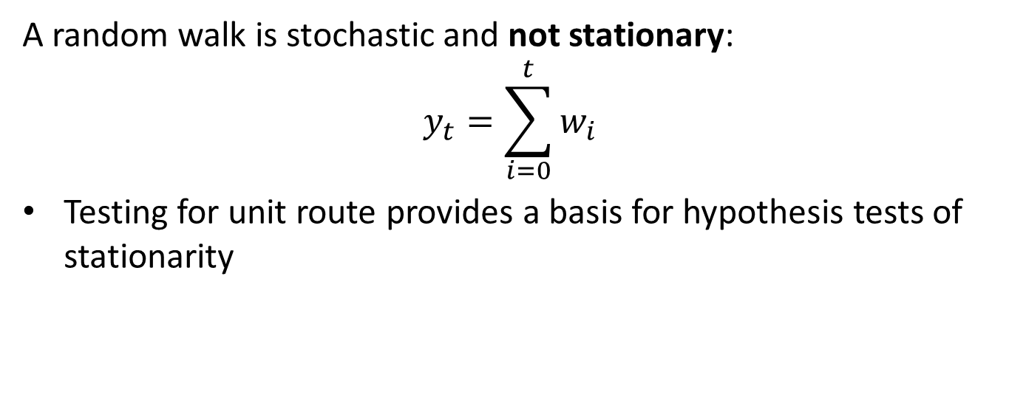
Stationarity
A random walk is stochastic and not stationary:
$$y_{t}=\sum_{i=0}^{t}{w_{i}}$$
Testing for unit route provides a basis for hypothesis tests of stationarity

Slide 54

Stationarity
There are several ways to define a model for a stationary process
A unit root test on an AR process
$$∇ y_{t}=\left(1−φ\right)y_{t−1}+w_{t}$$
A unit root test with a constant
Often constant is initial value, $c=y_{0}$
Or a mean value $c=μ$
$$y_{t}=c+φy_{t−1}+w_{t}$$
Trend stationary process, with or without a constant
Used to test if a process is stationary about a deterministic trend, $β$, and intercept $β_{o}=c$
$$y_{t}=c+βt+φy_{t−1}+w_{t}$$

Slide 55
Stationarity
There are a number of ways to determine if a time series is stationary
We will work with two of the many possible tests here:
Augmented Dicky-Fuller test or ADF test
ADF tests are unit root tests of the significance a linear time series model
Coefficients represent components of the time series, e.g. constsant, trend and lagged differences
Null distribution is that the series is non-stationary
Kwiatkowski–Phillips–Schmidt–Shin (KPSS) test is a unit root test for stationarity about a trend of time series
Null hypothesis is that the time series is trend stationary
Don’t me confused by the different null hypotheses for these tests!

Slide 56
Stationarity
There is often a small difference between a time series nonstationary time series with a unit root and a time series with a root close to unit
Therefore, unit root tests are said to lack power
Lack of power means a hypothesis test may not be able to reject a hypothesis of non-stationarity
In other cases, the opposite might be true
It is best to include a visual inspection of the properties of the time series as well

Slide 57

Stationarity
Example of hypothesis tests on 5 example time series
White noise series, is stationary
Time series with periodic behavior, is nonstationary
Random walk, nonstationary
Time series with trend, nonstationary
Time series with trend and seasonal component, nonstationary

Slide 58

Stationarity
Example of hypothesis tests on 5 example time series
White noise series
ADF; reject hypothesis of nonstationary
KPSS test cannot reject null hypothesis of stationary
Example of tests for stationarity

Slide 59
Stationarity
Example of hypothesis tests on 5 example time series
Periodic series
ADF; reject hypothesis of stationary
KPSS test cannot reject null hypothesis of stationary
Ambiguous result from low-power, so assume nonstationary
Example of tests for stationarity

Slide 60
Stationarity
Example of hypothesis tests on 5 example time series
Random walk series
ADF; cannot reject hypothesis of nonstationary
KPSS reject null hypothesis of stationary
Example of tests for stationarity

Slide 61
Stationarity
Example of hypothesis tests on 5 example time series
Trend series
ADF; reject hypothesis of trend-nonstationary
KPSS test cannot reject null hypothesis of trend-stationary
Example of tests for stationarity

Slide 62
Stationarity
Example of hypothesis tests on 5 example time series
Seasonal series
ADF; reject hypothesis of trend-nonstationary
KPSS test cannot reject null hypothesis of trend-stationary
An incorrect inference, perhaps result of noise and low power of test!
Example of tests for stationarity

Slide 63
Summary
Fundamental elements of time series
Fundamental components which cannot be predicted
White noise
Random walks
Autocorrelation and partial autocorrelation
Trend
Seasonal components
Differencing to transform to stationarity
Seasonal differencing
Non-seasonal differencing
Stationarity properties
augmented Dicky-Fuller test
KPSS test

