Slide 1
Models Categorical Variables and Nonlinear Response
Steve Elston

Slide 2
Review
Linear models are a flexible and widely used class of models
Fit model coefficients by least squares estimation
Least squares is a maximum likelihood estimate, given Normally distributed residuals
Can use many types of predictor variables
We prefer the simplest model that does a reasonable job
The principle of Occam’s razor
Must consider the bias-variance trade-off
Outliers can have significant effect on linear model parameter estimates

Slide 3
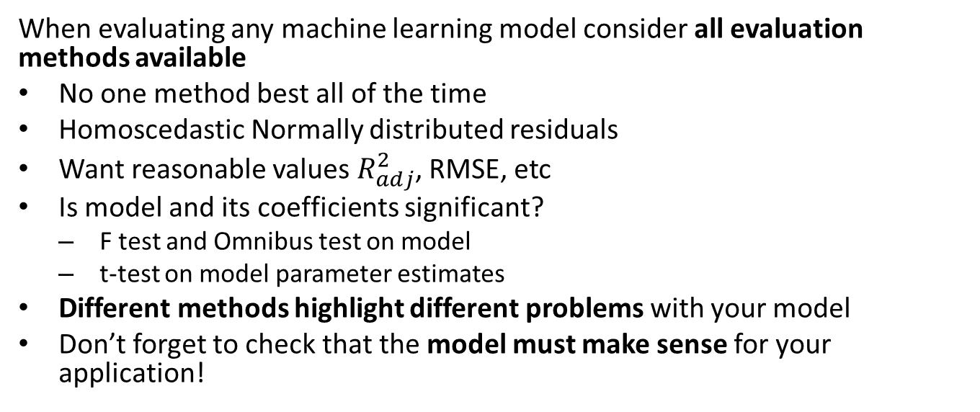
Review
When evaluating any machine learning model consider all evaluation methods available
No one method best all of the time
Homoscedastic Normally distributed residuals
Want reasonable values $R_{adj}^{2}$, RMSE, etc
Is model and its coefficients significant?
F test and Omnibus test on model
t-test on model parameter estimates
Different methods highlight different problems with your model
Don’t forget to check that the model must make sense for your application!

Slide 4
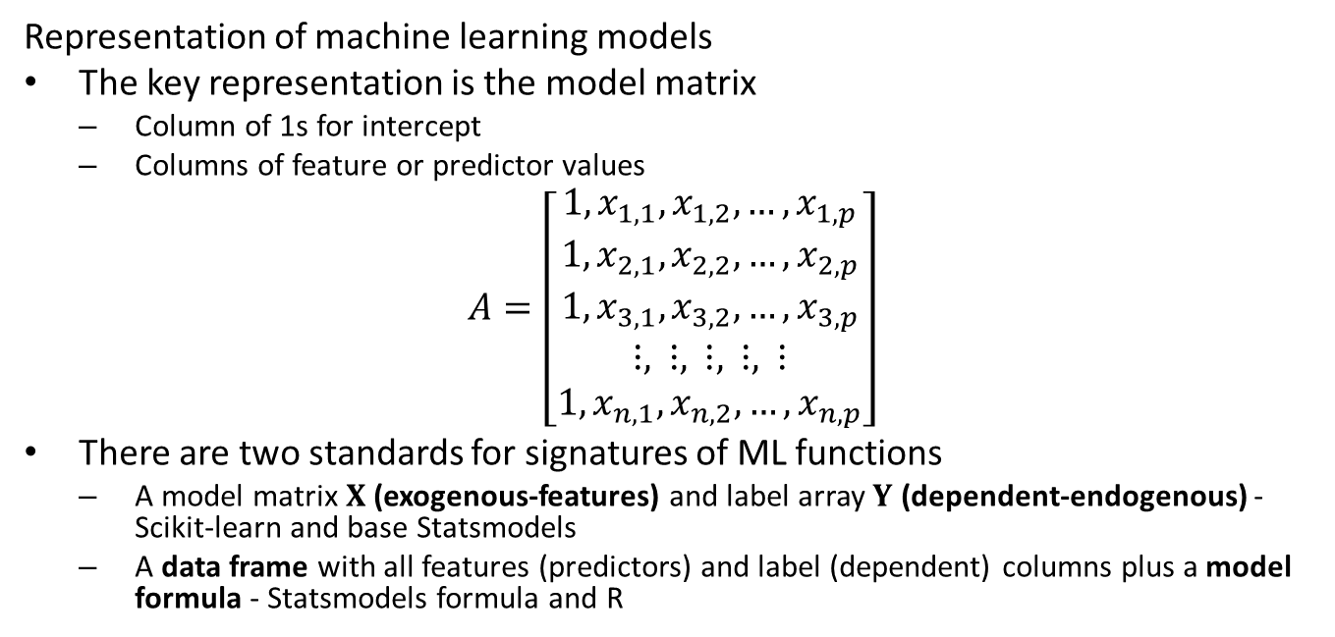
Review
Representation of machine learning models
The key representation is the model matrix
Column of 1s for intercept
Columns of feature or predictor values
$$A=\left[\begin{matrix}1,x_{1,1},x_{1,2},…,x_{1,p} \\ 1,x_{2,1},x_{2,2},…,x_{2,p} \\ 1,x_{3,1},x_{3,2},…,x_{3,p} \\ ⋮, ⋮, ⋮, ⋮, ⋮ \\ 1,x_{n,1},x_{n,2},…,x_{n,p}\end{matrix}\right]$$
There are two standards for signatures of ML functions
A model matrix $X$ (exogenous-features) and label array $Y$ (dependent-endogenous) - Scikit-learn and base Statsmodels
A data frame with all features (predictors) and label (dependent) columns plus a model formula - Statsmodels formula and R

Slide 5
Review
There are a number of assumptions in linear models that you overlook at your peril!
The feature or predictor variables should be independent of one another
This is rarely true in practice
Multi-collinearity between features makes the model under-determined
We assume that numeric features or predictors have zero mean and about the same scale
To not bias the regression coefficient estimation, predictors must have 0 mean
Predictors with a large numeric range must not dominate training
Values of each predictor or feature should be iid
If variance changes with sample, the coefficient cannot be constant
If predictor values have serial correlation the iid assumption is violated - use time series models

Slide 6
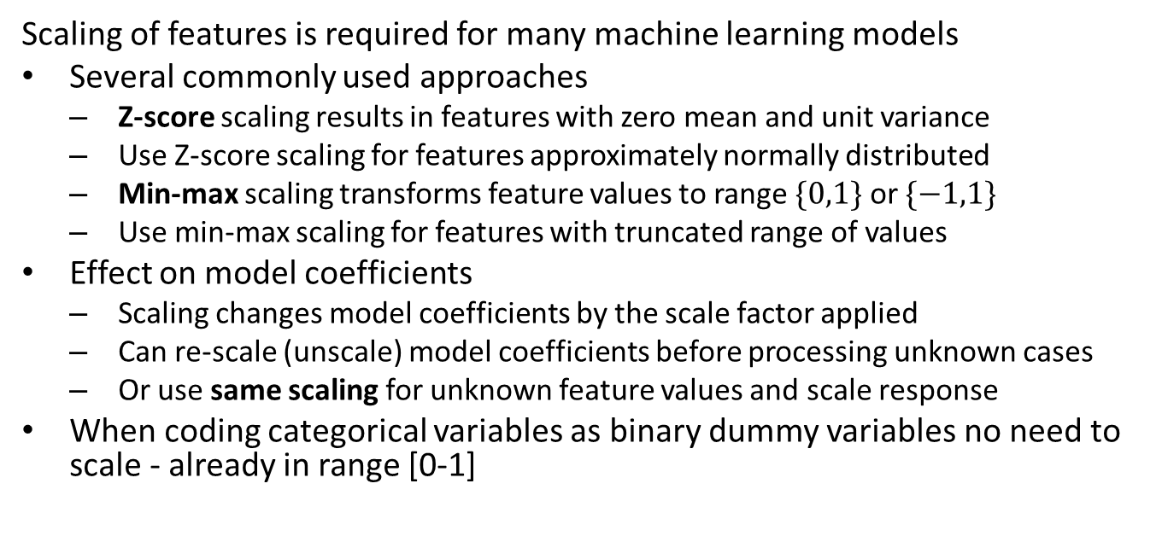
Review
Scaling of features is required for many machine learning models
Several commonly used approaches
Z-score scaling results in features with zero mean and unit variance
Use Z-score scaling for features approximately normally distributed
Min-max scaling transforms feature values to range $\{0,1\}$ or $\{−1,1\}$
Use min-max scaling for features with truncated range of values
Effect on model coefficients
Scaling changes model coefficients by the scale factor applied
Can re-scale (unscale) model coefficients before processing unknown cases
Or use same scaling for unknown feature values and scale response
When coding categorical variables as binary dummy variables no need to scale - already in range [0-1]

Slide 7
Introduction
Working with categorical variables
One-hot encoding
Working with contrasts
Effects and adjustments
Building models with nonlinear or non-Normal response
Use generalized linear model (GLM) for nonlinear response
Link function transforms nonlinear model to linear model
Evaluating Binomial response models
Compare model performance with deviance
Poisson regression

Slide 8
Working with Categorical Variables
Linear models, like nearly all machine learning models, use numeric features
How can we use categorical variables in linear models?
Need to transform categories to numeric variables with one hot encoding
Each category becomes a binary dummy variable, encoded [0,1]
Only one dummy variable has nonzero value - encodes the category
n categories represented by n-1 dummy variables; all 0s encodes one level
Binary variables are an exception
Represent with a single binary variable. [0,1] values

Slide 9
Working with Categorical Variables
Example: Consider a data set with categorical variables
## id female race ses schtyp prog read write math science socst ## 0 70 0 4 1 1 1 57 52 41 47 57 ## 1 121 1 4 2 1 3 68 59 53 63 61 ## 2 86 0 4 3 1 1 44 33 54 58 31 ## 3 141 0 4 3 1 3 63 44 47 53 56 ## 4 172 0 4 2 1 2 47 52 57 53 61 ## 5 113 0 4 2 1 2 44 52 51 63 61 ## 6 50 0 3 2 1 1 50 59 42 53 61 ## 7 11 0 1 2 1 2 34 46 45 39 36 ## 8 84 0 4 2 1 1 63 57 54 58 51 ## 9 48 0 3 2 1 2 57 55 52 50 51

Slide 10
Working with Categorical Variables
Example: split the data into train and test subsets
nr.seed(2345) msk = nr.choice(test_scores.index, size = 120, replace=False) test_scores_train = test_scores.iloc[msk,:] print(test_scores_train.shape)
## (120, 11)
test_scores_test = test_scores.drop(msk, axis=0) print(test_scores_test.shape)
## (80, 11)

Slide 11
Working with Categorical Variables
Example: We can encode a categorical variable with the Python Patsy package to get the X (model) and Y(label) arrays:
from patsy import dmatrices Y, X = dmatrices("socst ~ C(ses, levels=[1,2,3])", data=test_scores) print(X[:5])
## [[1. 0. 0.] ## [1. 1. 0.] ## [1. 0. 1.] ## [1. 0. 1.] ## [1. 1. 0.]]
print(Y[:5])
## [[57.] ## [61.] ## [31.] ## [56.] ## [61.]]

Slide 12
Working with Categorical Variables
Example: A simple linear model with one categorical variable
import statsmodels.formula.api as smf linear_model = smf.ols("socst ~ C(ses)", data=test_scores_train).fit() linear_model.summary()
## <class 'statsmodels.iolib.summary.Summary'> ## """ ## OLS Regression Results ## ============================================================================== ## Dep. Variable: socst R-squared: 0.097 ## Model: OLS Adj. R-squared: 0.082 ## Method: Least Squares F-statistic: 6.285 ## Date: Thu, 15 Aug 2024 Prob (F-statistic): 0.00255 ## Time: 19:30:18 Log-Likelihood: -446.60 ## No. Observations: 120 AIC: 899.2 ## Df Residuals: 117 BIC: 907.6 ## Df Model: 2 ## Covariance Type: nonrobust ## =============================================================================== ## coef std err t P>|t| [0.025 0.975] ## ------------------------------------------------------------------------------- ## Intercept 47.5926 1.949 24.415 0.000 43.732 51.453 ## C(ses)[T.2] 4.8635 2.366 2.055 0.042 0.177 9.550 ## C(ses)[T.3] 9.1296 2.579 3.540 0.001 4.023 14.237 ## ============================================================================== ## Omnibus: 3.392 Durbin-Watson: 2.023 ## Prob(Omnibus): 0.183 Jarque-Bera (JB): 3.413 ## Skew: -0.397 Prob(JB): 0.182 ## Kurtosis: 2.772 Cond. No. 4.53 ## ============================================================================== ## ## Notes: ## [1] Standard Errors assume that the covariance matrix of the errors is correctly specified. ## """

Slide 13
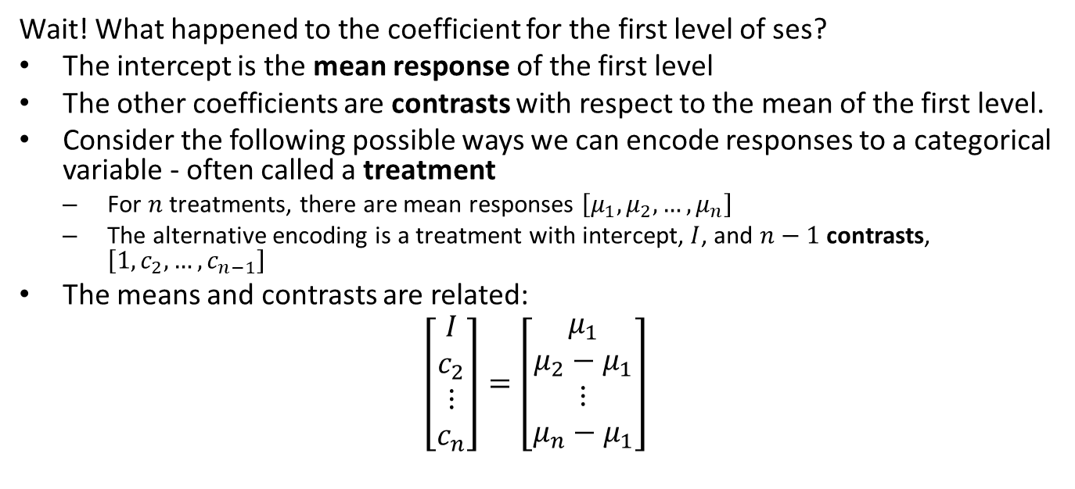
Working with Categorical Variables
Wait! What happened to the coefficient for the first level of ses?
The intercept is the mean response of the first level
The other coefficients are contrasts with respect to the mean of the first level.
Consider the following possible ways we can encode responses to a categorical variable - often called a treatment
For $n$ treatments, there are mean responses $\left[μ_{1},μ_{2},…,μ_{n}\right]$
The alternative encoding is a treatment with intercept, $I$, and $n−1$ contrasts, $\left[1,c_{2},…,c_{n−1}\right]$
The means and contrasts are related:
$$\left[\begin{matrix}I \\ c_{2} \\ ⋮ \\ c_{n}\end{matrix}\right]=\left[\begin{matrix}μ_{1} \\ μ_{2}−μ_{1} \\ ⋮ \\ μ_{n}−μ_{1}\end{matrix}\right]$$

Slide 14
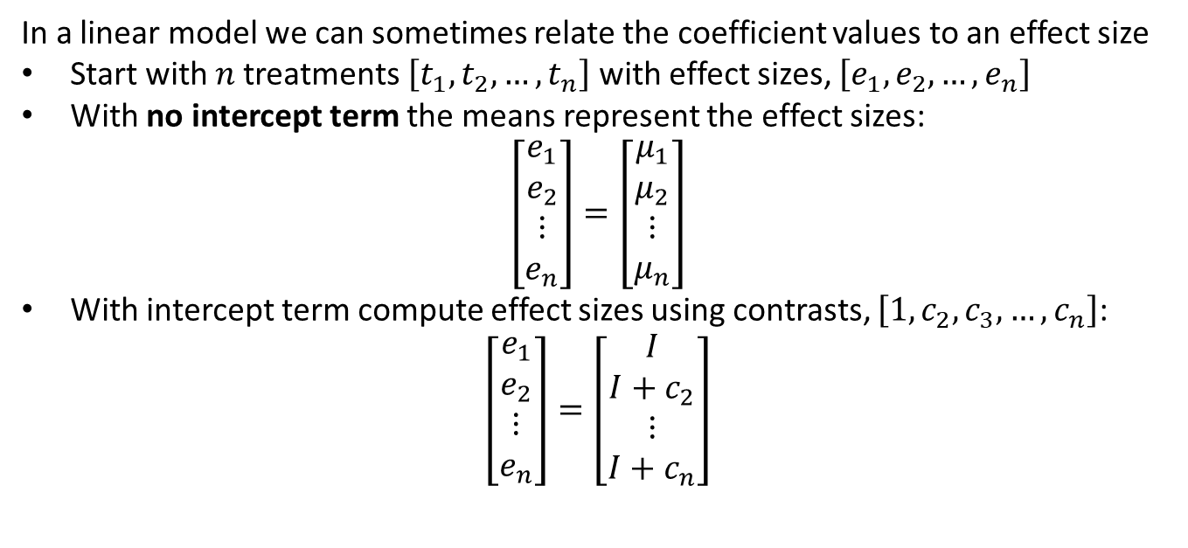
Working with Categorical Variables
In a linear model we can sometimes relate the coefficient values to an effect size
Start with $n$ treatments $\left[t_{1},t_{2},…,t_{n}\right]$ with effect sizes, $\left[e_{1},e_{2},…,e_{n}\right]$
With no intercept term the means represent the effect sizes:
$$\left[\begin{matrix}e_{1} \\ e_{2} \\ ⋮ \\ e_{n}\end{matrix}\right]=\left[\begin{matrix}μ_{1} \\ μ_{2} \\ ⋮ \\ μ_{n}\end{matrix}\right]$$
With intercept term compute effect sizes using contrasts, $\left[1,c_{2},c_{3},…,c_{n}\right]$:
$$\left[\begin{matrix}e_{1} \\ e_{2} \\ ⋮ \\ e_{n}\end{matrix}\right]=\left[\begin{matrix}I \\ I+c_{2} \\ ⋮ \\ I+c_{n}\end{matrix}\right]$$

Slide 15
Working with Categorical Variables
In a linear model we can sometimes relate the coefficient values to an effect size
Assumes the treatments are orthogonal
In other words, applied one at a time
e.g. a case can only be in one category
Assumes that the model coefficients are statistically independent
Coefficients are dependent in overfit model
Often need to adjust for other effects
Other treatments
Levels of other categorical variables
Use partial slope of continuous variables
In other words interpret with care!
Don’t over-interpret your model
Conditions in real world hard to verify, particularly for observational data

Slide 16
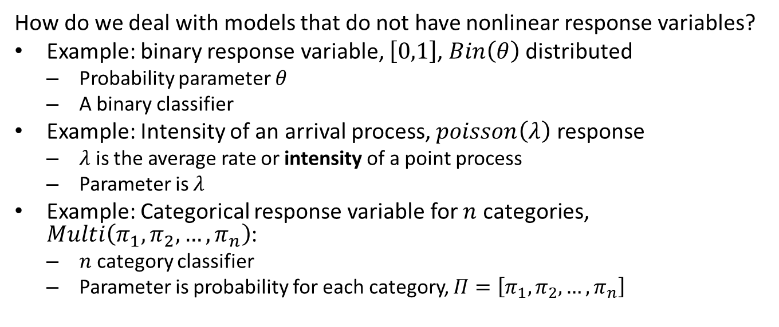
Models with Nonlinear Response
How do we deal with models that do not have nonlinear response variables?
Example: binary response variable, $\left[0,1\right]$, $Bin\left(θ\right)$ distributed
Probability parameter $θ$
A binary classifier
Example: Intensity of an arrival process, $poisson\left(λ\right)$ response
$λ$ is the average rate or intensity of a point process
Parameter is $λ$
Example: Categorical response variable for $n$ categories, $Multi\left(π_{1},π_{2},…,π_{n}\right)$:
$n$ category classifier
Parameter is probability for each category, $Π=\left[π_{1},π_{2},…,π_{n}\right]$

Slide 17
Models with Nonlinear Response
The generalized linear model (GLM) is a framework for nonlinear response models
Nonlinear response is non-Normally distributed
Use a link function to transform to a linear model
Linear model has Normally distributed response
Link function transform nonlinear response to Normal distribution
To compute the nonlinear response
Start with a linear model, OLS
Transform response with inverse link function
Works for all exponential family response distributions

Slide 18
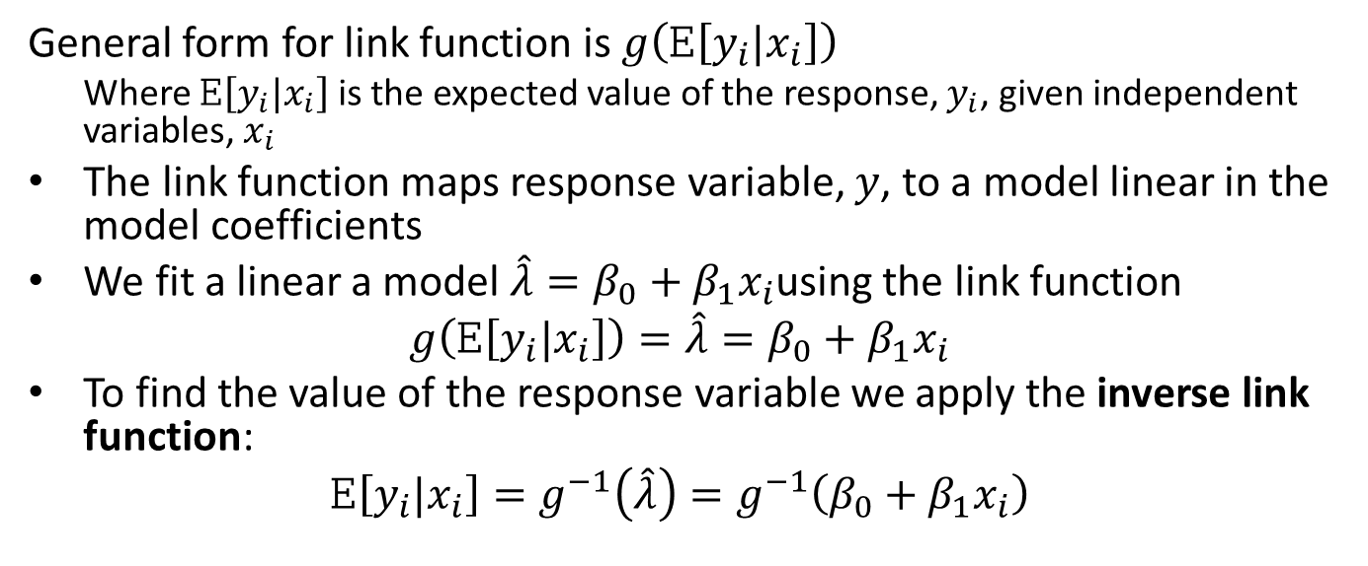
The Generalized Linear Model
General form for link function is $g\left(E\left[y_{i}|x_{i}\right]\right)$
Where $E\left[y_{i}|x_{i}\right]$ is the expected value of the response, $y_{i}$, given independent variables, $x_{i}$
The link function maps response variable, $y$, to a model linear in the model coefficients
We fit a linear a model $\hat{λ}=β_{0}+β_{1}x_{i}$using the link function
$$g\left(E\left[y_{i}|x_{i}\right]\right)=\hat{λ}=β_{0}+β_{1}x_{i}$$
To find the value of the response variable we apply the inverse link function:
$$E\left[y_{i}|x_{i}\right]=g^{−1}\left(\hat{λ}\right)=g^{−1}\left(β_{0}+β_{1}x_{i}\right)$$

Slide 19
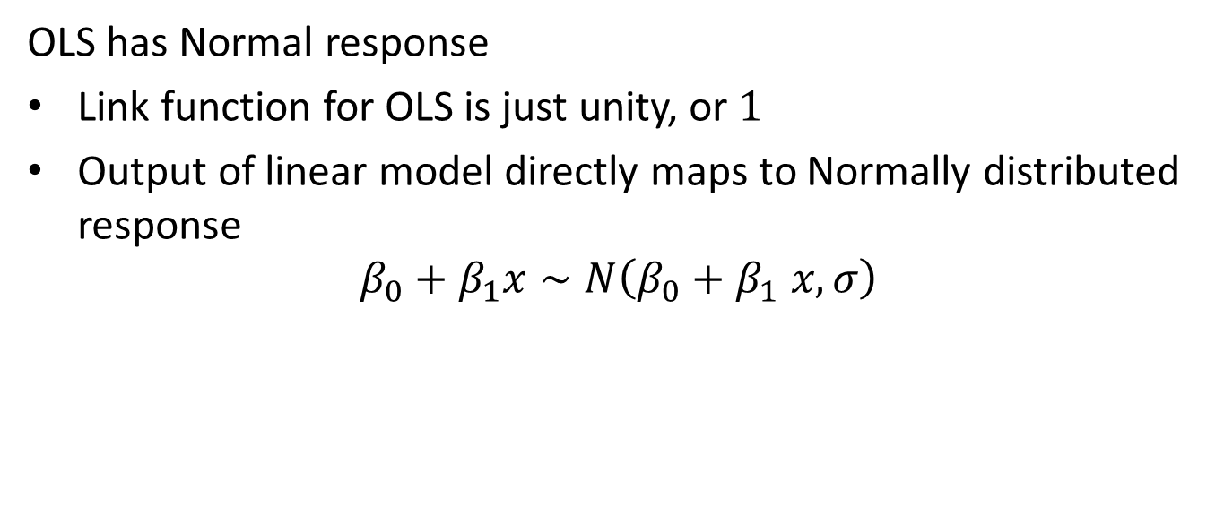
The Generalized Linear Model
OLS has Normal response
Link function for OLS is just unity, or $1$
Output of linear model directly maps to Normally distributed response
$$β_{0}+β_{1}x∼N\left(β_{0}+β_{1} x,σ\right)$$

Slide 20
The Logistic Regression Model
Construct a generalized linear model using a Binomial distribution
Commonly known as logistic regression
Logistic regression widely used as a classification model
Logistic regression is linear model, with a binary response or label values, {False, True} or {0, 1}
Response computed as a log likelihood, leading to a Binomial distributed response
Categorical response is simple extension to categorical distribution
One Binomial to many
Many Binomial to many

Slide 21
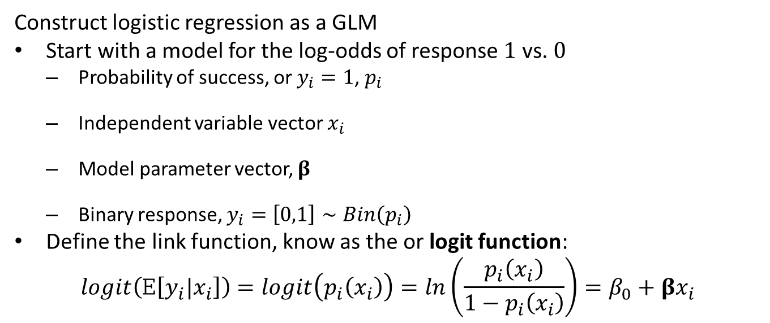
The Logistic Regression Model
Construct logistic regression as a GLM
Start with a model for the log-odds of response $1$ vs. $0$
Probability of success, or $y_{i}=1$, $p_{i}$
Independent variable vector $x_{i}$
Model parameter vector, $β$
Binary response, $y_{i}=\left[0,1\right]∼Bin\left(p_{i}\right)$
Define the link function, know as the or logit function:
$$logit\left(E\left[y_{i}|x_{i}\right]\right)=logit\left(p_{i}\left(x_{i}\right)\right)=ln\left(\frac{p_{i}\left(x_{i}\right)}{1−p_{i}\left(x_{i}\right)}\right)=β_{0}+βx_{i}$$

Slide 22
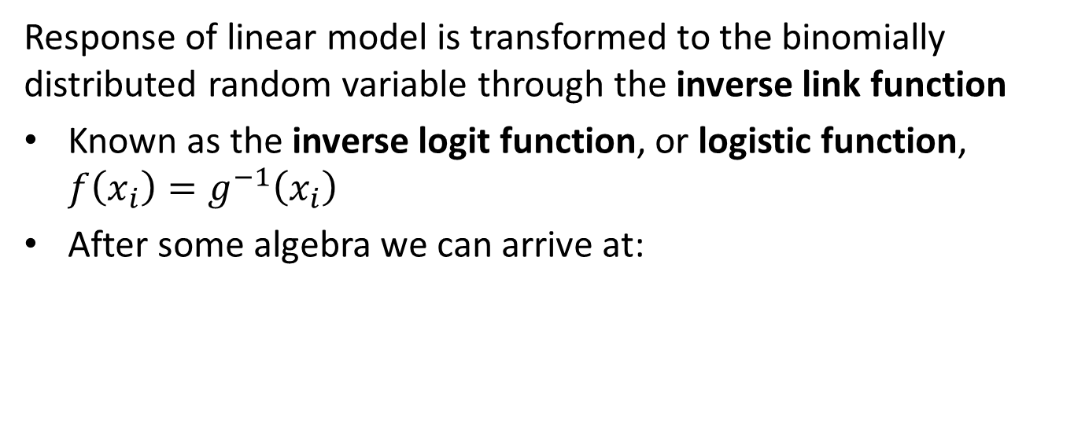
The Logistic Regression Model
Response of linear model is transformed to the binomially distributed random variable through the inverse link function
Known as the inverse logit function, or logistic function, $f\left(x_{i}\right)=g^{−1}\left(x_{i}\right)$
After some algebra we can arrive at:

Slide 23
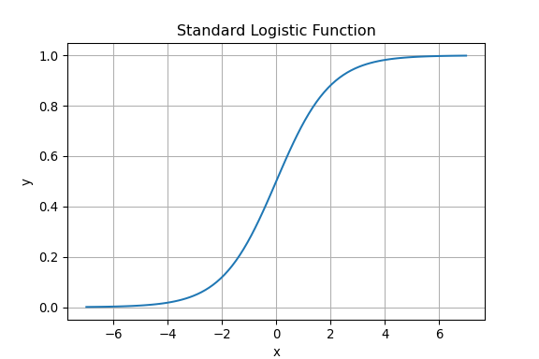

Logistic Regression Model
What does the transformation function look like?
Consider a simple 1-dimensional case
$$y_{i}=\frac{1}{1+e^{−x_{i}}}$$

Slide 24
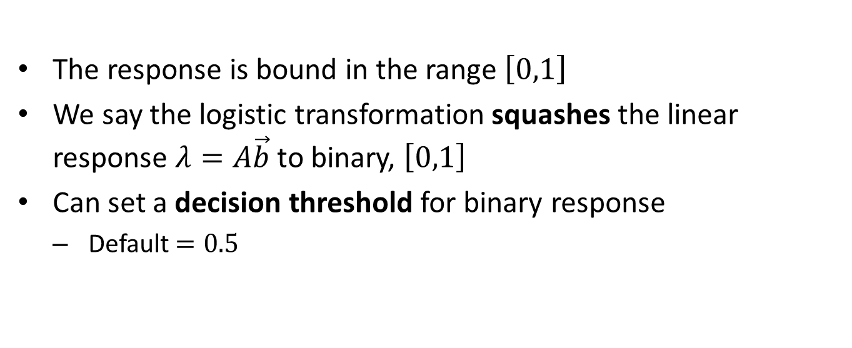
The response is bound in the range $\left[0,1\right]$
We say the logistic transformation squashes the linear response $λ=A\vec{b}$ to binary, $\left[0,1\right]$
Can set a decision threshold for binary response
Default $=0.5$

Slide 25
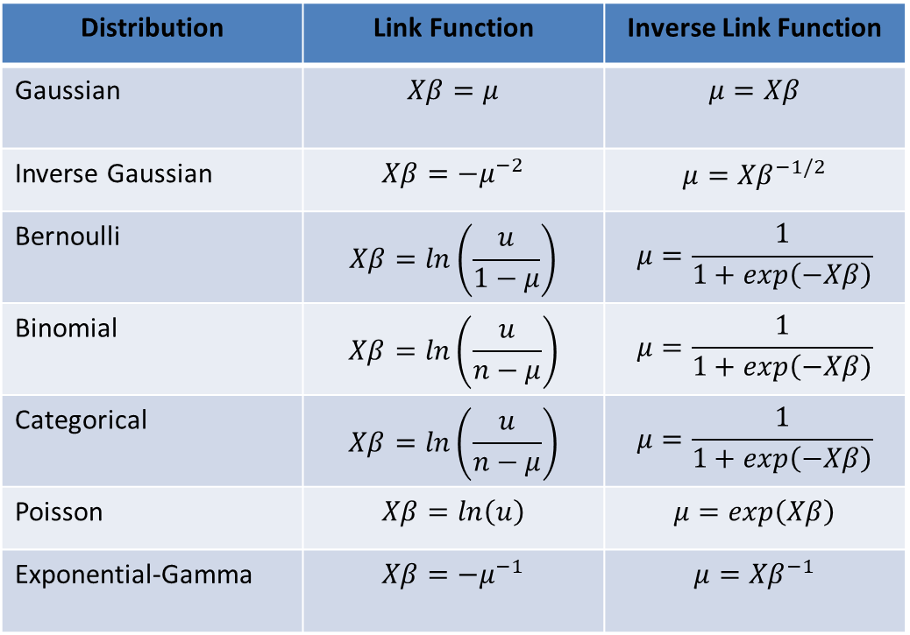
The Generalized Linear Model
Distribution | Link Function | Inverse Link Function
Gaussian | $$Xβ=μ$$ | $$μ=Xβ$$
Inverse Gaussian | $$Xβ=−μ^{−2}$$ | $$μ={Xβ}^{−1/2}$$
Bernoulli | $$Xβ=ln\left(\frac{u}{1−μ}\right)$$ | $$μ=\frac{1}{1+exp\left(−Xβ\right)}$$
Binomial | $$Xβ=ln\left(\frac{u}{n−μ}\right)$$ | $$μ=\frac{1}{1+exp\left(−Xβ\right)}$$
Categorical | $$Xβ=ln\left(\frac{u}{n−μ}\right)$$ | $$μ=\frac{1}{1+exp\left(−Xβ\right)}$$
Poisson | $$Xβ=ln\left(u\right)$$ | $$μ=exp\left(Xβ\right)$$
Exponential-Gamma | $$Xβ=−μ^{−1}$$ | $$μ={Xβ}^{−1}$$
Example Link functions
Supported in statsmodels
Supported in Scikit-Learn

Slide 26
Evaluation of Classifiers
 | Classified Negative | Classified Positive
Negative | TN | FP
Positive | FN | TP
How can we evaluate a classifier’s accuracy?
Determine proportions of test cases which are classified as:
True Positives (TP): Are positive and should be positive
True Negatives (TN): Are negative and should be negative
False Positives (FP): Classified as positive but are actually negative; Type I errors
False Negatives (FN): Classified as negative but are actually positive; Type II errors
Organize these metrics into a confusion matrix

Slide 27
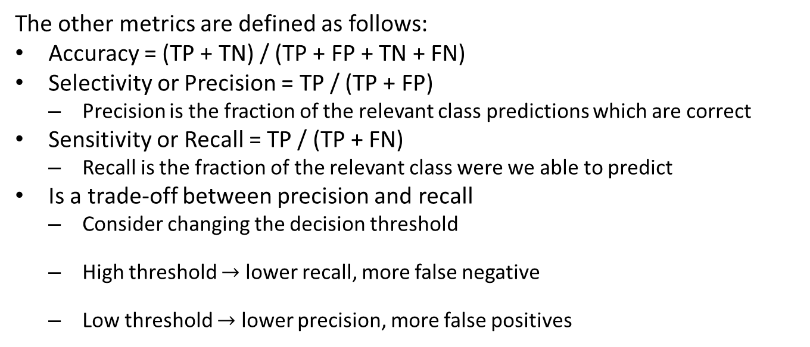
Evaluation of Classifiers
The other metrics are defined as follows:
Accuracy = (TP + TN) / (TP + FP + TN + FN)
Selectivity or Precision = TP / (TP + FP)
Precision is the fraction of the relevant class predictions which are correct
Sensitivity or Recall = TP / (TP + FN)
Recall is the fraction of the relevant class were we able to predict
Is a trade-off between precision and recall
Consider changing the decision threshold
High threshold $→$ lower recall, more false negative
Low threshold $→$ lower precision, more false positives

Slide 28
Example of Logistic Regression
How well can we predict the type of school given the test scores?
## Prep the data test_scores['schtyp'] = np.subtract(test_scores['schtyp'], 1) ## Fit the model formula = 'schtyp ~ math' logistic_reg_model = smf.glm(formula=formula, data=test_scores, family=sm.families.Binomial()).fit() print(logistic_reg_model.summary())
## Generalized Linear Model Regression Results ## ============================================================================== ## Dep. Variable: schtyp No. Observations: 200 ## Model: GLM Df Residuals: 198 ## Model Family: Binomial Df Model: 1 ## Link Function: Logit Scale: 1.0000 ## Method: IRLS Log-Likelihood: -86.978 ## Date: Thu, 15 Aug 2024 Deviance: 173.96 ## Time: 19:30:19 Pearson chi2: 199. ## No. Iterations: 4 Pseudo R-squ. (CS): 0.009511 ## Covariance Type: nonrobust ## ============================================================================== ## coef std err z P>|z| [0.025 0.975] ## ------------------------------------------------------------------------------ ## Intercept -3.1718 1.129 -2.809 0.005 -5.385 -0.959 ## math 0.0283 0.020 1.382 0.167 -0.012 0.068 ## ==============================================================================

Slide 29
Example of Logistic Regression
The data frame now looks like this with the predicted probability and the binary scores:
## score the results threshold=0.18 test_scores['predicted'] = logistic_reg_model.predict() test_scores['score'] = [1 if x>threshold else 0 for x in test_scores['predicted']] test_scores.loc[:,['schtyp','math','predicted','score']].head(20)
## schtyp math predicted score ## id ## 70 0 41 0.117996 0 ## 121 0 53 0.158163 0 ## 86 0 54 0.161968 0 ## 141 0 47 0.136844 0 ## 172 0 57 0.173824 0 ## 113 0 51 0.150772 0 ## 50 0 42 0.120973 0 ## 11 0 45 0.130295 0 ## 84 0 54 0.161968 0 ## 48 0 52 0.154432 0 ## 75 0 51 0.150772 0 ## 60 0 51 0.150772 0 ## 95 0 71 0.238200 1 ## 104 0 57 0.173824 0 ## 38 0 50 0.147184 0 ## 115 0 43 0.124015 0 ## 76 0 51 0.150772 0 ## 195 1 60 0.186356 1 ## 114 0 62 0.195090 1 ## 85 0 57 0.173824 0

Slide 30
Example of Logistic Regression
Now, evaluate the model - the classifier is almost useless - no Kagle awards!:
import sklearn.metrics as sklm def print_metrics(labels, scores): metrics = sklm.precision_recall_fscore_support(labels, scores) conf = sklm.confusion_matrix(labels, scores) print(' Confusion matrix') print(' Score negative Score positive') print('Actual negative %6d' % conf[0,0] + ' %5d' % conf[0,1]) print('Actual postitive %6d' % conf[1,0] + ' %5d' % conf[1,1]) print('') print('Accuracy %0.2f' % sklm.accuracy_score(labels, scores)) print(' ') print(' Negative Positive') print('Num case %6d' % metrics[3][0] + ' %6d' % metrics[3][1]) print('Precision %6.2f' % metrics[0][0] + ' %6.2f' % metrics[0][1]) print('Recall %6.2f' % metrics[1][0] + ' %6.2f' % metrics[1][1]) print('F1 %6.2f' % metrics[2][0] + ' %6.2f' % metrics[2][1]) print_metrics(test_scores['schtyp'], test_scores['score'])
## Confusion matrix ## Score negative Score positive ## Actual negative 127 41 ## Actual postitive 22 10 ## ## Accuracy 0.69 ## ## Negative Positive ## Num case 168 32 ## Precision 0.85 0.20 ## Recall 0.76 0.31 ## F1 0.80 0.24

Slide 31
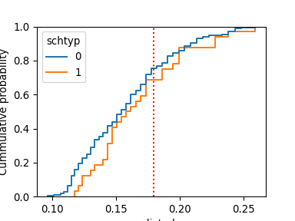
Example of Logistic Regression
How can we understand the cut-off value in terms of the CDF of the positive and negative cases?

Slide 32
Both CDFs are at 1.0 by about probability = 0.25 - this is a very skewed situation!
CDF curves nearly the same = poor model
Positive cases to the left of cut-off are Type II errors
Negative cases to the right of cut-off are Type I errors

Slide 33
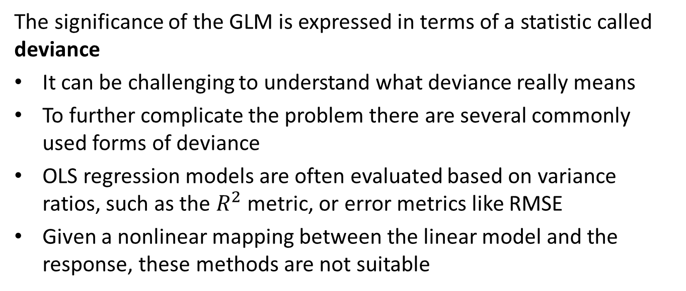
What is Deviance?
The significance of the GLM is expressed in terms of a statistic called deviance
It can be challenging to understand what deviance really means
To further complicate the problem there are several commonly used forms of deviance
OLS regression models are often evaluated based on variance ratios, such as the $R^{2}$ metric, or error metrics like RMSE
Given a nonlinear mapping between the linear model and the response, these methods are not suitable

Slide 34
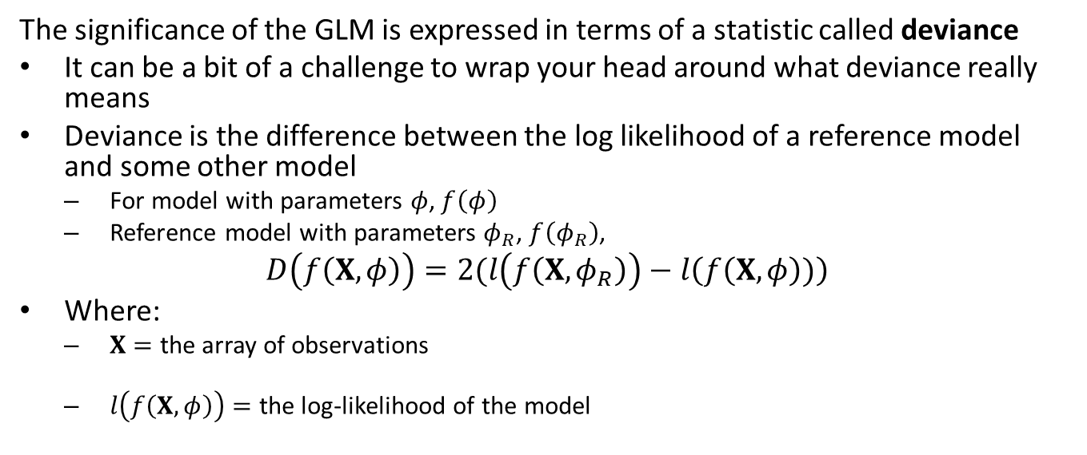
What is Deviance?
The significance of the GLM is expressed in terms of a statistic called deviance
It can be a bit of a challenge to wrap your head around what deviance really means
Deviance is the difference between the log likelihood of a reference model and some other model
For model with parameters $φ$, $f\left(φ\right)$
Reference model with parameters $φ_{R}$, $f\left(φ_{R}\right)$,
$$D\left(f\left(X,φ\right)\right)=2(l\left(f\left(X,φ_{R}\right)\right)−l\left(f\left(X,φ\right))\right)$$
Where:
$X=$ the array of observations
$l\left(f\left(X,φ\right)\right)=$ the log-likelihood of the model

Slide 35
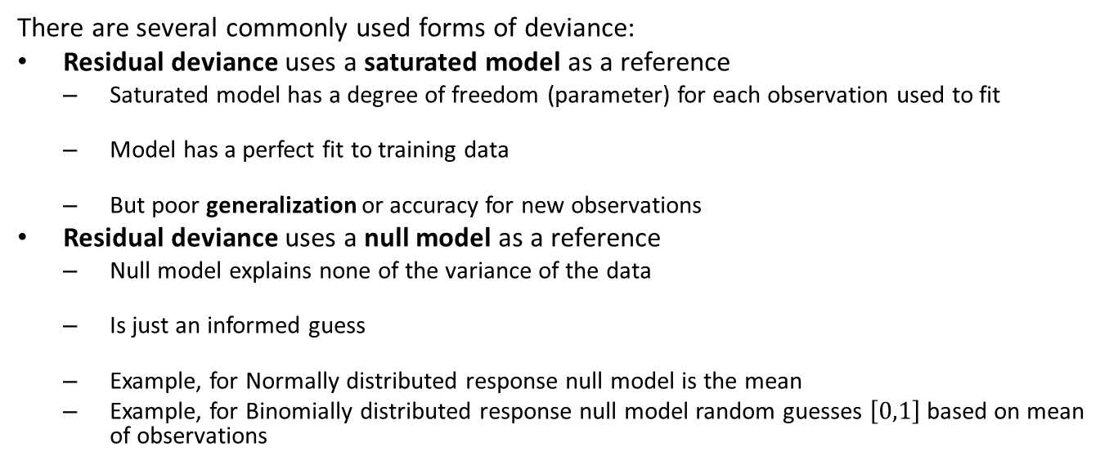
What is Deviance?
There are several commonly used forms of deviance:
Residual deviance uses a saturated model as a reference
Saturated model has a degree of freedom (parameter) for each observation used to fit
Model has a perfect fit to training data
But poor generalization or accuracy for new observations
Residual deviance uses a null model as a reference
Null model explains none of the variance of the data
Is just an informed guess
Example, for Normally distributed response null model is the mean
Example, for Binomially distributed response null model random guesses $\left[0,1\right]$ based on mean of observations

Slide 36
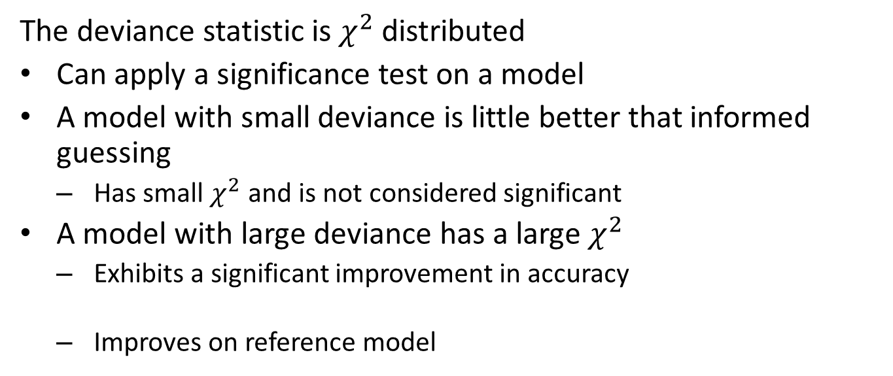
What is Deviance?
The deviance statistic is $χ^{2}$ distributed
Can apply a significance test on a model
A model with small deviance is little better that informed guessing
Has small $χ^{2}$ and is not considered significant
A model with large deviance has a large $χ^{2}$
Exhibits a significant improvement in accuracy
Improves on reference model

Slide 37
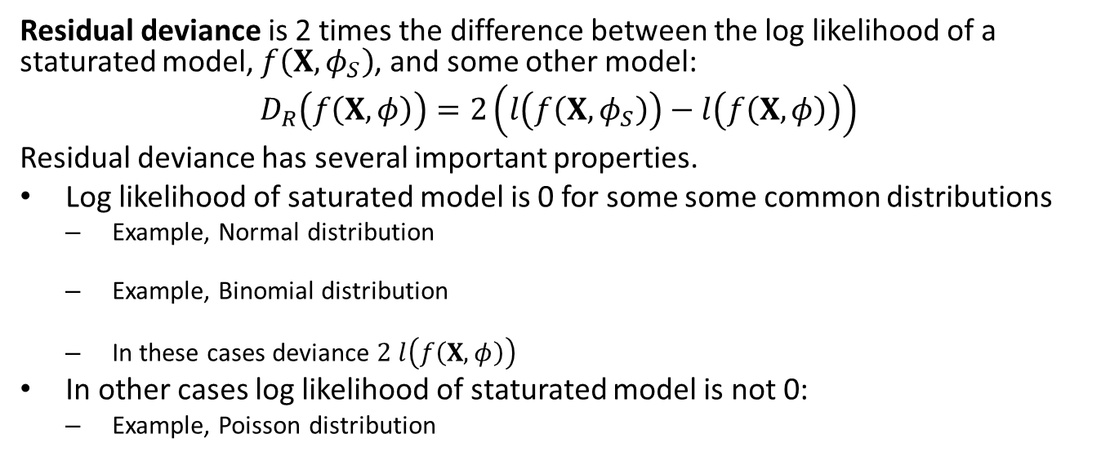
Residual Deviance
Residual deviance is 2 times the difference between the log likelihood of a staturated model, $f\left(X,φ_{S}\right)$, and some other model:
$$D_{R}\left(f\left(X,φ\right)\right)=2\left(l\left(f\left(X,φ_{S}\right)\right)−l\left(f\left(X,φ\right)\right)\right)$$
Residual deviance has several important properties.
Log likelihood of saturated model is 0 for some some common distributions
Example, Normal distribution
Example, Binomial distribution
In these cases deviance $2 l\left(f\left(X,φ\right)\right)$
In other cases log likelihood of staturated model is not 0:
Example, Poisson distribution

Slide 38
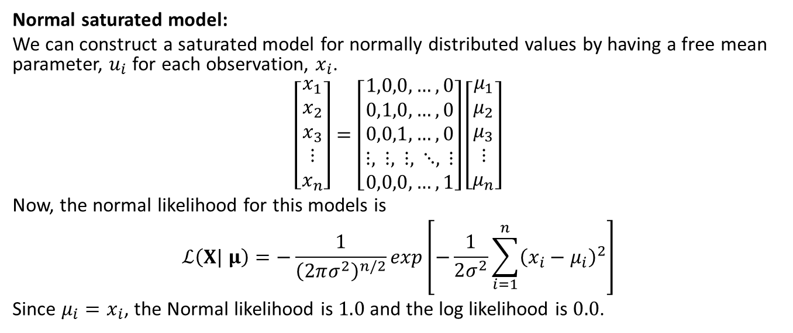
Residual Deviance
Normal saturated model:
We can construct a saturated model for normally distributed values by having a free mean parameter, $u_{i}$ for each observation, $x_{i}$.
$$\left[\begin{matrix}x_{1} \\ x_{2} \\ x_{3} \\ ⋮ \\ x_{n}\end{matrix}\right]=\left[\begin{matrix}1,0,0,…,0 \\ 0,1,0,…,0 \\ 0,0,1,…,0 \\ ⋮, ⋮, ⋮, ⋱, ⋮ \\ 0,0,0,…,1\end{matrix}\right]\left[\begin{matrix}μ_{1} \\ μ_{2} \\ μ_{3} \\ ⋮ \\ μ_{n}\end{matrix}\right]$$
Now, the normal likelihood for this models is
$$ℒ\left(X| μ\right)=−\frac{1}{{\left(2πσ^{2}\right)}^{n/2}}exp\left[−\frac{1}{2σ^{2}}\sum_{i=1}^{n}{{\left(x_{i}−μ_{i}\right)}^{2}}\right]$$
Since $μ_{i}=x_{i}$, the Normal likelihood is $1.0$ and the log likelihood is $0.0$.

Slide 39
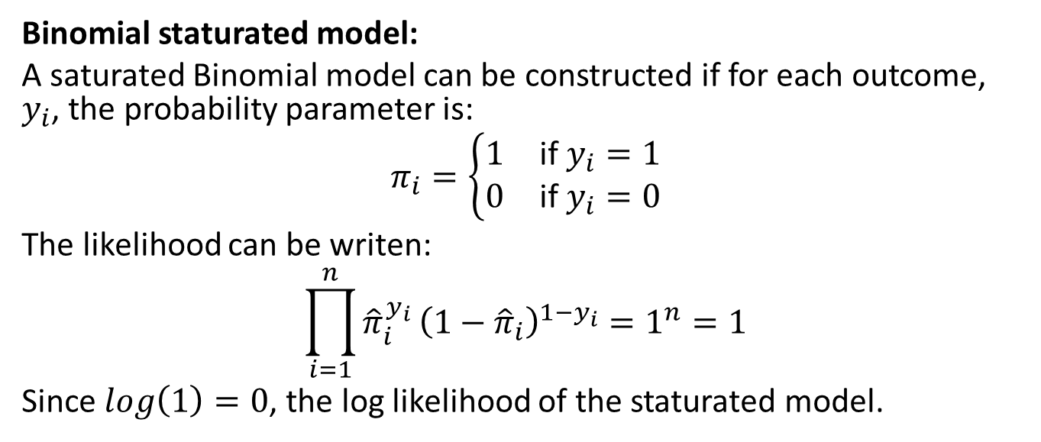
Residual Deviance
Binomial staturated model:
A saturated Binomial model can be constructed if for each outcome, $y_{i}$, the probability parameter is:
$$π_{i}=\left\{\begin{matrix}1 & \text{if} y_{i}=1 \\ 0 & \text{if} y_{i}=0\end{matrix}\right.$$
The likelihood can be writen:
$$\prod_{i=1}^{n}{{\hat{π}}_{i}^{y_{i}}}{\left(1−{\hat{π}}_{i}\right)}^{1−y_{i}}=1^{n}=1$$
Since $log\left(1\right)=0$, the log likelihood of the staturated model.

Slide 40
Null Deviance
Null deviance is measured with respect to a null model
Intuitively, the null model is informed guessing
Null deviance is a measure of how much the model improves accuracy beyond guessing

Slide 41
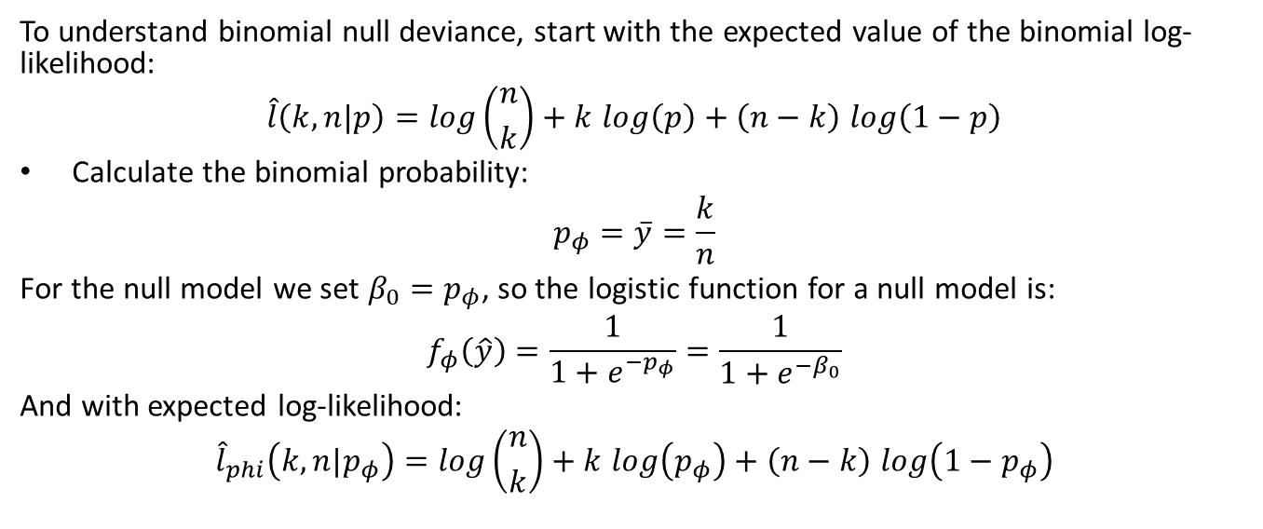
Null Deviance
To understand binomial null deviance, start with the expected value of the binomial log-likelihood:
$$\hat{l}\left(k,n|p\right)=log\left({n \atop k}\right)+k log\left(p\right)+\left(n−k\right) log\left(1−p\right)$$
Calculate the binomial probability:
$$p_{φ}=\overset{‾}{y}=\frac{k}{n}$$
For the null model we set $β_{0}=p_{φ}$, so the logistic function for a null model is:
$$f_{φ}\left(\hat{y}\right)=\frac{1}{1+e^{−p_{φ}}}=\frac{1}{1+e^{−β_{0}}}$$
And with expected log-likelihood:
$${\hat{l}}_{phi}\left(k,n|p_{φ}\right)=log\left({n \atop k}\right)+k log\left(p_{φ}\right)+\left(n−k\right) log\left(1−p_{φ}\right)$$

Slide 42
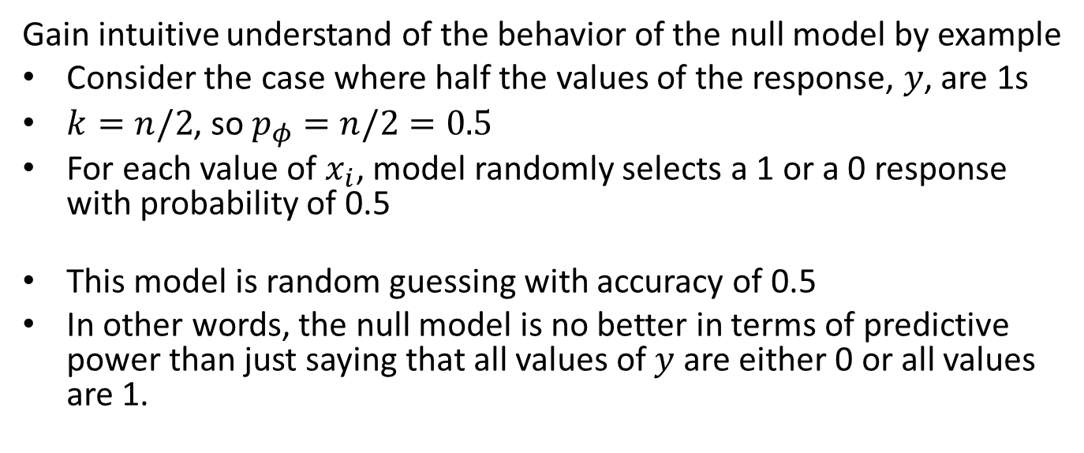
Null Deviance
Gain intuitive understand of the behavior of the null model by example
Consider the case where half the values of the response, $y$, are 1s
$k=n/2$, so $p_{φ}=n/2=0.5$
For each value of $x_{i}$, model randomly selects a 1 or a 0 response with probability of 0.5
This model is random guessing with accuracy of 0.5
In other words, the null model is no better in terms of predictive power than just saying that all values of $y$ are either 0 or all values are 1.

Slide 43
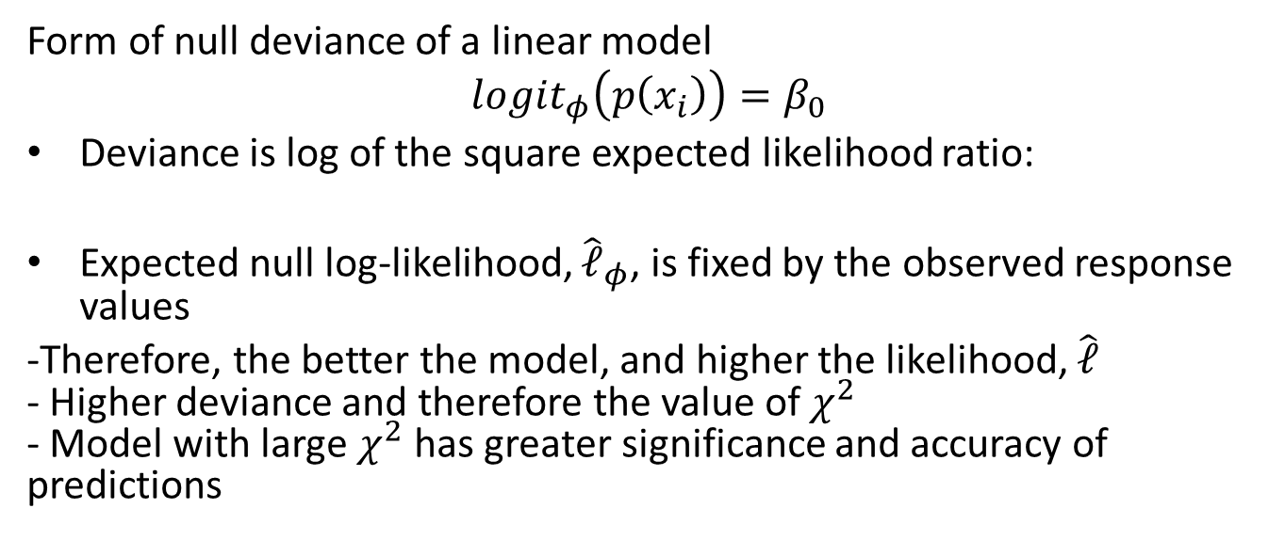
Null Deviance
Form of null deviance of a linear model
$$logit_{φ}\left(p\left(x_{i}\right)\right)=β_{0}$$
Deviance is log of the square expected likelihood ratio:
Expected null log-likelihood, ${\hat{𝓁}}_{φ}$, is fixed by the observed response values
-Therefore, the better the model, and higher the likelihood, $\hat{𝓁}$ - Higher deviance and therefore the value of $χ^{2}$ - Model with large $χ^{2}$ has greater significance and accuracy of predictions

Slide 44
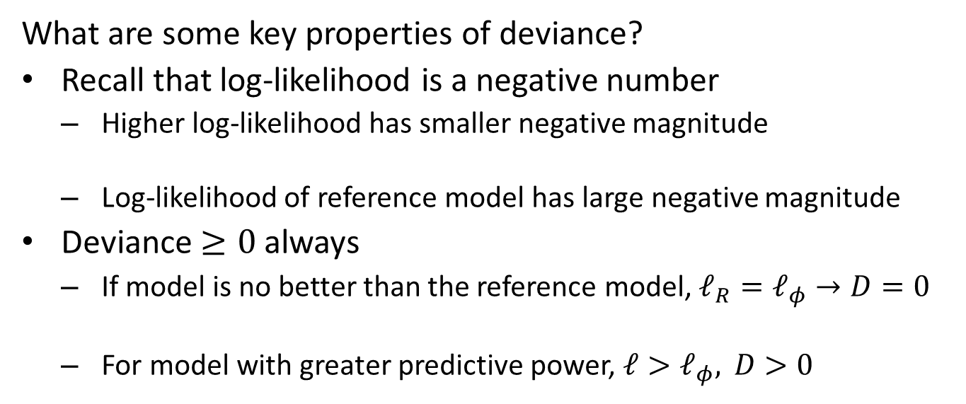
Properties of Deviance
What are some key properties of deviance?
Recall that log-likelihood is a negative number
Higher log-likelihood has smaller negative magnitude
Log-likelihood of reference model has large negative magnitude
Deviance $≥0$ always
If model is no better than the reference model, $𝓁_{R}=𝓁_{φ}→D=0$
For model with greater predictive power, $𝓁>𝓁_{φ}, D>0$

Slide 45
Applying Deviance
Deviance concepts discussed here can be applied to any GLM
In some cases, deviance can be used directly
Is explained variance significant?
In other cases, log-likelihood ratio is used directly for model evaluation
Compare performance of different models

Slide 46
Solving Maximum Likelihood Problem
We have investigated methods for finding maximum likelihood solutions at large scale
ML algorithms are employed routinely to logistic regression problems on a massive scale
Variations of the stochastic gradient descent (SGD) algorithms
Quasi-Newton’s methods like the limited memory Broyden–Fletcher–Goldfarb–Shanno (l-BFGS) algorithm

Slide 47
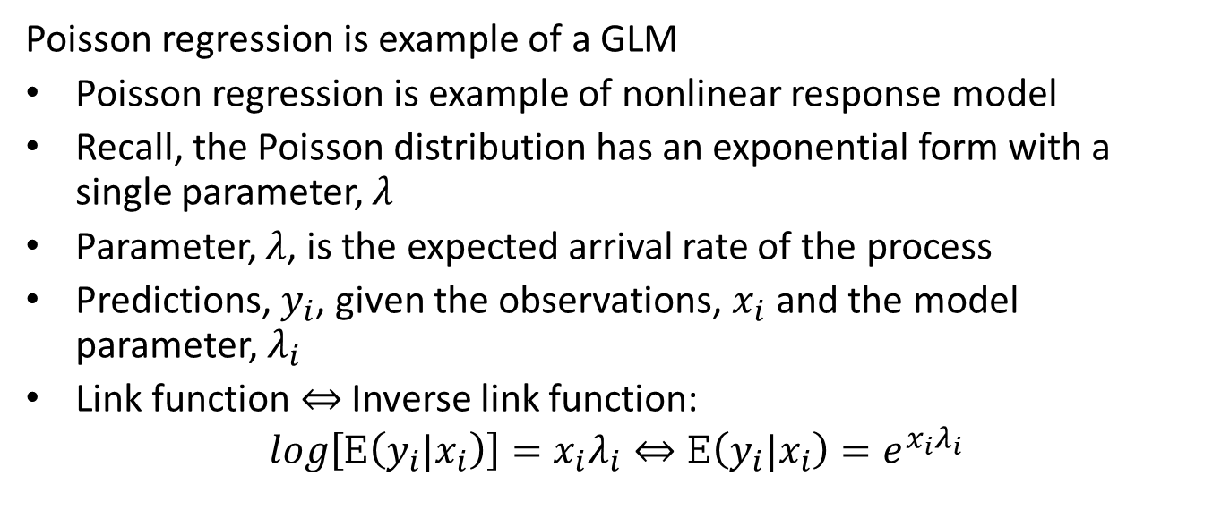
Poisson Regression as GLM
Poisson regression is example of a GLM
Poisson regression is example of nonlinear response model
Recall, the Poisson distribution has an exponential form with a single parameter, $λ$
Parameter, $λ$, is the expected arrival rate of the process
Predictions, $y_{i}$, given the observations, $x_{i}$ and the model parameter, $λ_{i}$
Link function $⇔$ Inverse link function:
$$log\left[E\left(y_{i}|x_{i}\right)\right]=x_{i}λ_{i}⇔E\left(y_{i}|x_{i}\right)=e^{x_{i}λ_{i}}$$

Slide 48
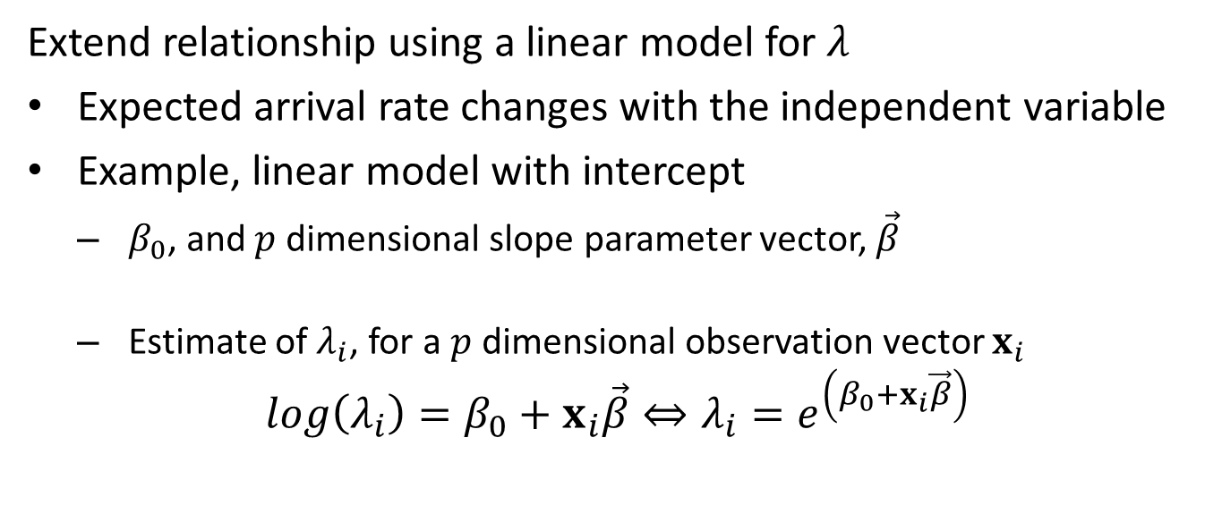
Poisson Regression as GLM
Extend relationship using a linear model for $λ$
Expected arrival rate changes with the independent variable
Example, linear model with intercept
$β_{0}$, and $p$ dimensional slope parameter vector, $\vec{β}$
Estimate of $λ_{i}$, for a $p$ dimensional observation vector $x_{i}$
$$log\left(λ_{i}\right)=β_{0}+x_{i}\vec{β}⇔λ_{i}=e^{\left(β_{0}+x_{i}\vec{β}\right)}$$

Slide 49
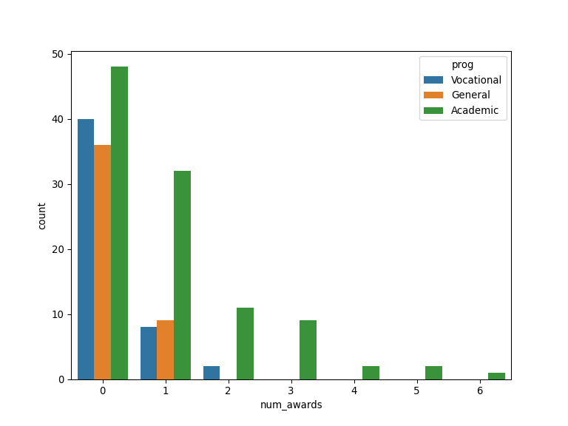
Poisson Regression Example
Data for number of awards for students by program and math score
Count data - suitable for Poisson model
Note exponential decrease in counts with math score and program

Slide 50
Poisson Regression Example
Fit a model and examine result
## Optimization terminated successfully. ## Current function value: 0.913761 ## Iterations 6
## <class 'statsmodels.iolib.summary.Summary'> ## """ ## Poisson Regression Results ## ============================================================================== ## Dep. Variable: num_awards No. Observations: 200 ## Model: Poisson Df Residuals: 196 ## Method: MLE Df Model: 3 ## Date: Thu, 15 Aug 2024 Pseudo R-squ.: 0.2118 ## Time: 19:30:23 Log-Likelihood: -182.75 ## converged: True LL-Null: -231.86 ## Covariance Type: nonrobust LLR p-value: 3.747e-21 ## ========================================================================================= ## coef std err z P>|z| [0.025 0.975] ## ----------------------------------------------------------------------------------------- ## Intercept -4.1633 0.663 -6.281 0.000 -5.462 -2.864 ## C(prog)[T.General] -1.0839 0.358 -3.025 0.002 -1.786 -0.382 ## C(prog)[T.Vocational] -0.7140 0.320 -2.231 0.026 -1.341 -0.087 ## math 0.0702 0.011 6.619 0.000 0.049 0.091 ## ========================================================================================= ## """

Slide 51
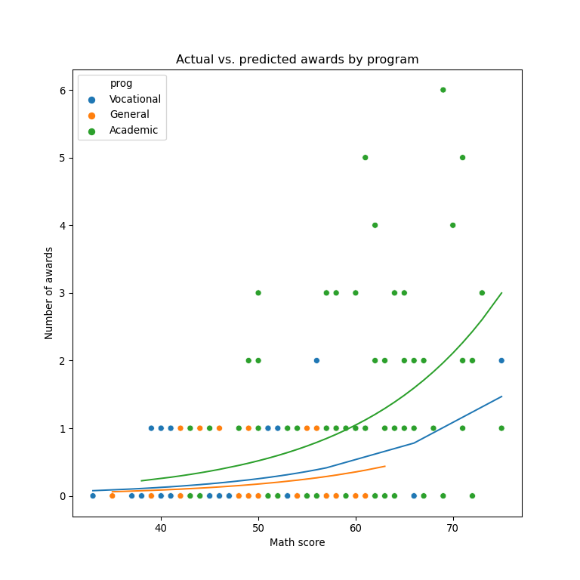
Poisson Regression Example
Maximum likelihood regression lines for counts with Poisson model

Slide 52
Summary
Models with nonlinear response have non-Normal distributions
The generalized linear model accommodates nonlinear response distributions
Link function transforms to linear model
Inverse link function transforms from Normal distribution to response distribution
Evaluating Binomial response models
Confusion matrix organizes
Compute metrics from elements of confusion matrix
Use multiple evaluation criteria
Compare model performance with deviance

