Slide 1

PII Detection with DeBERTaV3 + DoRA
Targeted Synthetic Data for Robust NER
CS 6140 Machine Learning • Final Project
Jonathan Tarun Rajasekaran & Ari S.

Slide 2
The Problem: PII Detection Failures
Singh & Narayanan (2025) evaluated state-of-the-art PII detection models and found critical gaps:
28%
67%
Non-identification rate
Misclassification rate
PII completely missed
Wrong entity type assigned
Models tested: Piiranha, Starpii, MS Presidio
These failures occur in real-world text with typos, international formats, and emerging PII types
Source: Singh & Narayanan, "On the Limitations of Open-Source PII Detection Models" (2025)

Slide 3
Our Approach
Two-pronged strategy: targeted training data + efficient fine-tuning
1. Synthetic Data Generation
2. Efficient Fine-tuning
Target 6 NER failure dimensions
LLM generation + validation
10 regional PII formats
16 PII types from research
DeBERTaV3-large base model
DoRA adaptation method
Only 2.6% params trainable
Preserves pretrained knowledge
ai4privacy
Synthetic
Combined
+
→
150K
6K
156K

Slide 4
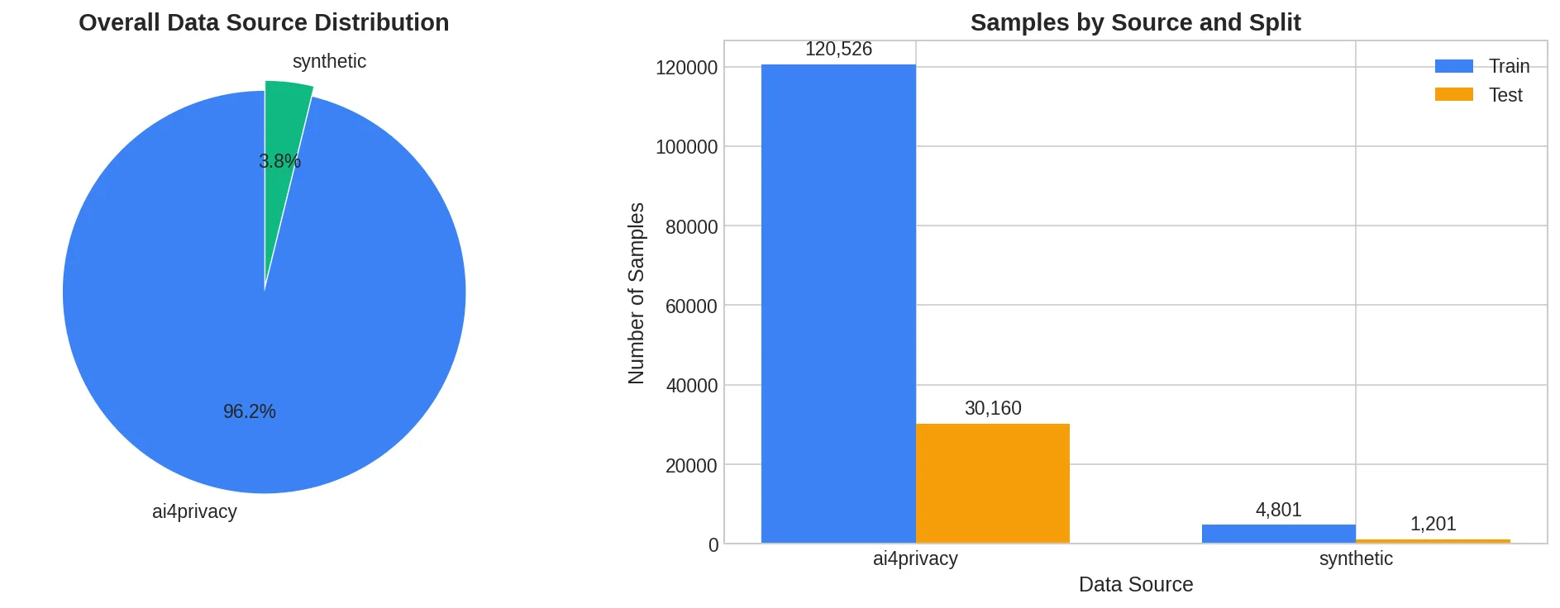
Dataset Composition
Total Samples
156,695
ai4privacy
Train: 120,526
Test: 30,160
Synthetic
Train: 4,801
Test: 1,201
Synthetic data is only 3.8% of total but targets critical failure modes
Train/Test Split
80% / 20%

Slide 5
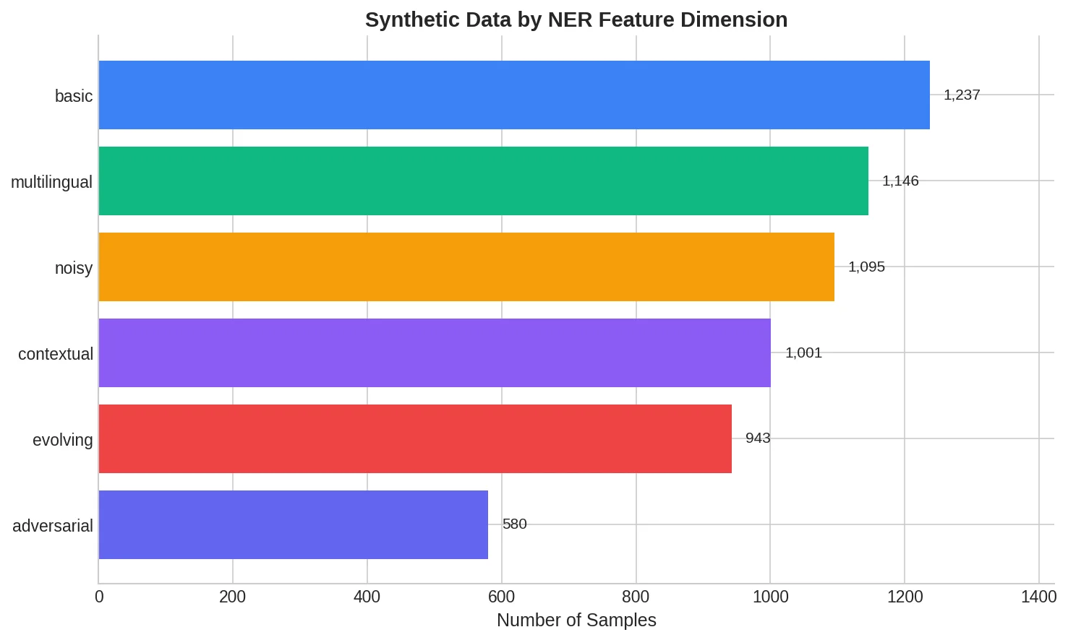
Targeting NER Failure Modes
Each dimension addresses specific weaknesses:
Basic
Standard, well-formatted entities
Multilingual
International formats in English text
Noisy
Typos, informal text, OCR errors
Contextual
Ambiguous entities needing context
Evolving
Crypto wallets, UPI IDs, TOTP codes
Adversarial
Intentionally deceptive patterns

Slide 6
Generation & Validation Pipeline
1. Generation
2. Initial Filter
3. Validation
4. Final Dataset
Grok
→
99.0%
→
GPT-5.1
→
6,002
10,944 attempts
10,836 valid JSON
Entity boundary check
55.4% yield
Validation Metrics
Entity Boundary Accuracy
Label Accuracy
Low label accuracy due to schema mismatches (e.g., "PERSON" vs "NAME") — resolved via consolidation mapping
96.6%
49.3%
Key insight: Two-stage LLM pipeline (generator + validator) ensures high-quality training data while maintaining reasonable throughput

Slide 7
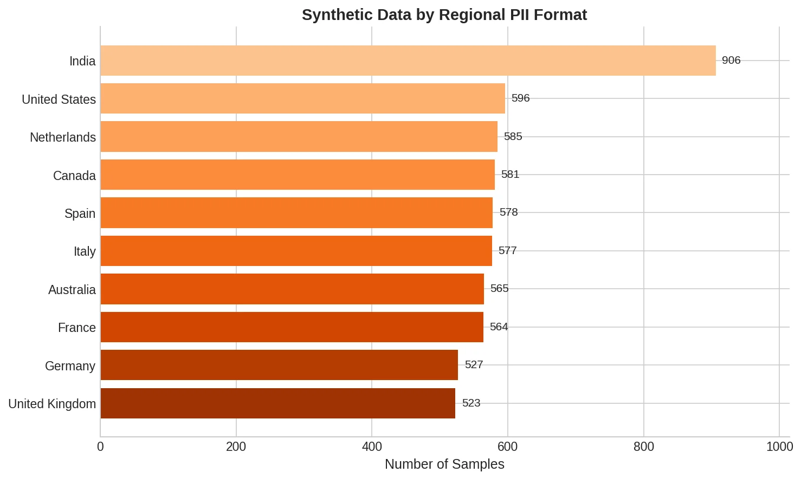
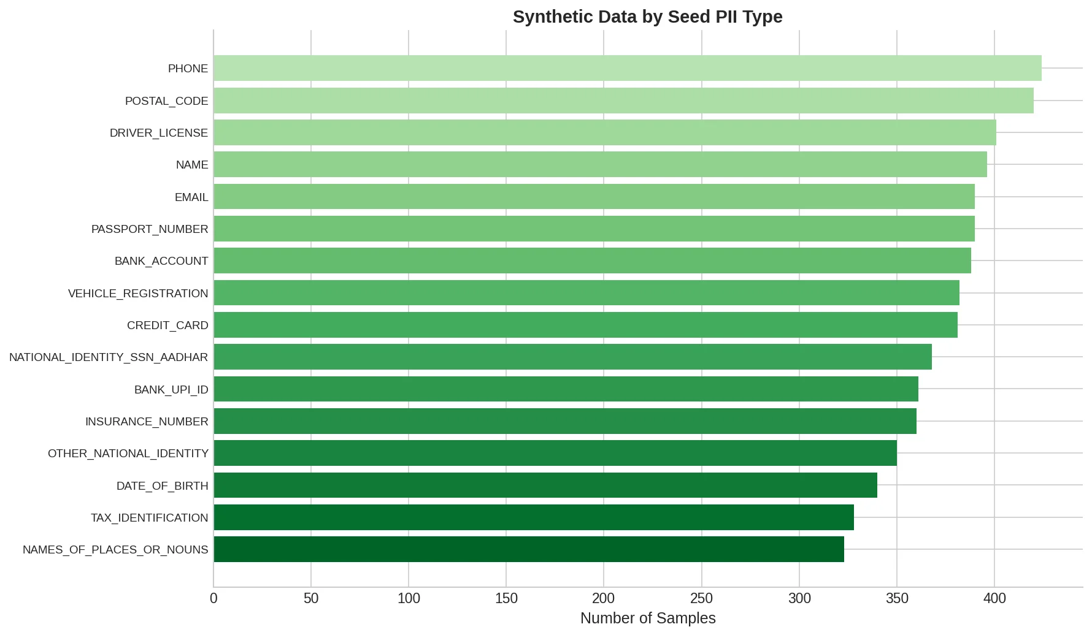
Regional & PII Type Coverage
10 Regional Formats
16 PII Types (Singh & Narayanan Taxonomy)
India oversampled for UPI/Aadhaar coverage
Balanced distribution across all PII categories

Slide 8
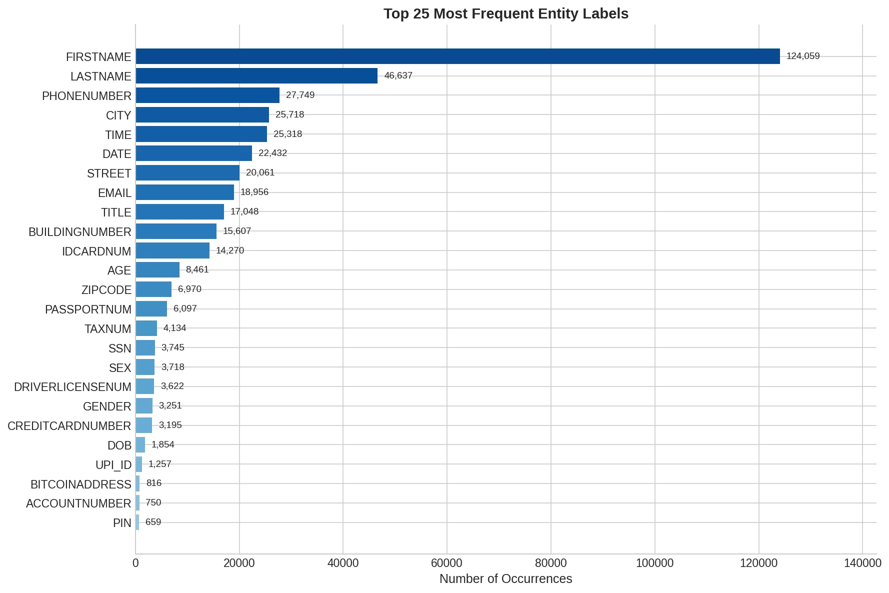
Label Consolidation
Problem: Label Fragmentation
Original data had 450+ label variants for semantically identical entities
Example consolidations:
PHONE, PHONE_NUMBER, TELEPHONENUM → PHONENUMBER
PERSON, NAME, PERSON_NAME → FIRSTNAME/LASTNAME
SSN, SOCIAL_NUM, SOCIALNUM → SSN
Result: 252 Canonical Labels
Semantic mapping preserves entity relationships while reducing sparsity
Long-tail distribution: Only 22 labels with 1000+ samples, but all labels represented in training

Slide 9
Model Architecture: DeBERTaV3 + DoRA
DeBERTaV3-large
Why this combination?
304M parameters (24 layers)
Disentangled attention
Enhanced mask decoder
SOTA on NER benchmarks
Larger model = Better context
Superior contextual understanding for ambiguous entities
Parameter efficiency
Train only 2.6% — faster, less overfitting
DoRA (Weight-Decomposed LoRA)
Knowledge preservation
Decomposes weights: magnitude + direction
Low-rank updates to direction only
More stable than standard LoRA
Preserves pretrained representations
Maintains pretrained language understanding
Total
Trainable
Ratio
304M
7.82M
2.6%

Slide 10
Training Configuration
Training Stats
DoRA Settings
Total steps
Final loss
Rank (r)
16
19,000
0.271
Alpha
32
Dropout
0.05
Hardware: NVIDIA H100 (Modal)
Target modules
q, k, v, dense
Hyperparameters
Overfitting Prevention
Early stopping (patience=3)
DoRA regularization
Low rank constraint (r=16)
Dropout on adapter layers
Learning rate
2e-5
Batch size
32
Epochs
5 (early stop)
Patience
3
Training time: ~2 hours on H100

Slide 11
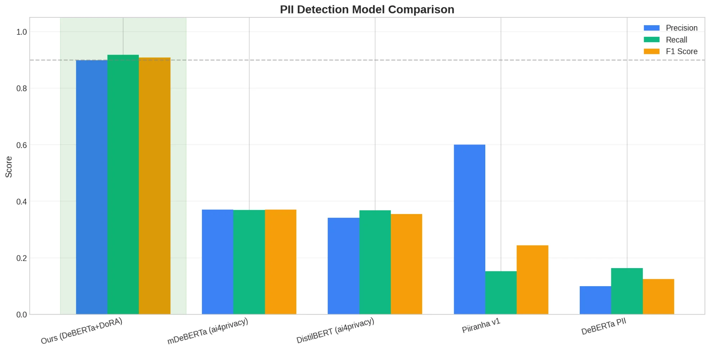
Results: Model Comparison
Our model achieves balanced high precision (0.898) AND high recall (0.918)
Piiranha has high precision (0.60) but very low recall (0.15) — misses most PII
Evaluated on 31,361 test samples • All models tested with their published weights

Slide 12
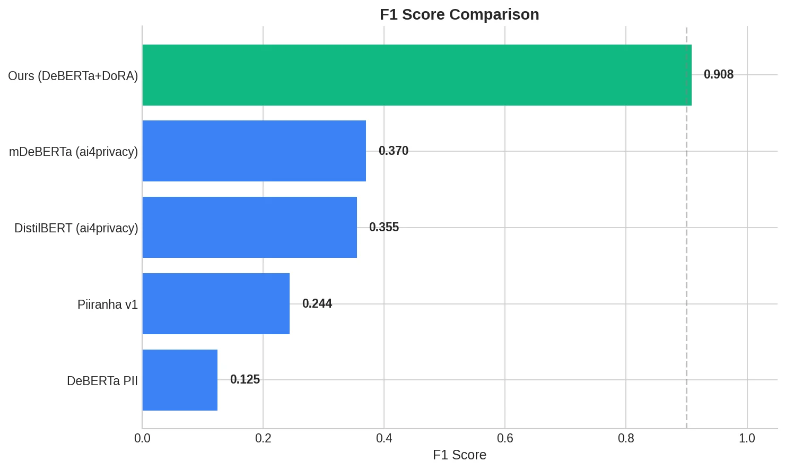
Key Results
Our F1 Score
0.908
Accuracy
ROC AUC
97.9%
0.9998
Improvement
vs Piiranha
vs mDeBERTa
+272%
+145%
252 labels vs 18-116 for baselines

Slide 13
Why This Approach Works
1
Targeted Training Data
2
Larger Base Model
Synthetic data specifically addresses the 6 failure modes identified in prior research. Even at 3.8% of total data, it dramatically improves edge case handling.
DeBERTaV3-large provides superior contextual understanding for ambiguous entities. The disentangled attention mechanism excels at capturing entity boundaries.
3
4
Quality Validation
DoRA Efficiency
Training only 2.6% of parameters prevents catastrophic forgetting of pretrained knowledge while efficiently adapting to PII-specific patterns.
Two-stage LLM pipeline (Grok + GPT-5.1) ensures 96.6% entity boundary accuracy in synthetic data. Bad training examples are filtered before they can hurt the model.

Slide 14
Limitations
Evaluation Fairness
Synthetic Data Bias
Due to time constraints, we did not retrain baseline models on our augmented dataset. Comparison uses their original published weights, which may underestimate their potential with similar training data.
Some generated samples contain non-English text despite English prompts. The "multilingual" dimension may introduce patterns not representative of real-world English PII.
Label Granularity
Computational Cost
252 labels may be overly granular for some use cases. Many real applications only need ~20-30 categories. Fine-grained labels increase model complexity without clear downstream benefit.
DeBERTaV3-large requires significant GPU memory for inference (~8GB). May not be suitable for edge deployment or resource-constrained environments.
Out-of-Distribution Testing
Temporal Validity
Model has not been tested on truly out-of-distribution data (e.g., different domains, adversarial inputs crafted to evade detection).
PII formats evolve rapidly (new payment systems, ID formats). Model may degrade on emerging PII types not represented in training data.

Slide 15
Future Work & Conclusion
Future Directions
Conclusion
Label Simplification
Targeted synthetic data + efficient fine-tuning dramatically improves PII detection.
252 → ~30 practical categories
0.908 F1 — 145-272% improvement over baselines.
Adversarial Testing
Testing against new data and PII types in the future
Resources
Deployment Optimization
huggingface.co/Ari-S-123/deberta-v3-large-pii-consolidated
huggingface.co/datasets/Ari-S-123/pii-detection-english-consolidated
Quantization for edge deployment
github.com/Ari-S-123/pii-masking
Fair Comparison
Thank You
Questions?
Retrain baselines on augmented data

