Slide 1
Project Title:
Wikipedia Article Quality Prediction through Citation Network
Kuon Ito, Lorenz Rückert, Nafiß Tavakol, Marius Helten

Slide 2
Goal:
Predict the quality of Wikipedia articles by analyzing both their citation networks and intrinsic article features.
Build a Graph Neural Network (GNN) model to:
Combine structural and semantic signals from the citation graph.
Leverage article-level features as node attributes.
Understand how quality signals propagate through knowledge networks, helping to identify patterns of high-quality content.

Slide 3
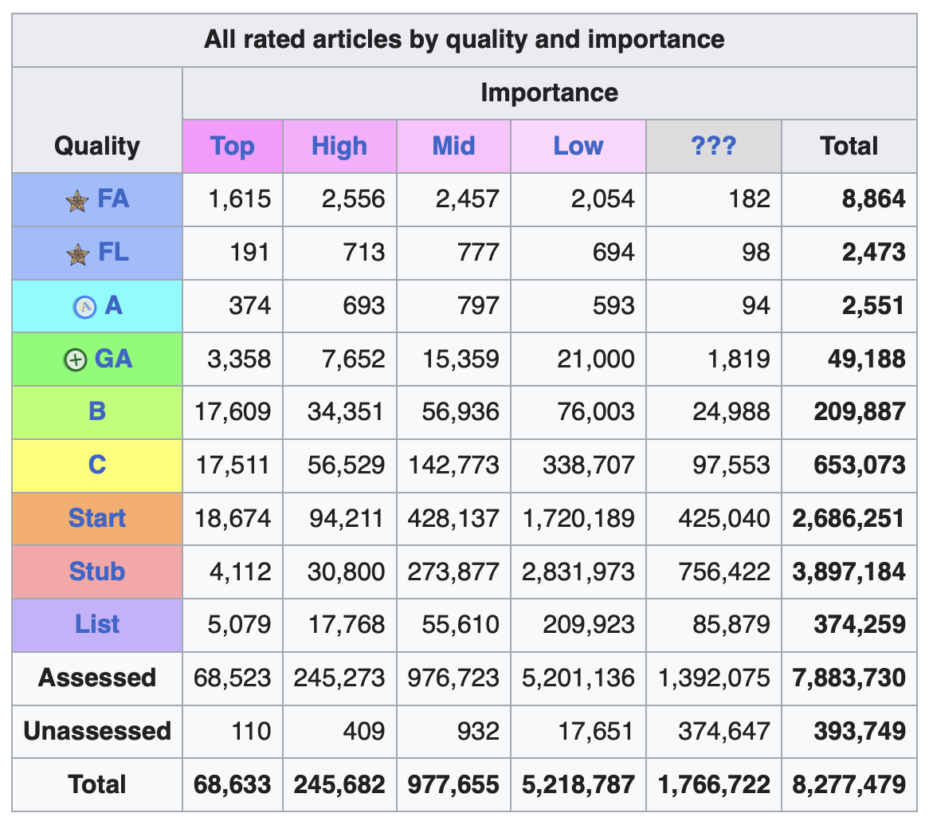
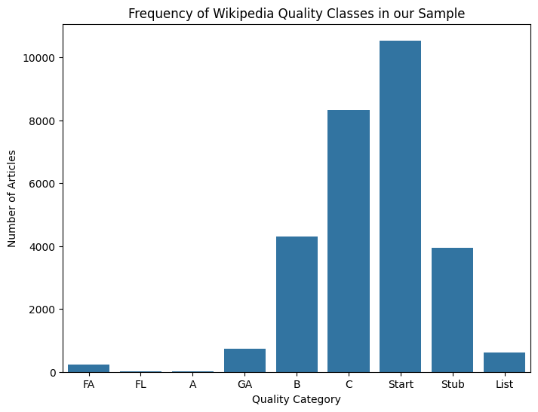
Target Variable:
https://en.wikipedia.org/wiki/Wikipedia:Content_assessment

Slide 4
Data Collection:
Sources: 4
Source | Purpose
Wikipedia Dump | Text, structure
Pageviews API | Popularity and user attention
Edit History API Wikipedia API | Editorial activity patterns Crawling Wikipedia and Building network

Slide 5
Structure Features
Style, Readability, Semantic Features
Network Features
Article length
Number of sections
Number of subsections
Number of paragraphs
Infobox presence
Number of images
Number of categories
Internal links count
External links count
Templates used
Number of references
Abstract size
In-degree: Number of articles referencing this article
Out-degree: Number of articles this article references
PageRank: Importance of an article in the citation network
Clustering coefficient: How tightly connected its neighbors are
Style Features
• POS tag counts
Readability Features
• Readability scores
Semantic Features
• doc2vec embedding
Features Explanation

Slide 6
Benchmarks for GNN
- use use Wikipedia’s ORES (ML-based quality prediction) as a benchmark for evaluating our GNN model
- MLP with just the features to see if network structure is needed
- different GNNs (GraphSage, GCN, usw...)

Slide 7
Problems / Challenges
  1 - Data Collection with APIs + WikiDumps for additional features
    - Size of the sample
    - Sample Selection (Topic or Crawl)
  2 – Distribution Issue, very unbalanced dataset
  3 – Theoretical mechanism behind quality propagation?
    - Citation ≠ Wikipedia Link

Slide 8
Project Steps
Part 1:
Data Collection and Preliminary Analysis
Part 2:
Deep Learning Model
Part 3:
Knowledge Network Analysis

Slide 9
Steps of Data Collection
1. Get Article Text and Metadata
From Wikipedia dumps:
  Extract article titles and content
  Parse the pagelinks dump to find which articles cite others
2. Build Citation Graph
Nodes: All articles in dataset
Edges: Directed links
3. Add Node Features
From article text (readability, structure, embeddings)
From external APIs (pageviews, edit history)
4. Target
Quality labels: FA, GA, B, C, Start, Stub

Slide 10
Wikipedia Dumps (Article Content & Metadata): https://dumps.wikimedia.org/enwiki/latest
File: enwiki-latest-pages-articles.xml.bz2
Contains:
- Full article texts (the content of Wikipedia pages)
- Titles, categories, templates
- Internal hyperlinks
Use WikiExtractor to process the dump:
- Clean HTML/text (Get plain article text)
- Extract article titles (for matching with API)
- Extract hyperlinks
Node attributes and computing features

Slide 11
Wikimedia Pageviews API (Article Popularity)
API endpoint:
https://wikimedia.org/api/rest_v1/#/Pageviews%20data
1- Get Article Titles from Dump(extract titles After running WikiExtractor)
2- Format Article Titles for API Use(Replace spaces with underscores)
3- Use the Wikimedia Pageviews API
4- Save to CSV
Query API using article titles from the dump:
  Daily or monthly number of views for any article
  For specific date ranges

Slide 12
Wikimedia Edit History API (Article Activity)
API endpoint:
API:Revisions– MediaWiki
This API provides cacheable and straightforward access to Wikimedia content and data, in machine-readable formats.
Provides:
  Full list of edits to an article (timestamps, editor usernames, comments, size changes,…)
  Editor metadata

Slide 13
Structure
Style, Readability, Semantic
Network
Features

Slide 14
Problems / Challenges
Source of Data ?
  API?
    Is there a key?
  Wikidump really large file
  Prepared Datasets allowed? (Link)

