Slide 1
Snack Squad: A Customizable Snack Ordering and Delivery App
Team Incognito
Team Members: -Ariharan.R
Subash.M
Mugesh.MC
Ramesh kanna.KKM

Slide 2
DESCRIPTION
The Snack Squad app is a customizable snack ordering and delivery app that offers a variety of snacks and drinks from around the world
Snacks :Snack Squad offers a wide selection of snacks, including sweet, savory, spicy, and sour options.
Mystery boxes: Snack Squad also offers Mystery Boxes, which are a selection of treats handpicked just for you.
Discounts and promotions: Snack Squad offers exclusive discounts, promotions, and freebies to its app users.
Delivery: Snack Squad delivers snacks directly to your doorstep.

Slide 3
Program:
plugins {
id 'com.android.application'
id 'org.jetbrains.kotlin.android'
}
android {
namespace 'com.example.snackordering'
compileSdk 33
defaultConfig {
applicationId "com.example.snackordering"
minSdk 24
targetSdk 33
versionCode 1
versionName "1.0"
testInstrumentationRunner "androidx.test.runner.AndroidJUnitRunner"
vectorDrawables {
useSupportLibrary true
}
}

Slide 4
buildTypes {
release {
minifyEnabled false
proguardFiles getDefaultProguardFile('proguard-android-optimize.txt'), 'proguard-rules.pro'
}
}
compileOptions {
sourceCompatibility JavaVersion.VERSION_1_8
targetCompatibility JavaVersion.VERSION_1_8
}
kotlinOptions {
jvmTarget = '1.8'
}
buildFeatures {
compose true
}
composeOptions {
kotlinCompilerExtensionVersion '1.2.0'
}
packagingOptions {
resources {
excludes += '/META-INF/{AL2.0,LGPL2.1}'
}
}
}

Slide 5
dependencies {
implementation 'androidx.core:core-ktx:1.7.0'
implementation 'androidx.lifecycle:lifecycle-runtime-ktx:2.3.1'
implementation 'androidx.activity:activity-compose:1.3.1'
implementation "androidx.compose.ui:ui:$compose_ui_version"
implementation "androidx.compose.ui:ui-tooling-preview:$compose_ui_version"
implementation 'androidx.compose.material:material:1.2.0'
implementation 'androidx.room:room-common:2.5.0'
implementation 'androidx.room:room-ktx:2.5.0'
testImplementation 'junit:junit:4.13.2'
androidTestImplementation 'androidx.test.ext:junit:1.1.5'
androidTestImplementation 'androidx.test.espresso:espresso-core:3.5.1'
androidTestImplementation "androidx.compose.ui:ui-test-junit4:$compose_ui_version"
debugImplementation "androidx.compose.ui:ui-tooling:$compose_ui_version"
debugImplementation "androidx.compose.ui:ui-test-manifest:$compose_ui_version"
}

Slide 6
# Add project specific ProGuard rules here.
# You can control the set of applied configuration files using the
# proguardFiles setting in build.gradle.
#
# For more details, see
# http://developer.android.com/guide/developing/tools/proguard.html
# If your project uses WebView with JS, uncomment the following
# and specify the fully qualified class name to the JavaScript interface
# class:
#-keepclassmembers class fqcn.of.javascript.interface.for.webview {
# public *;
#}
# Uncomment this to preserve the line number information for
# debugging stack traces.
#-keepattributes SourceFile,LineNumberTable
# If you keep the line number information, uncomment this to
# hide the original source file name.
#-renamesourcefileattribute SourceFile

Slide 7
<?xml version="1.0" encoding="UTF-8"?>
<module type="JAVA_MODULE" version="4">
<component name="NewModuleRootManager" inherit-compiler-output="true">
<exclude-output />
<content url="file://$MODULE_DIR$">
<sourceFolder url="file://$MODULE_DIR$/java" isTestSource="false" />
</content>
<orderEntry type="inheritedJdk" />
<orderEntry type="sourceFolder" forTests="false" />
</component>
</module>

Slide 8
package com.example.snackordering
import androidx.test.platform.app.InstrumentationRegistry
import androidx.test.ext.junit.runners.AndroidJUnit4
import org.junit.Test
import org.junit.runner.RunWith
import org.junit.Assert.*
/**
* Instrumented test, which will execute on an Android device.
*
* See [testing documentation](http://d.android.com/tools/testing).
*/
@RunWith(AndroidJUnit4::class)
class ExampleInstrumentedTest {
@Test
fun useAppContext() {
// Context of the app under test.
val appContext = InstrumentationRegistry.getInstrumentation().targetContext
assertEquals("com.example.snackordering", appContext.packageName)
}
}

Slide 9
<?xml version="1.0" encoding="utf-8"?>
<manifest xmlns:android="http://schemas.android.com/apk/res/android"
xmlns:tools="http://schemas.android.com/tools">
<application
android:allowBackup="true"
android:dataExtractionRules="@xml/data_extraction_rules"
android:fullBackupContent="@xml/backup_rules"
android:icon="@drawable/fast_food"
android:label="@string/app_name"
android:supportsRtl="true"
android:theme="@style/Theme.SnackOrdering"
tools:targetApi="31">
<activity
android:name=".AdminActivity"
android:exported="false"
android:label="@string/title_activity_admin"
android:theme="@style/Theme.SnackOrdering" />
<activity
android:name=".LoginActivity"
android:exported="true"
android:label="SnackSquad"
android:theme="@style/Theme.SnackOrdering">
<intent-filter>
<action android:name="android.intent.action.MAIN" />

Slide 10
<category android:name="android.intent.category.LAUNCHER" />
</intent-filter>
</activity>
<activity
android:name=".TargetActivity"
android:exported="false"
android:label="@string/title_activity_target"
android:theme="@style/Theme.SnackOrdering" />
<activity
android:name=".MainPage"
android:exported="false"
android:label="@string/title_activity_main_page"
android:theme="@style/Theme.SnackOrdering" />
<activity
android:name=".MainActivity"
android:exported="false"
android:label="MainActivity"
android:theme="@style/Theme.SnackOrdering" />
</application>
</manifest>

Slide 11
package com.example.snackordering
import android.icu.text.SimpleDateFormat
import android.os.Bundle
import android.util.Log
import androidx.activity.ComponentActivity
import androidx.activity.compose.setContent
import androidx.compose.foundation.Image
import androidx.compose.foundation.layout.*
import androidx.compose.foundation.lazy.LazyColumn
import androidx.compose.foundation.lazy.LazyRow
import androidx.compose.foundation.lazy.items
import androidx.compose.material.MaterialTheme
import androidx.compose.material.Surface
import androidx.compose.material.Text
import androidx.compose.runtime.Composable
import androidx.compose.ui.Modifier
import androidx.compose.ui.graphics.Color
import androidx.compose.ui.layout.ContentScale
import androidx.compose.ui.res.painterResource
import androidx.compose.ui.unit.dp
import androidx.compose.ui.unit.sp
import com.example.snackordering.ui.theme.SnackOrderingTheme
import java.util.*

Slide 12
class AdminActivity : ComponentActivity() {
private lateinit var orderDatabaseHelper: OrderDatabaseHelper
override fun onCreate(savedInstanceState: Bundle?) {
super.onCreate(savedInstanceState)
orderDatabaseHelper = OrderDatabaseHelper(this)
setContent {
SnackOrderingTheme {
// A surface container using the 'background' color from the theme
Surface(
modifier = Modifier.fillMaxSize(),
color = MaterialTheme.colors.background
) {
val data=orderDatabaseHelper.getAllOrders();
Log.d("swathi" ,data.toString())
val order = orderDatabaseHelper.getAllOrders()
ListListScopeSample(order)
}
}
}
}
}

Slide 13
@Composable
fun ListListScopeSample(order: List<Order>) {
Image(
painterResource(id = R.drawable.order), contentDescription = "",
alpha =0.5F,
contentScale = ContentScale.FillHeight)
Text(text = "Order Tracking", modifier = Modifier.padding(top = 24.dp, start = 106.dp, bottom = 24.dp ), color = Color.White, fontSize = 30.sp)
Spacer(modifier = Modifier.height(30.dp))
LazyRow(
modifier = Modifier
.fillMaxSize()
.padding(top = 80.dp),
horizontalArrangement = Arrangement.SpaceBetween
){
item {
LazyColumn {
items(order) { order ->
Column(modifier = Modifier.padding(top = 16.dp, start = 48.dp, bottom = 20.dp)) {
Text("Quantity: ${order.quantity}")
Text("Address: ${order.address}")
}
}
}
}}}

Slide 14
package com.example.snackordering
import android.content.Context
import android.content.Intent
import android.os.Bundle
import androidx.activity.ComponentActivity
import androidx.activity.compose.setContent
import androidx.compose.foundation.Image
import androidx.compose.foundation.layout.*
import androidx.compose.material.*
import androidx.compose.runtime.*
import androidx.compose.ui.Alignment
import androidx.compose.ui.Modifier
import androidx.compose.ui.graphics.Color
import androidx.compose.ui.layout.ContentScale
import androidx.compose.ui.res.painterResource
import androidx.compose.ui.text.font.FontFamily
import androidx.compose.ui.text.font.FontWeight
import androidx.compose.ui.unit.dp
import androidx.compose.ui.unit.sp
import androidx.core.content.ContextCompat
import com.example.snackordering.ui.theme.SnackOrderingTheme

Slide 15
class LoginActivity : ComponentActivity() {
private lateinit var databaseHelper: UserDatabaseHelper
override fun onCreate(savedInstanceState: Bundle?) {
super.onCreate(savedInstanceState)
databaseHelper = UserDatabaseHelper(this)
setContent {
SnackOrderingTheme {
// A surface container using the 'background' color from the theme
Surface(
modifier = Modifier.fillMaxSize(),
color = MaterialTheme.colors.background
) {
LoginScreen(this, databaseHelper)
}
}
}
}
}

Slide 16
@Composable
fun LoginScreen(context: Context, databaseHelper: UserDatabaseHelper) {
Image(painterResource(id = R.drawable.order), contentDescription = "",
alpha =0.3F,
contentScale = ContentScale.FillHeight,
)
var username by remember { mutableStateOf("") }
var password by remember { mutableStateOf("") }
var error by remember { mutableStateOf("") }
Column(
modifier = Modifier.fillMaxSize(),
horizontalAlignment = Alignment.CenterHorizontally,
verticalArrangement = Arrangement.Center
) {

Slide 17
Text(
fontSize = 36.sp,
fontWeight = FontWeight.ExtraBold,
fontFamily = FontFamily.Cursive,
color = Color.White,
text = "Login"
)
Spacer(modifier = Modifier.height(10.dp))
TextField(
value = username,
onValueChange = { username = it },
label = { Text("Username") },
modifier = Modifier.padding(10.dp)
.width(280.dp)
)
TextField(
value = password,
onValueChange = { password = it },
label = { Text("Password") },
modifier = Modifier.padding(10.dp)
.width(280.dp)
)

Slide 18
if (error.isNotEmpty()) {
Text(
text = error,
color = MaterialTheme.colors.error,
modifier = Modifier.padding(vertical = 16.dp)
)
}
Button(
onClick = {
if (username.isNotEmpty() && password.isNotEmpty()) {
val user = databaseHelper.getUserByUsername(username)
if (user != null && user.password == password) {
error = "Successfully log in"
context.startActivity(
Intent(
context,
MainPage::class.java
)
)
//onLoginSuccess()
}

Slide 19
if (user != null && user.password == "admin") {
error = "Successfully log in"
context.startActivity(
Intent(
context,
AdminActivity::class.java
)
)
}
else {
error = "Invalid username or password"
}
} else {
error = "Please fill all fields"
}
},
modifier = Modifier.padding(top = 16.dp)
) {
Text(text = "Login")
}

Slide 20
Row {
TextButton(onClick = {context.startActivity(
Intent(
context,
MainActivity::class.java
)
)}
)
{ Text(color = Color.White,text = "Sign up") }
TextButton(onClick = {
})
{
Spacer(modifier = Modifier.width(60.dp))
Text(color = Color.White,text = "Forget password?")
}
}
}
}
private fun startMainPage(context: Context) {
val intent = Intent(context, MainPage::class.java)
ContextCompat.startActivity(context, intent, null)
}

Slide 21
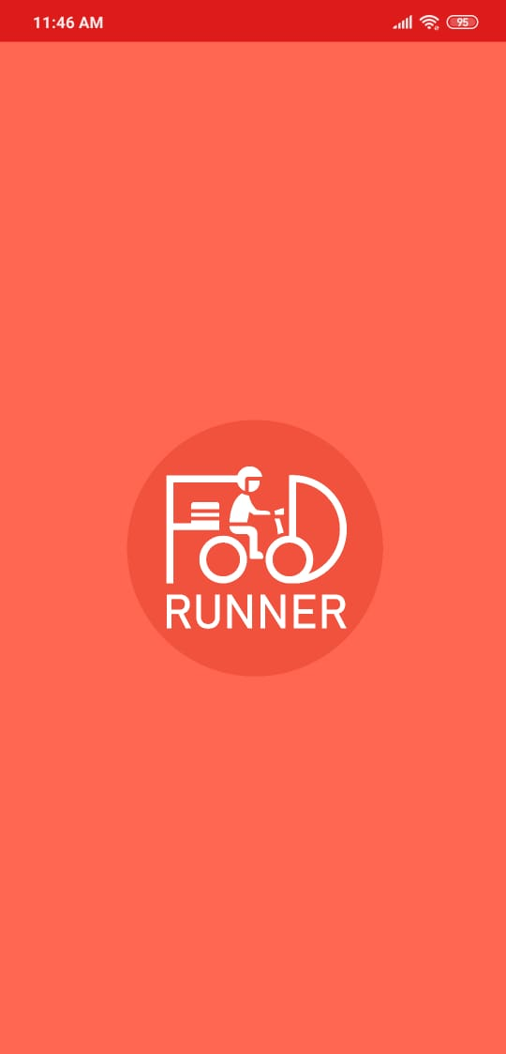
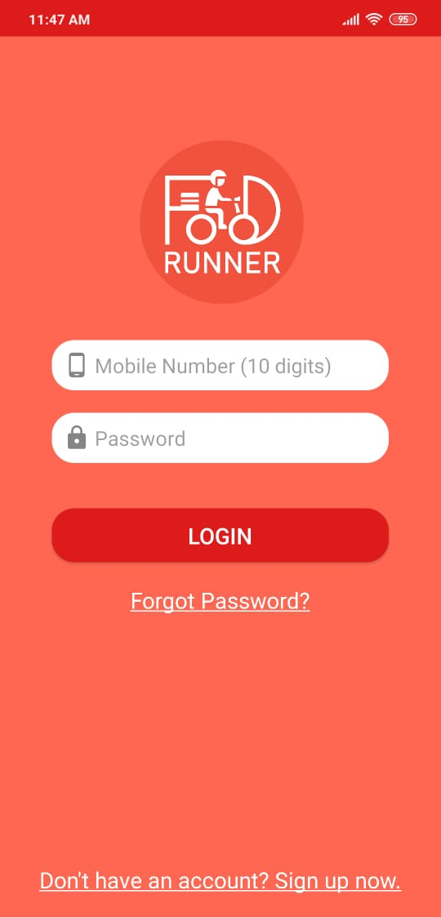
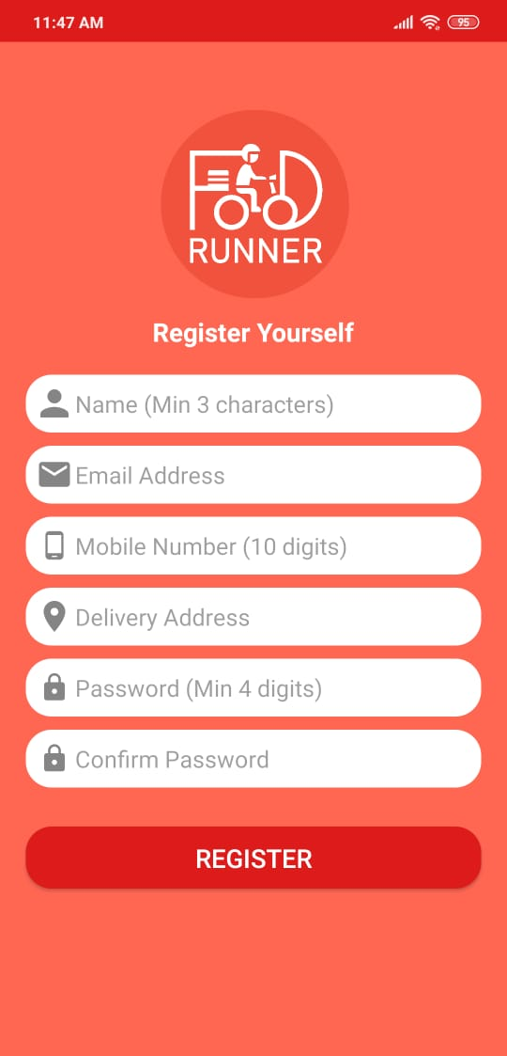
OUTPUT:

Slide 22
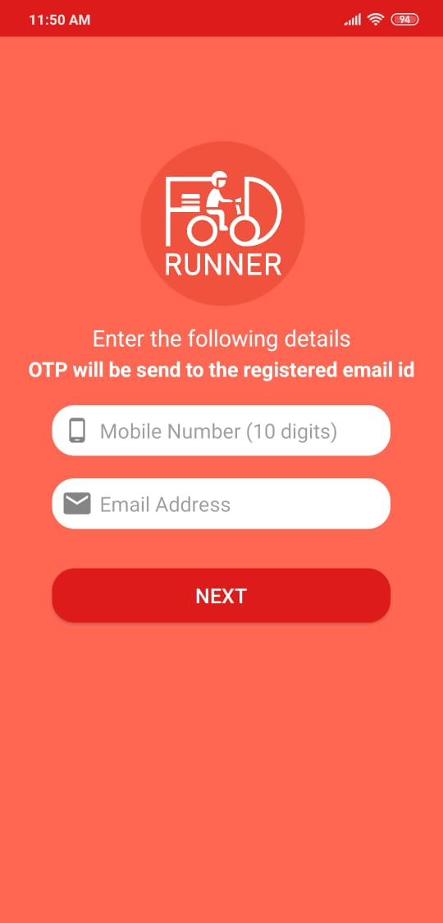
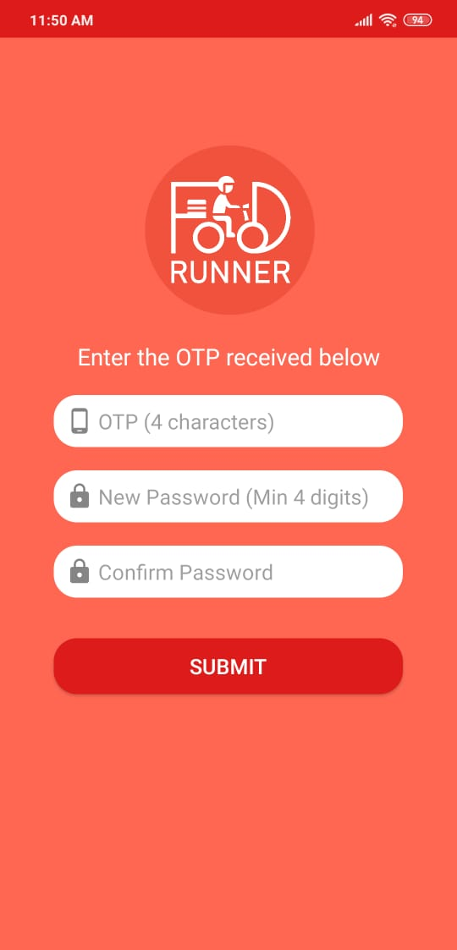
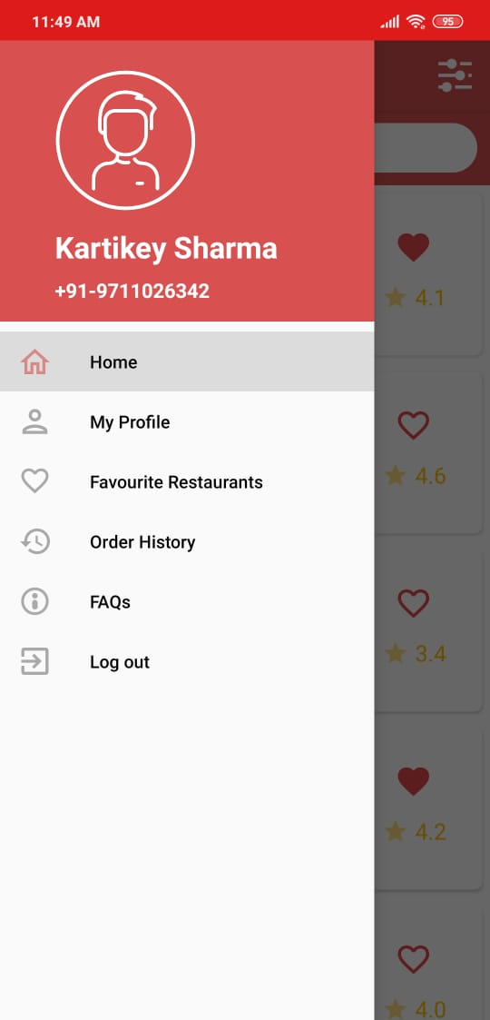

Slide 23
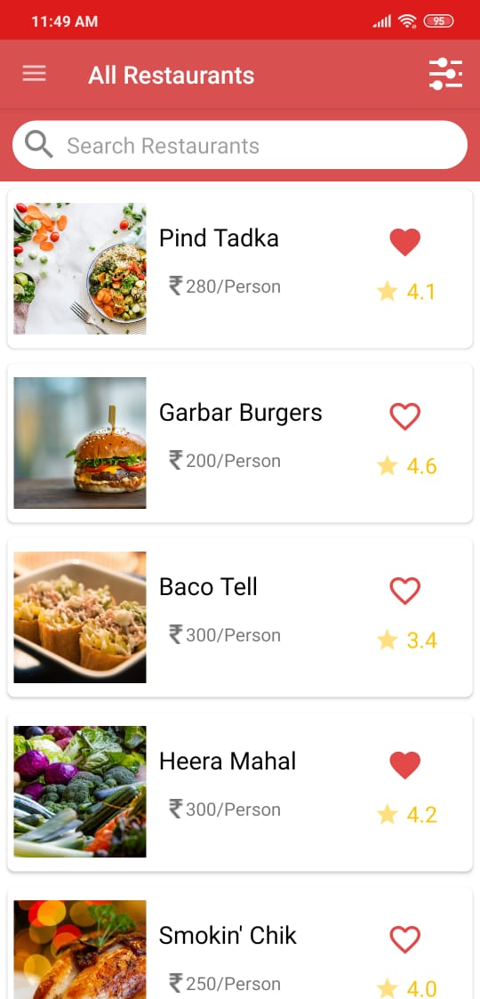
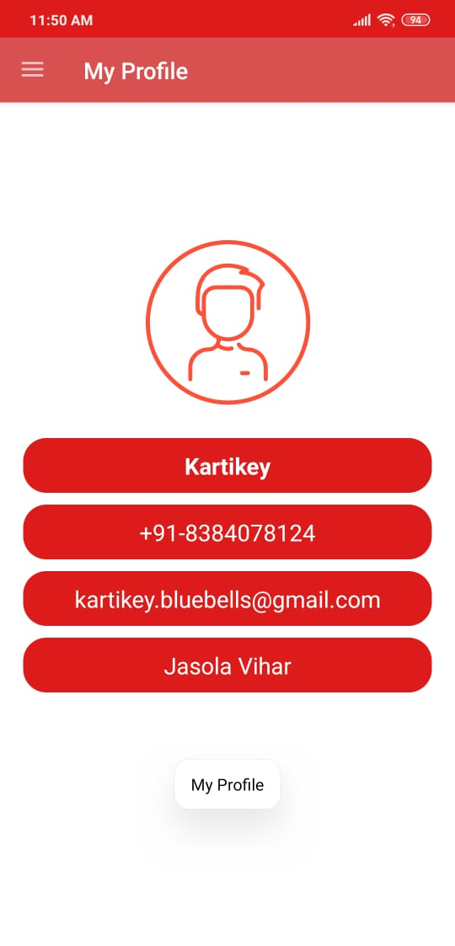
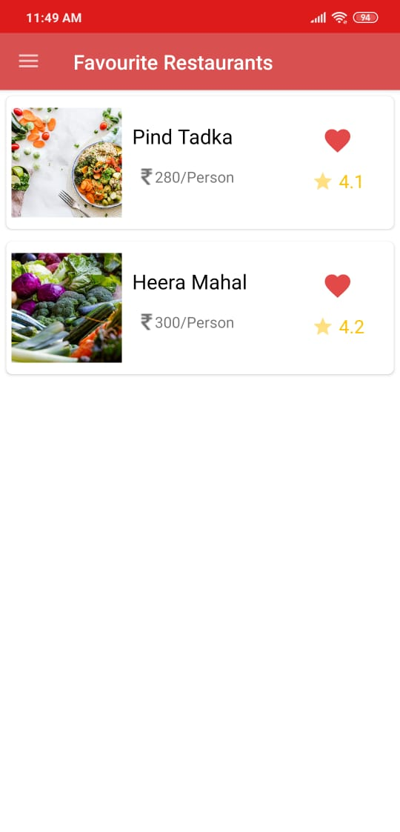

Slide 24
THANK YOU!

