Slide 1









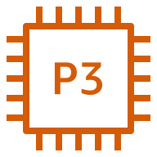






AWS Cloud
Availability Zone 1
Availability Zone 2
VPC
Public subnet
Internet gateway
Public subnet
NAT gateway
Application Load Balancer
NAT gateway
Amazon ECS
Private subnet
Private subnet
Auto Scaling group
Namespace
P3 instance
P3 instance
Container
Task
Cheminformatics service
Container
Task
Amazon CloudWatch
Container
Task
MegaMolBART service
Container
Task
Amazon EFS

