Slide 1













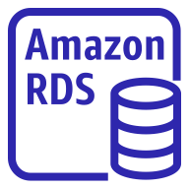

AWS Cloud
Availability Zone 1
Availability Zone 2
VPC
Public subnet
Internet gateway
Public subnet
Amazon Route 53
NAT gateway
Application Load Balancer
NAT gateway
Amazon EFS
Private subnet
Private subnet
ACM
Auto Scaling group
Instance
Instance
Amazon S3
Amazon RDS instance
Amazon RDS instance
Amazon ECR

