Slide 1

Natural Language Processing Project
Created by Andy Fordjour, Bernard Ong, Ari Kaminski

Slide 2
About
Our idea for the CSIT-200 Fall 2021 Group Project was to create a program that scrapes web data for customer reviews on Newegg product pages.
After doing research, we created the idea that we can scrape the review data and import to a csv file, then use TextBlob library to assign a sentiment score for each review.

Slide 3
Libraries used…
We used two separate libraries for our project to be successful.
TextBlob -NLTK Library that assigns sentiment score.
Works by reading the text and assigning a score between -1 and 1
BeautifulSoup – Web scraping library to pull username and review data from newegg.com

Slide 4
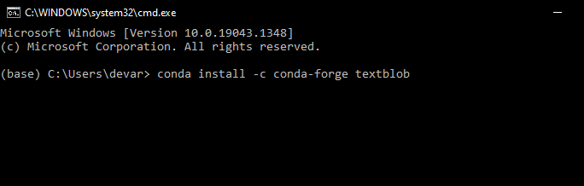
How to install TextBlob
First, Open Anaconda Navigator and run CMD.exe Prompt
To Install TextBlob, Type conda install –c conda-forge textblob
Type y to complete installation
Last, type python – m textblob.download_corpora
TextBlob is now installed.

Slide 5
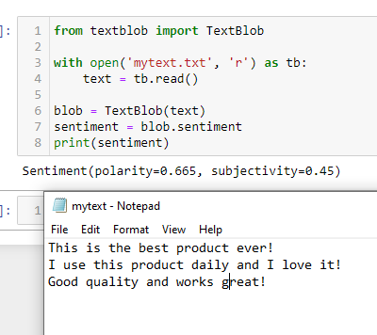
Beginning of Project
Originally, we had planned to use a .txt file to read and write our reviews. After coding and testing, we decided that a CSV file was optimal.
In the example, TextBlob reads mytext.txt, parses the doc for positive/negative words, and assigns a sentiment score.

Slide 6
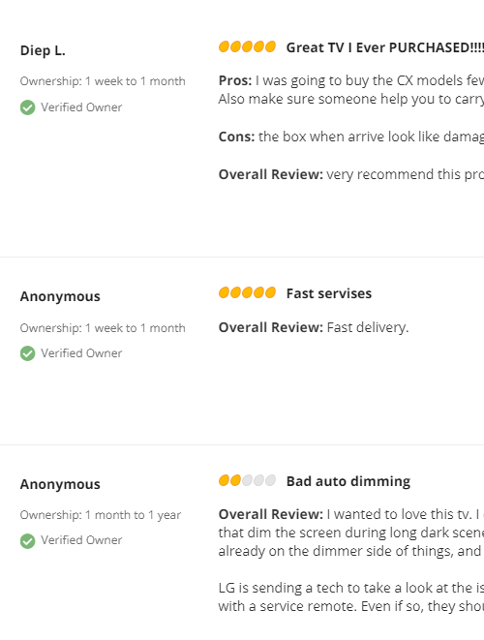

Testing a High Rated Product
In this example, we tested a high rated product on newegg.com, a TV with 5/5 stars
We can see that Diep L rating this TV 5 stars, while TextBlob
assigned a score of .3199, roughly equivalent to 3.5 stars
Anon 1 Scored his review 5 stars, TextBlob assigned score of .1,
roughly equivalent to 2.5 stars
Anon 2 Scored his review 2 stars, TextBlob assigned score of -.01,
roughly equivalent to 2.5 stars

Slide 7


Testing a Low Rated Product
In this example, we tested a low rated graphics card on newegg.com, a rating of 2/5 stars
David W Assigned a score of 5/5 stars, TextBlob sentiment was .5
Jason F Assigned a score of 1/5 stars, TextBlob sentiment was .1
Eugene N assigned a score of 1/5 stars, TextBlob sentiment was .2
Erin S assigned a score of 2/5 stars, TextBlob sentiment was .7

Slide 8
Find all function beautiful soup div tags are labeled with class amazon tags has an ID specific to review

