Slide 1

Natural Language Processing Project
Created by Andy Fordjour, Bernard Ong, Ari Kaminski

Slide 2
About
Our idea for the CSIT-200 Fall 2021 Group Project was to create a program that scrapes web data for customer reviews on Newegg product pages. With some great progress from Bernard, we were able to scrape Amazon’s review data as well.
After doing research, we created the idea that we can scrape the review data and import to a csv file, then use TextBlob library to assign a sentiment score for each review.

Slide 3
Libraries used…
We used two separate libraries for our project to be successful.
TextBlob -NLTK Library that assigns sentiment score.
Works by reading the text and assigning a score between -1 and 1
BeautifulSoup – Web scraping library to pull username and review data from newegg.com

Slide 4
How TextBlob Works
TextBlob is a simple Natural Language Processing python library. It actively uses an NLTK Dictionary of words, which classify into positive and negative words
When reading text, each word parsed has a pre-defined sentiment score. Upon reaching the end of the text, all word scores are compiled and return a single sentiment score, on a scale of -1 to 1.
-1 = 1 stars, -.5 = 2 stars, 0 = 3 stars, .5 = 4 stars, 1 = 5 stars

Slide 5
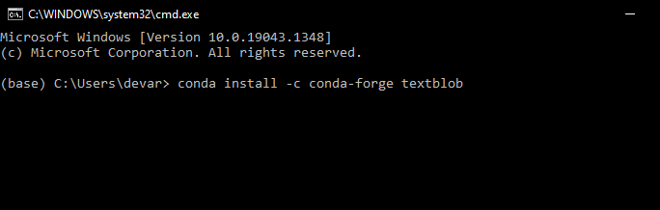
How to install TextBlob
First, Open Anaconda Navigator and run CMD.exe Prompt
To Install TextBlob, Type conda install –c conda-forge textblob
Type y to complete installation
Last, type python – m textblob.download_corpora
TextBlob is now installed.

Slide 6
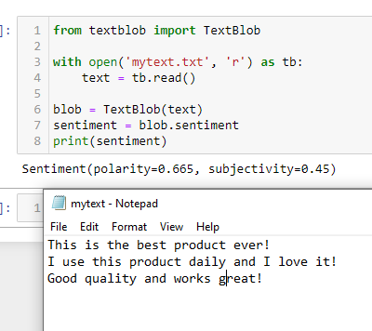
Beginning of Project
Originally, we had planned to use a .txt file to read and write our reviews. After coding and testing, we decided that a CSV file was optimal.
In the example, TextBlob reads mytext.txt, parses the doc for positive/negative words, and assigns a sentiment score.

Slide 7
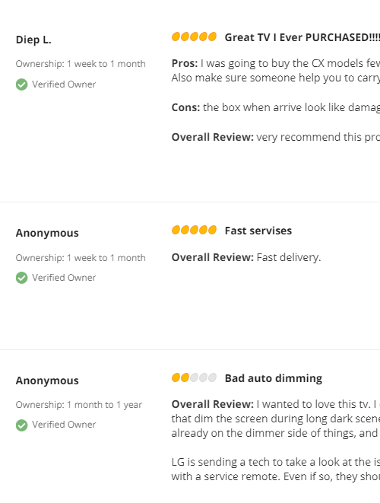

Testing a High Rated Product
In this example, we tested a high rated product on newegg.com, a TV with 5/5 stars
We can see that Diep L rating this TV 5 stars, while TextBlob
assigned a score of .3199, roughly equivalent to 3.5 stars
Anon 1 Scored his review 5 stars, TextBlob assigned score of .1,
roughly equivalent to 2.5 stars
Anon 2 Scored his review 2 stars, TextBlob assigned score of -.01,
roughly equivalent to 2.5 stars

Slide 8
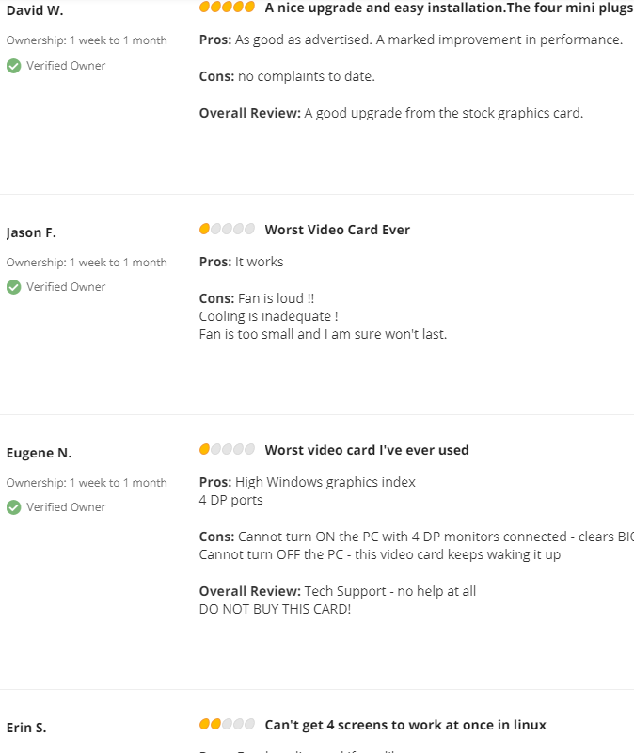

Testing a Low Rated Product
In this example, we tested a low rated graphics card on newegg.com, a rating of 2/5 stars
David W Assigned a score of 5/5 stars, TextBlob sentiment was .5
Jason F Assigned a score of 1/5 stars, TextBlob sentiment was .1
Eugene N assigned a score of 1/5 stars, TextBlob sentiment was .2
Erin S assigned a score of 2/5 stars, TextBlob sentiment was .7

Slide 9
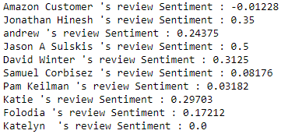
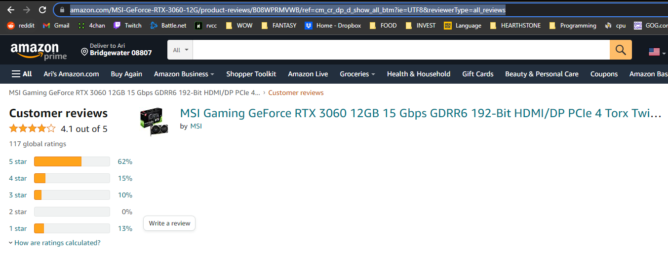
Testing an Amazon Product
For amazon to work, we must go directly to the Products’ Review page and copy the link for our input.
Here we can see many review sentiments for a graphics card product.

Slide 10
In conclusion…
After testing several different product review pages, we concluded that although TextBlob and NLP is a neat tool, it is not an accurate representation of a customer’s review.
We learned how to install a Library not included in Anaconda, and how to scrape web data using BeautifulSoup. We worked on converting a dictionary into a list, importing it into a csv file, and having TextBlob do the rest.

