Slide 1





Cross Platform Content Moderation
DSCI-511 TERM PROJECT
Comparing platform decisions against LLM applied policies
Ari Munkhtur
Jayesh Bane
4,164
38
6,492
POSTS COLLECTED
PLATFORM ACTIONS
LLM VERDICTS

Slide 2
THE QUESTION
Collect
Pull real moderated content from two open platforms: Bluesky and Lemmy
Simulate
Apply X and Meta policy texts as prompts to a local LLM. Judge the same content pulled.
Compare
Measure divergence: Platform action vs LLM verdict
Do LLM apply moderation policies the same way humans do ?
Why ?
Policy as a prompt is being proposed as a scalable moderation infrastructure.
This dataset aims to show whether the substitution holds in practice or whether policy text itself drives divergence outcomes.
Outcome : reproduceable pipeline and workflow for trust and safety research

Slide 3
Data sources
Bluesky
3000 posts collected
28 unique moderation actions
Official labeler only: moderation.bksy.app
Community labelers are excluded
Public search and endpoints
Lemmy
1164 posts collected
10 unique moderation actions
Three federated instances
Lemmy.world
Lemmy.ml
Programming.dev
Bluesky
Official community guidelines as of May of 2026
Policies converted are hateful conduct, spam and violence
Official community guidelines as of May of 2026
Policies converted are authenticity, violent content, and hateful conduct.

Slide 4
Acquiring the data
1
2
3
4
5
›
›
›
›
Platform
APIs
Collectors
SQLite
LLM
Verdict
AT Protocol +
Lemmy modlogs
Python,
async HTTP
moderation.db
UNIQUE on ap_id
Gemma 9B
local Ollama
Policy sim,
wide schema
Design decisions
Single SQLite db.
Ignore duplicate posts on Lemmy
3 categories of LLM policy
Violence
Hate speech
Spam
6 LLM calls per post ( 3 categories X 2 policies)
Content filters
English only
Only text but keep the media in hashed URLs
LLM settings
Gemma4 (8B parameters) via local Ollama
JSON output : action, category, confidence

Slide 5
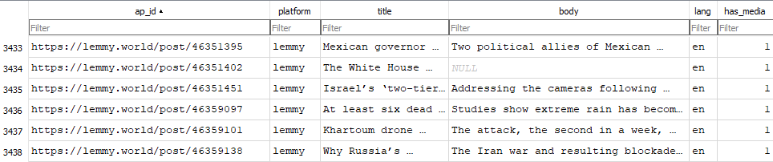
Dataset constructed
4164
unique posts
2164
Judged by LLM
39
Unique moderation actions
6492
Policy as prompt results
Posts
Media
ap_id
platform
body
title
lang
has_media
post_id
url
Mime_type
Moderation_observed
Policy simulation
post_id
Action_type
Mod_reason
Observed_at
post_id
category
Meta_actions
X_action

Slide 6
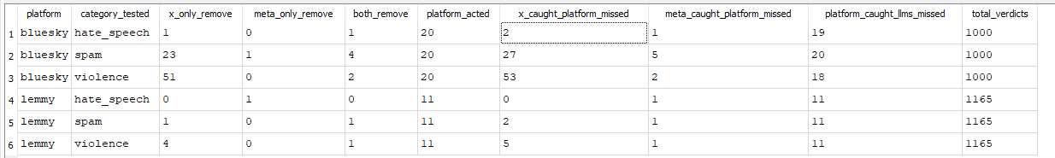
KEY FINDINGS
X catches way more than Meta on Bluesky violence and spam
Platforms and LLMs are catching completely different content.
Across 6,490 verdicts:
X policy flagged 80 posts that Meta policy did not
Platforms acted on 117 posts that neither LLM flagged, indicating platform moderation and category policy enforcement operate on different threat surfaces.

Slide 7
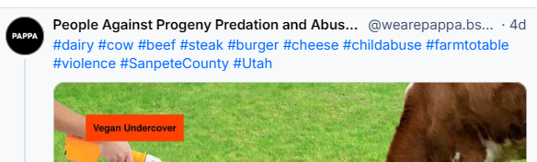
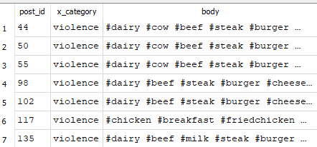
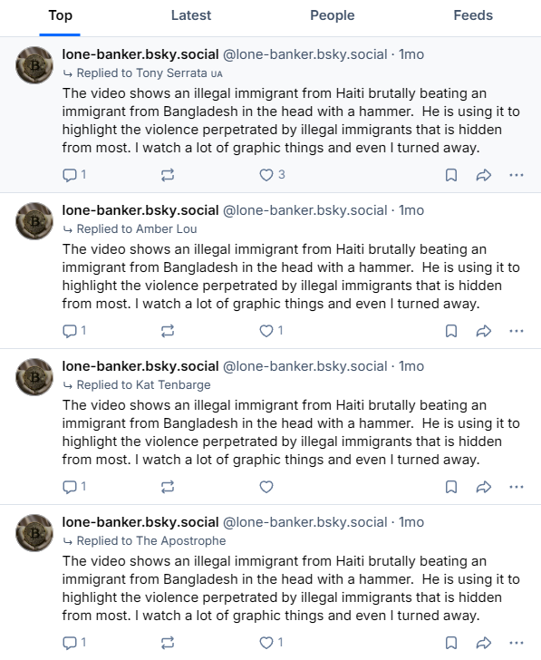
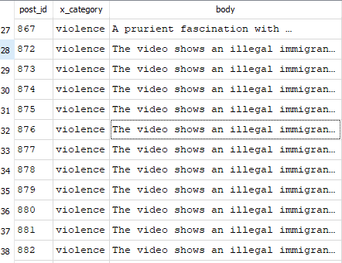
KEY FINDINGS
X policy is sensitive to repetition
Notes:
A vegan activist account that posts pre-made graphic infographics linking animal cruelty news stories to child abuse imagery. Each post uses the same hashtag template with location-specific variations.
One user reply-spamming the same paragraph about a Haiti immigrant violence video to multiple different accounts

Slide 8
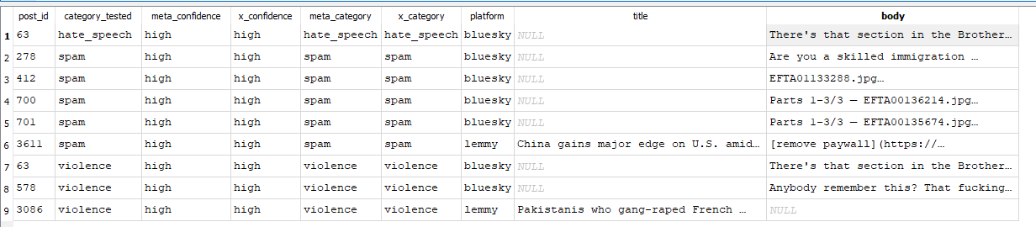
KEY FINDINGS
From verdicts where both X and Meta agreed to remove while platform did not:
Only 3 are genuine violations.
While 6 are just discussions about said category.
The LLMs are too eager, the platforms are doing it right.

Slide 9
Potential users
Trust and Safety researchers
Benchmark LLM moderation against hand labeled content
Study policy text driven divergence.
ML engineers
Training data for moderation classifiers
Evaluation set for safety models
Policy analysts
Empirical comparison of X and Meta policies as they get updated
Evidence of platform content accountability
Educators
Case studies for AI ethics (epistemic integrity, technological determinism)
Moderation as sociotechnical problem

Slide 10
DISTRIBUTION
Format
Singel SQLite DB file.
Schema documentation
Collector scripts
LLM scripts
Included
4164 unique posts from Bluesky and Lemmy
6000 LLM verdict
Excluded
No author identifiers
No image bytes only URLs
No private user data

Slide 11
ACCESS RIGHTS AND ETHICS
All data collected via official public APIs: Bluesky AT Protocol and Lemmy API
Polite collection using rate-limited requests at 0.5 seconds, along with a descriptive User Agent to identify the collector
Authentication is optional and is used only to surface some hidden moderation signals (Lemmy removal reasons, Bluesky Ozone labels)
Media is stored as URL and URL hashes only, image bytes are never downloaded to avoid local storage of graphic or illegal content
The database stores only the post content and platform moderation state, never any PII of the poster
Due to the sensitive nature of the content, handling is limited to research analysis, not redistribution

Slide 12
ISSUES AND LIMITATIONS
Lemmy exposes an explicit modlog with removal reasons, but Bluesky has no modlog, so moderation must be inferred from Ozone labels and post tombstones
On Bluesky, it is difficult to distinguish a mod removal from a user deletion
Lemmy removal reasons are free-text, so keyword-based classification can result in false positives/negatives
English-only post collection limits true global moderation activity
Media URL hashes are pseudo dedup keys; the same image uploaded again can result in a different URL
Current analysis is limited only to text

Slide 13
FUTURE WORK
Temporal Dimension: Re-fetch posts to track how moderation states change over time
Multimodal Analysis: Download the media to enable image-based policy analysis and support true deduplication based on the hash of the image bytes
Better Classification: Integrate a trained model or LLM labeler to replace keyword matching for moderation reasons
Validation: LLM as a Judge can be implemented to compare the outputs of multiple models against human judgments for reliability
Multilingual Coverage: Extend support for data collection beyond English

Slide 14
Team contributions
Ari Munkhtur
LLM policy simulation pipeline (Meta + X)
SQLite schema
LLM operations on dataset
Jayesh Bane
Data acquisition lead
Schema documentation
Collector scripts

