Slide 1
Build an agent from scratch
One idea at a time, from keyword matching to tool-calling agents, MCP, evals and provider switching, in a project that fetches jokes.
agent-lab · Go · Ollama · all stages 0 to 6 built
Notes:
agent-lab is a learning project. Each stage teaches one LLM or agent concept in a tiny domain.

Slide 2
Eight stages, one dial: who is in charge?
0
Keywords
no LLM
1
Structured output
LLM parses
2
Tool loop
LLM decides
3
Tools + memory
LLM remembers
3b
langchaingo
same, framework
4
MCP server
shared tools
5
Evals
measure it
6
Providers
any model
Each stage hands a little more control from your code to the model, then measures the result.
Tiny domain on purpose: ask for a joke, get one from a real API
Plain HTTP and Go structs, no SDK, so the wire format is visible
Every API and model is faked in tests; nothing needs the network
Notes:
All eight stages are built and tested offline. Stage 6 OpenAI and Claude adapters have not run against the live APIs.

Slide 3
Who decides at each stage
Stage | Interprets request | Chooses next action | Retries | Remembers | Picks tools
0 Keywords | your code | your code | – | – | –
1 Structured | the model | your code | – | – | –
2 Tool loop | the model | the model | yes | – | –
3 Multi-tool | the model | the model | yes | yes | yes
DESIGN RULE
The joke client takes a typed Request, never free text. The model fills a form, your code normalizes it, and only then does anything touch the network.

Slide 4
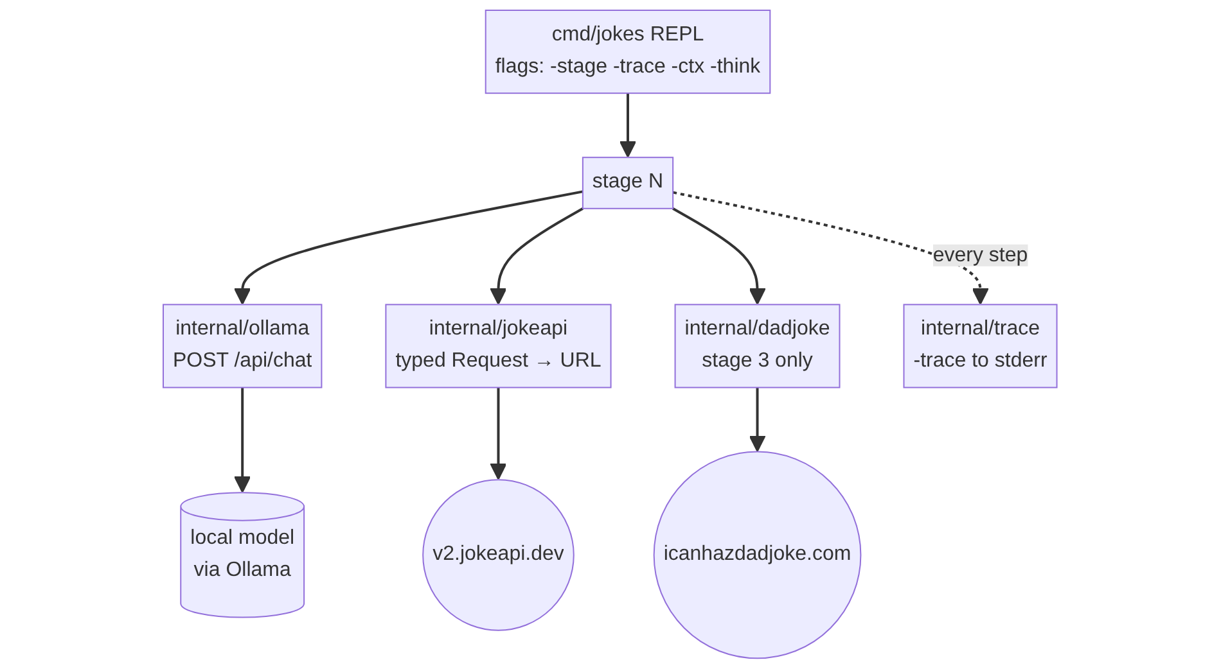
The shared plumbing
One REPL builds one stage with -stage N
Every stage reuses the Ollama, JokeAPI and trace packages
-trace prints every prompt, tool call, result and token count
Memory limits: ctx 8192, output 2048, keep-alive 2m

Slide 5
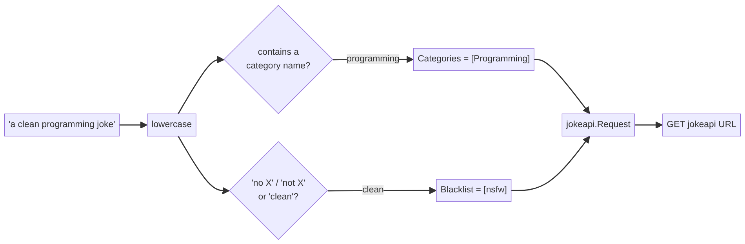
Stage 0: keywords, the baseline to beat
Lowercase the text and look for known words
Category names, "one-liner", "no politics"
Fast, free and predictable
WHERE IT BREAKS
"keep it family friendly" matches nothing. "clean" blacklists only nsfw.
Notes:
No LLM. strings.Contains for categories, type, and no-flag patterns.

Slide 6
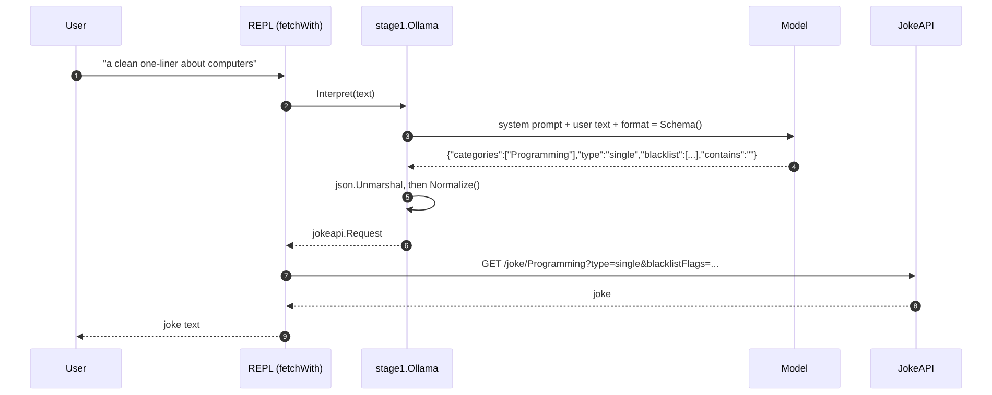
Stage 1: structured output, the model as parser
One call, with the JSON schema in the format field
The model can only emit valid JSON
Decode, then Normalize(): trust nothing
Ollama or Claude API behind one prompt
LESSON
The LLM becomes a typed function: text in, struct out.
Notes:
One LLM call constrained by a JSON schema. Ollama turns the schema into a grammar.

Slide 7
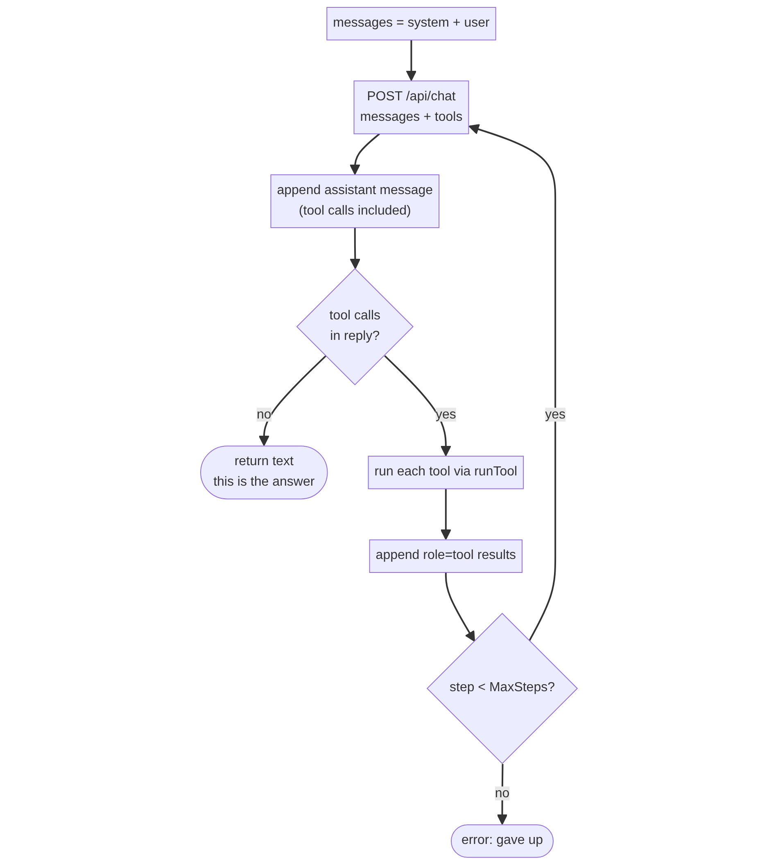
Stage 2: the agent is a loop
Describe a get_joke tool; the model decides when and how to call it
Assistant message with tool calls goes back into history
Tool errors return as results, so the model can retry
MaxSteps = 6 stops runaway loops
LESSON
An agent is a loop where the model's output can be an action.
Notes:
Frameworks are conveniences over this loop.

Slide 8
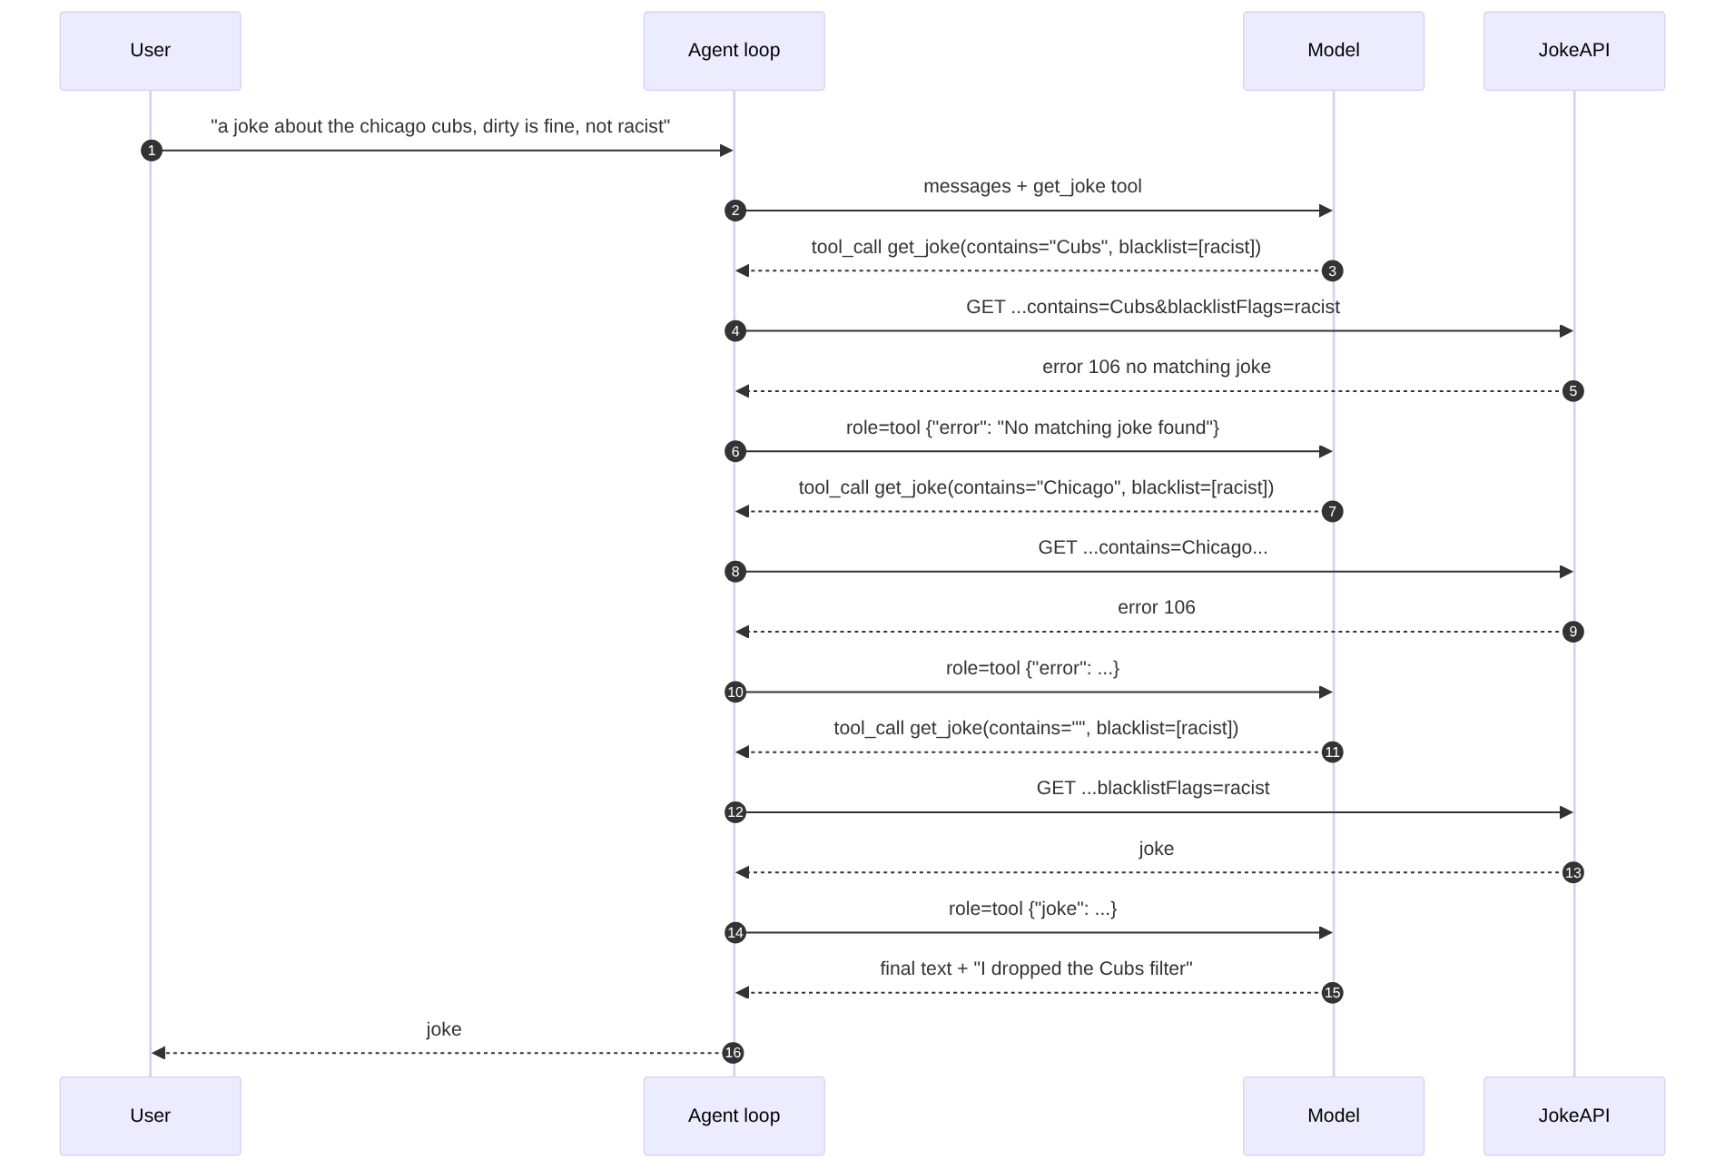
Retry without writing a retry loop
"No matching joke" goes back as a tool result
The model shortens the filter and calls again
The blacklist stays on through every attempt
It tells the user what it relaxed
Notes:
Cubs, then Chicago, then no filter. The racist blacklist is never loosened.

Slide 9
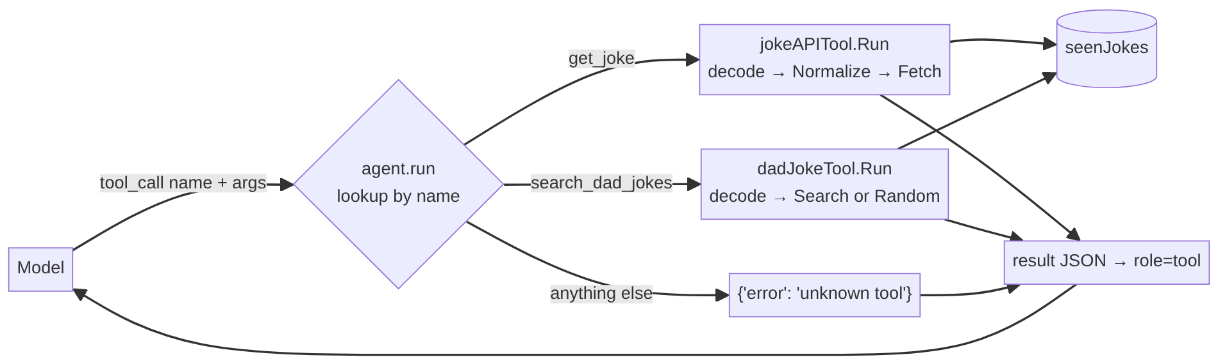
Stage 3: many tools and memory
TOOLS
get_joke (JokeAPI) and search_dad_jokes. Descriptions are part of the prompt.
MEMORY IN THE MODEL
The transcript is re-sent each call. Flexible, fuzzy, first to be trimmed.
MEMORY IN CODE
seenJokes tracks told jokes exactly and survives trimming.
Notes:
The model has no memory. Memory is re-sending the transcript.

Slide 10
Trimming can erase a restriction
Before trim
system
turn 1: "no racist"
turn 2
turn 3
turn 4
After trim
system
dropped
turn 2
turn 3
turn 4
turn 5
Trim fires at 10 turns, or when the last prompt used over 3/4 of num_ctx (6144 tokens)
It drops whole turns only, so a tool result never loses its call
THE TRADE-OFF
Real systems summarize old turns or pin standing instructions in the system prompt.
Notes:
Run with -ctx 2048 to force trimming and watch a restriction vanish.

Slide 11
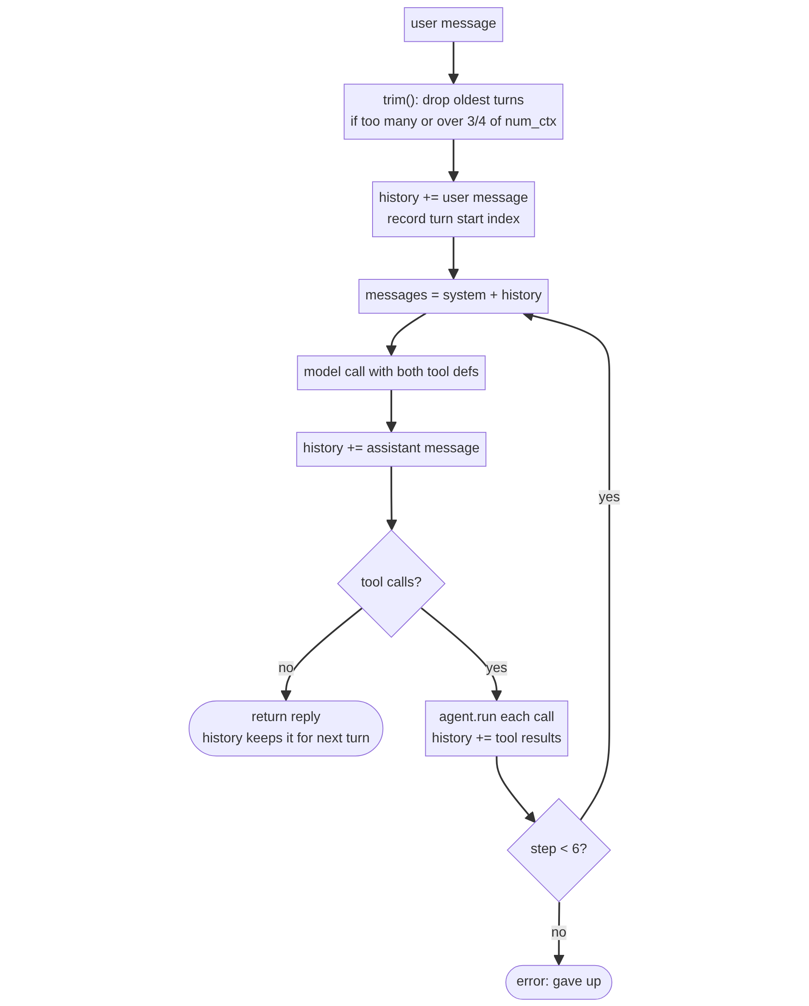
One user message, end to end
trim() first, then add the user message
Send system prompt plus history with both tools
Run any tool calls; results go into history
Repeat up to 6 steps, then return the reply
Try it
a joke about dogs
another one
explain that one
from now on nothing political
/reset
Notes:
Same loop as stage 2, plus where history lives and the trim step in front.

Slide 12
Stage 3b: the same agent in langchaingo
Hand-written in stage 3 | Framework concept | What we found
Ollama HTTP structs | openai client on /v1 | Native client drops tools; /v1 has no num_ctx
Tool{Def, Run} registry | tools.Tool, one string | Typed schema becomes prose; JSON inside a string
for step loop | agents.Executor | A tool Go error aborts the run; return text instead
history + trim() | Window buffer | Text only, flattened into the system prompt
-trace | Callbacks | Works; token counts hide in GenerationInfo
Built. A framework removes code, not decisions: stage 3 and 3b are both about 275 lines.
Notes:
Stage 3b findings. The native langchaingo Ollama client ignores tool definitions, so we use its OpenAI client against Ollama /v1, which cannot set num_ctx or keep_alive. Tools take a single string. The executor aborts on tool errors. Memory is flattened text.

Slide 13
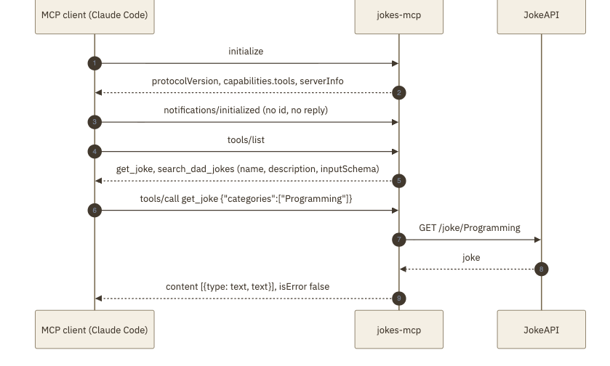
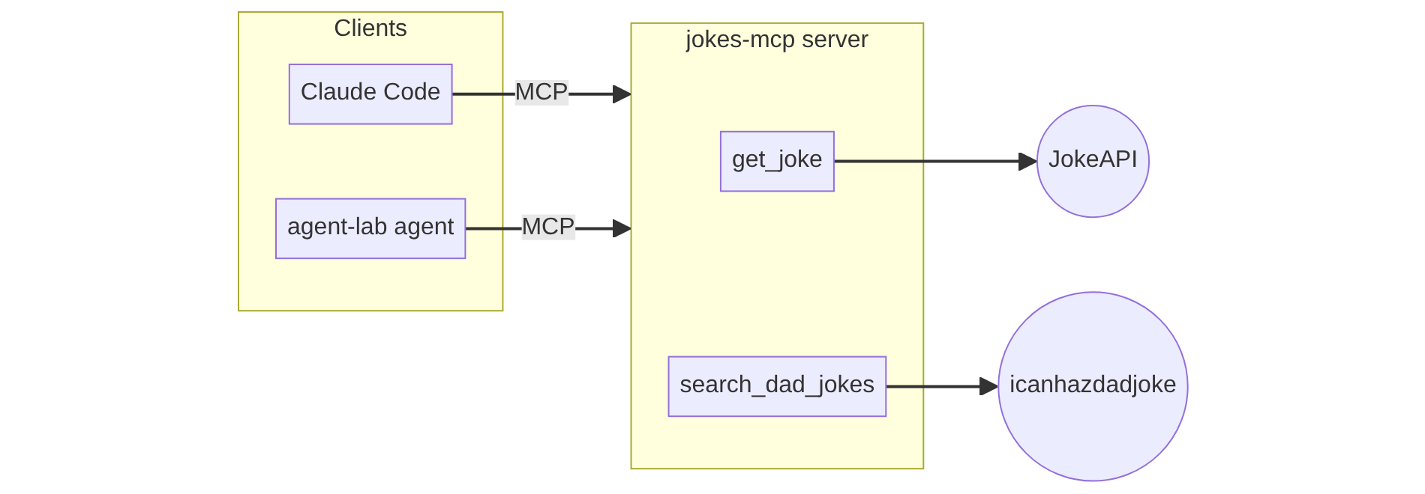
Stage 4: tools behind an MCP server
Hand-written JSON-RPC over stdio, about 160 lines, no SDK
initialize, tools/list, tools/call; notifications get no reply
stdout is the protocol, so -trace logs to stderr
A failing tool returns isError, not a protocol error
claude mcp add jokes -- go run ./cmd/jokes-mcp
The client owns the model and the loop; the server only runs tools.
Notes:
The MCP server exposes get_joke and search_dad_jokes. Claude Code can connect to it. Stage 6 reuses the same tool code in-process.

Slide 14
Stage 5: evals
13 request cases and 6 conversation cases, with plain Go checks
Checks read typed requests and tool calls, not reply prose
Stage 0: 7 of 13. Stage 1 (qwen3.5:9b-mlx): 8 of 13. Stage 6 agent: 5 of 6
Known weaknesses are cases on purpose: clean, no-unasked-explanations
One run each; use -n 3 for pass rates
make eval · go run ./cmd/jokes-eval -stage 1 -n 3
Notes:
Scores are single runs on the local model on 2026-10-06. The stage 0 score is exact. The stage 6 failure was the known unasked-explanation weakness.

Slide 15
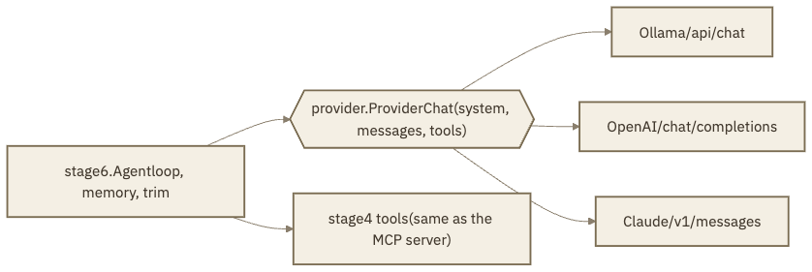
Stage 6: one loop, any provider
provider.Provider: system, messages, tools in; one message out
Ollama, OpenAI and Claude adapters in plain HTTP
OpenAI args are a JSON string; Claude wants tool results in a user message
Tools are stage 4's; the repeat check moved into the loop
OpenAI and Claude tested on fakes only, not yet live
-stage 6 -provider ollama | openai | claude
Notes:
Adapters hide the wire differences: system prompt placement, argument encoding, tool result placement and call IDs. Run the same eval per provider to compare.

Slide 16
Reuse it: swap the domain, keep the skeleton
In agent-lab | In your project | Support-ticket bot
jokeapi.Request | Typed request struct | TicketQuery{Status, Priority}
Normalize() | Validate model output | Reject unknown assignees
get_joke tool | One tool per API capability | search_tickets, add_comment
"No matching joke" | Errors the model can act on | "0 tickets. Widen the dates."
Blacklist never loosened | Hard constraints in code too | Read-only, one project
seenJokes | Exact state in code | Tickets already shown
trim() | Context policy | Pin the user's project and role
Notes:
Example domain is a support-ticket bot.

Slide 17
Habits to take with you
Typed boundaries
Models write structs, not strings.
Errors go to the model
Return failures as results.
Cap every loop
Steps, retries and output.
Trace everything
Read the prompts and results.
Fake the model in tests
Script a conversation.
Measure with evals
Turn failures into cases.
make test · make eval · go run ./cmd/jokes -stage 3 -trace

