Slide 1

Cybersecurity Portfolio
Crafting secure systems and practical tools through intentional Python development and threat analysis.

Slide 2
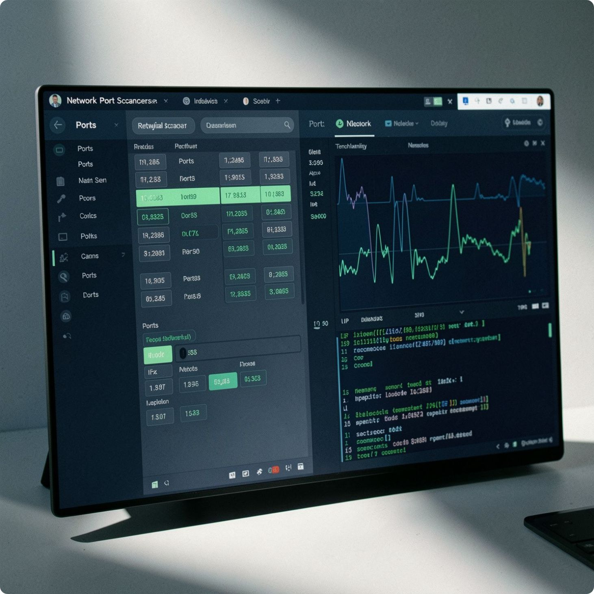
Project 1: Network Port Scanner
CASE STUDY 01
Challenge
Identifying active services and open ports manually is slow and inefficient for network auditing
Solution
Developed a Python-based port scanner utilizing TCP sockets and automated Banner Grabbing for service detection.
Result
A lightweight, efficient scanning tool capable of quickly recognizing active network services on target infrastructure.

Slide 3
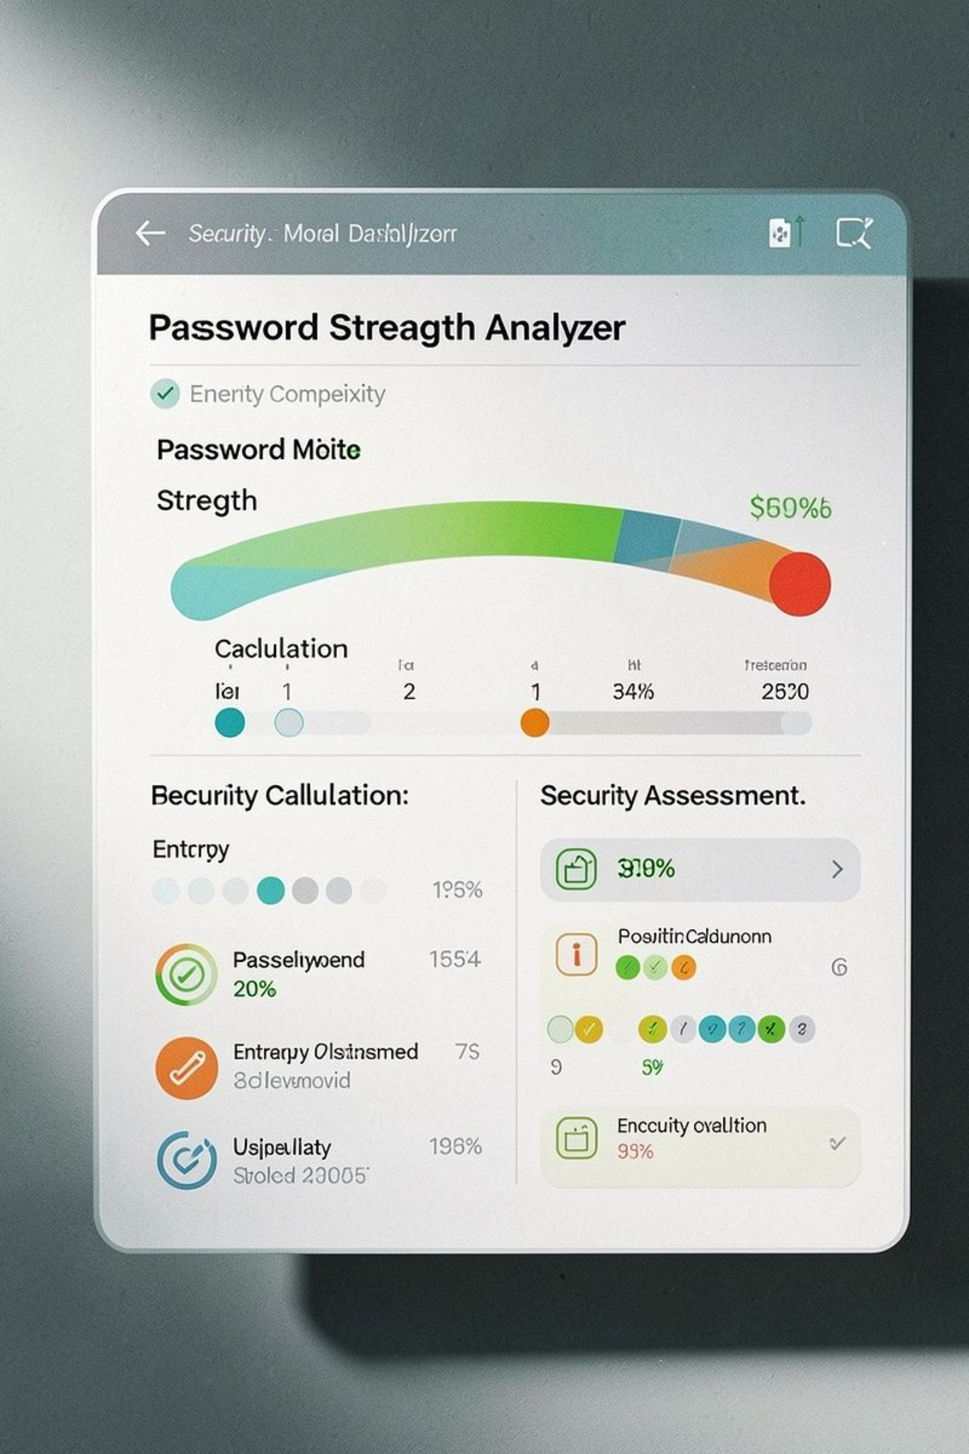
Project 2: Password Strength Analyzer
⚡ Challenge
🎯 Solution
Users frequently create weak passwords, exposing systems to unauthorized access and brute-force attacks
Built an entropy-based analysis tool using Regular Expressions to enforce strict password policies and calculate complexity scores.
✅ Result
Provided clear, actionable recommendations to users to significantly improve password security hygiene.

Slide 4

Let's Create Something Great
Great design starts with a conversation. Whether you have a brief ready or just a spark of an idea — I'm ready to listen, collaborate, and build something remarkable together.
📬 Get in Touch
Maryam Mohamed
Maryam Mohamed | LinkedIn
🚀 Next Project
Ready to collaborate on cybersecurity projects, threat intelligence, and secure Python development. Let's connect!

