Slide 1
Systems Analysis and Design
Alan Dennis, Barbara Haley Wixom, and Roberta Roth John Wiley & Sons, Inc.
Slides by Candace S. Garrod
Red Rocks Community College
Notes:
*

Slide 2
Key Ideas
Determine how projects are selected and understand the various approached to the SDLC that are used to structure a development project.
Understand how to select a project methodology based on project characteristics and become familiar with project estimation.
Create a project work plan and understand how to staff a project.
Important techniques to coordinate and manage a project, and how to manage risk on the project.
PowerPoint Presentation for Dennis, Wixom & Roth Systems Analysis and Design, 4th Edition
Copyright 2009 © John Wiley & Sons, Inc. All rights reserved..
2 - *

Slide 3
PROJECT SELECTION
Systems projects today are evaluated in the context of an entire portfolio of projects.
Determination of a project’s contribution to an entire portfolio of a project reinforces the need for a feasibility study.
Portfolio management takes into consideration the different of projects that exist in an organization
PowerPoint Presentation for Dennis, Wixom & Roth Systems Analysis and Design, 4th Edition
Copyright 2009 © John Wiley & Sons, Inc. All rights reserved..
2 - *

Slide 4
An approval committee must be selective about where to allocate resources as most organizations have limited funds.
If there are three potentially high-payoff projects, and they all have the same risk, then maybe only one of the projects will be selected.
PowerPoint Presentation for Dennis, Wixom & Roth Systems Analysis and Design, 4th Edition
Copyright 2009 © John Wiley & Sons, Inc. All rights reserved..
2 - *

Slide 5
How Do Projects Begin?
Business needs should drive projects.
Project sponsor recognizes business need for new system and desires to see it implemented.
Business needs determine the system’s functionality (what it will do).
The project’s business value should be clear.
PowerPoint Presentation for Dennis, Wixom & Roth Systems Analysis and Design, 4th Edition
Copyright 2009 © John Wiley & Sons, Inc. All rights reserved..
2 - *

Slide 6
CREATING THE PROJECT PLAN
Notes:
*

Slide 7
Project Methodology Options
Waterfall Development
Parallel Development
V-model (variation of the Waterfall Development
Rapid Application Development (RAD)
Iterative Development
Agile Development
PowerPoint Presentation for Dennis, Wixom & Roth Systems Analysis and Design, 4th Edition
Copyright 2009 © John Wiley & Sons, Inc. All rights reserved..
2 - *

Slide 8
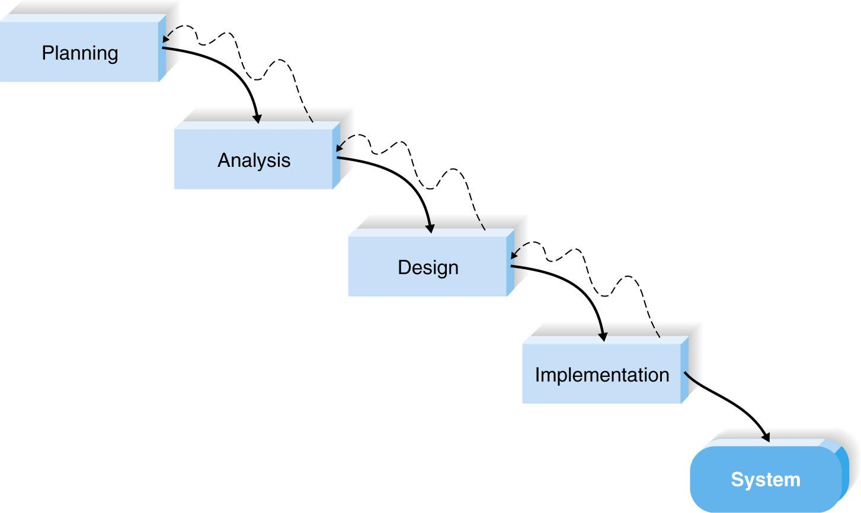
Waterfall Development
PowerPoint Presentation for Dennis, Wixom & Roth Systems Analysis and Design, 4th Edition
Copyright 2009 © John Wiley & Sons, Inc. All rights reserved..
2 - *

Slide 9
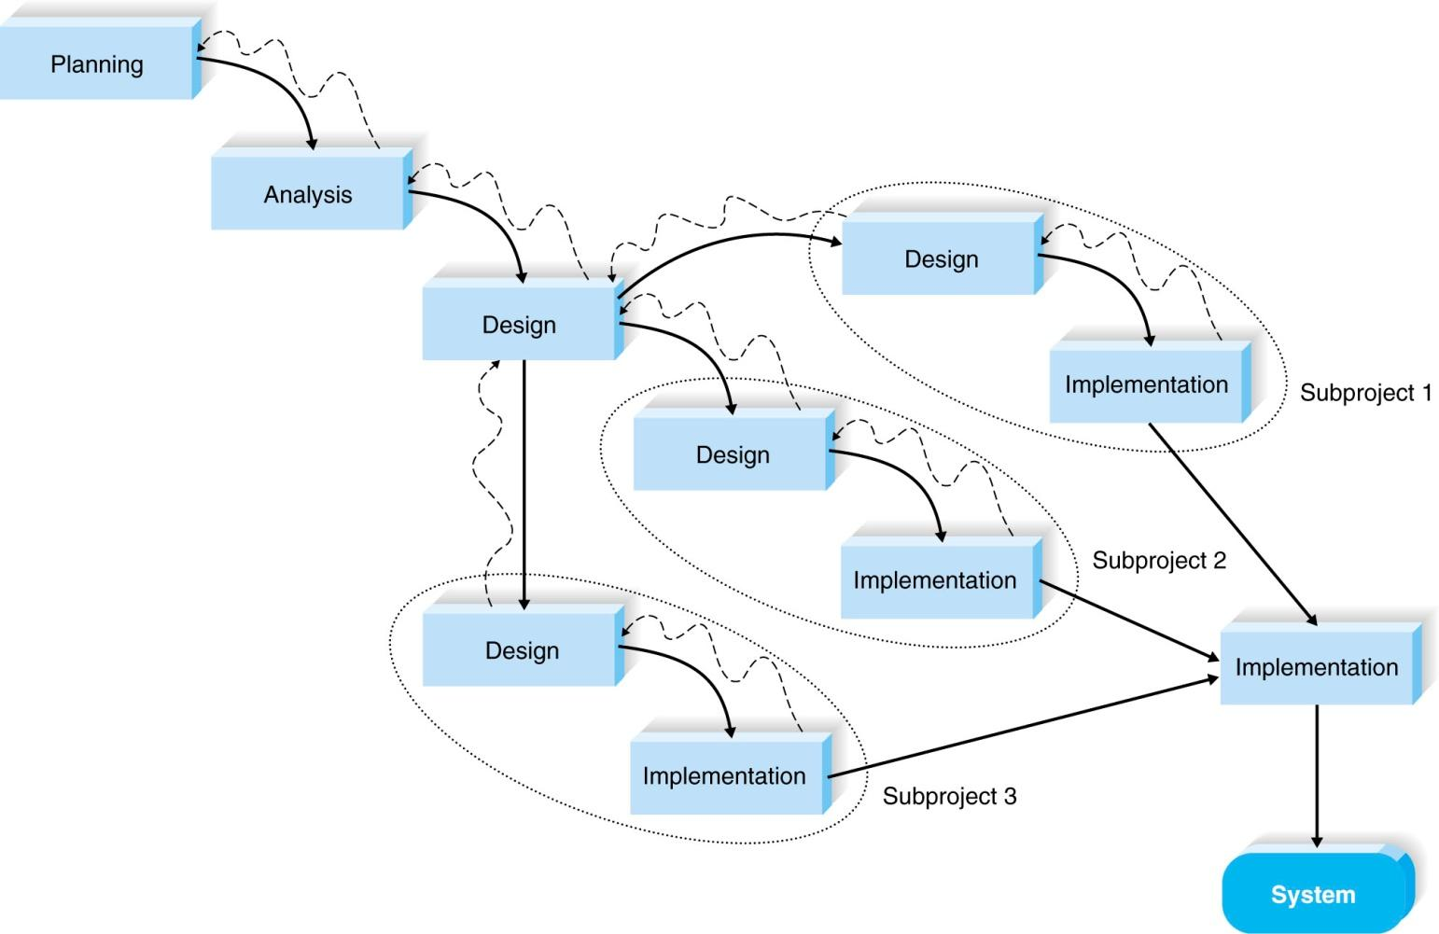
Parallel Development
PowerPoint Presentation for Dennis, Wixom & Roth Systems Analysis and Design, 4th Edition
Copyright 2009 © John Wiley & Sons, Inc. All rights reserved..
2 - *

Slide 10
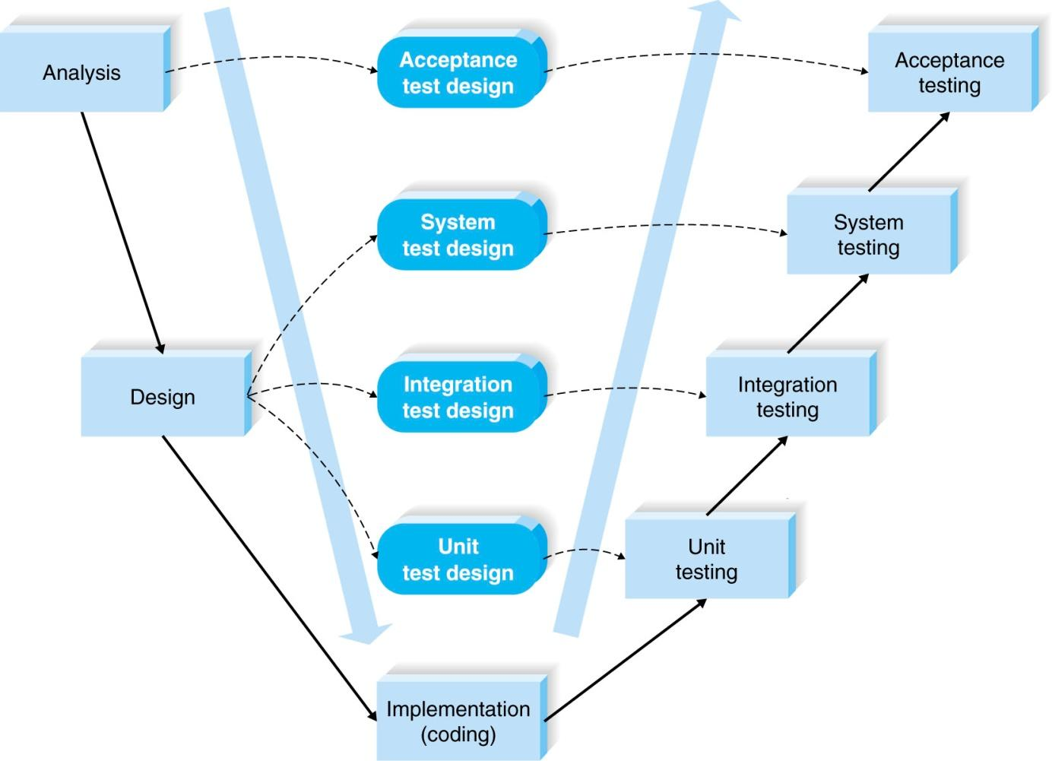
V-model
PowerPoint Presentation for Dennis, Wixom & Roth Systems Analysis and Design, 4th Edition
Copyright 2009 © John Wiley & Sons, Inc. All rights reserved..
2 - *

Slide 11
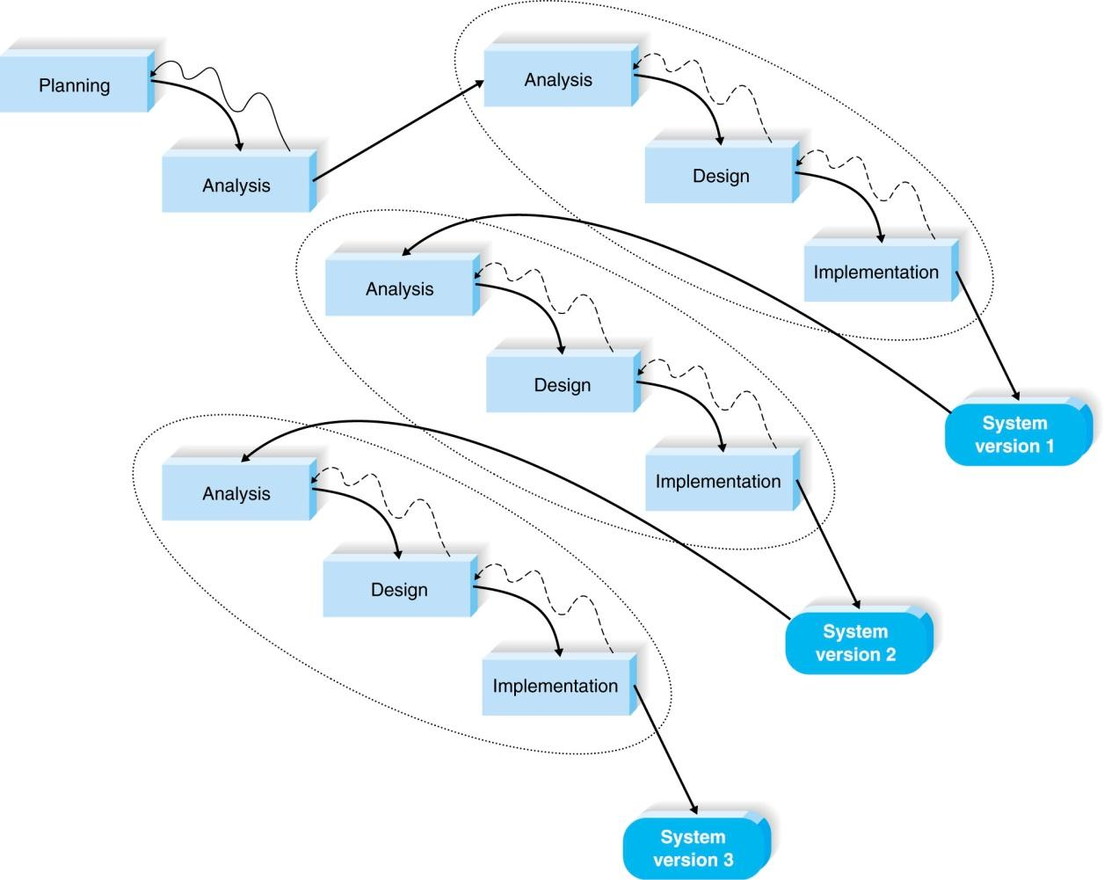
Iterative Development
PowerPoint Presentation for Dennis, Wixom & Roth Systems Analysis and Design, 4th Edition
Copyright 2009 © John Wiley & Sons, Inc. All rights reserved..
2 - *

Slide 12
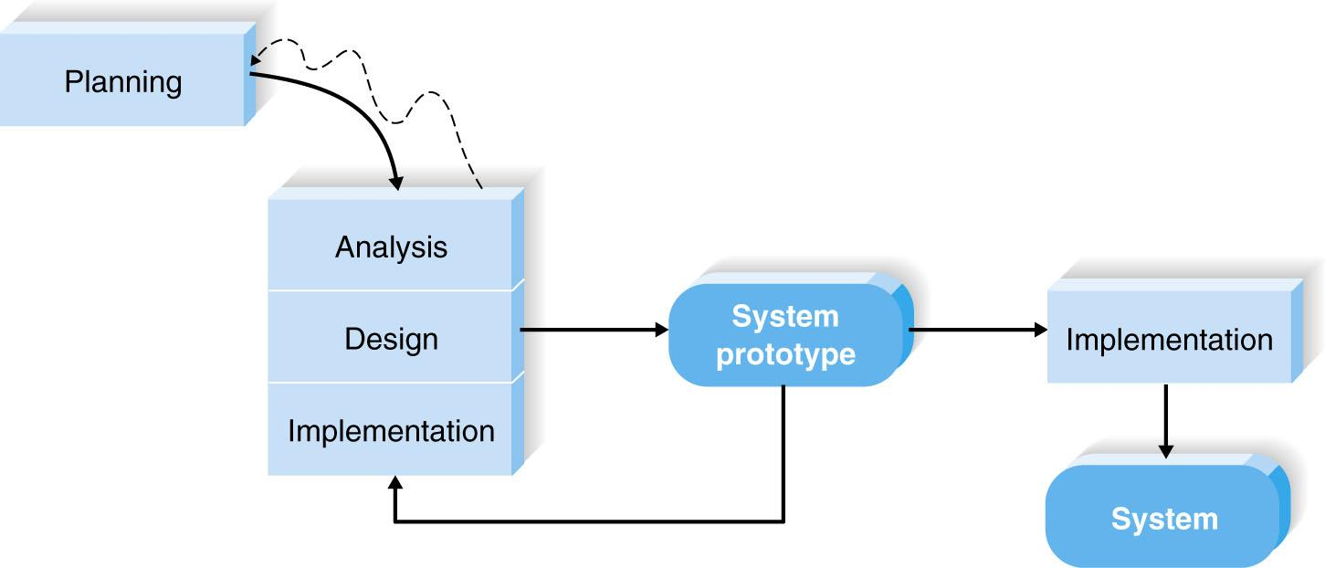
Example of System Prototyping
PowerPoint Presentation for Dennis, Wixom & Roth Systems Analysis and Design, 4th Edition
Copyright 2009 © John Wiley & Sons, Inc. All rights reserved..
2 - *

Slide 13
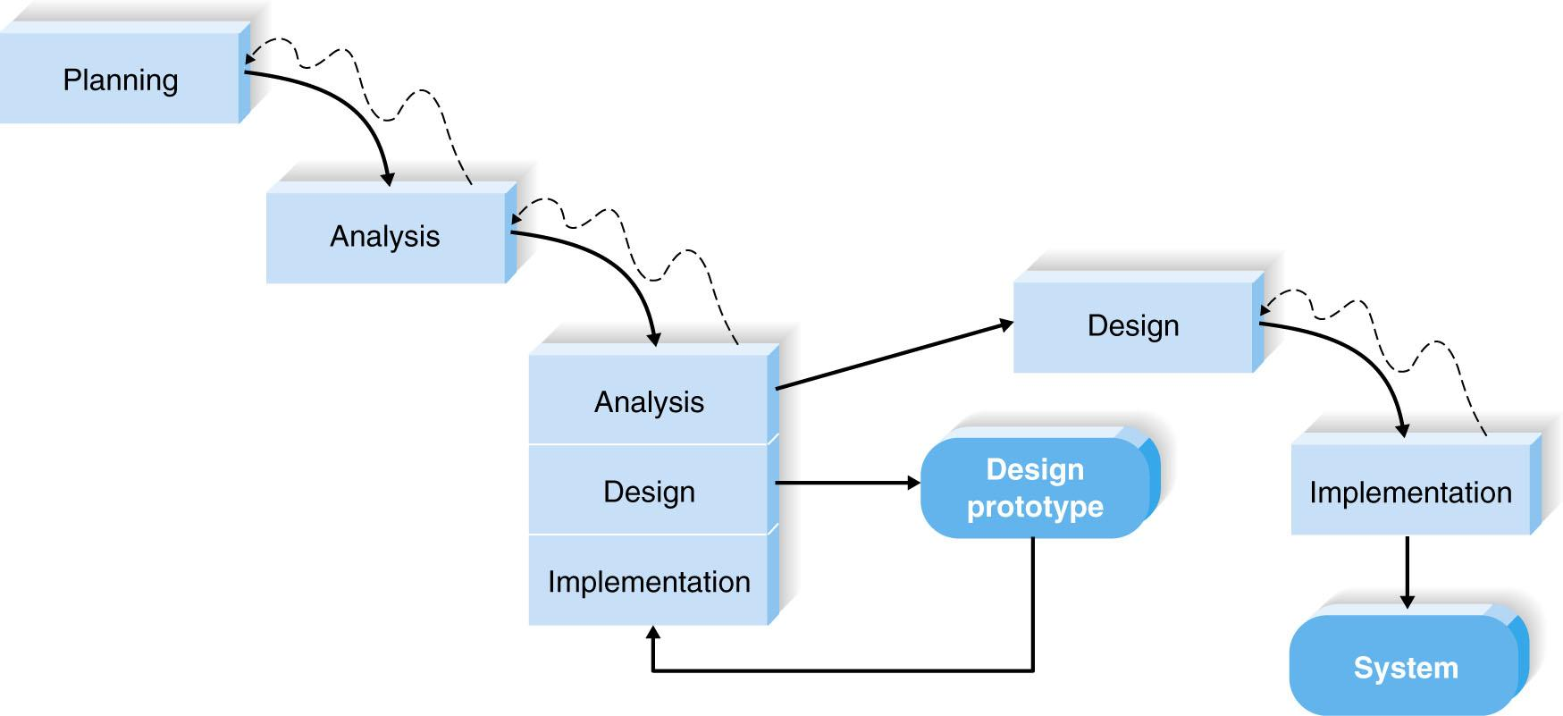
Example of Throwaway Prototyping
PowerPoint Presentation for Dennis, Wixom & Roth Systems Analysis and Design, 4th Edition
Copyright 2009 © John Wiley & Sons, Inc. All rights reserved..
2 - *

Slide 14
Agile Development
A group of programming-centric methodologies that focus on streamlining the SDLC.
Includes face-to-face communication
Extreme programming – emphasizes customer satisfaction and teamwork.
PowerPoint Presentation for Dennis, Wixom & Roth Systems Analysis and Design, 4th Edition
Copyright 2009 © John Wiley & Sons, Inc. All rights reserved..
2 - *

Slide 15
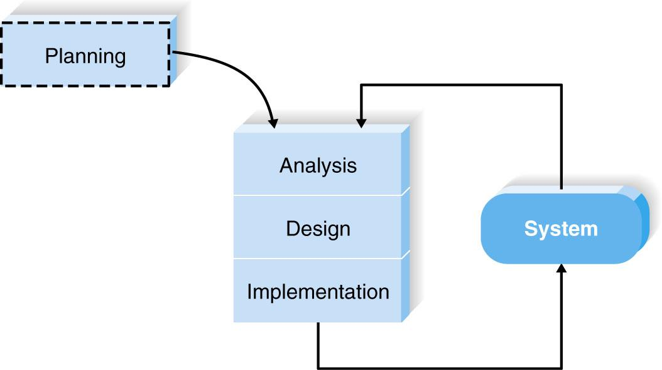
Example of Extreme Programming
PowerPoint Presentation for Dennis, Wixom & Roth Systems Analysis and Design, 4th Edition
Copyright 2009 © John Wiley & Sons, Inc. All rights reserved..
2 - *

Slide 16
Selecting the Appropriate Development Methodology
PowerPoint Presentation for Dennis, Wixom & Roth Systems Analysis and Design, 4th Edition
Copyright 2009 © John Wiley & Sons, Inc. All rights reserved..
2 - *

Slide 17
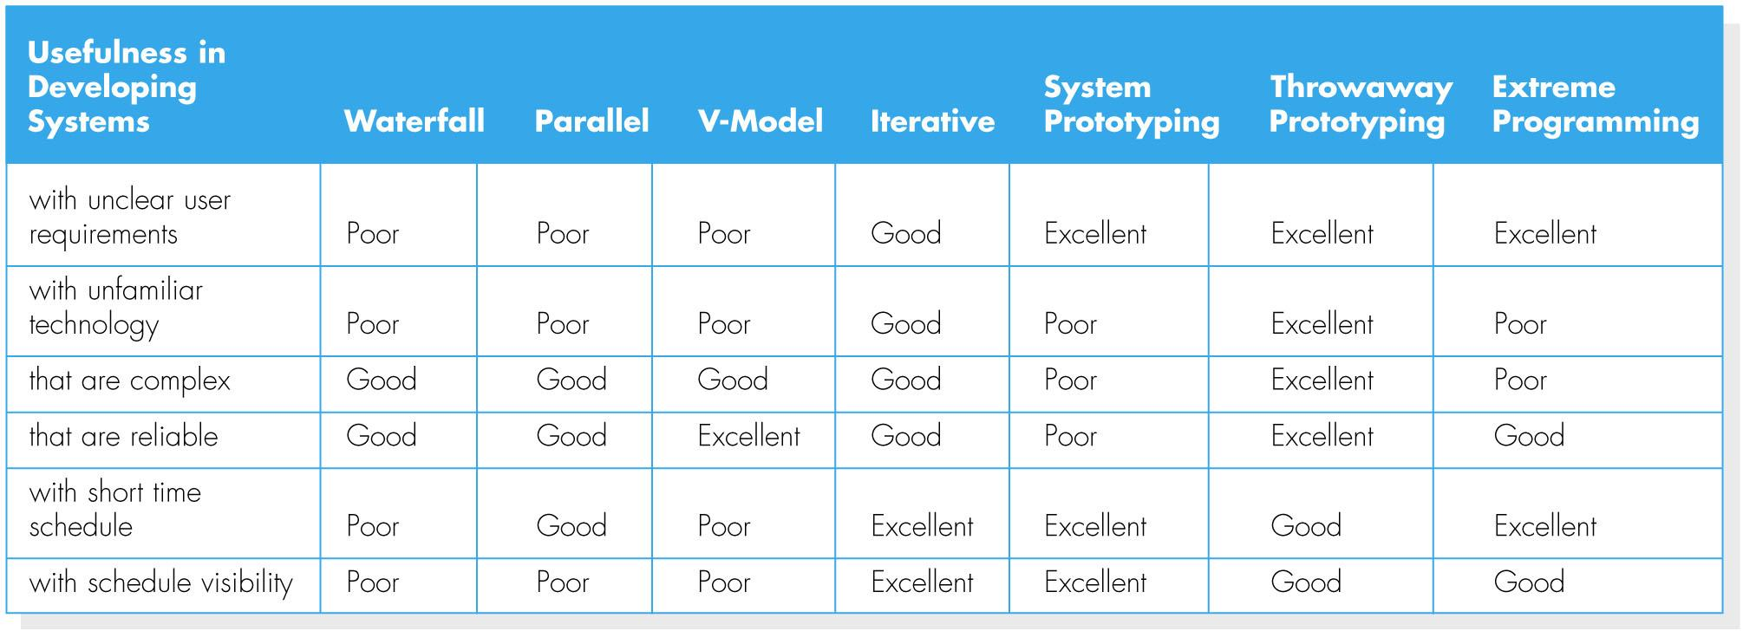
Criteria for Selecting a Methodology
PowerPoint Presentation for Dennis, Wixom & Roth Systems Analysis and Design, 4th Edition
Copyright 2009 © John Wiley & Sons, Inc. All rights reserved..
2 - *

Slide 18
Important Factors to Consider
Clarity of User Requirements
Familiarity with Technology
System Complexity
System Reliability
Short Time Schedules
Schedule Visibility
PowerPoint Presentation for Dennis, Wixom & Roth Systems Analysis and Design, 4th Edition
Copyright 2009 © John Wiley & Sons, Inc. All rights reserved..
2 - *

Slide 19
Estimating the Project Time Frame
PowerPoint Presentation for Dennis, Wixom & Roth Systems Analysis and Design, 4th Edition
Copyright 2009 © John Wiley & Sons, Inc. All rights reserved..
2 - *

Slide 20
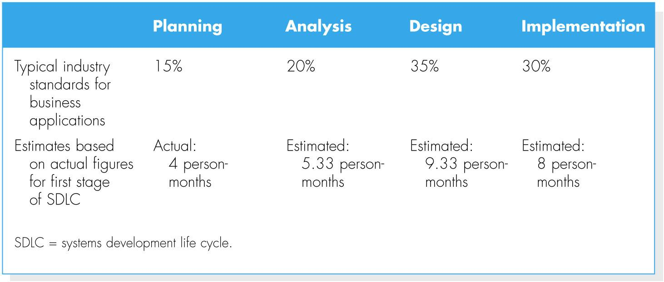
Estimating Project Time Using Industry Standards
PowerPoint Presentation for Dennis, Wixom & Roth Systems Analysis and Design, 4th Edition
Copyright 2009 © John Wiley & Sons, Inc. All rights reserved..
2 - *

Slide 21
Developing the Work Plan
Identify Tasks
The Project Work Plan
PowerPoint Presentation for Dennis, Wixom & Roth Systems Analysis and Design, 4th Edition
Copyright 2009 © John Wiley & Sons, Inc. All rights reserved..
2 - *

Slide 22
STAFFING THE PROJECT
Notes:
*

Slide 23
Staffing Attributes
Staffing levels will change over a project’s lifetime
Adding staff may add more overhead than additional labor
Using teams of 8-10 reporting in a hierarchical structure can reduce complexity
PowerPoint Presentation for Dennis, Wixom & Roth Systems Analysis and Design, 4th Edition
Copyright 2009 © John Wiley & Sons, Inc. All rights reserved..
2 - *

Slide 24
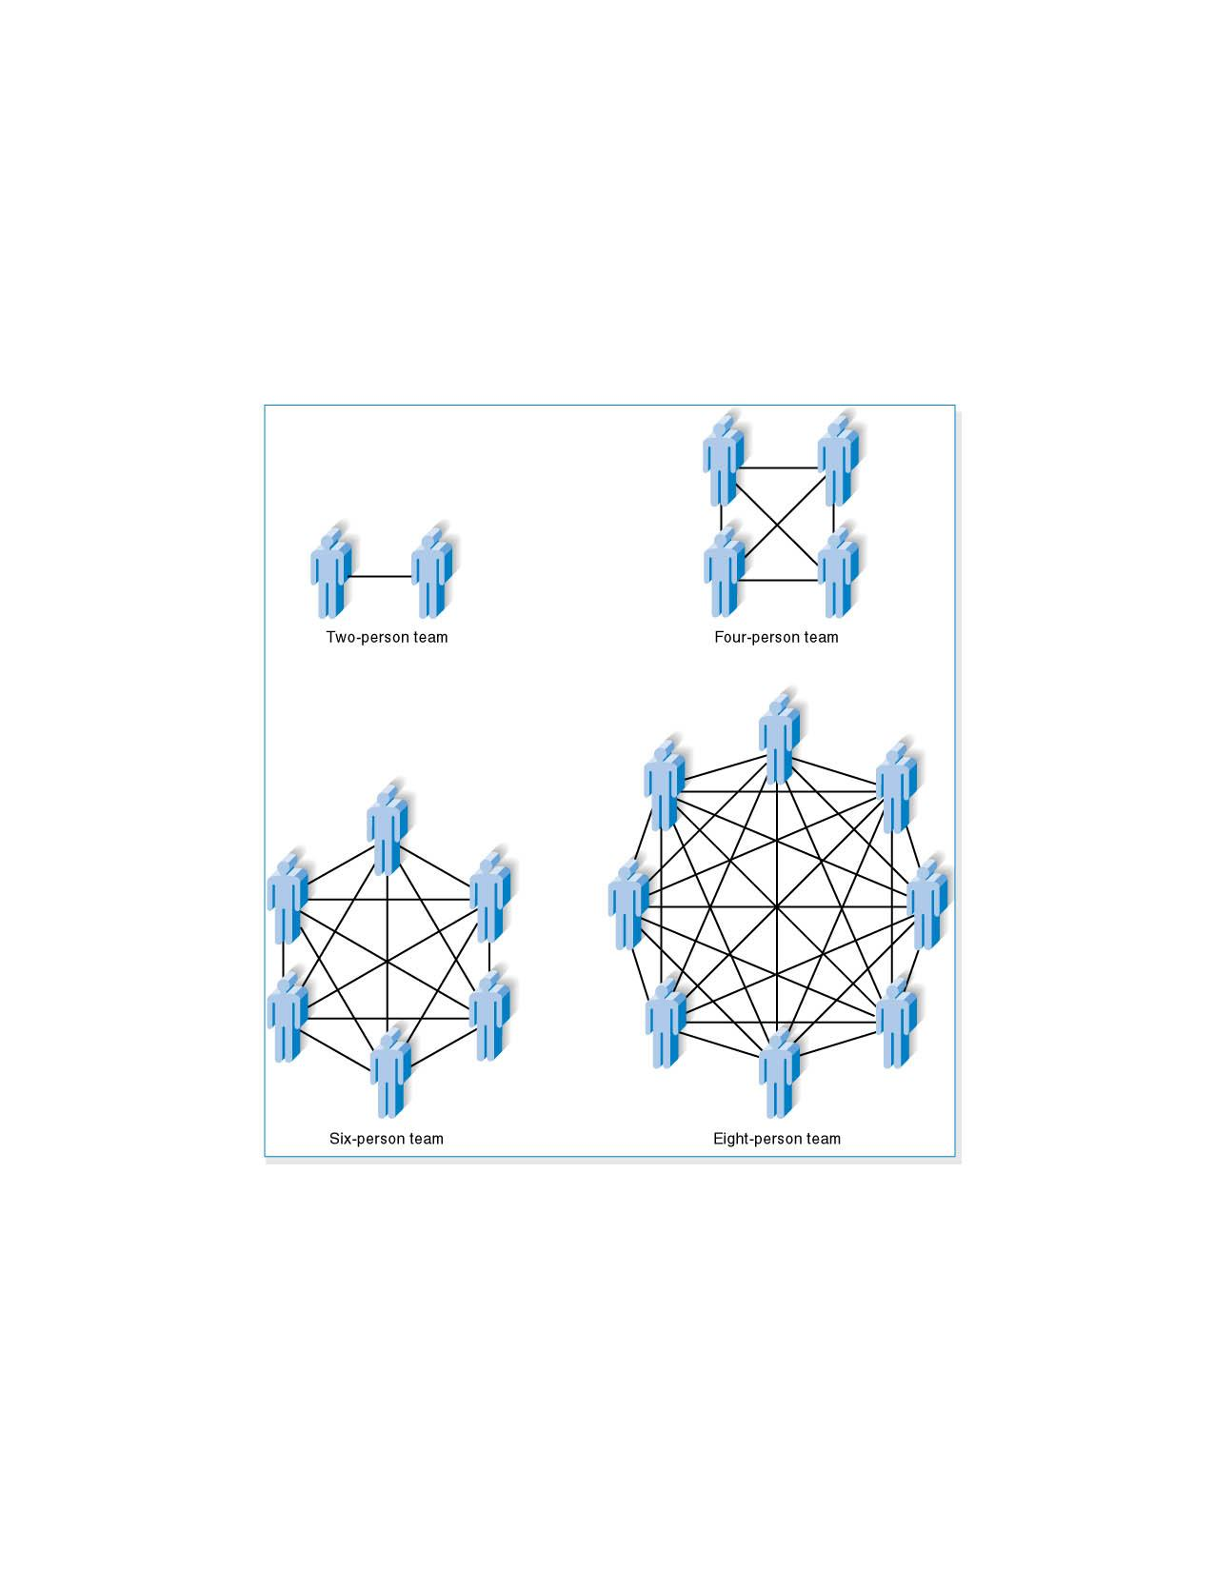
Increasing Complexity with Larger Teams
PowerPoint Presentation for Dennis, Wixom & Roth Systems Analysis and Design, 4th Edition
Copyright 2009 © John Wiley & Sons, Inc. All rights reserved..
2 - *

Slide 25
Key Definitions
The staffing plan describes the kinds of people working on the project
The project charter describes the project’s objectives and rules
A functional lead manages a group of analysts
A technical lead oversees progress of programmers and technical staff members
PowerPoint Presentation for Dennis, Wixom & Roth Systems Analysis and Design, 4th Edition
Copyright 2009 © John Wiley & Sons, Inc. All rights reserved..
2 - *

Slide 26
Motivation
Use monetary rewards cautiously
Use intrinsic rewards
Recognition
Achievement
The work itself
Responsibility
Advancement
Chance to learn new skills
PowerPoint Presentation for Dennis, Wixom & Roth Systems Analysis and Design, 4th Edition
Copyright 2009 © John Wiley & Sons, Inc. All rights reserved..
2 - *

Slide 27
Handling Conflict
Clearly define project plans
Recognize project importance to organization
Project charter listing norms and groundrules
Develop schedule commitments ahead of time
Forecast other priorities and their possible impact on the project
PowerPoint Presentation for Dennis, Wixom & Roth Systems Analysis and Design, 4th Edition
Copyright 2009 © John Wiley & Sons, Inc. All rights reserved..
2 - *

Slide 28
COORDINATING PROJECT ACTIVITIES
Notes:
*

Slide 29
CASE Tools
Planning Analysis Design Implementation
Upper CASE Lower CASE
Integrated CASE (I-CASE)
PowerPoint Presentation for Dennis, Wixom & Roth Systems Analysis and Design, 4th Edition
Copyright 2009 © John Wiley & Sons, Inc. All rights reserved..
2 - *

Slide 30
CASE Components
Diagrams Screen
Designs
CASE Repository
Procedural Metadata
Logic
PowerPoint Presentation for Dennis, Wixom & Roth Systems Analysis and Design, 4th Edition
Copyright 2009 © John Wiley & Sons, Inc. All rights reserved..
2 - *

Slide 31
Standards
Examples
Formal rules for naming files
Forms indicating goals reached
Programming guidelines
PowerPoint Presentation for Dennis, Wixom & Roth Systems Analysis and Design, 4th Edition
Copyright 2009 © John Wiley & Sons, Inc. All rights reserved..
2 - *

Slide 32
Documentation
Project binder
Table of contents
Continual updating
PowerPoint Presentation for Dennis, Wixom & Roth Systems Analysis and Design, 4th Edition
Copyright 2009 © John Wiley & Sons, Inc. All rights reserved..
2 - *

Slide 33
MANAGING AND CONTROLLING THE PROJECT
PowerPoint Presentation for Dennis, Wixom & Roth Systems Analysis and Design, 4th Edition
Copyright 2009 © John Wiley & Sons, Inc. All rights reserved..
2 - *

Slide 34
Timeboxing
Fixed deadline
Reduced functionality, if necessary
Fewer “finishing touches”
PowerPoint Presentation for Dennis, Wixom & Roth Systems Analysis and Design, 4th Edition
Copyright 2009 © John Wiley & Sons, Inc. All rights reserved..
2 - *

Slide 35
Timeboxing Steps
Set delivery date
Deadline should not be impossible
Should be set by development group
Prioritize features by importance
Build the system core
Postpone unfinished functionality
Deliver the system with core functionality
Repeat steps 3-5 to add refinements and enhancements
PowerPoint Presentation for Dennis, Wixom & Roth Systems Analysis and Design, 4th Edition
Copyright 2009 © John Wiley & Sons, Inc. All rights reserved..
2 - *

Slide 36
Managing Risk
Risk assessment
Actions to reduce risk
Revised assessment
PowerPoint Presentation for Dennis, Wixom & Roth Systems Analysis and Design, 4th Edition
Copyright 2009 © John Wiley & Sons, Inc. All rights reserved..
2 - *

Slide 37
Classic Mistakes
Overly optimistic schedule
Failing to monitor schedule
Failing to update schedule
Adding people to a late project
PowerPoint Presentation for Dennis, Wixom & Roth Systems Analysis and Design, 4th Edition
Copyright 2009 © John Wiley & Sons, Inc. All rights reserved..
2 - *

Slide 38
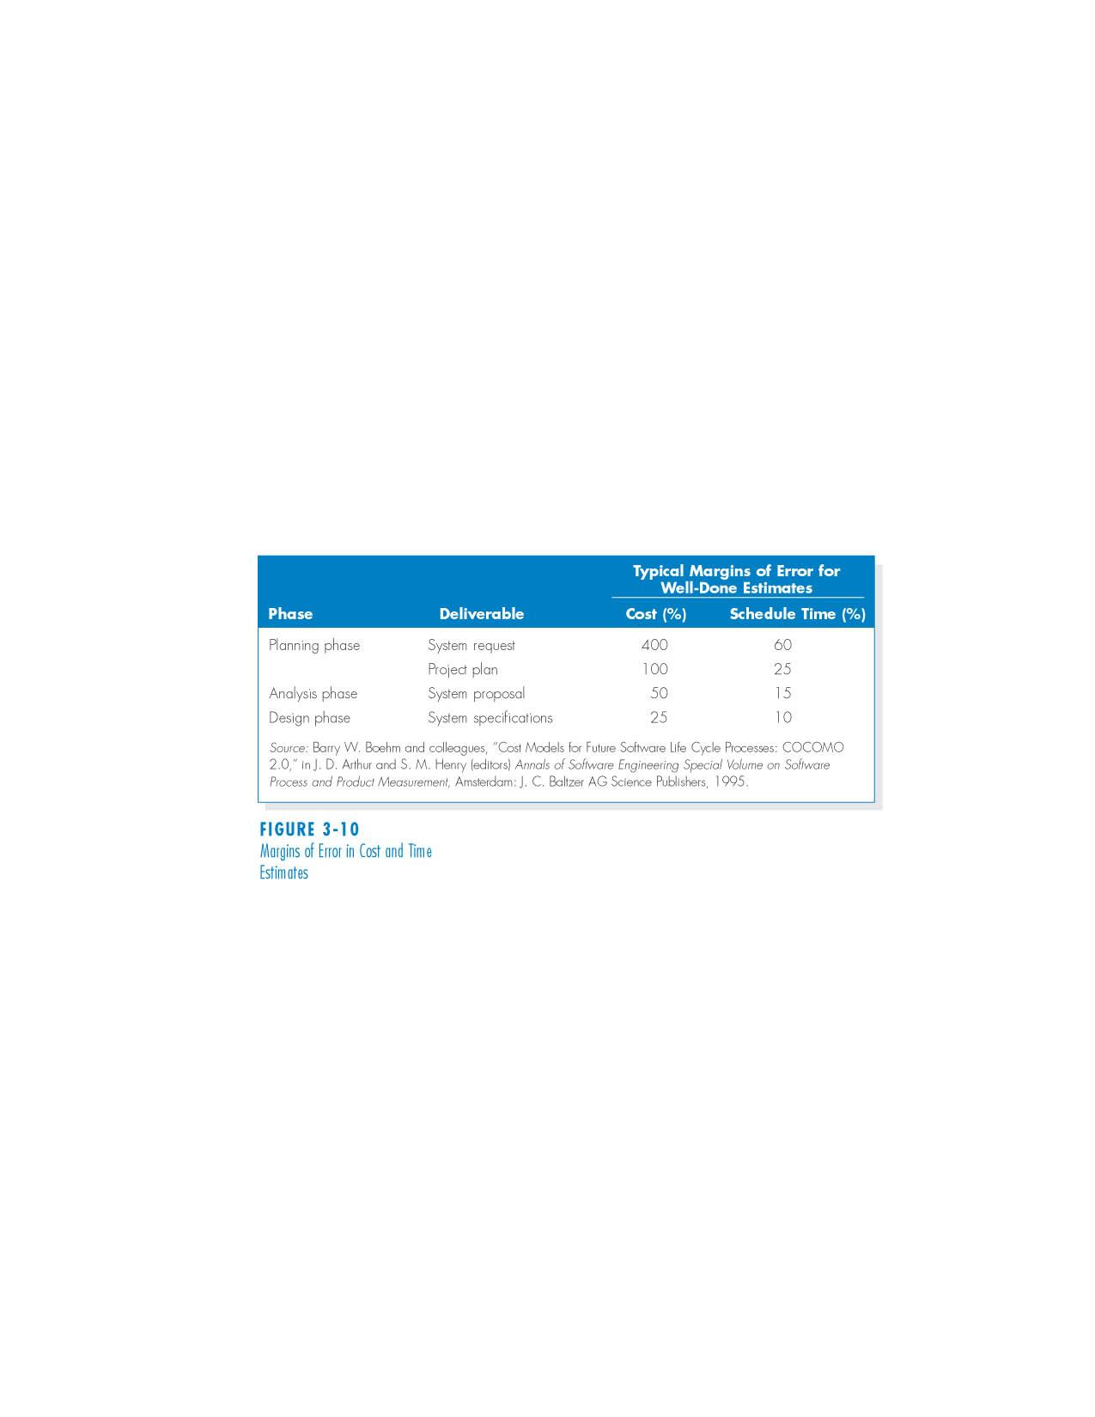
Margins of Error in Cost and Time Estimates
PowerPoint Presentation for Dennis, Wixom & Roth Systems Analysis and Design, 4th Edition
Copyright 2009 © John Wiley & Sons, Inc. All rights reserved..
2 - *

Slide 39
COORDINATING PROJECT ACTIVITIES
PowerPoint Presentation for Dennis, Wixom & Roth Systems Analysis and Design, 4th Edition
Copyright 2009 © John Wiley & Sons, Inc. All rights reserved..
2 - *

Slide 40
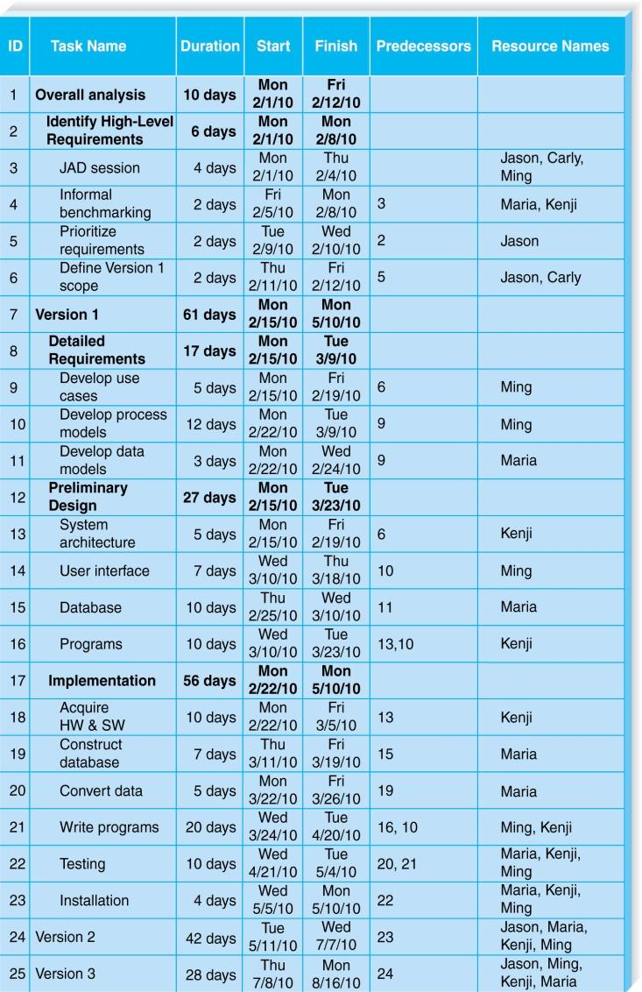
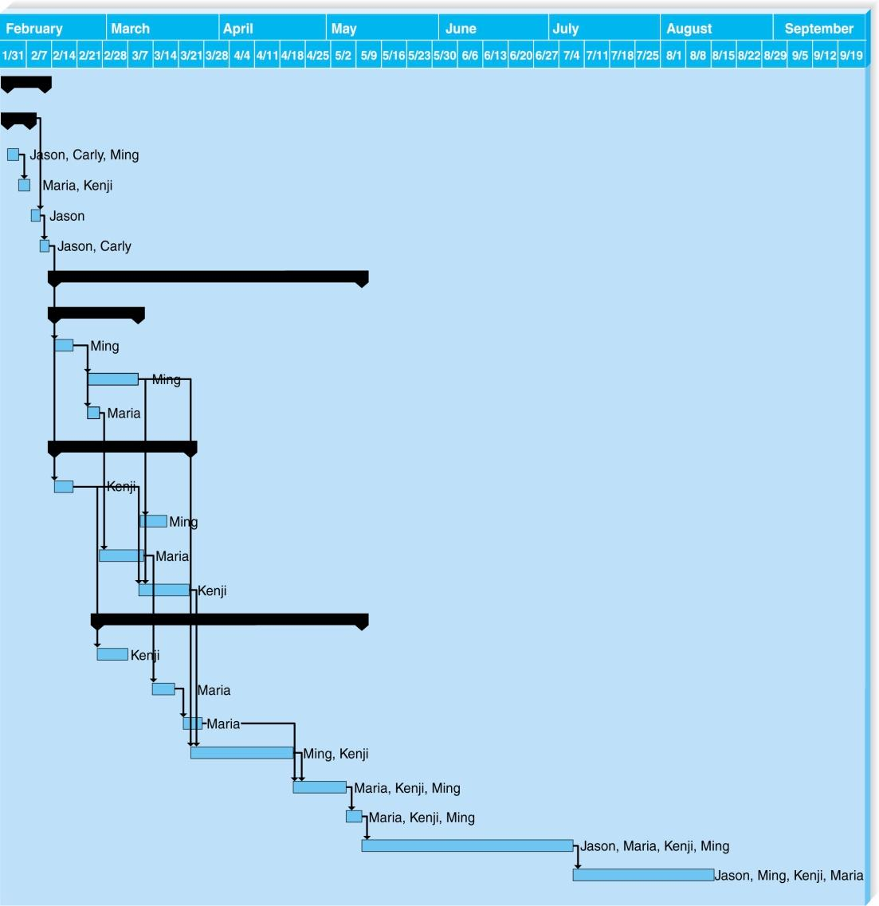
Example of a Gantt Chart
PowerPoint Presentation for Dennis, Wixom & Roth Systems Analysis and Design, 4th Edition
Copyright 2009 © John Wiley & Sons, Inc. All rights reserved..
2 - *

Slide 41
Summary
Project initiation involves creating and assessing goals and expectations for a new system
Identifying the business value of the new project is a key to success
Feasibility study is concerned with insuring that technical, economic, and organizational benefits outweigh costs and risks
Project selection involves viewing the project within the context of the entire project portfolio, and selecting those projects that contribute to balance in the portfolio
PowerPoint Presentation for Dennis, Wixom & Roth Systems Analysis and Design, 4th Edition
Copyright 2009 © John Wiley & Sons, Inc. All rights reserved..
2 - *

Slide 42
Copyright © 2009 John Wiley & Sons, Inc.
All rights reserved. Reproduction or translation of this work beyond that permitted in Section 117 of the 1976 United States Copyright Act without the express written permission of the copyright owner is unlawful.
Request for further information should be addressed to the Permissions Department, John Wiley & Sons, Inc.
The purchaser may make back-up copies for his/her own use only and not for redistribution or resale.
The Publisher assumes no responsibility for errors, omissions, or damages, caused by the use of these programs or from the use of the information contained herein.
PowerPoint Presentation for Dennis, Wixom & Roth Systems Analysis and Design, 4th Edition
Copyright 2009 © John Wiley & Sons, Inc. All rights reserved..
2 - *
Notes:
*

