Slide 1
network devices

Slide 2
Network devices are part of the basic infrastructure of any company. It is also an essential component, for it enables teamwork and provides access to the Internet. It also allows all staff members (including management) to share a company's hardware, printers, servers, and services and thus communicate and exchange data.

Slide 3
Router
Hub
Switch
Bridge
Repeater

Slide 4
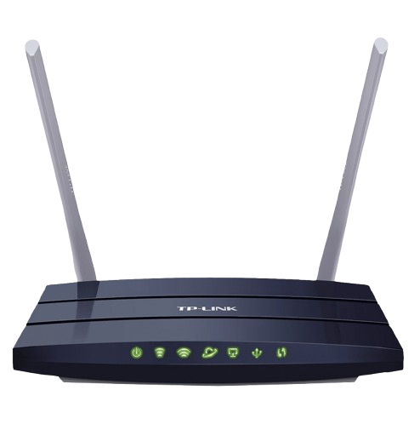
Router: A router is an electronic device that interconnects two or more computer networks and selectively interchanges data packets between them. Each data packet contains address information that a router can use to determine if the source and destination are on the same network or if the data packet must be transferred from one network to another. Where multiple routers are used in an extensive collection of interconnected networks, the routers exchange information about target system addresses so that each router can build up a table showing the preferred paths between any two systems on the interconnected networks.

Slide 5
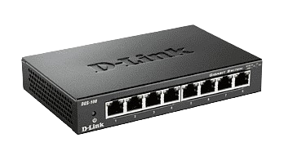
Hub: An Ethernet hub, active hub, network hub, repeater hub, hub, or concentrator
is a device for connecting multiple twisted pair or fiber optic Ethernet devices and making them act as a single network segment? Hubs work at the OSI model's physical layer (layer 1). A device is a form of multiport repeater. Repeater hubs also participate in collision detection, forwarding a jam signal to all ports if it detects a collision.

Slide 6
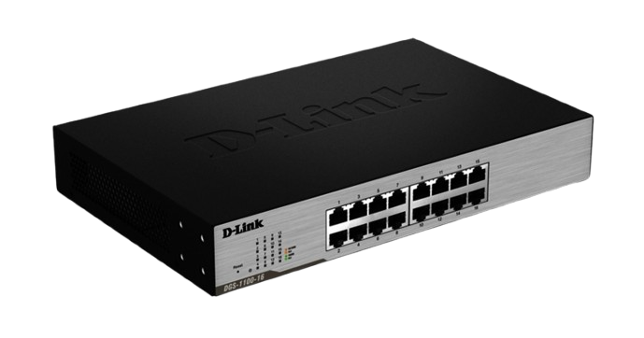
Switch: A network switch or switching hub is a computer networking device that connects network segments. The term commonly refers to a network bridge that processes and routes data at the OSI model's data link layer (layer 2). Switches that additionally process data at the network layer (layer three and above) are often referred to as Layer 3 switches or multilayer switches.

Slide 7
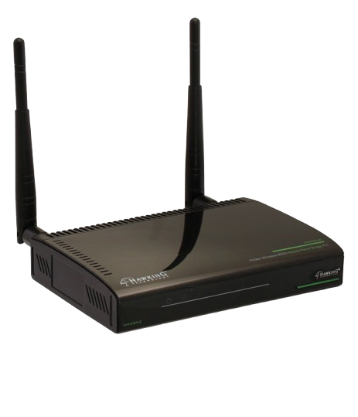
Bridge: A network bridge connects multiple network segments at the OSI model's data link layer (Layer 2). In Ethernet networks, the term bridge formally means a device that behaves according to the IEEE 802.1D standard. A bridge and switch are very much alike, and a switch is a bridge with numerous ports. Switch, or Layer 2 switch, is often used interchangeably with a bridge. Bridges can analyze can send the given packet to another segment of the network.

Slide 8
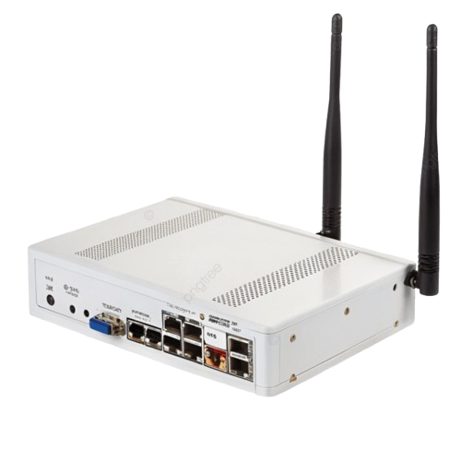
Repeater: Functioning at Physical Layer. A repeater is an electronic device that receives a signal and retransmits it at a higher level and higher power or onto the other side of the obstruction so that the signal can cover longer distances. Repeaters have two ports, so they cannot be used to connect to more than two devices

Slide 9
Performing an Initial Router Configuration

Slide 10
In this activity, you will use the D-Link Router or Tp-link Router to apply an initial configuration to a router, including host name, passwords, and other basic settings.

Slide 11
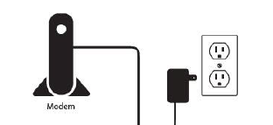
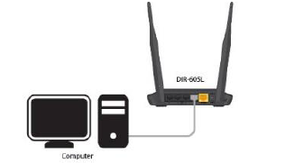
Step 1: Unplug the Power to your Cable/DSL Internet Modem
Step 2: Connect an Ethernet cable from your computer/laptop to a LAN port (Port 1,2,3 or 4) on the DIR-605L

Slide 12
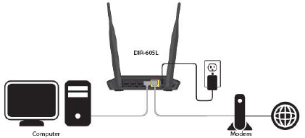
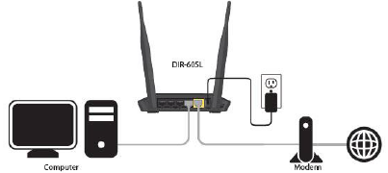
Step 3: Connect your Cable/DSL modem to the Yellow Internet Port on the DIR
Step 4: Power on both the DIR-605L and your Internet Cable/DSL Modem

Slide 13
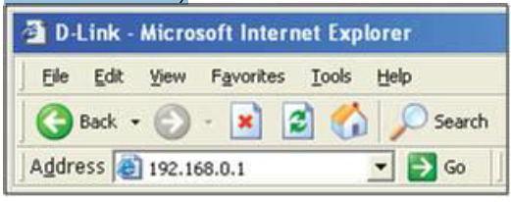
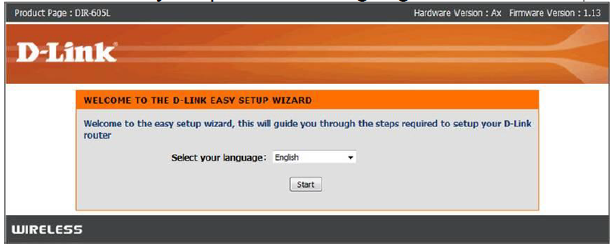
Step 5: Open your Internet browser (Internet Explorer/Firefox) and enter http://192.168.0.1 or http://tplink.net into the address bar (In some cases, you may get automatically directed here)
Step 6: The Setup Wizard should appear
• Select your preferred Language and click Start

Slide 14
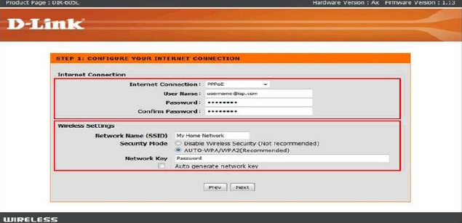
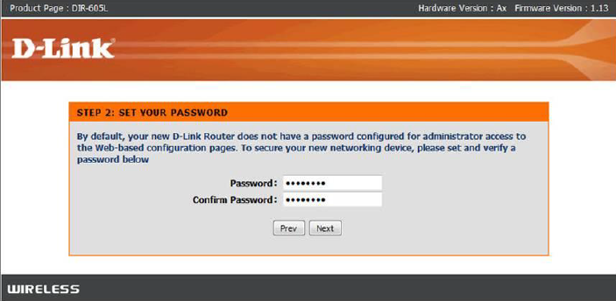
Setup a Wireless Network Name and Password
Enter an administrator password for the router

Slide 15
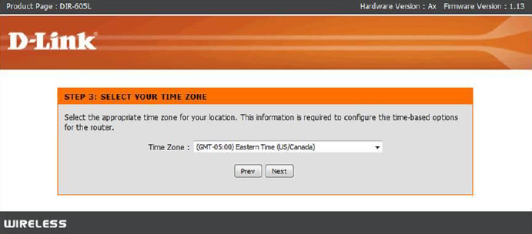
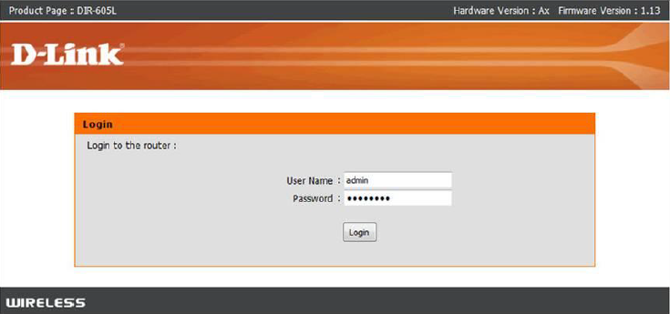
Select your Time Zone
The router will apply the new settings and reboot. You should be prompted with the routers Login Screen • Enter the username: admin and your created password (created earlier)

