Slide 1
Exploring the Effects of Behavioral and Demographic Attributes on Health Outcomes
By: Aria Agarwal

Slide 2
The BRFSS Dataset + Aim
The BRFSS Dataset
- is a state-based health behavior survey that collects information on individuals health risk behaviors such as lifestyle and demographic factors including amount of sleep, smoking and exercise habits, and general health perception as well as chronic illnesses.
- collected in 2020 and accessed through Kaggle, but was originally downloaded from the CDC website.
Project Aim
-cluster and analyze individuals based on their demographic and behavioral attributes to examine the correlation between health outcomes.
-The project does not aim to determine whether or not an individual will get a certain disease based on their attributes, but to analyze the correlation between lifestyle and health outcomes.
-UsesK-Nearest Neighbors and Logistic Regression to classify the user's health outcomes, and visualizing the data through K-means and histograms.

Slide 3
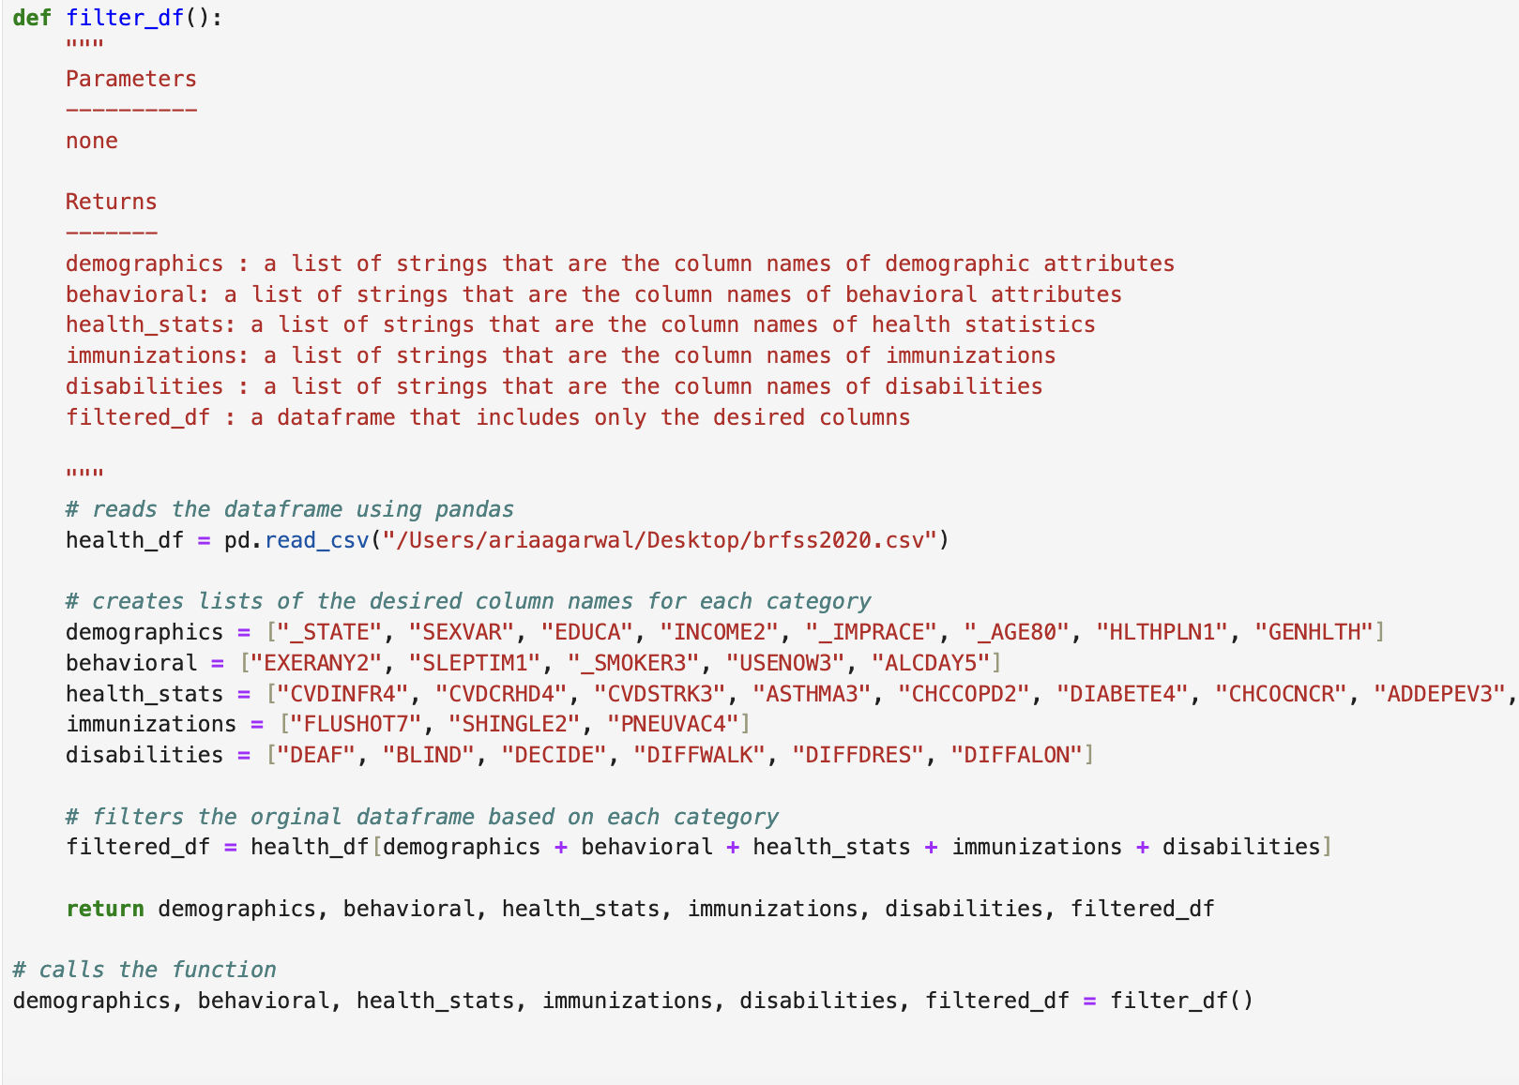
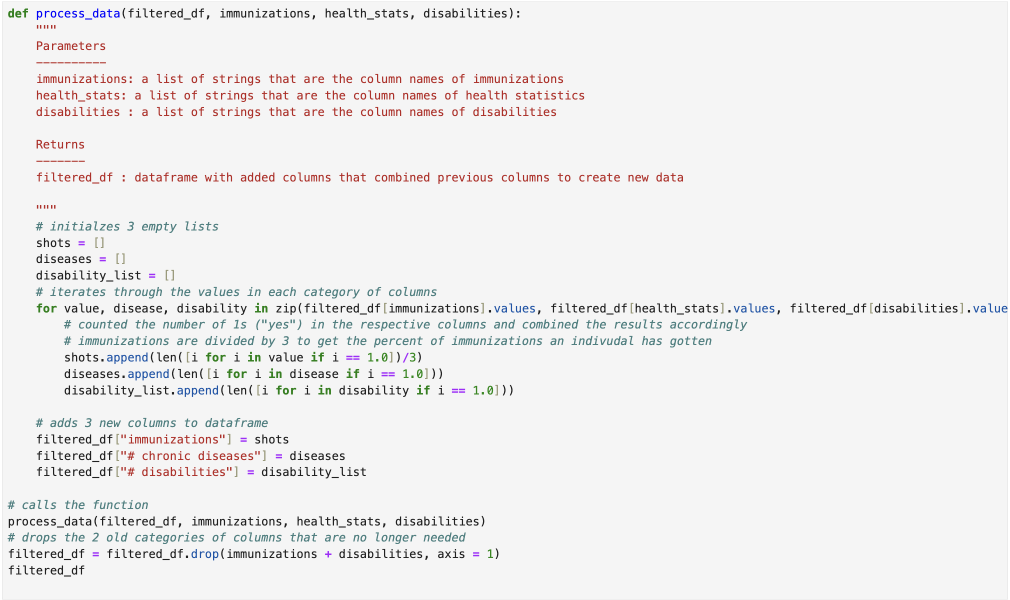
Loading, Processing the Data
-Filtered the dataset by selecting columns to go in 5 categories: demographics, behavioral, health statistics, immunizations, and disabilities
-Aggregate the data by combining columns to produce a single output.
-To clean the data, in the columns that had 2 responses, either 1 or 2, I switched each 2 to 0 to make the data more cohesive with convention, as well as dropping null values.

Slide 4
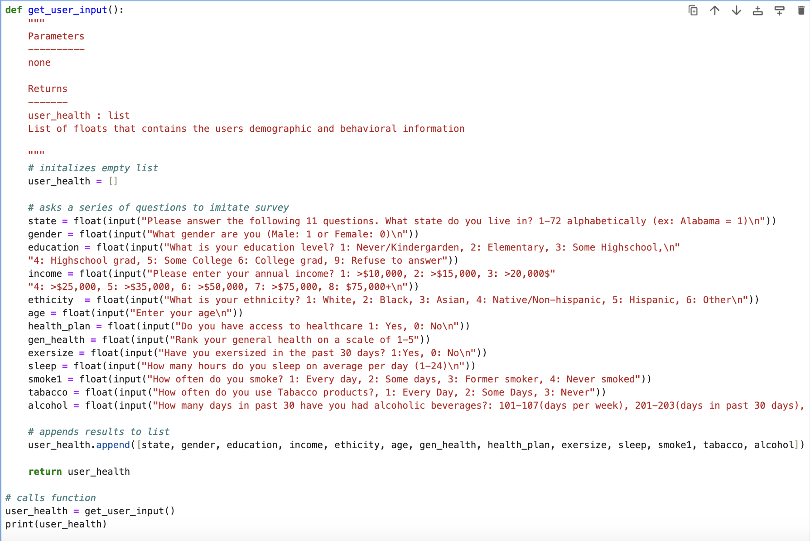
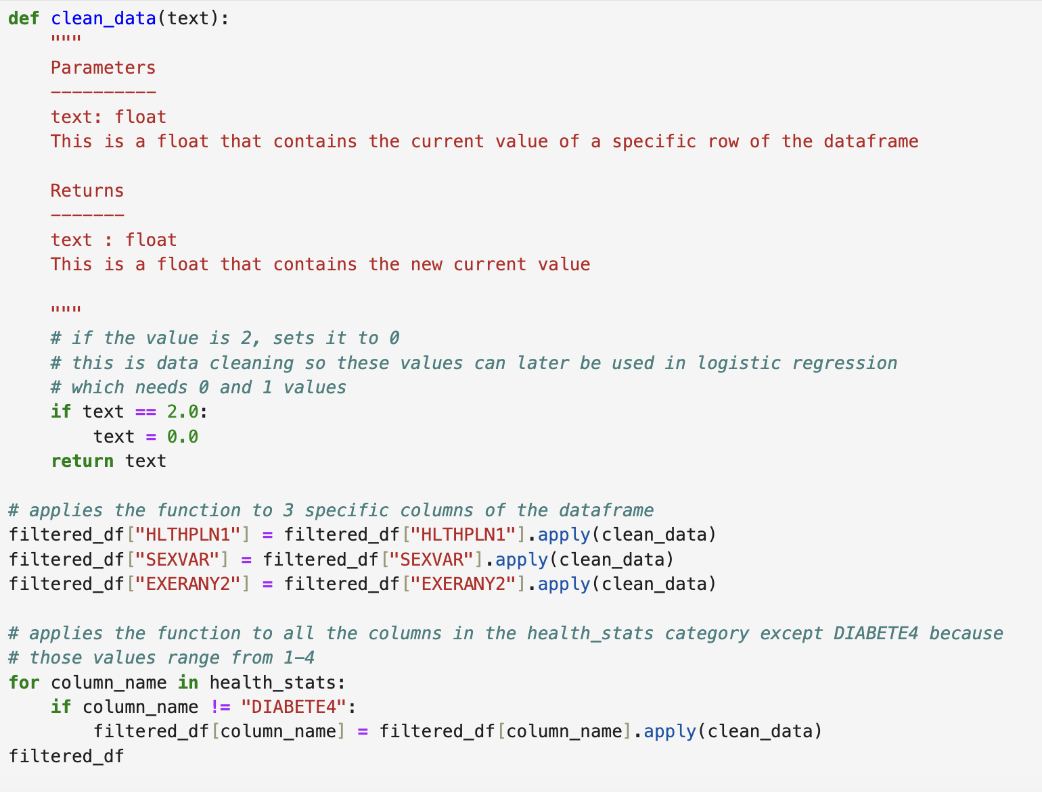

Cleaning and Getting User Input
To get the user input, a mini survey was created that imitates the large survey conducted by the CDC to collect data for the
BRFSS dataset. These questions collect the users behavioral and demographic information to later be used in prediction and classification.
To clean the data, in the columns that had 2 responses, either 1 or 2, I switched each 2 to 0 to make the data more cohesive with convention, as well as dropping null values.

Slide 5
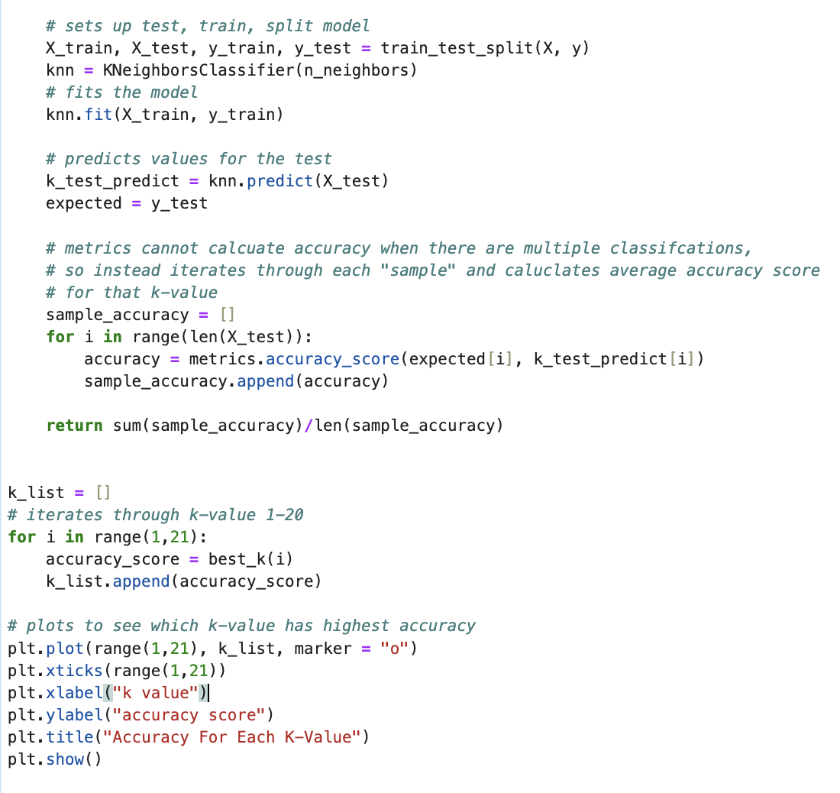
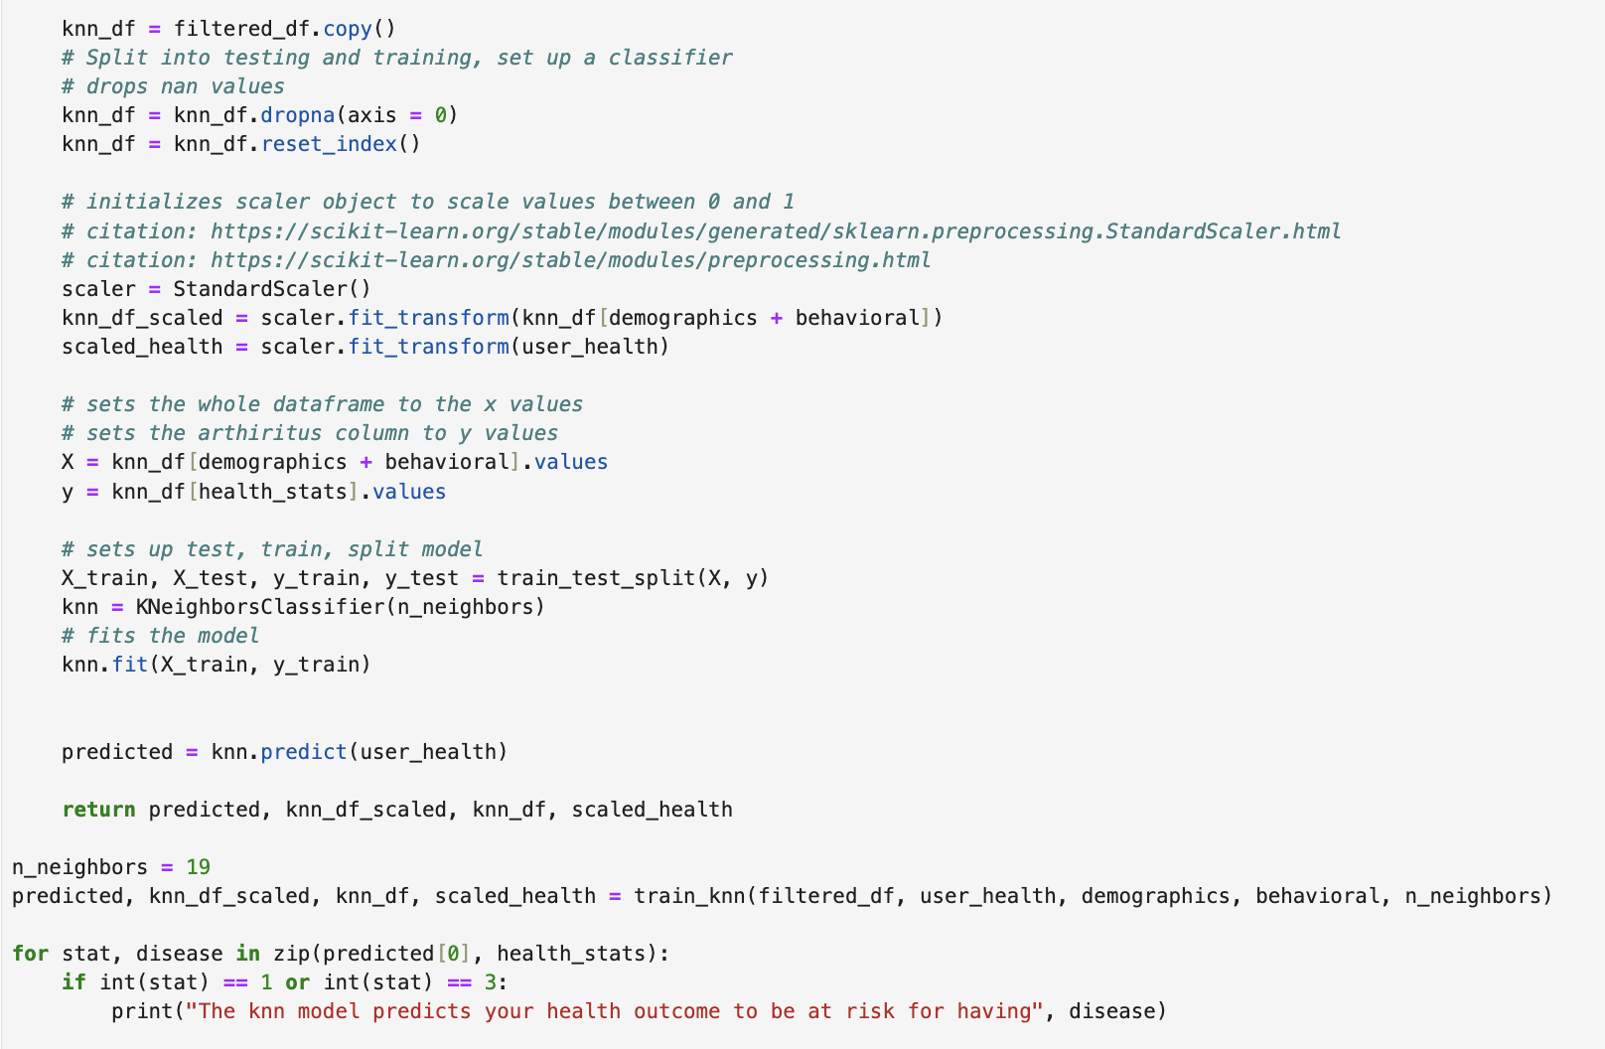
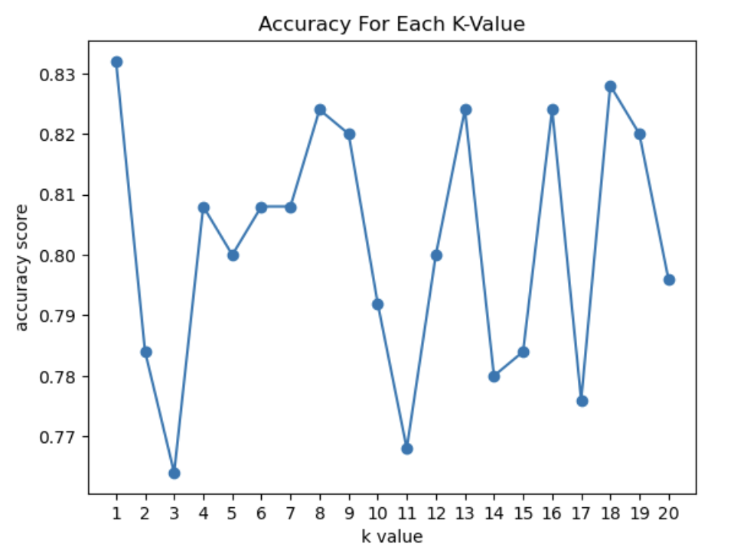
Predicting User Health: Knn Model
Uses test, train, split and sklearn.metrics to produce a list of accuracy scores for each k-value
The Knn model uses the users demographic and behavioral information
to produce a predicted set of chronic conditions they may have.
However, instead of interpreting these predictions as such, this project
chooses to classify a positive result as being at risk for the condition
rather than using the result as an actual prediction. This is because
realistically and accurately predicting whether an individual will
develop a chronic condition based on their attributes is outside the
scope of this project, and requires further biological testing to produce
accurate results.
Picks a k value and produces a graph
to determine which k-value has the highest accuracy score

Slide 6
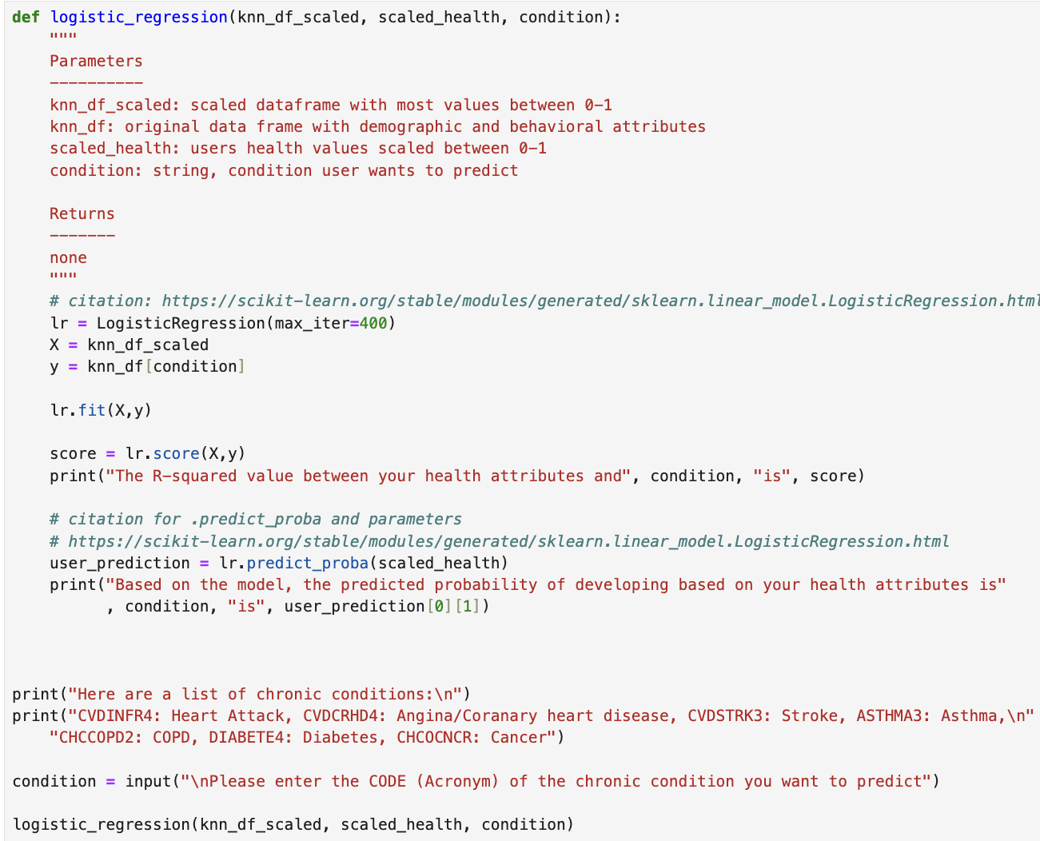
Predicting User Health: Logistic Regression
Logistic regression is used as another tool for classification by producing the probability of an individual
developing a certain chronic condition based on the users input of behavioral and demographic attributes

Slide 7

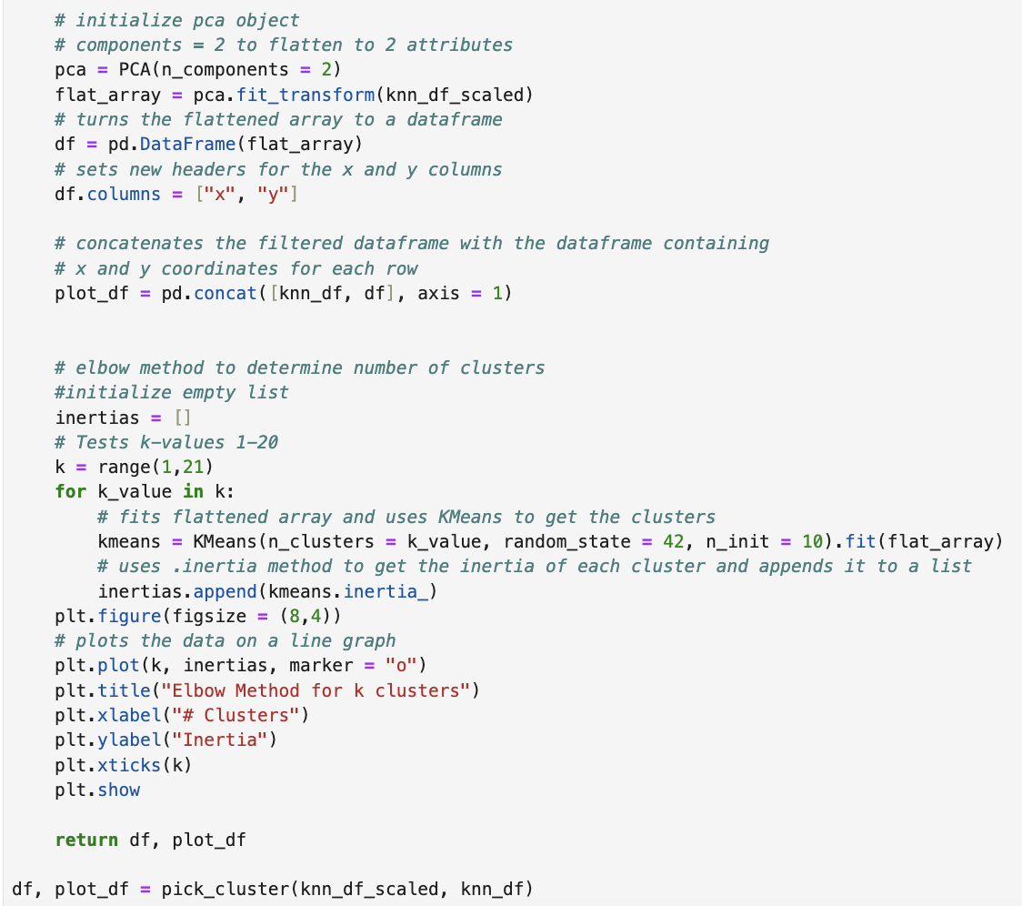
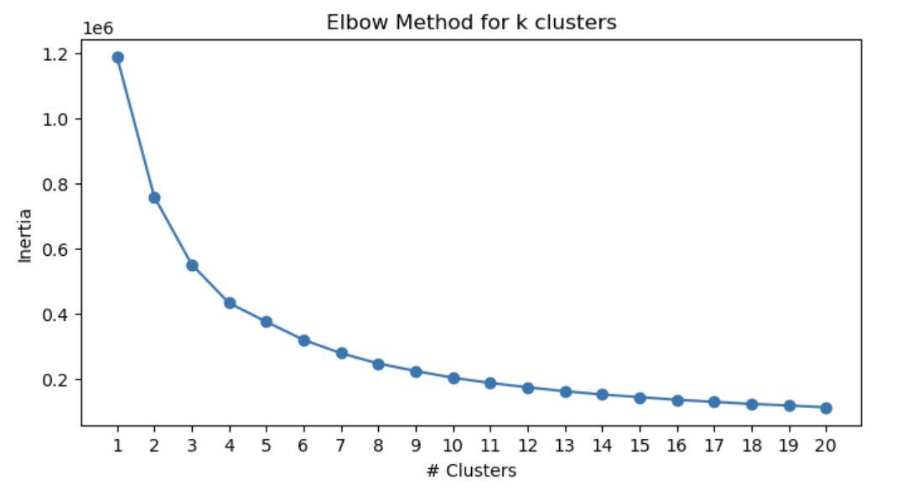

Visualizing the Data: KMeans
Based on the graph, around 9-10 clusters is when the graph continuously starts to flatten, which is the optimal number of clusters for kmeans
This code first flattens the data into 2 dimensions using PCA, then uses the elbow method to determine the optimal number of clusters

Slide 8
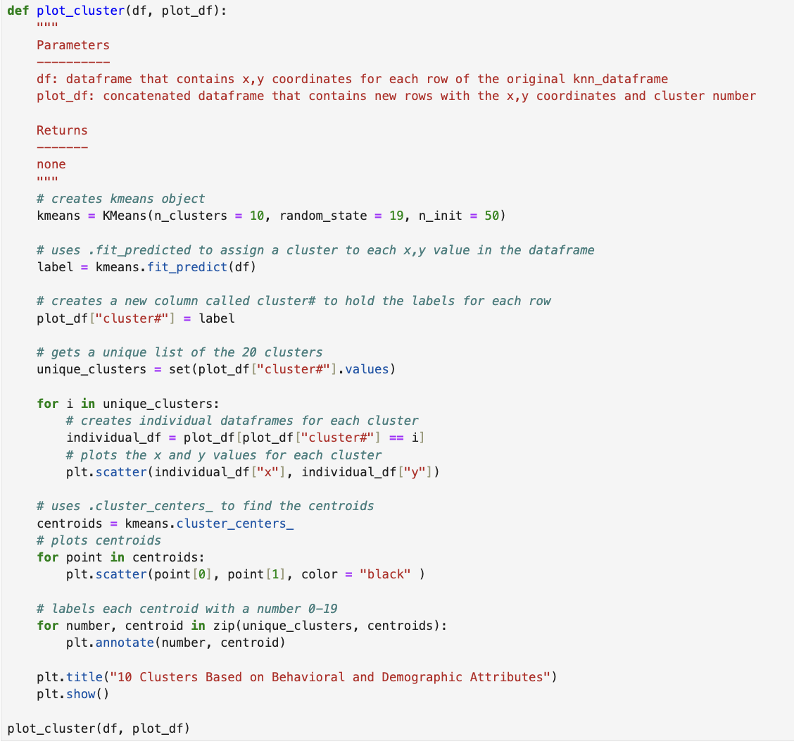
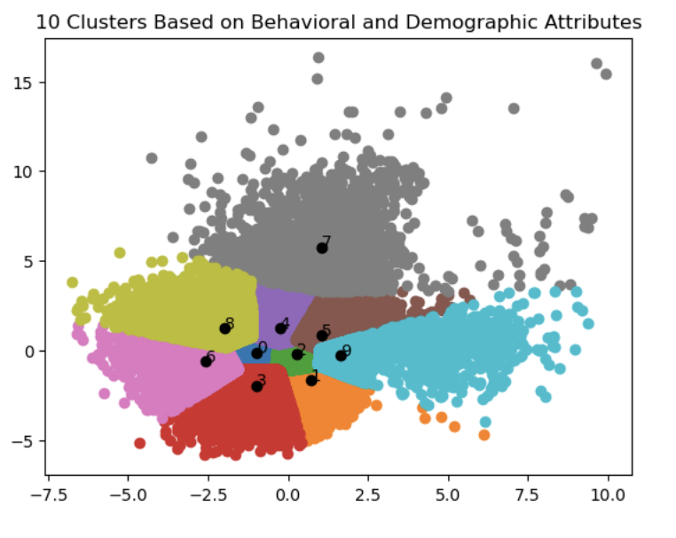

Visualizing the Data: KMean
Plots the data on a scatter plot, and finds the centroids for each cluster and labels it on the graph. Clusters that are closer together contain individuals with similar behavioral/demographic attributes
Uses kmeans.fit_predict on the dataframe with x,y coordinates to categorize the data into clusters, then adds a new column to the dataframe with the cluster# and creates a new dataframe for each cluster

Slide 9
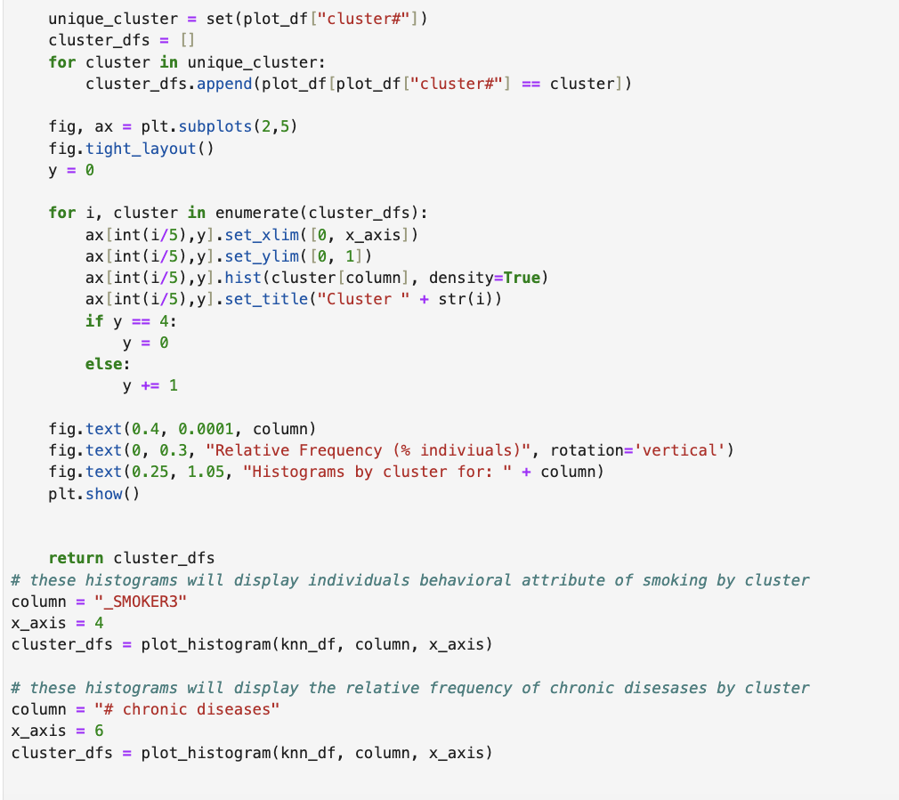
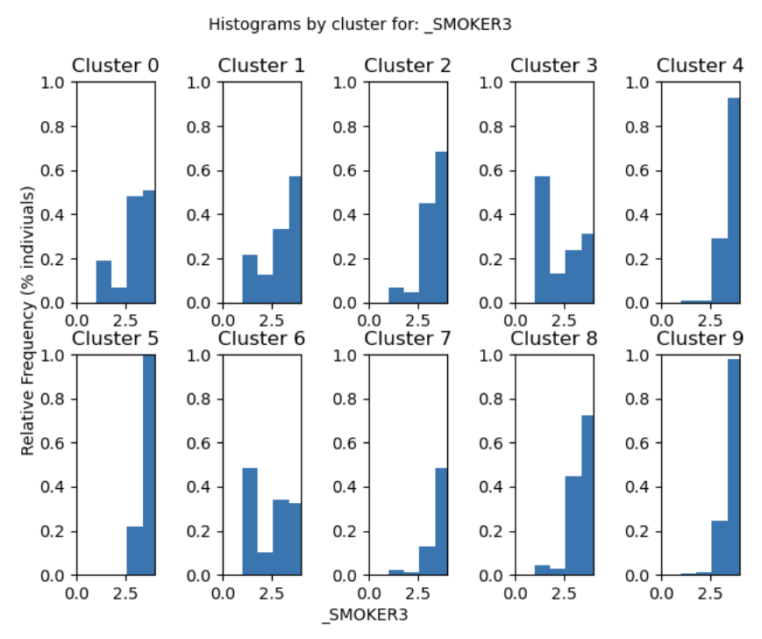
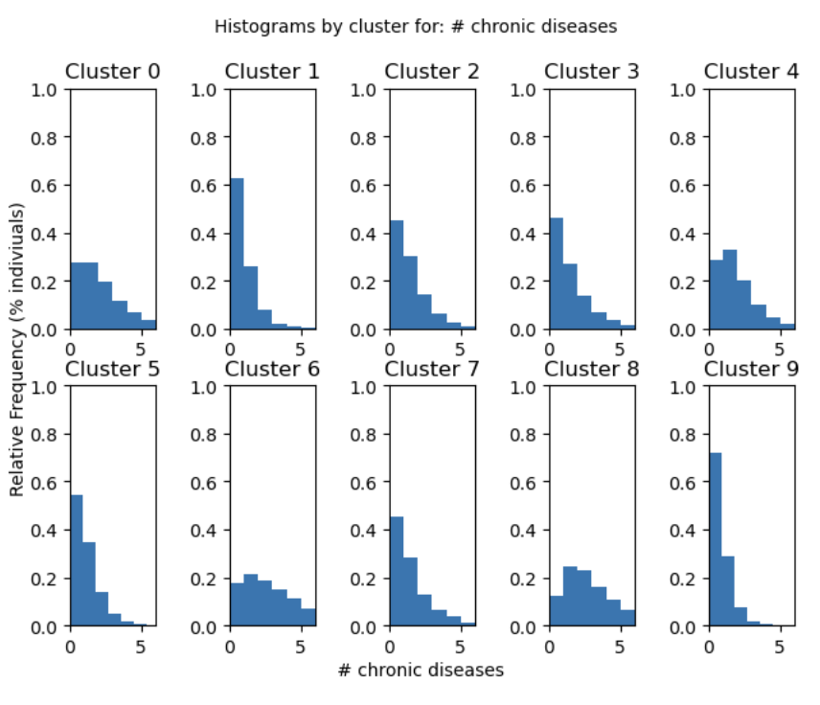
Histograms
Smoking was recorded on a scale of 0-4, with 4 being never having smoked, and chronic diseases was measured on a scale of the amount of diseases 1-5. The general trend seems to be in clusters that have a lower frequency of individuals smoking (left-skewed histograms), there is a lower frequency of individuals with chronic diseases (right-skewed histograms). This could indicate a correlation between excessive smoking and the prevalence of chronic diseases.
Also between clusters in each set of histograms, some have even distributions indicating a higher frequency of individuals with chronic diseases, and some clusters are right-skewed indicating a healthier population
This code creates histograms of smoking habits and chronic diseases based off the data from each cluster, to better visualize the behavior and health outcomes of each cluster

Slide 10
Analysis and Conclusion
Conclusion
The aim of this project is to cluster and analyze individuals based on their demographic attributes and behavioral attributes to examine their correlation between health outcomes.
One limitation of this project was that the prediction of a user's health outcome cannot be properly determined due to the lack of biological testing. It would be inaccurate to use classification algorithms such as KNN to predict health outcomes, as further testing on a scientific grounds is needed. To account for this, the project instead interprets positive results as a mere correlation rather than a "yes" or "no" answer.
Some key observations was that clusters who smoked also had a higher frequency of individuals with chronic diseases. Also, clusters that had higher frequencies of chronic diseases were close together on the KMeans graph, indicating a correlation between demographics, behavior, and chronic health outcomes.
Potential Future Implementation
This project can also be useful in informing health officials about which communities are underserved in terms of access to healthcare. Historically, low income people of color are disproportionately affected by inadequacies in the American healthcare system leading to worse care and health outcomes. This project can be useful in examining these relationships further to draw meaningful conclusions and potentially implement new policies to promote equity within the American healthcare system.

