Slide 1
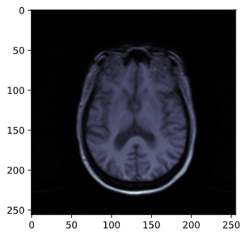



CNeuronalN Disease
Alzheimer Disease Predictions
18th March, 2021
Ariadna Puigventós
Data Scientist
Analytics & Insight Specialist

Slide 2

CNeuronalN Disease, 18th March
..index
Abstract project
Work planning
Understand Alzheimer Disease
Hypothesis
Prediction
Method workflow
Bonus track theory
Next steps
Spend time

Slide 3


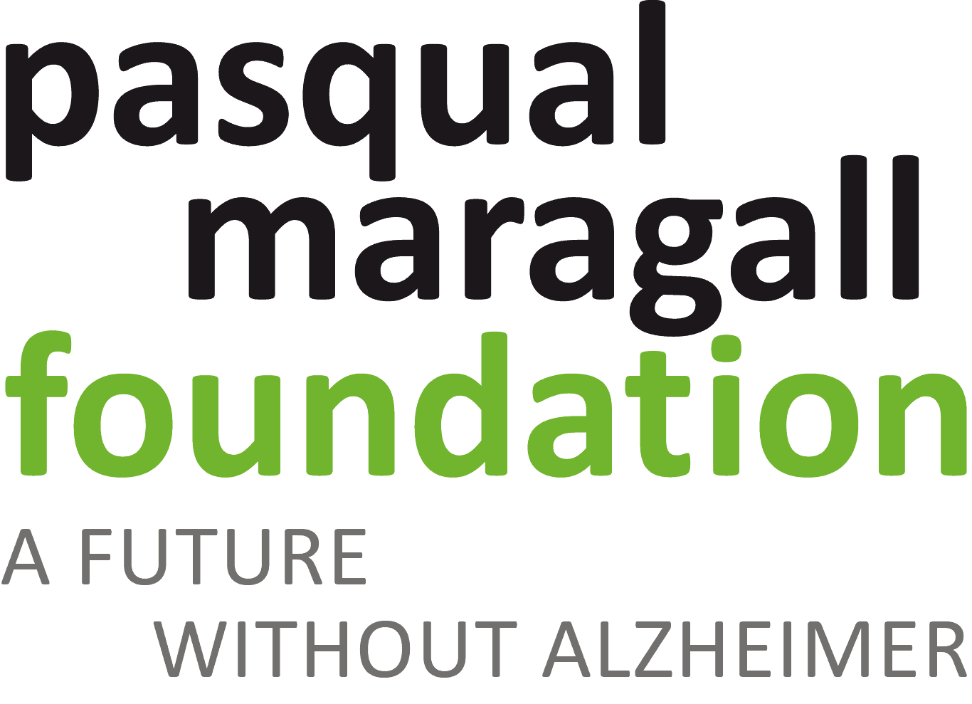
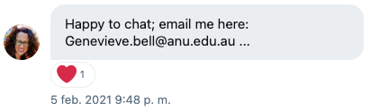



CNeuronalN Disease, 18th March
..abstract project
+
+
Entrevista al Dr. Neurólogo del Hospital del Mar de Barcelona
Neurologist, researcher and leader the HEBE project
All starts with this tweet.
She’s Anthropologist & ethics in AI
It is talking about the ethic of AI in medicine and their evolution and Human tasks in companies.
Image Axial Dataset
Clinic Dataset
(Numérico/categórico)

Slide 4
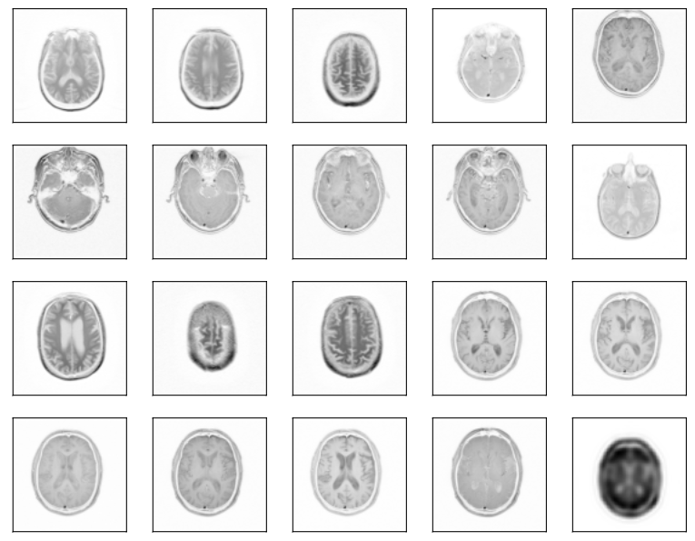
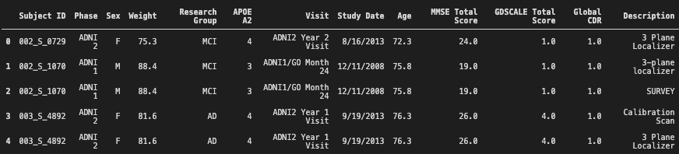
CNeuronalN Disease, 18th March
..abstract project
Image Axial Dataset
Clinic Dataset
(Numérico/categórico)

Slide 5
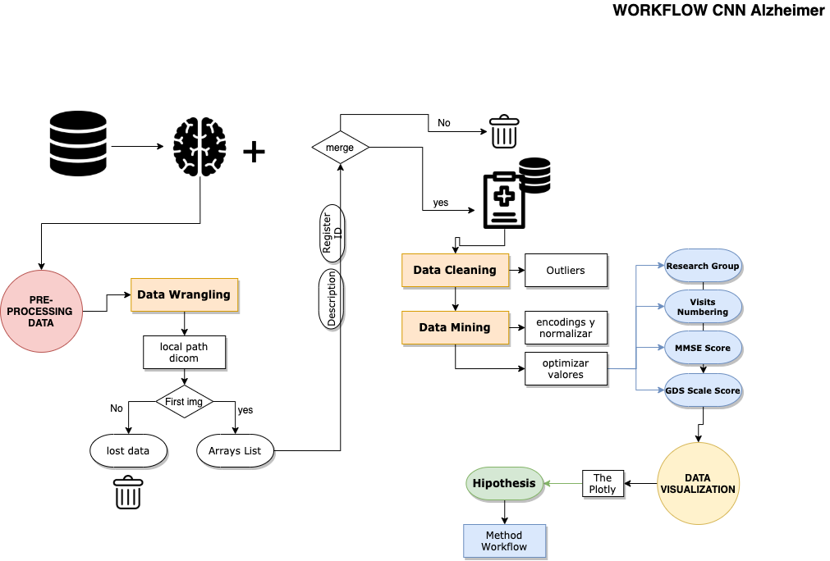
CNeuronalN Disease, 18th March
..work planning
310 images
192 x 192 x 1
2267 images
256 x 256 x 1

Slide 6
CNeuronalN Disease, 18th March
..work planning

Slide 7
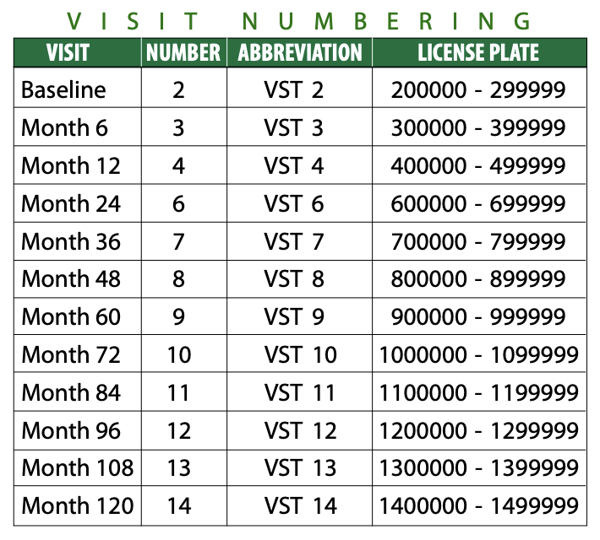
CNeuronalN Disease, 18th March
..first: understand Alzheimer Disease
{AD: Alzheimer Disease: 2, MCI: Normal Cognitive: 1}
Psichomotricity tests
MMSE: [26 - 30] —> GDS Scale Score 1
MMSE: [25 - 29] —> GDS Scale Score 2
MMSE: [20 - 27] —> GDS Scale Score 3
MMSE: [18 - 23] —> GDS Scale Score 4
MMSE: [16 - 20] —> GDS Scale Score 5
MMSE: [10 - 19] —> GDS Scale Score 6
MMSE: [5 - 15] —> GDS Scale Score 7
MMSE: [0 - 12] —> GDS Scale Score 8
# It allows a MAE < 3 points

Slide 8
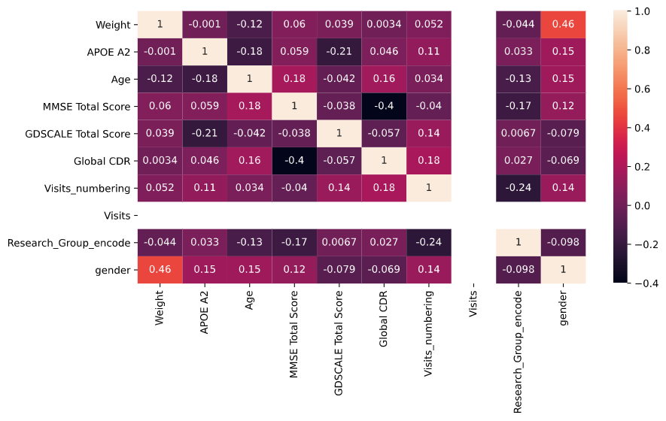
CNeuronalN Disease, 18th March
..first: understand Alzheimer Disease

Slide 9

CNeuronalN Disease, 18th March
..first: understand Alzheimer Disease

Slide 10
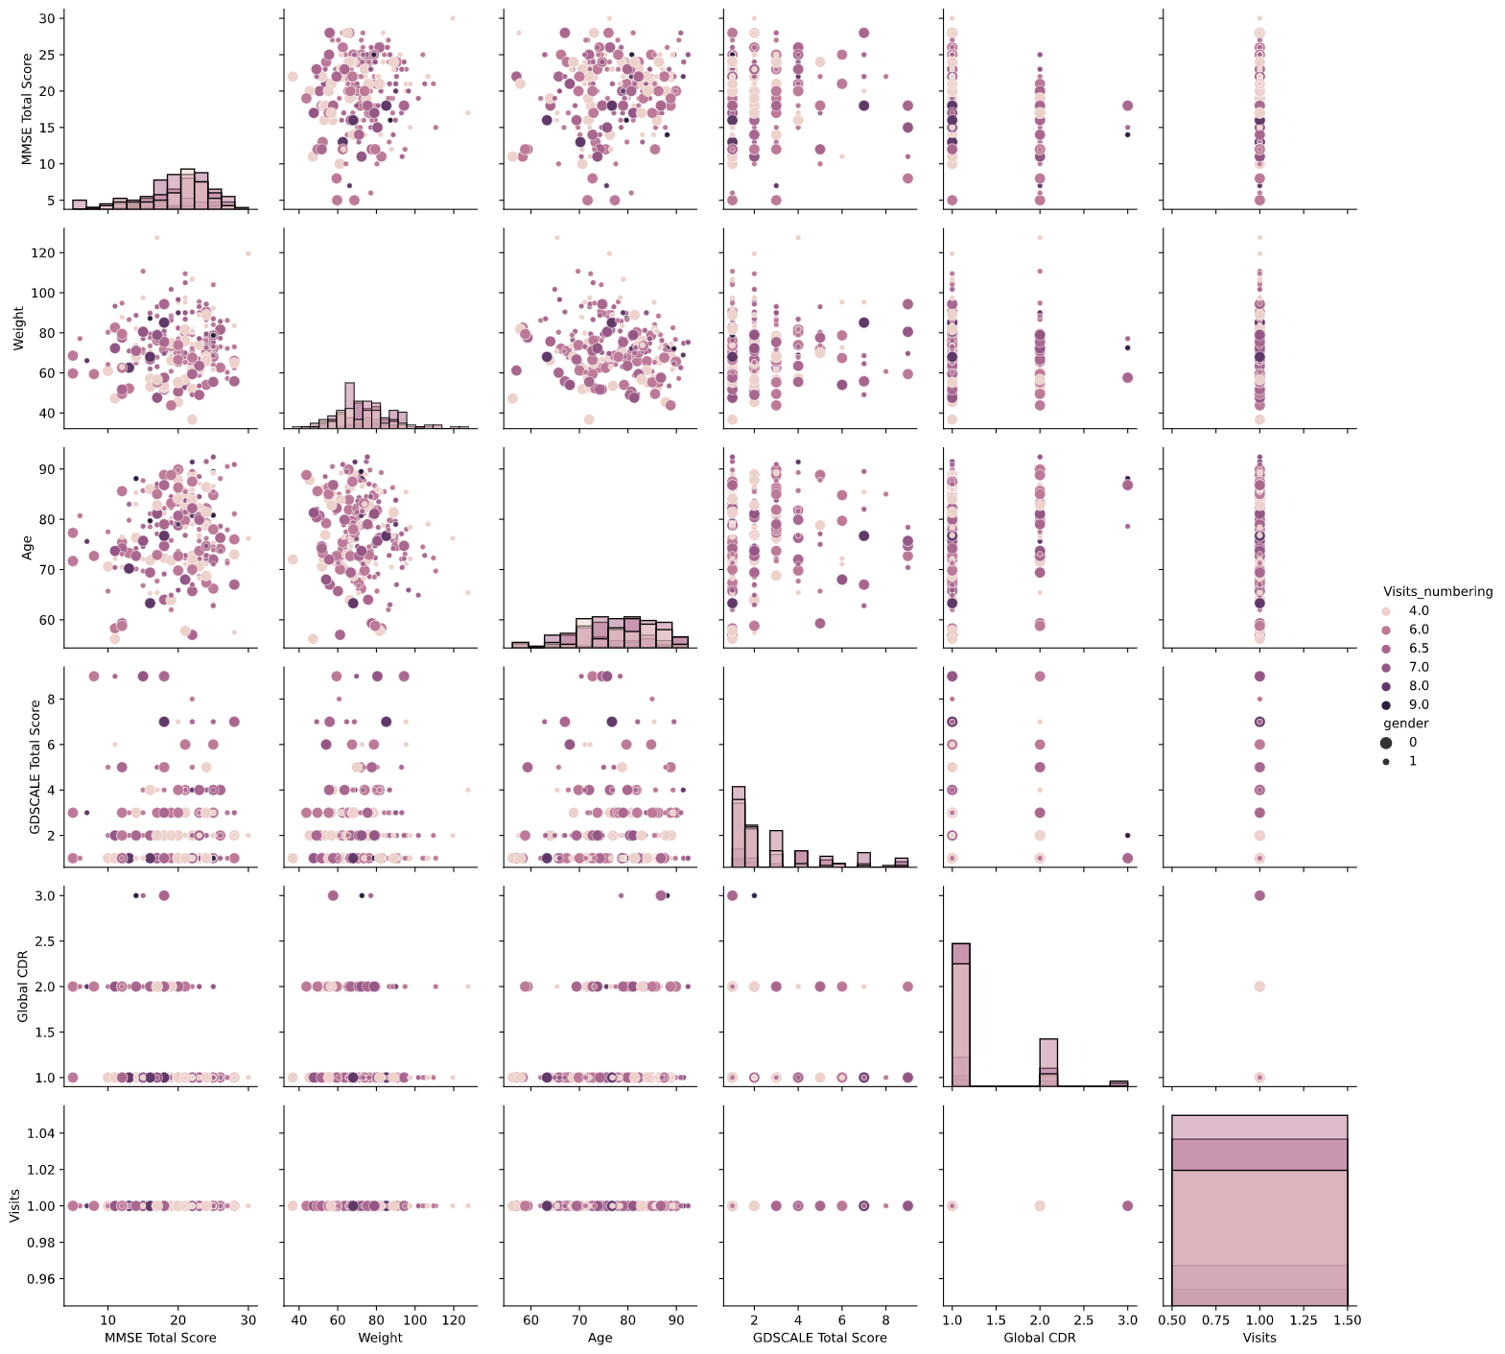
CNeuronalN Disease, 18th March
..first: understand Alzheimer Disease

Slide 11
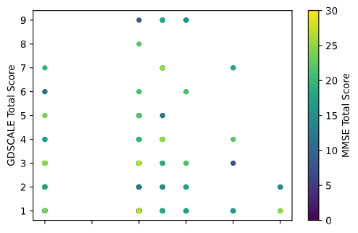
CNeuronalN Disease, 18th March
..first: understand Alzheimer Disease

Slide 12
CNeuronalN Disease, 18th March
..first: understand Alzheimer Disease
4
6
7
8
10
11
Visits Numbering

Slide 13

CNeuronalN Disease, 18th March
..work planning

Slide 14
CNeuronalN Disease, 18th March
..work planning

Slide 15
CNeuronalN Disease, 18th March
..hyphotesis
Whether the disease of the patient correlates
with the number of visits the patient have
(or has had them) to know the capacity of a hospital.

Slide 16
CNeuronalN Disease, 18th March
..prediction
How serious is the patient’s diagnosis (GDS Scale Score)
because for allowing to know MMSE Score
and which the patient is part of Research Group as well.
{
Regressor
Problem
Classifier
Problem
..y
MMSE Score
GDS Scale Score

Slide 17
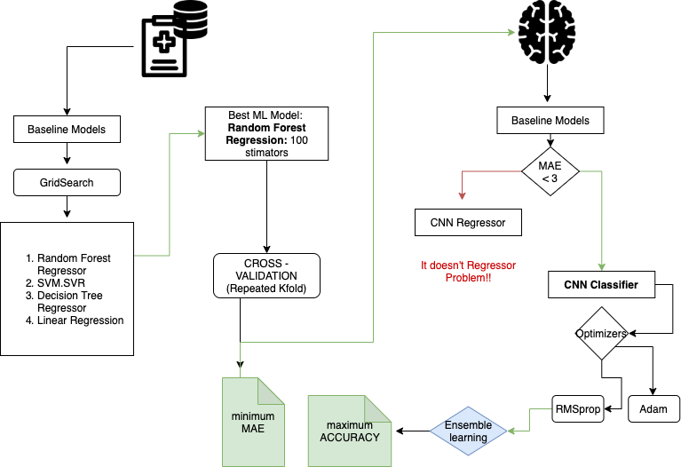
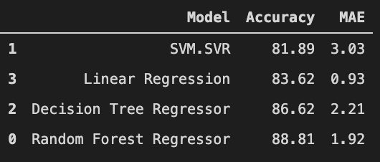
CNeuronalN Disease, 18th March
..method workflow
{
..1
MMSE
Score
Regressor
Problem

Slide 18
CNeuronalN Disease, 18th March
..method workflow
..2

Slide 19
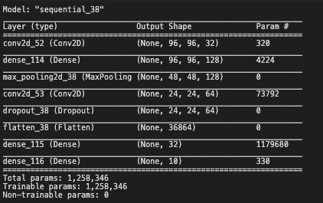
CNeuronalN Disease, 18th March
..method workflow
RNN Classifier:
Optimizer: Adam
Loss: Sparse_categorical_crossentropy
Metrics: accuracy
RNN Classifier:
Optimizer: RMSprop
Loss: Sparse_categorical_crossentropy
Metrics: accuracy + MAE

Slide 20
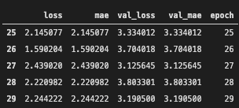
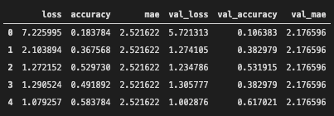

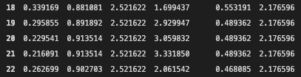

CNeuronalN Disease, 18th March
..method workflow
RNN Classifier:
Optimizer: Adam
Loss: Sparse_categorical_crossentropy
Metrics: accuracy
RNN Classifier:
Optimizer: RMSprop
Loss: Sparse_categorical_crossentropy
Metrics: accuracy + MAE

Slide 21
CNeuronalN Disease, 18th March
..method workflow
..2
1.92
83%

Slide 22

CNeuronalN Disease, 18th March
..method workflow
..2
y_pred_CNN_C_RMSprop
2.45
83%

Slide 23
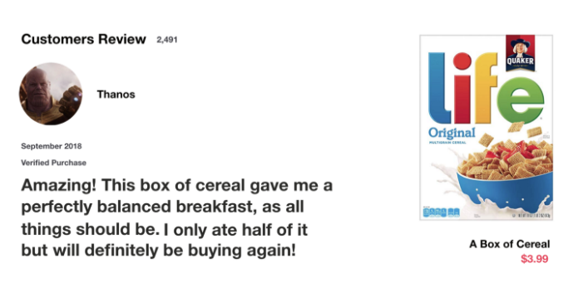
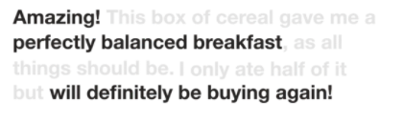

CNeuronalN Disease, 18th March
..bonus track theory
RNN LSTM, what’s happening?
Source: townrdsdatascience

Slide 24
CNeuronalN Disease, 18th March
..bonus track theory
RNN LSTM, what’s happening?
STM short-term-memory tries to hold back keywords in a temporal series (past and present).
They have internal mechanisms called gates that an regulate the flow of information.
They carry relevant information throughout of the sequence, so the earlier steps can make it’s way to later time steps, reducing the effects of STM.
Source: townrdsdatascience

Slide 25
CNeuronalN Disease, 18th March
..next steps
Predict visits numbering by MMSE/GDS with all images per patient/visit.
Keep going with LSTM practical model with AD project
Regarding this project with ethics issues in medicine and another human fields.
Get hardware and software resources.
Upload a predicted image to the API works.

Slide 26
CNeuronalN Disease, 18th March
..thanks
al Covid-19
al mal tiempo
al AVE
a Apple Support
…y no menos importante a…

Slide 27
¡A vosotros!
Gabriel, Clara, Dio, tocayo, Javis, Álex, Mar de amore, Xelitas, Alfonso,
Leo-nil, Migueles, Estela, Juan I, ==lentejas (Robert), María, Kapilin, Anais, Andreea.

