Slide 1


Slide 2
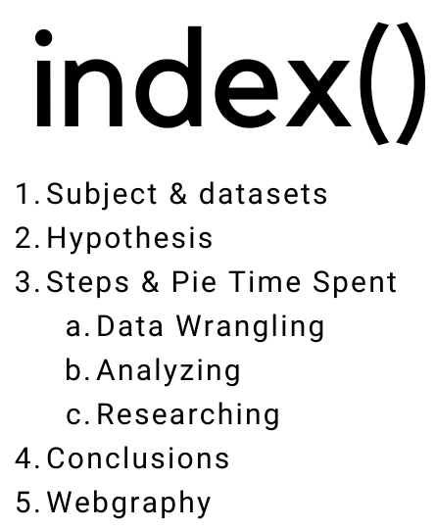

Best Marathons Majors, 10th, January

Slide 3
1. Subject & Datasets
Best Marathons Majors, 10th, January
The subject is about where the best marathons majors are from in athletics category.
Main dataset is about 6 Best Marathons Majors by Countries.
The second one is about latitude of each Country dataset which compete in marathons.
The third dataset is only to reconfirm the global idea with 120 Olympic Games dataset by Countries and categories.

Slide 4
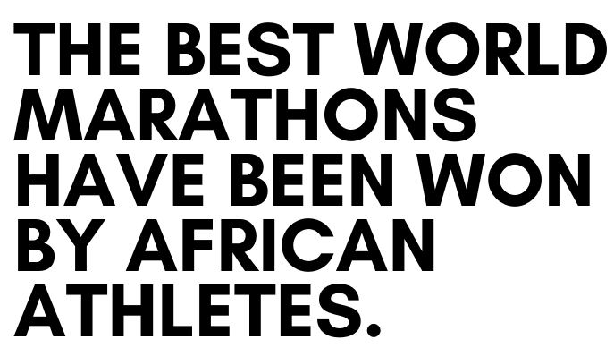
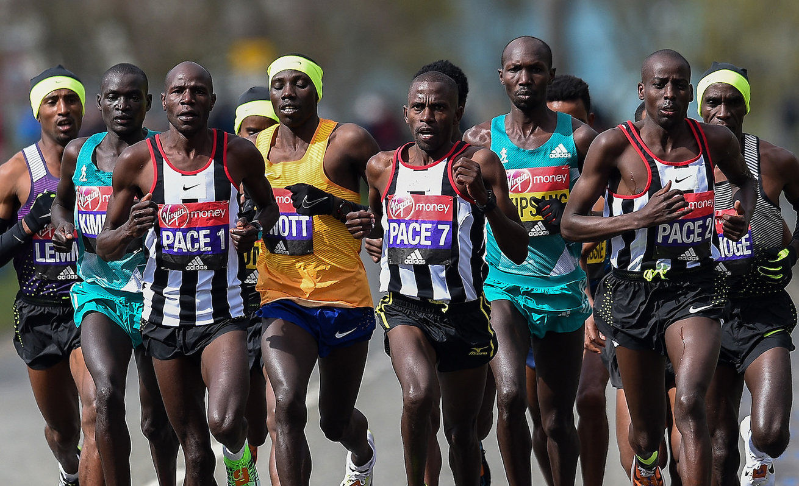
2. Hypothesis
Best Marathons Majors, 10th, January

Slide 5
3. All Steps
Best Marathons Majors, 10th, January
SET UP
It worked with different tests files in notebook/ folder where there are different operations, correct and fail code.
After, when the code returned correctly, it was transferred and copied in each module appropriate with its function in utils/ folders.
Imported every function to main.ipynb file in src/ folder.

Slide 6
3. All Steps
Best Marathons Majors, 10th, January
DATA WRANGLING
The main dataset was cleaned and changed type of majority columns to astype category or float64, even in one case did an encoding.
There were not any duplicates but it detected some outliers in variable “Time”. It was necessary to change of Time Column from object type to float64 with method “to_timedelta64[s].
It applied different methods to confirm the hypothesis like head(), tail() and most repeated values who won more than one time.

Slide 7
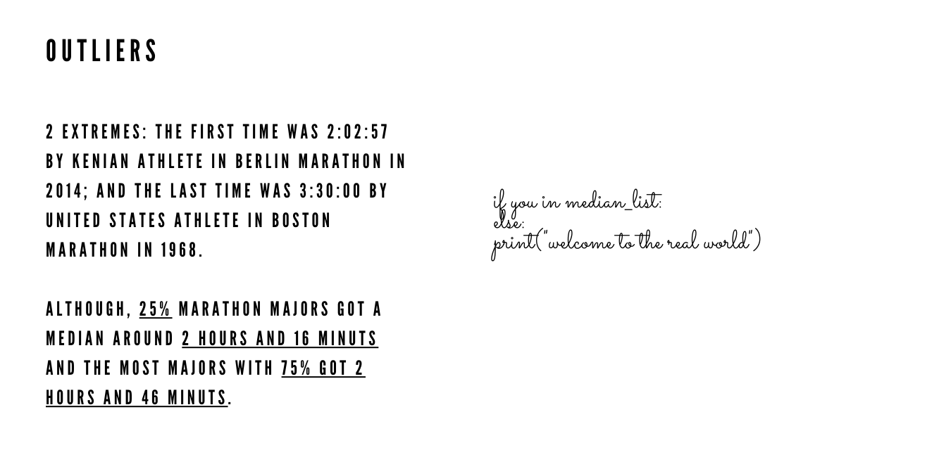
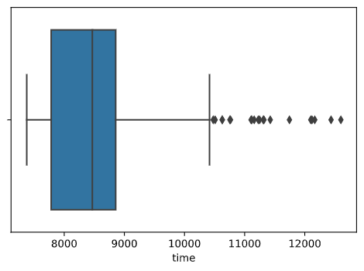
Best Marathons Majors, 10th, January

Slide 8
3. All Steps
Best Marathons Majors, 10th, January
ANALYZING
A pie chart for showing the top 10 countries and the rest of the countries in a new row “others” category must be to concat the main dataset with a new DataFrame with the new row.
An histogram to reconfirm the hypothesis and in this case it must be with 36 bins (not 5) because it was better to demonstrate.
An histogram to show the difference or equality between gender. It must be to change type from object to category.

Slide 9
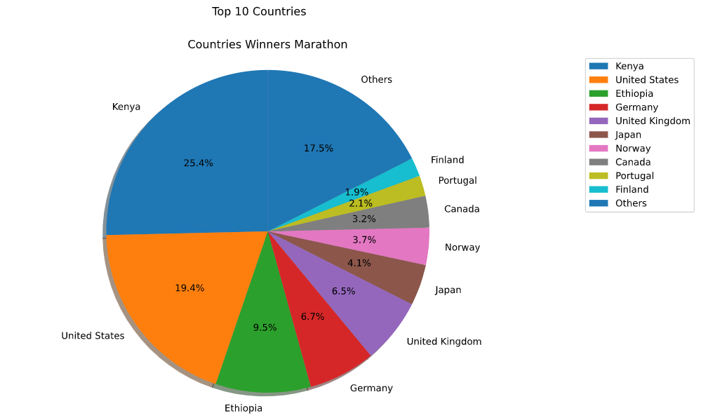
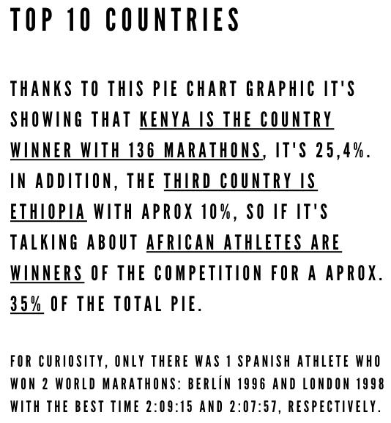
Best Marathons Majors, 10th, January

Slide 10
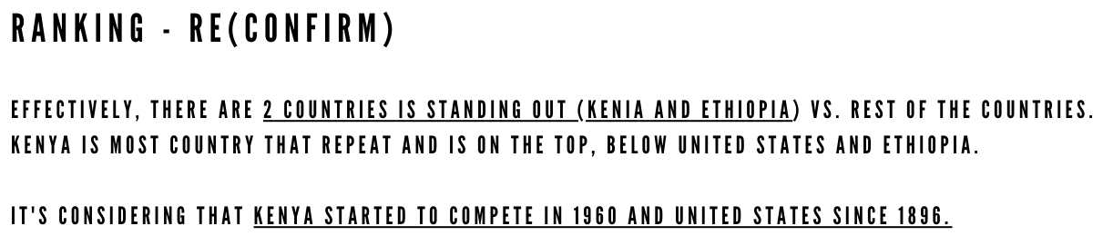
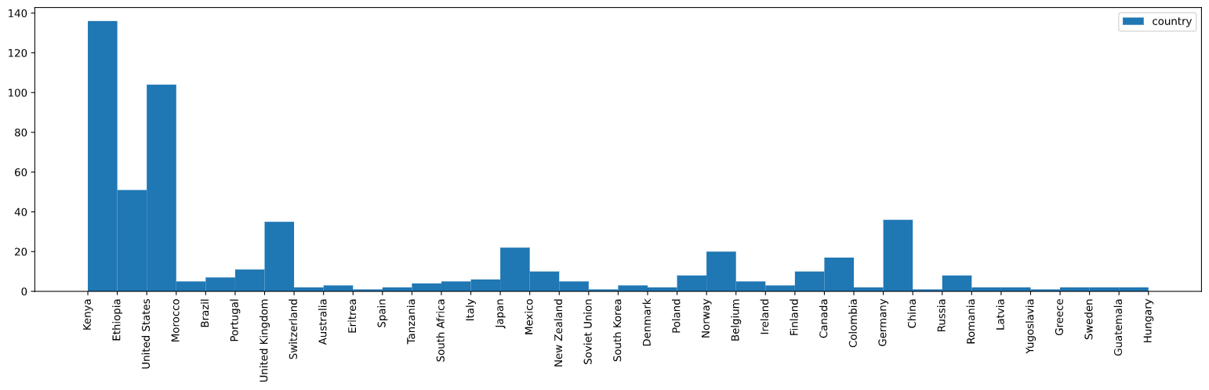
Best Marathons Majors, 10th, January

Slide 11
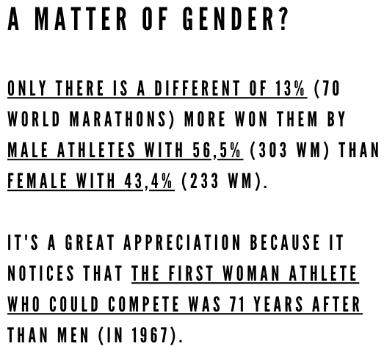
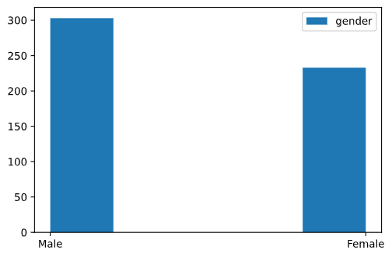
Best Marathons Majors, 10th, January

Slide 12
3. All Steps
Best Marathons Majors, 10th, January
ANALYZING
In the case Correlation Matrix it has needed to tell different sub-steps:
The columns in the DF were object type, so it needed to change the type to integer to show correlation matrix.
But, it was not possible from object to category or object to integer, so it did an Encode each column: encoding the gender (like boolean) to Male is 0 and Female is 1; encoding the country to 37 codes and encoding the marathon city to 6 codes.
It created 3 new columns with encoding values, respectively.
At the end, the time column has been changed from object to split string and after it was changed to float64 by seconds.

Slide 13
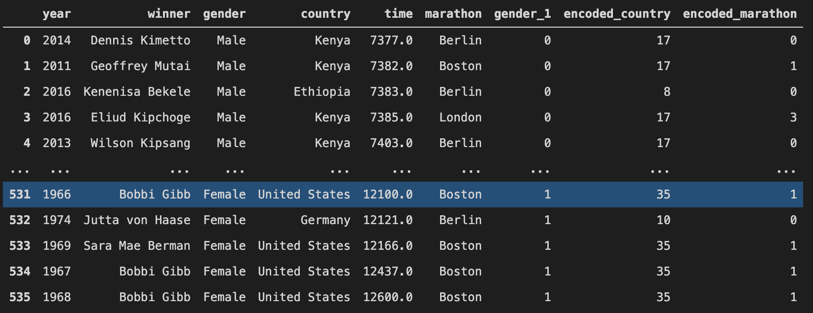
Best Marathons Majors, 10th, January
ANALYZING
DataFrame with 3 encoded new columns:

Slide 14
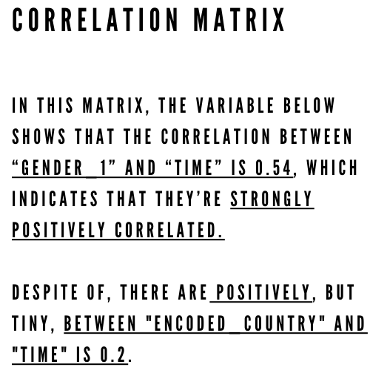
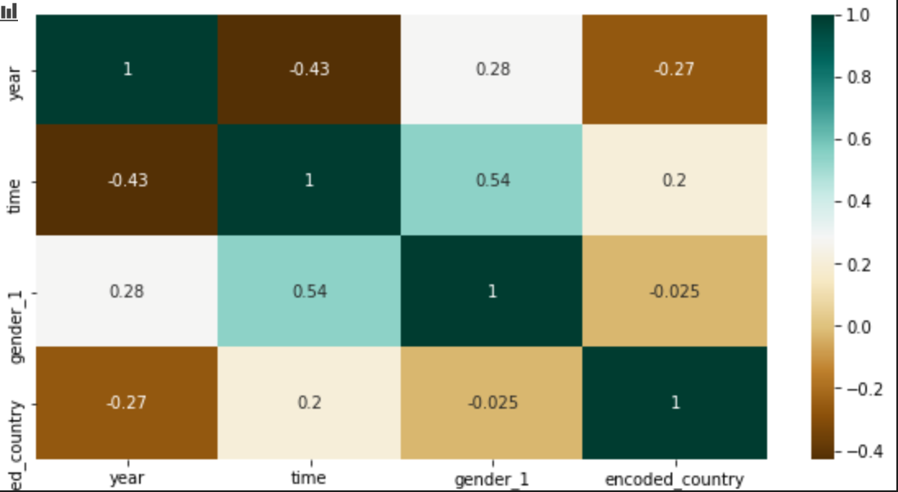
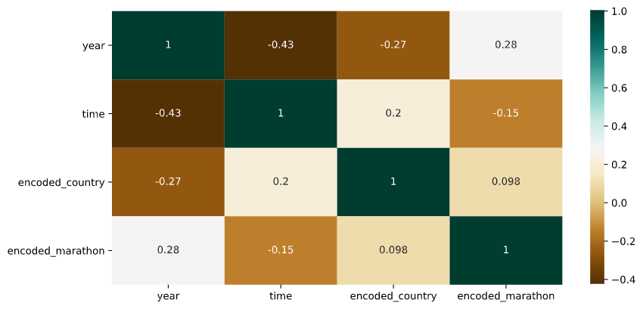
Best Marathons Majors, 10th, January

Slide 15
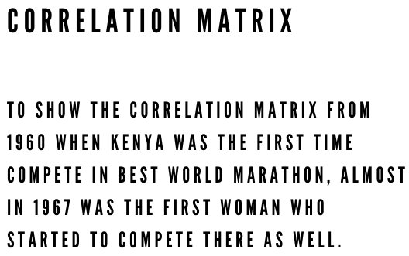
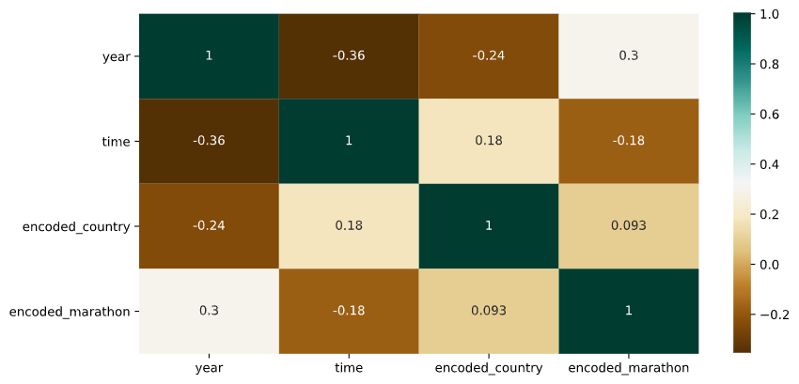
Best Marathons Majors, 10th, January

Slide 16

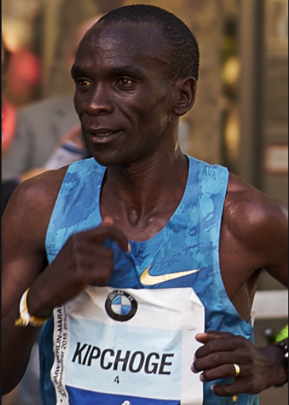
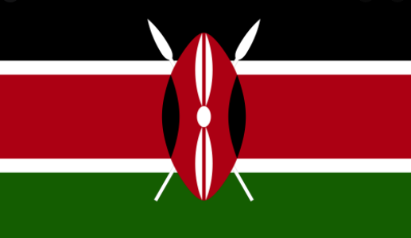
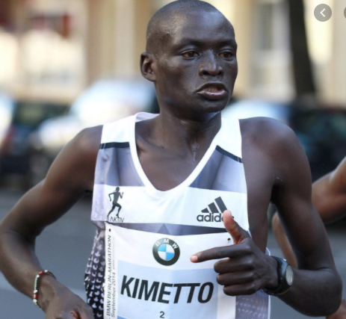
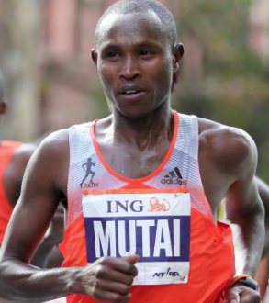


3. All Steps
Best Marathons Majors, 10th, January
RESEARCHING
ELIUD KIPCHOGE
London, 2019 (2:02:37)
Cleaned, cooked, garden duties and slept in an humiliate way.
DENNIS KIMETTO
Berlin, 2014 (2:02:57)
Grow up in a farm community and trained with runners team.
GEOFFREY MUTAI
Boston, 2011 (2:03:02)
Didn’t wear shoes until he was teenager. Applied to a competition and he was accepted as long as he could maintenance the level.

Slide 17
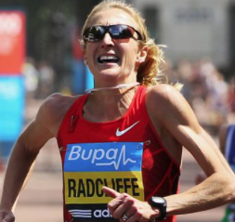

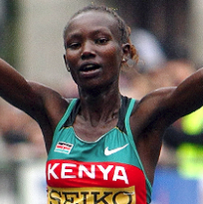
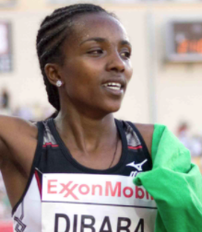

3. All Steps
Best Marathons Majors, 10th, January
RESEARCHING
PAULA RADCLIFFE
London, 2003 (2:15:25)
Run since she was 12 years old in an Athletic Club.
MARY KEITANY
London, 2017 (2:17:00)
When she was child had to walk more than 2km without shoes to get some water and 10km to go the school.
TIRUNESH DIBABA
Chicago, 2017 (2:18:31)
From athletic family and she was child she already trained in the highest area in Ethiopia.

Slide 18
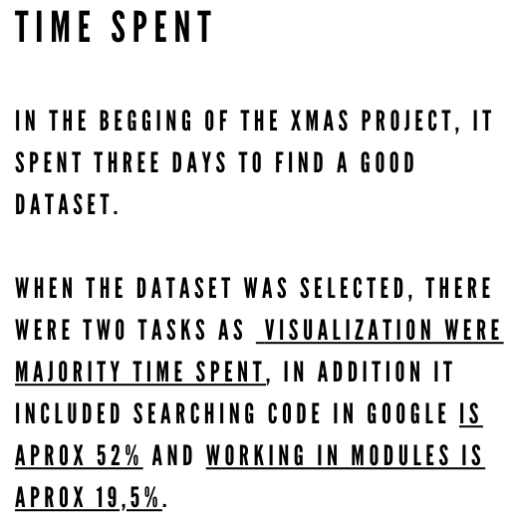
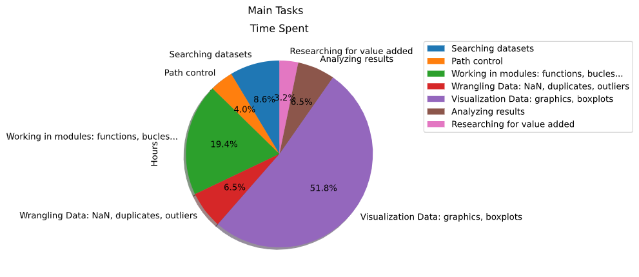
Best Marathons Majors, 10th, January

Slide 19
4. Conclusions
Best Marathons Majors, 10th, January
The hypothesis is confirmed because there are more than cases shows that African, overcoat Kenyan, athletes win most best world marathons.
There are touchpoint:
African countries have had a lot of difference to compete in marathons and another competitions as well (dataset 3).
There are less variety between African athletes than north athletes.
The median time is 2 hours 46 minutes, it is rare value to get a race with only 2 hours.
Gender vs Time is strongly positive correlation, but not much with country.
Two brands more used by African athletes are Nike or Adidas.
Altitude of the countries could be an influence for the best runners (2 dataset).

Slide 20
4. Conclusions
Best Marathons Majors, 10th, January
What would you change if you need to do another EDA project?
This subject was so much interesting and funny because it could extend more data about brand shoes sales or if the altitude influences really for African Athletes.
In addition, it is knowing that marathons cause and increase the temperatures of cities.
What do you learn doing this project?
First of all, starting the project, set up all functions in the modules.
After, a lot of new methods, functions and searching in Google.
At the end, how the visualization data can show and verify some theories, and learning it’s possible to get an idea and extend it to predict the consequences.

Slide 21

5. Webgraphy
General Information to Inspiration
https://www.mundodeportivo.com/atletismo/20190307/46894079804/por-que-los-atletas-africanos-ganan-siempre-en-maraton.html
https://journals.plos.org/plosone/article?id=10.1371/journal.pone.0037407
Impact of Environmental on marathon running performance
https://www.efdeportes.com/efd148/la-superioridad-de-los-atletas-africanos.htm
Datasets Search
www.data.world.com
www.kaggle.com
Recollect Data
https://github.com/ali-ce/datasets/blob/master/Marathon-Majors/Winners.csv
https://data.world/newns92/abbott-world-marathon-majors-winners
https://data.world/johayes13/summer-winter-olympic-games
https://www.kaggle.com/heesoo37/120-years-of-olympic-history-athletes-and-results?select=noc_regions.csv
https://developers.google.com/public-data/docs/canonical/countries_csv
Code webpages to work project
https://stackoverflow.com/questions/38229357/how-to-sum-time-in-a-dataframe
https://stackoverflow.com/questions/12065885/filter-dataframe-rows-if-value-in-column-is-in-a-set-list-of-values
https://towardsdatascience.com/exploratory-data-analysis-in-python-c9a77dfa39ce
https://mode.com/example-gallery/python_histogram/
https://pbpython.com/pandas_dtypes.html
https://pandas.pydata.org/pandas-docs/stable/reference/api/pandas.DataFrame.hist.html
https://pandas.pydata.org/pandas-docs/
https://matplotlib.org/gallery/pie_and_polar_charts/pie_features.html#sphx-glr-gallery-pie-and-polar-charts-pie-features-py
https://datatofish.com/pie-chart-matplotlib/
https://www.delftstack.com/es/howto/matplotlib/how-to-change-the-figure-size-in-matplotlib/
https://stackoverflow.com/questions/57314529/multiple-pie-charts-from-pandas-dataframe
https://likegeeks.com/es/matrix-correlacion-python/
https://seaborn.pydata.org/examples/grouped_barplot.html
https://opensource.com/article/19/7/create-pull-request-github
https://scikit-learn.org/stable/modules/generated/sklearn.preprocessing.OneHotEncoder.html
https://stackoverflow.com/questions/54052471/mapping-values-in-place-for-example-with-gender-from-string-to-int-in-pandas-d
https://stackoverflow.com/questions/29432629/plot-correlation-matrix-using-pandas
https://towardsdatascience.com/label-encoder-and-onehot-encoder-in-python-83d32288b592
https://stackoverflow.com/questions/41463763/merge-2-dataframes-with-same-values-in-a-column
https://stackoverflow.com/questions/48587997/matplotlib-pie-graph-with-all-other-categories
https://realpython.com/pandas-merge-join-and-concat/
https://stackoverflow.com/questions/31405860/three-python-modules-calling-one-another
https://www.statology.org/how-to-read-a-correlation-matrix/
https://towardsdatascience.com/pie-charts-in-python-302de204966c
https://markdown.es/sintaxis-markdown/#parrafos

Slide 22


