Slide 1

DAB-422-Group 4 Capstone Project-II
Mentor: Abiodun Sodiq Shofoluwe
Project Name: International Student Recruitment Analytics
Rishikesh Gaikwad: 0812570
Ankit Padhiar: 0803142
Fei Gao : 0822295
Abhigna Sudini: 0813526

Slide 2
Agenda
1. Introduction and Problem Statement
2. Dataset and Business Process
3. Methodology
4.Data Modelling
5.Model implementation
6. Contribution

Slide 3

Introduction
International Education Office is responsible for international recruitment.
It enables college to make data-driven decisions and allocate resources efficiently, ultimately improving their success in attracting and retaining international students.
International Student Recruitment Analytics is critical for educational institutions to compete in the global education market.
https://www.hotcoursesabroad.com/india/canada/school-college-university/st-clair-college/416108/international.html

Slide 4
Problem statement
Develop and implement an advanced analytics solution to enhance the recruitment of International Students for St. Clair College.
Improve the quality, diversity, and quantity of international students.
Improve Recruitment Efficiency.
Foster data-driven decision-making in the recruitment process.

Slide 5



Dataset overview
Data Sources:
Source: https://international.ocas.ca/select-portal
Data collection method: Exported from the system by the International Education Office.
Date of Collection: Oct. 13th, 2023
Initial Data Overview:
Size of the dataset: 12.6MB
Type of data: Spreadsheet
File format: .xlsx
Dataset Features:
Records: 46331
Columns: 61
Duration: Fall – 2022 to Fall - 2023

Slide 6
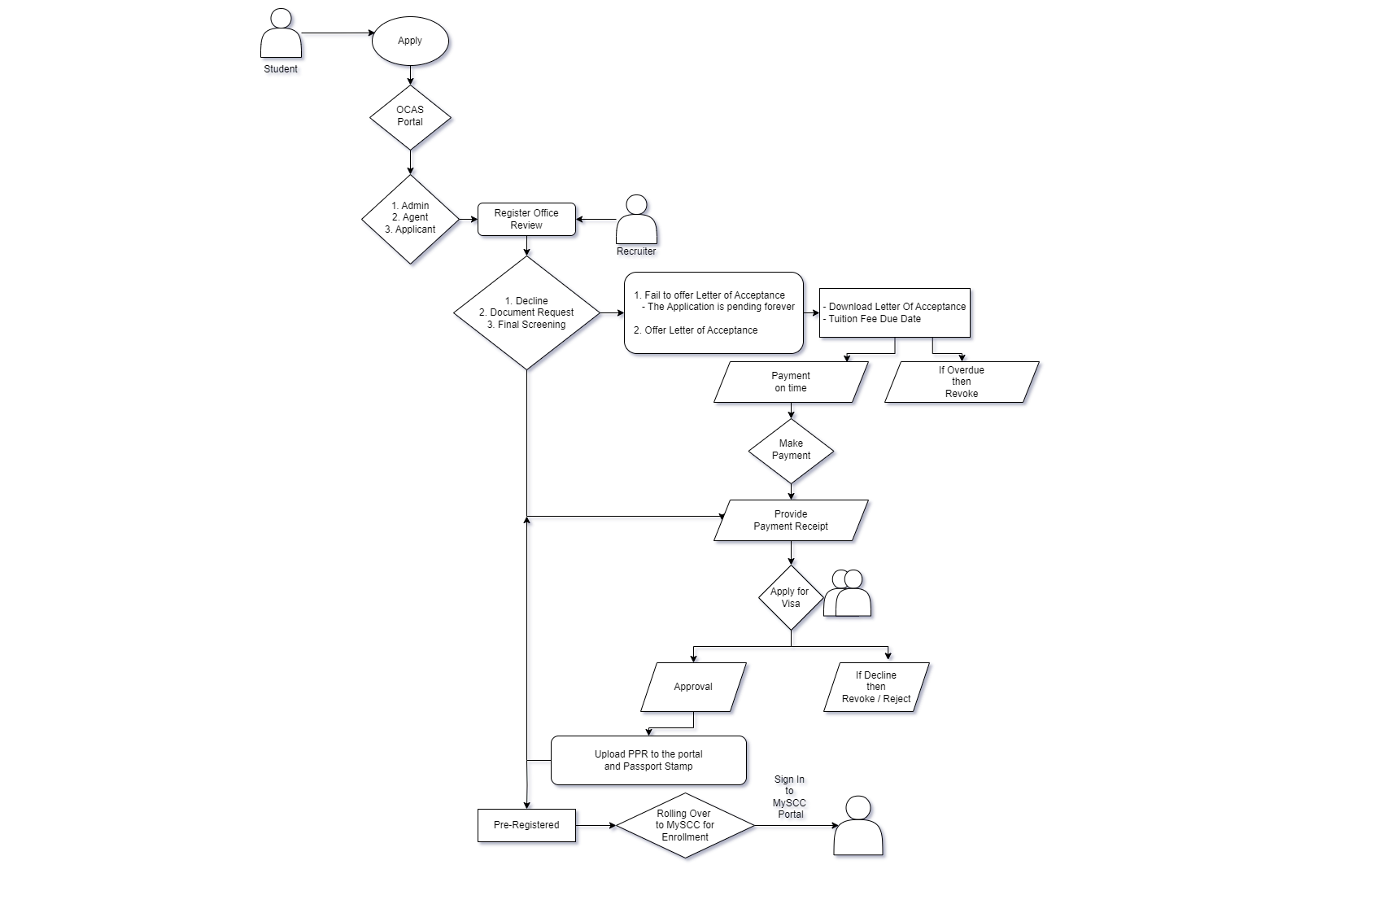
Business process diagram

Slide 7

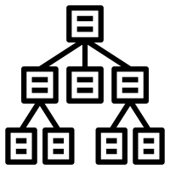






Methodology
Spreadsheet
EDA
ML-RF Model
Pickle File
WebApp
Web Page:
Local Host
Dashboard Design

Slide 8
Data pre-processing
Initial Dataset Loading
Handling Missing Values
Date Transformation
Encoding Categorical Variables
Normalization of Data
Feature Reduction

Slide 9
Feature selection
Feature Selection using Chi-Square
Feature Selection using Decision Tree
Feature Selection using Random Forest
Feature Selection using Random Forest Top 10 Features with its Subsets

Slide 10
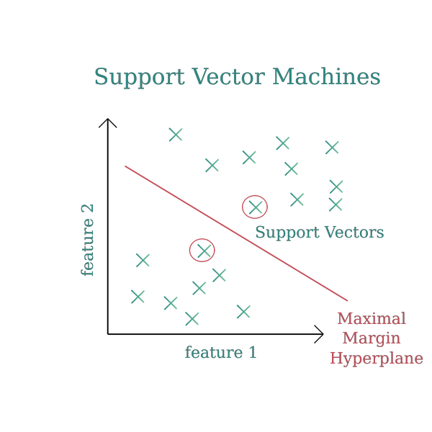
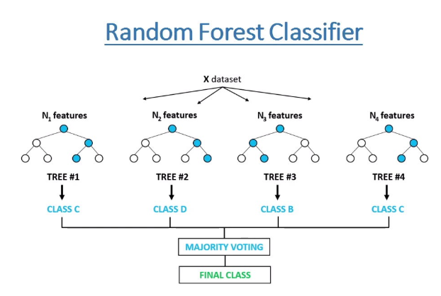

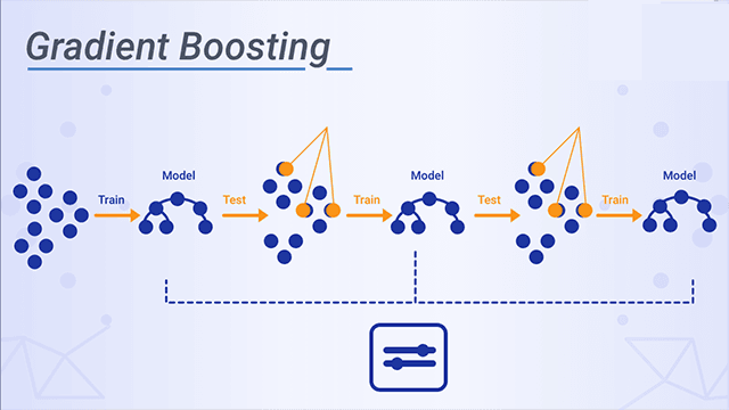
Implementation and evaluation of advanced ML models
Performance metrics:
Accuracy
Precision
Recall (Sensitivity)
F1 Score
AUC-ROC
MLP

Slide 11
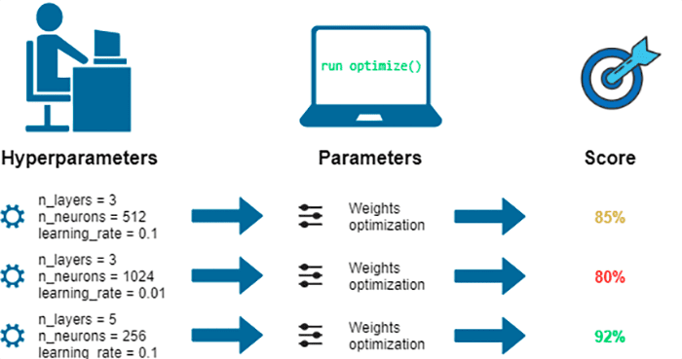
Tuning and Optimization
1. Manual Tuning
2. Automated Hyperparameter Optimization
2.1 Grid search
2.2 Random search
3. Cross-validation

Slide 12
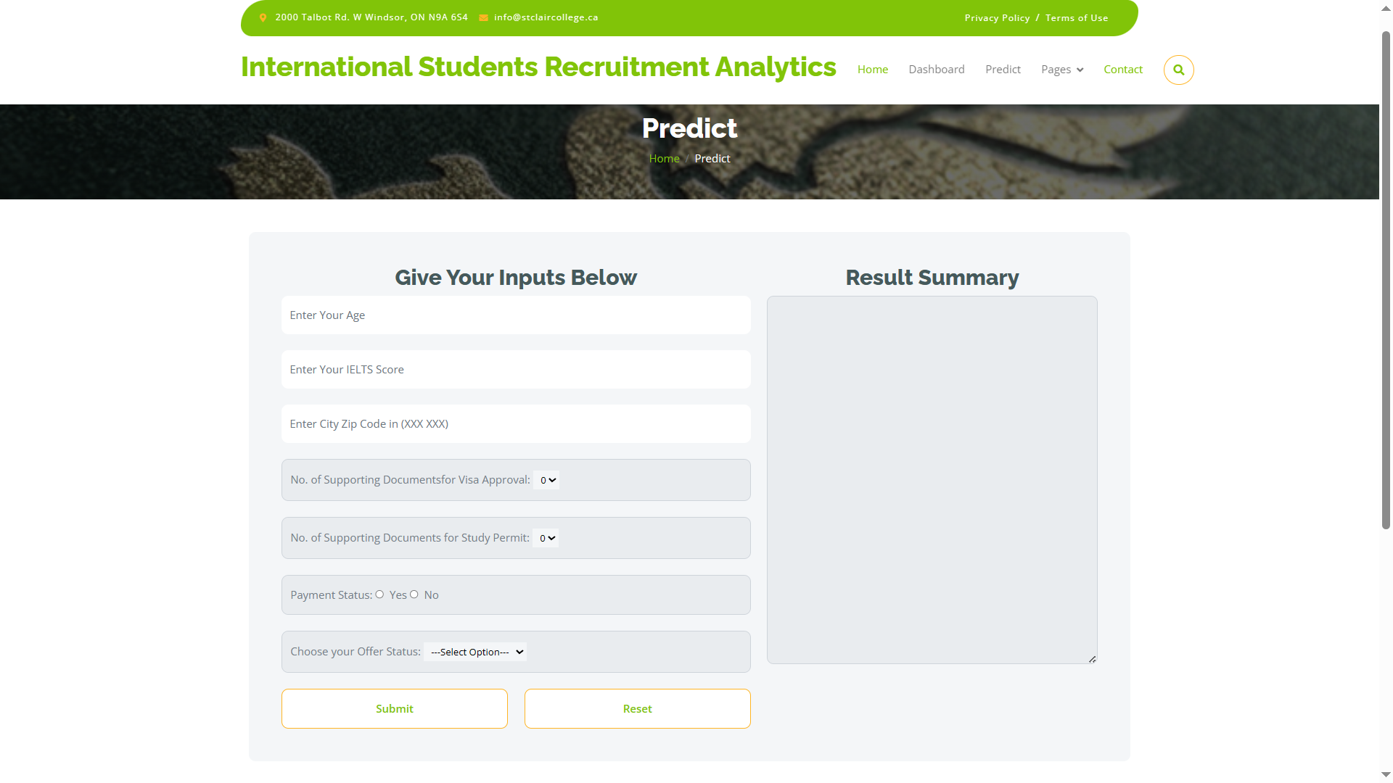
Model implementation
This page is application of ML model for forecasting whether candidate is likely to Enroll or unlikely to enroll.
http://127.0.0.1:5000

Slide 13
Contribution
Group members | Contribution
Rishikesh Gaikwad | Dashboard, ML model, feature selection
Fei Gao | ML model, model optimization and tuning
Ankitkumar Kamleshbhai Padhiar | ML model evaluation, web application
Abhigna Reddy Sudini | ML model evaluation, Documenting

Slide 14
Reference
Hyperparameter tuning for Deep Learning with scikit-learn, Keras, and TensorFlow | AIGlobalLabAIGlobalLab
Introduction to Gradient Boosting Machines (xenonstack.com)
SVM (Support Vector Machines) diagram vector image | Free SVG
Random Forest Classifier Tutorial: How to Use Tree-Based Algorithms for Machine Learning (freecodecamp.org)
Can It Happen? Artificial Intelligence Without Machine Learning » EML (enjoymachinelearning.com)

Slide 15
Thank You

