Slide 1
Group 07 Project web site:
GitHub: http://github.com/users/ArialGaofei/projects/1/views/1
Jira: https://fg21.atlassian.net/jira/software/projects/DAB103/boards/1

Slide 2
Data analysis for Human trafficking
DAB-103 Analytic Tool & Decision Making
Group 07 Section 01
Weijia Zhang 0817669
Fei Gao 0822295

Slide 3


Team members
Weijia Zhang
Fei Gao
www.linkedin.com/in/weijia-zhang1109
www.linkedin.com/in/fei-gao-b1264324b
WeijiaZ1013 (github.com)
ArialGaofei (FEI GAO) (github.com)

Slide 4
contents
1.Background/Motivation
2.Problem Statement
3.Project Proposal
4.Analysis Questions
5.Dataset Description

Slide 5
What is Human Trafficking?
Human trafficking, also known as trafficking in person, is often described as a modern-day form of slavery. It involves the recruitment, transportation, exercising control, or influence over the movements of a person in order to exploit that person, typically through sexual exploitation or forced labor. Human trafficking is a heinous crime that exploits the most vulnerable. The victims are mostly women and children, are deprived of their normal lives and compelled to provide labor or sexual services, through a variety of coercive practices, often for the direct profit of their perpetrators.
Human trafficking is an offence under the Criminal Code of Canada and the Immigration and Refugee Protection Act. The extent of human trafficking, both in Canada and international, is difficult to assess due to the hidden nature of the crime, the reluctance of victims and witnesses to come forward to law enforcement and the difficulty of identifying victims. We know that anyone can fall victim to this crime, although women and girls represent most of victims in Canada.

Slide 6
Today’s world
Statistics on Human Trafficking
Canada has been identified as a source, destination and transit country for victims of human trafficking for the purposes of sexual exploitation and forced labour. As of 2020, Statistics Canada reported that:
2,977 incidents of human trafficking have been reported to police services in Canada between 2010-2020.
82% of incidents of human trafficking were reported in census metropolitan areas.
96% of victims of police-reported human trafficking were women and girls.
81% of persons accused of human trafficking between 2010-2020 were men.
25% of victims of police-reported human trafficking were under the age of 18, 45% between 18-24, and 20% between 25-34.
Visit Statistics Canada’s "Trafficking in persons in Canada, 2020" Juristat for more data on human trafficking as reported by police services and courts in Canada between 2010 and 2020.

Slide 7
Motivation
Globally, human trafficking continues to grow despite increased attention and resources from governments and non-governmental organizations.
it is nearly impossible to measure the full extent of human trafficking, since it is an illegal practice. By focusing on the factors that contribute the most to the increase in human trafficking, this project aims to reduce the high human trafficking rate.
We will analyze multiple factors, such as the socio-demographic profile of victims (such as their gender and age), the trafficking process (such as how victims are controlled), and the type of exploitation. Peer-to-peer analysis of the data will reveal which factors we should focus on more in order to reduce human trafficking.

Slide 8
Problem statement
Human trafficking can be reduced by knowing several things, such as which areas we need to focus on. Specifically, what is the most affected age group, which gender is more vulnerable to human trafficking, and which region contributes most to human trafficking? A thorough understanding of victims' sociodemographic profiles and trafficking processes is essential. To reduce the rate of human trafficking, we should have a better understanding of all these things.

Slide 9
Project Proposal
In this project, our team will analyze the dataset that contains the past data of human trafficking victims. We will analyze the data statistically and remove anomalies from it using data transformation techniques. The data will be analyzed by visualizing multiple variables present in the dataset to explore useful insights. The final product will be a PowerPoint presentation that presents our findings.

Slide 10
Analysis Questions
Which age groups & gender is impacted the most?
Which countries are impacted the most?
What are the top categories of human trafficking among Forced Labour,
Sexual Exploit, Sex and Labour, Forced Marriage, Forced Military,
Organ Removal, Slavery and Practices.
At what degree this human trafficking practice have been done.

Slide 11
Dataset Description

Slide 12
Dataset Description
This is the first synthetic dataset of victim of trafficking case records.
These data consist of information on identified and reported victims of human trafficking. The analysis will be based on the global dataset of victims of human trafficking obtained from the Counter Trafficking Data Collaborative website.
Dataset Link: https://www.ctdatacollaborative.org/global-dataset-0
The dataset contains 19051 rows and 37 variables in either ‘float64’, or ‘object’.
For the transformation step we will be checking the null values, deleting rows with all Nan, converting data type and trying to find a way to display many Boolean columns.

Slide 13
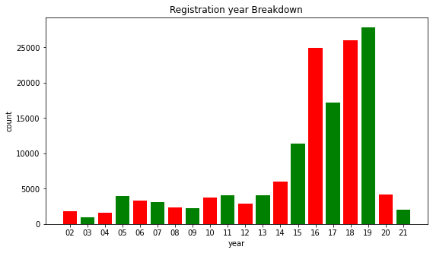
Exploratory Data Analysis of the Dataset
Over the past decade, the number of human trafficking victims has increased from 30,000 to nearly 120,000 worldwide, whereas due to travel restrictions caused by the COVID-19 pandemic, the number of trafficking victims declined.

Slide 14
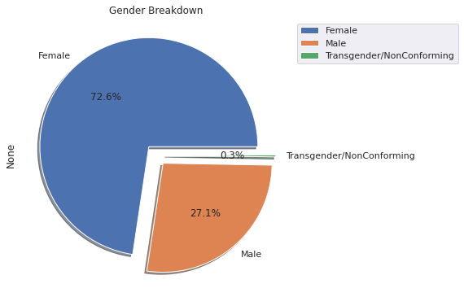
Visualization of Gender distribution
Result: We can see that females counts for most human trafficking victims.

Slide 15
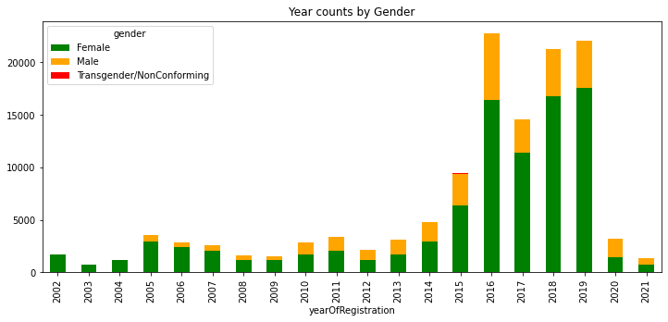
Gender distribution by year
Result: we can see that the number of male victims has also increased after 2015.

Slide 16
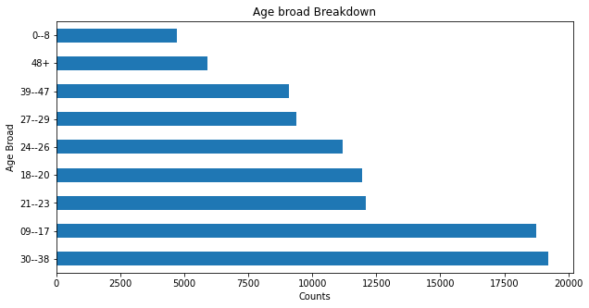
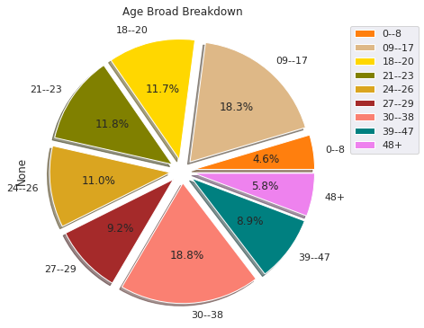
Age broad distribution and percentage
Result: The maximum number of victims are between ages 9-17 and 30-38.

Slide 17
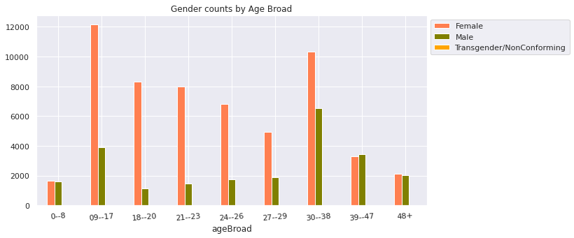
Age broad By Gender
Obviously: Females between age of 9-17 are most likely to be victims of human trafficking.

Slide 18
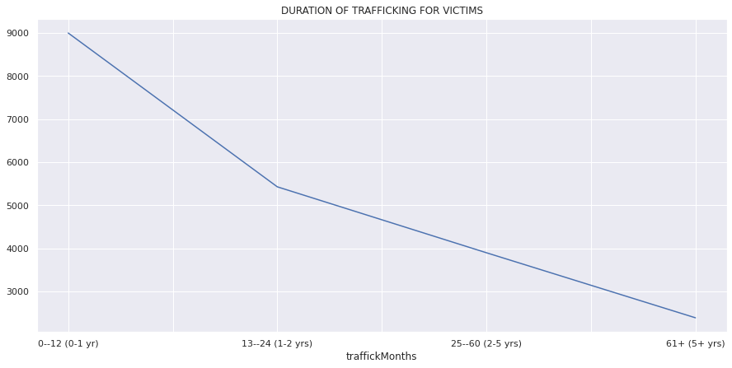
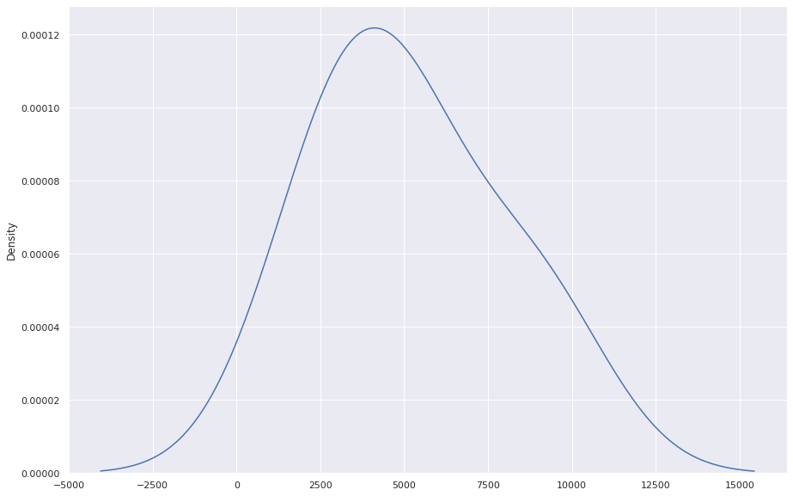
Indicates the reported duration of trafficking in months
Analysis result: From the pie chart above, it is evident that the duration of victims’ trafficking is mainly concentrated in the stage of 0-12. The number of victims follows a normal distribution.

Slide 19
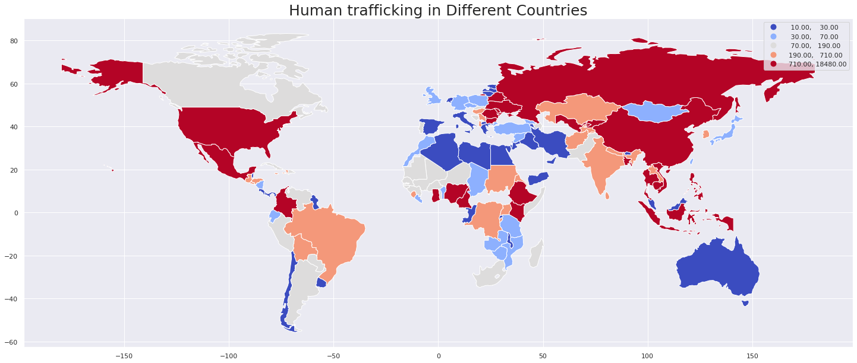
The distribution of human trafficking in different countries
Result: The highest number of victims are from Russia, China, USA and Mexico.

Slide 20
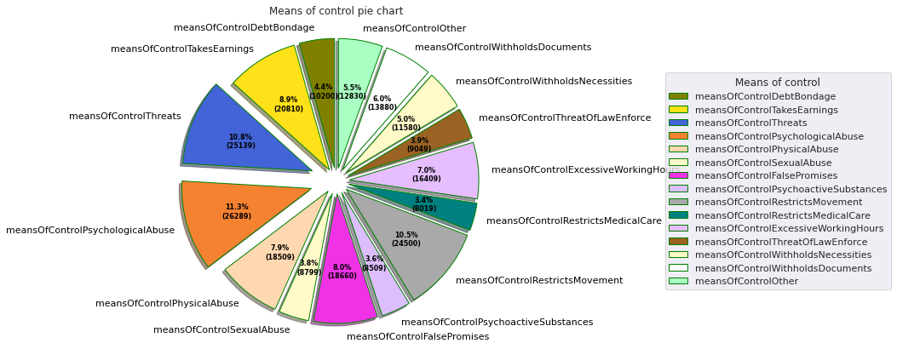
Percentage of Means of control
Result: The maximum number of victims reported psychological abuse and threats as the means used to control them.

Slide 21
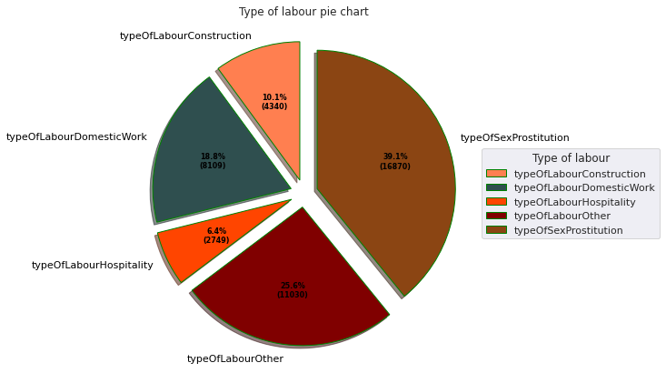
Percentage of type of labour
Result: Most of the human trafficking victims were forced into sex prostitution.

Slide 22
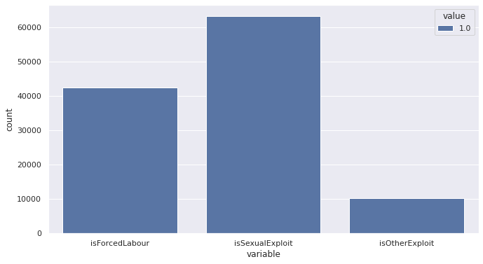
Exploratory Data Analysis of the Dataset
Result: It is clear that the maximum number of victims were sexually exploited.

Slide 23
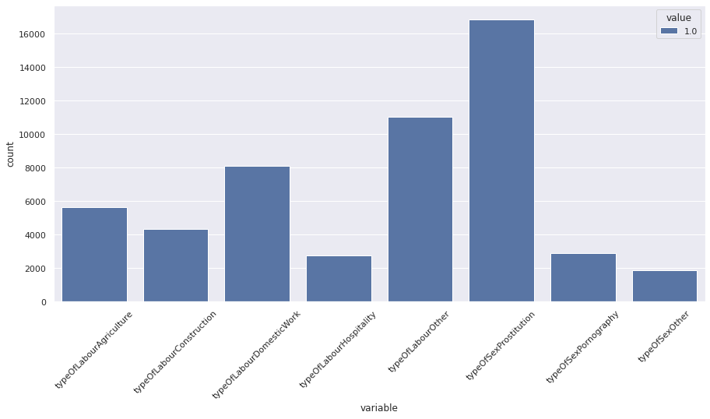
Exploratory Data Analysis of the Dataset
Result: It is clear that the maximum number of victims were forced into sex prostitution.

Slide 24
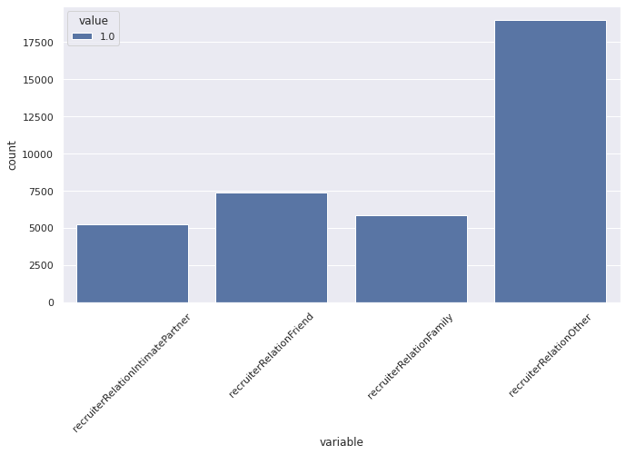
Exploratory Data Analysis of the Dataset
Result: It is clear that the maximum number of victims were not related to the recruiter.

Slide 25
Thank You

