Slide 1
DAB-103 Analytic Tool & Decision Making Data Analysis for Human Trafficking
Group 07 Section 01
Weijia Zhang 0817669
Fei Gao 0822295

Slide 2





Group members
Project GitHub
LinkedIn
LinkedIn

Slide 3
Outline
Background
Motivation
Problem Statement
Objective
Analysis Questions
6. Dataset Description
7. Data Analysis and Conclusions
8. Recommendations
9. Summary
10. References

Slide 4
What is Human Trafficking?^{[1]}
A modern-day form of slavery
Involving the recruitment, transportation, exercising control, or influence
Compelled to provide labor or sexual services
The extent of human trafficking is difficult to assess
The hidden nature of the crime
The reluctance of victims and witnesses to come forward to law enforcement
The difficulty of identifying victims

Slide 5
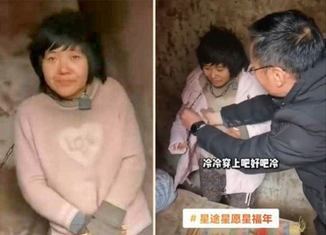
Motivation
Anyone can fall victim to this crime. See
Xuzhou chained woman incident – Wikipedia^{[2]}
Trafficking in persons in Canada, 2020 (statcan.gc.ca)^{[3]}
To provide governments with information that can be used to enforce the law, improve awareness of the public, and monitor the human trafficking.

Slide 6
Problem Statement
Provide public policy makers and law makers with better insights of human trafficking in order to enact laws, improve law enforcement, and educate the public.

Slide 7
Objectives
Analyze the socio-demographic profile of victims
Analyze the geographic distribution
Analyze types of exploitation, means of control, and relationships between victims and recruiters
Present a descriptive visualization of the dataset

Slide 8
Analysis Questions
What is typic profile of the most victims of human trafficking?
How long is the typical period of exploitation?
What is the global distribution of human trafficking?
What are the most common means of control and type of exploitation?
What are the most common relationships between victims and recruiters?

Slide 9
Dataset Description
Counter Trafficking Data Collaborative (CTDC) Synthetic Data Set ^{[4]}
The first synthetic dataset of victims of trafficking case records
The synthetic dataset itself is already a clean dataset.
From all CTDC partners (IOM, Polaris, Liberty Shared, A21, OTSH)
Put through two stages of de-identification to protect victims’ security and privacy.
37 variables on the socio-demographic profile of victims, the trafficking process, and the type of exploitation

Slide 10
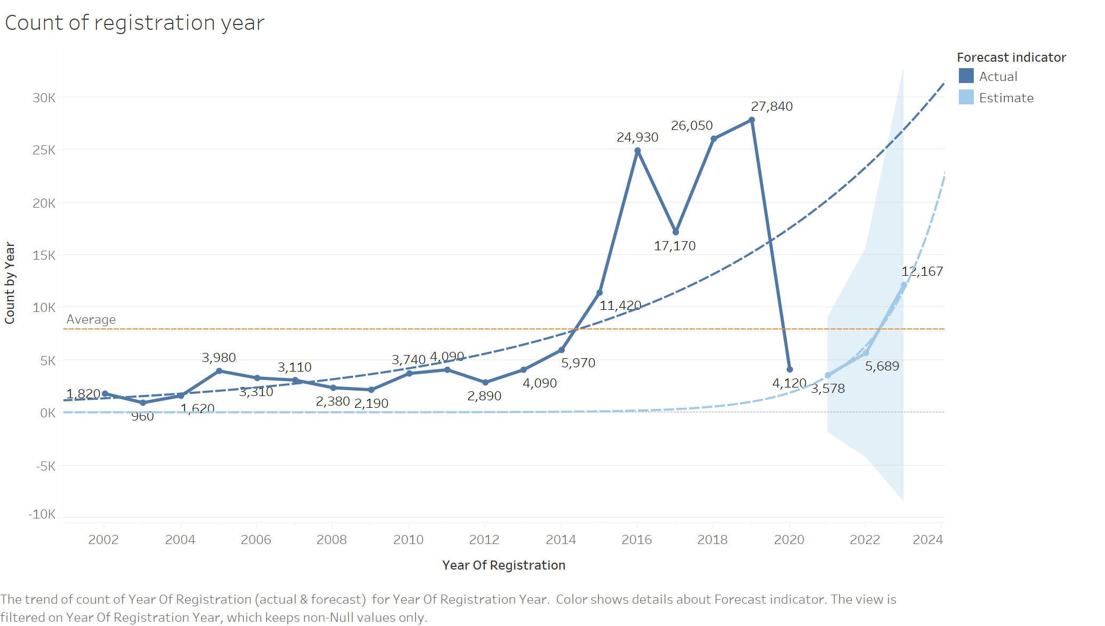
What is typic profile of the most victims of human trafficking?
The covid-19 has greatly affected human trafficking; the number of reported victims reduced dramatically.

Slide 11
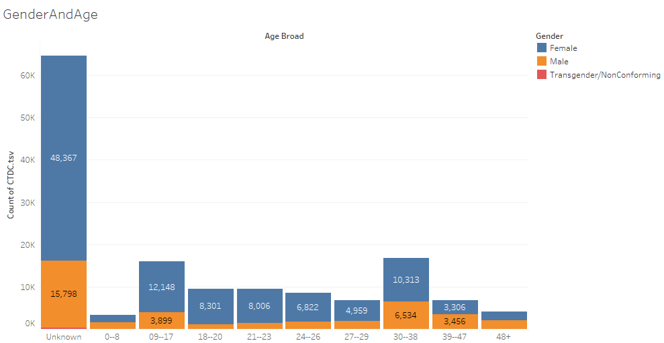
Female is three times more than male. Females in 10-17,30-38 are the majority of victims in women. Males in 30-38 and 10-17 are the majority of victims in men.

Slide 12
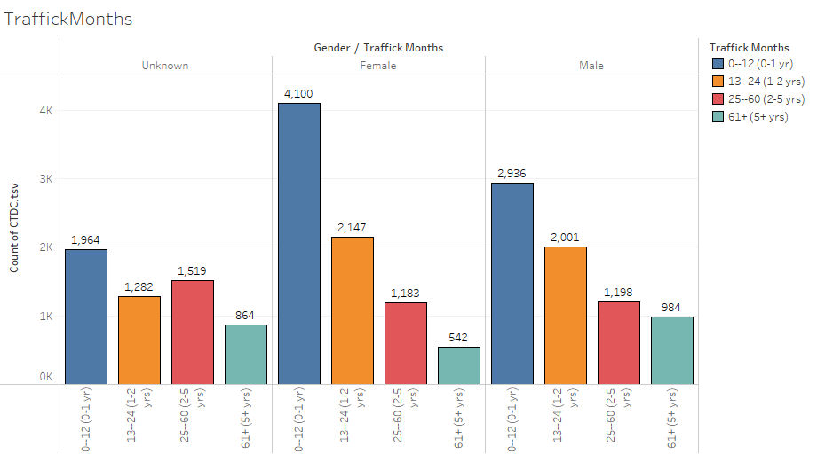
How long is the typical period of exploitation?
The duration of exploitation is mainly concentrated in a period of 0-12 months.

Slide 13
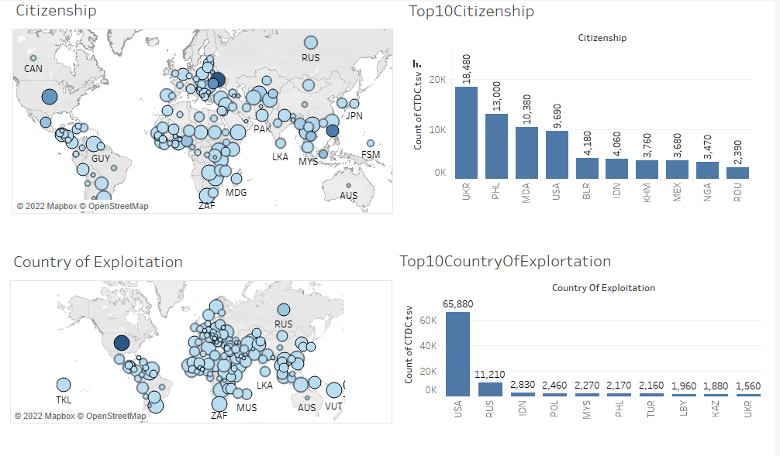
What is the global distribution of human trafficking?
The top ten victims’ citizenship are Ukraine, the Philippines, Moldova, America, Belarus, Indonesia, Cambodia, Mexico, Nigeria, and Romania.
The top ten exploitation countries are the America, Russia, Indonesia, Poland, Malaysia, Philippines, Turkey, Libya, Kazakhstan, and Ukraine.

Slide 14
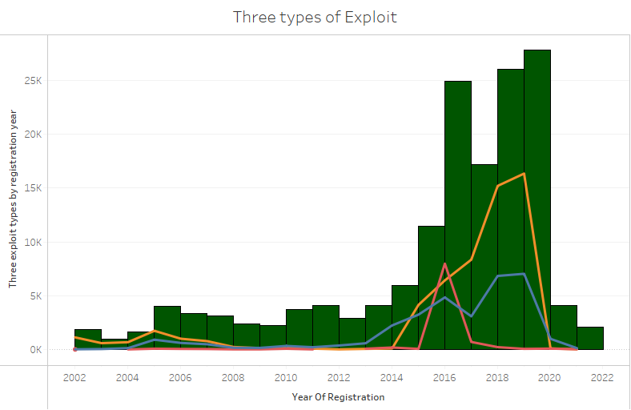
What are the most common means of control and type of exploitation?
Sexual exploitation is more than two other types of exploitation over the registration year.

Slide 15
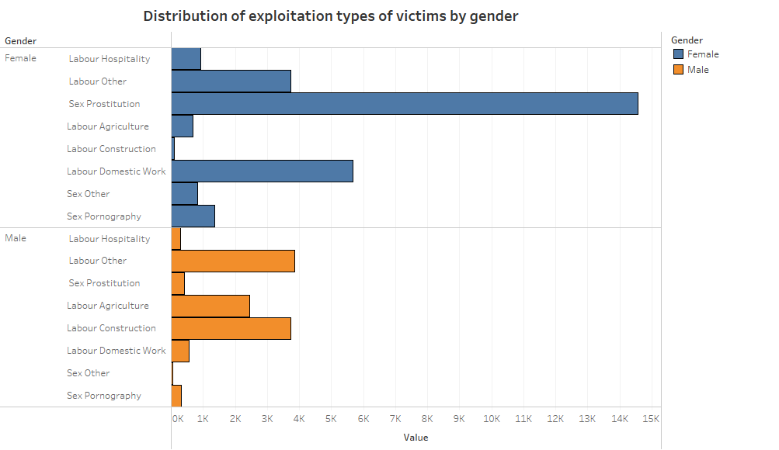
The main types of exploitation in women are sexual prostitution and domestic work, while men is labour.

Slide 16
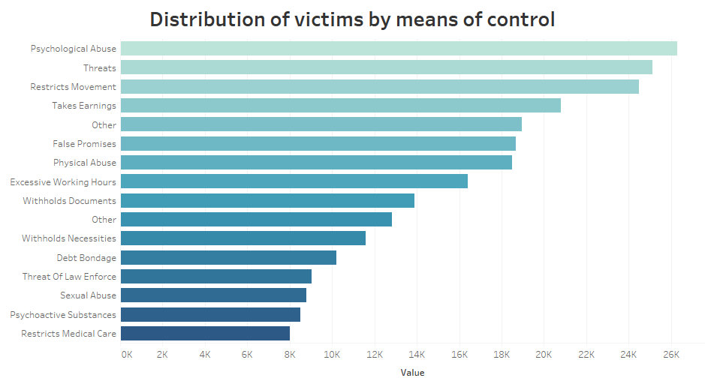
The most means of control are threats, psychological abuse, and restricted movements.

Slide 17
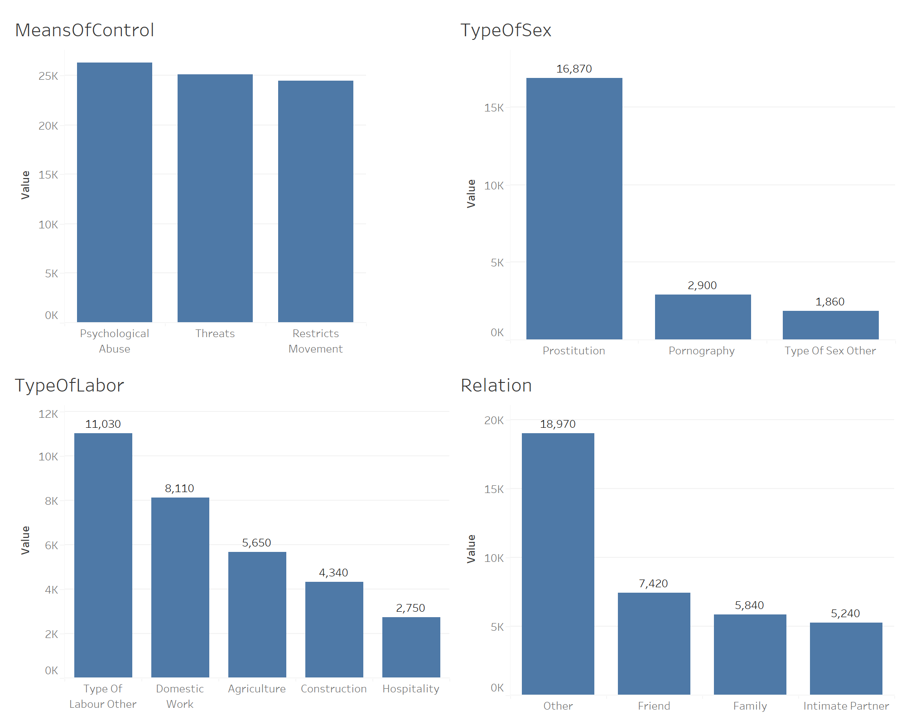
What are the most common relationships between victims and recruiters?
The most means of control is psychological abuse
The most type of sex is prostitution
Result: The most type of labor is other
The relationship between recruiter and victims is other

Slide 18
Summary
Sex exploitation is more than labor exploration. The most sex exploitation type are sex prostitution, and the most labor explorations are other types and domestic work.
The age group with most human trafficking is 9-17 and 30-38.
The duration of exploitation is mainly concentrated in a period of 0-12 months.
The countries with the high cases of human trafficking are American, Russia and Indonesia.
The relation between the victim and the recruiter is others except for intimate partner, friend, and family.

Slide 19
Recommendations
As women and children are the most vulnerable victims, governments should enact laws to protect women and children as well as to prevent compelled prostitution, thereby reducing exploitation and slavery.
Enhance women’s awareness of self-protection and improve their education level in order to deliver them from their illegal treatment.
Advocate cooperation between countries with high victims, and callup these countries in case with high victims to obtain more real information.

Slide 20
Project web site:
References:
[1] What is human trafficking? (2021, July 7). Language selection - Department of Justice / Sélection de la langue - Ministère de la Justice. https://justice.gc.ca/eng/cj-jp/tp/what-quoi.html
[2] Xuzhou chained woman incident. (2022, November 3). Wikipedia, the free encyclopedia. Retrieved December 4, 2022, from https://en.wikipedia.org/wiki/Xuzhou_chained_woman_incident
[3] Trafficking in persons in Canada, 2020. (2022, June 9). Statistics Canada: Canada's national statistical agency / Statistique Canada : Organisme statistique national du Canada. https://www150.statcan.gc.ca/n1/pub/85-002-x/2022001/article/00010-eng.htm
[4] Dataset Link: https://www.ctdatacollaborative.org/global-dataset-0
The Python Data Science Handbook by Jake VanderPlas (O’Reilly). Copyright 2016 Jake VanderPlas, 978-1-491-91205-8. https://jakevdp.github.io/PythonDataScienceHandbook/
GitHub: http://github.com/users/ArialGaofei/projects/1/views/1
Jira: https://fg21.atlassian.net/jira/software/projects/DAB103/boards/1
Tableau Public: CTDC | Tableau Public

Slide 21
Thank you

