Slide 1

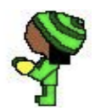
1
Move Right
Move Left
3
3
player1
player2

Slide 2
2
Move Right
Move Left
3
3

Slide 3

3
Punch
jump
؟
?

Slide 4

4
Punch
kick
؟
?

Slide 5
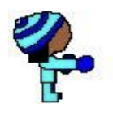
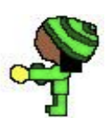
5
Punch
Punch
؟
?

Slide 6
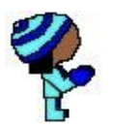
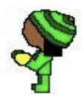
6
Move Right
Wait
؟
?

Slide 7
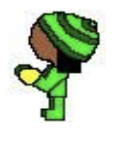
7
Jump
Wait
؟
?

Slide 8
8
punch
kick
؟
?

Slide 9

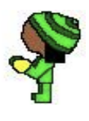
9
Kick
Jump
؟
?

Slide 10


10
Move Left
Kick
؟
?

Slide 11

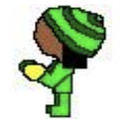
11
Kick
Move left
؟
?

