Slide 1
Independent Directed Studies 2016/2017 Video Game Development
Edmond Xue and Sean Wang (2-2)

Slide 2



Learning Outcomes
Gain transferrable experience
Familiarize ourselves with common graphics tools (not just in Java)
Use the knowledge learned in AP Computer Science A as well as apply Computer Science principles to create a fun but challenging final product

Slide 3
The Game - Objective
To attain the highest score possible by defeating zombies
Use balls as a primary weapon
Collect coins from defeated zombies
Purchase upgrades and new balls with coins in the upgrade store
Try to defeat as many zombies as possible before the player runs out of health

Slide 4
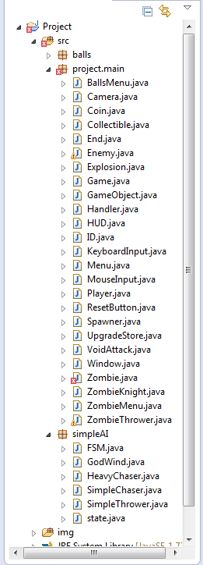
Key Components / Classes
Game
Window
Player
Enemy (abstract)
Ball (abstract)
AI files (FSM, etc.)
Key / Mouse Input

Slide 5

Key Obstacles
Collision Detection
Moving Camera
Menu
Mouse / Key Input
AI
Graphics

Slide 6
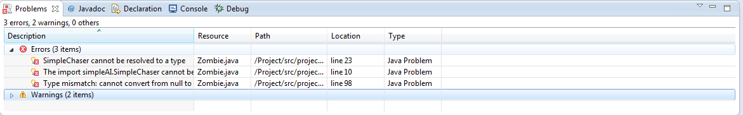
Difficulties
Camera
Code to work with both absolute position and position relative to window
Rendering a continuous background
Debugging
Threading (running multiple tasks at once)
NullPointer and ArrayIndexOutOfBounds exceptions were common problems

Slide 7
Art
Edmond used Photoshop to create 16-bit sprites.
Coin
Life Ball

Slide 8
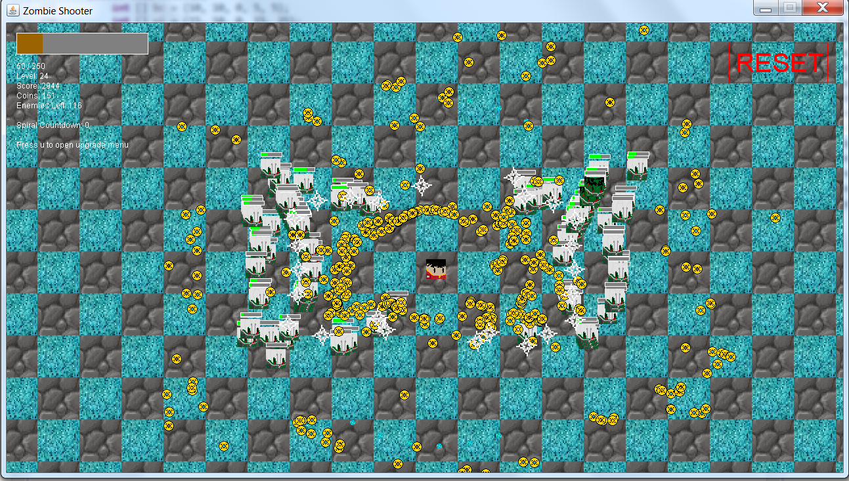
Screenshot of game

Slide 9
Demo
We will demonstrate our completed game.

Slide 10
Motivation
Want to challenge ourselves
Prepare ourselves for future projects in the work force
Produce a game that is both enjoyable to create as well as play
To have fun

Slide 11
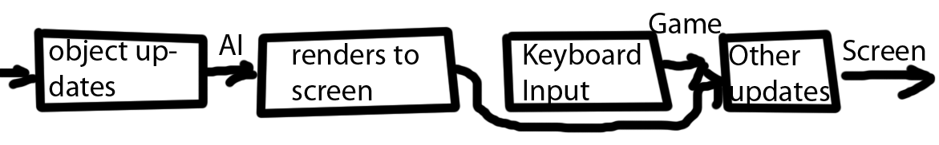
Process
Development of a rough inheritance hierarchy
Production of the art and code to produce a Graphics window
Basic classes such as Game Object
Miscellaneous features to increase interest
User interactivity (keyboard / mouse input, menu system, etc.)
Debugging (difficult process)

Slide 12
What did we learn through this project?
Skills
Team Working
Time Management
Transferrable Skills
Experience
Can be used in the future
Common features in programming languages

Slide 13
Team Work Skills
Communication is key in any work environment.
Having team working skills is essential for any computer scientist.
While Sean created the main outline for most classes, he often ran into problems, but Edmond was there to help out.

Slide 14
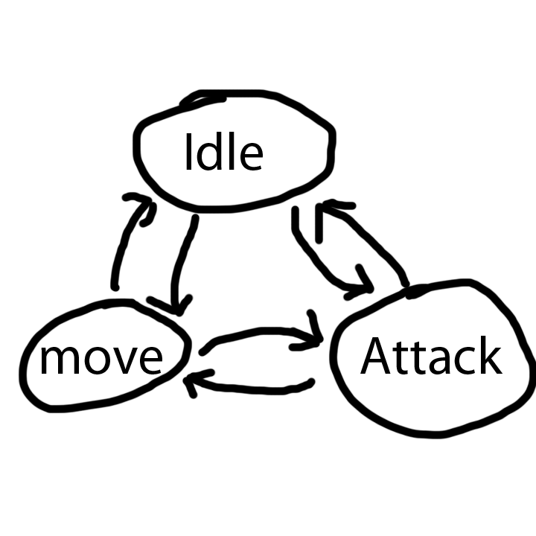
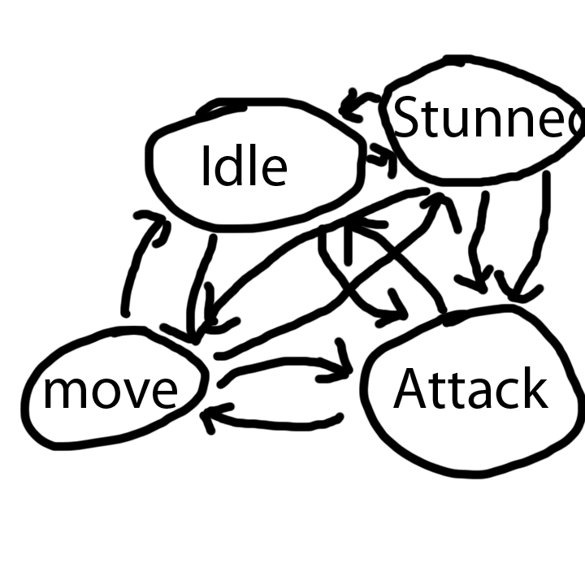
AI
Finite State Machine
Go for simplicity

Slide 15
Finite State Machine (FSM)
What is a finite state machine?
Use of states
Every enemy builds a conditions list (e.g. HAS_HEALTH, PLAYER_IN_RANGE)
Runs the corresponding AI’s updateConditions method
Reads from the effects list built from AI (e.g. STUNNED, STRAIGHT_LINE_MOVE)

Slide 16
Successes (Final Product)
Camera: realistic and follows the player
Good menu system:
Reset button (after losing and in game)
Balls and Zombie Menus as well as Help Menu
Variety of Features
Balls with different effects
Zombies with different behavior
Art / Graphical elements

Slide 17
What Went Well (Process)
Communication
There were few problems when it came to teamwork.
Shared our files on github
Helped each other extensively
Time management (effective use of class time)

Slide 18
Improvements (Final Product)
More Features
More than three types of zombies
Different game modes (currently only one is endless)
Collision Detection
Currently use squares for bounds detection (curved objects do not work well)
Does not work well when objects are too fast
Efficiency
Game can lag on higher levels

Slide 19
What would we have done differently?
Code organization – more comments, fewer redundancies in the code:
Better coding makes it easier to share code and for group members to read.
Better timeline:
Even though we were not particularly behind schedule, a more rigid schedule would have led to better results.

Slide 20
Conclusion
The project was successful; it was meaningful and we gained a lot in the process.
Familiarized ourselves with common tasks associated with game development.
Even though we programmed in Java, we gained invaluable experience.
Excited to make our own projects on our own time and share them on github.

Slide 21
Quick References
Primary tutorial for learning basics of game development:
Let's Build a Game in Java: https://www.youtube.com/playlist?list=PLWms45O3n--6TvZmtFHaCWRZwEqnz2MHa
Code used for Camera and Coin: Linear interpolation (LERP) function:
https://en.wikipedia.org/wiki/Linear_interpolation

Slide 22
Questions?

