Slide 1

Exploratory Data Analysis
G2M insight for Cab Investment firm
9/17/2022

Slide 2

Agenda
Executive Summary
Problem Statement
Approach
EDA
EDA Summary
Recommendations

Slide 3
Description:
XYZ is a private equity firm in US. Due to remarkable growth in the Cab Industry in last few years and multiple key players in the market, it is planning for an investment in Cab industry.
Provide actionable insights to help XYZ firm in identifying the right company for making investment.
Cab Companies:
Yellow Cab
Pink Cab

Slide 4
EXPLORATORY DATA ANALYSIS DATA VISUALIZATION

Slide 5
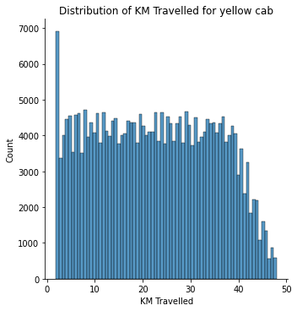
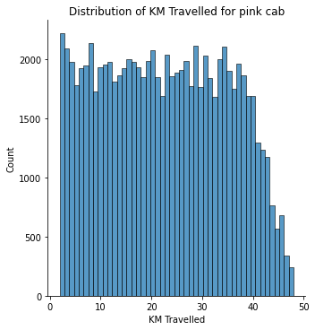
Distance Traveled by Each Cab

Slide 6
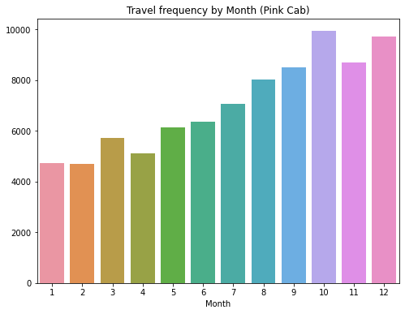
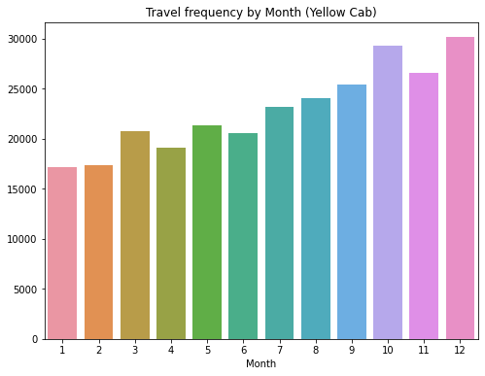
Travel Frequency per Month:

Slide 7
Travel Frequency per Month:
Yellow cab has higher travel frequency on holidays like December

Slide 8
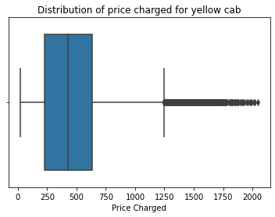
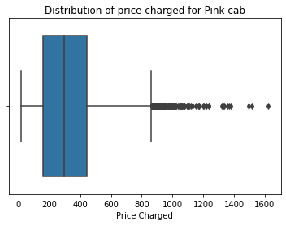
Distribution of price charged:

Slide 9
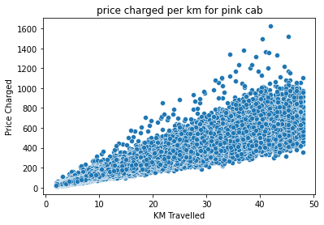
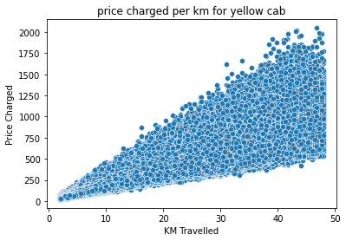
Price Charged per KM:

Slide 10
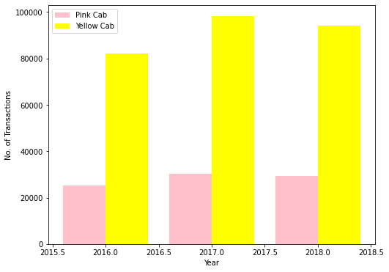
Transaction per Year:

Slide 11
Transaction per Year:
Yellow cabs have higher transaction.

Slide 12
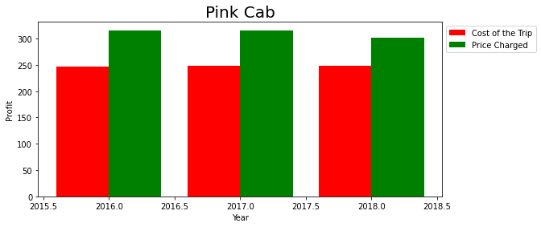
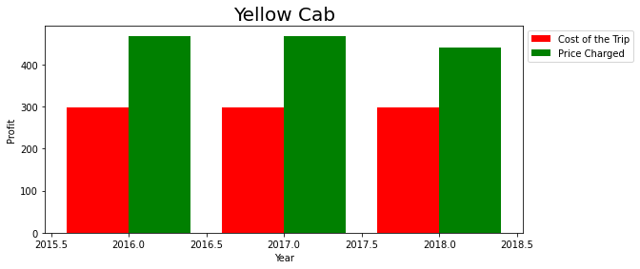
Profit Margin per year for both Cabs:

Slide 13
Profit Margin per year for both Cabs:
Yellow cabs have higher profit margin.

Slide 14
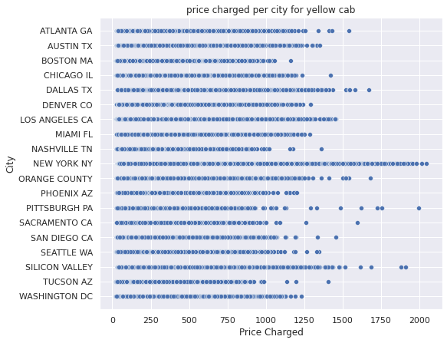
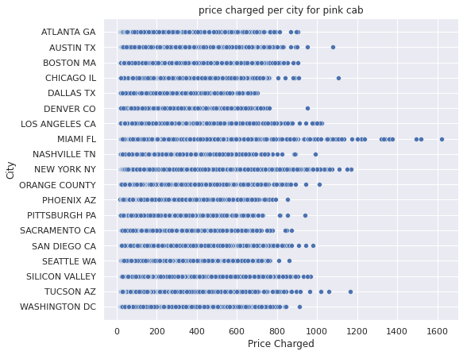
Price charged per city:

Slide 15
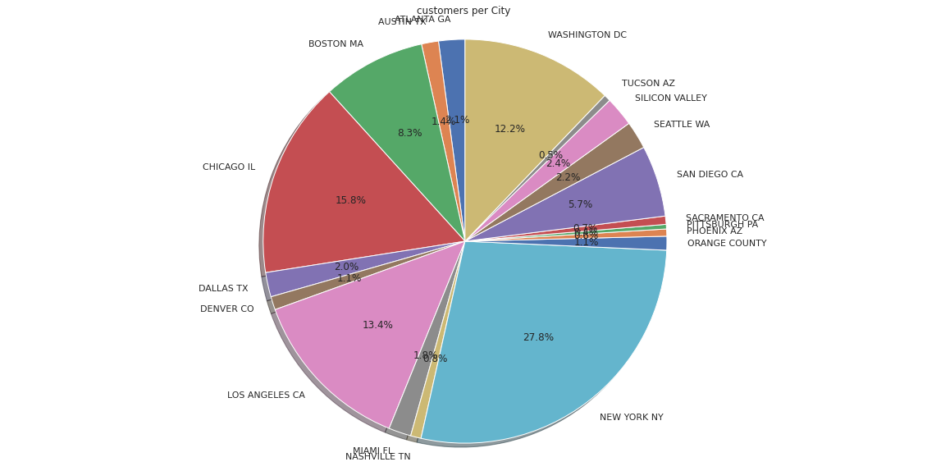
Cab users per city:
NEW YORK has most cab users

Slide 16
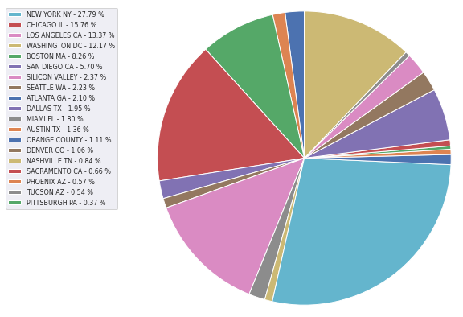
Cab users per city:

Slide 17
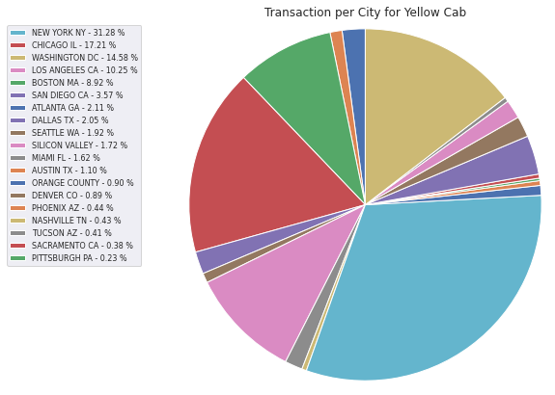
Transaction per City for Yellow Cab:

Slide 18
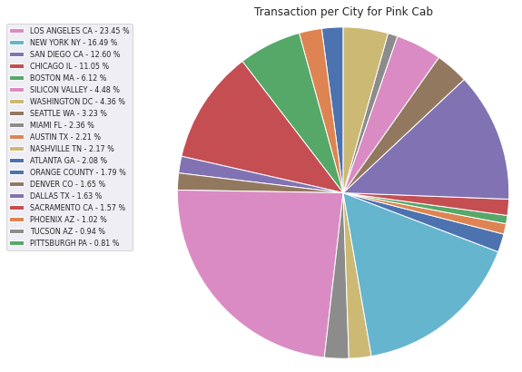
Transaction per City for Pink Cab:

Slide 19
Transaction per City for Pink Cab:
NY has most taxi users
Yellow cab has higher transaction in NY

Slide 20
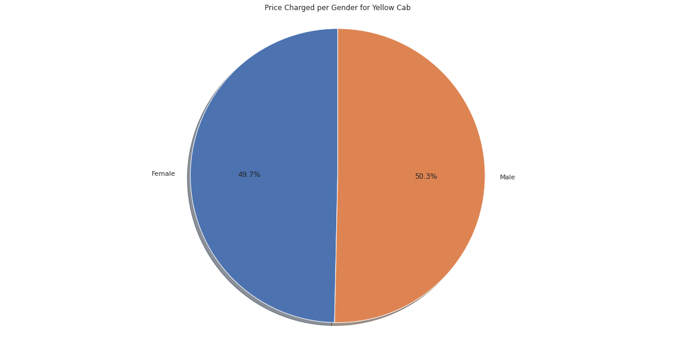
Price Charged per Gander for Yellow Cab:

Slide 21

Price Charged per Gander for Pink Cab:

Slide 22
Price Charged per Gander
Yellow Cab charge less from Female Customers whereas Pink Cab charges same for both Male and Female Customers.

Slide 23
EDA SUMMARY

Slide 24
Pink Cab
Distance Traveled is in range of 2 to 48 km.
About 9000 travel on December which is holiday.
Price charged are in range of 150 to 420 dollars.
Price charged per gender is the same.
Transaction per year:
2016: 20000 – 40000
2017: 20000 – 40000
2018: 20000 – 40000
Profit margin is lower compared to yellow cab

Slide 25
Yellow Cab
Distance Traveled is in range of 2 to 48 km.
About 30000 travel on December which is holiday.
Price charged are in range of 250 to 600 dollars.
Charged less for female customers.
Transaction per year:
2016: 80000 – 100000
2017: 80000 – 100000
2018: 80000 – 100000
Profit margin is higher compared to pink cab

Slide 26
Recommendation
Yellow cab has higher transaction every year
The number of transactions for yellow cab increases in 2017 and 2018 but for pink cab stays the same.
NY has most taxi users and they mostly use yellow cab
Yellow cab has higher profit margin
Therefore:
Yellow Cab is recommended for investment.

Slide 27
G2M insight for Cab Investment firm
Thank You

