Slide 1




EDUverse
Login
All you need about Education
SELF
Improvement
POWER Profile
University

Slide 2




EDUverse
All you need about Education
Welcome
to POWER Profile
POWER Profile akan membantumu untuk memperkenalkan portofoliomu secara resmi kepada dunia.
Daftar sekarang
Selamat bergabung dengan database
portofolio terbesar di dunia

Slide 3
EDUverse
All you need about Education
Get Started
First Name
Last Name
Username
Password
Confirm Password
Email
Phone
Register

Slide 4
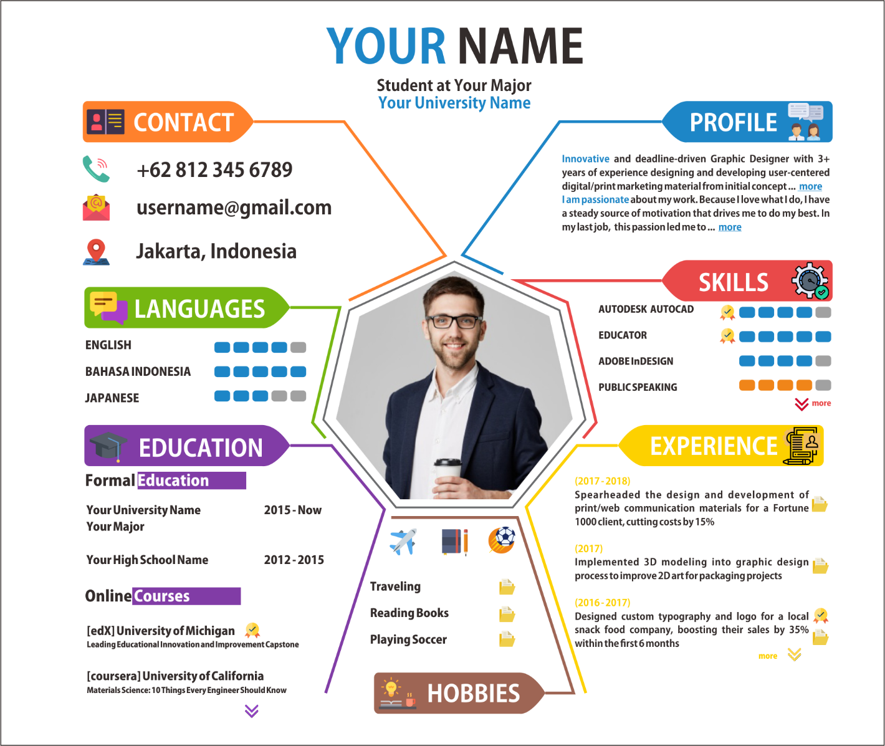

Slide 5

EDUverse
All you need about Education
Conference
Training
Courses
by Topic
by Area
Education
Teaching and Learning
Higher Education
Vocational Education
E-Learning
Lifelong Learning
Engineering & Technology
Engineering
Manufacturing
Robotics
Polymers and Plastics
Renewable Energy
Bussiness and Economics
Banking and Finance
Business Ethics
Economics
Management
E-Commerce
Asia
Indonesia
China
Japan
Singapore
Taiwan
North America
United States of America
Canada
Mexico
Greenland
South America
Argentina
Brazil
Chile
Paraguay
Interdisciplinary
Children and Youth
Communications and Media
Leadership
Disaster Management
Globalization
Health & Medicine
Medicine and Medical Science
Food Safety
Psychiatry
Public Health
Nursing
Social Sciences & Humanities
Islamic Studies
Anthropology
Arts
Politics
Law
Linguistics
Europe
Finland
Denmark
United Kingdom
Germany
Turkey
Italy
Spain
France
Oceania
Australia
New Zealand
Africa
Egypt
South Africa
Nigeria
Marocco

Slide 6
EDUverse
All you need about Education
Conference
Training
Courses
by Topic
by Area
Education
Teaching and Learning
Higher Education
Vocational Education
E-Learning
Lifelong Learning
November 2018
1st 4th International Conference of the American Pragmatics Association (AMPRA-4). Albany, United States of America
1st 11th International Forum for Business Economics Advancement & Strategic Management (BEASM) Singapore, Singapore
1st Live Stream: Autism – Strategies for Self-Regulation, Learning and Challenging Behaviors Online, United States of America
1st International Conference on Social Contribution of Academic Research in Business Management Studies and Social Science
Singapore, Singapore
2nd International Conference on Research in Education, Teaching and Learning Paris, France
2nd 7th International Congress on Human Sciences Barcelona, Spain
2nd International Conference on Management, Business & Economics 2018 Mysore, India
2nd RMP International Conference in Business, Management and Education 2018 (RICBME 2018) Kuching, Malaysia
2nd 6th International Conference on Modern Approach in Humanities Paris, France
2nd International Conference on Mass Communication, Journalism & Social Sciences 2018 Mysore, India
3rd TFCR International Conference on Marketing Management, Business, Economics, Finance, Social Sciences & Humanities
Istanbul, Turkey
3rd AUSSRE 2018 Int. Conference on New Approaches in Business , Social Science,Education Research and Knowledge
Management Sydney, Australia
4th International Conference on Mechanical, Electrical and Medical Intelligent System 2018 (ICMEMIS2018) Kiryu, Japan
4th 2nd International Conference on Social and Economic Development (ICSED) 2018 Kuala Terengganu, Malaysia
5th 2018 2nd International Conference on Education and E-Learning (ICEEL 2018) Bali, Indonesia
5th Spare Parts and Services Pricing Düsseldorf, Germany
5th 2018 8th International Conference on Languages, Literature and Linguistics (ICLLL 2018) Bali, Indonesia

Slide 7
EDUverse
All you need about Education
Conference
Training
Courses
by Topic
by Area
Education
Teaching and Learning
Higher Education
Vocational Education
E-Learning
Lifelong Learning
January 2019
10th 2019 The 2nd International Conference on e-Society, e-Learning and e-Technologies (ICSLT 2019)--Ei Compendex and Scopus
Laxenburg, Austria
12th 19th Int. Conference on Theoretical and Practical Implications in the field of Social Sciences, Humanities Business Barcelona,
Spain
14th 28th International Conference on Management, Business, Social and Humanities Research (MBSHR) Hong Kong, Hong Kong
15th MERIT Summit Vienna, Austria
15th 2019 International Symposium on Teaching, Education, and Learning - Winter Session (ISTEL-Winter 2019) Nagasaki, Japan
18th 2nd International Conference on Communication Media, Education Research and Business Management (CMEBM) Dubai,
United Arab Emirates
18th 1st Australia and New Zealand Symposium on Academic Research (ANZSAR- 2019) Adelaide, Australia
19th 2019 International Conference on Education and Global Studies (IConEGS 2019) Sapporo, Japan
21st 8th Academic International Conference on Multi-Disciplinary Studies and Education - AICMSE 2019 January (Oxford) Oxford,
United Kingdom
22nd International European Academic Conference on Education and Humanities(WEI-EH-Barcelona 2019) Barcelona, Spain
25th 2019 International conference on natural language processing (ICNLP 2019)--Ei Compendex and Scopus Beijing, China
25th 12th International Conference on Language, Education, Humanities, and Innovation 2019 Hong Kong, Hong Kong
25th International Conference on Open Learning and Education Technologies Hong Kong, Hong Kong
26th 28th int. Conference on implications of research in business, economics, management social sciences and humanities Osaka,
Japan
28th 2019 6th International Conference on Education and Psychological Sciences (ICEPS 2019) Singapore, Singapore

Slide 8
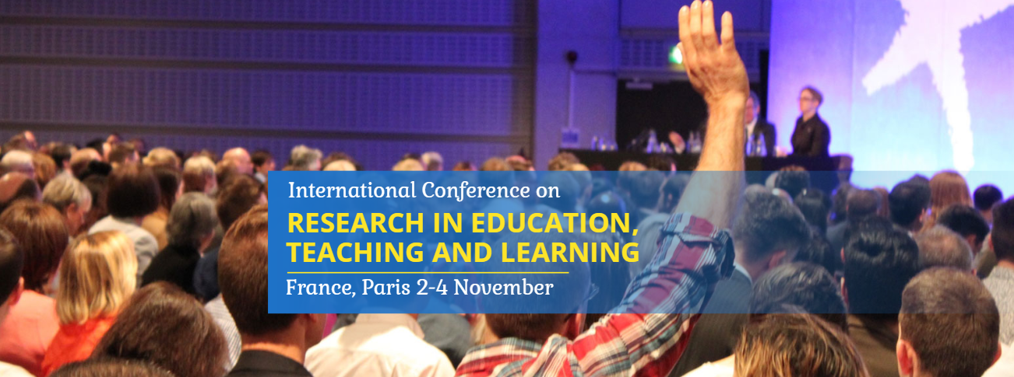

EDUverse
All you need about Education
Conference
Training
Courses
by Topic
by Area
About Conference
International Conference on Research in Education, Teaching and Learning
Topic of Interest
Important Dates
Register and Submit
Contact
Go to location
Powered by :
The International Conference on Research in Education, Teaching and Learning on November 2nd to 4th, 2018 in Paris, France aims to bring together academia, researchers and scholars in order to exchange and share their experiences and research results about all aspects of specialized and interdisciplinary fields. This event provides an opportunity for all to network, share ideas and also present their research work. In addition, discussion on the latest innovations, trends and practical concerns and challenges faced in these fields are also encouraged.

Slide 9
EDUverse
All you need about Education
Conference
Training
Courses
by Topic
by Area
About Conference
Education Theory and Practice
Counselor Education
Educational Foundations
Education Practice trends and Issues
Theory and Practice of Physical Education Development
Teaching Materials and Courseware Construction
Education and Research Management
Educational Measurement and Evaluation
Teaching method Promote
Pedagogy
Curriculum, Research and Development
Education Policy and Administration
Educational Administration
Education Policy and Leadership
Rural Education
Student Affairs
Lifelong Education
Education, Research and Globalization
Teacher Education
Education and Management
Continuous Education
Higher Education
Public Education Policy
Comparison of Sports Education in Different Cultures
Sports for health education
Adult and Continuing Education
Learning
Lifelong Learning
E-learning
Teaching and Learning
Learning Difficulties
Learning Psychology
Inductive reasoning
Machine Learning
Language Acquisition
Topic of Interest
Important Dates
Register and Submit
Contact
Go to location
Powered by :

Slide 10
EDUverse
All you need about Education
Conference
Training
Courses
by Topic
by Area
About Conference
Topic of Interest
Description | Date
Paper Submission Deadline | 11 October 2018
Communication of Acceptance | 4 to 10 days after submission
Early Registration Deadline | 20 September 2018
Last Date for Registration | 18 October 2018
Conference Date | 2 – 4 November
Important Dates
Register and Submit
Contact
Go to location
Powered by :

Slide 11

Under progress to get inspiration
Buat tabel jadwal konferensi seperti
Di https://conferencealerts.com/

Slide 12


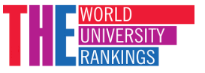


















EDUverse
All you need about Education
University Rank
University Management
University
World Rank
Indonesia Rank
Type university name
Type university name
COMPARE
Kementerian Riset, Teknologi,
Dan Pendidikan Tinggi Republik Indonesia
Times Higher Education
1 |  | University of Oxford
2 |  | University of Cambridge
3 |  | Stanford University
4 |  | Massachusetts Institute of Technology
5 |  | California Institute of Technology
6 |  | Harvard University
7 |  | Princeton University
1 |  | Massachusetts Institute of Technology
2 |  | Stanford University
3 |  | Harvard University
4 |  | California Institute of Technology
5 |  | University of Oxford
6 |  | University of Cambridge
7 |  | ETH Zurich – Swiss Federal Institute of Technology
1 |  | Institut Teknologi Bandung
2 |  | Universitas Gadjah Mada
3 |  | Institut Pertanian Bogor
4 |  | Universitas Indonesia
5 |  | Universitas Diponegoro
6 |  | Institut Teknologi Sepuluh November
7 |  | Universitas Airlangga
United Kingdom
Bandung
United States
United Kingdom
Yogyakarta
United Kingdom
United Kingdom
Bogor
United States
Depok
United States
United States
United States
Semarang
United States
United Kingdom
Surabaya
United States
United Kingdom
Surabaya
United Kingdom

Slide 13
Under progress to get inspiration
EDUverse
All you need about Education
University Rank
University Management
Klasifikasi berdasarkan program studi
Login bisa sebagai dosen dan mahasiswa
Social media terintegrasi

