Slide 1
Replication Study Ariana Alves Antunes
Competence versus Priorities: Negative Electoral Responses to Education Quality in Brazil
Hidalgo, F. Daniel; Boas, Taylor; Toral, Guillermo, 2021, "Replication Data for: Competence versus Priorities: Negative Electoral Responses to Education Quality in Brazil", https://doi.org/10.7910/DVN/YILXB4, Harvard Dataverse, V1,
Applied Statistics II – 4 April, 2023

Slide 2
What is the paper about?
The research is regarding educational performance information and electoral accountability, relying on two different research designs.
First, a regression discontinuity design is employed to compare municipalities across Brazil that barely met a school quality target and those that barely missed it
Second, a field experiment in the state of Pernambuco that examines the effect of providing information about a municipality’s ANA performance on votes for the incumbent mayor’s re-election is analysed.
The main goal is the measure education quality to study whether and how voters respond to signals of public education quality.
1. IDEB* Basic Education Development index
2. ANA National Literacy Assessment

Slide 3


Model
RDD*: Regression-discontinuity (RD) designs are quasi-experimental research designs popular in social, behavioural and natural sciences. The RD design is usually employed to study the (local) causal effect of a treatment, intervention or policy.
In this study, is was mainly comparing the difference in means - specificizing what compromises the groups - clearly municipalities that could miss the targets or get it on reasons being behind corruption.
The project has two different parts, this paper is focusing only on the regression model (RDD*) used to identify the effect of meeting the IDEB target on electoral outcomes in municipalities across Brazil. Which I was able to replicate as followed
Model:
“Where Y1i,j and Y0i,j represent the potential outcome of interest (vote share or re-election of the mayor) under treatment (having met the IDEB target) and under control (having missed it).
If average potential outcomes are continuous, we can estimate the local average treatment effect (LATE) around the cut-off:
c = -.05 by taking the difference in means above and below the threshold”

Slide 4
Data
For election outcomes, data from Brazil’s Superior Electoral Court was used.
For IDEB scores and targets, the Ministry of Education’s IDEB results for primary education at the level of the municipality.
For balance checks and further specifications, we use data from the 2010 census and from the Basic Municipal Information data set for 2009, both administered by Brazil’s official statistics agency (IBGE, Instituto Brasileiro de Geografia e Estatística), as well from the Ministry of Education’s yearly school census.
Three IDEB waves (2007, 2011, and 2015) was used, the results of which were published before the municipal elections of 2008, 2012, and 2016.
The effective sample excludes municipality-period observations (1) where the mayor is not eligible to run for re-election because of term limits.
When using vote share as the dependent variable, we also exclude observations where eligible mayors choose not to run.

Slide 5
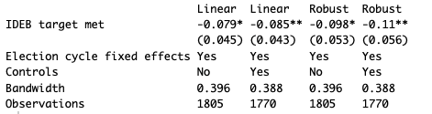
Data Replication
Data 2020 replicated 2023
RDD analysis – replicate the data on the Table 1. Effect of Meeting the IDEB Target on Re-election of the Mayor

Slide 6
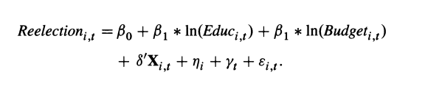
Main Findings / Output comparison
What could have been added?
Observational research designs such as RDDs are subject to concerns about statistical modelling assumptions. RDD analysis of the effect of meeting IDEB targets relies on aggregate data, limiting the ability to test mechanisms about how voters process information generated by standardized tests.
A better approach could have been to run an OLS with municipalities elections from two years and look within municipalities at the effect of increases in the log of municipality spending on public education on whether the incumbent party was re-elected for mayor’s office.
For municipality i in election year t:

Slide 7
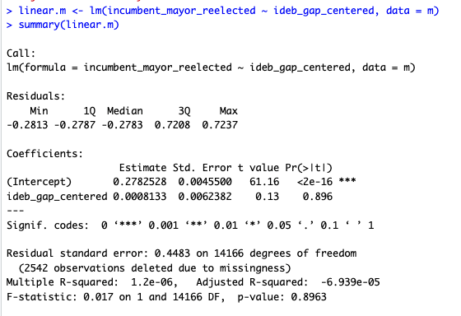
Main Findings / Output comparison
What could have been added?
Ordinary Least Squares regression (OLS) is a common technique for estimating coefficients of linear regression equations which describe the relationship between one or more independent quantitative variables and a dependent variable (simple or multiple linear regression).

Slide 8
Conclusion
Conceptual replications
Conceptual replication is when research is conducted by using different methods to repeat the original study.
Despite difference in methods, the new data is similar to the original study findings, by trying a different approach it can be observed the same results as per original paper but with high statistical evidence.

Slide 9

Questions
Thank you for your time!

