Slide 1
Lecture 10
STAT 451 VISUALIZING DATA
Fall 2023
Many thanks to Prof. Abel Rodriguez, many slides from this course are adapted from his data visualization class.

Slide 2
Nonstandard data
We want to extend the tools discussed in the class to represent
Network (relational) data: we have information about the strength of the relationship between each pair of elements in a group (e.g., how many times A sends an email to B).
Text: we have the content of multiple books/papers, and we want to find a way to visualize that content (without having to read and memorize each of the books!)

Slide 3
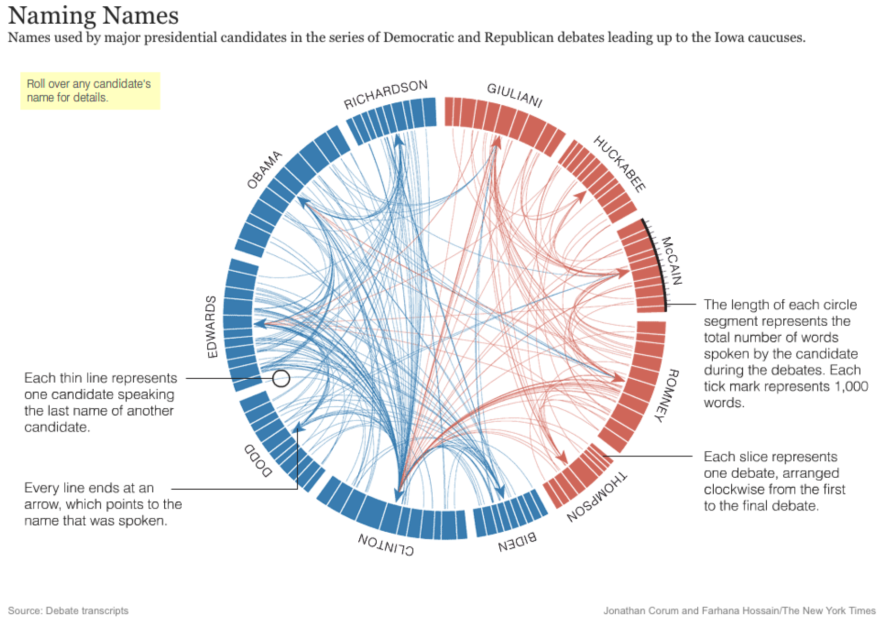
Visualizations for networks: circular network diagram
http://www.nytimes.com/interactive/2007/12/15/us/politics/DEBATE.html

Slide 4
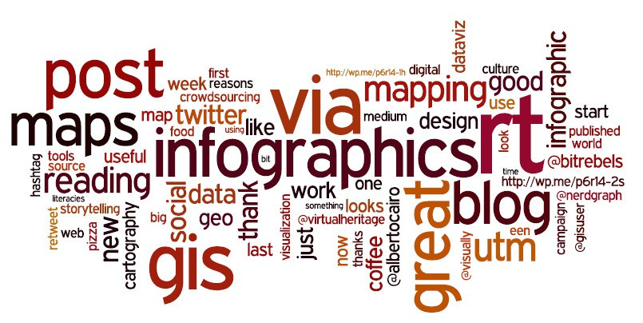
Visualizations for text: Word clouds
http://www.wordle.net

Slide 5
Networks
Networks summarize data about the relationships between pairs of subjects.
How many times has a politician mentioned another one in his/her speeches.
Who is a friend of who in Facebook.
How many emails one person sent another.
Network data usually comes in the form of a square matrix where entry (i,j) is a measure of the relationship between subjects i and j.

Slide 6
Networks
One possible classification of networks is:
Binary: Only know if they are related or not (e.g., whether they are friends in Facebook or not). Matrix only has zeros and ones.
Weighted: We also know how strong the relationship is between individuals (e.g., we know the number of emails that each user sent to all others). Matrix might contain integers or real numbers.
Usually diagonal elements of the matrix are zeros (no self relation).

Slide 7
Networks
Another possible classification is:
Directed: a link from A to B has a different interpretation than a link from B to A (e.g., receiving an email is different from sending one).
Undirected: the relationship we are interested does not have a direction (or we elect to ignore it). For example, Facebook friendships.
Facebook friendships could be made into a directed network by recording who initiated the link.

Slide 8
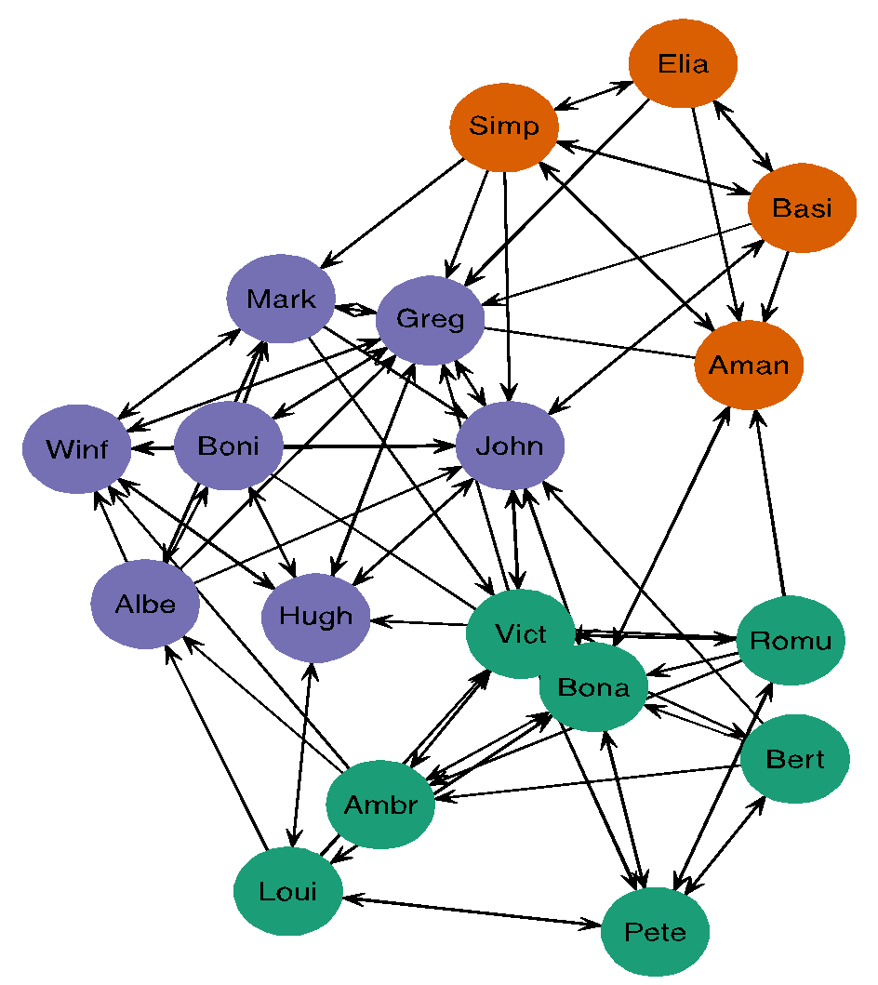
Visualizing netwoks
Networks are usually visualized using graphs!
Nodes (the circles) correspond to individuals.
The lines/arrows identify the presence (or strength) of links between individuals

Slide 9
Binary Networks
Sampson’s network: relationships (likes) among monks in a New England monastery.
Binary and directed (all lines have the same width, and end in arrows).
18 monks classified by Sampson into three “factions” (coded through color).

Slide 10
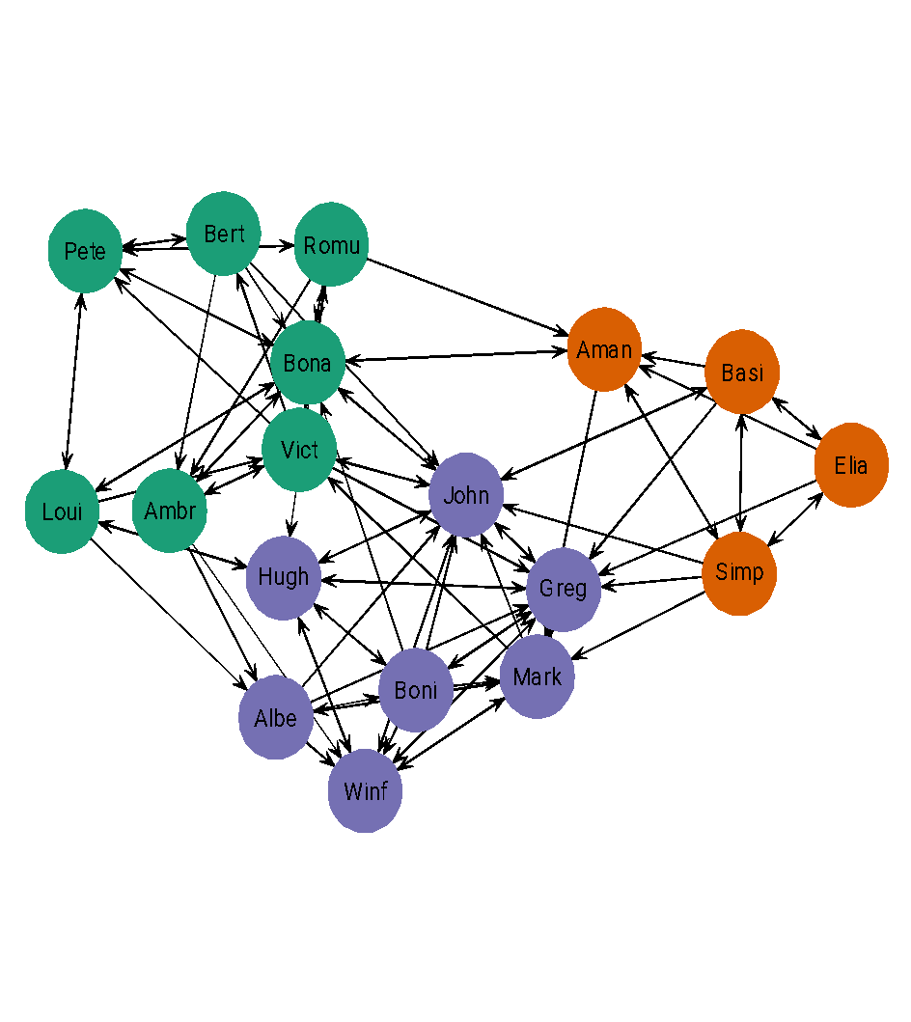
Binary Networks
Arranging the nodes so that the graph is legible is an issue.
A number of algorithms have been presented in the literature:
Fruchterman and Reingold's algorithm.
Kamada-Kawai’s algorithm.

Slide 11
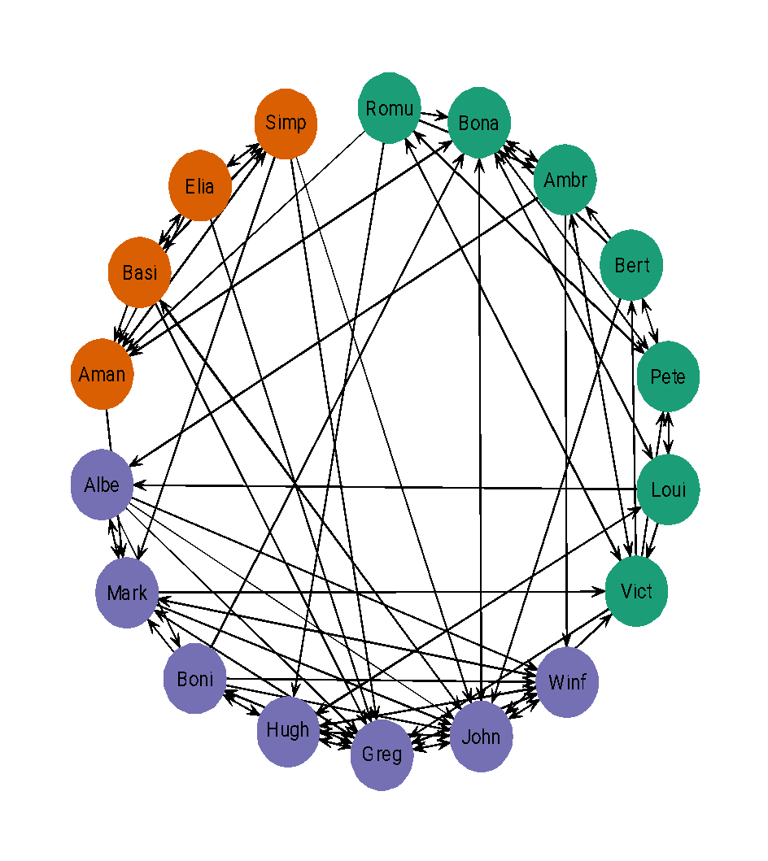
Binary Networks
A simpler solution is to arrange the nodes on a circle.
This is one of the few examples in which polar coordinates actually work well!
Note that, in all cases, the nodes have been ordered according to the Sampson’s groups.

Slide 12
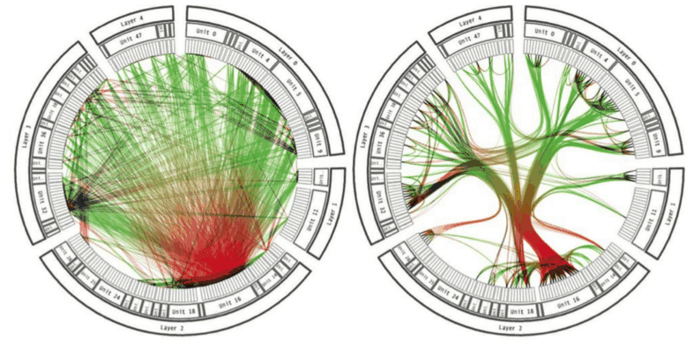
Networks
Straight lines can be difficult to read
This design for the links is much more readable!

Slide 13
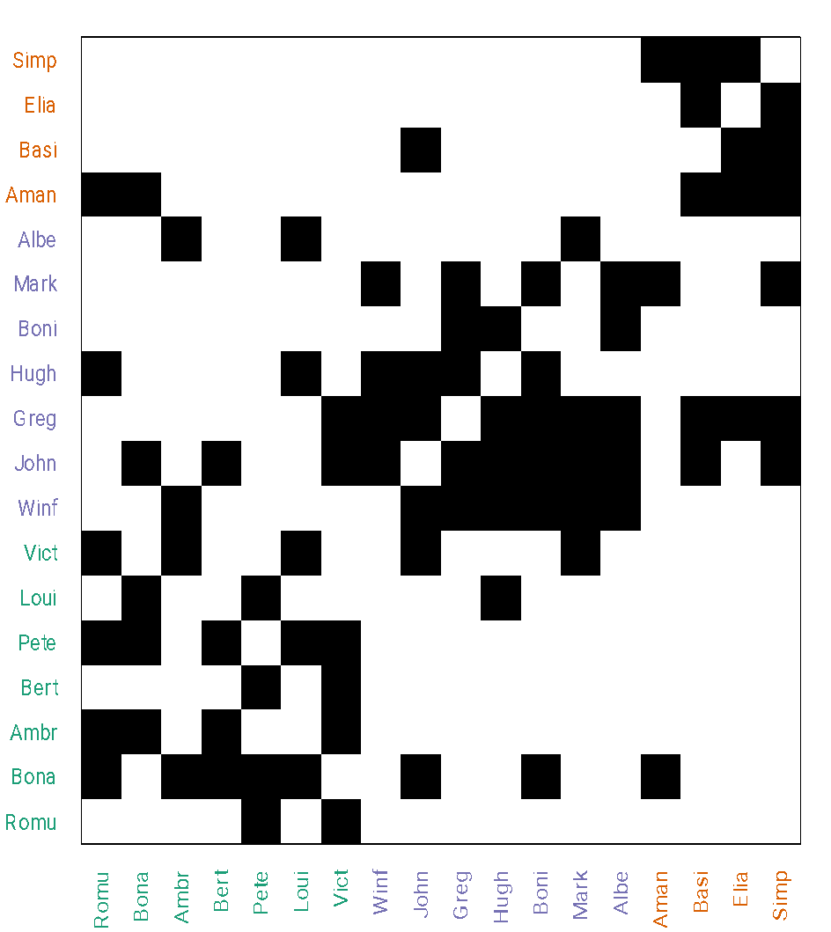
Binary Networks
An alternative visualization for this network involves a heatmap.
In this case, because the network is binary, you only need two colors!
The faction structure is a bit clearer here, but the visualization is not all that appealing.

Slide 14
Weighted Networks
Similar ideas can be used for weighted networks.
Color and/or line thickness can be used to represent the strength of the link (I suggest using both!)

Slide 15
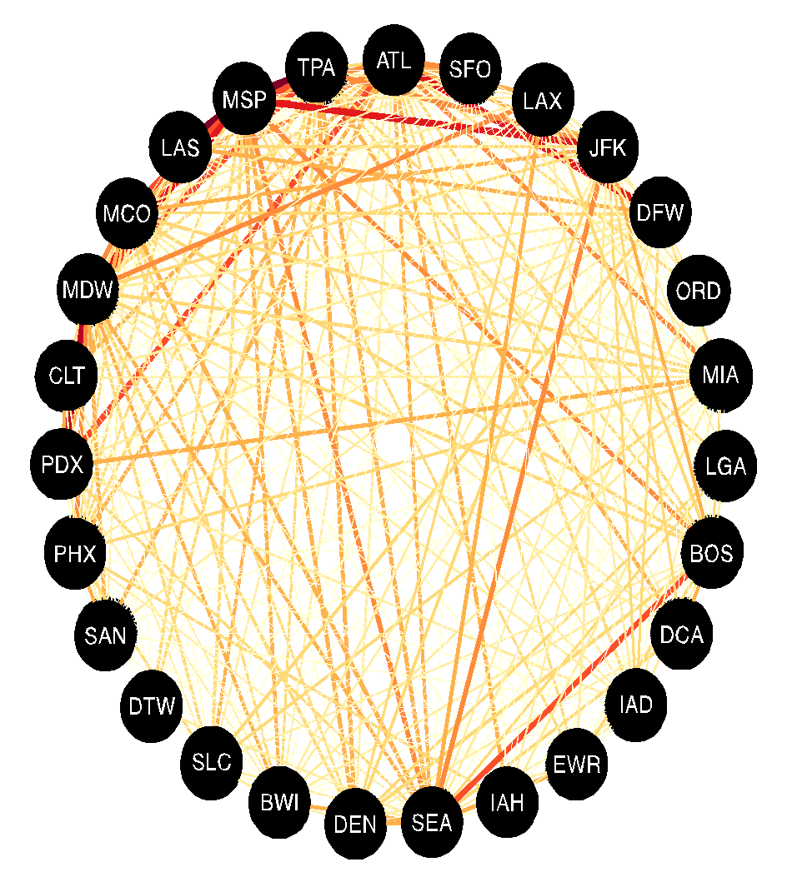
Weighted Networks
Network of 27 most important US airports.
Weight of the links corresponds to the number of seats available between both airports.
Shortcomings:
No geographical information (maybe reorder the vertices?)
Because the network is dense, it is very hard to read!!

Slide 16
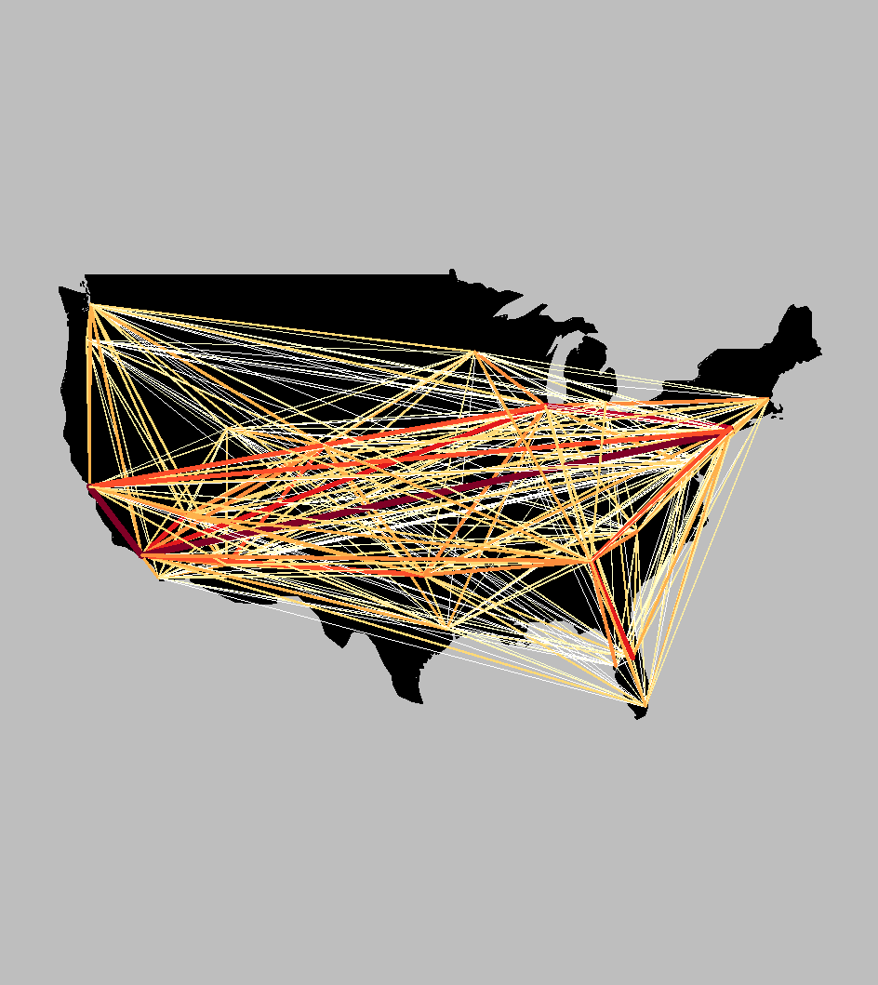
Weighted Networks
A more sophisticated version of the visualization that overlays the network on a map.
More informative about geography, but still hard to read!

Slide 17
Weighted Networks
One solution is to split the airports into two (or more) groups
According to size (large vs. small).
According to geographical location (East vs. West)
If you split into two groups (say Eastern and Western airports) you need to create three maps.
If you split into more groups, the number of maps grows very fast.

Slide 18
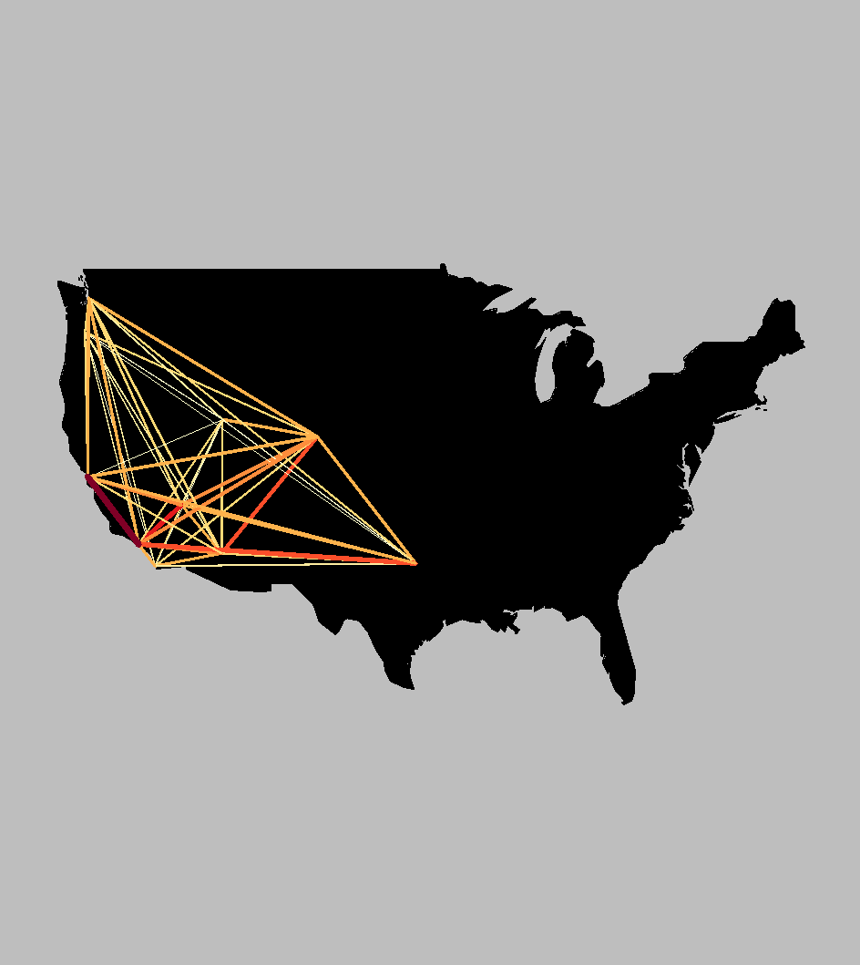
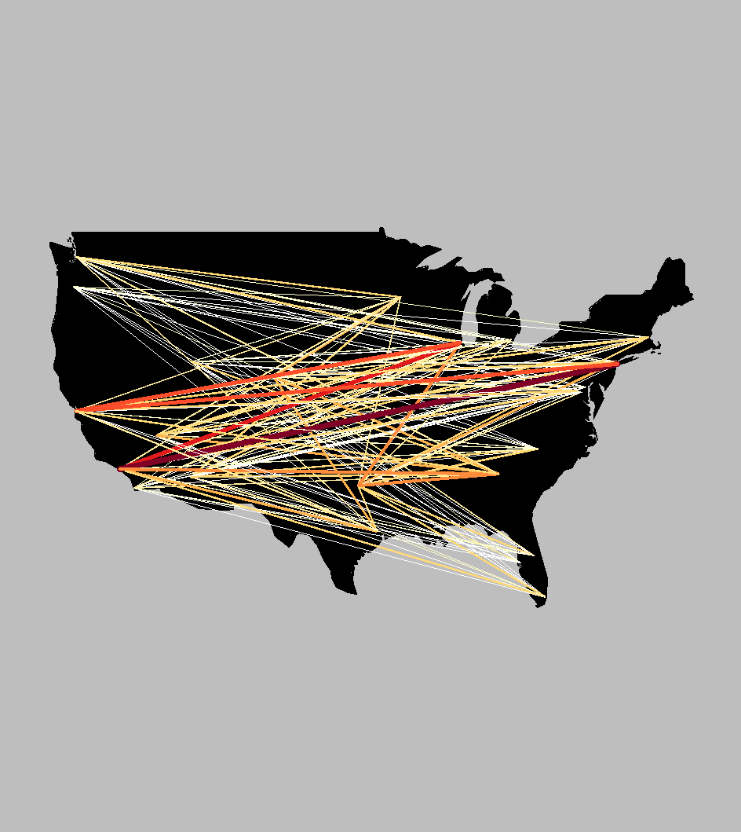
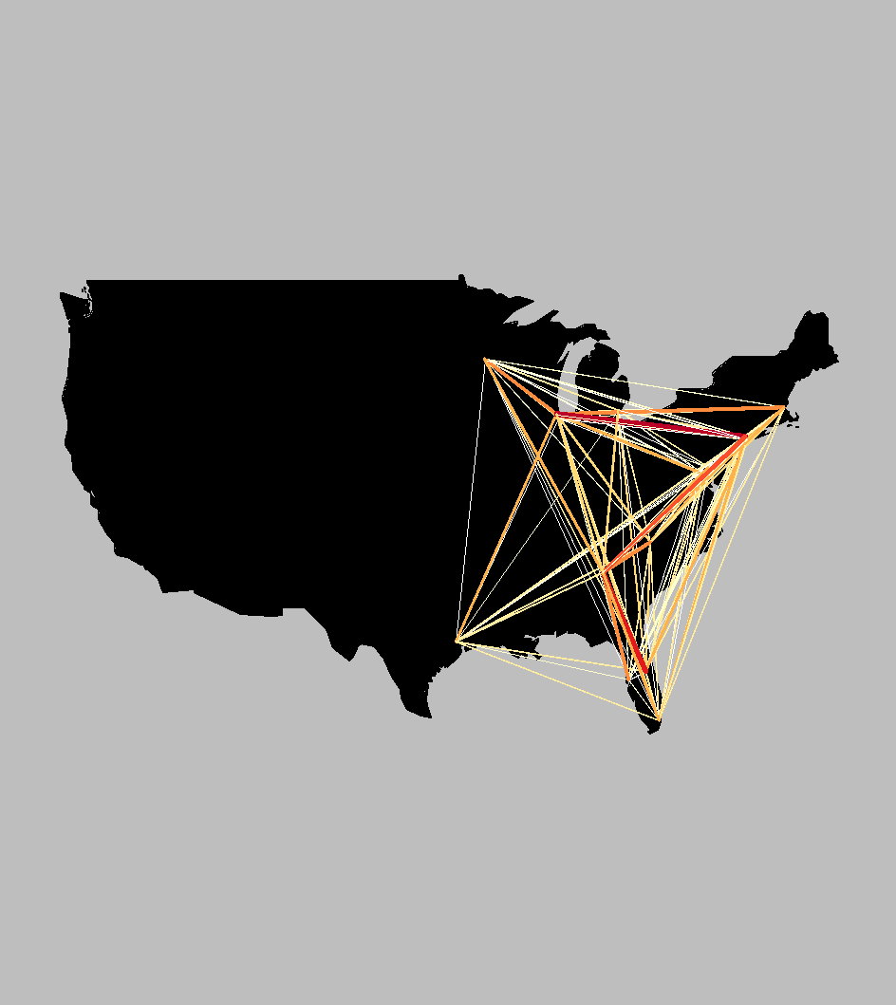
Weighted Networks
For dense networks like this, an interactive
visualization works much better!

Slide 19
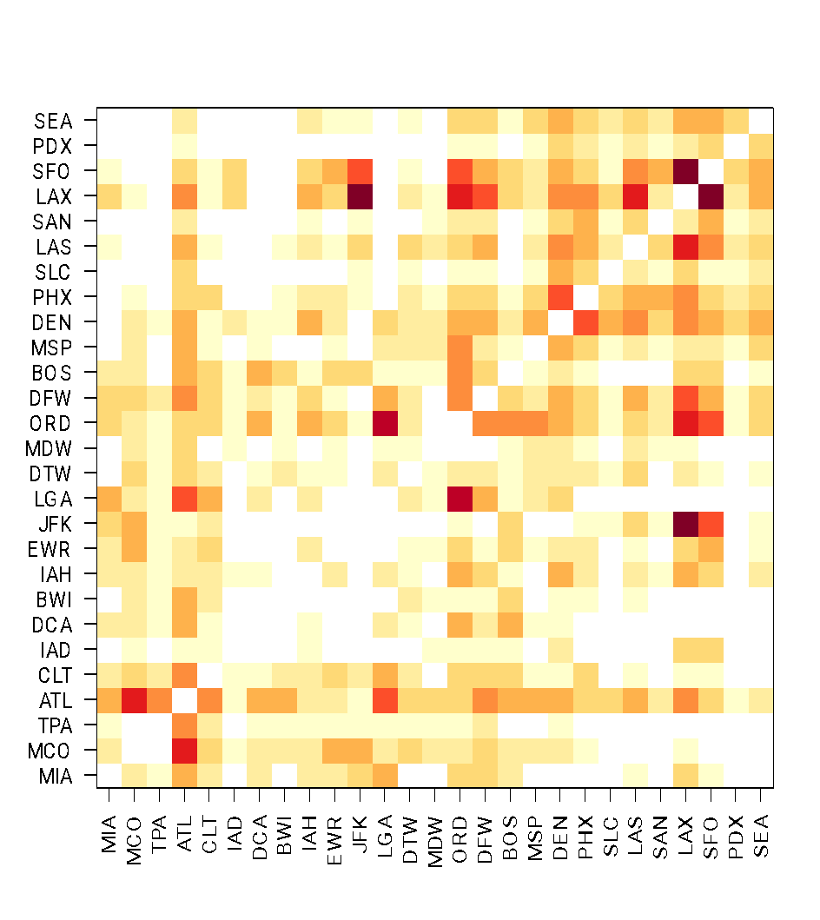
Weighted Networks
The previous graphs are a bit less cluttered, but still very hard to read.
For dense graphs, heatmaps can be the best (if less visually attractive) solution.
Here I ordered the airports according to their distance to Miami International Airport.

Slide 20
Text data
Suppose we have access to all the books written by two different authors (e.g., Hemingway and Salinger).
How we can visualize the differences between the two writers?
We need to find appropriate (numerical) summaries of the data.
We have to find good representations for those summaries.

Slide 21
Text data
The simplest numerical summary of a text is the frequency of the different words in the corpus.
A slightly more sophisticated version of this idea uses pairs of words (also called bigrams), or more generally, sequences of n words (n-grams).
Should all words be counted?
Run vs. running?
Should we include common words (the, a, …)?
Should we just focus on a few “important” words?

Slide 22
Text data
“Stemming” is the process of reducing inflected or derived words to their stem, base or root:
For most purposes, run, runs, and running are not really different words (just conjugations of a common one).
Similarly, house and houses are the same word.

Slide 23
Text data
Filtering “stop words” is the process of eliminating very common words (such as the, is, at, which, and on).
This is appropriate in many applications …
But for some (like distinguishing among writers) you might want to discard all other words and retain only certain stop words.

Slide 24
Text data
Even after excluding stop words, sometimes working with all remaining words is still unwieldy and you want to focus on a smaller subsets.
When the corpus is made of multiple documents, term frequency–inverse document frequency (td-idf) is a summary statistic that can be helpful in selecting words.

Slide 25
Text data
td-idf is a summary that is used to select words that provide, in some sense, maximum separation among documents.
td-idf depends on two quantities:
One that captures how common a word is in a given document.
A second one that captures how frequent a word is overall.
You want words that are not too frequent overall but have a high frequency in specific documents.

Slide 26
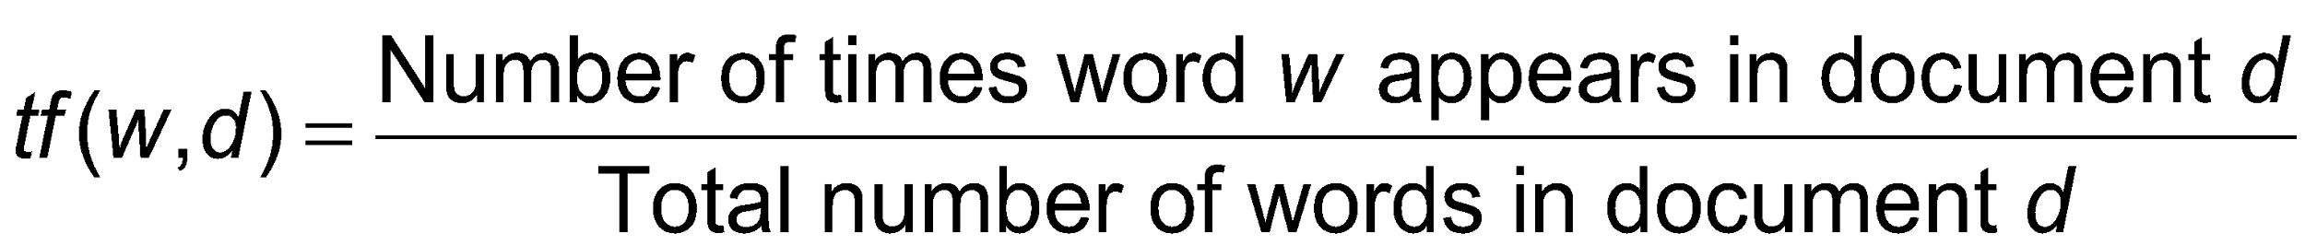
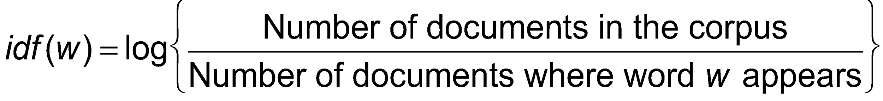
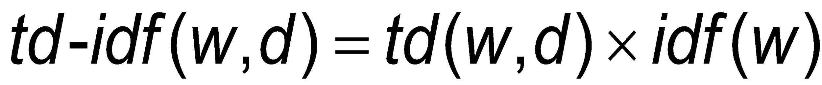
Text data
Pick top k words (say, k = 10) for each document, and work only with those words.

Slide 27
Text data
No matter how you select the vocabulary used to represent the documents, the summary statistic will correspond to word frequencies!
The best ways to graphically represent frequencies is
Bar plots.
Dot plots.
Remember that pie charts are considered suboptimal.

Slide 28
Text data
The challenge in this case is that the number of words is typically going to be high (at least in the hundreds).
Can you really make a readable bar plot (or even dot plot) with hundreds of bars?
Note that a pie chart would be even worse in this case …

Slide 29
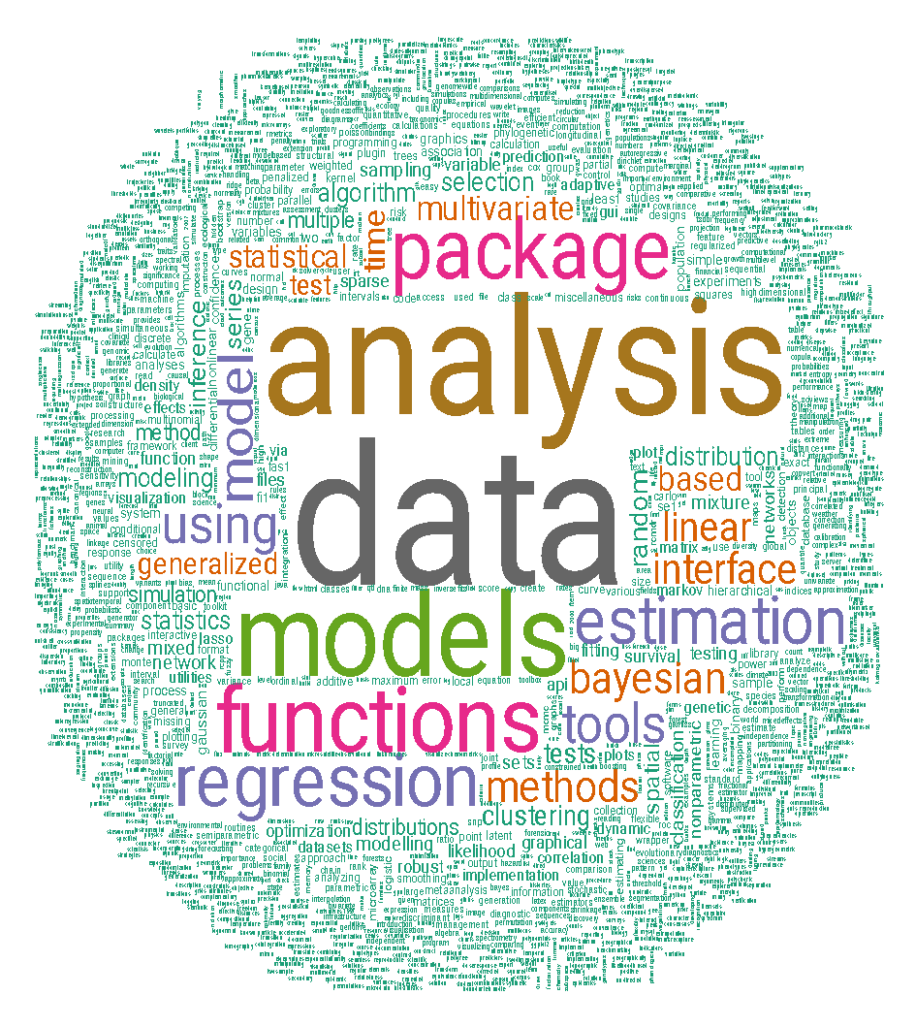
Word clouds
Word clouds like the ones on the right are an alternative visualization for categorical data that allows you represent hundreds of categories together.

Slide 30
Word clouds
Word clouds are very popular on the web:
They are good for visualizing the “big picture” (e.g., what are the most important words).
However, because they use areas to represent proportions, word clouds do not allow for very accurate comparisons!
Solution: complement the word cloud with a bar chart associated with the most frequent words in the vocabulary that allows for more accurate comparisons.

Slide 31
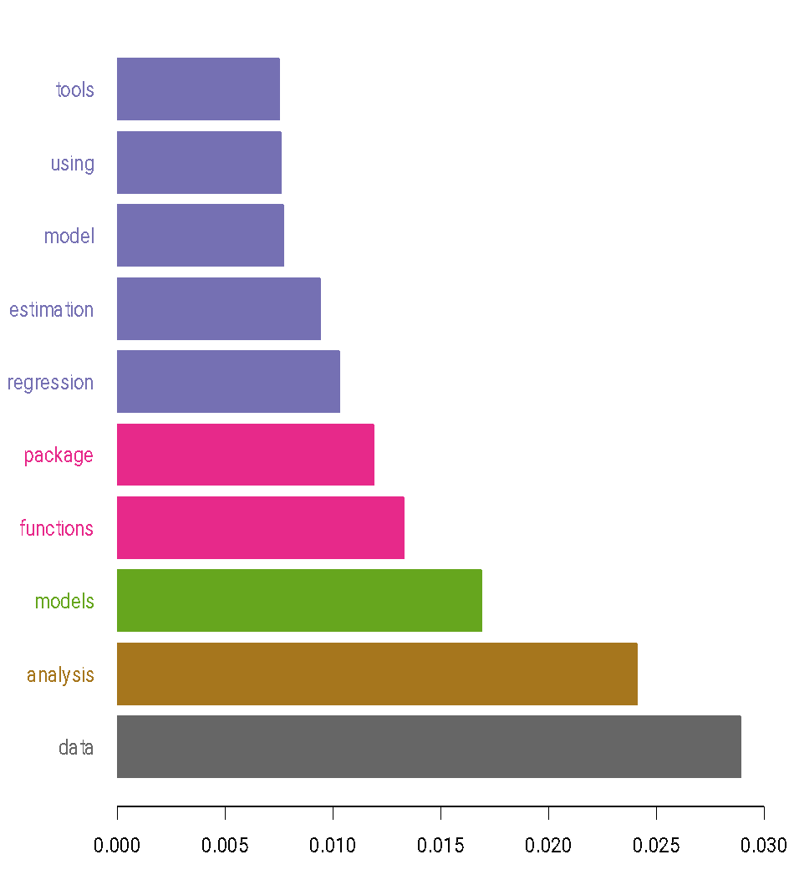
Creating word clouds
Note that I used the same colors on the left and right to facilitate comparisons

Slide 32
Comparing multiple documents in a corpus
When using word clouds/barplots to compare documents, it can be useful to construct them for each document and also for the corpus as a whole (recall the definition of tf-idf).
However, graphing tf-idf instead of frequencies is often not very helpful …

