Slide 1
Lecture 6
STAT 451 VISUALIZING DATA
Fall 2023
Many thanks to Prof. Abel Rodriguez, many slides from this course are adapted from his data visualization class.

Slide 2
What is visualization for?
Remember that we discussed two different uses of visualization:
Amplify cognition: allow us to see patterns in the data in order to make informed decisions.
Communicate: inform (convince?) other people of the presence of those patterns in order to help them make better decisions.

Slide 3
Exploratory Data Analysis
Before you can tell a story, you need to find it!
Exploratory data analysis (EDA) consists of a set of graphical and quantitative tools that allow us to summarize data and start making sense of it!
Different tools should be used depending on:
The type of data you have.
What questions you are trying to answer.
This lecture serves both as an introduction to EDA, and an introduction to basic visualization tools.

Slide 4
Types of data
A usual classification:
Qualitative (or categorical).
Quantitative.
A different one
Panel data.
Longitudinal (time series) data.
Spatial data.

Slide 5
Types of Data
Qualitative data, also called categorical or attribute data. These can be separated into different categories that are distinguished by some non-numeric characteristics.
Nominal data consist of names, labels or categories only. There is no natural ordering to these categories.
Ordinal data can be arranged in some order but differences between data values either cannot be determined or are meaningless.

Slide 6
Examples of nominal variables
Party to which a politician belongs.
Types of listings in AirBnB (apartment, house, castle, igloo, etc).
Type of worker in the weaving dataset (home or factory weaver).
Eye color (black, blue, brown, black).

Slide 7
Example of an ordinal variable
This scale is used to classify the performance status of patients in a clinical trial.
The score of a patient in this scale is a categorical variable. The categories are ordered, but the differences in magnitude are meaningless.
 | Description
0 | Fully active, able to carry on all pre-disease performance without restriction.
1 | Restricted in physically strenuous activity but ambulatory and able to carry out work of a light or sedentary nature.
2 | Ambulatory and capable of all self-care but unable to carry out any work activities; up and about more than 50% of waking hours.
3 | Capable of only limited self-care; confined to bed or chair more than 50% of waking hours.
4 | Completely disabled; not capable of any self-care; totally confined to bed or chair.

Slide 8
Types of Data
Quantitative data consists of numbers representing counts or measurements.
Discrete data: the number of possible values is either a finite number or a countable number.
Continuous data: are the result from infinitely many possible values not restricted to certain specified values.

Slide 9
Examples of discrete data
Number of new cases of breast cancer reported annually from 1995 to 2002.
Number of people who voted for Barack Obama in each state in the 2012 presidential election.
Note that in some cases discrete data is obtained by “summarizing” qualitative data (i.e., counting the number of cases associated with each category).

Slide 10
Examples of continuous data
Unemployment rate.
Inflation rate.
Change in gross domestic product.
Temperature.
Weight.
Bank capitalization

Slide 11
Panel/temporal/spatial data
Longitudinal (time series) data: order in which the observations are presented is important because they are associated with a specific point in time.
Spatial data: order could also be important because data is associated with specific geographic regions or locations in a map.
Panel data: order in which the observations appear does not matter. Multiple observations are sometimes called “replicates”.

Slide 12
Panel/temporal/spatial data
These are not mutually exclusive classes. For example:
You can have data that is both spatial and temporal (actually very common): Evolution of unemployment on the different states over time.
Longitudinal panel data arises if you have multiple replicates at each point in time. Actually, this is uncommon unless you disregard some information such as spatial location.

Slide 13
Question
A physician describes a patient in an in-take questionnaire as “abstains from alcohol, light drinker, moderate drinker, heavy drinker”. What type of variable is this?
Nominal.
Ordinal.
Continuous.
Discrete.

Slide 14
Question
Trees are classified as “oak, maple, elm”. What type of variable is this?
Nominal.
Ordinal.
Continuous.
Discrete.

Slide 15
Before you start …
Before you start looking at the data, think about what goals are.
What questions do you need answered?
Depending on your goals, you might need to pre-process your data:
Do you want to show the original data or its changes?
Do you want to represent the absolute change or the relative change? If computing relative changes, what is your baseline?
Should you present total values, or should you normalize by some quantity (i.e., GDP or GDP/person)?
Should you apply any correction (e.g., use CPI = Consumer Price Index to transform past values into present values)?
Absolute or relative frequencies?

Slide 16
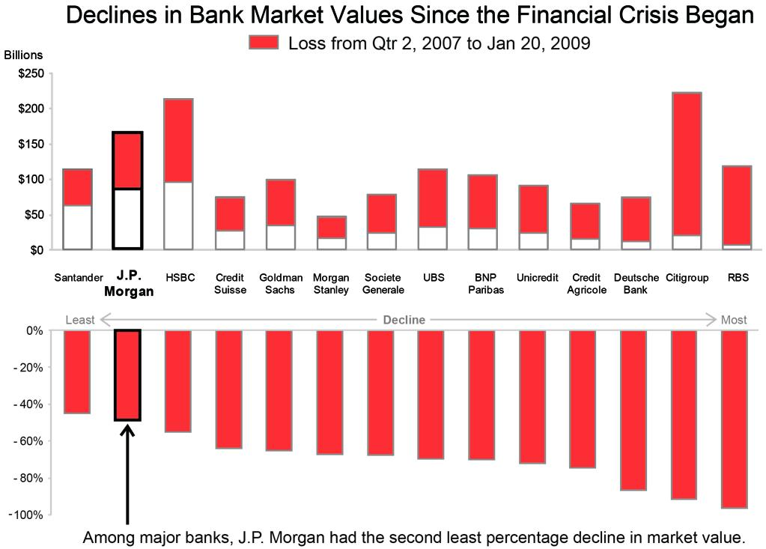
Raw data or increments?
When visualizing the market capitalization of banks, what is important is the percent drop in value between 2007 and 2009.
In addition to plotting the data, we really want to plot the relative change.

Slide 17
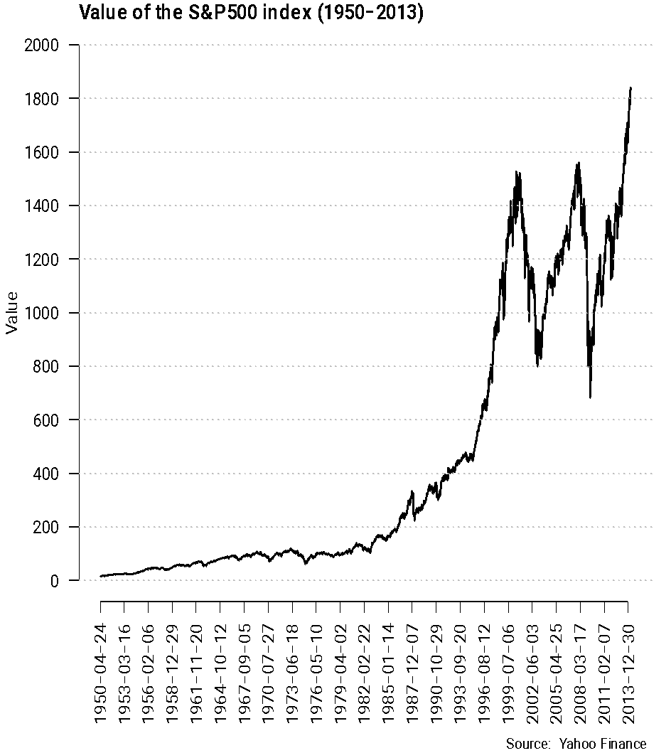
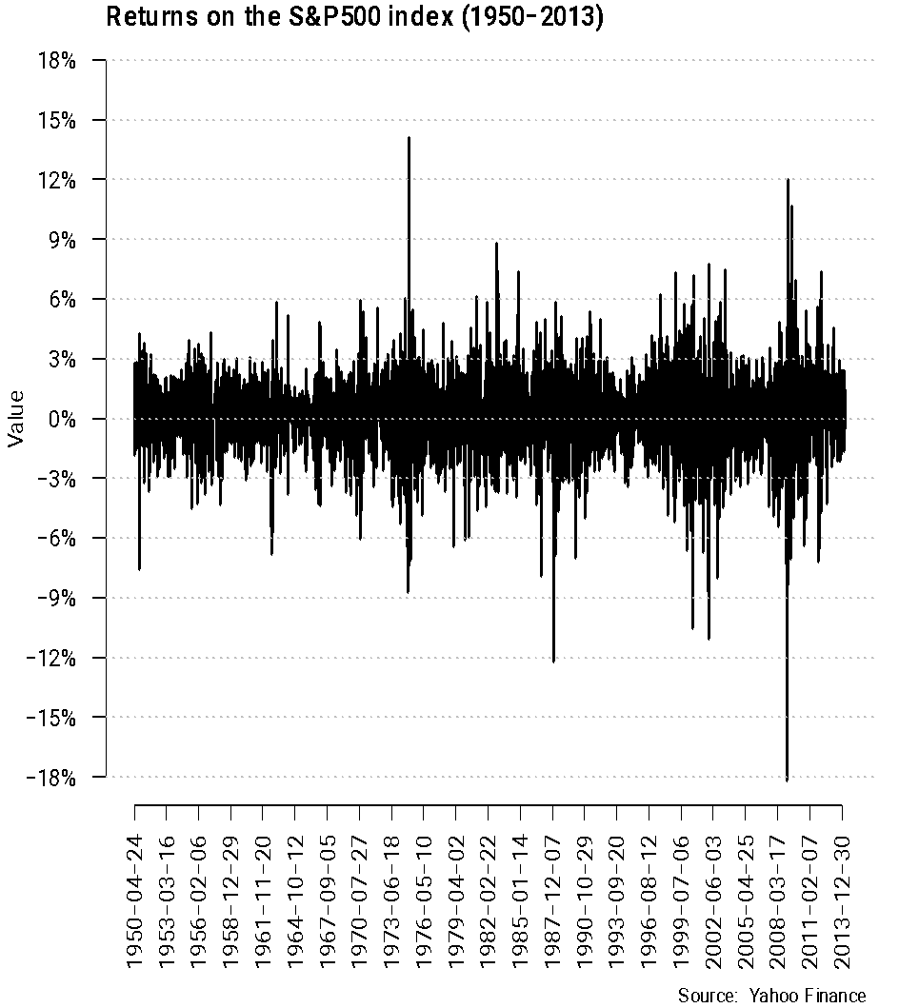
Raw data or increments?
More volatility recently?

Slide 18
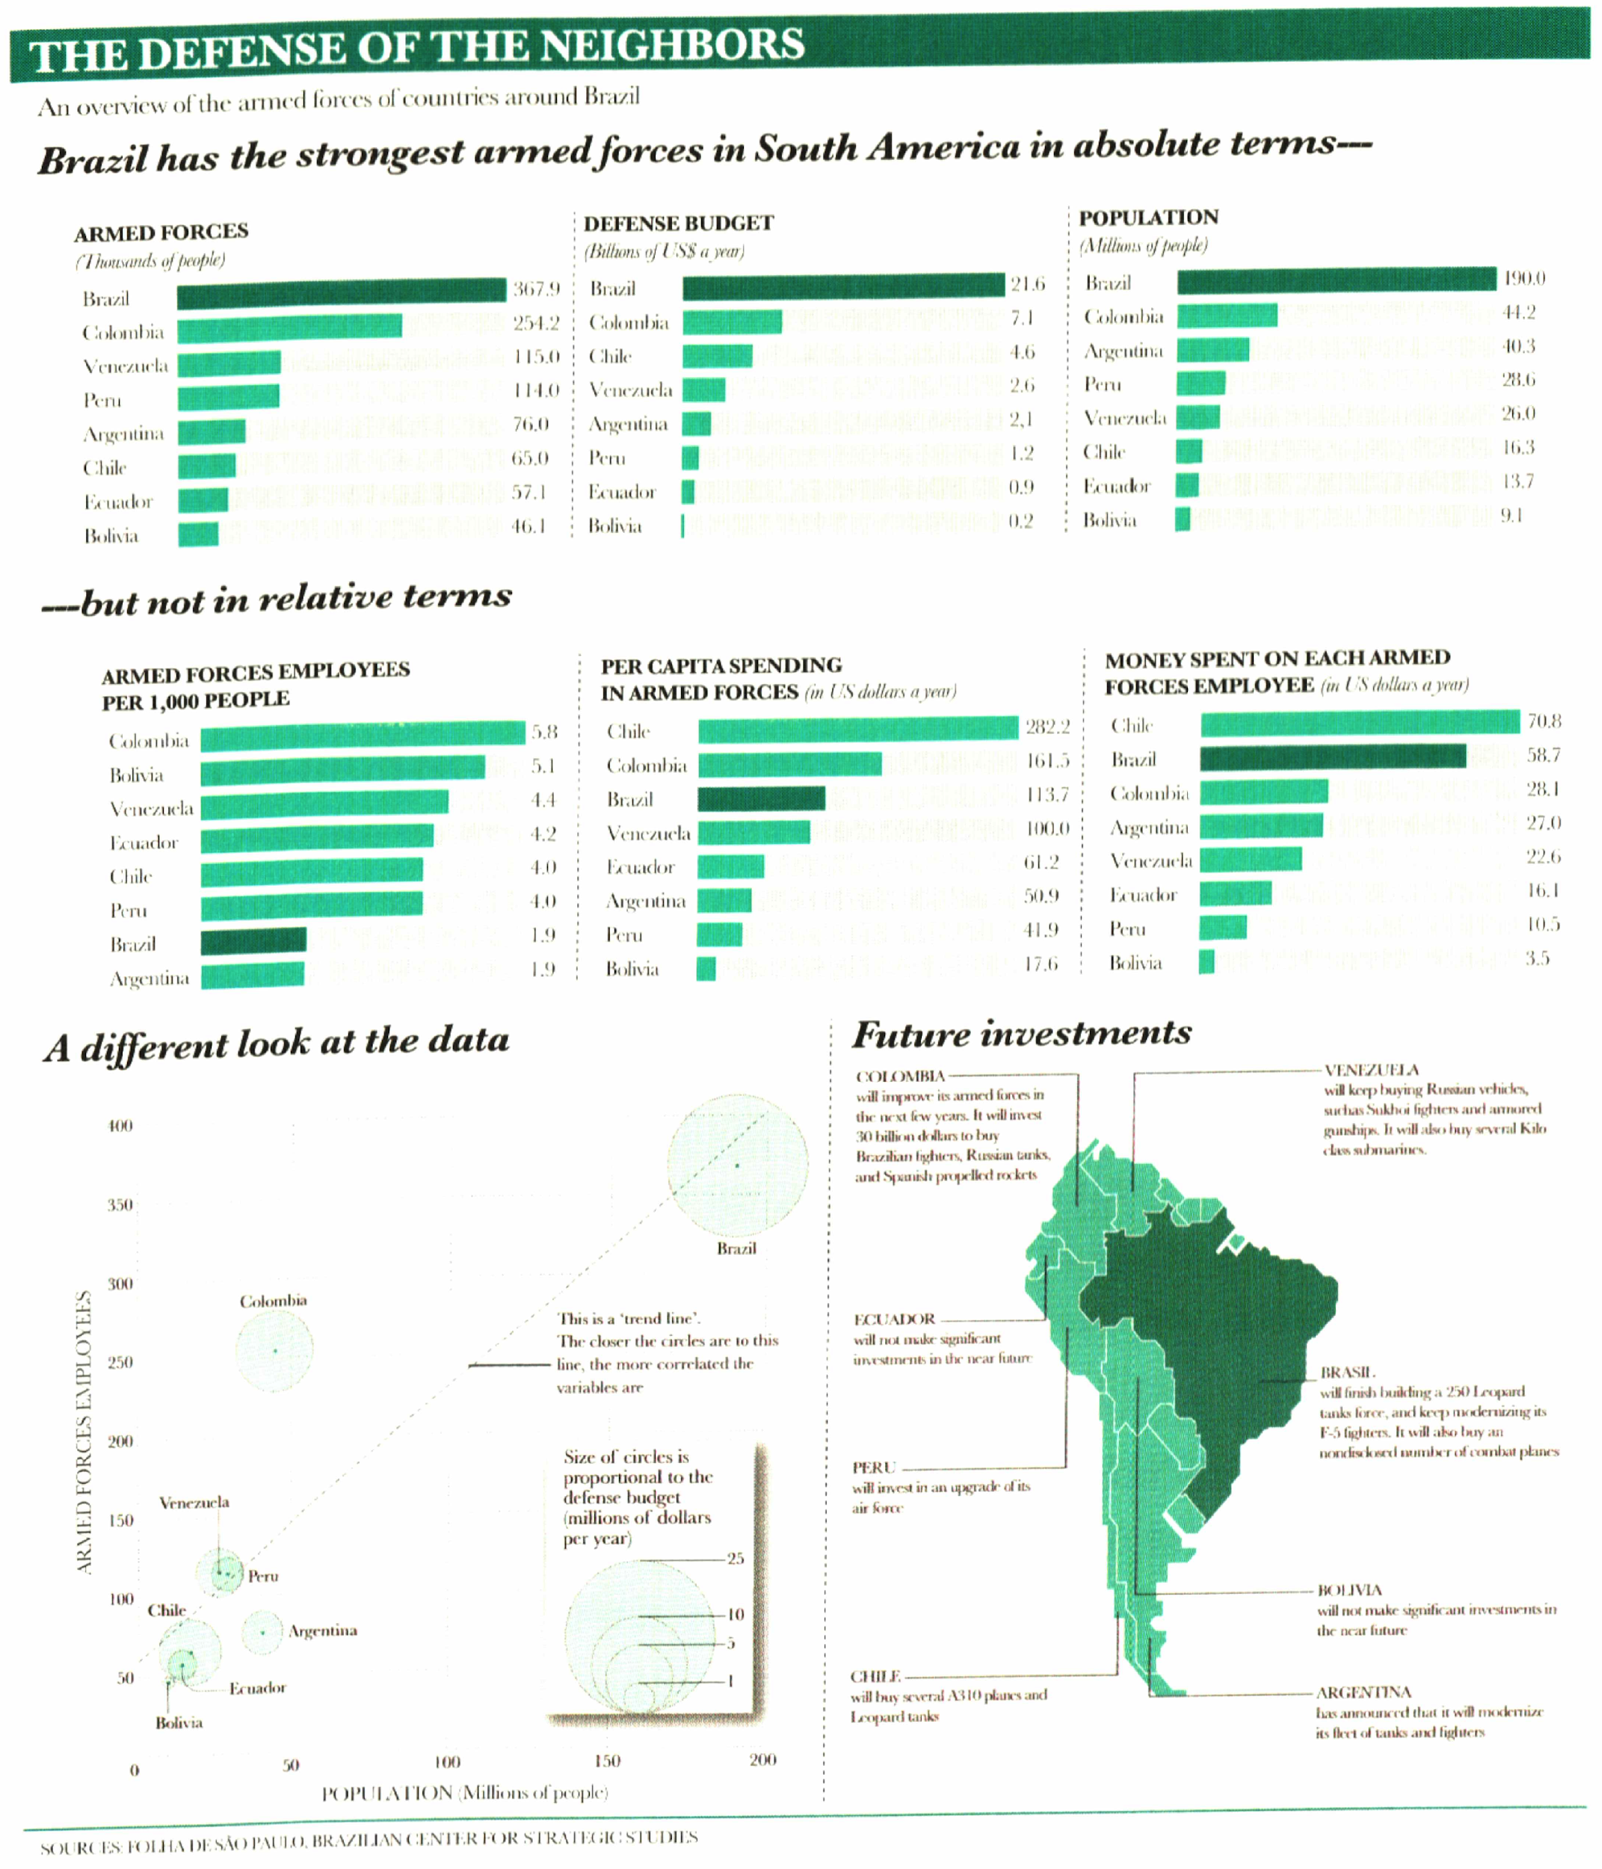
Normalizing data
Comparing military or educational spending across countries is meaningless in absolute terms: larger/richer countries should spend more!
See minute 10:25 of https://www.ted.com/talks/david_mccandless_the_beauty_of_data_visualization

Slide 19
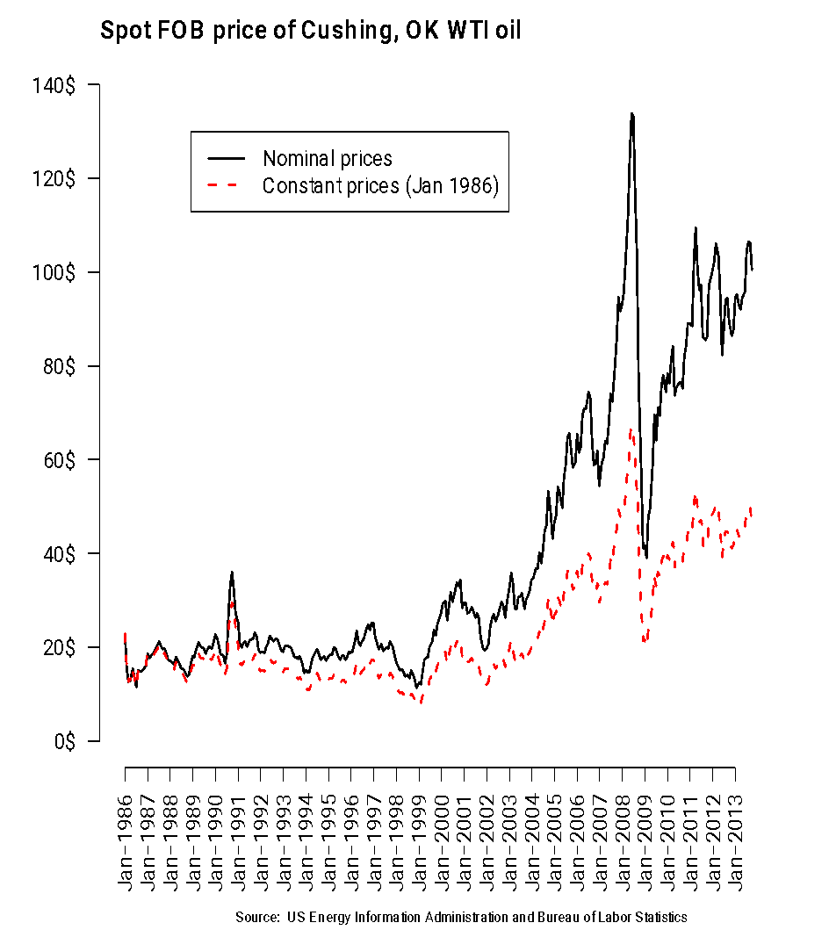
Using present values
A dollar in 1950 went a long way farther than a dollar today!
When comparing prices over time, you need to adjust old prices using the CPI (inflation).
If you prefer, you can use last year dollars instead.
See
http://www.perceptualedge.com/articles/guests/inflation_matters.pdf

Slide 20
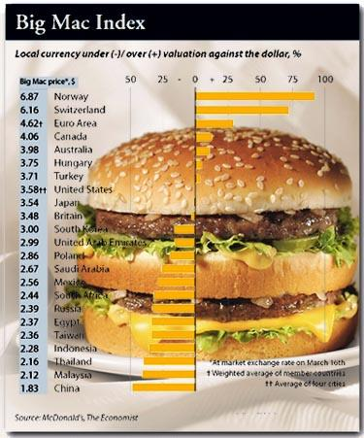
Using present values
Similarly, life in a small town in the Midwest is cheaper than in Manhattan! Key term is purchasing power parity.
Have you ever heard of the Big Mac index?
Just like the CPI can be used to adjust prices over time, ppp can be used to adjust prices geographically.
Taken from “The Economist”

Slide 21
Numerical summaries
A key task in EDA is summarizing the data: Going from a long list of numbers to just a handful that give us the “Big Picture”.
Means, medians, modes, ranges, variances, etc.
Numerical summaries are very useful in developing visualizations. For example:
Range of data gives limits for plots.
Means/standard deviations and medians/quartiles provide values for reference lines.
Frequencies are the basis for histograms.
Median/quartiles are the basis for boxplots.

Slide 22
Summaries for categorical data
Relative frequency
Mode: the category with the highest relative frequency.
Relative odds of groups A vs. group B

Slide 23
Summaries for quantitative data
Mean, Median: Skewed variables (to be discussed later) like salaries, territory, population are better described by their median.
Range, midrange
Standard deviation
Quantiles
Frequency tables

Slide 24
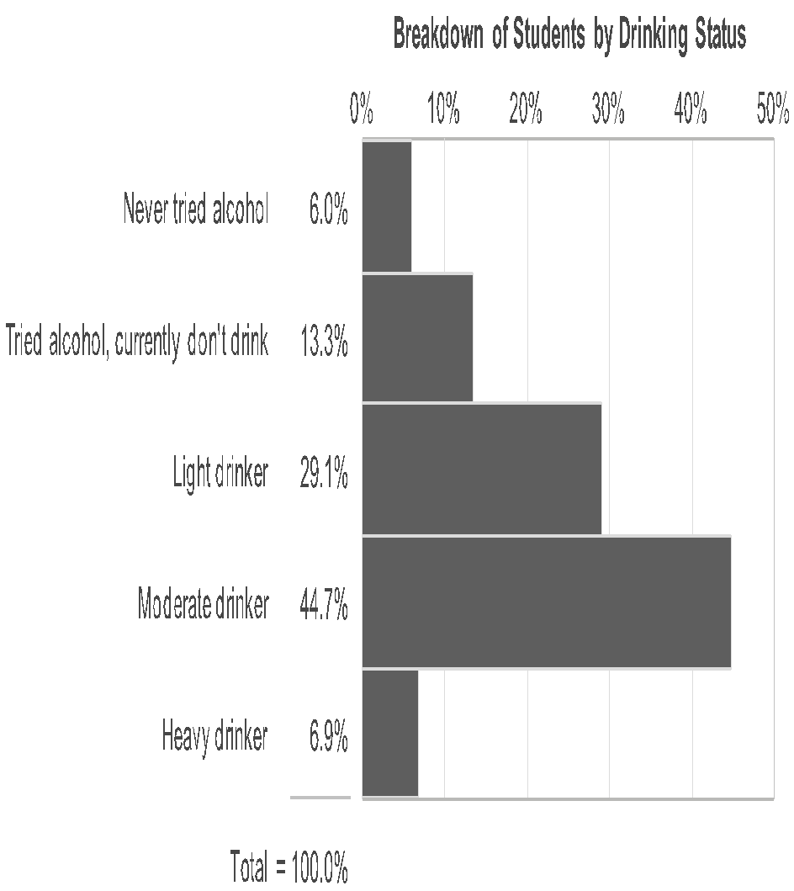
Visualization for categorical data
The most common tool for exploring categorical data is the bar plot.
Count the number of cases that are associated with each category.
Represent either the total count or the relative frequency.

Slide 25
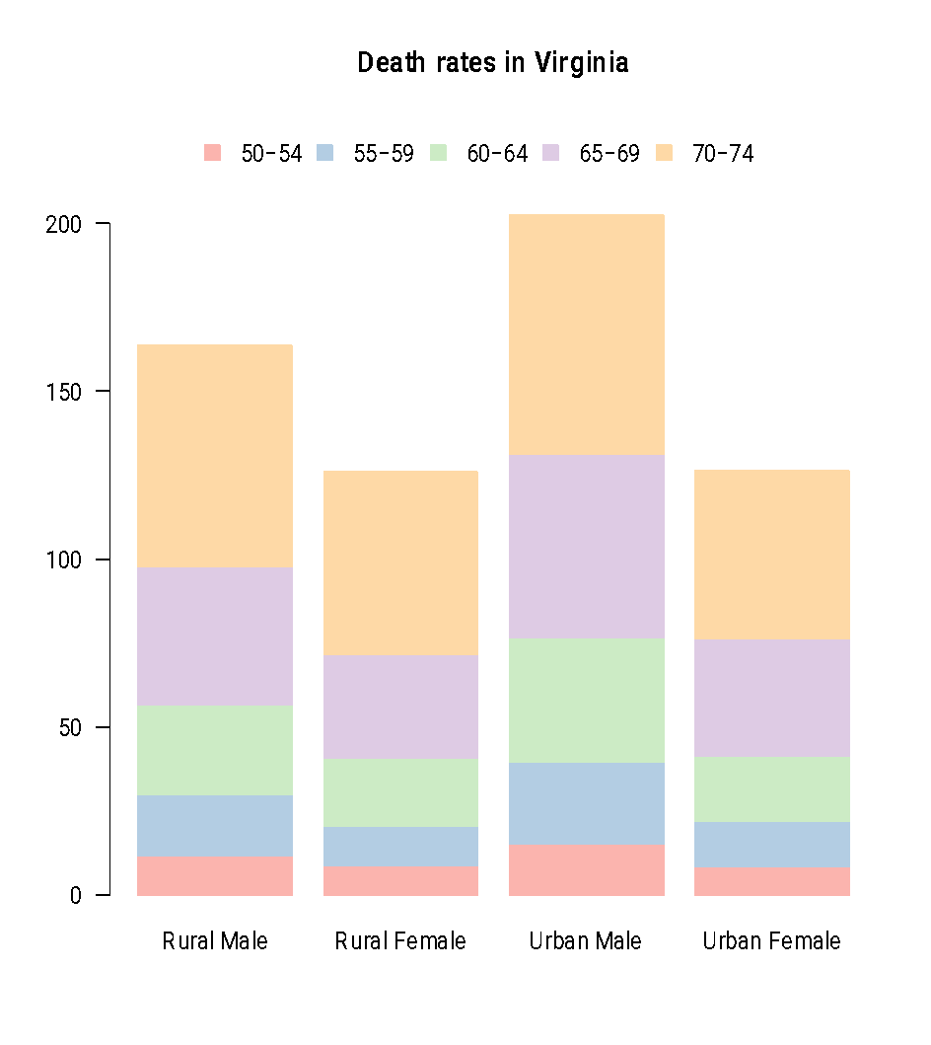
Visualization for categorical data
When data is indexed not by one but two mutually exclusive categorical variables, stacked bar plots are a possible solution.
The main problem with stacked bar plots is that accurate comparisons across groups are somewhat difficult.

Slide 26
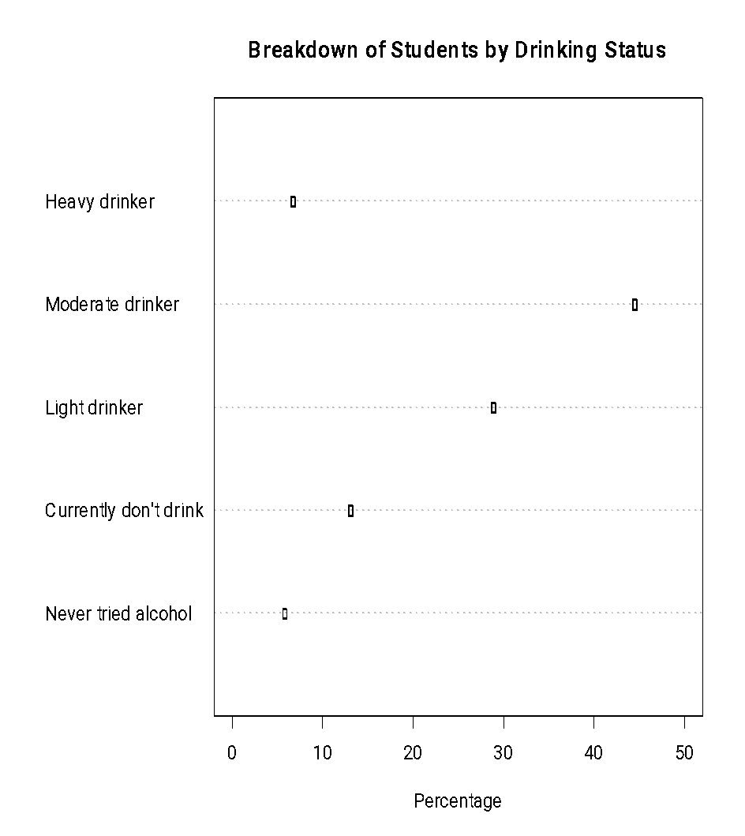
Exploring categorical data
Dot plots are a reasonable alternative to bar plots.
One advantage of dot plots is that they allow you to represent multiple variables simultaneously!

Slide 27
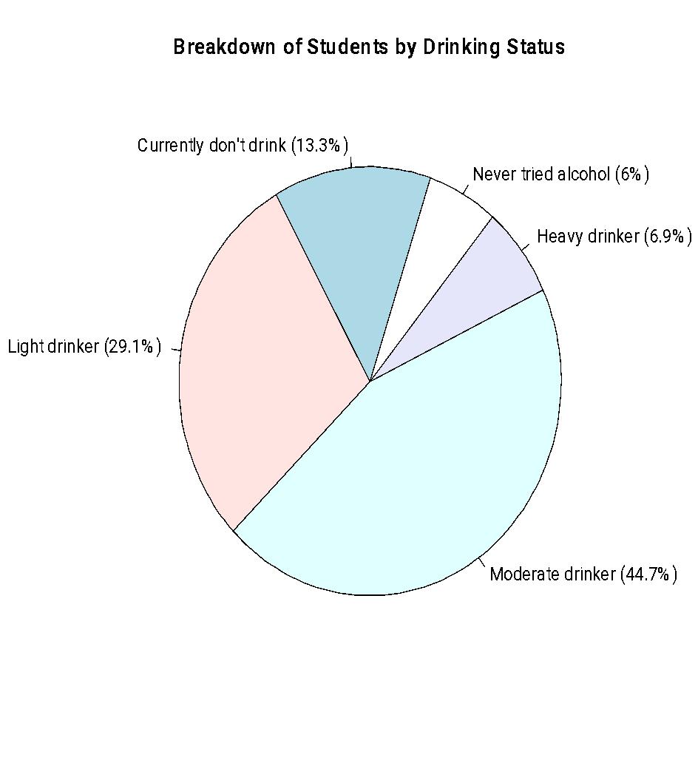
Exploring categorical data
Pie charts are a popular but less desirable alternative to bar plots and dot plots.
“Data that can be shown by pie charts always can be shown by a dot chart. This means that judgements of position along a common scale can be made instead of the less accurate angle judgements.”

Slide 28
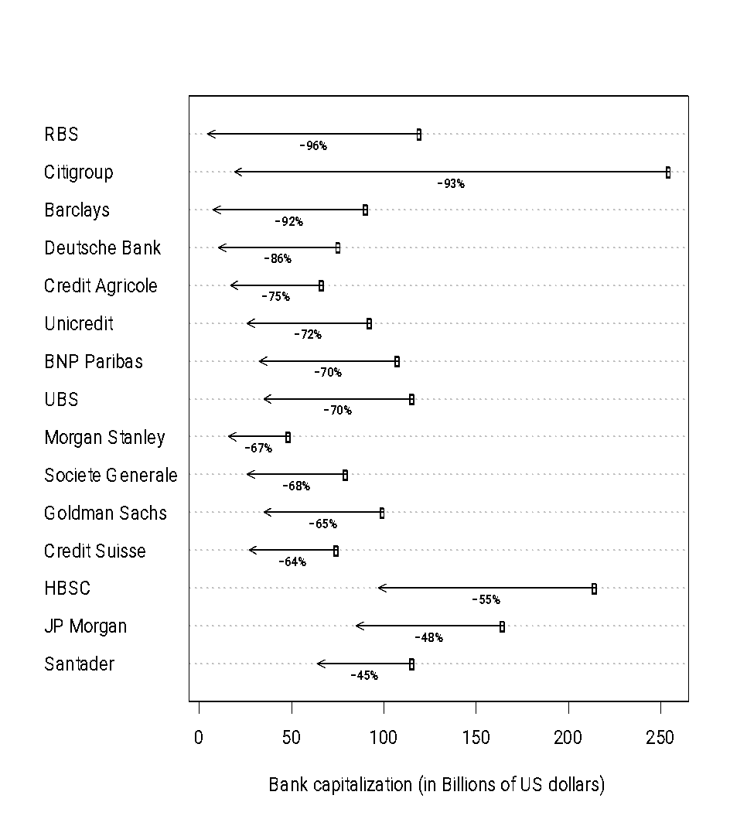
Exploring continuous data
Bar plots and dot plots can also be used to represent continuous data associated with various categories (not only proportions).
However, they are useful mainly when a single, or at most a small number of quantities are associated with each category.

Slide 29
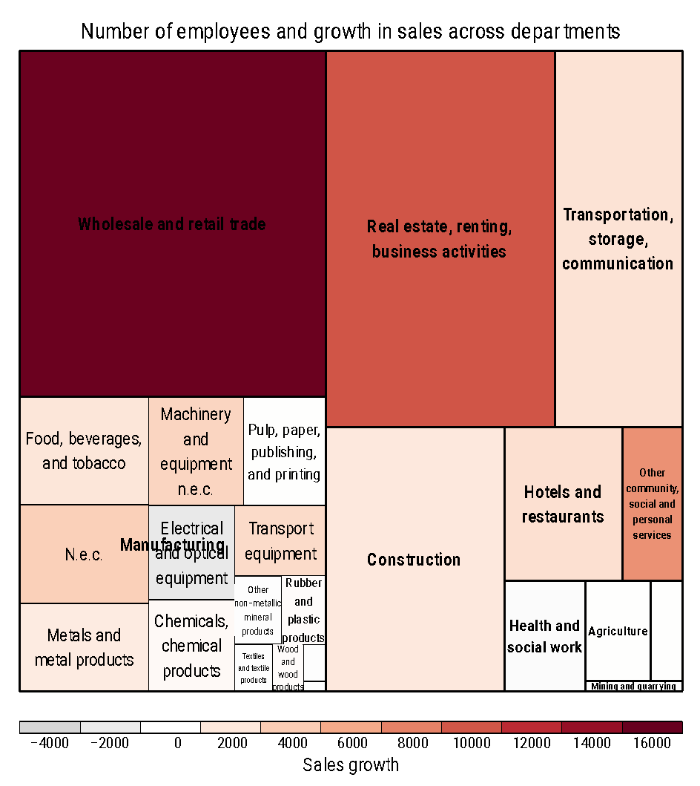
Exploring continuous data
When the multiple classification variables are present and there is a hierarchical (nested) structure rather than a crossed structure, tree maps are a viable alternative.
This treemap encodes two variables (one using the size of the square, another using color).

Slide 30
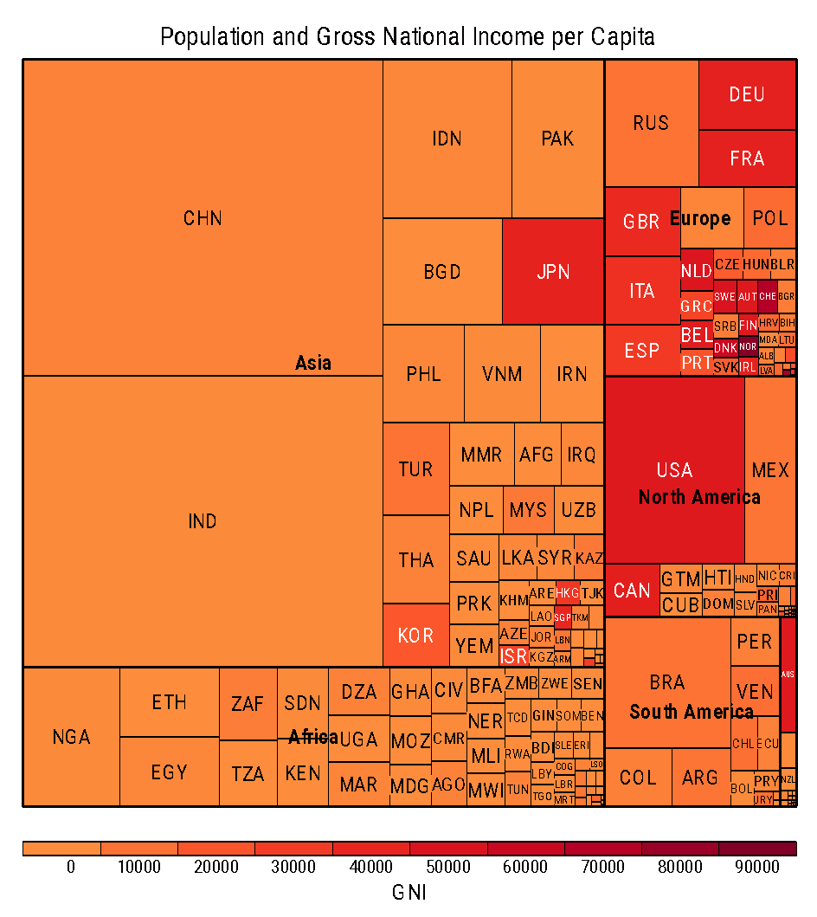
Exploring continuous data
The hierarchical structure here corresponds to countries, which are nested in continents.
Bold lines separate continents, areas of the big rectangles are proportional to the population of the continents.
Thinner lines partition continents into countries. Again, areas are proportional to populations.
Color encodes GNI.

Slide 31
Exploring continuous data
The main problem with tree maps is that they do not allow for accurate comparisons in any of the dimensions.
It is difficult to tell how much bigger the “wholesale and retail trade” than “real estate, renting, business activities” is (answer: about 23% larger).

Slide 32
Exploring continuous data
When a large number of values are associated with one or more categories, meaningful visualizations can be constructed by graphically representing some of the numerical summaries we discussed before!
This leads to some well known graphs:
Histograms/frequency polygons.
Boxplots.

Slide 33
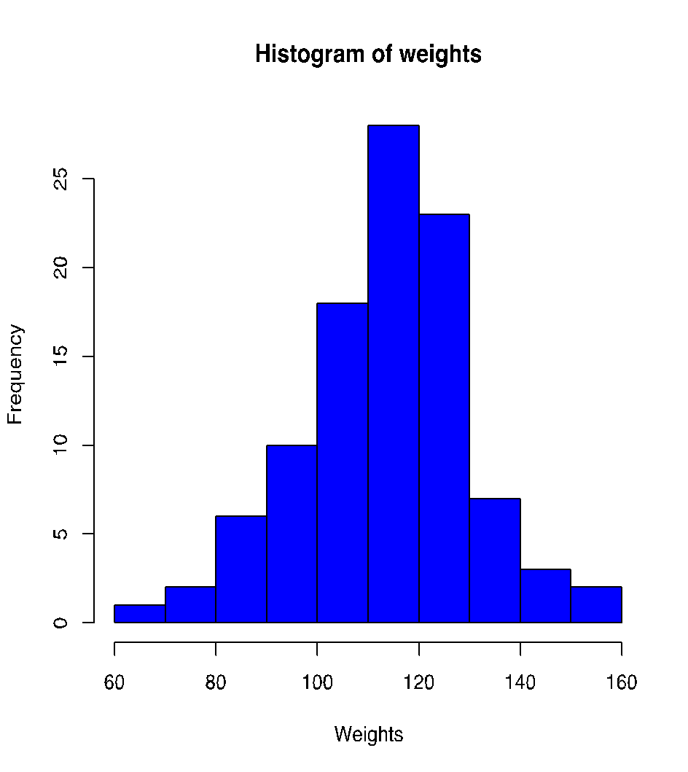
Histograms
A histogram is a graphical representation of the frequency table that uses the height of bars to represent the frequency on each class.
Note that it is very similar to a bar plot, but here it is important that the bars be strictly adjacent.
This histogram represents absolute frequencies.
You could instead represent relative frequencies.
The histogram would look the same, just the
scale of the y axis would change.

Slide 34
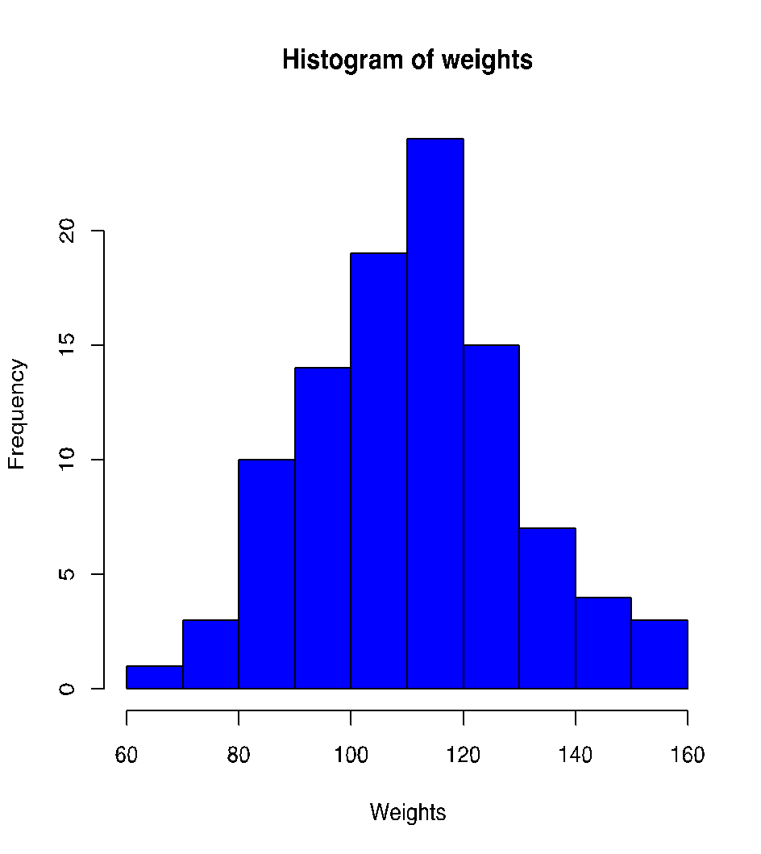
Histograms
A histogram with one major peak is called unimodal.

Slide 35
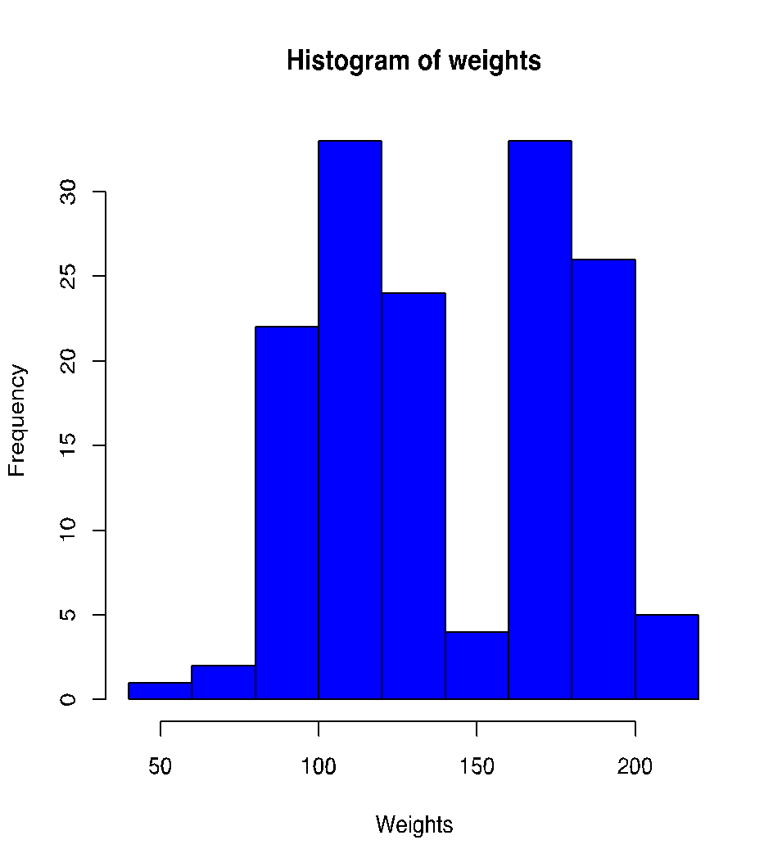
Histograms
A histogram with two major peak is called bimodal.
Bimodal distributions usually arise when working with mixed populations (an important categorical variable has been ignored).

Slide 36
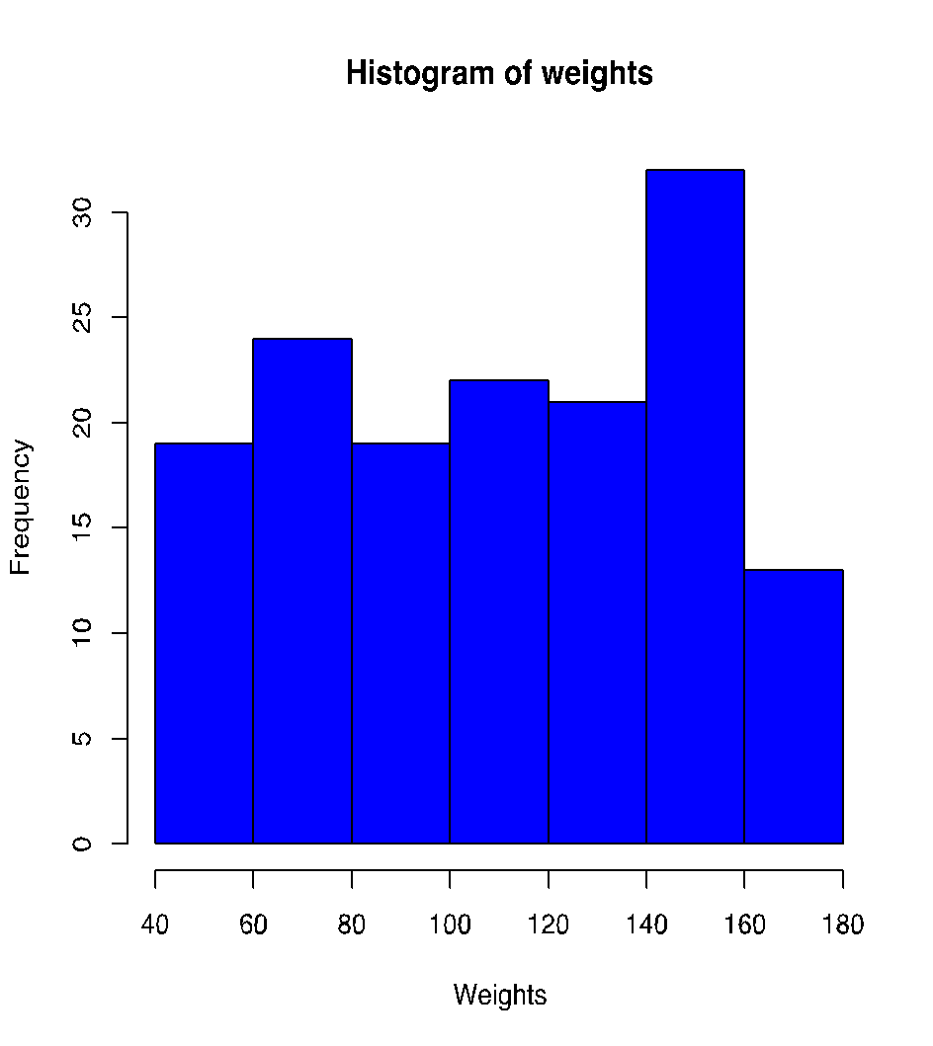
Histograms
A histogram with roughly the same number of observations per interval is called a uniform histogram.

Slide 37
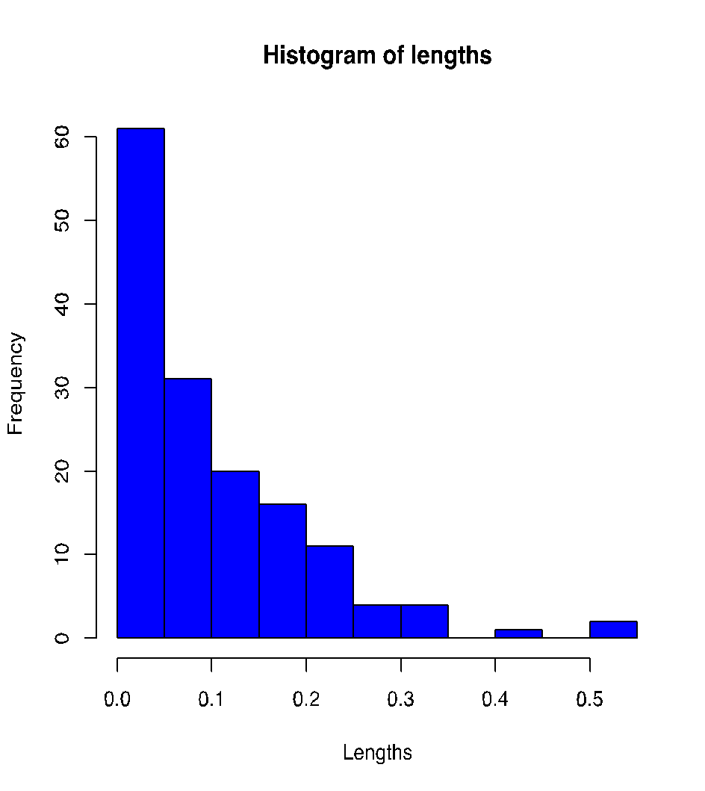
Histograms
When the right side of the histogram, with the larger half of the observations, extends a greater distance than the left side, the histogram is referred to as skewed to the right.

Slide 38
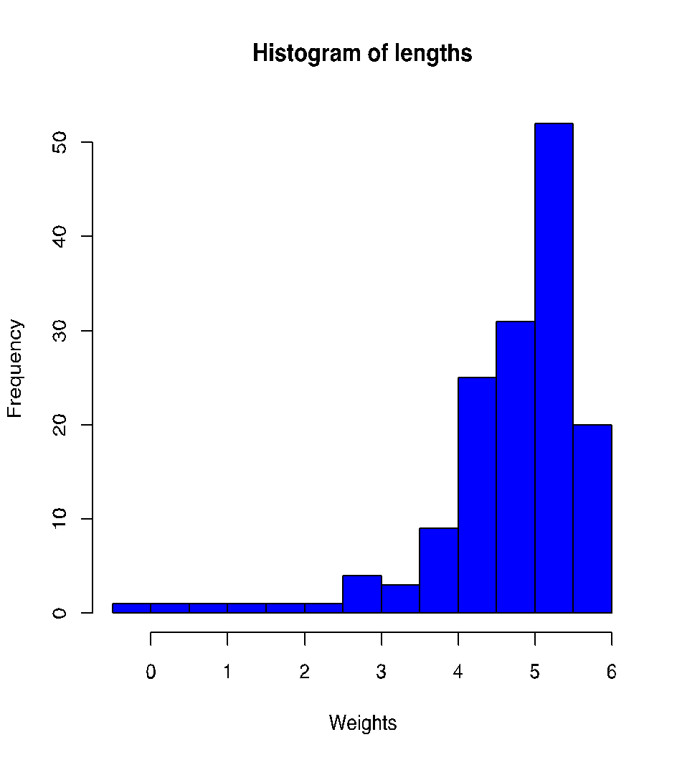
Histograms
When the left side of the histogram extends a greater distance than the right side, the histogram is referred to as skewed to the left.

Slide 39
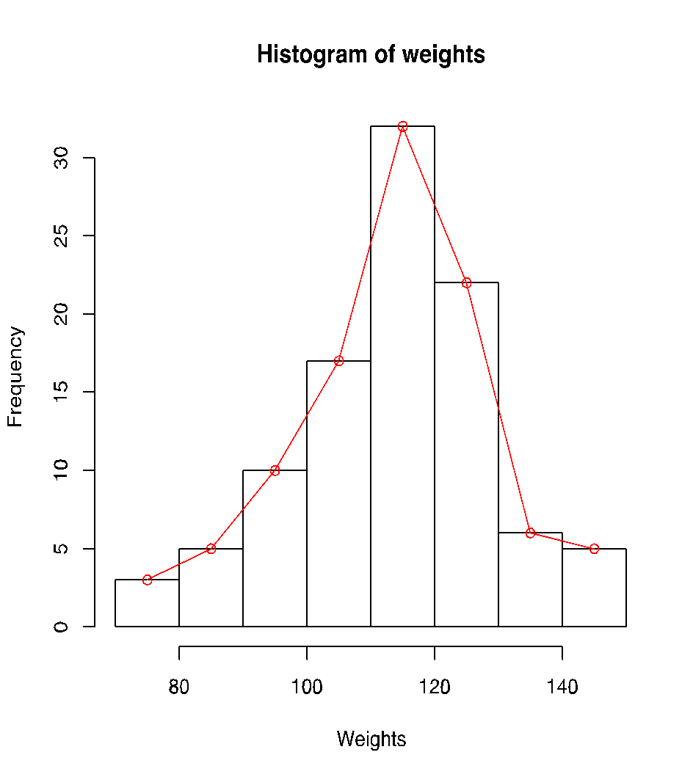
Frequency polygons
A frequency polygon is similar to a histogram, but replaces the bars with lines connecting the mid points of the tops of the bars.
They are particularly useful when comparing multiple groups of observations.

Slide 40
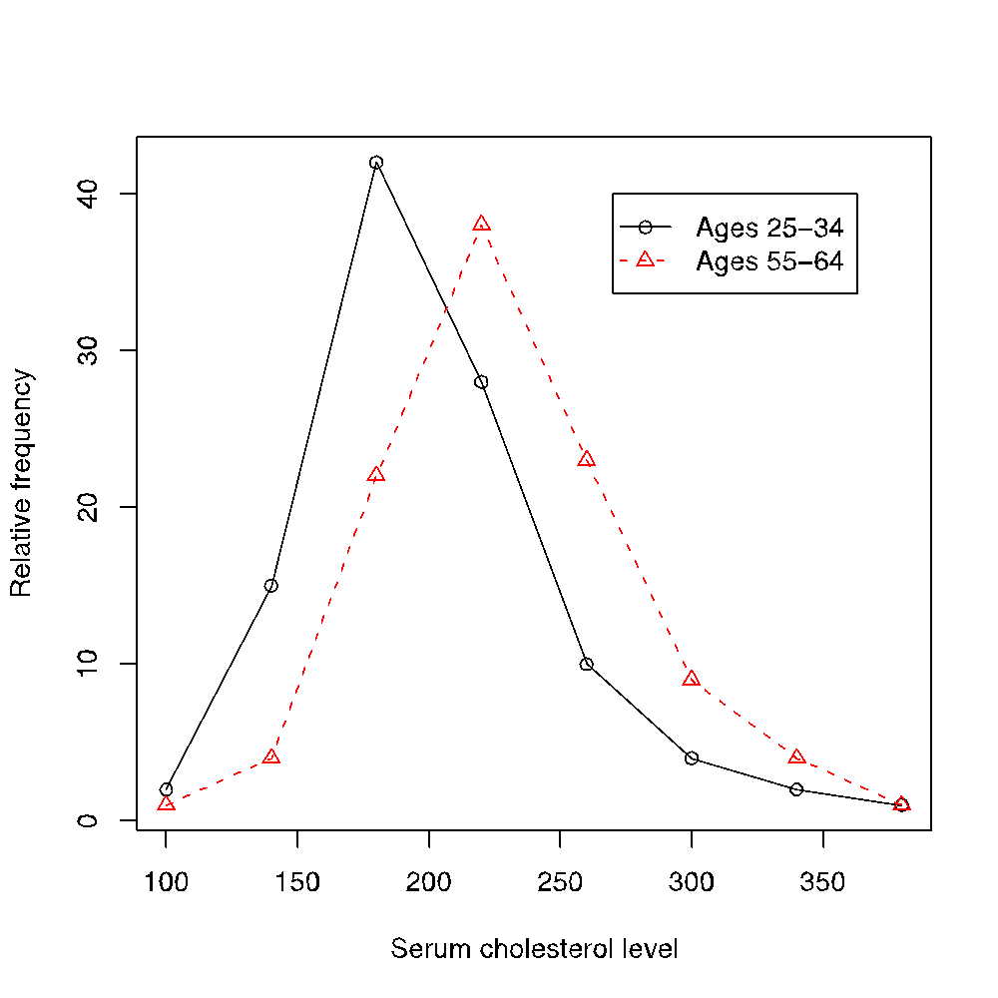
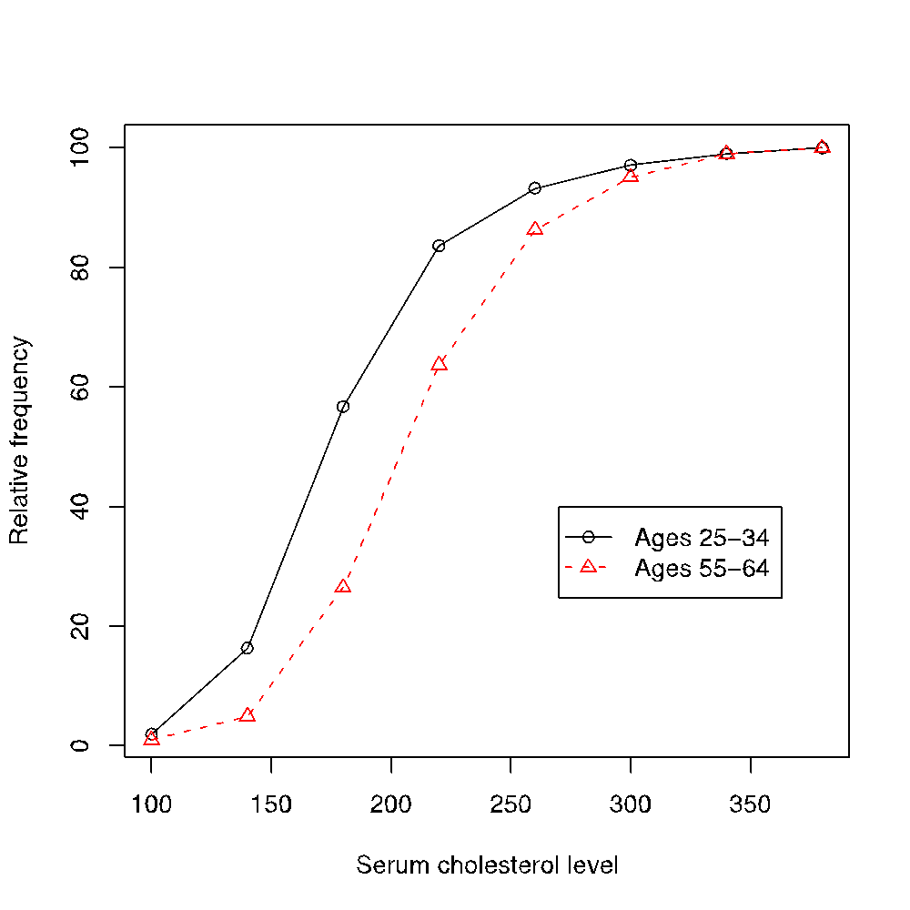
Frequency polygons
blood
Assume we want to compare the serum cholesterol levels for two age groups. What do these frequency polygons tell you?

Slide 41
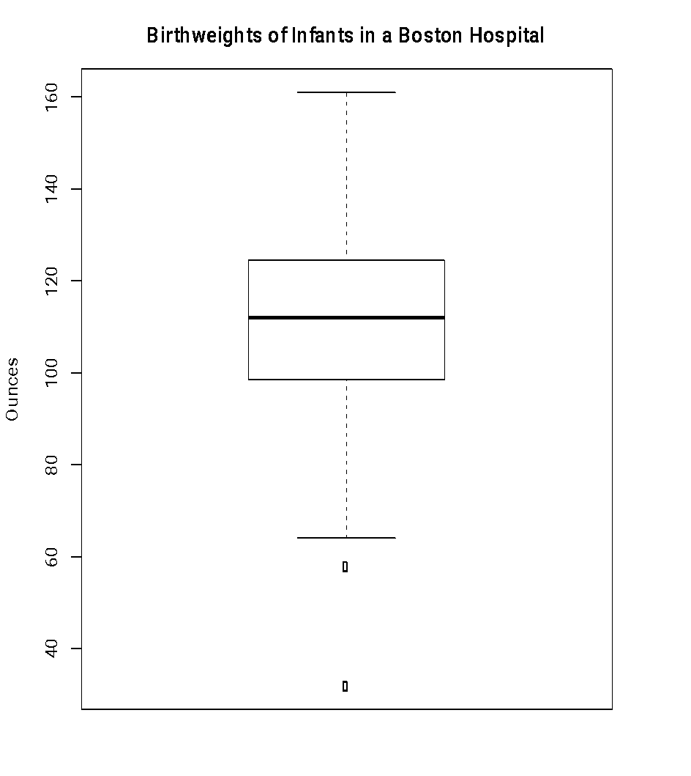
Boxplots
Rather than presenting frequency tables graphically, boxplots are based on the quartiles of the data.
They provide similar information to histograms and frequency polygons, but they facilitate comparisons across multiple groups and are robust to outliers.

Slide 42
Boxplots

Slide 43
Boxplots
To construct a boxplot:
Compute the quartiles Q1, Q2, Q3.
The central box extend between Q1 and Q3.
A line is drawn at Q2.
Lines projecting out of the box extend to adjacent values, i.e. the most extreme observations in the data that are not more than 1.5 the height of the box beyond either quartile.
Outliers (points outside the above range) are represented as circles.
Variations might include the mean, or use a smaller multiplier for the adjacent values.

Slide 44
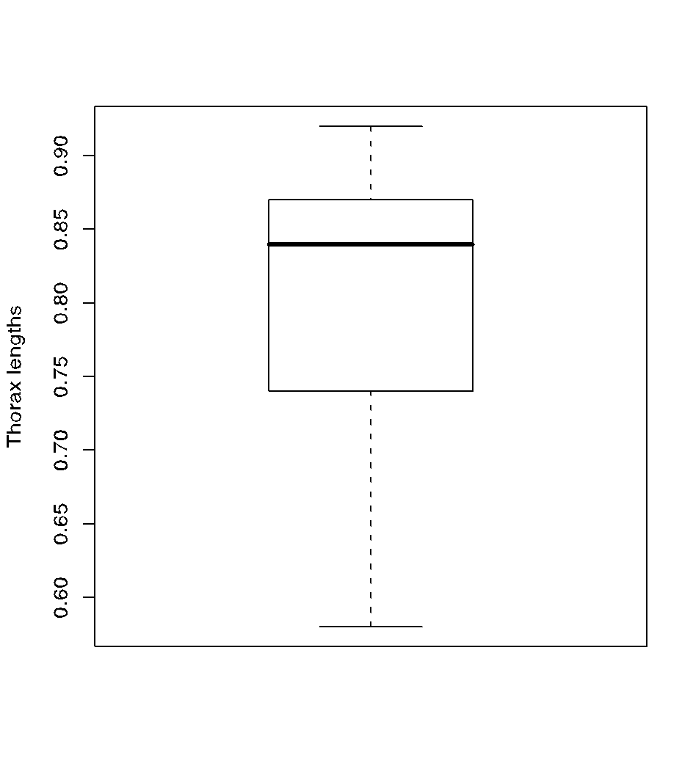
Boxplots
The distribution seems to be somewhat left skewed.
The interval (0.74, 0.87) contains the 50% central values.

Slide 45
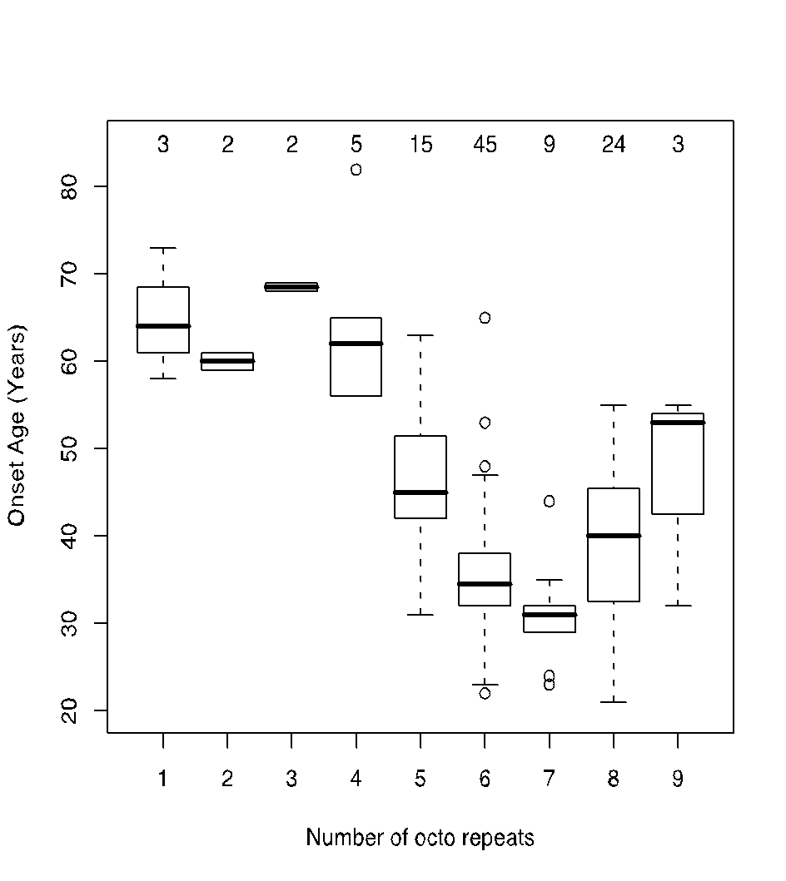
Boxplots
Onset age for patients suffering from prion disease for different number of octo repeats expansions. Numbers on top represent the number of observations in the group.

Slide 46
Boxplots
People with five or more repeats appear to have an earlier onset than those with four or more.
Onset age seems to be above 60 years for a small number of repeats and between 30 and 50 for a larger number.
Patients as young as 25 can suffer from the disease when a large number of repeat is present.

Slide 47
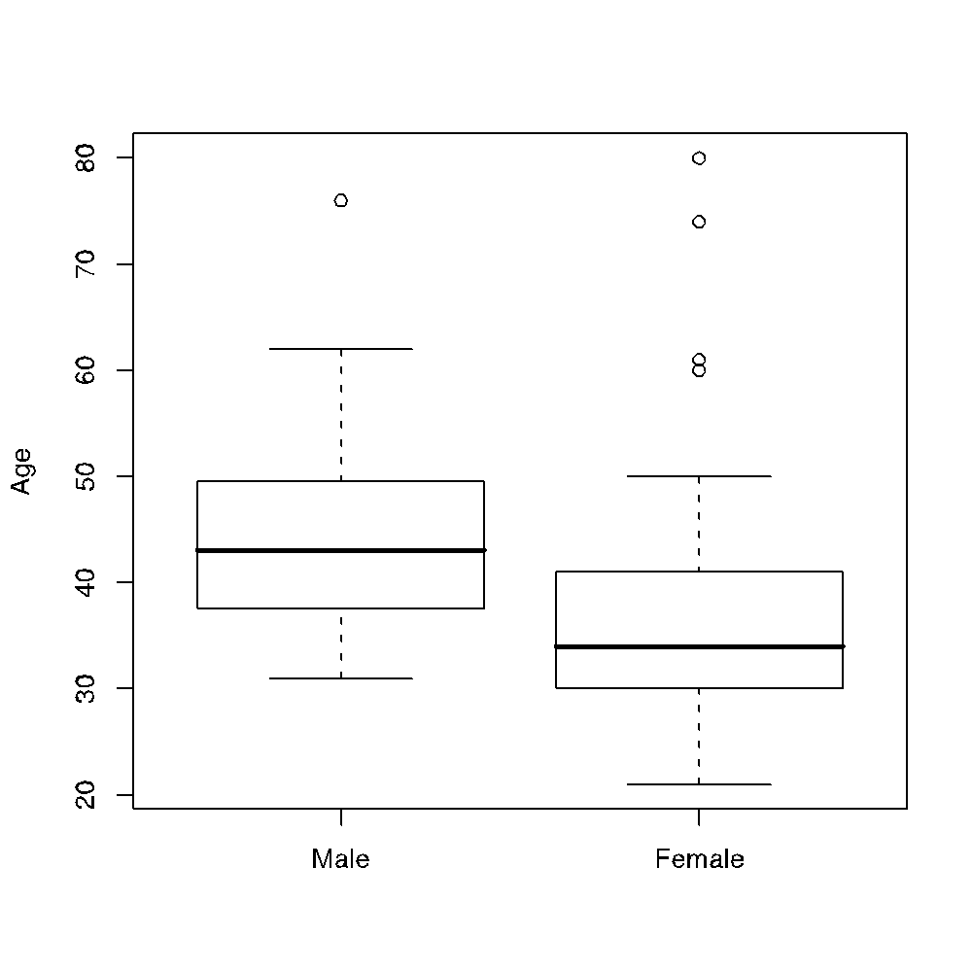
Boxplots
The boxplots correspond to the ages of actors and actresses who have won the Oscar. Which of the following is not necessarily true.
No male actor over 80 in the sample has won the Oscar.
25% of the actresses who have won the Oscar were 30 or younger.
75% of the actresses who have won the Oscar were under 45 years of age
At least 50% of the male actors who have won Oscars have been over 45.

Slide 48
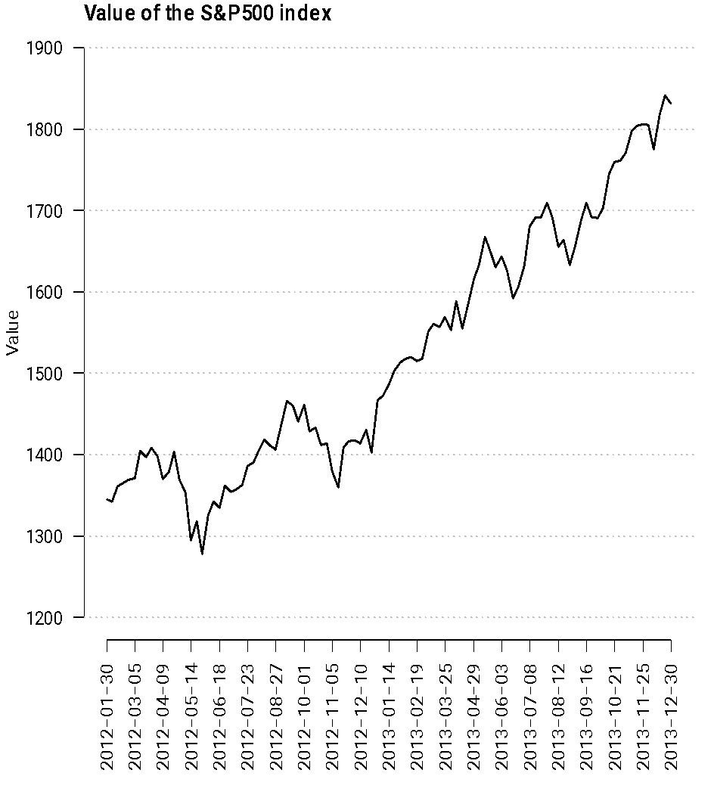
Exploring time series data
When exploring time series data we are interested in maintaining the order of the data!
Because of the sequential nature of the data, lines are preferable in this case: lines suggest continuity!

Slide 49
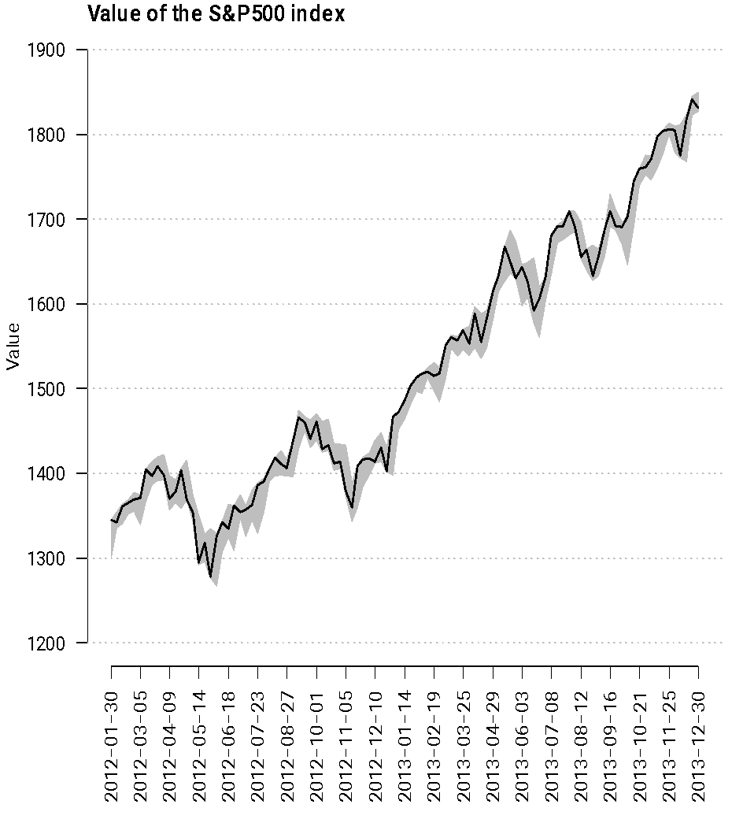
Exploring time series data
When multiple data points are available at each point in time, including some information about dispersion in the graph is useful!
Here we included a shaded area between the lines corresponding to the maximum and the minimum prices on each day.

Slide 50
Exploring dependence among variables
Previous summaries and visualizations allow us to explore variables independently from each other, but are not very good at showing us how two variables are related to each other:
Does one variable increase or decrease when the other increases?
We are often focused on linear correlations because they are simple to interpret.

Slide 51
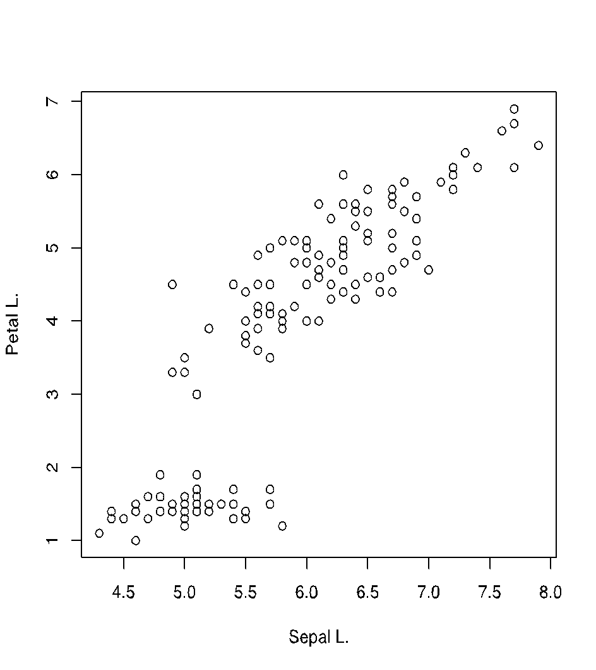
Scatterplots
Scatter plots use dots located on a Cartesian plane to encode the value of two continuous variables.
Petal length and sepal length: measures in centimeters of petal and sepal lengths for 150 flowers from each of 3 species of iris (setosa, versicolor, virginica).

Slide 52
Scatterplots
Note that using lines here would be meaningless: there is no sense or order associated with the pairs of numbers.

Slide 53
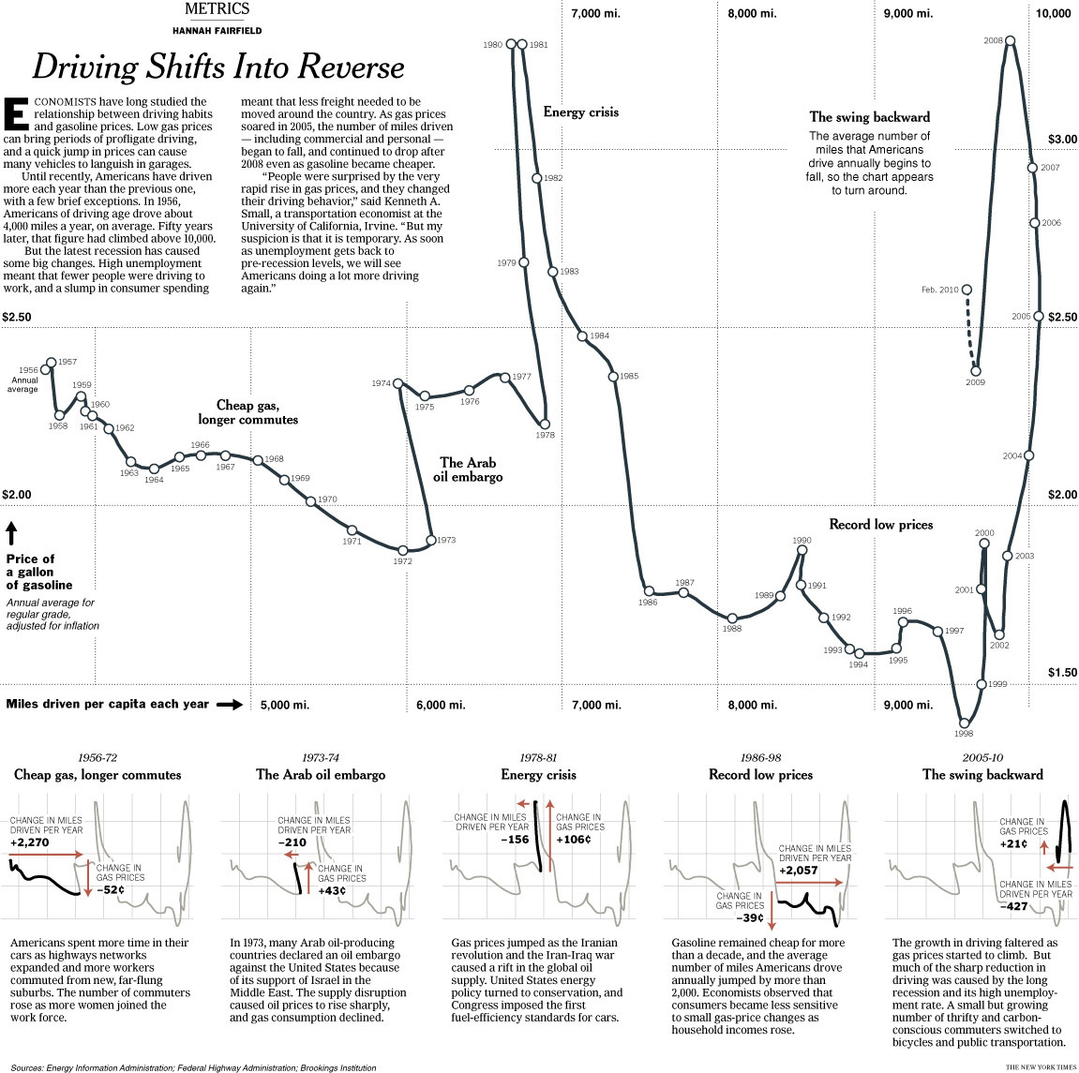
Scatterplots
However, when such a natural order does exist (and you don’t have too many points), joining the points (maybe with a curved line rather than a sequence of straight ones) would make sense.

Slide 54
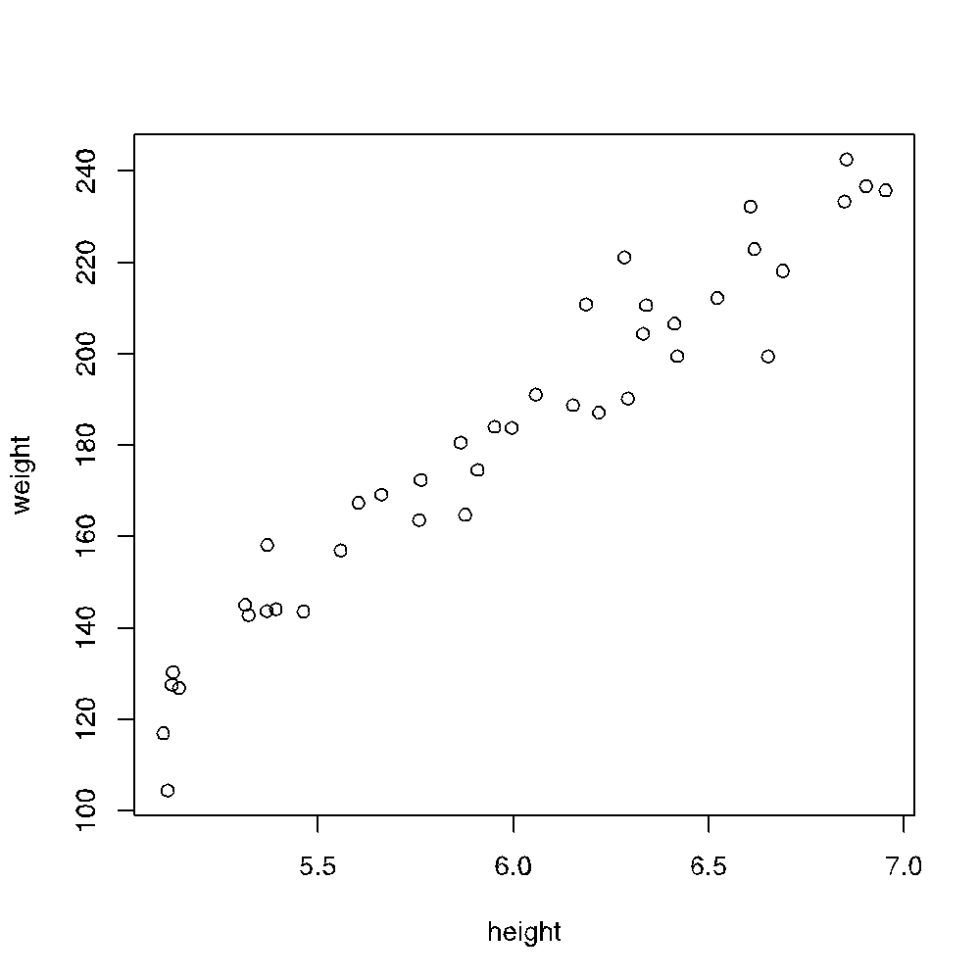
Scatterplots
From the attached scatterplot, what of following does not makes sense.
Weight tends to increase with height.
The relationship between height and weight is linear.
The average weight for a height of 6’ is 180 pds.
None of the above.
All of the above.

Slide 55
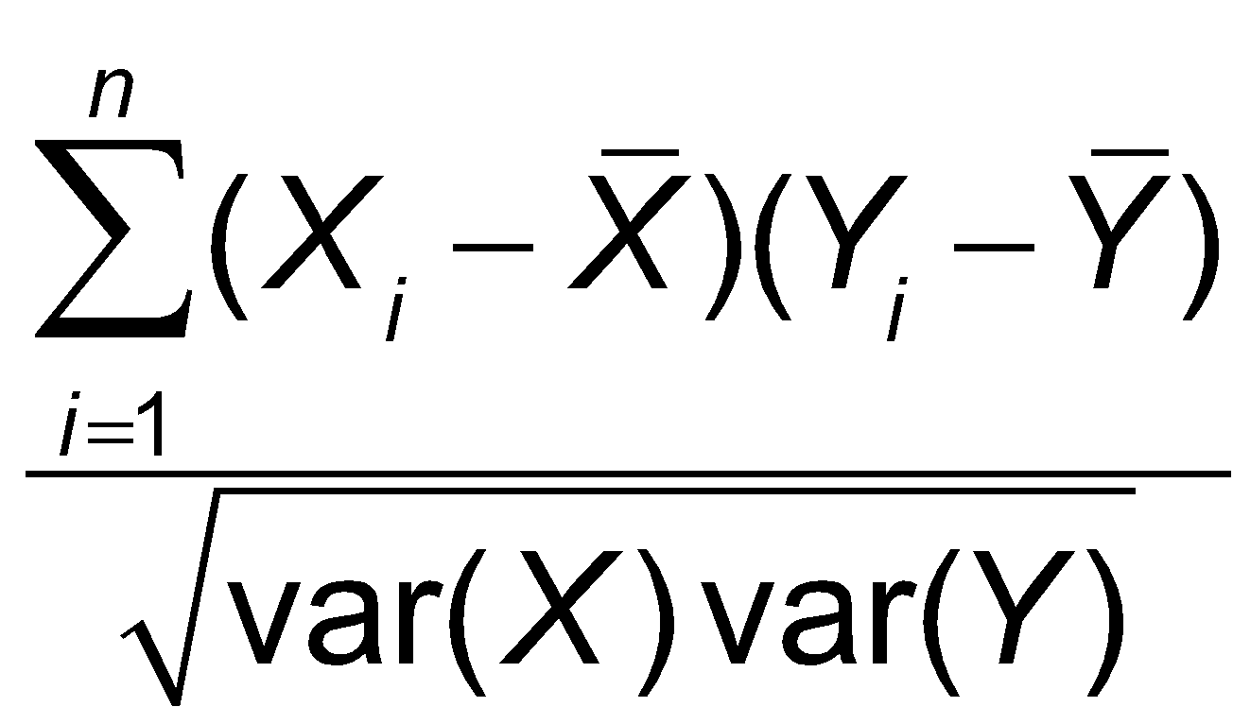
Exploring dependence among variables
The correlation coefficient is a numerical summary that measures the level of linear dependence between two variables!
Correlation coefficient varies between -1 and 1.
Values close to +1 indicate one variable grows linearly as the other does
Values close to -1 indicate one variable decreases linearly when the other increases.
Values close to 0 indicate no linear correlation.

Slide 56
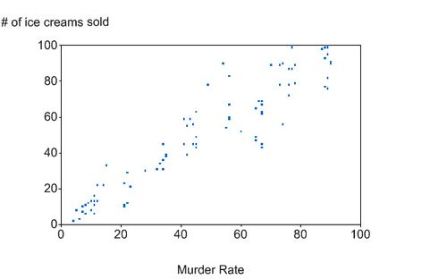
Exploring dependence among variables
You have to be careful not to confuse correlation with causation.
One very well known and repeatable correlation is that murder rates correlate to ice cream sales.
https://www.precisionnutrition.com/research-review-fish-oil-prostate

Slide 57
Exploring dependence among variables
MURDER CAUSES PEOPLE TO EAT ICE CREAM?
Even though ice cream sales and murders increase at the same time, lots of people buy and eat ice cream, not just murderers. In fact, even if every murderer bought ice cream after committing the deed, this would make no statistical difference.
If committing murder caused people to buy and eat ice cream, then nabbing bad guys would be as simple as hanging out at ice cream parlors and grocery stores near the freezer department!

Slide 58
Exploring dependence among variables
BUYING OR EATING ICE CREAM CAUSES MURDER?
If this were true, then banning ice cream would stop murder.
Ice cream parlors would be the epicenter of murders
Ice Cream
Murder

Slide 59
Exploring dependence among variables
BUYING OR EATING ICE CREAM CAUSES MURDER:
If this were true, then banning ice cream would stop murder.
Ice cream parlors would be the epicenter of murders
Muder
Ice Cream

Slide 60
Exploring dependence among variables
SOMETHING ELSE CAUSES THE INCREASE IN BOTH MURDERS AND ICE CREAM SALES:
Maybe warm weather leads to an increase on both variables?
Correlation is not directly between the to variables, but indirectly through a third variable.
Warm weather
Ice Cream
Murder

Slide 61
Some additional information
http://www.perceptualedge.com/articles/visual_business_intelligence/exploratory_vistas.pdf

