Slide 1

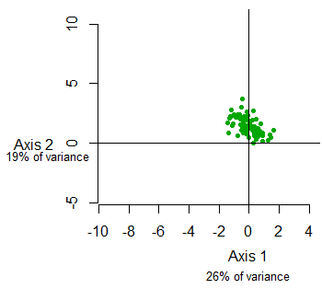
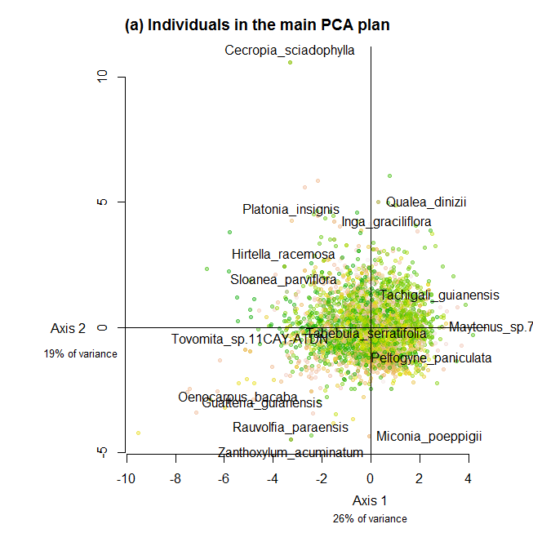
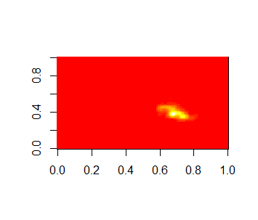
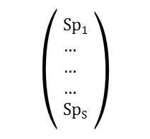
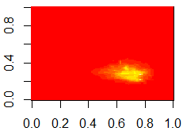
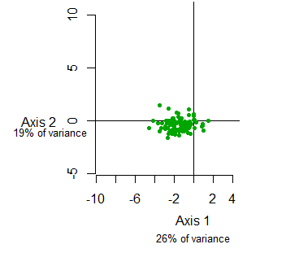
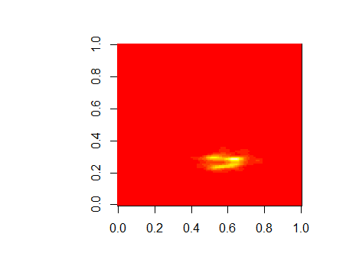

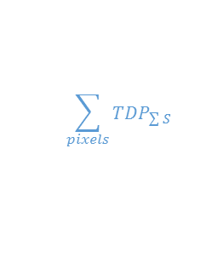
The functional redundancy is measured as the overlap among species in communities' functional space [Carmona et al., 2016]. First, the samples of the trait database are mapped in a 2-dimensional plan with a PCA analysis. Then, multivariate kernel density estimator associated with individual trees were give species traits probability distribution (TDP).
TDP, weighted by species abundance, are summed to give communities TDP: the functional redundancy is the sum of TDP overlaps, corresponding to the average number of species that could be removed from without reducing the functional space.
All species x Traits matrix
Individuals in the functional space
Species functional space
Species trait probability density (TDP)
Traits
Weighted sum for inventoried species
For each species (S)
Traitª₁ … … Trait^{x}₁
… …
… …
… …
Traitª_{S} Trait^{x}_{S}
PCA
Inventory TDP
Species
Sum across space
Kernel density
/
2D Normal dist.
$${Red}^{I}$$
…
…
$$\sum_{pixels}{{TDP}_{\sum{S}}}$$
Inventory
(I)
Species with several samples: kde2d
Species with only 1 sample: dnorm(), with species location in the space as mean value
But what standard deviation?
The lower the sd, the higher the redundancy (density values are higher)
For now I used the mean intraspecific sd from several-sample species

Slide 2
The functional redundancy is measured as the overlap among species in communities' functional space [Carmona et al., 2016]. First, the samples of the trait database are mapped in a 2-dimensional plan with a PCA analysis. Then, multivariate kernel density estimator associated with individual trees were give species traits probability distribution (TDP).
TDP, weighted by species abundance, are summed to give communities TDP: the functional redundancy is the sum of TDP overlaps, corresponding to the average number of species that could be removed from without reducing the functional space.
Individus dans l’espace fonctionnel
Espace fonctionnel
Densité de probabilité des traits (TDP)
Matrice Espèces x Traits
Traits
Pour chaque espèce
Somme pondérée par les abondances
Traitª₁ … … Trait^{x}₁
… …
… …
… …
Traitª_{S} Trait^{x}_{S}
ACP
TDP pour l’inventaire
Espèces
Somme sur l’espace
Estimation par noyau
/
Distribution Normale.
…
…
$${Red}^{I}$$
$$\sum_{pixels}{{TDP}_{\sum{S}}}$$
Inventaire

Slide 3
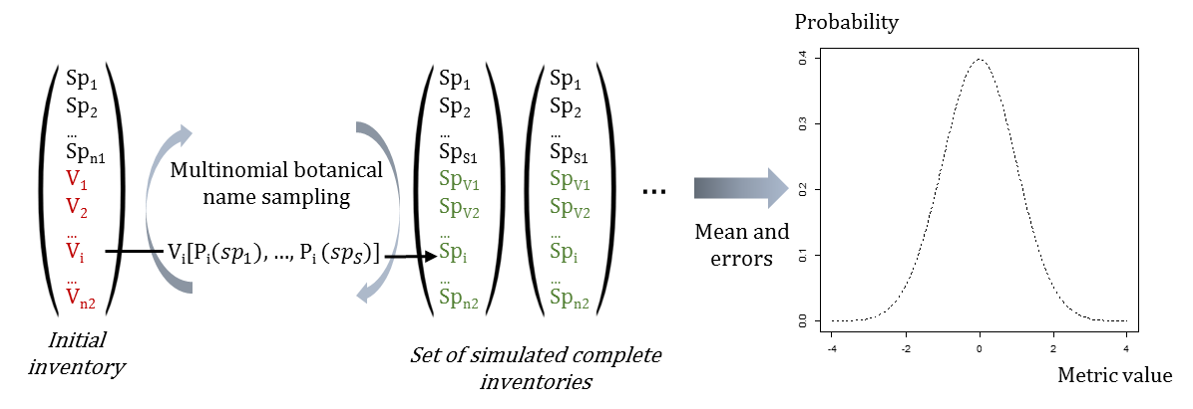
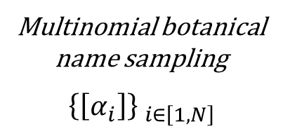
Probability
Sp₁
Sp₂
…
Sp_{S1}
V₁
V₂
…
V_{S2}
Sp₁
Sp₂
…
Sp_{S1}
Sp_{V1}
Sp_{V2}
…
Sp_{VS2}
Sp₁
Sp₂
…
Sp_{S1}
Sp_{V1}
Sp_{V2}
…
Sp_{VS2}
Multinomial botanical name sampling
$${\left\{\left[α_{i}\right]\right\} }_{i∈\left[1,N\right]}$$
…
Mean and errors
Initial inventory
Set of simulated complete inventories
Metric value

