Slide 1

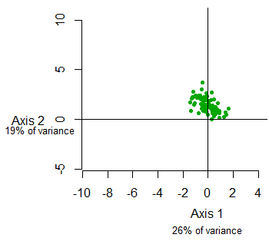
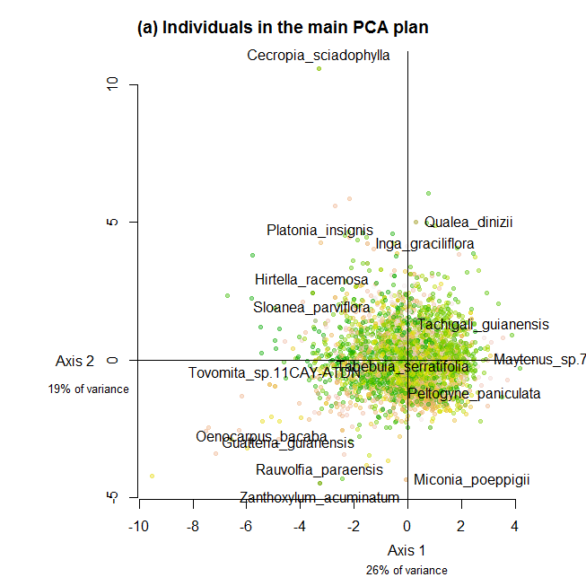
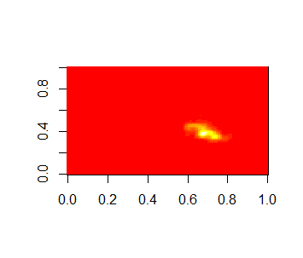
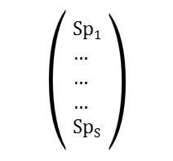
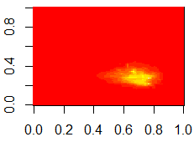
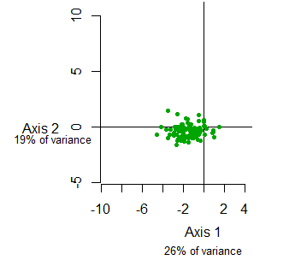
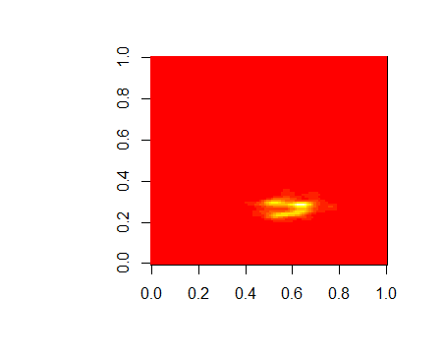


The functional redundancy is measured as the overlap among species in communities' functional space [Carmona et al., 2016]. First, the samples of the trait database are mapped in a 2-dimensional plan with a PCA analysis. Then, multivariate kernel density estimator associated with individual trees were give species traits probability distribution (TDP).
TDP, weighted by species abundance, are summed to give communities TDP: the functional redundancy is the sum of TDP overlaps, corresponding to the average number of species that could be removed from without reducing the functional space.
All species x Traits matrix
Individuals in the functional space
Species functional space
Species trait probability density (TDP)
Traits
Weighted sum for inventoried species
For each species (S)
Traitª₁ … … Trait^{x}₁
… …
… …
… …
Traitª_{S} Trait^{x}_{S}
PCA
Inventory TDP
Species
Sum across space
Kernel density
/
2D Normal dist.
$${Red}^{I}$$
…
…
$$\sum_{pixels}{{TDP}_{\sum{S}}}$$
Inventory
(I)
Species with several samples: kde2d
Species with only 1 sample: dnorm(), with species location in the space as mean value
But what standard deviation?
The lower the sd, the higher the redundancy (density values are higher)
For now I used the mean intraspecific sd from several-sample species

