Slide 1

Microsoft Word: A Comprehensive Guide
Welcome to this comprehensive guide to mastering Microsoft Word. We will explore the basic and advanced features of this powerful word processing software.
Mr.Mazaheri
Presented by Nima Soltani
Fall 1403

Slide 2
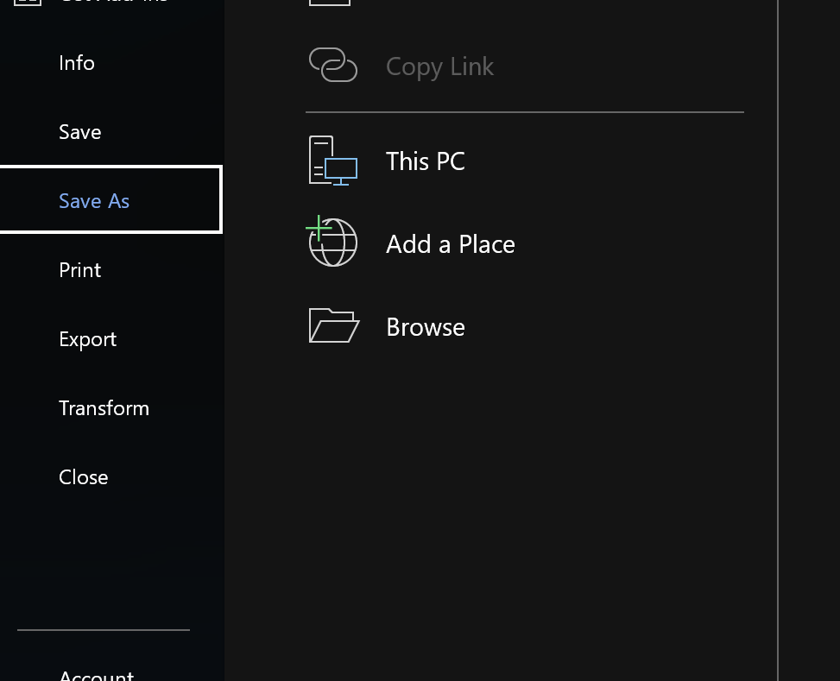
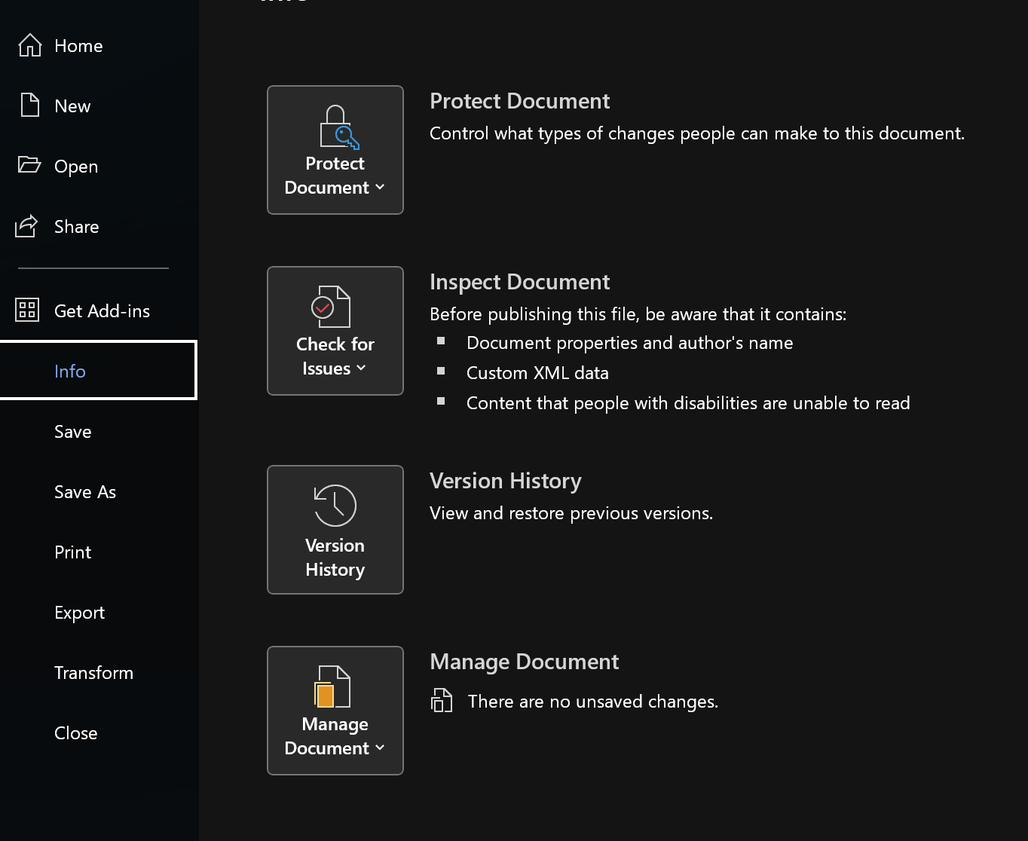
File Management Fundamentals
Saving and Opening Files
Document Management Techniques
Learn the basics of saving documents, selecting appropriate file formats, and efficiently opening files.
Explore best practices for organizing documents, using folders, and applying descriptive file names for easy retrieval.

Slide 3
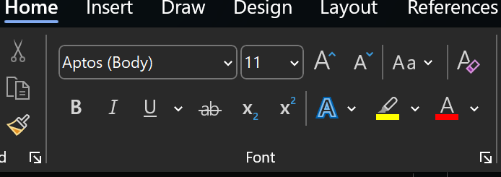
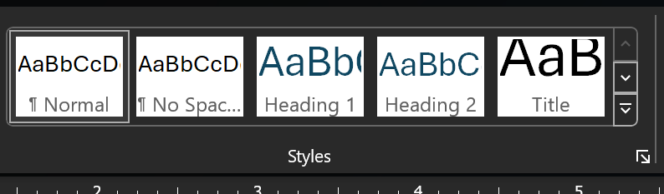
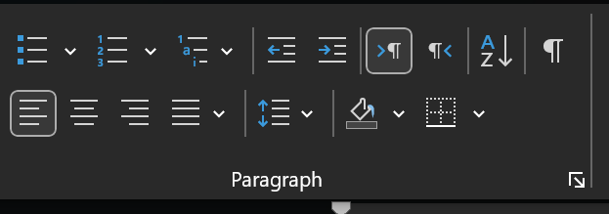
Styling Your Text and Paragraphs
Font Selection
Paragraph Formatting
Text Effects and Styles
Choose from a wide range of fonts and adjust their size, style, and color to create visually appealing documents.
Control paragraph alignment, spacing, indentation, and line height for a polished presentation.
Explore a variety of text effects, including bold, italic, underline, and highlighting.

Slide 4
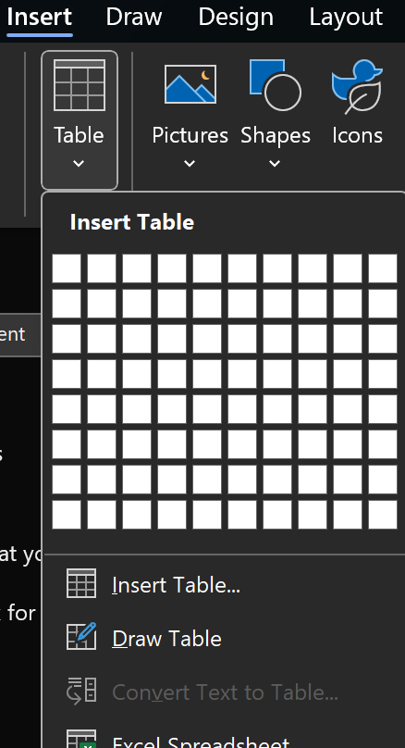
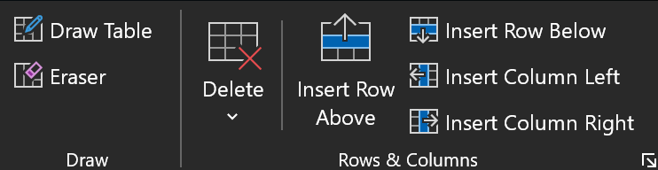
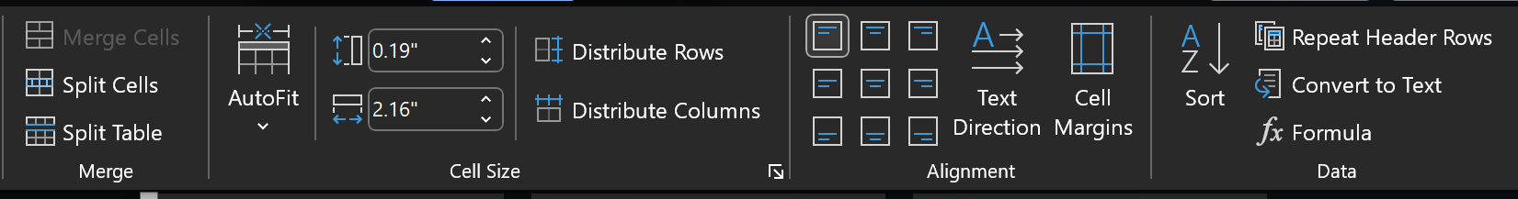
Tables and Columns for Structure
Column Formatting
Creating Tables
Explore ways to create columns for text and images, adjust column width, and enhance visual appeal.
Learn how to insert tables, define rows and columns, and apply formatting to create organized structures.
Table Data Manipulation
Discover how to merge, split, and sort table cells to refine and analyze data effectively.

Slide 5
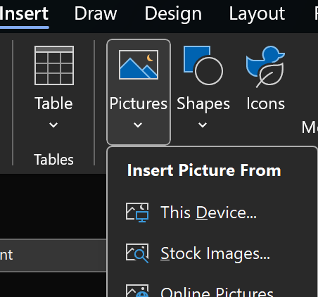

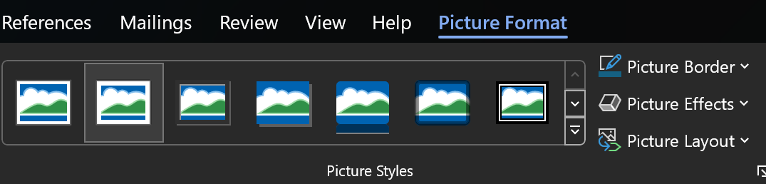

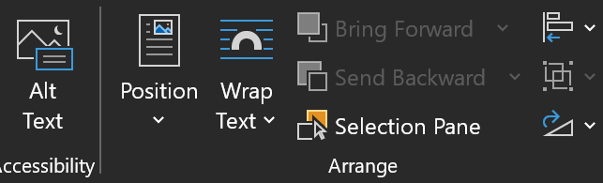

Images and Visual Elements
Inserting Images
Learn how to add images from your computer, the web, or other sources to enrich your documents.
Image Formatting
Explore resizing, cropping, and positioning options to optimize image display within your document.
Image Captions
Add descriptive captions and alt text to images to provide context and accessibility.

Slide 6
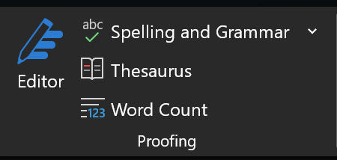
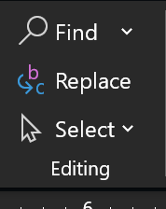
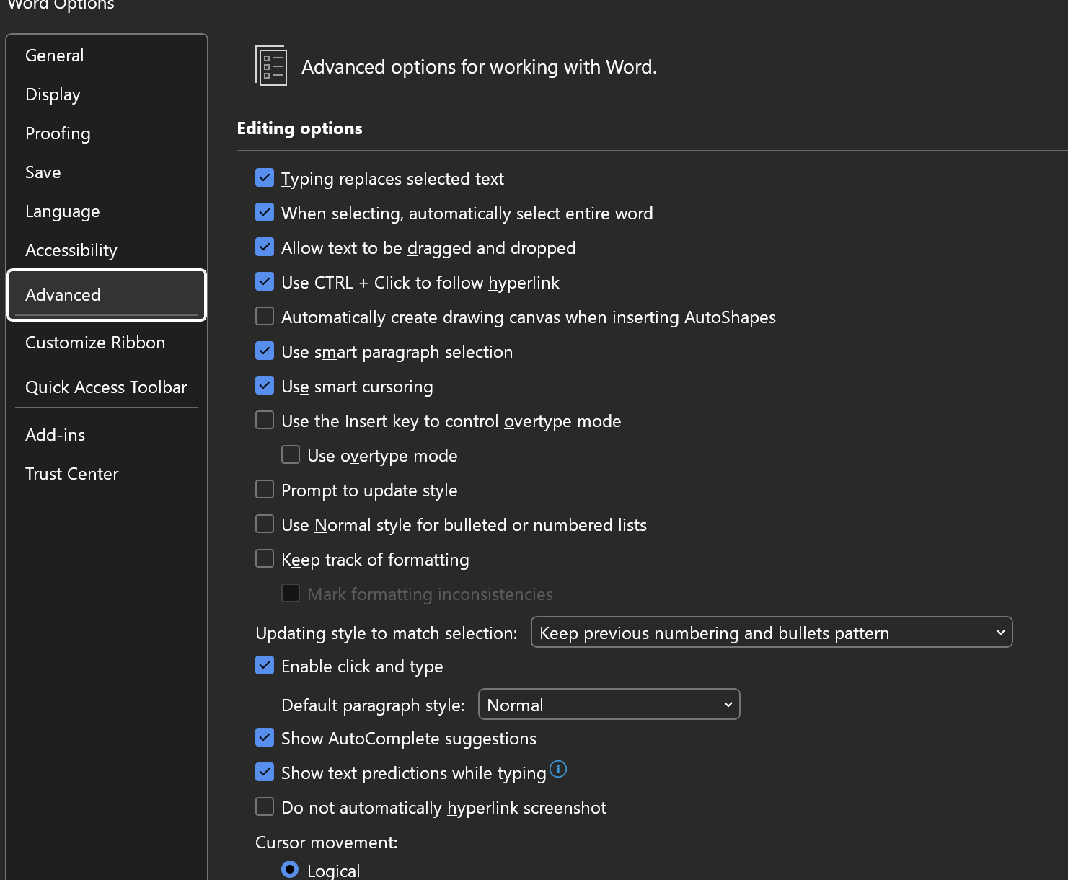
Advanced Editing Features
1
Spell and Grammar Check
Utilize built-in tools to identify
and correct spelling and grammar
errors for professional-looking documents.
2
Find and Replace
Efficiently search and replace
text within your document
, saving time and ensuring consistency.
3
Advanced Formatting Options
Explore advanced formatting features,
including bookmarks, cross-references,
and styles for complex documents.

Slide 7
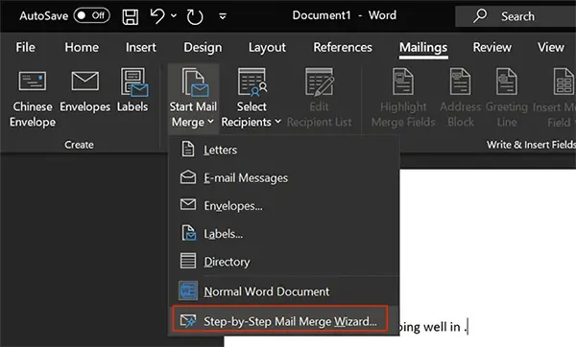

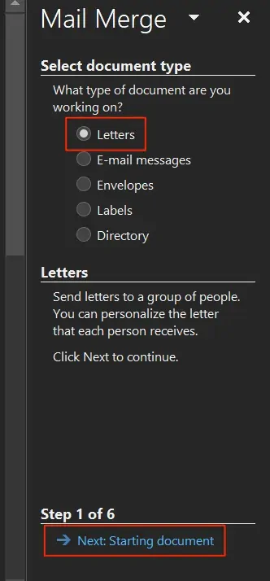


Automating with Mail Merge
Creating Data Sources
Learn how to create and manage data sources containing recipient information for mail merges.
Merge Fields and Templates
Understand how to insert merge fields into your documents to personalize content for each recipient.
Generating Personalized Documents
Create personalized letters, labels, envelopes, and other documents with mail merge functionality.

Slide 8



Collaborating and Sharing
Cloud Storage and Sharing
1
Explore cloud-based solutions for storing, sharing, and collaborating on Word documents.
Version Control and Track Changes
2
Utilize tools for tracking revisions, managing versions, and resolving conflicts during collaboration.
Real-time Collaboration
3
Work simultaneously with others on a document, allowing for real-time editing and communication.

Slide 9
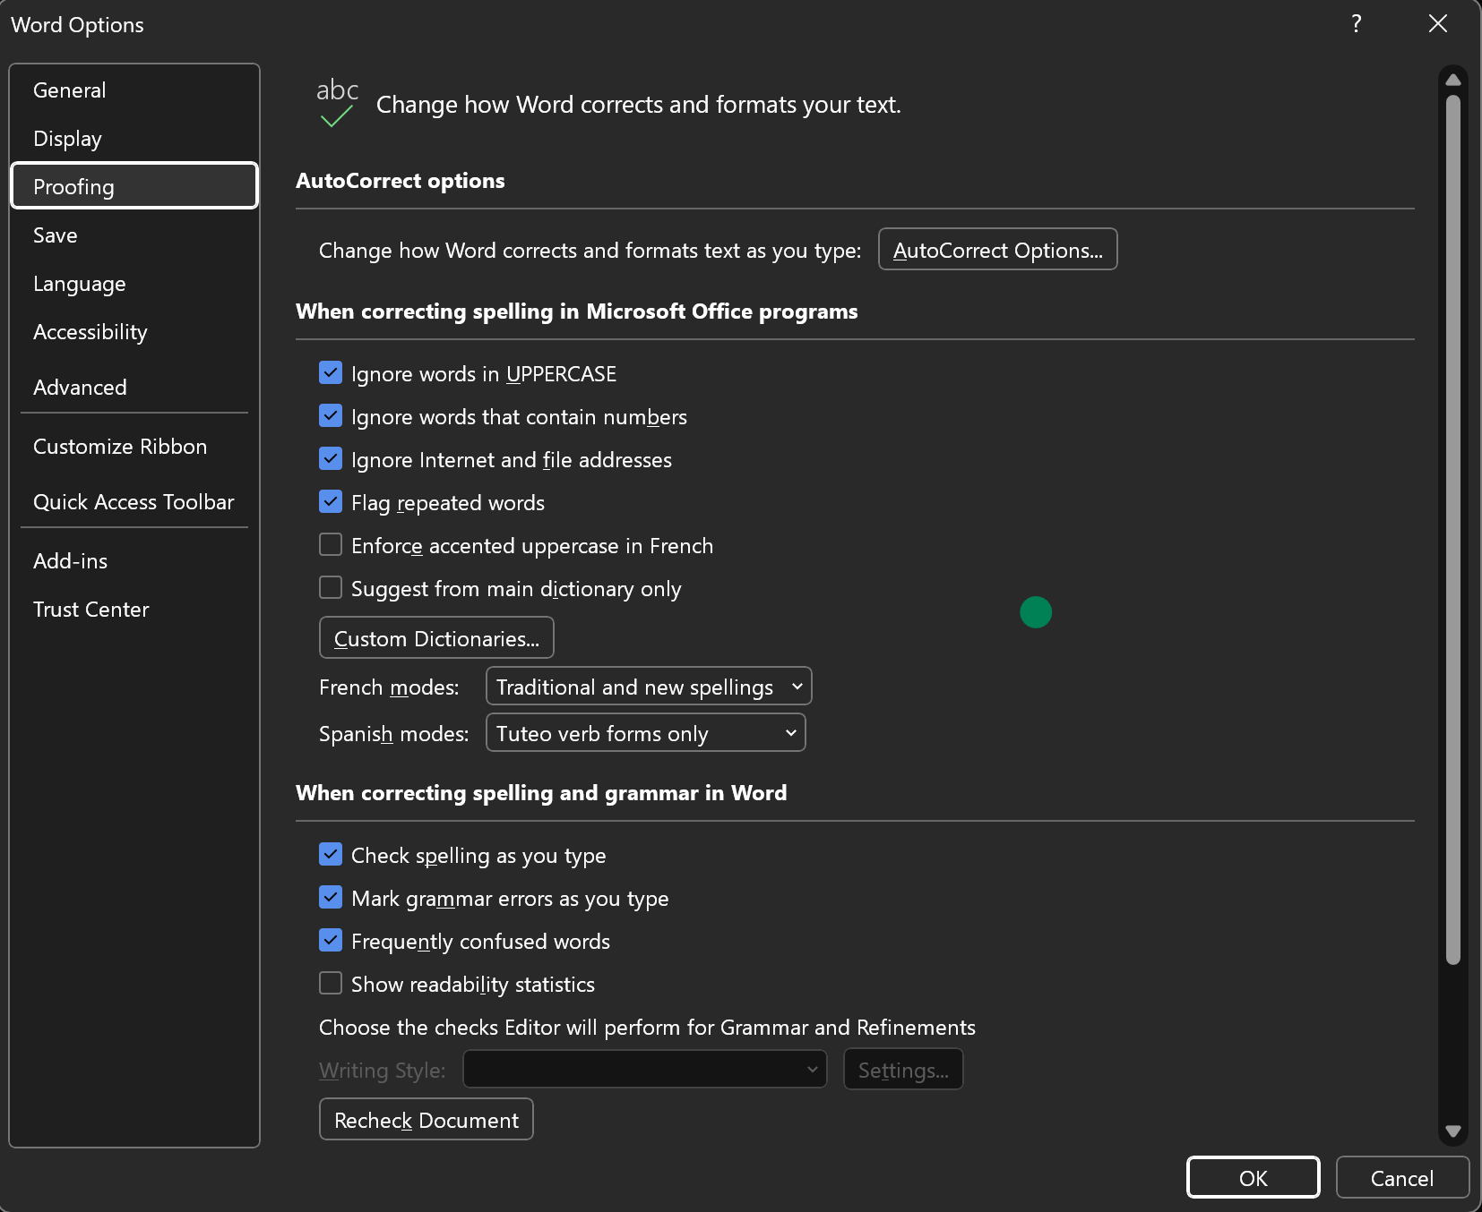
Troubleshooting and Customizations
Common Word Issues
Learn how to identify and resolve common errors and issues encountered when working with Word.
Customization and Personalization
Explore ways to customize Word settings, toolbars, and templates to tailor the experience to your preferences.
Resource and Support Options
Discover where to find help and support, including online documentation, forums, and tutorials.

Slide 10

Recommended Resources and Links
1
Microsoft Office Support
Get comprehensive help and guidance from Microsoft.
2
Word Tips and Tricks
Explore advanced techniques and shortcuts.
3
Free Online Courses
Enhance your skills with free online courses.

Slide 11
THANKS
Any questions?

