Slide 1
retrospective
CIS 440 ∙ Dr. Joseph Clark

Slide 2
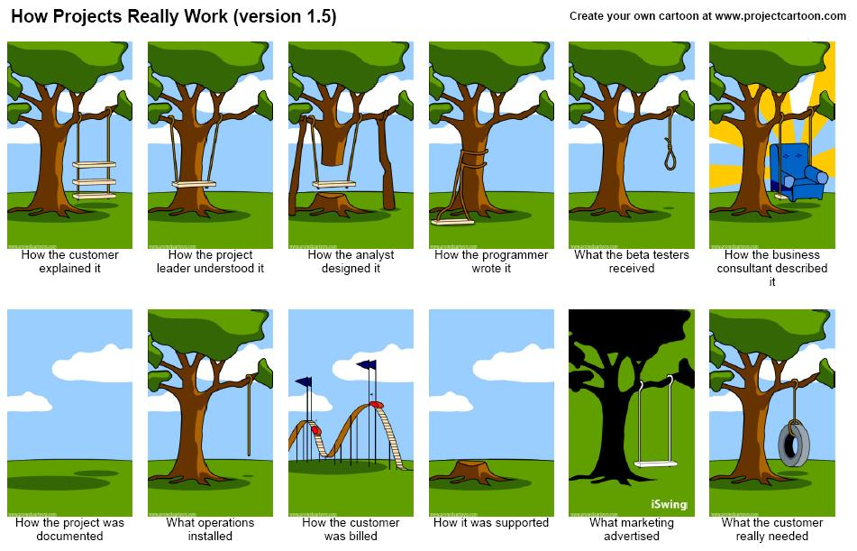

Slide 3
Congratulations!
Good work on the projects!
I heard nothing but positive comments from your clients, and other faculty and guests who attended the demonstrations on Tuesday.
Client Feedback
If your clients haven’t received the final deliverable yet, schedule a meeting or presentation for them.
I am sending a feedback questionnaire to your clients and will follow up with them to make sure they do it.

Slide 4
Follow-up
Make sure the final versions of your code and README files are committed to GitHub by the end of today.
Your final report is due by midnight tonight – if you haven’t already finished it, submit via Blackboard or e-mail it to me tonight.
I am willing to wait until tomorrow if you want to do a nice high-quality printout.
You should see grades for your personal project and the “scavenger hunt” assignments by tomorrow.
…if not, check with me.
Please copy or back up the files that are on GitHub. I may delete the repo soon.
Especially if it is a private repository. I only have a limited number of licenses for private repos, so I will delete them before the spring semester starts.

Slide 5
Leverage this experience
It’s always good to get as much mileage as you can out of a school project!
Here are some suggestions:
Add the project to your resume/CV.
Add to your CV any new programming languages or software tools you learned.
Ask your client to consider writing you a letter of recommendation.
Blog or write something about “lessons learned”.
Send your write-up to your home-town newspaper, magazine, or some other media that might report on it.
Clone the project to your personal GitHub profile, so people can see your work.
Ask your client for a job, or offer to partner with them in their startup.

Slide 6
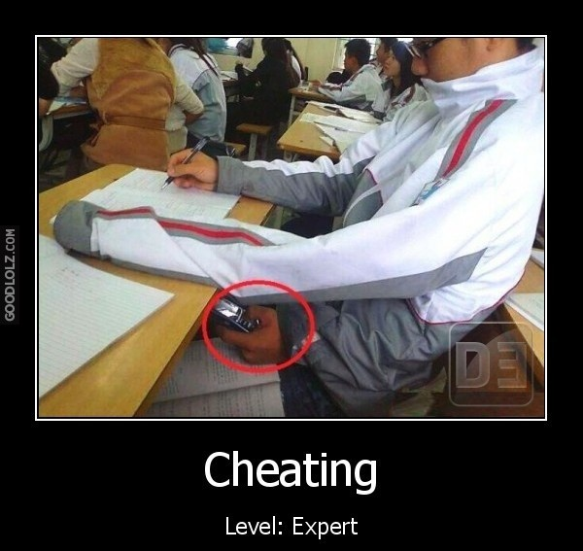
Your final exam
The CIS Skills Assessment is previewed on the course Blackboard site. You can see the questions and the grading criteria.
There’s no single right answer for the case study, so be creative—pick some aspect of the “proposal” that appeals to you and go with that.
You get one page for each question. Scratch paper is available, but we’re really looking for quality, not quantity.
It is open-book, open-notes. Feel free to bring anything you think will help you as long as it’s not an electronic device, and you’re not communicating with friends or helpers.

Slide 7
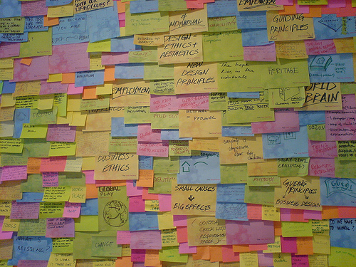
Feedback for improving the class
One final “retrospective” activity.
Form groups of any size (doesn’t have to be your project teams) and “design your own capstone course”.
Using an abundance of sticky notes and whiteboard markers, design a 15-week schedule of topics and activities (2 meetings per week) for this course in the future.
When done, tell the class about how it would differ from the schedule we used this fall.

