Slide 1
ACTIVE DIRECTORY AUTOMATION COMPLETE TUTORIAL
How to get user account expiration date:Part 11
TOTAL TECHNOLOGY

Slide 2
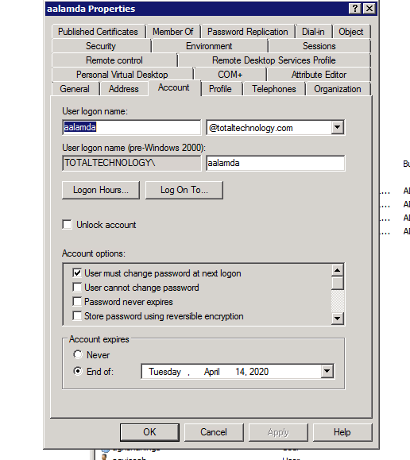

TOTAL TECHNOLOGY

Slide 3
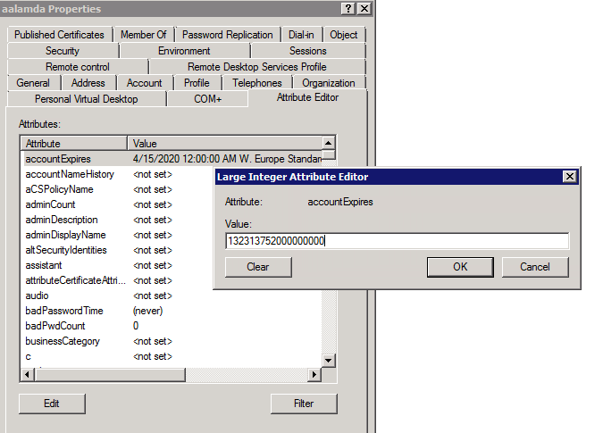
TOTAL TECHNOLOGY

Slide 4
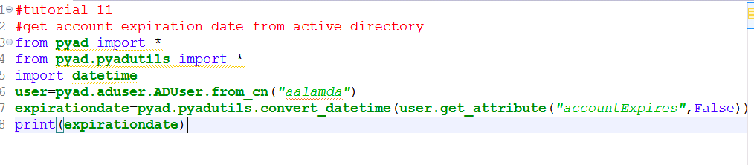
CODE
TOTAL TECHNOLOGY

