Slide 1
NUMPY COMPLETE TUTORIAL MACHINE LEARNING PREREQUISITE
Numpy Array Slicing In Detail
Tutorial 9

Slide 2
What is slicing
With 2d array
Will be applied on both dimension first on row wise & then column wise
: is used for slicing
Separated by , (comma)
: is called slicing call
Can be mixed up with get item call(inedxing)
Slicing keeps the dimension intact
Get item call collapses one dimenson

Slide 3
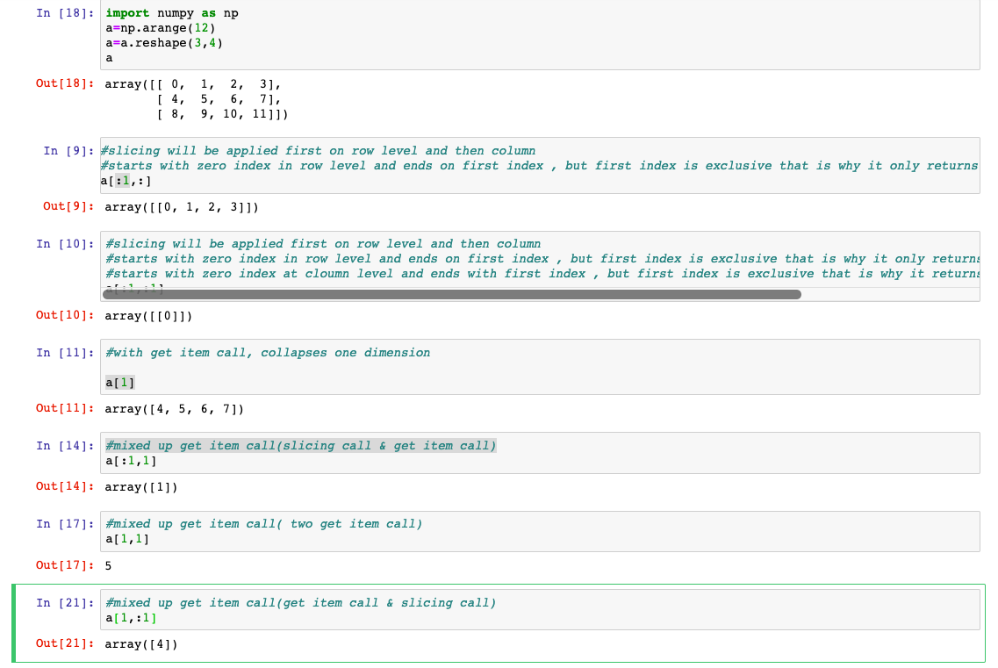
Example
0 1 2 3
4 5 6 7
8 9 10 11

