Slide 1
Whatsapp Automation Complete Tutorial
How to create VIP access for using Whatsapp Bot
Tutorial :8

Slide 2
Pre-requisites
Twilio acoount
Ngrok
Mongodb atlas or any db
Api to get live data
https://rapidapi.com/api-sports/api/covid-193

Slide 3
Database Setup
Sign up for mongodb cloud instance from https://cloud.mongodb.com/
Create database and collection with name (anything you want)

Slide 4
Flow
DB
3rd party api
Code or application
User phone
Twilio sandbox

Slide 5
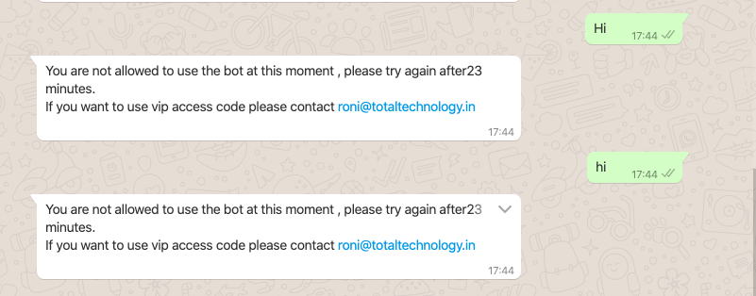
Present scenario

Slide 6
Use case
Genaral users should not use the bot for 30 minutes after one successful request and vip users can access without restriction
How to do that ?

