Slide 1
NUMPY COMPLETE TUTORIAL MACHINE LEARNING PREREQUISITE
More Examples On Numpy Array Creations
Tutorial 5

Slide 2
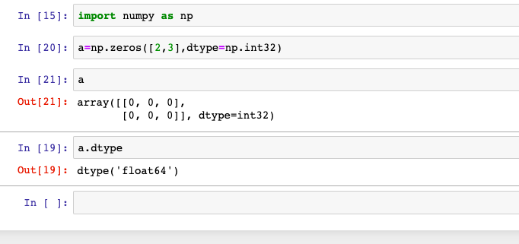
Zeros
np.zeros
Return a new array of given shape and type, filled with zeros

Slide 3
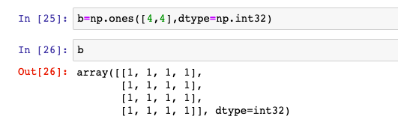
ones
np.ones
Return a new array of given shape and type, filled with ones.

Slide 4
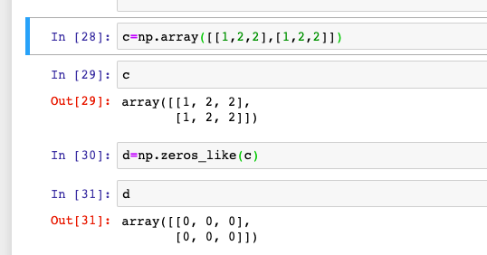
zeros_like
np.zeros_like
Return an array of zeros with the same shape and type as a given array.

Slide 5
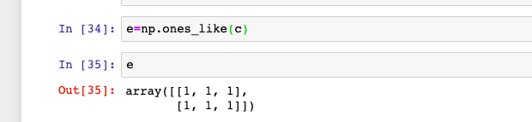
ones_like
np.ones_like
Return an array of ones with the same shape and type as a given array.

