Slide 1
NUMPY COMPLETE TUTORIAL MACHINE LEARNING PREREQUISITE
Advance Menthods For Numpy Array Creations
Tutorial 6

Slide 2
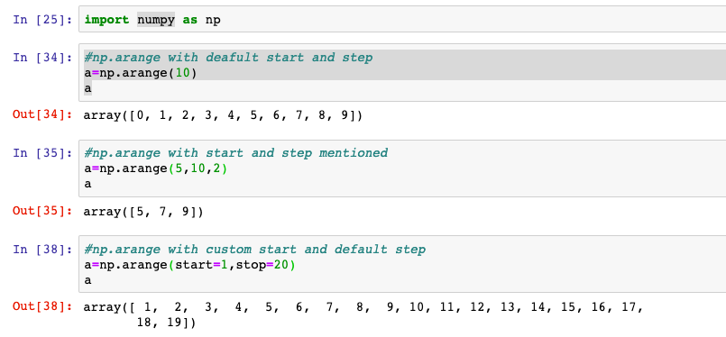
np.arange()
Return evenly spaced values within a given interval.

Slide 3
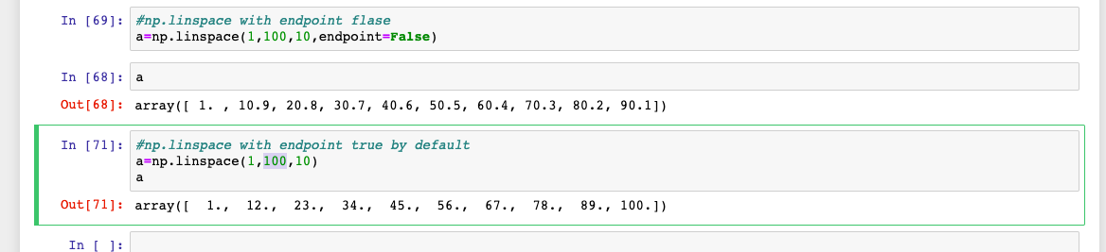
np.linspace()
Return evenly spaced numbers over a specified interval.

