Slide 1
NUMPY COMPLETE TUTORIAL MACHINE LEARNING PREREQUISITE
Numpy Array Indexing & Slicing(1d & 2d Numpy Array)
Tutorial 8

Slide 2
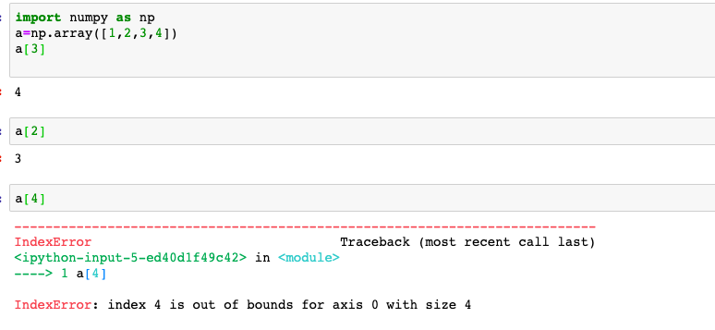
What is indexing

Slide 3
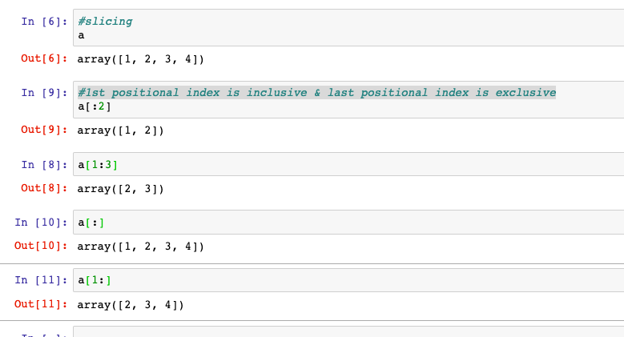
What is slicing
Slicing returns the same data structure with shape passed in the slicing operation
Slicing will be done by : operator
1st positional index is inclusive & last positional index is exclusive
not mentioning anything at 1st index means always consider first element
not mentioning anything at last index means always consider the last element

Slide 4
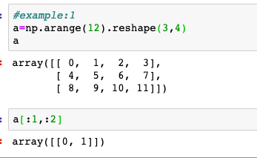
Slicing Example:1
0 1 2 3
4 5 6 7
9 10 11
How to get the highlighed element

Slide 5
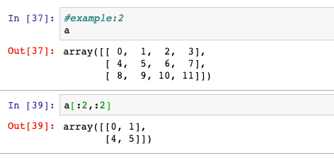
Slicing Examples:2
0 1 2 3
4 5 6 7
9 10 11
How to get the highlighed element

Slide 6
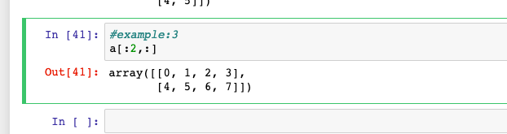
Slicing Example:3
0 1 2 3
4 5 6 7
9 10 11
How to get the highlighed element

Slide 7
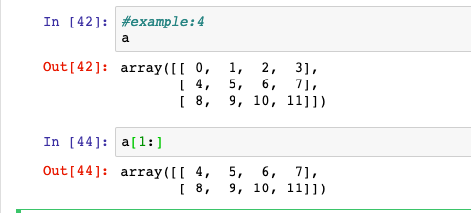
Slicing Example:4
0 1 2 3
4 5 6 7
8 9 10 11
How to get the highlighed element

Slide 8
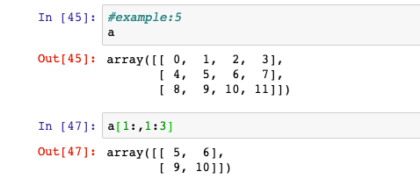
Slicing Example:5
0 1 2 3
4 5 6 7
8 9 10 11
How to get the highlighed element

