Slide 1
Rust Programming Complete Tutorial
Setup Rust Environment
Part 2

Slide 2
Download & Install Rust
https://www.rust-lang.org/
Follow the steps mentioned

Slide 3
Validate the installation
cargo –version
Rustc --version

Slide 4
Introduction to rustc
Open the vscode extension marketplace
And serach for rust(rls)
Install the extension
fn main(){
println!("hello from total tehnology")
}
To compile using rustc:
rustc filename
outputfilename

Slide 5
Setup rust project using cargo
cargo init

Slide 6
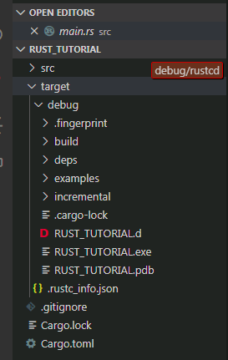
Run rust program using cargo
cargo run

Slide 7
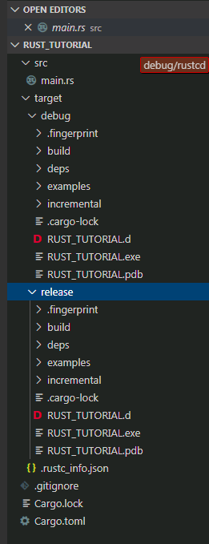
Build Release rust project for production using cargo
Only for build :
cargo build
Build for production release:
cargo build --release

