Slide 1
NUMPY COMPLETE TUTORIAL MACHINE LEARNING PREREQUISITE
Numpy 3d Array Slicing In Detail
Tutorial 10

Slide 2
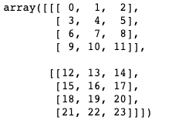

Example :1
How to get the below slice :
a[:1,:2,:2]
Answer

Slide 3

Example:2
How to get the below slice :
Answer
a[:1,2:,:]

Slide 4

Example:3
How to get the below slice :
Answer
a[1:,1:,1:]

Slide 5
Example:4
How to get the below slice :
answer
a[:1,2:3,:2]

