Slide 1
NUMPY COMPLETE TUTORIAL MACHINE LEARNING PREREQUISITE
Create Numpy Array From Csv File
Tutorial 10

Slide 2
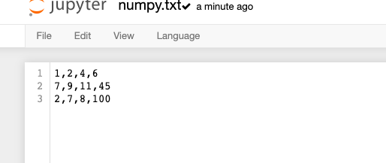
Read Csv file and generate numpy array

Slide 3
codes
import numpy as np
from io import StringIO
import io
with io.open("numpy.txt")as f1:
data=f1.read()
f1.close()
a=np.genfromtxt(StringIO(data),delimiter=",")
Delimiter as comma

Slide 4
codes
import numpy as np
from io import StringIO
import io
with io.open("numpy.txt")as f1:
data=f1.read()
f1.close()
a=np.genfromtxt(StringIO(data),delimiter="|")
Delimiter as pipe

