Slide 1
NUMPY COMPLETE TUTORIAL MACHINE LEARNING PREREQUISITE
Numpy Array Indexing & Slicing
Tutorial 8

Slide 2
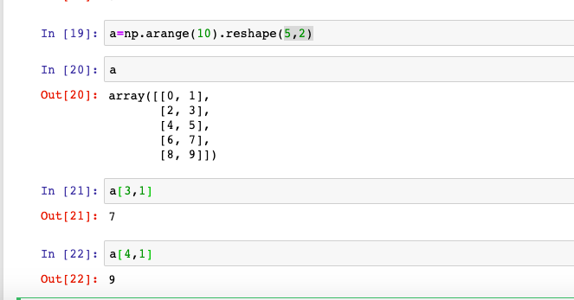
What is indexing

Slide 3
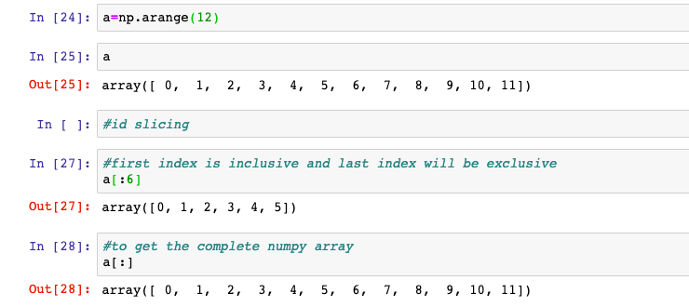
What is slicing
Slicing returns the data structure with shape passed in the slicing operation
Slicing will be done by : operator

Slide 4
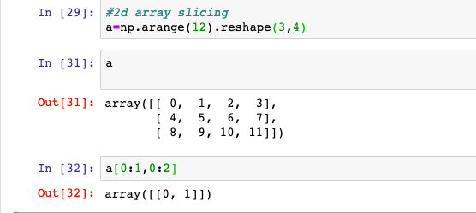
Slicing Examples
0 1 2 3
4 5 6 7
9 10 11
How to get the highlighed element

Slide 5
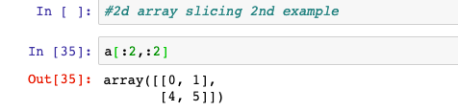
Slicing Examples
0 1 2 3
4 5 6 7
9 10 11
How to get the highlighed element

Slide 6
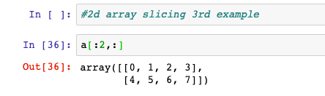
Slicing Examples
0 1 2 3
4 5 6 7
9 10 11
How to get the highlighed element

Slide 7
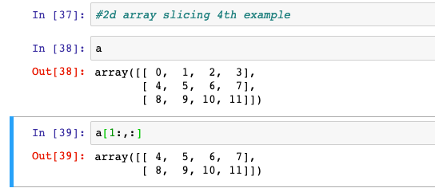
Slicing Examples
0 1 2 3
4 5 6 7
8 9 10 11
How to get the highlighed element

Slide 8
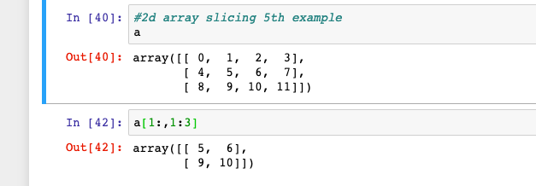
Slicing Examples
0 1 2 3
4 5 6 7
8 9 10 11
How to get the highlighed element

