Slide 1
NUMPY COMPLETE TUTORIAL MACHINE LEARNING PREREQUISITE
Numpy Fancy Indexing
Tutorial 14

Slide 2
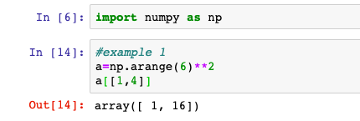
What is fancy indexing
NumPy offers more indexing facilities than regular Python sequences. In addition to indexing by integers and slices,
Numpy arrays indexed by arrays(list) of integers is known as fancy indexing
Example:1

Slide 3
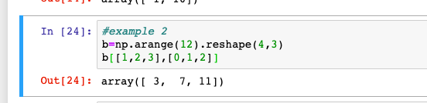
Fancy indexing with 2d array

Slide 4
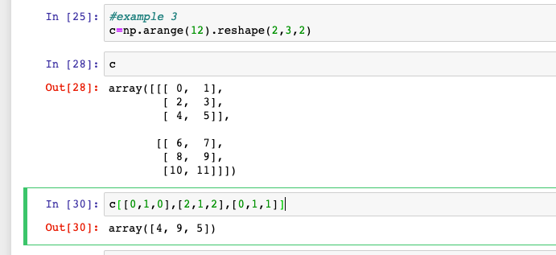
Fancy indexing with 3d array

