Slide 1
Rust Programming Complete Tutorial
Data Types In RUST
Part 6

Slide 2
RUST DATA TYPES
Data Types
Every value in Rust is of a specific type this describes what kind of data is being supplied and how to work with that data.
In this context we will two data types ,scalar and compound.Keep in mind that Rust is a
statically typed language, means it must know the types of all variables at compile time.

Slide 3
SCALAR DATA TYPES IN RUST
Definition
scalar type represents a single value.
Rust has four primary scalar types: integers, floating-pointn umbers, Booleans, and characters.
Reference :https://doc.rust-lang.org/

Slide 4
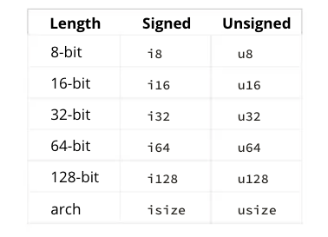
Integer Data types
Number without fractional component

Slide 5
Integer Data types
Number without fractional component
Each variant can be either signed or unsigned and has an explicit size.
Signed and unsigned refer to whether it’s possible for the number to be negative or positive
in other words, whether the number needs to have a sign with it (signed) or whether
it will only ever be positive and can therefore be represented without a sign (unsigned).
Signed numbers are stored using two’s complement representation.
Each signed variant can store numbers from -(2^{n - 1}) to 2^{n - 1} - 1 inclusive.
where n is the number of bits that variant uses.
Unsigned variants can store numbers from 0 to 2^{n} - 1, so a u8 can store numbers from
0 to 2⁸ - 1, which equals 0 to 255.
Additionally, the isize and usize types depend on the kind of computer your program is
running on: 64 bits if you’re on a 64-bit architecture and 32 bits if you’re on a 32-bit
architecture.
i8 can store numbers between -127 to 127

Slide 6
Sample Code
Integer Data Types

